Slide 1
Yahboom ROS2 board

Slide 2
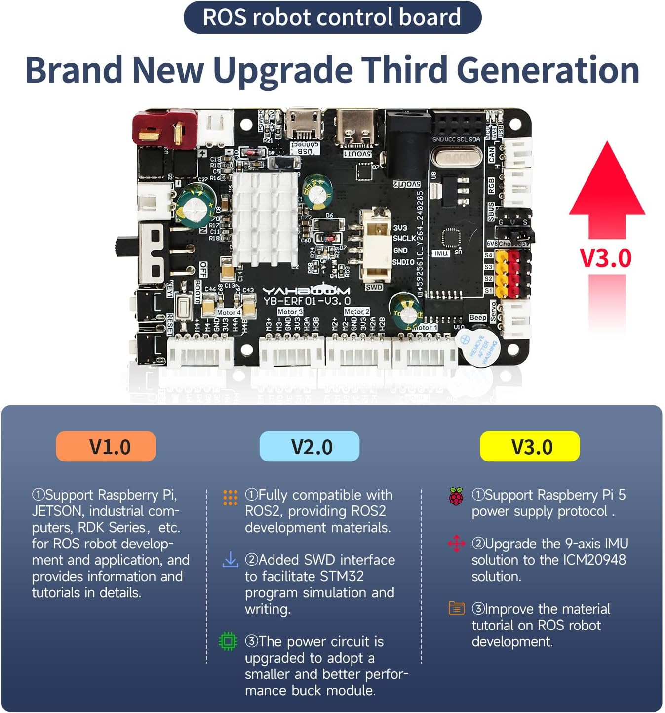

Slide 3
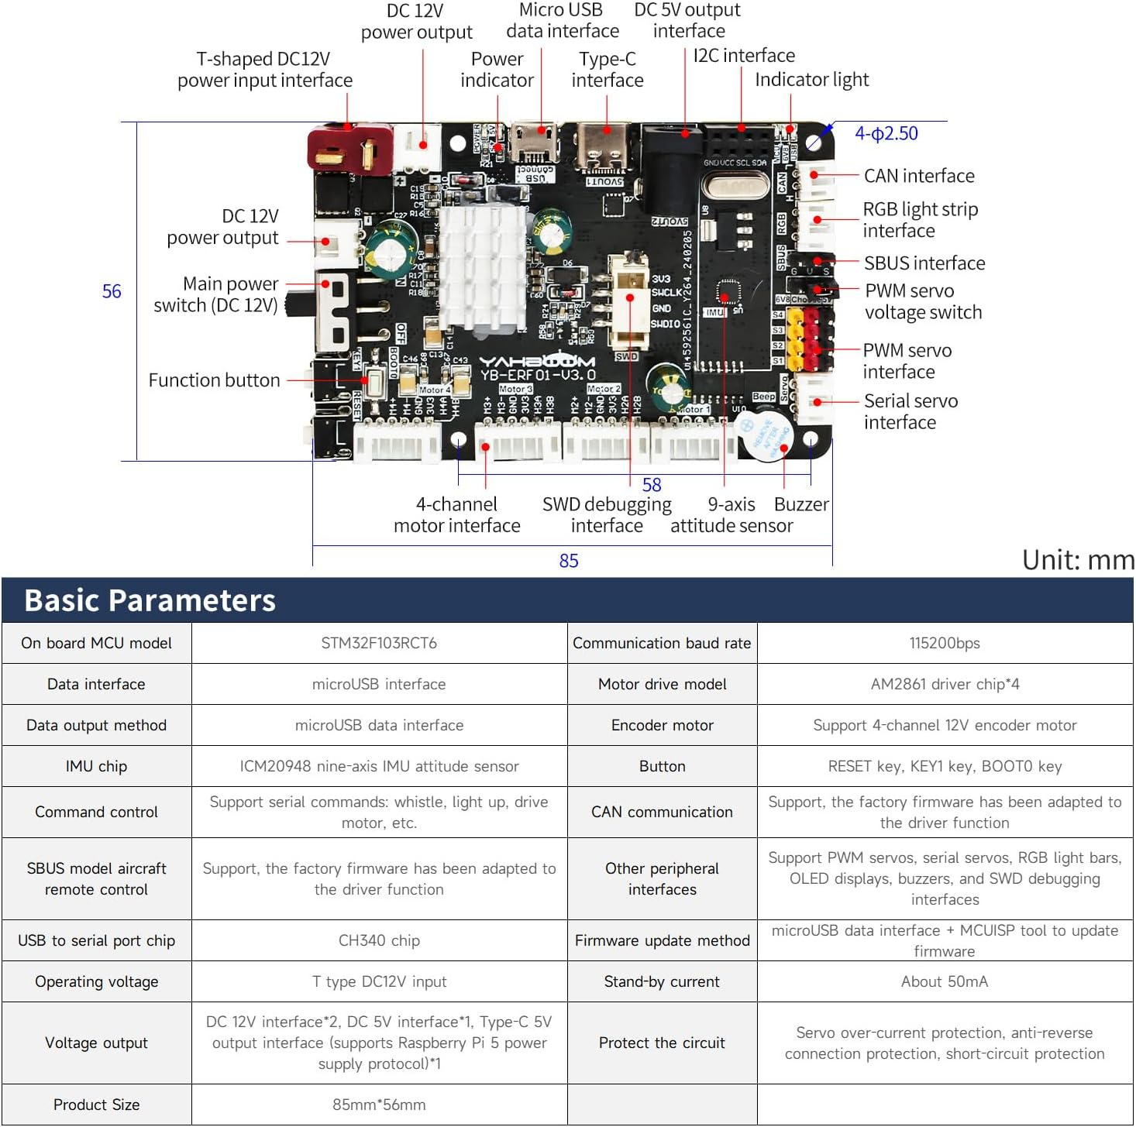

Slide 4
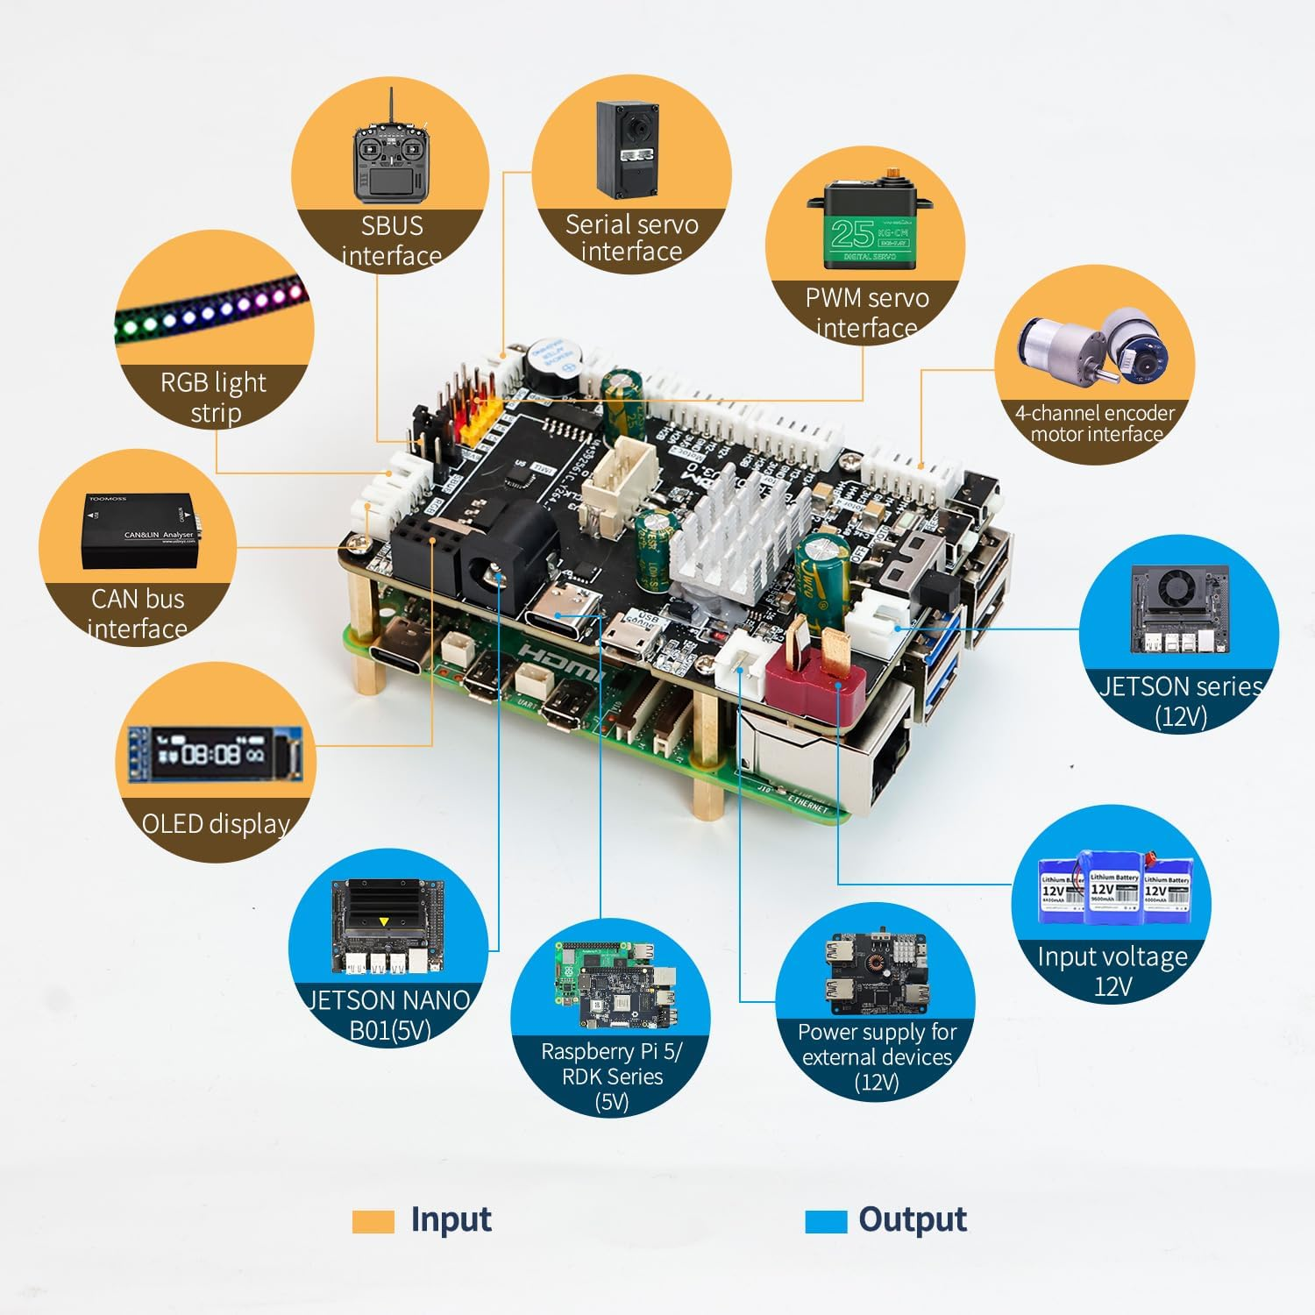

Slide 5
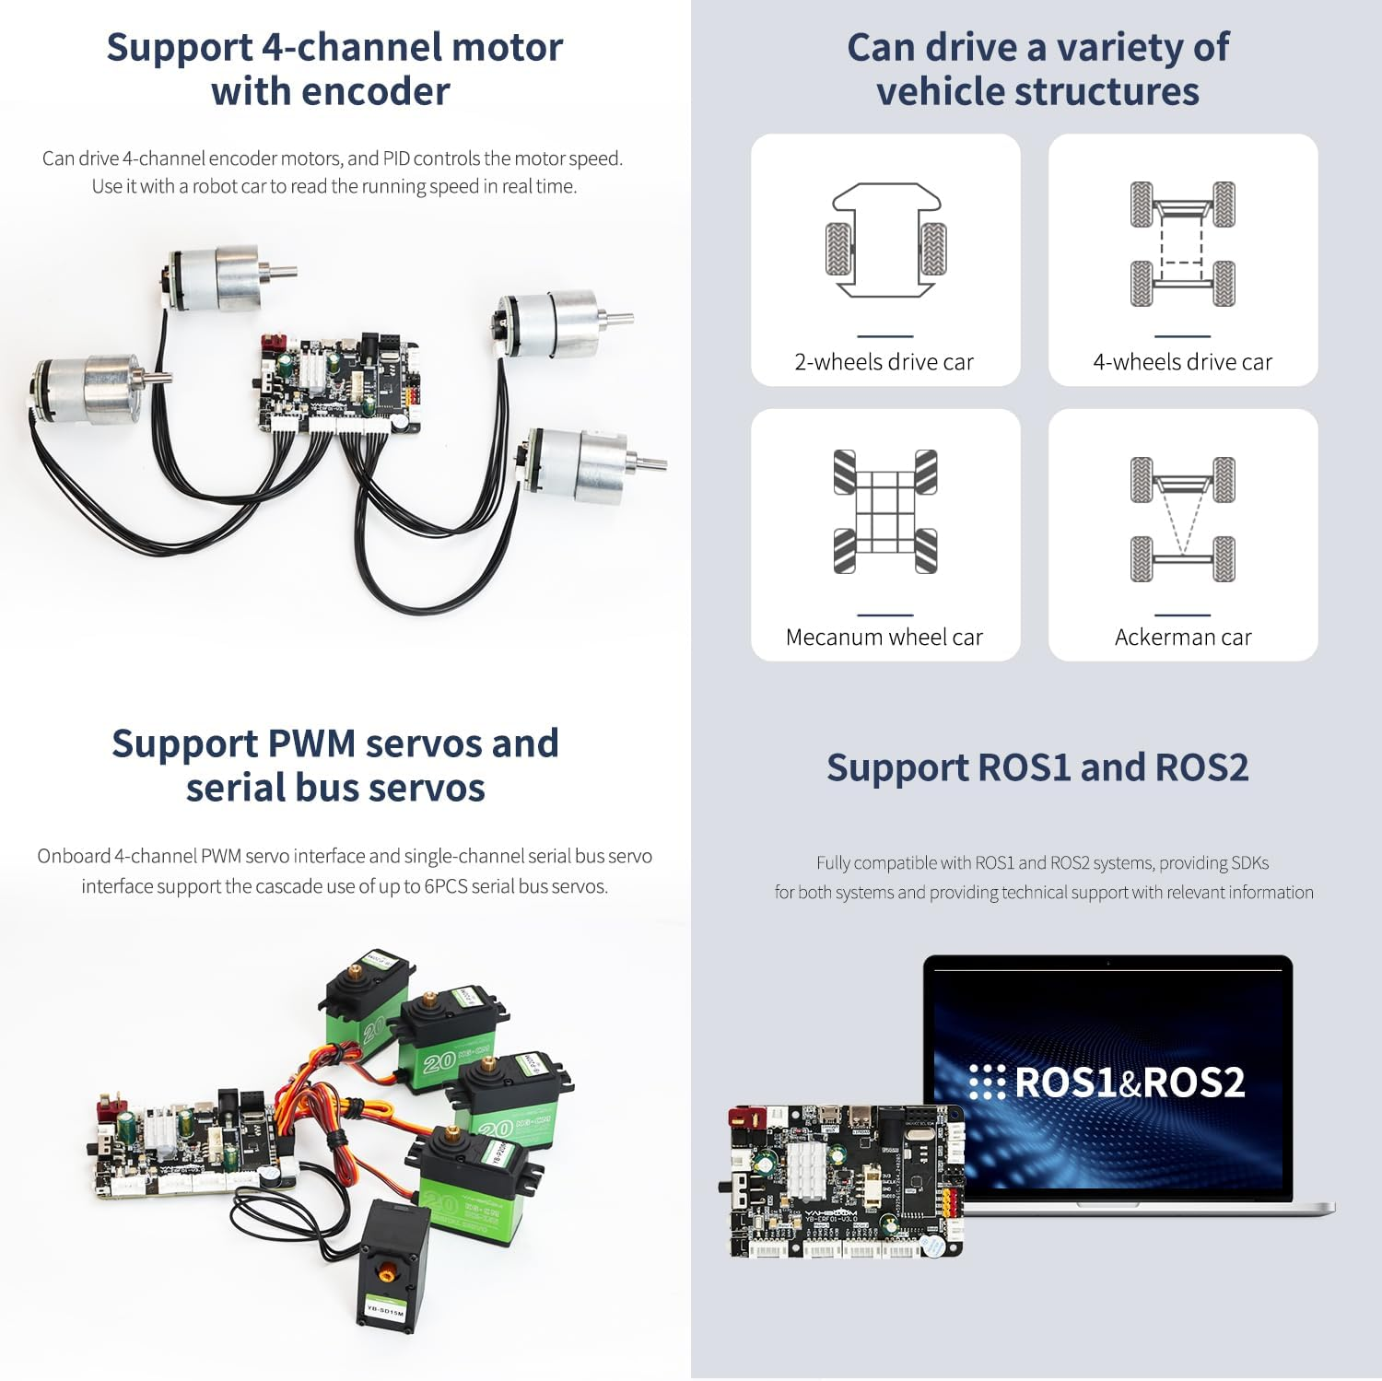
Supports 4 motors w/encoders
Appears to support up to 5 regular servos.
3-pin white connector is for serial bus servos (up to 6)!!

Slide 6
Links
ROS Robot Expansion Board

Slide 7
Connecting from Linux / Pi using straight Python (the Rosmaster_Lib)
lsusb to verify it sees the ‘QinHeng’ device plugged into USB
Make /etc/udev/rules.d/myserial.rules file with:
KERNEL=="ttyUSB*", ATTRS{idVendor}=="1a86", ATTRS{idProduct}=="7523", MODE:="0777", SYMLINK+="myserial“
'/dev/myserial' is what the Rosmaster bot constructer uses to connect
It should have these permissions: -rwxr-xr-x
ls -l /dev/myserial should show the link: /dev/myserial → ttyUSB0
Install Rosmaster library from code from downloaded py_install.zip:
cd py_install
sudo python3 setup.py install
*Might also have to re-install the serial library
sudo pip3 uninstall serial
sudo pip3 install pyserial
Then you can execute in python:
from Rosmaster_Lib import Rosmaster
bot = Rosmaster()
bot.set_beep(100)
bot.set_motor(50,0,0,0)
You can also call the Rosmaster_Lib directly, which makes it output status lines over and over:
python3 /home/guy/py_install/Rosmaster_Lib/Rosmaster_Lib.py
*Works on Pi 5 and Windows WSL (after binding USB), but not on Jetson Orin Nano

Slide 8
Connecting from Windows Subsystem for Linux
Need to install a windows-side driver (in non-Linux command line):
winget install usbipd
Each time you (re-)connect the USB:
usbipd list
Should show a ‘USB-SERIAL CH340’ for the ROS board
*From the list put in the correct bus-ID for the device you want to use in WSL:
usbipd bind --busid 1-3
*maybe give error, but no harm in running this twice
usbipd attach --wsl --busid 1-3
Stuff may need to be installed on the Linux side, as well
In WSL to see if it’s really connected from Windows:
lsusb
should show: Bus 001 Device 002: ID 1a86:7523 QinHeng Electronics CH340 serial converter
ls -l /dev/myserial
*should show /dev/myserial → ttyUSB0 symbolic link

Slide 9
Control motors and movement
Set motor speed directly:
from Rosmaster_Lib import Rosmaster
bot = Rosmaster()
bot.set_motor(50,0,0,0)
bot.set_beep(100)
Hmmm…

Slide 10
Controlling PWM servos
from Rosmaster_Lib import Rosmaster
bot = Rosmaster()
This works!
bot.set_pwm_servo(1, 90)
But limited to only 4 PWM servo control lines. Serial controller can do up to 6 and give positional verification feedback – need to get that working!

Slide 11
Control serial servos
9. Control serial servos
from Rosmaster_Lib import Rosmaster
bot = Rosmaster()
bot.set_uart_servo_torque(1)
*This doesn’t do anything…crap…
*Also, serial servo lights up but flashes pattern – something wrong.
bot.set_uart_servo_angle(1, 180, 1000)
*No matter the parameter ID it always returns -1, crap.
bot.get_uart_servo_angle(1)

Slide 12
Other serial servo board:
https://www.amazon.com/Hiwonder-Servo-Controller-Serial-Tester/dp/B09ZL6ZBBN
This might work controlling the serial servos…

Slide 13
Installing ROS2 in Linux
https://www.yahboom.net/study/ROS-Driver-Board
Under ‘ROS2 Basic Course’ – ‘ROS2 install Humble’

Slide 14
Testing the ROS2 install with the Turtle simulator
Run in separate terminals:
# Always source first:
source /opt/ros/humble/setup.bash
# Run ros2 w/turtle simulator
ros2 run turtlesim turtlesim_node
# Control the turtle with the keyboard:
ros2 run turtlesim turtle_teleop_key
# Get telemetry info:
ros2 topic echo /turtle1/cmd_vel

Slide 15
Creating new ROS2 workspace https://docs.ros.org/en/humble/Tutorials/Beginner-Client-Libraries/Creating-A-Workspace/Creating-A-Workspace.html
source /opt/ros/humble/setup.bash
mkdir -p ~/ros2_ws/src
cd ~/ros2_ws/src
# Clone your repo into src (this is example that includes the turtle sim).
git clone https://github.com/ros/ros_tutorials.git -b humble
# Go back to base directory.
cd ..
# Need to initialize (just once).
sudo rosdep init
rosdep update
rosdep install -i --from-path src --rosdistro humble
colcon build
# In a NEW terminal source the original and the new build:
source /opt/ros/humble/setup.bash
cd ~/ros2_ws
source install/local_setup.bash
ros2 run turtlesim turtlesim_node
# If you change the source, need to do the colcon build again and source it again!

Slide 16
Change tutorial turtlesim to do what you want?
Example modify: change ~/ros2_ws/src/ros_tutorials/turtlesim/src/turtle_frame.cpp
Change setWindowTitle to “JoesTurtleSim”
cd ~/ros2_ws
colcon build
source & run again (see previous)

Slide 17
Running with the real RosMaster board taken from downloaded VM ~/workspace
Make sure USB connected: ls -l /dev/myserial
# Setup basic ros2 humble environment:
source /opt/ros/humble/setup.bash
# Run the Rosmaster board driver (in another terminal):
python3 /home/guy/py_install/Rosmaster_Lib/Rosmaster_Lib.py
# Source the local workspace’s environment setup:
source ~/workspace/src/install/local_setup.bash
# Bring up ros2:
ros2 launch yahboomcar_description display.launch.py
This exits out with error:
[ERROR] [rviz2-3]: process has died [pid 13919, exit code -11, cmd '/opt/ros/humble/lib/rviz2/rviz2 -d /home/guy/workspace/src/install/yahboomcar_description/share/yahboomcar_description/rviz/yahboomcar.rviz --ros-args -r __node:=rviz2'].
# Other examples show something like this:
ros2 launch yahboomcar_bringup bringup.launch.py
*there is no yahboomcar_bringup or bringup.launch.py
**Where to get this?!?

