Slide 1
BeagleBone Blue

Slide 2
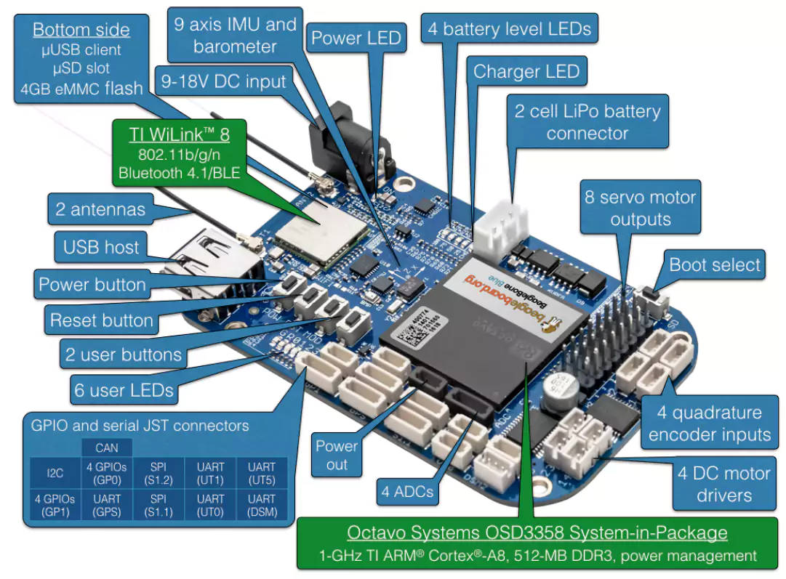

Slide 3
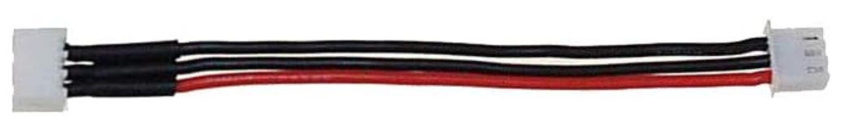
Power
A/C outler power: 12V supply **BUT motors will be weak and servos will barely move if at all!!
but good for installing packages (usually takes a long time, battery could run out)
Can also power w/microUSB port hidden on bottom of board
But, again, not enough power.
Better connection: to 2S 7.4V battery using this connector:

Slide 4
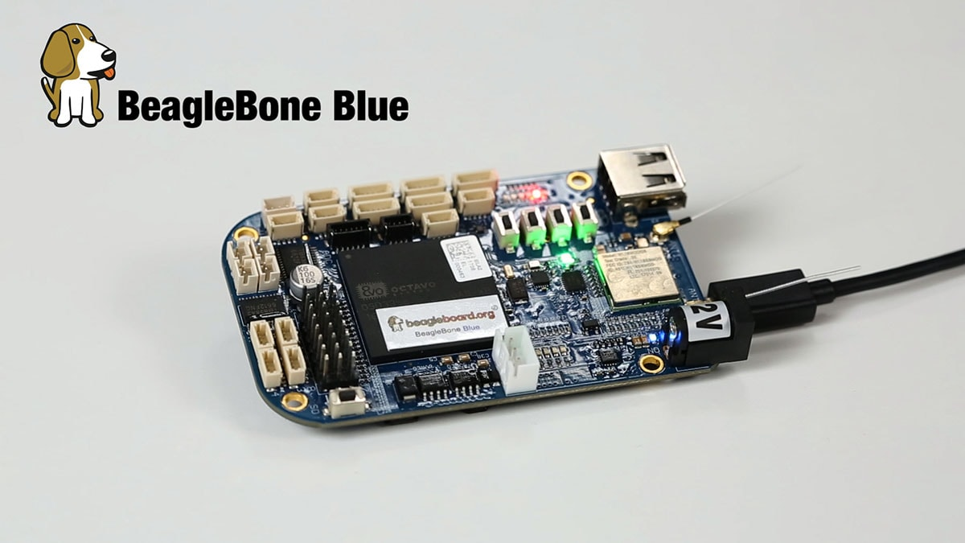
Can power w/microUSB port on bottom of board

Slide 5
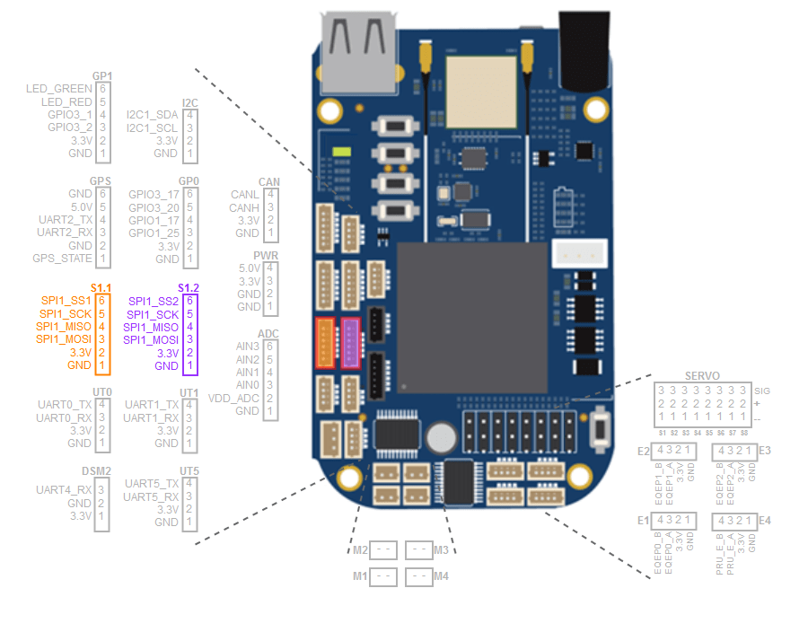
Connector pins

Slide 6
Connecting to BeagleBone terminal
Connect to the BeagleBone’s WiFi service
Password: BeagleBone
SSH into 192.168.8.1
ssh debian@192.168.8.1 pass blick77 (or use Putty)
If connecting thru serial cable it’s 192.168.7.2
If connecting from Linux/Mac it’s 192.168.6.2
If in browser, can also go to 192.168.8.1 to bring up UI terminal thru HTTP
If you connect to two different BeagleBones it gives ‘Remote Host Identification has changed’ error. To fix:
ssh-keygen -R 192.168.8.1

Slide 7
Connecting
BeagleBone has two Wifi adapters, one is used as WiFi server named something like BeagleBone-CB0B
SSH into 192.168.8.1 username: debian password: temppwd / blick77
Thru serial cable: 192.168.7.2 (on Mac 192.168.6.2)
You can open AS MANY SSH connections as you want!
Copy files using SCP: scp 192.168.8.1:/home/debian/etc…
'Remote Host Identification has changed' error - delete old key and try again (caused by multiple BeagleBones with same ID):
ssh-keygen -R 192.168.8.1
http://192.168.8.1 to use Cloud9 web interface

Slide 8
Dual WiFi adapters: connect one to internet
Acts as WiFi server as well as can connect to internet
Use connmanctl to setup WiFi, in console type these commands:
enable wifi
tether wifi disable
agent on
scan wifi (*need to wait until these come back with response)
services
connect wifi_XXX
exit
*might take some seconds to actually connect. ping doesn’t work, so just try sudo apt update.

Slide 9
Testing motors and servos https://old.beagleboard.org/static/librobotcontrol/
rc_test_motors
-d 0.0 to 1.0 duty cycle
-m 1 to 4 to specify motor (otherwise all 4 motors)
-s sweep motors back and forth at duty cycle to better test them
-b enable motor break
-F custom frequency
-f enable free spin function
rc_test_servos
-c 1 to 8 to specify which servo
-p -1.5 to 1.5 specify position
-s 0.0 to 1.5 sweep servo back and forth to test
-r use DSM radio channel to control servo *How to hookup DSM radio??
-f specify pulse frequency
-s send pulse width in microseconds

Slide 10
joes_robot_control – run w/sudo!
The joes_robot_control will set individual motor speeds and servo positions taking direction from the /tmp/robot.txt file
And now also robot0-9.txt files for multiple devices set individually.
Best to set a range of motion with a semicolon between values because just one single value might not register.
This makes servo #1 sweep from 0.0 to 0.5 position
echo '0.0;0.0,0.0;0.0,0.0;0.0,0.0;0.0,0.0;0.5,-1000.0,-1000.0,-1000.0,-1000.0,-1000.0,-1000.0,-1000.0' > /tmp/robot.txt
Servo changes of just 0.2 change might not even register
rc_test_servos continually sends out the same position over and over, which is why it works well
*change joes_robot_control to ‘reinforce’ the position over a second if no new values are coming in!

Slide 11
Flashing the OS from an SD card
BeagleBone Blue has 4GB eMMC (and 512MB DDR3 memory)
The SD Card can be used to flash/replace the eMMC
Use EduMIP version on blue Lexar SD Card
If the SD Card is a ‘flasher’ version you don’t even need to hold down the flash button.
If it’s flashing it will cycle LEDs in a cyclon fashion back and forth.
Once’s it done it will auto-shut itself down (and no more LEDs cycling).
Take the SD card out (so it doesn’t do it again) and reboot.
To create a new flasher SD Card from the current eMMC:
/opt/scripts/tools/eMMC/beaglebone-black-make-microSD-flasher-from-eMMC.sh

Slide 12
Setup OS onto internal Flash memory
Burn ‘flasher’ image onto SD card
Use EduMIP flasher image to get the ‘libcontrol’ installed correctly.
https://www.renaissancerobotics.com/BeagleboneBlue.html

Slide 13
USB Camera
https://subscription.packtpub.com/book/hardware-and-creative/9781788293136/5/05lvl1sec28/connecting-your-usb-camera-to-your-beaglebone-blue-and-viewing-the-images
Check if camera is present:
lsusb
cd /dev; ls video*
It should show up as video0 or similar
Compatible cameras:
Logitech C270: 720p
Logitech C310: 720p

Slide 14
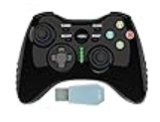
Wireless Controller
Works with embedded\librobotcontrol_arm\joes_robot_control\JoystickToRobotTmp.py
To install driver:
pip3 install evdev
Really need sudo pip3 install evdev - it requires sudo anyways to access /dev/input/event1
Controller has NO BATTERY, needs to be plugged into microUSB!
ALSO do NOT plug controller into computer USB port, because then controller gives input to the PC (and not wirelessly).

Slide 15
Using Bluetooth controller
sudo bluetoothctl
power on
agent on
default-agent
scan on
pair XX:XX:XX:XX:XX:XX
trust XX:XX:XX:XX:XX:XX
connect
quit
*Difficult to find which device is which, never got this to work
It does work on Pi, though: \embedded\RaspberryPi\GameControllerRobot\8bitdo_controller\

Slide 16
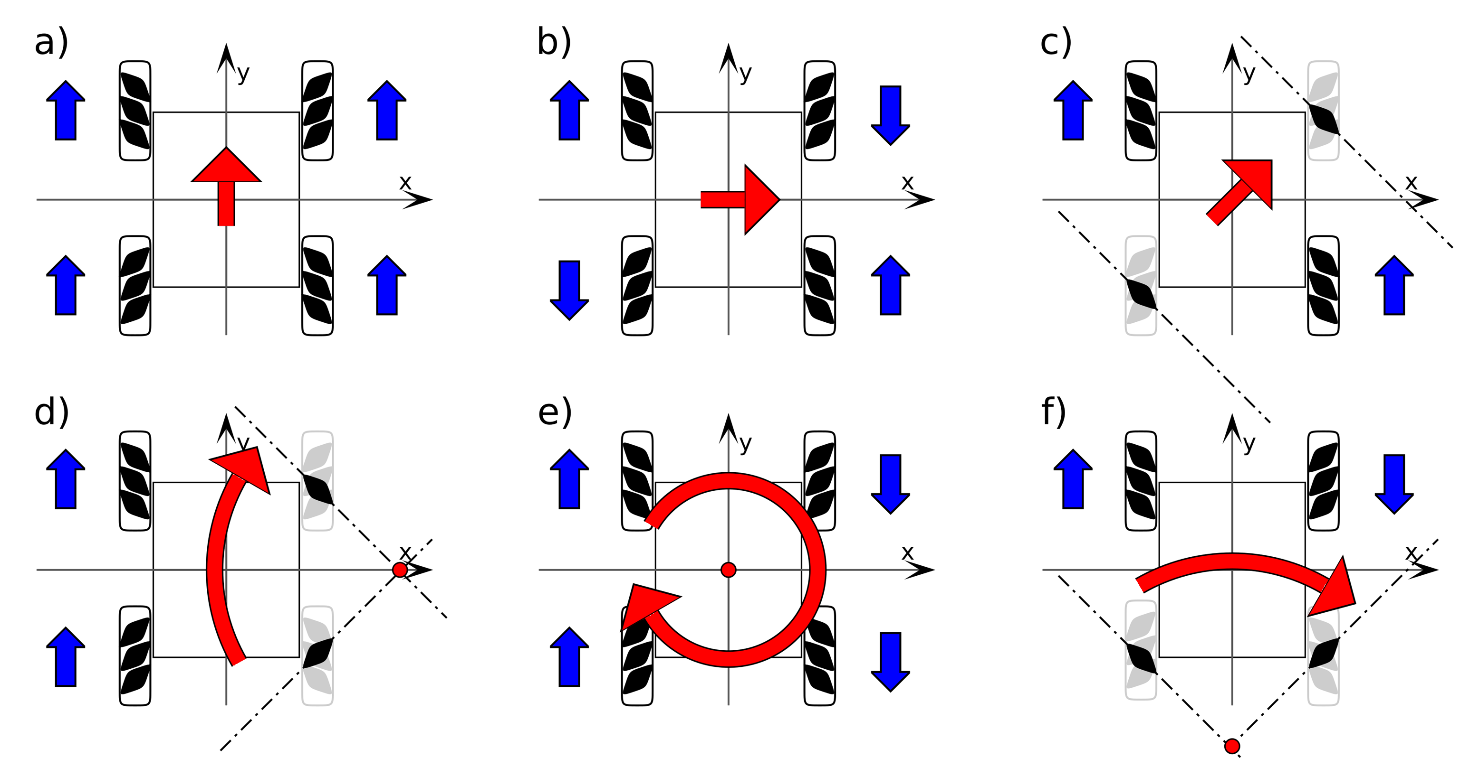
Mecanum Wheel Control Principle
wheels should be in an 'X' from above

