Slide 1
DETECTING USER STANCE ON CONTROVERSIAL TOPICS

Slide 2


PROBLEM STATEMENT
The Problem is to detect user stance from posts collected from Social Media Platform on Controversial Topics and use them to get overall opinion of public.

Slide 3
STATE OF THE ARTWORK
Significant progress has been made in the field of Stance analysis and great amount of research work has been done to achieve considerable success in this area. Following are some of the previous work done in this category:
i)‘Stance and Sentiments In Tweets’ by Saif M Mohammad, Parinaz Sobhani and Svetlana Kiritchenko explored that although, access to both stance and sentiment annotations allows us to explore several things but knowing the sentiment expressed by a tweet is beneficial for stance classification, it alone is not sufficient, hence more things need to be figured out and hence they implemented a linear-kernel support vector machine (SVM) classifier that relies on features drawn from the training instances, such as word and character n-grams, as well as those obtained using external resources, such as word-embedding features.

Slide 4
ii) ’Automatic Stance Detection Using End-to-End Memory Networks’ by Mitra Mohtarami, Ramy Baly, James Glass, Preslav Nakov, Lluís Màrquez, A. Moschitti discussed that an unprecedented amount of false information has been flooding the internet. Consequently manual fast checking has emerged with the promise to support accurate and unbiased analysis of public statements. To solve this problem they implemented a novel memory network model enhanced with CNN and LSTM networks for stance detection is being utilised.
iii) ’Stance Detection with Hierarchical Attention Network’ by Qingying Sun, Zhongqing Wang, Qiaoming Zhu and Guodong Zhou discusses linguistic information, such as polarity and arguments of the document, is correlated with the stance of the document, and can inspire us to explore the stance. For solving this problem they proposed a Hierarchical Model is proposed.

Slide 5
LIMITATIONS
i)The dataset collected in these papers focused only on very limited areas.
ii)The hashtags and other things present in social media text can be misleading and have not been focused well. Also, People often use sarcastic language to troll the opposite opinion hashtags.
iii) Their models are skewed towards English language in particular and are not tried and tested on other languages. Performance on various other languages would not be good due to complex structures.

Slide 6
OBJECTIVES AND WORK DISTRIBUTION
Our objective is to create an intelligent software that detects user stance and other factors to gather useful data and find substantial results in real time.
TASKS | GROUP MEMBER
Analysing & Implementing previous work on Stance Detection. Pre-Processing Of Dataset. (Removing Hashtags, Calculating Sentiment Score, etc) Implementing some Machine Learning Models. Making Presentation for the Project. | Shubham Dubey
Implementing ML models with techniques like SMOTE sampling. Implementing Vanilla NN with Label Smoothing. Visualization Code and Code Optimization. Researching and finding new methods to improve the models. | Shivam Aggarwal
Text Preprocessing tasks (like POS, etc) and doing literature survey. Implementing LSTM and Stacked LSTM models using Transfer Learning. Writing the Final Project Report. | Sahil Gupta

Slide 7
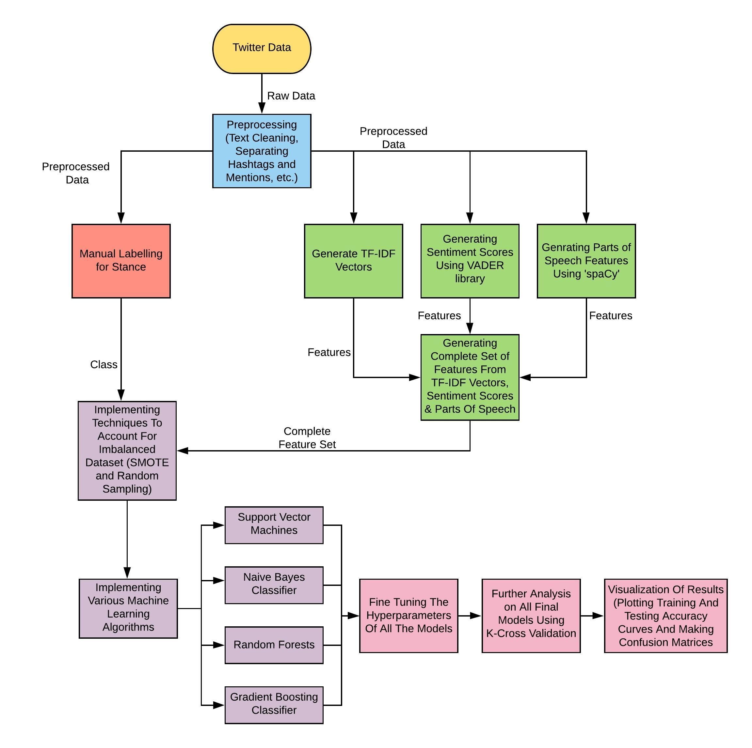
PROPOSED DESIGN AND IMPLEMENTATION
This is the implementation that we have performed using Machine Learning Models.

Slide 8
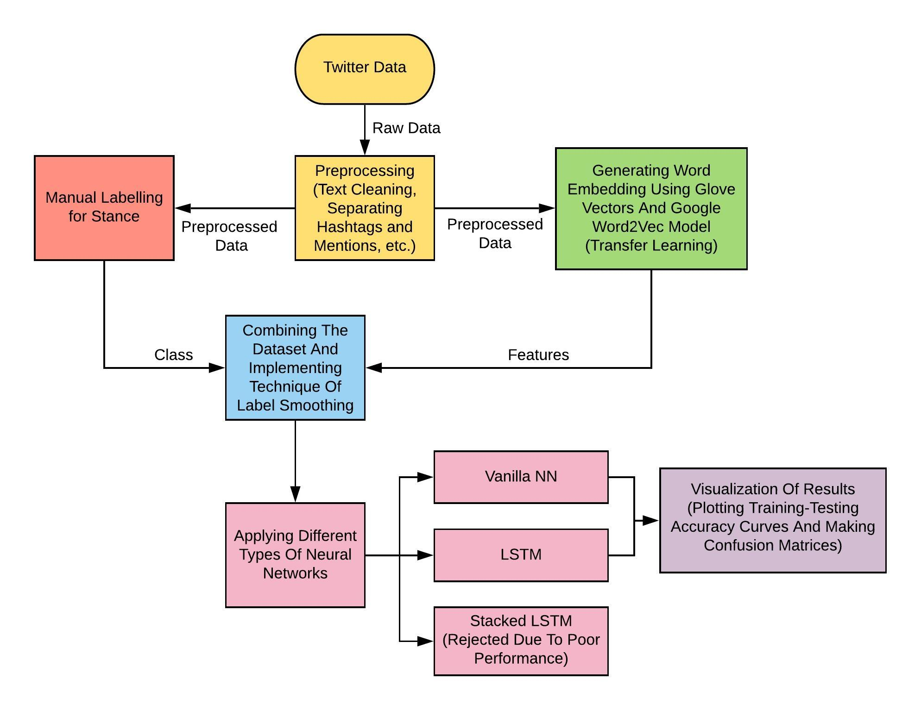
This is the implementation that we have performed using Deep Learning

Slide 9
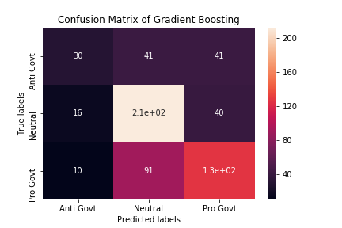
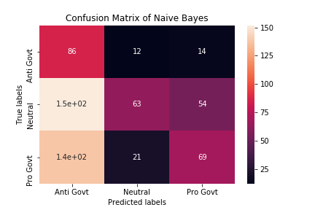
RESULT AND ANALYSIS
Confusion Matrix Of Gradient Boosting
Confusion Matrix Of Naive Bayes

Slide 10
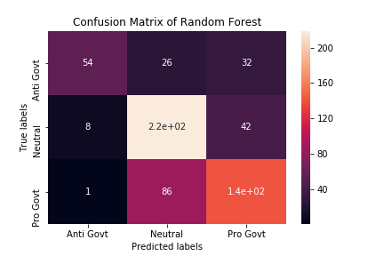
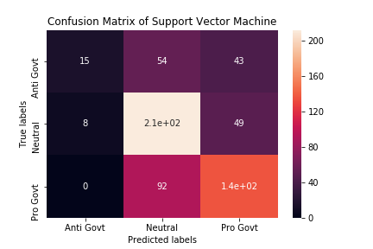
Confusion Matrix Of Random Forrest
Confusion Matrix Of Support Vector Machine

Slide 11
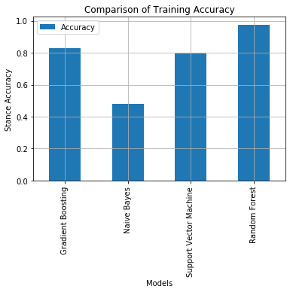
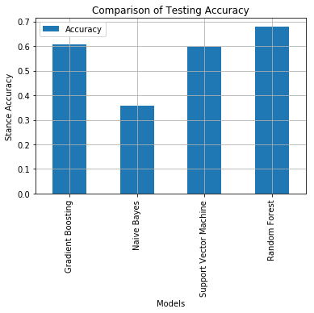
Graphs which compare the training and testing accuracies of different Models

Slide 12
CONCLUSION
After researching extensively about the work related to the problem of Stance detection and rigorously working to implement the stuff that seemed to better for our work, we made several models that gave comparable accuracies. To conclude this work, we want to put forth these points:
i) We created our own dataset targeting the General Elections Of 2019 which were collected from Twitter and performed all the required preprocessing such as calculating TF-IDF score, POS and sentiment scores which helped us in compiling a dataset that has a variety of features to move the work forward.
ii) As our data was imbalanced we found that techniques like SMOTE and Random Sampling can solve these problems in ML Models and Label Smoothing in Neural Networks to a great extent.

Slide 13
iii) Transfer Learning proved to be a promising method as per our research and work as well. We tried to use this extensively in our work and there was clear improvement in accuracies.
iv) Vanilla NN and Basic LSTM models performed at par with the ML models although they failed to surpass the results of ML models which was expected. This was due to the fact that we had a limited dataset.
v) In further work we would like to extend our dataset by adding more annotated tweets and adding more features to it. We would also try out more types of Neural Networks that could help to improve the performance.

Slide 14
FUTURE SCOPE
i) We compiled a dataset which contains processed tweets along with various other features for example sentiment score, TF-IDF and POS. We labelled our data according to standard rules followed in such tasks and hence we are able to present a dataset which according to our belief can be used in other research works. We wish to extend this dataset further by adding more annotated tweets and adding more useful features to it.
ii) Due to limitations of dataset, more complex Neural Network like Stacked LSTM failed to perform and hence it is quite clear that some different type of Neural Network needs to be used in such type of problem. Other Neural Network models can be figured out that could perform better for this problem.
iii) Such a model can be devised that can manage any target within the domain of Indian Politics. That can be of great utility in the current scenario.

