Slide 1

INSPEKT AI
01 / 07
Façade inspections.
Clearer decisions.
Understand your façade before you plan the repairs.
Inspection evidence for technical asset teams.
Supplied product imagery · Proposal by Genadio Colinas
EN
Notes:
Audience: the technical director at a commercial property owner planning façade maintenance. The architectural opening is illustrative. No inspection outcome is attributed to this building.
[Sources]
- Supplied Inspekt AI product raw video, platform screenshots and architectural reference images.
- https://inspektai.com/defect-analysis-dashboard/
- https://inspektai.com/year-on-year-comparison/
[/Sources]

Slide 2
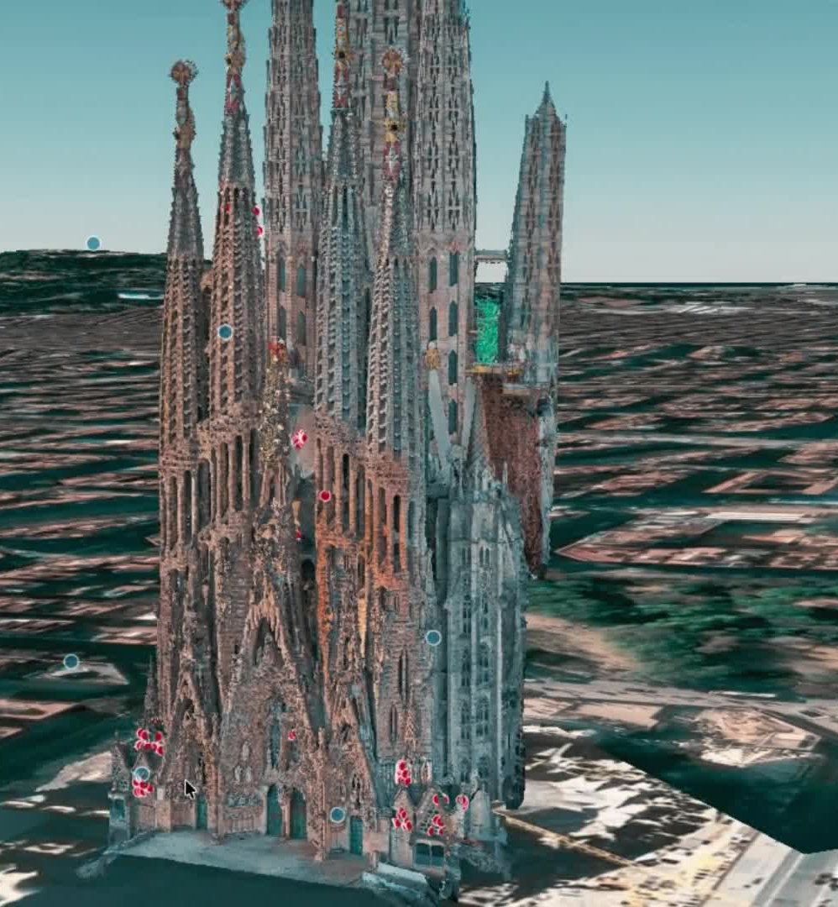
INSPEKT AI
02 / 07
Define the work
with better evidence.
Where is the finding?
What needs closer assessment?
What information supports the maintenance scope?
Supplied product imagery · Proposal by Genadio Colinas
EN
Notes:
These are proposed buyer questions, not quoted customer research. RICS describes the importance of scope, access and specialist input in planned maintenance.
[Sources]
- Supplied Inspekt AI product raw video, platform screenshots and architectural reference images.
- https://inspektai.com/defect-analysis-dashboard/
- https://inspektai.com/year-on-year-comparison/
- https://ww3.rics.org/uk/en/journals/property-journal/ppm-surveys-increase-asset-value.html
[/Sources]

Slide 3
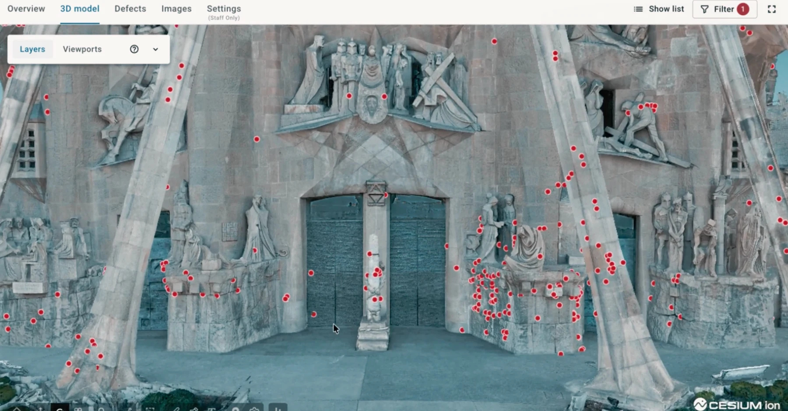
INSPEKT AI
03 / 07
Capture. Locate.
Review together.
01
Drone imagery provides the visual record.
02
AI-assisted analysis organises findings.
03
Specialist review supports interpretation.
Supplied product imagery · Proposal by Genadio Colinas
EN
Notes:
Distinguish image capture, AI assistance and specialist interpretation. Inspekt AI's documentation describes review of flagged anomalies. The responsible professional determines diagnosis and action.
[Sources]
- Supplied Inspekt AI product raw video, platform screenshots and architectural reference images.
- https://inspektai.com/defect-analysis-dashboard/
- https://inspektai.com/year-on-year-comparison/
[/Sources]

Slide 4
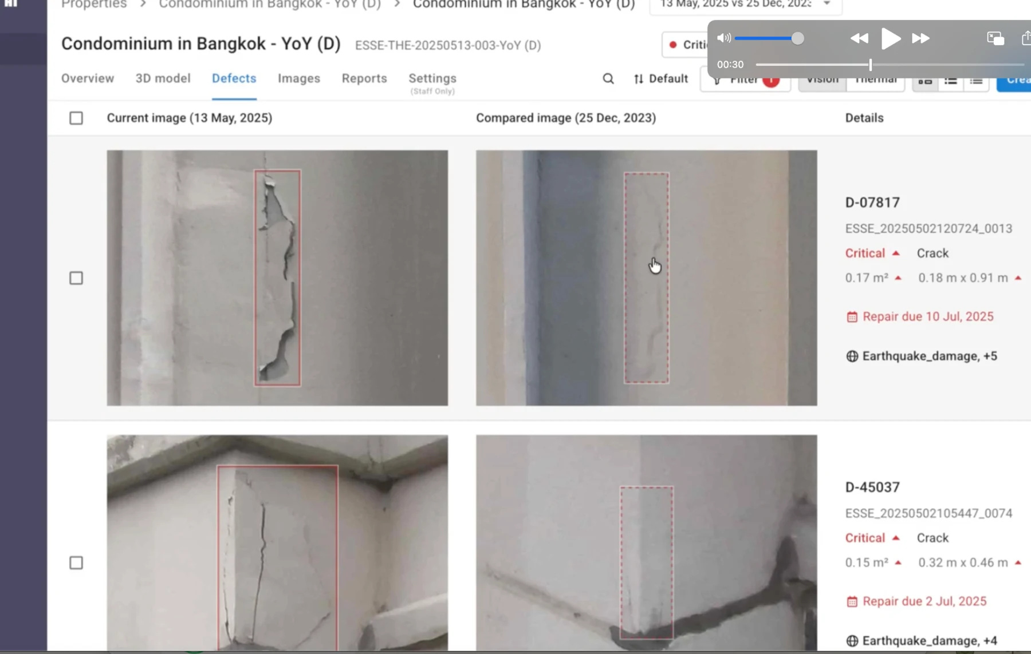
INSPEKT AI
04 / 07
Give each finding
its building context.
Open the image behind a finding.
Review its location and recorded details.
Bring the same evidence into the technical discussion.
Supplied product imagery · Proposal by Genadio Colinas
EN
Notes:
The supplied screenshots demonstrate interface functions. Retain original identifiers and labels. Do not invent new findings, dimensions or defect locations.
[Sources]
- Supplied Inspekt AI product raw video, platform screenshots and architectural reference images.
- https://inspektai.com/defect-analysis-dashboard/
- https://inspektai.com/year-on-year-comparison/
[/Sources]

Slide 5
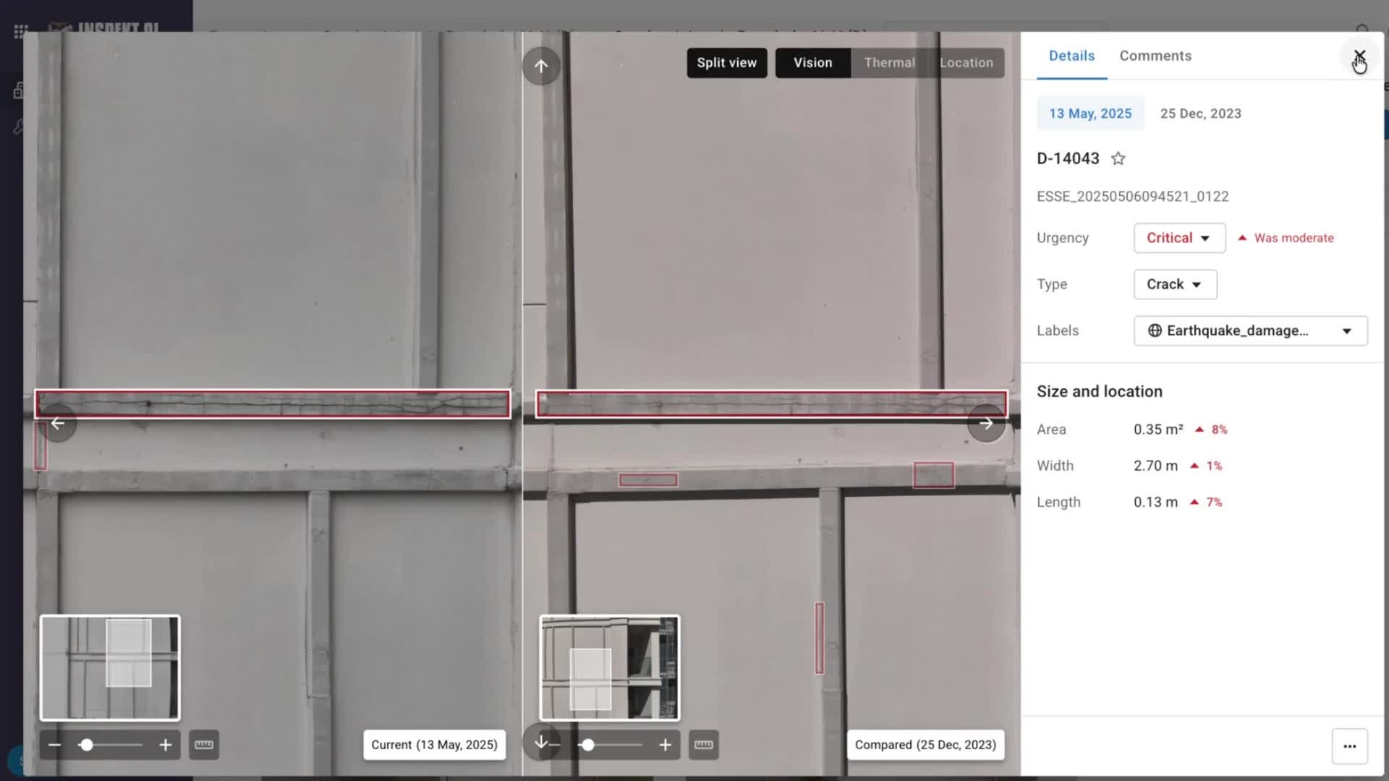
INSPEKT AI
05 / 07
See what changes
over time.
25 Dec 2023 / 13 May 2025
Compare dated images of the same area.
A first inspection can establish the starting record.
Supplied product imagery · Proposal by Genadio Colinas
EN
Notes:
The comparison is from the Bangkok example in the raw demonstration, not a measured Sagrada Família defect. Different viewpoints and lighting affect interpretation; no repair history or deterioration rate is established.
[Sources]
- Supplied Inspekt AI product raw video, platform screenshots and architectural reference images.
- https://inspektai.com/defect-analysis-dashboard/
- https://inspektai.com/year-on-year-comparison/
[/Sources]

Slide 6
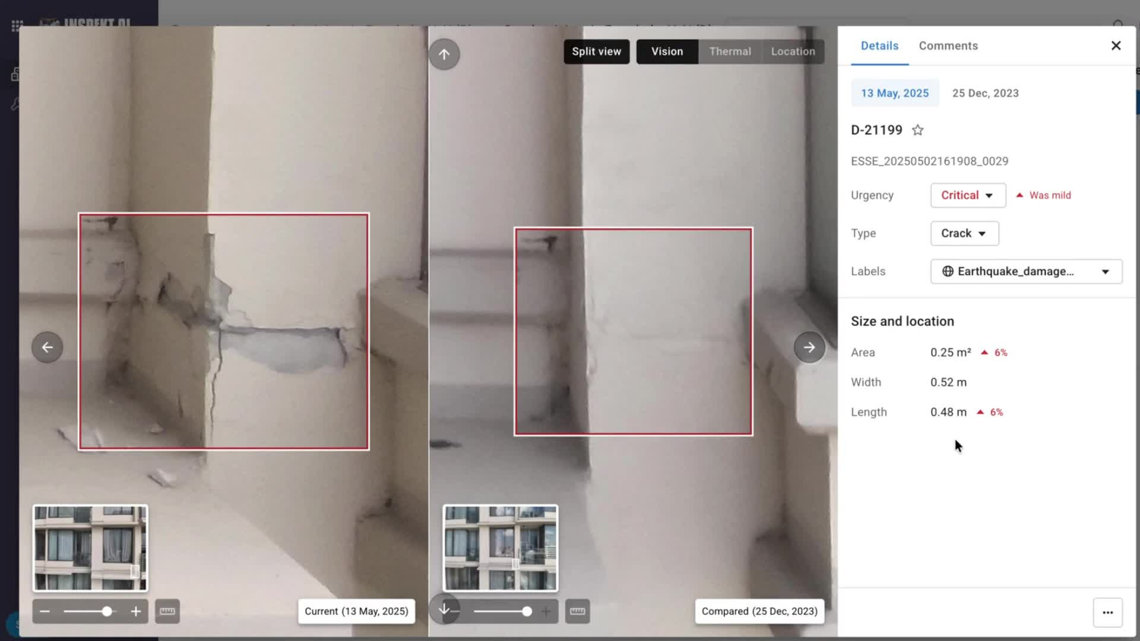
INSPEKT AI
06 / 07
Prepare priorities
your team can explain.
Use located findings and inspection records to discuss maintenance scope.
Agree what needs further assessment with the responsible technical team.
Supplied product imagery · Proposal by Genadio Colinas
EN
Notes:
The benefit is support for maintenance planning. Do not promise a final repair specification, guaranteed savings or automatic structural certification.
[Sources]
- Supplied Inspekt AI product raw video, platform screenshots and architectural reference images.
- https://inspektai.com/defect-analysis-dashboard/
- https://inspektai.com/year-on-year-comparison/
[/Sources]

Slide 7
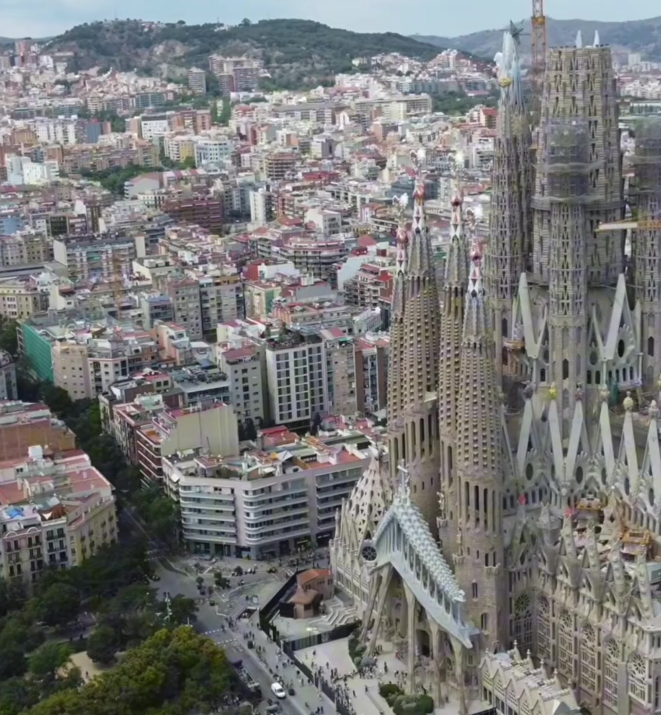
INSPEKT AI
07 / 07
Start with
your building.
Request an inspection proposal.
Share the location, main concern and desired timing.
Scope and access requirements are reviewed for each property.
Supplied product imagery · Proposal by Genadio Colinas
EN
Notes:
Proposed conversion: a qualified request for an inspection proposal. Do not promise an instant quote, fixed turnaround or free inspection. The official contact channel handles the enquiry.
[Sources]
- Supplied Inspekt AI product raw video, platform screenshots and architectural reference images.
- https://inspektai.com/defect-analysis-dashboard/
- https://inspektai.com/year-on-year-comparison/
[/Sources]

