Slide 1
Kelompok 6 RPL : RemindeR
1. Kukuh Yoga Pradana (A11.2018.11111)
2. Yosa Arya Wigiyanto (A11.2018.11113)
3. Diva Madani S. (A11.2018.11021)
4. Muhammad Raihan A. (A11.2018.11100)
5. Bima Ary Widiatmaja (A11.2018.11265)
6. Gigih Yudhamara (A11.2018.11556)

Slide 2
Project Charter
1.1 Nama Project
1.2 Nama Kelompok
1.3 Tanggal Mulai Project
1.4 Tanggal Berakhit Project
1.5 Deskripsi Project
1.6 Stakeholder

Slide 3
Project Scope
2.1 Ruang Lingkup
2.2 Deskripsi Fungsionalitas

Slide 4
Work Breakdown Structure

Slide 5
Tools
• Project Management : Asana dan Discord
• Diagram : Draw.io
• Wireframe : Balsamiq
• Mockup : https://mockuphone.com/

Slide 6
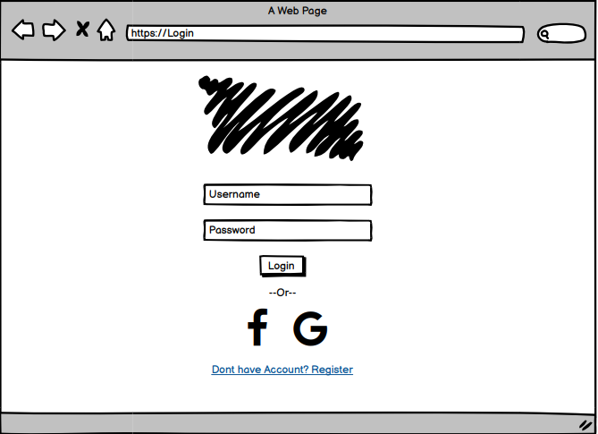
Login

Slide 7
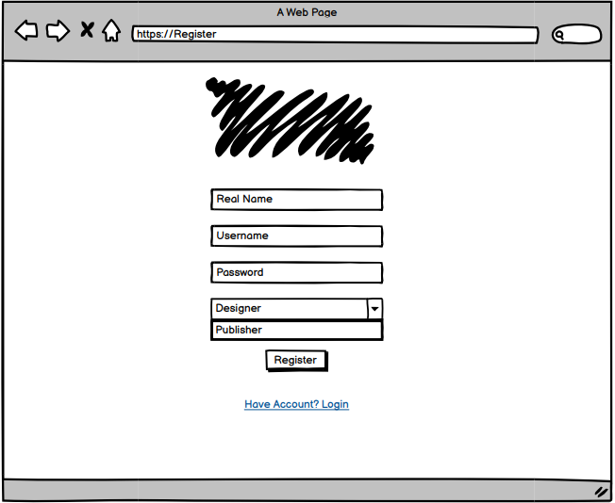
Register

Slide 8
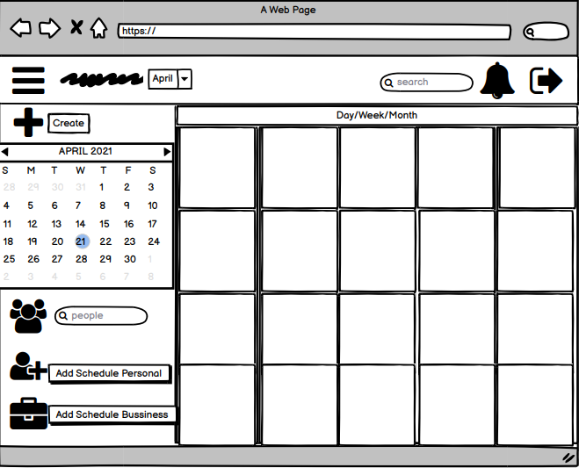
Dashboard

Slide 9
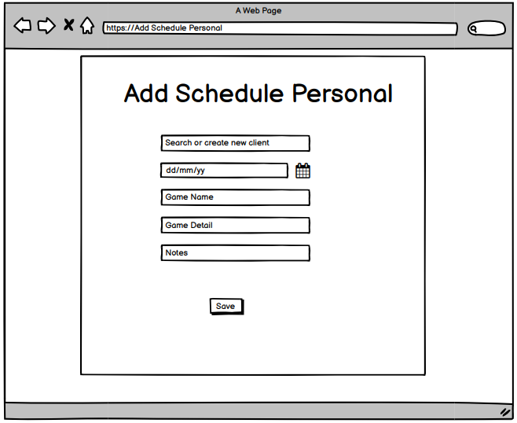
Add Schedule Personal

Slide 10
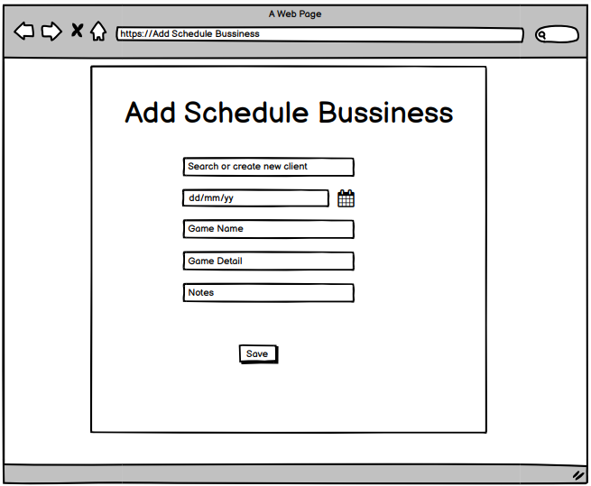
Add Schedule Bussiness

Slide 11

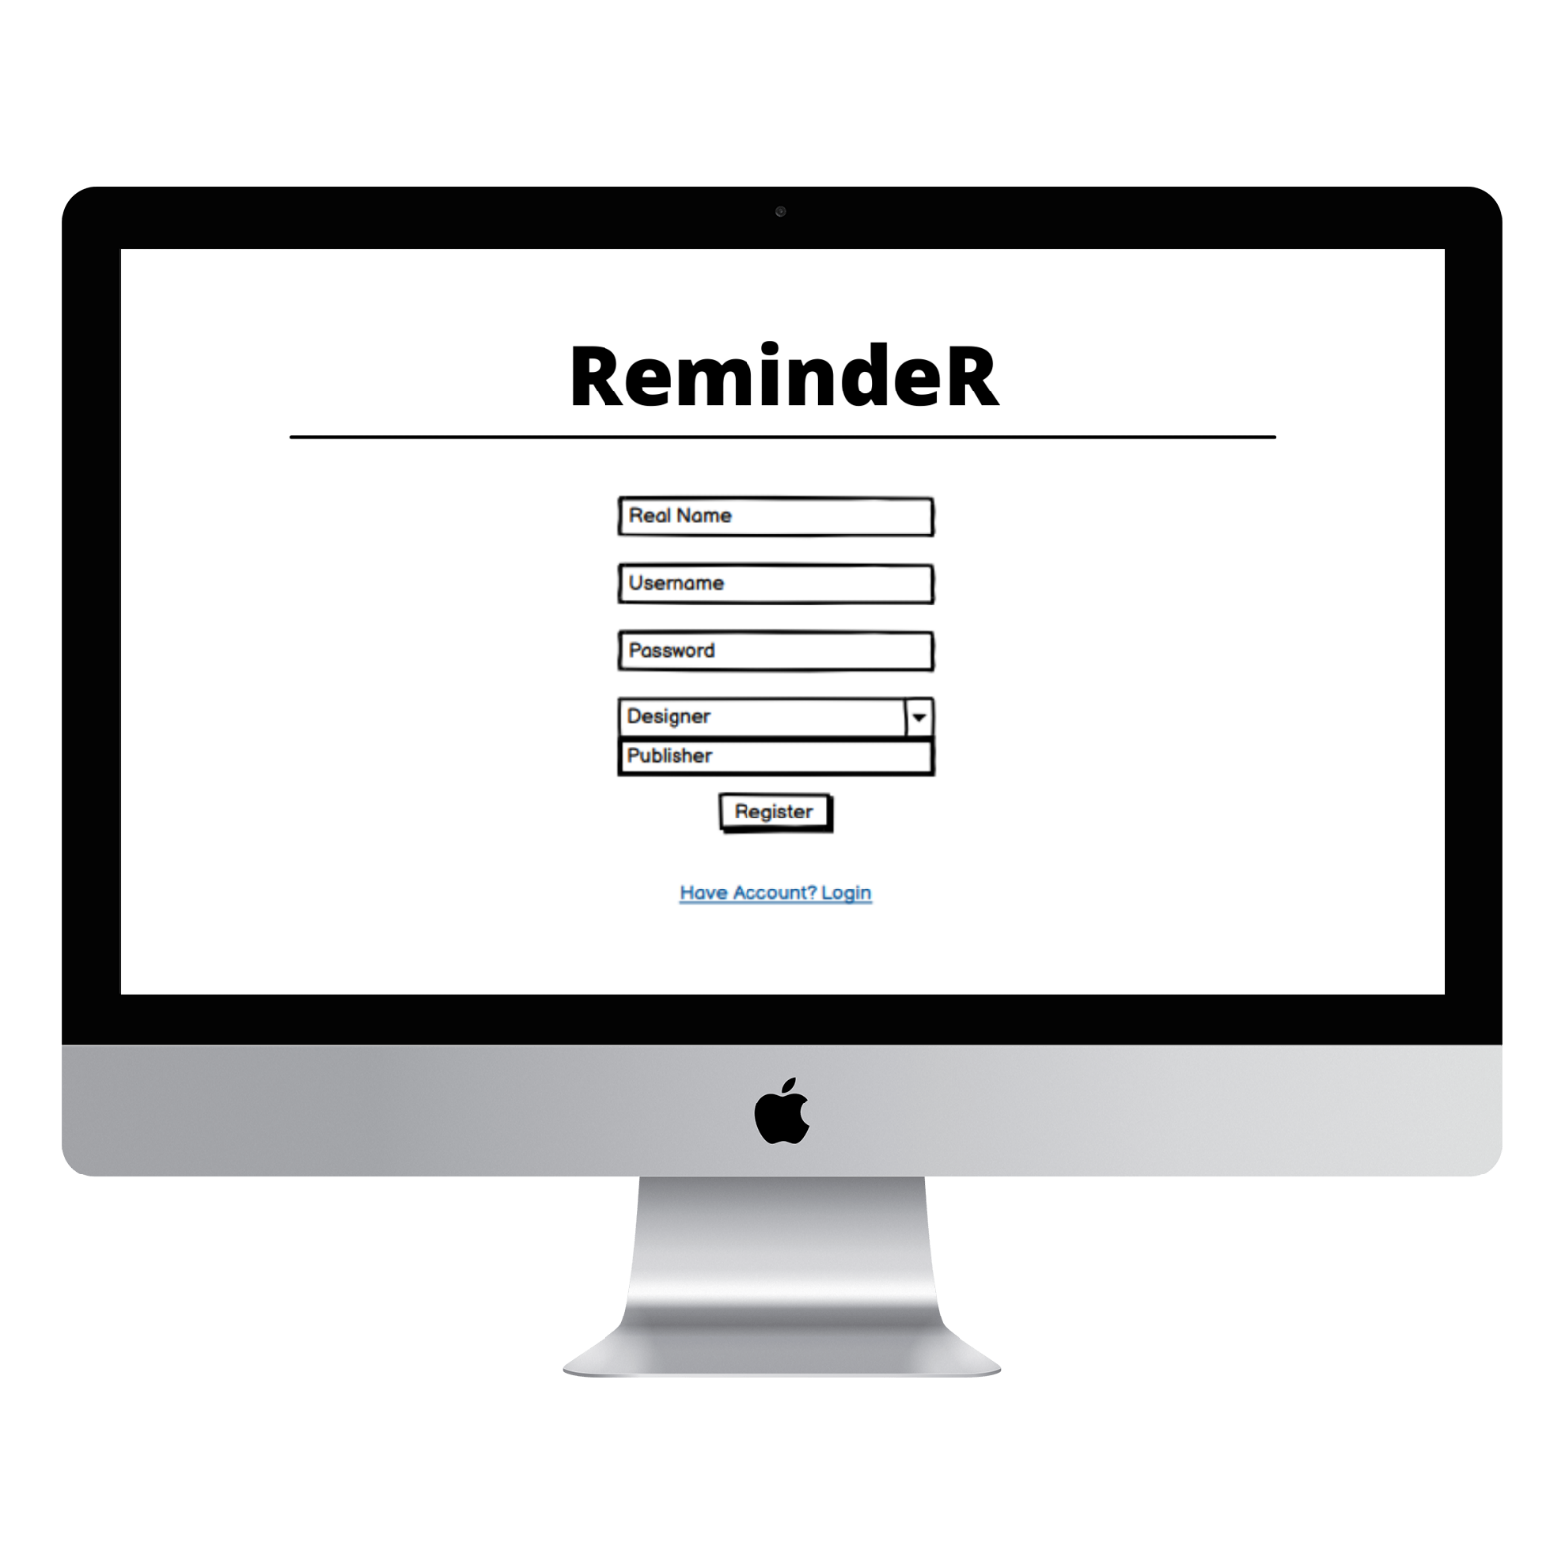
Mockup Login dan Register

Slide 12
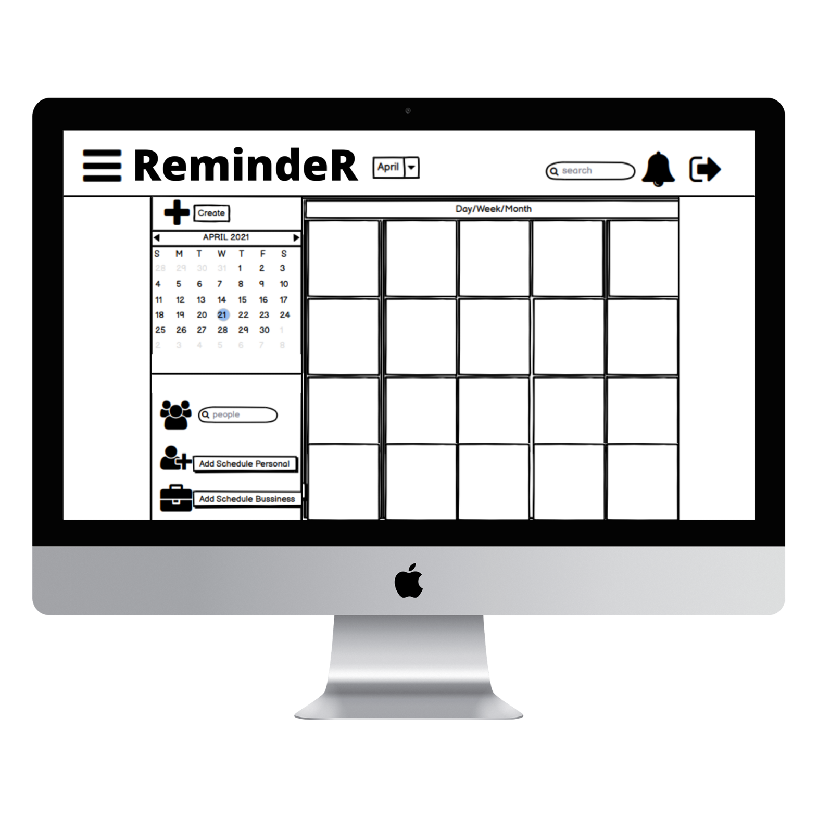
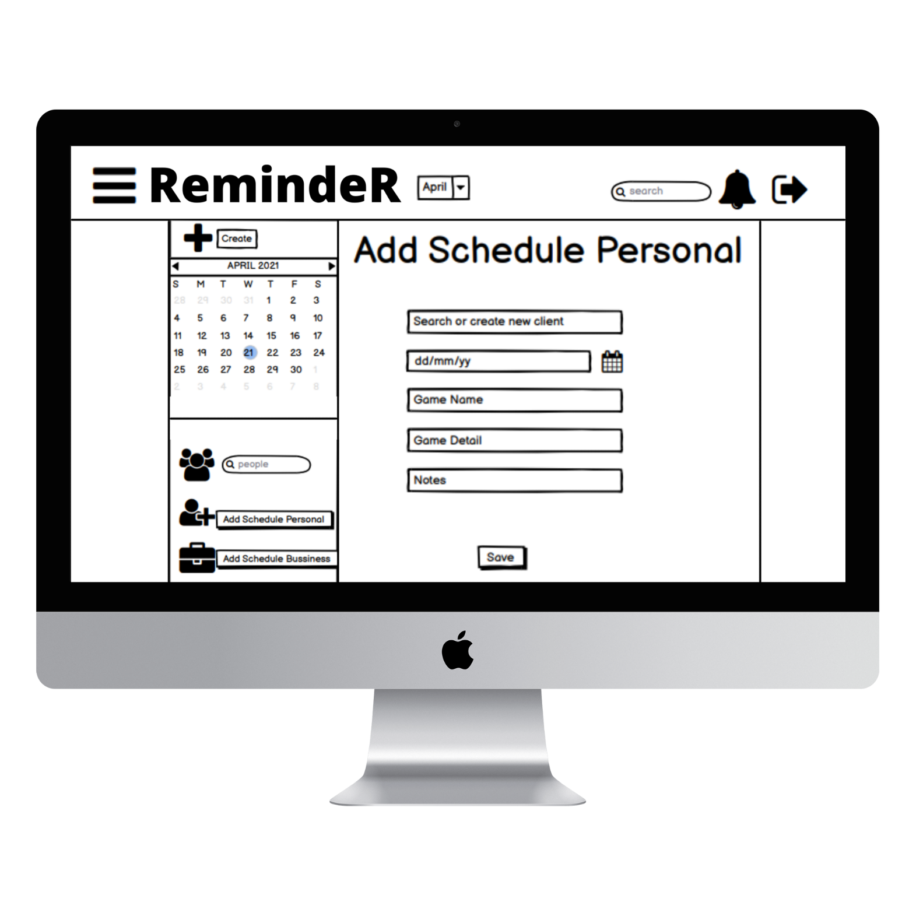

Mockup Dashboard dan Add Schedule

