Slide 1

THE EFFECT OF EXCHANGE RATE SHOCK
ON OUTPUT, INFLATION,
AND NET EXPORT
-
CASE OF NORWAY
TEAM 1

Slide 2
CONTENTS
Research Question
Findings and Results
Data
Research Methodology

Slide 3
Research Question
Effect of exchange rate shock on output, inflation, and net export?
H2: Exchange rate shocks have positive impacts on inflation
H3:Exchange rate shocks have positive impacts on output
H1: Exchange rate shocks have positive impact on net export

Slide 4

Research Methodology
Structural
Vector Autoregressive
(SVAR)

Slide 5
DATA
Variable | Data
Output | Real GDP growth
Inflation | CPI
Net export | Real (Export – Import)/GDP
Exchange rate | USD / NOK
Data source: http://www.macrohistory.net/

Slide 6
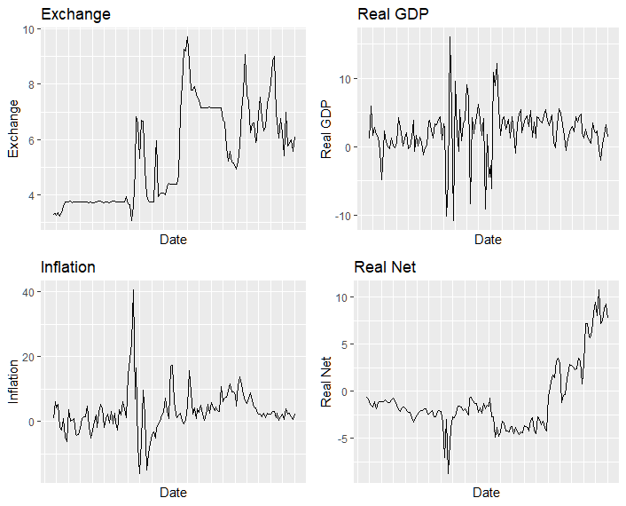

Slide 7
Data exploratory and analyzing process
Tests of Stationarity (Dickey–Fuller test)
Stationarize data
Model estimation
Result interpretation

Slide 8
Ordering Variables in SVAR
GDP
Net Export
Inflation
Exchange Rate

Slide 9
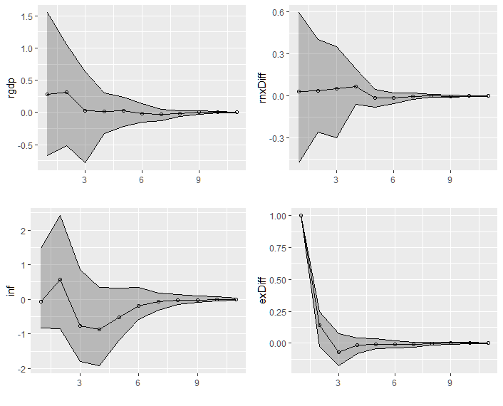
Impulse response of 1% change of exchange rate

Slide 10
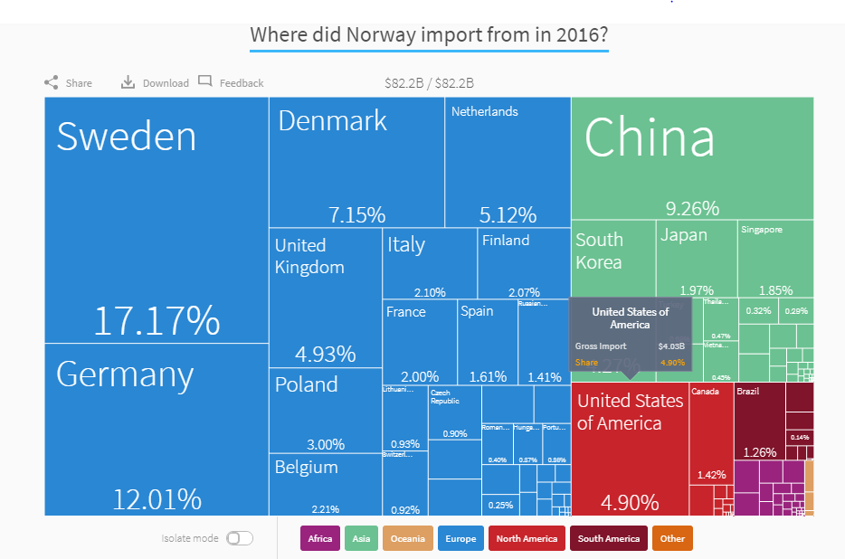

Slide 11
CONCLUSION
Exchange rate shocks have positive impact on net export and out put
Implication: If given funding, we would like to take this study further by mining more applicable data and testing more variables as well as applying this study to Vietnam.

Slide 12
Thank You!

