Slide 1
Hidden keys and repeated biometric records
Can multiple protected records reveal identity when keys remain hidden?
Fresh-key learned attacks: uncertainty remains; no equivalence claim.
Recurring transforms: large gains from multiple same-identity records.
Pool draws matter; a simple prediction-mean baseline is competitive.
New: 672 MOBIO/SCface endpoints, raw-input retraining and a local stricter-selection audit.
Research review draft | 19 September 2026 | 1/15
Notes:
Evidence baseline: commit 655ae1ecc2c9fc0aa80c828fe0303753296f66df. FEI run recorded base commit d1e4ceb3f975fb47d9a8321c47484bb1411f5239 with FEI additions uncommitted.
Sources: experiments/cross_dataset_key_pool_summary.csv; experiments/fei_multiexposure/README.md; experiments/mobio_mechanism_controls/results_summary.csv; experiments/mobio_correlation_controls/results_summary.csv.
Configuration: configs/attacks/fei_key_pool_boundary.yaml. See reports/figures/README.md for figure captions and docs/ROADMAP.md for pending gates. Diagram symbols are schematic, not biometric examples.
New pilot code freeze: d5f4e89. Configuration: configs/attacks/scheme_extension_pilot.yaml. Sources: experiments/scheme_extension_pilot/{results_summary,paired_uncertainty,equivalence_sensitivity,native_utility}.csv. SCface protocol and pilot freeze: 69a93e4; sources under experiments/scface_multiexposure and experiments/scface_scheme_extension_pilot. One-seed CPU pilots, 120-epoch cap; not a controlled ranking against earlier 400-epoch, three-seed studies. See figure_appendix.pdf for all figures, including native matching and uncertainty. Follow-up: experiments/scheme_followup_2026-09-18; 216 endpoints, two identity partitions, three model seeds. Pre-execution source/config hashes: execution_manifest.json; base commit 4352eeb, dirty working tree recorded. Primary sign-flip tests: Holm family 8; native gallery-label permutations: Holm family 12. Independent-pool follow-up: experiments/pool_replication_2026-09-19; 24 cells, 144 fits, 72 prediction-mean evaluations; source snapshots and input hashes recorded. Three-pool intervals are pointwise, not corrected significance tests. Full-text comparison uses the author's thesis section 5.4.

Slide 2
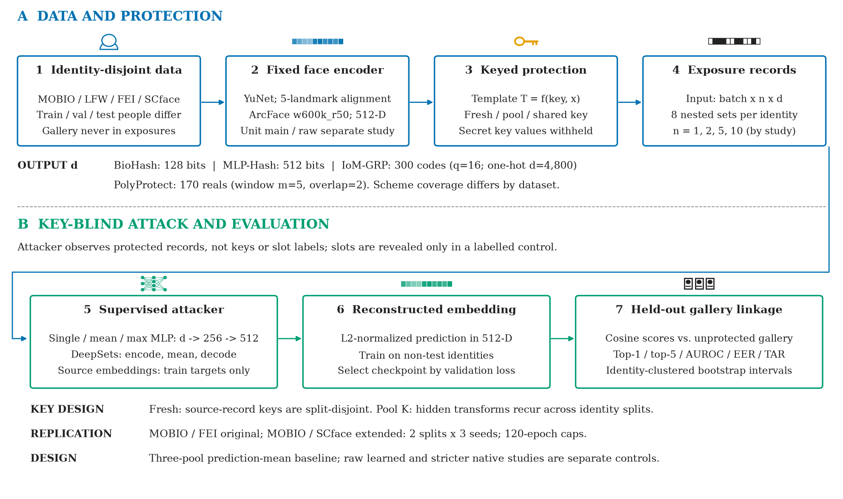
Experimental architecture
Train on separate identities. Reconstruct an embedding, then link to a held-out gallery.
Research review draft | 19 September 2026 | 2/15
Notes:
Evidence baseline: commit 655ae1ecc2c9fc0aa80c828fe0303753296f66df. FEI run recorded base commit d1e4ceb3f975fb47d9a8321c47484bb1411f5239 with FEI additions uncommitted.
Sources: experiments/cross_dataset_key_pool_summary.csv; experiments/fei_multiexposure/README.md; experiments/mobio_mechanism_controls/results_summary.csv; experiments/mobio_correlation_controls/results_summary.csv.
Configuration: configs/attacks/fei_key_pool_boundary.yaml. See reports/figures/README.md for figure captions and docs/ROADMAP.md for pending gates. Diagram symbols are schematic, not biometric examples.
New pilot code freeze: d5f4e89. Configuration: configs/attacks/scheme_extension_pilot.yaml. Sources: experiments/scheme_extension_pilot/{results_summary,paired_uncertainty,equivalence_sensitivity,native_utility}.csv. SCface protocol and pilot freeze: 69a93e4; sources under experiments/scface_multiexposure and experiments/scface_scheme_extension_pilot. One-seed CPU pilots, 120-epoch cap; not a controlled ranking against earlier 400-epoch, three-seed studies. See figure_appendix.pdf for all figures, including native matching and uncertainty. Follow-up: experiments/scheme_followup_2026-09-18; 216 endpoints, two identity partitions, three model seeds. Pre-execution source/config hashes: execution_manifest.json; base commit 4352eeb, dirty working tree recorded. Primary sign-flip tests: Holm family 8; native gallery-label permutations: Holm family 12. Independent-pool follow-up: experiments/pool_replication_2026-09-19; 24 cells, 144 fits, 72 prediction-mean evaluations; source snapshots and input hashes recorded. Three-pool intervals are pointwise, not corrected significance tests. Full-text comparison uses the author's thesis section 5.4.

Slide 3
Dataset and protection coverage
Dataset
Identities
Train/val/test
Embeddings
Variation
MOBIO
150
90/30/30
1,799 / 1,800
Sessions
LFW
125
75/25/25
1,500 / 1,500
In-the-wild
FEI
200
120/40/40
2,378 / 2,400
Pose/expression
SCface
130
78/26/26
2,851 / 2,860
Camera/distance
BioHash: 128 bits; four datasets; includes a Haar-sign control on MOBIO.
MLP-Hash: 512 bits; MOBIO; paper-specified, not source-exact.
IoM-GRP: 300 codes (q=16); PolyProtect: 170 reals (m=5, overlap=2).
Both: MOBIO/FEI original follow-up; MOBIO/SCface extended follow-up.
SCface: mugshot gallery and visible surveillance probes; 9 detection failures, all identities eligible.
Research review draft | 19 September 2026 | 3/15
Notes:
Evidence baseline: commit 655ae1ecc2c9fc0aa80c828fe0303753296f66df. FEI run recorded base commit d1e4ceb3f975fb47d9a8321c47484bb1411f5239 with FEI additions uncommitted.
Sources: experiments/cross_dataset_key_pool_summary.csv; experiments/fei_multiexposure/README.md; experiments/mobio_mechanism_controls/results_summary.csv; experiments/mobio_correlation_controls/results_summary.csv.
Configuration: configs/attacks/fei_key_pool_boundary.yaml. See reports/figures/README.md for figure captions and docs/ROADMAP.md for pending gates. Diagram symbols are schematic, not biometric examples.
New pilot code freeze: d5f4e89. Configuration: configs/attacks/scheme_extension_pilot.yaml. Sources: experiments/scheme_extension_pilot/{results_summary,paired_uncertainty,equivalence_sensitivity,native_utility}.csv. SCface protocol and pilot freeze: 69a93e4; sources under experiments/scface_multiexposure and experiments/scface_scheme_extension_pilot. One-seed CPU pilots, 120-epoch cap; not a controlled ranking against earlier 400-epoch, three-seed studies. See figure_appendix.pdf for all figures, including native matching and uncertainty. Follow-up: experiments/scheme_followup_2026-09-18; 216 endpoints, two identity partitions, three model seeds. Pre-execution source/config hashes: execution_manifest.json; base commit 4352eeb, dirty working tree recorded. Primary sign-flip tests: Holm family 8; native gallery-label permutations: Holm family 12. Independent-pool follow-up: experiments/pool_replication_2026-09-19; 24 cells, 144 fits, 72 prediction-mean evaluations; source snapshots and input hashes recorded. Three-pool intervals are pointwise, not corrected significance tests. Full-text comparison uses the author's thesis section 5.4.

Slide 4
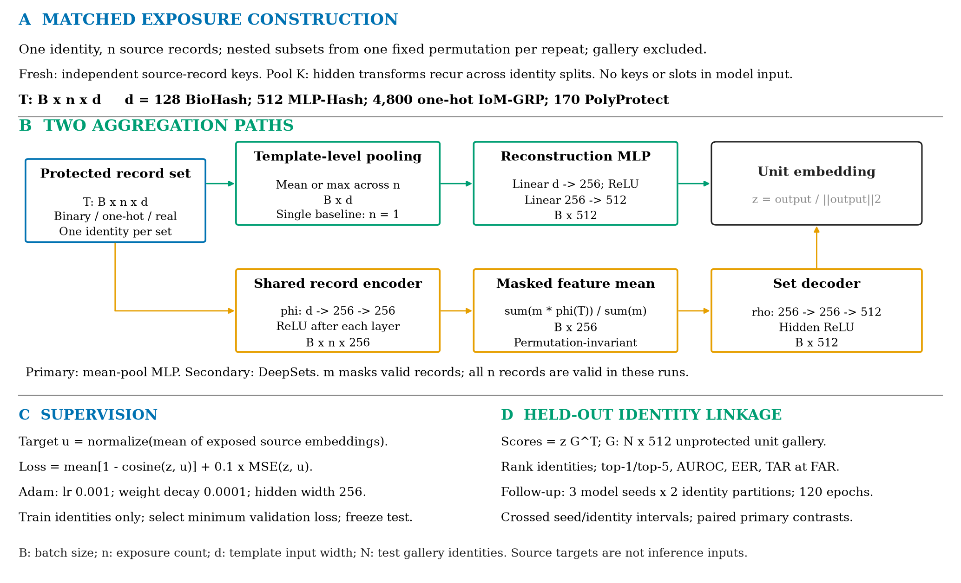
Set reconstruction and gallery linkage
Two aggregation paths; shared training objective; held-out identity linkage. Key values remain hidden.
Research review draft | 19 September 2026 | 4/15
Notes:
Evidence baseline: commit 655ae1ecc2c9fc0aa80c828fe0303753296f66df. FEI run recorded base commit d1e4ceb3f975fb47d9a8321c47484bb1411f5239 with FEI additions uncommitted.
Sources: experiments/cross_dataset_key_pool_summary.csv; experiments/fei_multiexposure/README.md; experiments/mobio_mechanism_controls/results_summary.csv; experiments/mobio_correlation_controls/results_summary.csv.
Configuration: configs/attacks/fei_key_pool_boundary.yaml. See reports/figures/README.md for figure captions and docs/ROADMAP.md for pending gates. Diagram symbols are schematic, not biometric examples.
New pilot code freeze: d5f4e89. Configuration: configs/attacks/scheme_extension_pilot.yaml. Sources: experiments/scheme_extension_pilot/{results_summary,paired_uncertainty,equivalence_sensitivity,native_utility}.csv. SCface protocol and pilot freeze: 69a93e4; sources under experiments/scface_multiexposure and experiments/scface_scheme_extension_pilot. One-seed CPU pilots, 120-epoch cap; not a controlled ranking against earlier 400-epoch, three-seed studies. See figure_appendix.pdf for all figures, including native matching and uncertainty. Follow-up: experiments/scheme_followup_2026-09-18; 216 endpoints, two identity partitions, three model seeds. Pre-execution source/config hashes: execution_manifest.json; base commit 4352eeb, dirty working tree recorded. Primary sign-flip tests: Holm family 8; native gallery-label permutations: Holm family 12. Independent-pool follow-up: experiments/pool_replication_2026-09-19; 24 cells, 144 fits, 72 prediction-mean evaluations; source snapshots and input hashes recorded. Three-pool intervals are pointwise, not corrected significance tests. Full-text comparison uses the author's thesis section 5.4.

Slide 5
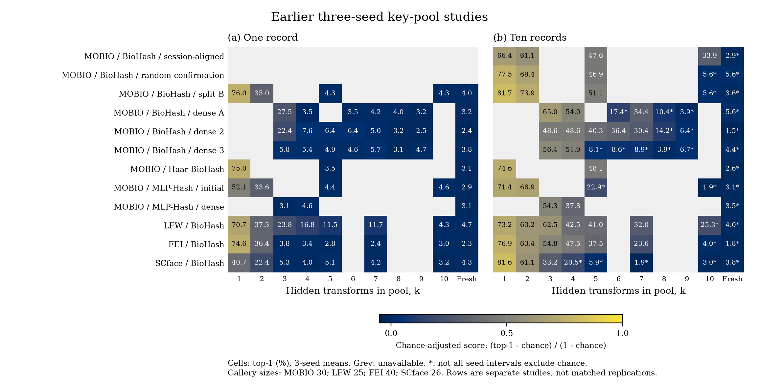
Earlier three-seed key-pool studies
73 conditions from 12 earlier studies. New one-seed pilots are reported separately.
Research review draft | 19 September 2026 | 5/15
Notes:
Evidence baseline: commit 655ae1ecc2c9fc0aa80c828fe0303753296f66df. FEI run recorded base commit d1e4ceb3f975fb47d9a8321c47484bb1411f5239 with FEI additions uncommitted.
Sources: experiments/cross_dataset_key_pool_summary.csv; experiments/fei_multiexposure/README.md; experiments/mobio_mechanism_controls/results_summary.csv; experiments/mobio_correlation_controls/results_summary.csv.
Configuration: configs/attacks/fei_key_pool_boundary.yaml. See reports/figures/README.md for figure captions and docs/ROADMAP.md for pending gates. Diagram symbols are schematic, not biometric examples.
New pilot code freeze: d5f4e89. Configuration: configs/attacks/scheme_extension_pilot.yaml. Sources: experiments/scheme_extension_pilot/{results_summary,paired_uncertainty,equivalence_sensitivity,native_utility}.csv. SCface protocol and pilot freeze: 69a93e4; sources under experiments/scface_multiexposure and experiments/scface_scheme_extension_pilot. One-seed CPU pilots, 120-epoch cap; not a controlled ranking against earlier 400-epoch, three-seed studies. See figure_appendix.pdf for all figures, including native matching and uncertainty. Follow-up: experiments/scheme_followup_2026-09-18; 216 endpoints, two identity partitions, three model seeds. Pre-execution source/config hashes: execution_manifest.json; base commit 4352eeb, dirty working tree recorded. Primary sign-flip tests: Holm family 8; native gallery-label permutations: Holm family 12. Independent-pool follow-up: experiments/pool_replication_2026-09-19; 24 cells, 144 fits, 72 prediction-mean evaluations; source snapshots and input hashes recorded. Three-pool intervals are pointwise, not corrected significance tests. Full-text comparison uses the author's thesis section 5.4.

Slide 6
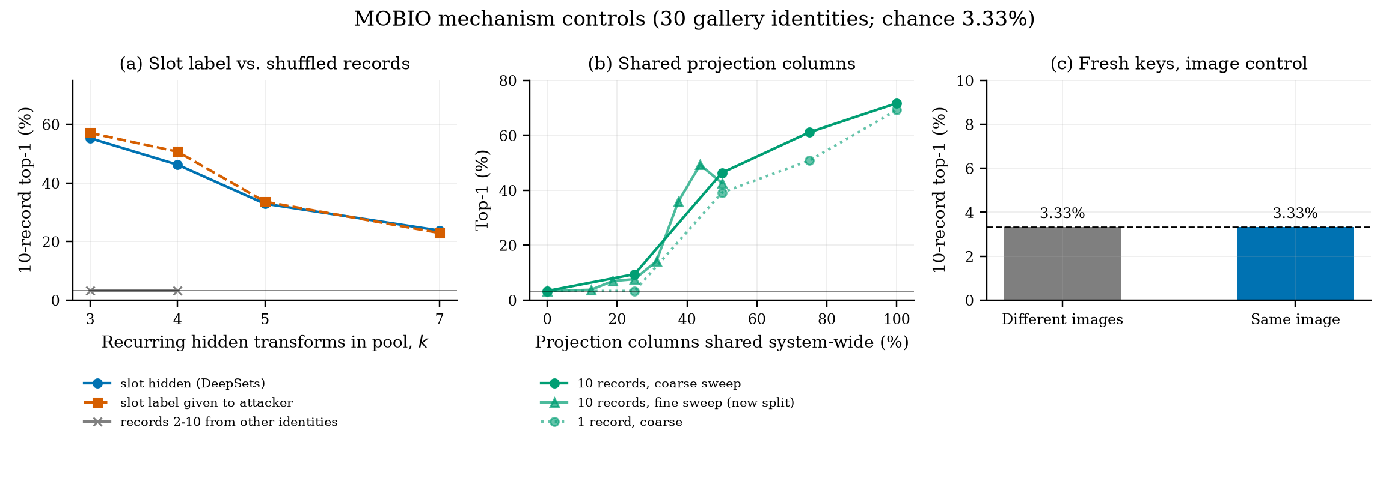
Mechanism and correlation controls
Slot identifiers are not key values. Coarse and fine correlation sweeps use separate partitions.
Research review draft | 19 September 2026 | 6/15
Notes:
Evidence baseline: commit 655ae1ecc2c9fc0aa80c828fe0303753296f66df. FEI run recorded base commit d1e4ceb3f975fb47d9a8321c47484bb1411f5239 with FEI additions uncommitted.
Sources: experiments/cross_dataset_key_pool_summary.csv; experiments/fei_multiexposure/README.md; experiments/mobio_mechanism_controls/results_summary.csv; experiments/mobio_correlation_controls/results_summary.csv.
Configuration: configs/attacks/fei_key_pool_boundary.yaml. See reports/figures/README.md for figure captions and docs/ROADMAP.md for pending gates. Diagram symbols are schematic, not biometric examples.
New pilot code freeze: d5f4e89. Configuration: configs/attacks/scheme_extension_pilot.yaml. Sources: experiments/scheme_extension_pilot/{results_summary,paired_uncertainty,equivalence_sensitivity,native_utility}.csv. SCface protocol and pilot freeze: 69a93e4; sources under experiments/scface_multiexposure and experiments/scface_scheme_extension_pilot. One-seed CPU pilots, 120-epoch cap; not a controlled ranking against earlier 400-epoch, three-seed studies. See figure_appendix.pdf for all figures, including native matching and uncertainty. Follow-up: experiments/scheme_followup_2026-09-18; 216 endpoints, two identity partitions, three model seeds. Pre-execution source/config hashes: execution_manifest.json; base commit 4352eeb, dirty working tree recorded. Primary sign-flip tests: Holm family 8; native gallery-label permutations: Holm family 12. Independent-pool follow-up: experiments/pool_replication_2026-09-19; 24 cells, 144 fits, 72 prediction-mean evaluations; source snapshots and input hashes recorded. Three-pool intervals are pointwise, not corrected significance tests. Full-text comparison uses the author's thesis section 5.4.

Slide 7
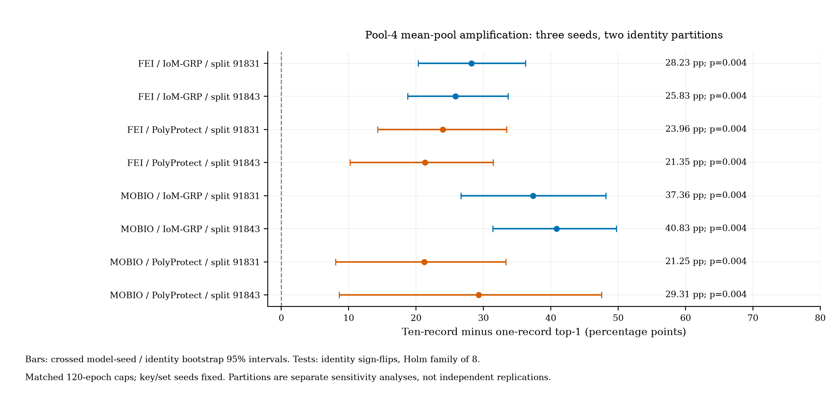
Replicated multi-record amplification
MOBIO / FEI; IoM-GRP / PolyProtect; 3 model seeds x 2 identity partitions; matched 120-epoch caps.
Research review draft | 19 September 2026 | 7/15
Notes:
Evidence baseline: commit 655ae1ecc2c9fc0aa80c828fe0303753296f66df. FEI run recorded base commit d1e4ceb3f975fb47d9a8321c47484bb1411f5239 with FEI additions uncommitted.
Sources: experiments/cross_dataset_key_pool_summary.csv; experiments/fei_multiexposure/README.md; experiments/mobio_mechanism_controls/results_summary.csv; experiments/mobio_correlation_controls/results_summary.csv.
Configuration: configs/attacks/fei_key_pool_boundary.yaml. See reports/figures/README.md for figure captions and docs/ROADMAP.md for pending gates. Diagram symbols are schematic, not biometric examples.
New pilot code freeze: d5f4e89. Configuration: configs/attacks/scheme_extension_pilot.yaml. Sources: experiments/scheme_extension_pilot/{results_summary,paired_uncertainty,equivalence_sensitivity,native_utility}.csv. SCface protocol and pilot freeze: 69a93e4; sources under experiments/scface_multiexposure and experiments/scface_scheme_extension_pilot. One-seed CPU pilots, 120-epoch cap; not a controlled ranking against earlier 400-epoch, three-seed studies. See figure_appendix.pdf for all figures, including native matching and uncertainty. Follow-up: experiments/scheme_followup_2026-09-18; 216 endpoints, two identity partitions, three model seeds. Pre-execution source/config hashes: execution_manifest.json; base commit 4352eeb, dirty working tree recorded. Primary sign-flip tests: Holm family 8; native gallery-label permutations: Holm family 12. Independent-pool follow-up: experiments/pool_replication_2026-09-19; 24 cells, 144 fits, 72 prediction-mean evaluations; source snapshots and input hashes recorded. Three-pool intervals are pointwise, not corrected significance tests. Full-text comparison uses the author's thesis section 5.4.

Slide 8
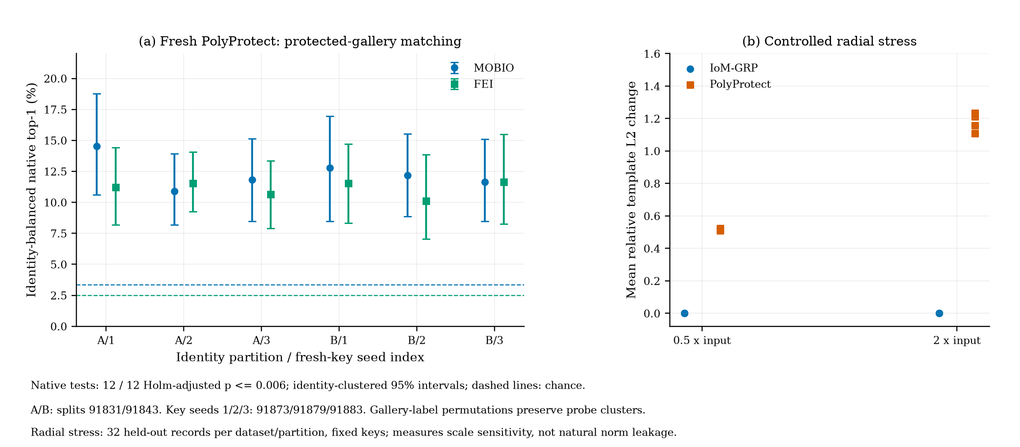
Native linkage and radial sensitivity
Protected-gallery matching is distinct from learned linkage. Radial sensitivity does not establish natural norm leakage.
Research review draft | 19 September 2026 | 8/15
Notes:
Evidence baseline: commit 655ae1ecc2c9fc0aa80c828fe0303753296f66df. FEI run recorded base commit d1e4ceb3f975fb47d9a8321c47484bb1411f5239 with FEI additions uncommitted.
Sources: experiments/cross_dataset_key_pool_summary.csv; experiments/fei_multiexposure/README.md; experiments/mobio_mechanism_controls/results_summary.csv; experiments/mobio_correlation_controls/results_summary.csv.
Configuration: configs/attacks/fei_key_pool_boundary.yaml. See reports/figures/README.md for figure captions and docs/ROADMAP.md for pending gates. Diagram symbols are schematic, not biometric examples.
New pilot code freeze: d5f4e89. Configuration: configs/attacks/scheme_extension_pilot.yaml. Sources: experiments/scheme_extension_pilot/{results_summary,paired_uncertainty,equivalence_sensitivity,native_utility}.csv. SCface protocol and pilot freeze: 69a93e4; sources under experiments/scface_multiexposure and experiments/scface_scheme_extension_pilot. One-seed CPU pilots, 120-epoch cap; not a controlled ranking against earlier 400-epoch, three-seed studies. See figure_appendix.pdf for all figures, including native matching and uncertainty. Follow-up: experiments/scheme_followup_2026-09-18; 216 endpoints, two identity partitions, three model seeds. Pre-execution source/config hashes: execution_manifest.json; base commit 4352eeb, dirty working tree recorded. Primary sign-flip tests: Holm family 8; native gallery-label permutations: Holm family 12. Independent-pool follow-up: experiments/pool_replication_2026-09-19; 24 cells, 144 fits, 72 prediction-mean evaluations; source snapshots and input hashes recorded. Three-pool intervals are pointwise, not corrected significance tests. Full-text comparison uses the author's thesis section 5.4.

Slide 9
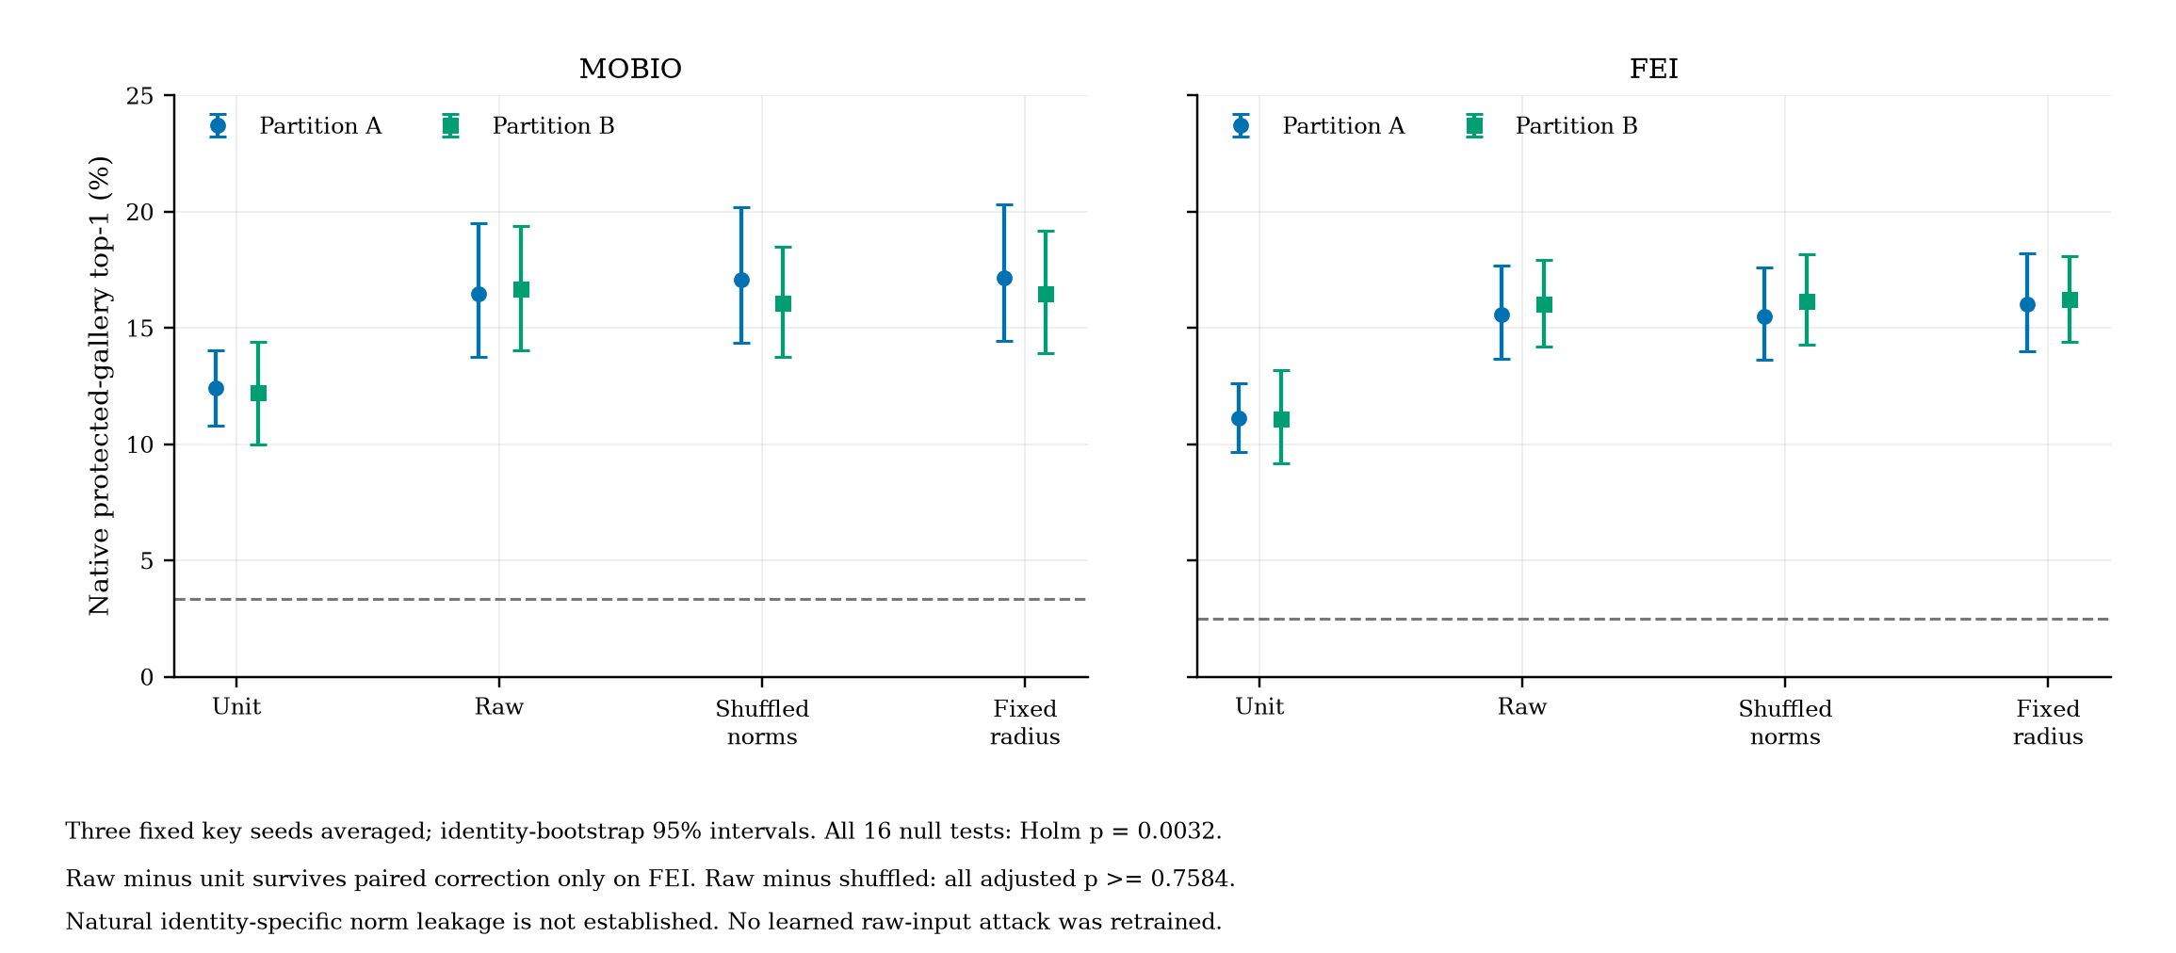
Genuine raw-input controls
Earlier native audit, not learned retraining. New raw learned and local stricter-selection results appear on slides 14-15.
Research review draft | 19 September 2026 | 9/15
Notes:
Evidence baseline: commit 655ae1ecc2c9fc0aa80c828fe0303753296f66df. FEI run recorded base commit d1e4ceb3f975fb47d9a8321c47484bb1411f5239 with FEI additions uncommitted.
Sources: experiments/cross_dataset_key_pool_summary.csv; experiments/fei_multiexposure/README.md; experiments/mobio_mechanism_controls/results_summary.csv; experiments/mobio_correlation_controls/results_summary.csv.
Configuration: configs/attacks/fei_key_pool_boundary.yaml. See reports/figures/README.md for figure captions and docs/ROADMAP.md for pending gates. Diagram symbols are schematic, not biometric examples.
New pilot code freeze: d5f4e89. Configuration: configs/attacks/scheme_extension_pilot.yaml. Sources: experiments/scheme_extension_pilot/{results_summary,paired_uncertainty,equivalence_sensitivity,native_utility}.csv. SCface protocol and pilot freeze: 69a93e4; sources under experiments/scface_multiexposure and experiments/scface_scheme_extension_pilot. One-seed CPU pilots, 120-epoch cap; not a controlled ranking against earlier 400-epoch, three-seed studies. See figure_appendix.pdf for all figures, including native matching and uncertainty. Follow-up: experiments/scheme_followup_2026-09-18; 216 endpoints, two identity partitions, three model seeds. Pre-execution source/config hashes: execution_manifest.json; base commit 4352eeb, dirty working tree recorded. Primary sign-flip tests: Holm family 8; native gallery-label permutations: Holm family 12. Independent-pool follow-up: experiments/pool_replication_2026-09-19; 24 cells, 144 fits, 72 prediction-mean evaluations; source snapshots and input hashes recorded. Three-pool intervals are pointwise, not corrected significance tests. Full-text comparison uses the author's thesis section 5.4.

Slide 10
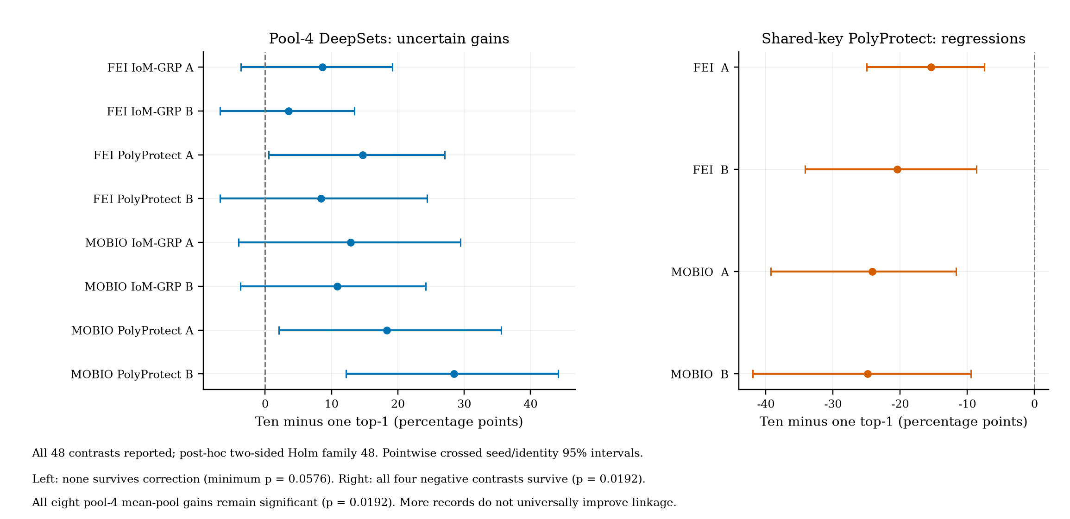
Failure analysis: aggregation is not always better
Original primary family unchanged. All 48 contrasts, including significant losses, are reported separately from historical exploration.
Research review draft | 19 September 2026 | 10/15
Notes:
Evidence baseline: commit 655ae1ecc2c9fc0aa80c828fe0303753296f66df. FEI run recorded base commit d1e4ceb3f975fb47d9a8321c47484bb1411f5239 with FEI additions uncommitted.
Sources: experiments/cross_dataset_key_pool_summary.csv; experiments/fei_multiexposure/README.md; experiments/mobio_mechanism_controls/results_summary.csv; experiments/mobio_correlation_controls/results_summary.csv.
Configuration: configs/attacks/fei_key_pool_boundary.yaml. See reports/figures/README.md for figure captions and docs/ROADMAP.md for pending gates. Diagram symbols are schematic, not biometric examples.
New pilot code freeze: d5f4e89. Configuration: configs/attacks/scheme_extension_pilot.yaml. Sources: experiments/scheme_extension_pilot/{results_summary,paired_uncertainty,equivalence_sensitivity,native_utility}.csv. SCface protocol and pilot freeze: 69a93e4; sources under experiments/scface_multiexposure and experiments/scface_scheme_extension_pilot. One-seed CPU pilots, 120-epoch cap; not a controlled ranking against earlier 400-epoch, three-seed studies. See figure_appendix.pdf for all figures, including native matching and uncertainty. Follow-up: experiments/scheme_followup_2026-09-18; 216 endpoints, two identity partitions, three model seeds. Pre-execution source/config hashes: execution_manifest.json; base commit 4352eeb, dirty working tree recorded. Primary sign-flip tests: Holm family 8; native gallery-label permutations: Holm family 12. Independent-pool follow-up: experiments/pool_replication_2026-09-19; 24 cells, 144 fits, 72 prediction-mean evaluations; source snapshots and input hashes recorded. Three-pool intervals are pointwise, not corrected significance tests. Full-text comparison uses the author's thesis section 5.4.

Slide 11
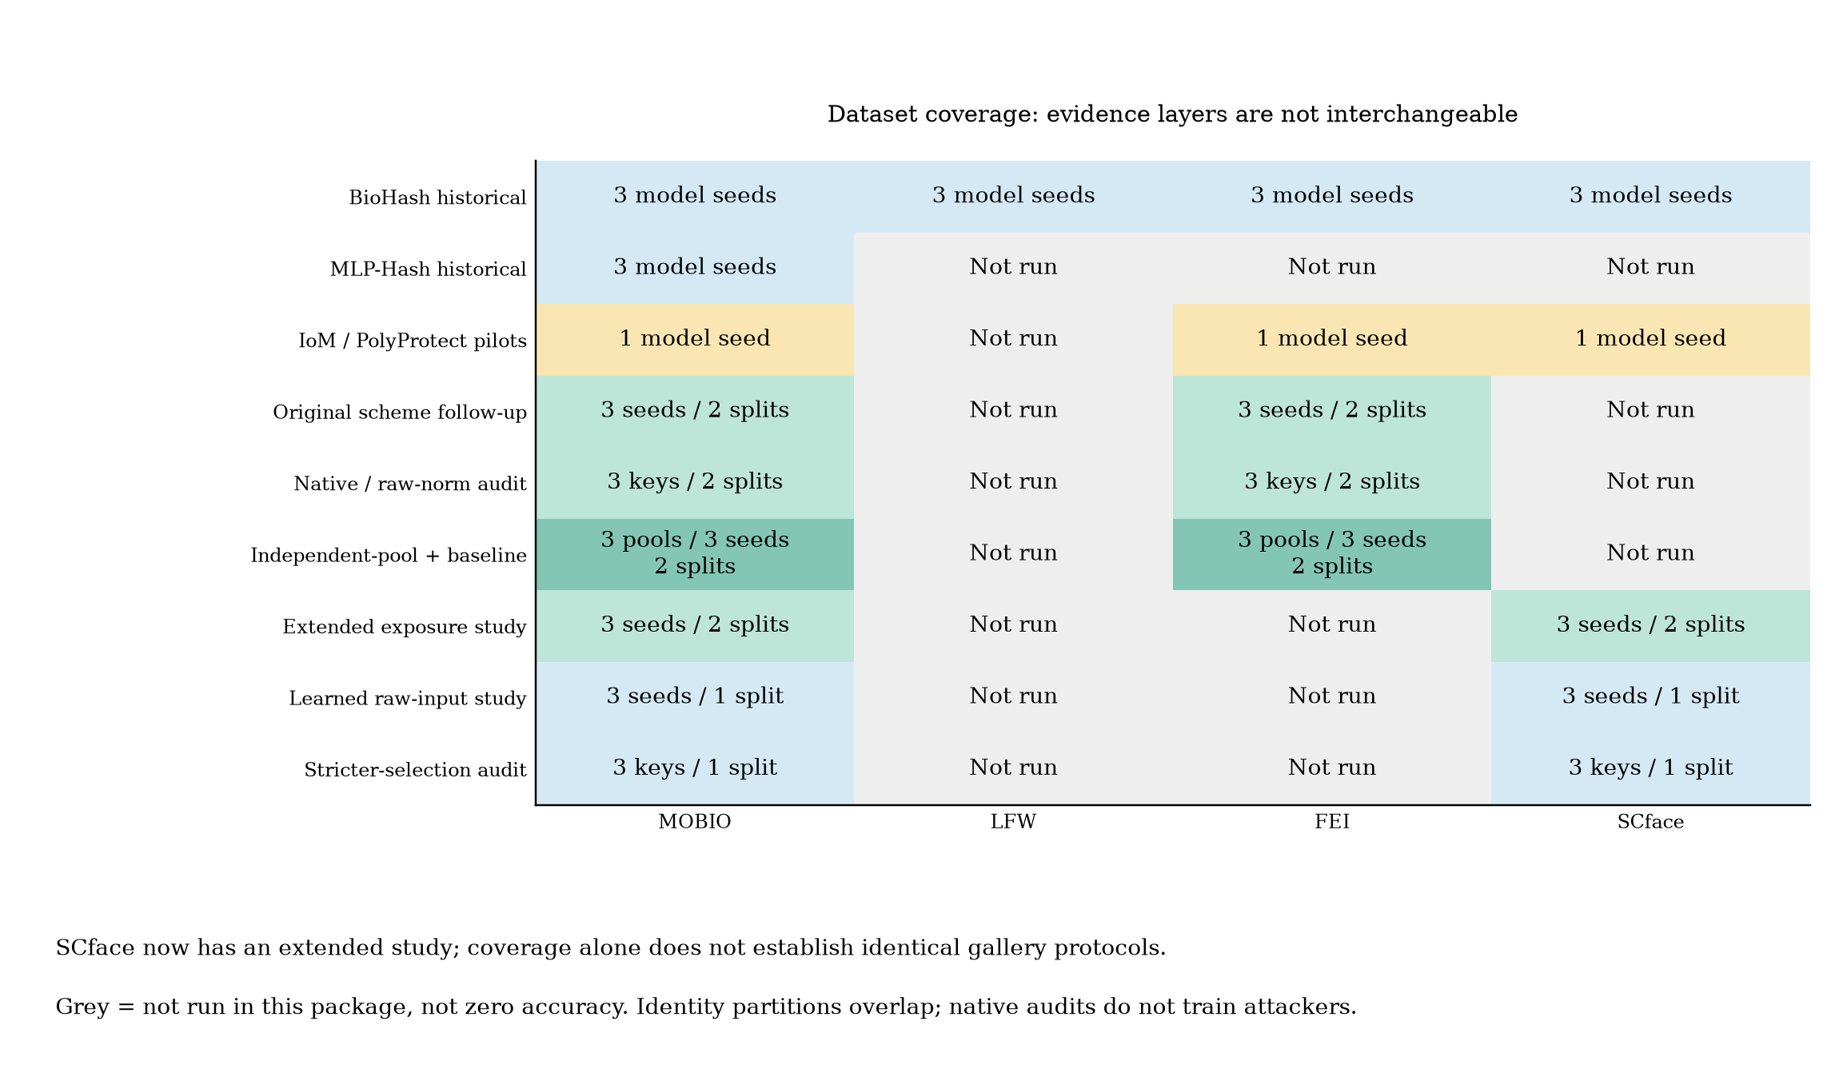
Four datasets, distinct evidence layers
SCface now has a three-seed/two-partition exposure study. LFW remains historical; missing cells are not zero accuracy.
Research review draft | 19 September 2026 | 11/15
Notes:
Evidence baseline: commit 655ae1ecc2c9fc0aa80c828fe0303753296f66df. FEI run recorded base commit d1e4ceb3f975fb47d9a8321c47484bb1411f5239 with FEI additions uncommitted.
Sources: experiments/cross_dataset_key_pool_summary.csv; experiments/fei_multiexposure/README.md; experiments/mobio_mechanism_controls/results_summary.csv; experiments/mobio_correlation_controls/results_summary.csv.
Configuration: configs/attacks/fei_key_pool_boundary.yaml. See reports/figures/README.md for figure captions and docs/ROADMAP.md for pending gates. Diagram symbols are schematic, not biometric examples.
New pilot code freeze: d5f4e89. Configuration: configs/attacks/scheme_extension_pilot.yaml. Sources: experiments/scheme_extension_pilot/{results_summary,paired_uncertainty,equivalence_sensitivity,native_utility}.csv. SCface protocol and pilot freeze: 69a93e4; sources under experiments/scface_multiexposure and experiments/scface_scheme_extension_pilot. One-seed CPU pilots, 120-epoch cap; not a controlled ranking against earlier 400-epoch, three-seed studies. See figure_appendix.pdf for all figures, including native matching and uncertainty. Follow-up: experiments/scheme_followup_2026-09-18; 216 endpoints, two identity partitions, three model seeds. Pre-execution source/config hashes: execution_manifest.json; base commit 4352eeb, dirty working tree recorded. Primary sign-flip tests: Holm family 8; native gallery-label permutations: Holm family 12. Independent-pool follow-up: experiments/pool_replication_2026-09-19; 24 cells, 144 fits, 72 prediction-mean evaluations; source snapshots and input hashes recorded. Three-pool intervals are pointwise, not corrected significance tests. Full-text comparison uses the author's thesis section 5.4.

Slide 12
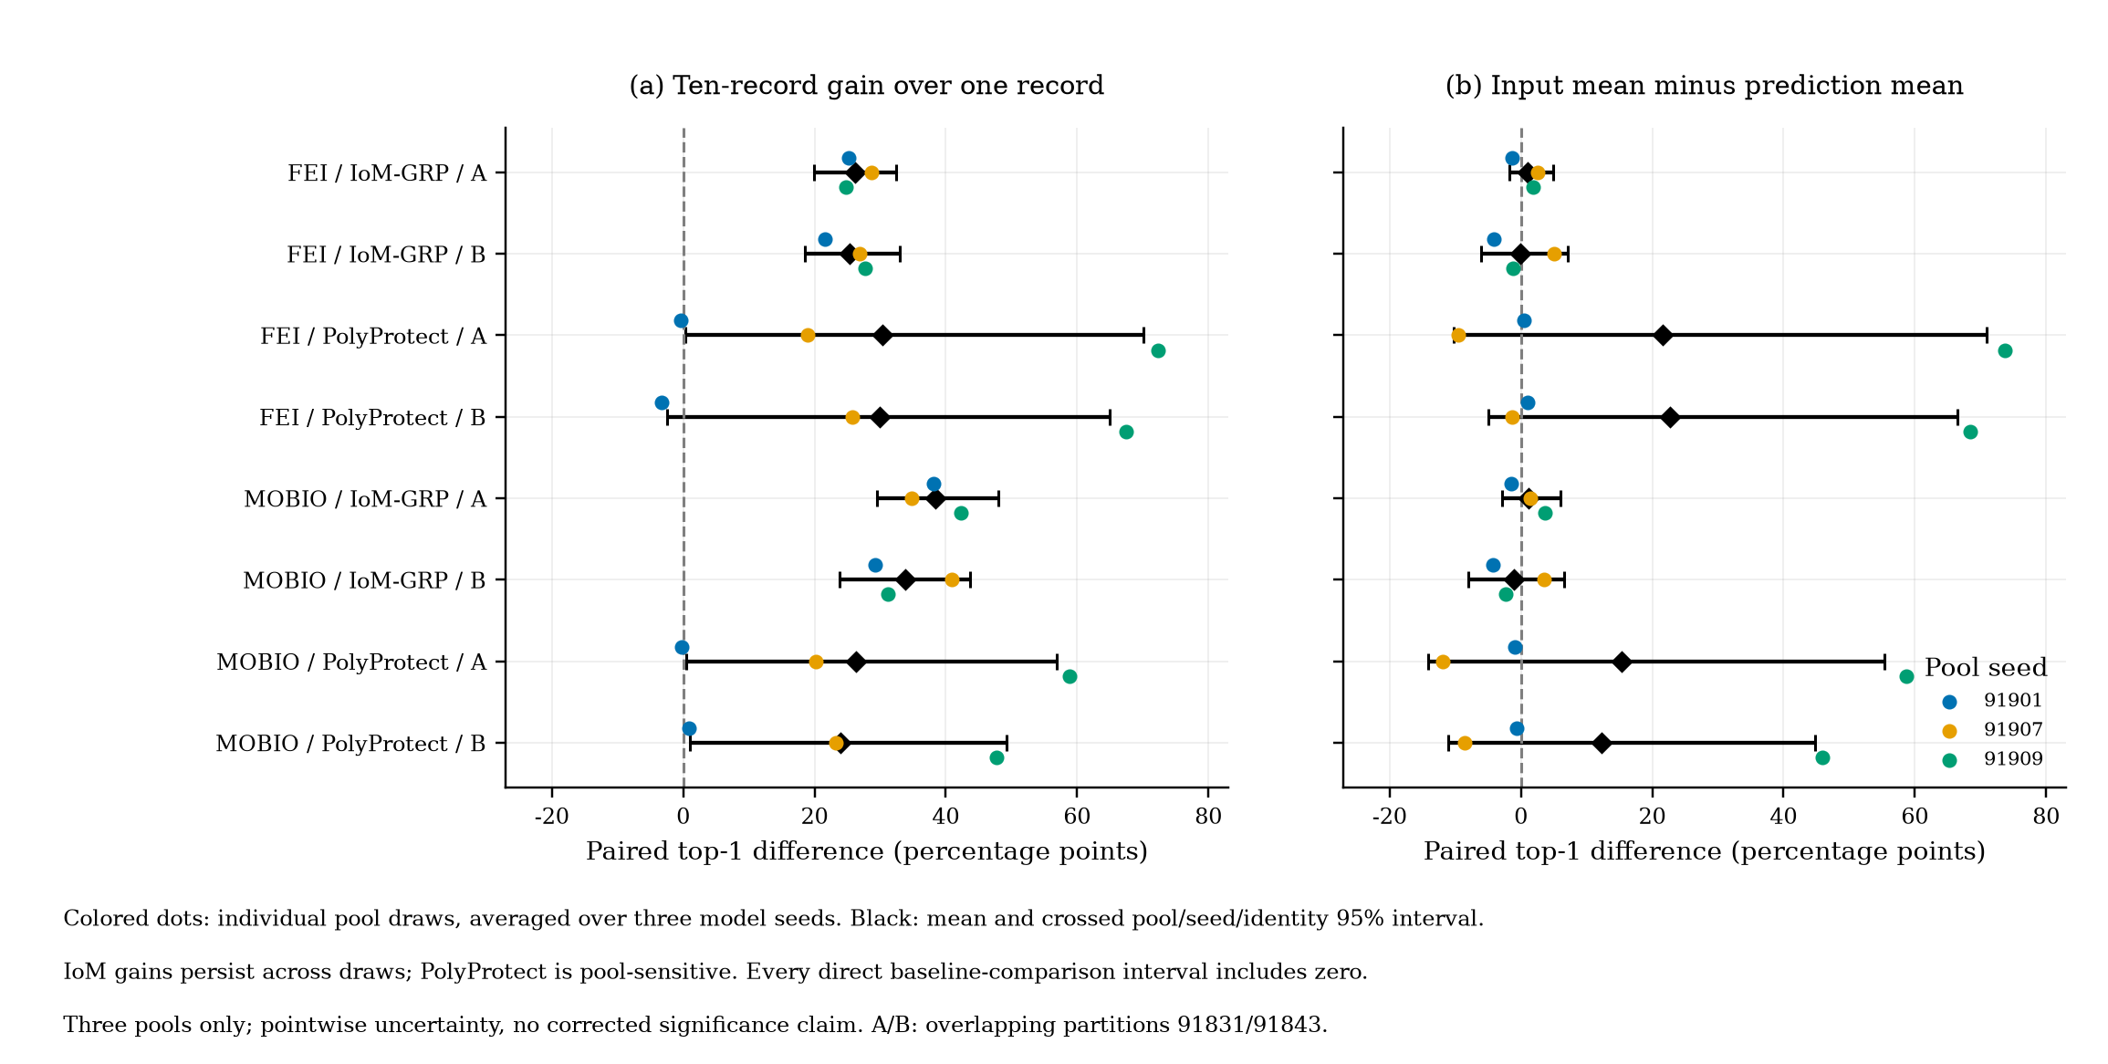
Independent pools and a matched baseline
Three new pool draws: IoM gains persist; PolyProtect is variable. Input-pooling superiority is not established.
Research review draft | 19 September 2026 | 12/15
Notes:
Evidence baseline: commit 655ae1ecc2c9fc0aa80c828fe0303753296f66df. FEI run recorded base commit d1e4ceb3f975fb47d9a8321c47484bb1411f5239 with FEI additions uncommitted.
Sources: experiments/cross_dataset_key_pool_summary.csv; experiments/fei_multiexposure/README.md; experiments/mobio_mechanism_controls/results_summary.csv; experiments/mobio_correlation_controls/results_summary.csv.
Configuration: configs/attacks/fei_key_pool_boundary.yaml. See reports/figures/README.md for figure captions and docs/ROADMAP.md for pending gates. Diagram symbols are schematic, not biometric examples.
New pilot code freeze: d5f4e89. Configuration: configs/attacks/scheme_extension_pilot.yaml. Sources: experiments/scheme_extension_pilot/{results_summary,paired_uncertainty,equivalence_sensitivity,native_utility}.csv. SCface protocol and pilot freeze: 69a93e4; sources under experiments/scface_multiexposure and experiments/scface_scheme_extension_pilot. One-seed CPU pilots, 120-epoch cap; not a controlled ranking against earlier 400-epoch, three-seed studies. See figure_appendix.pdf for all figures, including native matching and uncertainty. Follow-up: experiments/scheme_followup_2026-09-18; 216 endpoints, two identity partitions, three model seeds. Pre-execution source/config hashes: execution_manifest.json; base commit 4352eeb, dirty working tree recorded. Primary sign-flip tests: Holm family 8; native gallery-label permutations: Holm family 12. Independent-pool follow-up: experiments/pool_replication_2026-09-19; 24 cells, 144 fits, 72 prediction-mean evaluations; source snapshots and input hashes recorded. Three-pool intervals are pointwise, not corrected significance tests. Full-text comparison uses the author's thesis section 5.4.

Slide 13
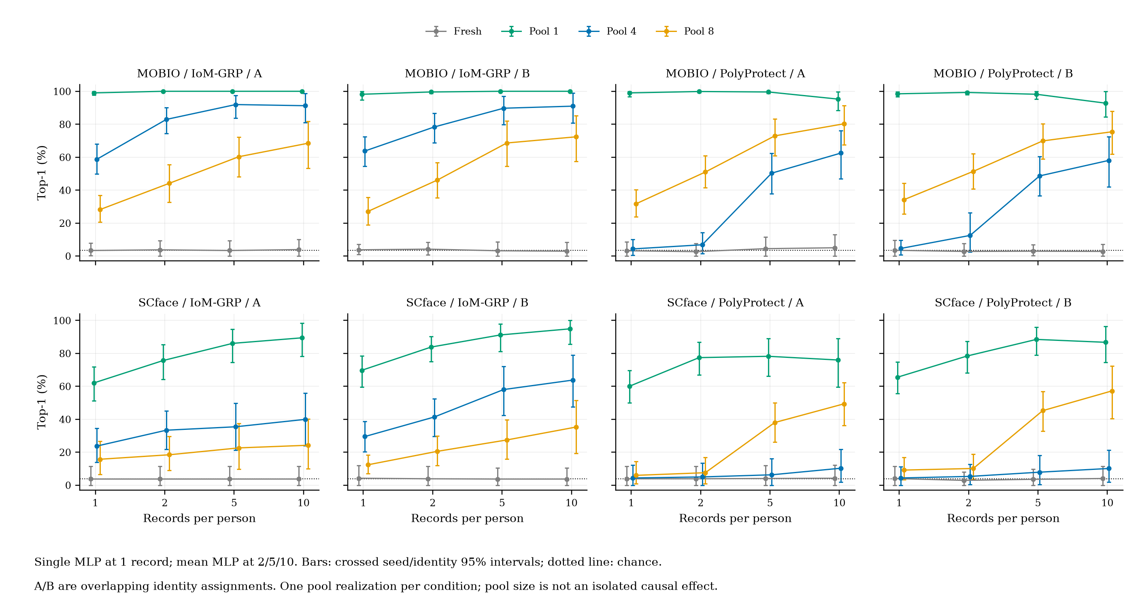
Extended exposures: MOBIO and SCface
672 endpoints; eight primary gains pass Holm correction. Larger pools do not guarantee lower observed linkage.
Research review draft | 19 September 2026 | 13/15
Notes:
Evidence baseline: commit 655ae1ecc2c9fc0aa80c828fe0303753296f66df. FEI run recorded base commit d1e4ceb3f975fb47d9a8321c47484bb1411f5239 with FEI additions uncommitted.
Sources: experiments/cross_dataset_key_pool_summary.csv; experiments/fei_multiexposure/README.md; experiments/mobio_mechanism_controls/results_summary.csv; experiments/mobio_correlation_controls/results_summary.csv.
Configuration: configs/attacks/fei_key_pool_boundary.yaml. See reports/figures/README.md for figure captions and docs/ROADMAP.md for pending gates. Diagram symbols are schematic, not biometric examples.
New pilot code freeze: d5f4e89. Configuration: configs/attacks/scheme_extension_pilot.yaml. Sources: experiments/scheme_extension_pilot/{results_summary,paired_uncertainty,equivalence_sensitivity,native_utility}.csv. SCface protocol and pilot freeze: 69a93e4; sources under experiments/scface_multiexposure and experiments/scface_scheme_extension_pilot. One-seed CPU pilots, 120-epoch cap; not a controlled ranking against earlier 400-epoch, three-seed studies. See figure_appendix.pdf for all figures, including native matching and uncertainty. Follow-up: experiments/scheme_followup_2026-09-18; 216 endpoints, two identity partitions, three model seeds. Pre-execution source/config hashes: execution_manifest.json; base commit 4352eeb, dirty working tree recorded. Primary sign-flip tests: Holm family 8; native gallery-label permutations: Holm family 12. Independent-pool follow-up: experiments/pool_replication_2026-09-19; 24 cells, 144 fits, 72 prediction-mean evaluations; source snapshots and input hashes recorded. Three-pool intervals are pointwise, not corrected significance tests. Full-text comparison uses the author's thesis section 5.4.

Slide 14
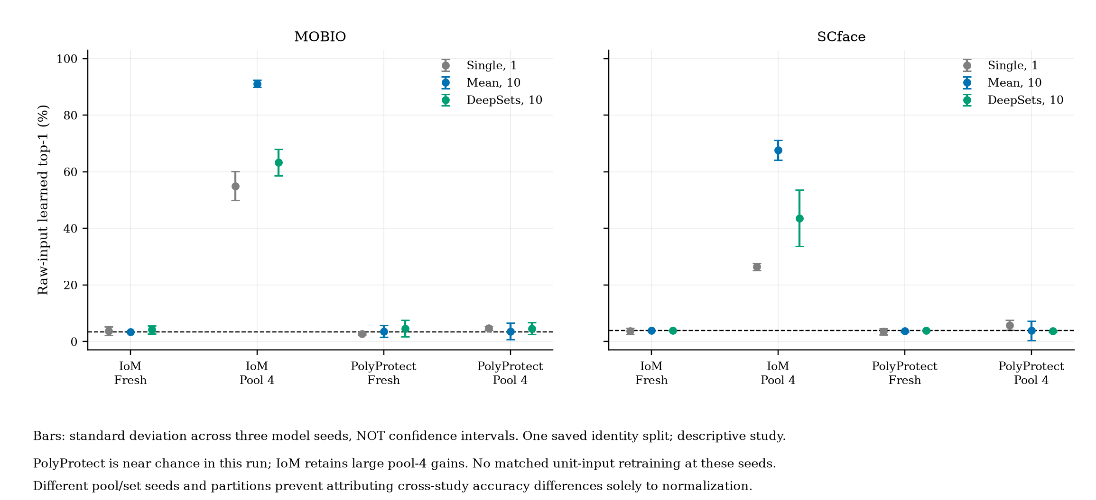
Learned attacks on raw embeddings
Separate descriptive study: bars are seed SD, not confidence intervals. No matched raw-versus-unit causal test.
Research review draft | 19 September 2026 | 14/15
Notes:
Evidence baseline: commit 655ae1ecc2c9fc0aa80c828fe0303753296f66df. FEI run recorded base commit d1e4ceb3f975fb47d9a8321c47484bb1411f5239 with FEI additions uncommitted.
Sources: experiments/cross_dataset_key_pool_summary.csv; experiments/fei_multiexposure/README.md; experiments/mobio_mechanism_controls/results_summary.csv; experiments/mobio_correlation_controls/results_summary.csv.
Configuration: configs/attacks/fei_key_pool_boundary.yaml. See reports/figures/README.md for figure captions and docs/ROADMAP.md for pending gates. Diagram symbols are schematic, not biometric examples.
New pilot code freeze: d5f4e89. Configuration: configs/attacks/scheme_extension_pilot.yaml. Sources: experiments/scheme_extension_pilot/{results_summary,paired_uncertainty,equivalence_sensitivity,native_utility}.csv. SCface protocol and pilot freeze: 69a93e4; sources under experiments/scface_multiexposure and experiments/scface_scheme_extension_pilot. One-seed CPU pilots, 120-epoch cap; not a controlled ranking against earlier 400-epoch, three-seed studies. See figure_appendix.pdf for all figures, including native matching and uncertainty. Follow-up: experiments/scheme_followup_2026-09-18; 216 endpoints, two identity partitions, three model seeds. Pre-execution source/config hashes: execution_manifest.json; base commit 4352eeb, dirty working tree recorded. Primary sign-flip tests: Holm family 8; native gallery-label permutations: Holm family 12. Independent-pool follow-up: experiments/pool_replication_2026-09-19; 24 cells, 144 fits, 72 prediction-mean evaluations; source snapshots and input hashes recorded. Three-pool intervals are pointwise, not corrected significance tests. Full-text comparison uses the author's thesis section 5.4.

Slide 15
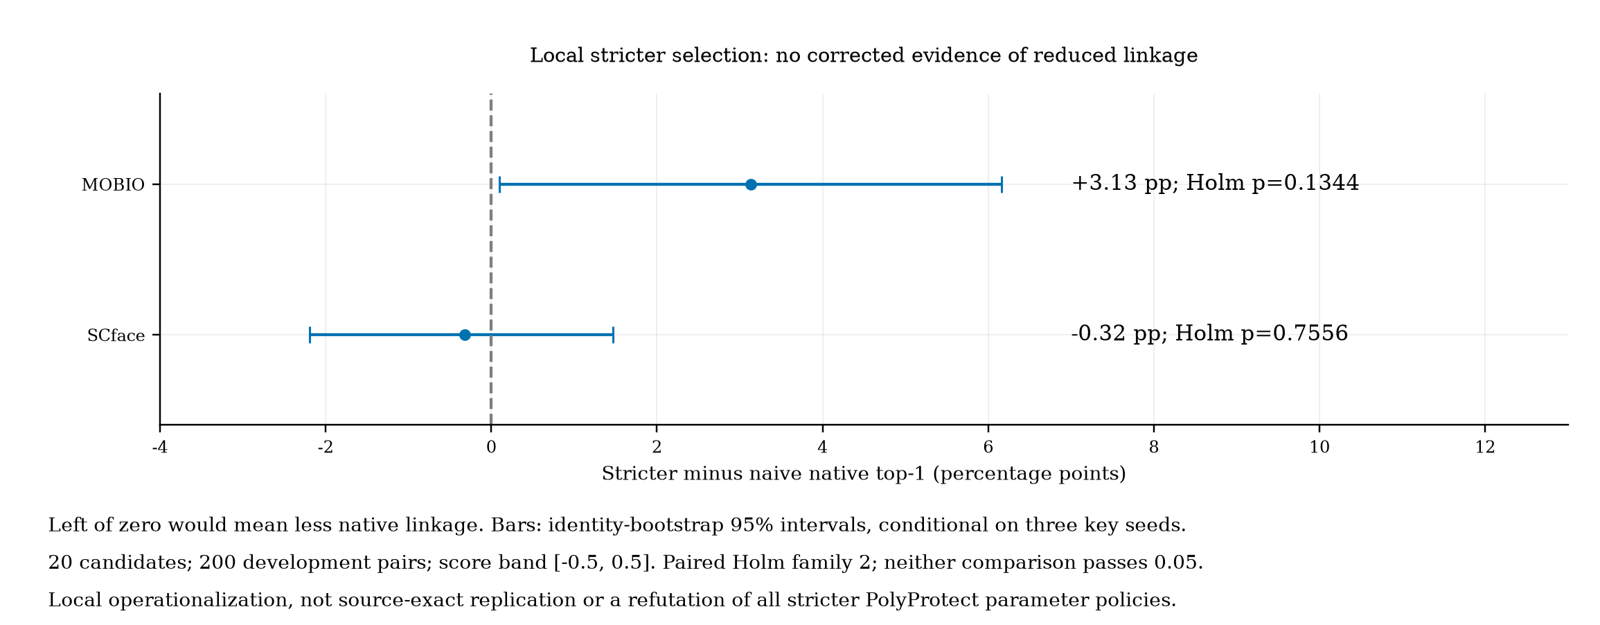
Local stricter PolyProtect selection
No corrected reduction from this local selection rule; not a source-exact refutation of the original policy.
Research review draft | 19 September 2026 | 15/15
Notes:
Evidence baseline: commit 655ae1ecc2c9fc0aa80c828fe0303753296f66df. FEI run recorded base commit d1e4ceb3f975fb47d9a8321c47484bb1411f5239 with FEI additions uncommitted.
Sources: experiments/cross_dataset_key_pool_summary.csv; experiments/fei_multiexposure/README.md; experiments/mobio_mechanism_controls/results_summary.csv; experiments/mobio_correlation_controls/results_summary.csv.
Configuration: configs/attacks/fei_key_pool_boundary.yaml. See reports/figures/README.md for figure captions and docs/ROADMAP.md for pending gates. Diagram symbols are schematic, not biometric examples.
New pilot code freeze: d5f4e89. Configuration: configs/attacks/scheme_extension_pilot.yaml. Sources: experiments/scheme_extension_pilot/{results_summary,paired_uncertainty,equivalence_sensitivity,native_utility}.csv. SCface protocol and pilot freeze: 69a93e4; sources under experiments/scface_multiexposure and experiments/scface_scheme_extension_pilot. One-seed CPU pilots, 120-epoch cap; not a controlled ranking against earlier 400-epoch, three-seed studies. See figure_appendix.pdf for all figures, including native matching and uncertainty. Follow-up: experiments/scheme_followup_2026-09-18; 216 endpoints, two identity partitions, three model seeds. Pre-execution source/config hashes: execution_manifest.json; base commit 4352eeb, dirty working tree recorded. Primary sign-flip tests: Holm family 8; native gallery-label permutations: Holm family 12. Independent-pool follow-up: experiments/pool_replication_2026-09-19; 24 cells, 144 fits, 72 prediction-mean evaluations; source snapshots and input hashes recorded. Three-pool intervals are pointwise, not corrected significance tests. Full-text comparison uses the author's thesis section 5.4.

