Slide 1
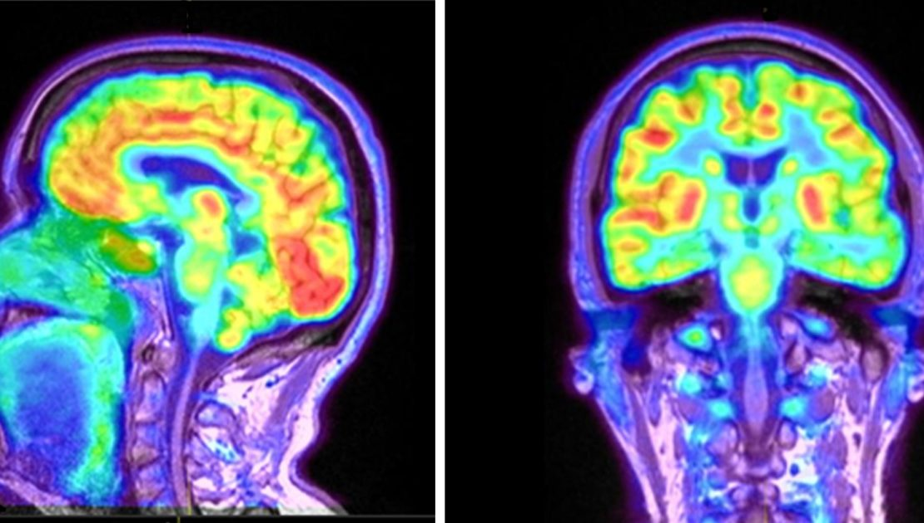
PET SCANS
The answer to “how” in a field that is so focused on “what”
https://www.petscaninmumbai.com/blog/pet-scan-for-brain/
BARYA ASHA

Slide 2
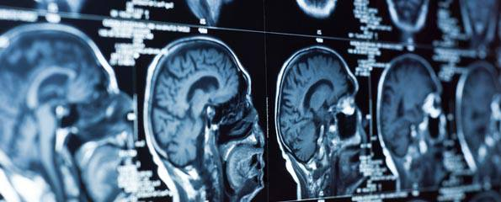
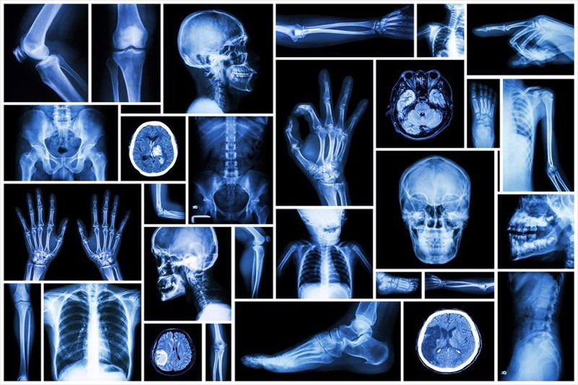
Traditional Imaging Modes
X-Ray, MRI, Ultrasound, CT Scans
Excellent at displaying anatomical structures
Poor at showing how these structures interact
How do we visualize the physiology?
https://www.myvmc.com/investigations/ct-scan-or-cat-scan-computed-tomography-imaging/
https://www.mymed.com/tests-procedures/x-rays

