Slide 1

XYZ Retail, Inc Retail Data Optimization Analysis Presentation Prepared By: Nidhi Chaurasia
Case Study PPT for Retail Data Optimization of XYZ, Inc for efficient data management and analysis

Slide 2
Understanding the Problem Statement
XYZ Retail Inc., Being a prominent player in Retail Industry is facing challenges in managing and analysing the data. The overview of the data problem are listed below:
There are different channels through which XYZ Retail generates data.
The data is not cleaned for analysis.
No proper database management system to store and analyze the data
No proper mechanism to analyse the data and create meaningful insights about the business.

Slide 3
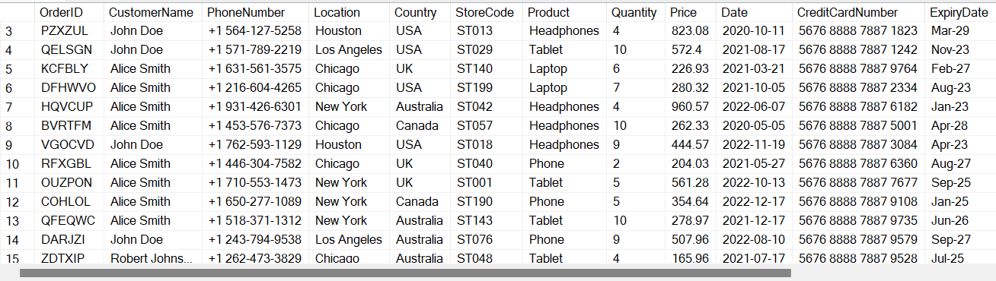
Sales Data of XYZ Retail Inc.
Column_name | Type | Length | Prec | Nullable
OrderID | varchar | 100 |  | NO
CustomerName | varchar | 100 |  | yes
PhoneNumber | varchar | 20 |  | yes
Location | varchar | 100 |  | yes
Country | varchar | 50 |  | yes
StoreCode | varchar | 50 |  | yes
Product | varchar | 100 |  | yes
Quantity | float | 8 | 53 | yes
Price | float | 8 | 53 | yes
Date | datetime | 8 |  | yes
EncryptedCreditCardNumber | varbinary | 256 |  | yes
ExpiryDate | Datetime | 10 |  | yes

Slide 4
Technologies Used:
We used SSIS (SQL Server Integration Services) for overall ETL/ELT Process.
Since, the data is a structured dataset. We will be using traditional datawarehouse concept.
SSIS, being best ETL Tool for structured dataset and easy to integrate with SQL Server makes it popular in data ingestion technology.
SSIS is an open-source Tool having huge community.
Since, we have structured database. We’ll be using RDBMS to load the data.
SQL Server is scalable and efficient to manage and perform further analysis due to its powerful architecture.
It is easier to connect PowerBI with SQL Server database and perform further analysis on clean data.

Slide 5
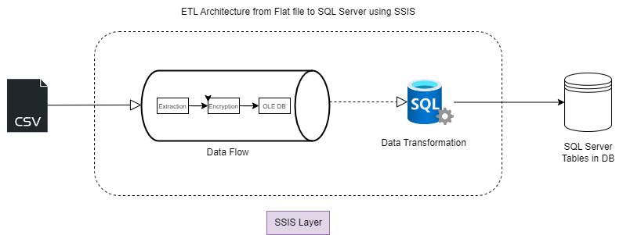
ETL Architecture
Source: Flat file(csv)
Flat file is extracted using SSIS dataflow task and we will be performing data transformation steps like:
Encrypting credit card number
Data Validations, Ingtegrity, Quality Check.
After Data transformation, data is loaded to SQL Server database.

Slide 6
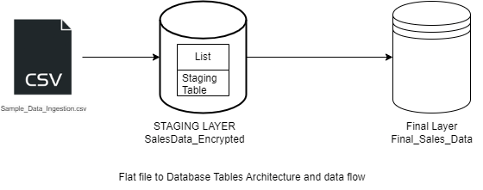
Data Flow Architecture from File to SQL Server Database
Flat file is first extracted, transformed and loaded to a staging table layer.
We performed further data cleaning and governance activities on staging layer to load the data in final layer.

Slide 7
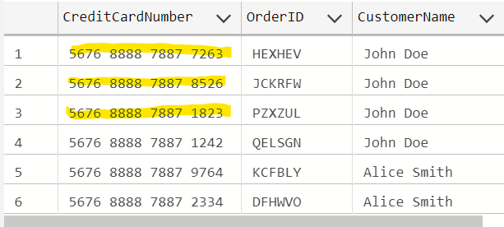
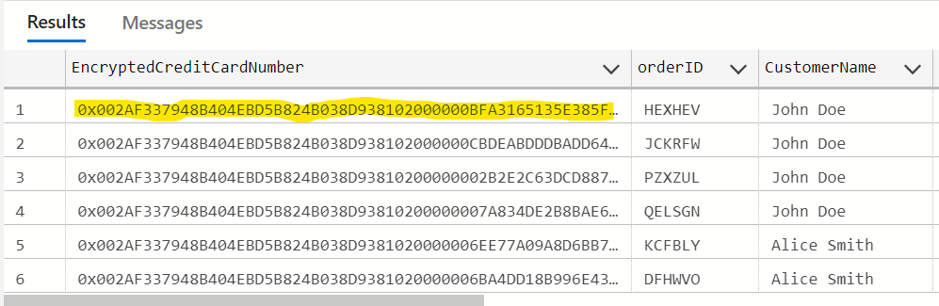
Data Transformations
Encrypting credit card numbers using SQL Server Certificate and Key feature.
Left hand table shows the credit card data in source file without encryption. In Right hand table, We applied data encryption transformation in SSIS and loaded credit card number with encrypted key

Slide 8
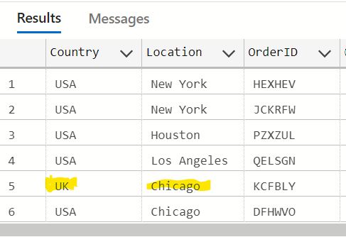
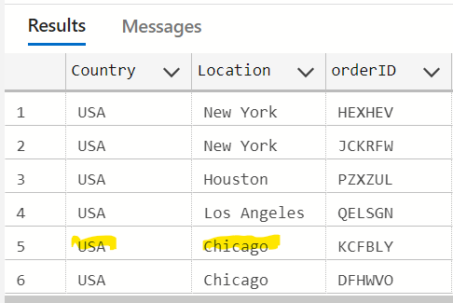
Country Data Transformation
Since, There were invalid country in the location provided in the raw table, We performed this data transformation to correct the country, location information using look up table.

Slide 9
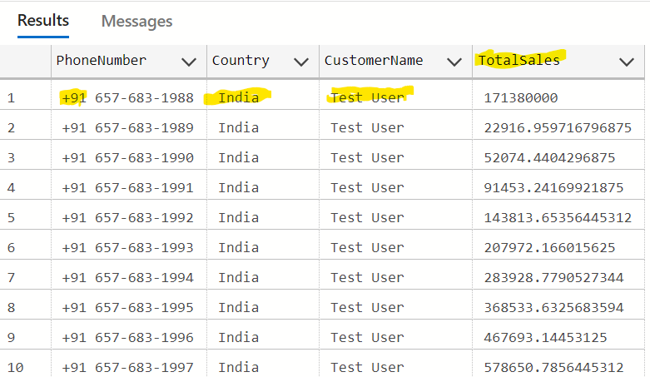
Other Data Transformations
Phone Number Enrichment according to country provided in the data
Standardizing Customer Name for Test User by removing numbers from name.
Removing decimals from the Quantity column data.
Calculating total sale amount and loading it as a derived column.
After Transformation, The data was loaded into the final table which was further used for data analysis.

Slide 10
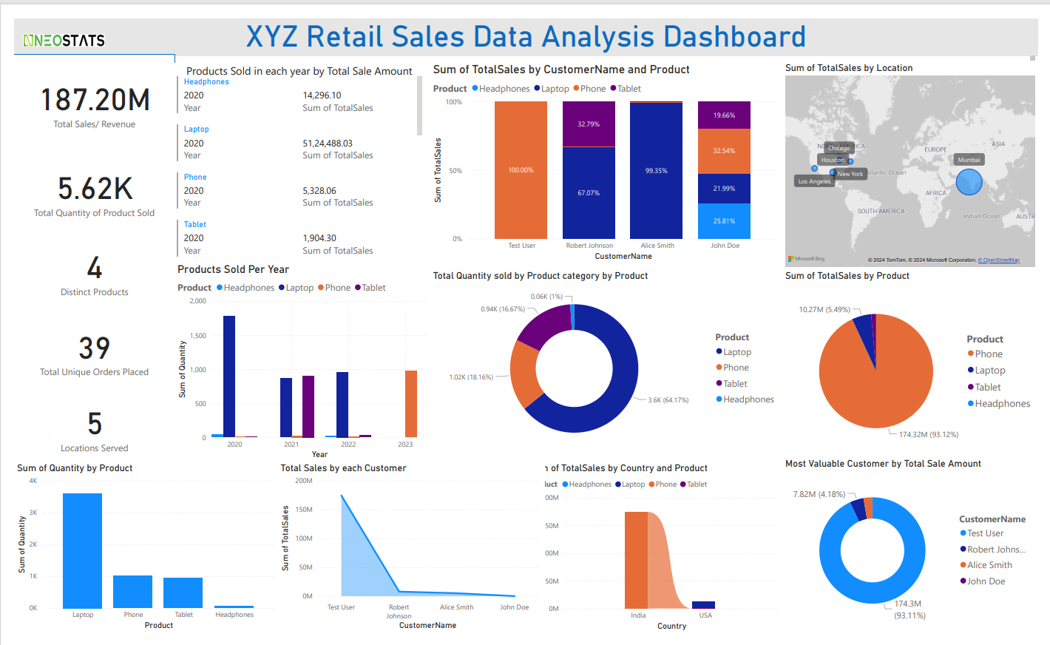
PowerBI Dashboard

Slide 11
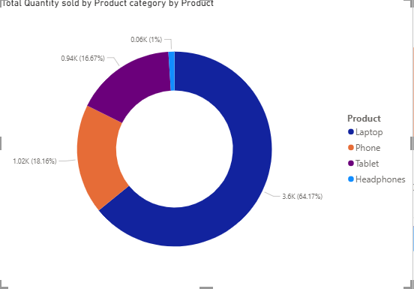
Best Performing Product
Laptop is the most sold product for XYZ Retail. Being highest in Quantities(64%)
Headphones is the least favourite product for XYZ Retail Cutomers.

Slide 12
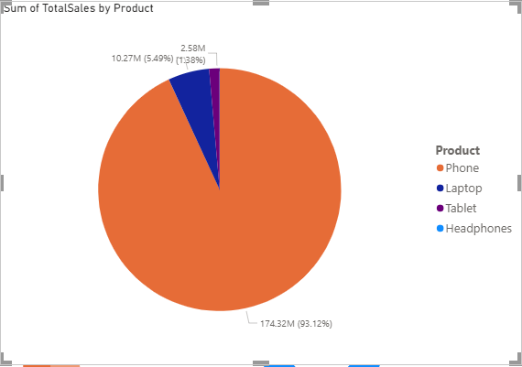
Best Performing Product by Revenue
Phone is the highest revenue generating product for XYZ Retail.
Headphones are the least sold product for XYZ Retail.

Slide 13
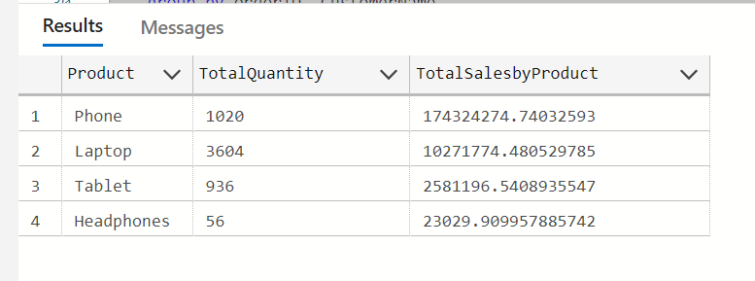
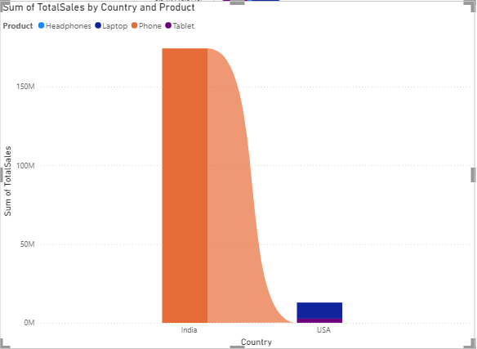
Total Sales Amount
Highest Sale amount is observed coming from the sales of Phone. From the Chart, It is clear that phone is the highest generating revenue Product. The highest revenue generating location for XYZ Retail is India.

Slide 14
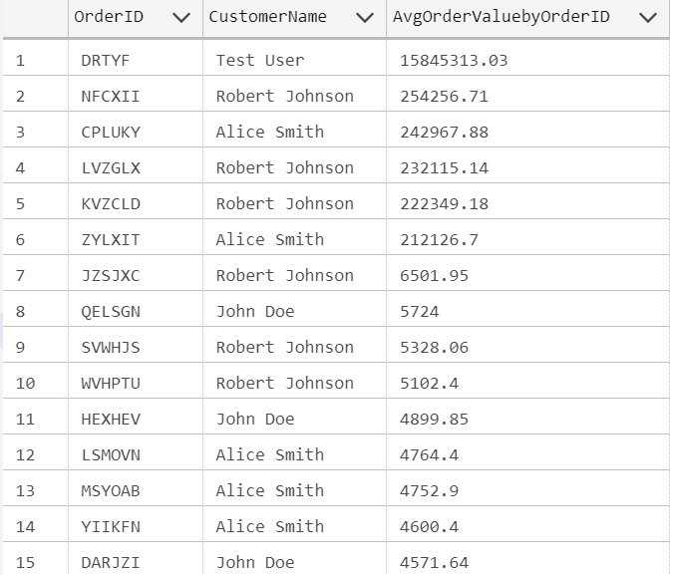
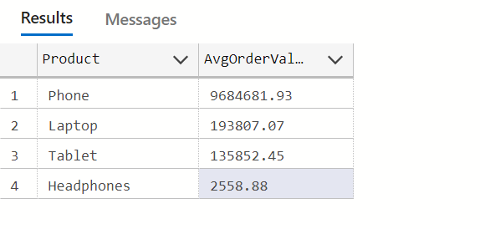
Average Order Value
It is observed that the highest average order value is from Customer Test User. Hence, Test User is the most valuable customer for XYZ Retail.

Slide 15
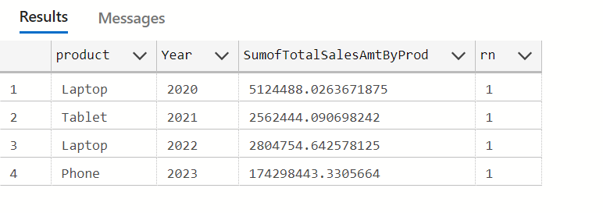
Total Revenue
In year 2023, Phone was the most sold and highest revenue generating product.
Similarly, Laptop was the highest revenue generating product in the year 2020 and 2022

Slide 16
After ingesting data into RDBMS and performing Data Analysis using SQL and PowerBI, We can conclude that : Phone is the most important product for XYZ Retail in India but not the other products. Hence, XYZ can focus on increasing sales activity for other products as well, in India. In other Locations, XYZ Retail should focus on increasing sales for phone and headphones as well.
Thank YOu

