Slide 1
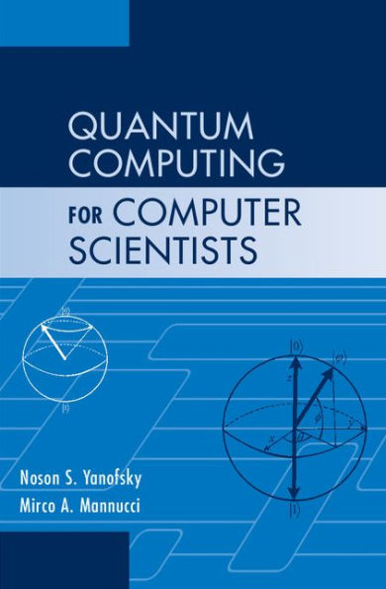
The No-cloning Theorem
Slides prepared by Dr. Leon Deligiannidis
These slides are based from the book:
Noson S. Yanofsky, Mirco A. Mannucci, “Quantum Computing for Computer Scientists”. Cambridge University Press ISBN 987-0-521-87996-5

Slide 2
No-Cloning Theorem
There are limitations to what can be done with quantum gates.
For one thing, every operation must be reversible.
Another limitation is a consequence of the No-Cloning Theorem.
This theorem says that it is impossible to clone an exact quantum state.
In other words, it is impossible to make a copy of an arbitrary quantum state without first destroying the original.
In “computerese,” this says that we can “cut” and “paste” a quantum state, but we cannot “copy” and “paste” it. “Move is possible. Copy is impossible.”

Slide 3
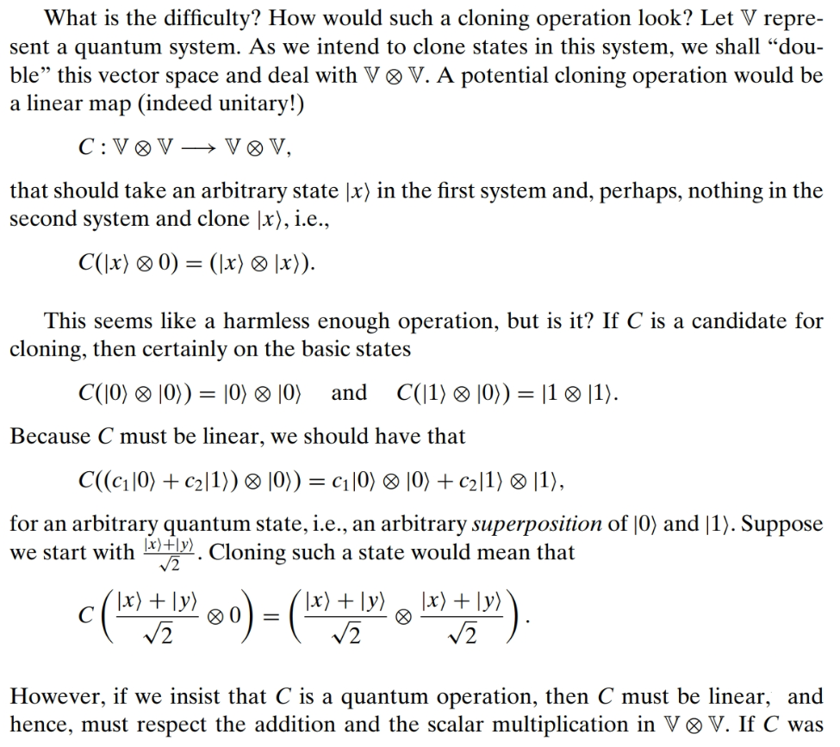
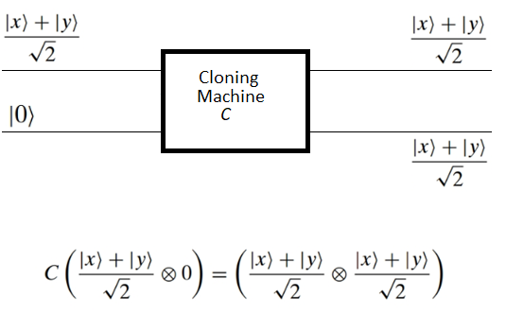
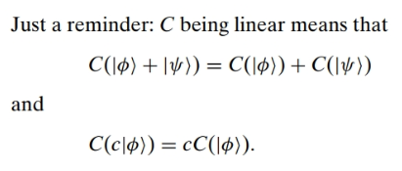


Slide 4
