Slide 1
Super Dense Coding
Slides prepared by Dr. Leon Deligiannidis

Slide 2
What is Super Dense Coding
Encodes 2 bits in one qubit (entangled qubit)
Transfer 2 classical bits of information to another party using one entangled qubit.

Slide 3
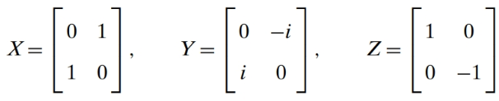
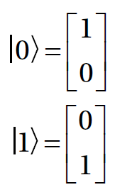
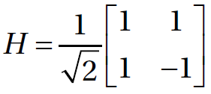
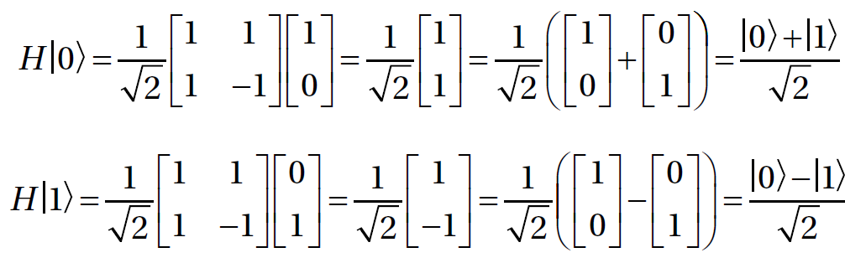

Slide 4
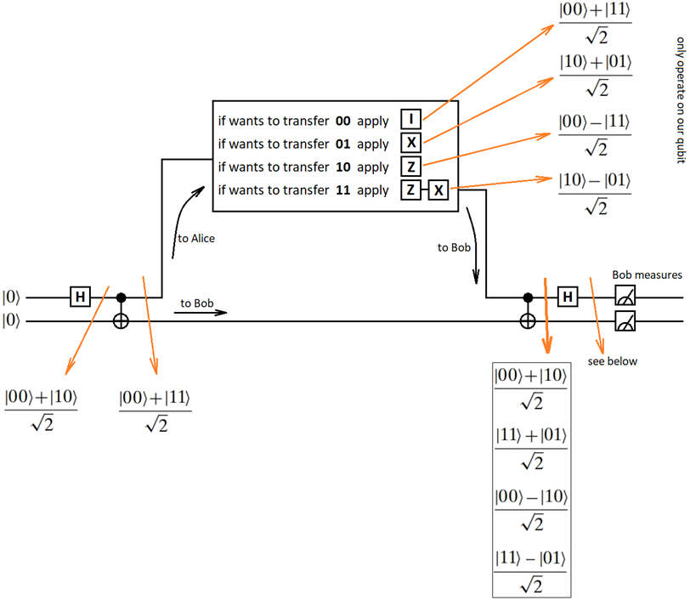
The Protocol

Slide 5
