Slide 1
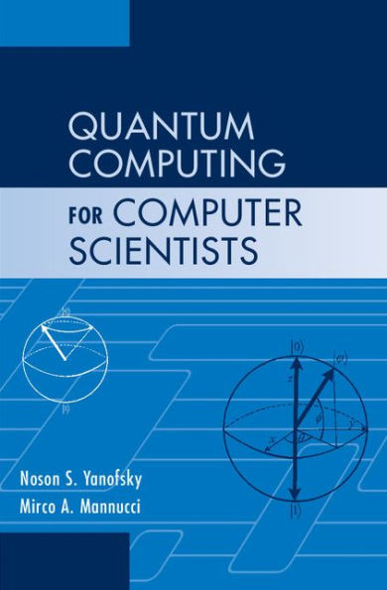
Quantum Teleportation
Slides prepared by Dr. Leon Deligiannidis
These slides are based from the book:
Noson S. Yanofsky, Mirco A. Mannucci, “Quantum Computing for Computer Scientists”. Cambridge University Press ISBN 987-0-521-87996-5

Slide 2
Quantum teleportation is the process by which the state of an arbitrary qubit is transferred from one location to another.
The no-cloning theorem states that we are not able to make a copy of the state of an arbitrary qubit.
That means that when the state of the original qubit is teleported to another location, the state of the original will necessarily be destroyed.

Slide 3
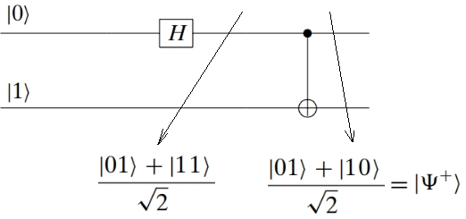
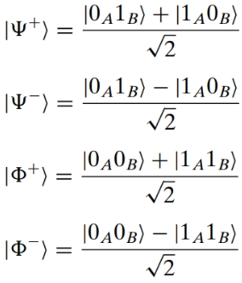
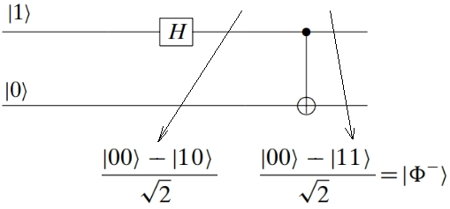
The teleportation algorithm will work with two entangled qubits, one held by Alice and one held by Bob.
The obvious canonical basis for this four-dimensional space is:
A noncanonical basis, called the Bell basis in honor of John Bell, consists of the following four vectors (every vector in this basis is entangled):

Slide 4

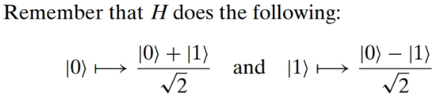
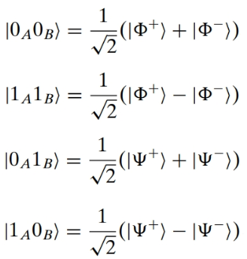
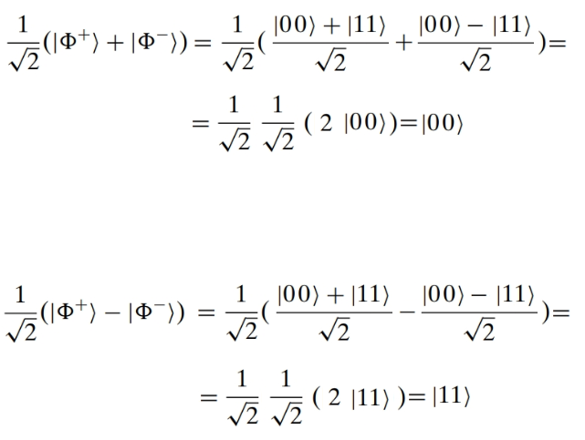
Because every vector in is a linear combination of canonical basis vectors and every canonical basis vector is a linear combination of Bell basis vectors, we have that the Bell basis is, in fact, a basis.

Slide 5
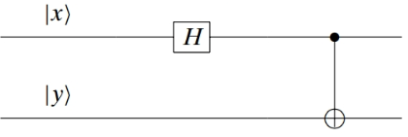
This quantum circuit with the appropriate inputs creates the elements of the Bell basis:

Slide 6

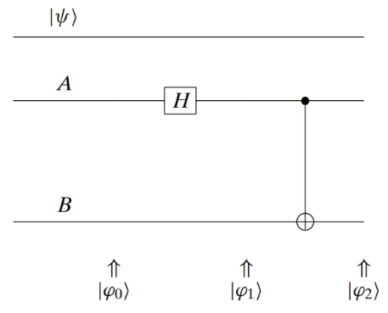
The Algorithm
Alice has a qubit |ψ⟩ = α|0⟩ + β|1⟩ in an arbitrary state that she would like to teleport to Bob.
Step 1. Two entangled qubits are formed as . One is given to Alice and one is given to Bob. We may envision these three qubits as three lines.

Slide 7
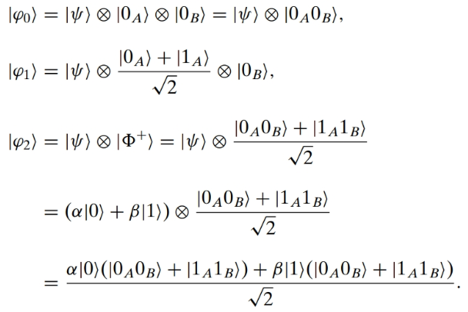
The top two lines are in Alice’s possession and the bottom line is in Bob’s pos- session. The states are as follows:

Slide 8
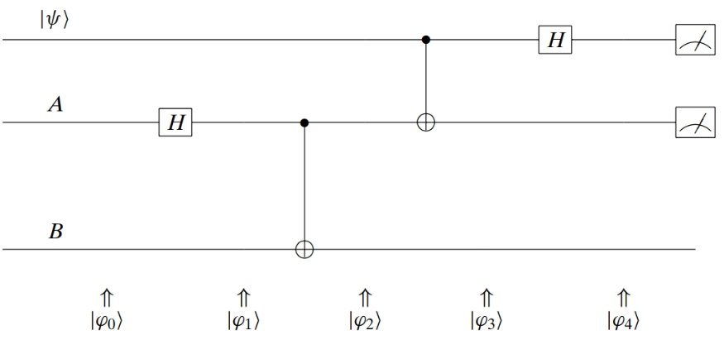
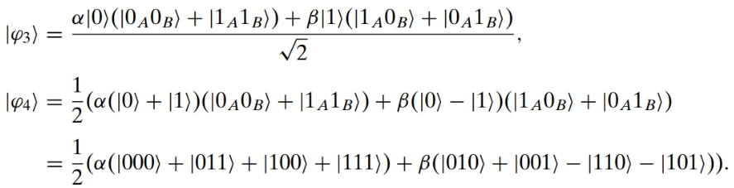
Step 2. Alice lets her |ψ⟩ interact with her entangled qubit. Steps 1, 2, and 3 can be seen in the following diagram:
targets
Control qubit

Slide 9
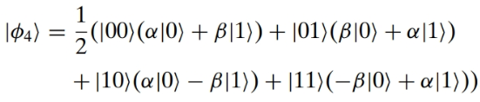
Regrouping these triplets |xyz⟩ in terms of |xy⟩, which is in Alice’s possession, we have:
So the system of three qubits is now in a superposition of four possible states.

Slide 10
Step 3. Alice measures her two qubits and determines to which of the four possible states the system collapses.
At the moment Alice measures her two qubits; all three qubits collapse to one of four possibilities. So if she measures |10⟩ then the third qubit is in state α|0⟩ − β|1⟩.
There are two problems to deal with:
Alice knows this state but Bob does not; and
Bob has α|0⟩ − β|1⟩, not the desired α|0⟩ + β|1⟩. Both problems are solved by Step 4.

Slide 11
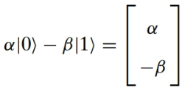
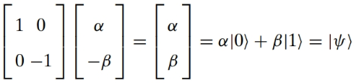
Step 4. Alice sends copies of her two bits (not qubits) to Bob who uses that information to achieve the desired state |ψ⟩.
In other words, if Bob receives |01⟩ from Alice, he then knows that his qubit is in state
hence he should act on his qubit with the following matrix:

Slide 12
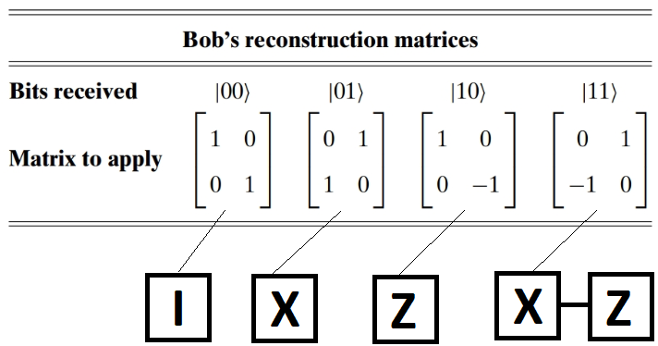
In detail, Bob must apply the following matrices upon receiving information from Alice:
After applying the matrix, Bob will have the same qubit that Alice had.

Slide 13
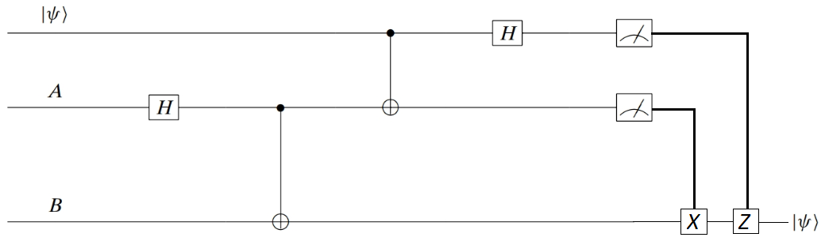
Quantum Teleportation Circuit

Slide 14
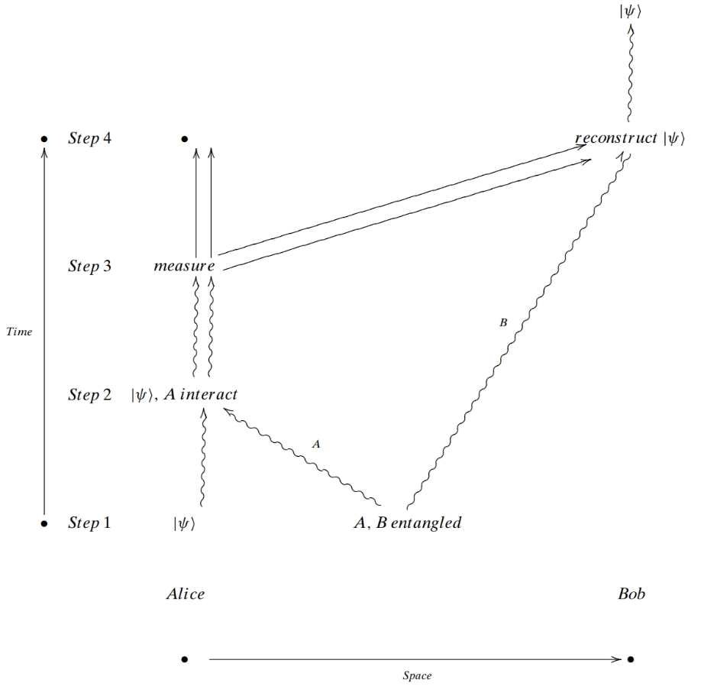
The following space–time diagram might be helpful. We use the convention that straight arrows correspond to the movement of bits and curvy arrows correspond to qubits on the move.
Notice that |ψ⟩ moves from the lower-left corner in Alice’s possession to the upper- right corner in Bob’s possession. Mission accomplished!
Alice is no longer in possession of |ψ⟩. She has only two classical bits. As we have seen, to “teleport” a single quantum particle, Alice has to send two classical bits. Without receiving them, there is no way that Bob can know what he has. These classical bits travel along a classical channel and thus they propagate at finite speed (less than the speed of light). Entanglement, in spite of its undisputable magic, does not allow you to communicate faster than the speed of light. Einstein’s theory of relativity would not permit such communication.
Implementation: See 001_teleport.py of ProjectQ

Slide 15

α and β were arbitrary complex numbers satisfying . They could have had an infinite decimal expansion. And yet, this potentially infinite amount of information has gone from Alice to Bob across the universe by passing only two bits. However, it is important to realize that this potentially infinite amount of information is passed as a qubit and useless to Bob. As soon as he measures the qubit, it will collapse to a bit.
Someone might argue that calling all the foregoing teleportation is a bit of a stretch. Indeed, no particle has been moved at all. However, from the point of view of quantum mechanics, two particles having exactly the same quantum state are, from the standpoint of physics, indistinguishable and can therefore be treated as the same particle.

Slide 16
Closing thoughts
What about Eve? She can certainly tap into the classical channel and snatch the two bits. But will it be useful to her?
There was nothing special about Alice using to entangle her |ψ⟩. She could have just as easily used any of the other three Bell vectors. Work out the result if she had used .

