Slide 1



MODULE 03
The Impact
Pathway
Expand your Q-Zero into the full five-level causal chain.
FACILITATED BY
www.amalandcompany.com
MAS GLA · Theory of Change
Notes:
Welcome. Name the session — 'today we unfold Q-Zero into the full pathway.' TIME: 1 min

Slide 2

Where we are
Module 3 of 5 · From sentence to chain
In Module 2 you wrote your Q-Zero — the spine of your TOC. Today we add the ribs: the five levels of the causal chain, with assumptions named at every link.
1
2
3
4
5
Why This Matters
Q-Zero
Impact Pathway
Logframe
Measuring & Validating
www.amalandcompany.com
Module 3 · The Impact Pathway
Page 02
Notes:
Quick orient. Point to M1-M2 as done, M3 as here. TIME: 1 min

Slide 3
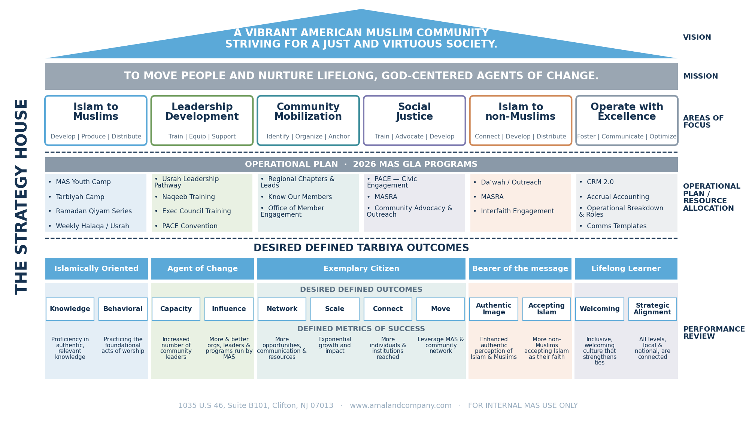

Slide 4
The big idea
Every arrow is a causal claim
1
2
3
4
5
→
→
→
→
INPUTS
ACTIVITIES
OUTPUTS
OUTCOMES
IMPACT
Each arrow says: “because of this, that happens.” Each arrow rests on an assumption — a condition that must be true for the arrow to hold.
www.amalandcompany.com
Module 3 · The Impact Pathway
Page 04
Notes:
Read the chain aloud. Emphasize: 'arrows are the load-bearing part. If any arrow is wrong, the chain breaks.' TIME: 3 min

Slide 5
The Impact Pathway
Five levels, four arrows — each arrow is a causal claim resting on an assumption.
assumption
assumption
assumption
assumption
1
2
3
4
5
INPUTS
ACTIVITIES
OUTPUTS
OUTCOMES
IMPACT
The people
we serve
What we
deliver
What we
count
What changes
in people
Long-term
community shift
Each arrow says: “because of this, that happens.”
If its assumption breaks, the chain stops right there.
www.amalandcompany.com
Module 3 · The Impact Pathway
Page 05

Slide 6
From Inputs to Impact — the Youth Camp pathway
Click to reveal each level ▶
1
INPUTS
2
ACTIVITIES
3
OUTPUTS
4
OUTCOMES
5
IMPACT
• 120 high-school juniors & seniors
• Vetted by interview
• MASGLA community
• 5-day retreat at Angelus Oaks
• Islamic mentorship
• Worship & group bonding
• Baseline: 40% salah
• Metric: completions + 3-mo salah %
• Target: 100 done · 65% salah
• Lasting Islamic bonds
• Trackable spiritual habits
• Continued independently
• Islamic identity into adulthood
• Future Muslim leaders
• Stronger community life
www.amalandcompany.com
Module 3 · The Impact Pathway

Slide 7



Walking the chain (1 of 2)
Inputs · Activities · Outputs
1
INPUTS — THE WHO
Key question: Who exactly are we serving? What do they look like before the program starts?
Common mistake: Listing budget, staff, or venue. Those are resources, not inputs. Inputs describe the PEOPLE.
2
ACTIVITIES — WHAT WE DELIVER
Key question: What structured experience does our team actually run?
Common mistake: Vague summaries. “We hold events.” Name the format, cadence, and duration.
3
OUTPUTS — WHAT WE COUNT
Key question: What countable things does the activity produce? (attendance, completions, sessions)
Common mistake: Confusing outputs with outcomes. Outputs are countable. Outcomes are what changes in people.
www.amalandcompany.com
Module 3 · The Impact Pathway
Page 06
Notes:
Walk each level. For each, read the key question aloud, then the common mistake. This is the level-1-to-3 half of the pathway. TIME: 5 min

Slide 8


Walking the chain (2 of 2)
Outcomes · Impact
4
OUTCOMES — WHAT CHANGES
Key question: What changes in a person's life because of our program that would not have happened otherwise?
Common mistake: Being too vague. “Grow spiritually” is not measurable. Specify behavior, condition, or knowledge changes.
Youth Camp: Youth form lasting Islamic bonds and adopt trackable spiritual habits they continue independently.
5
IMPACT — LONG-TERM SHIFT
Key question: What community-level shift do we contribute to across 3–5 years?
Common mistake: Overclaiming. Impact is contribution, not sole causation. Frame it as 'contributes to,' not 'causes.'
Youth Camp: A generation of high schoolers carrying Islamic identity into adult Muslim leadership.
www.amalandcompany.com
Module 3 · The Impact Pathway
Page 07
Notes:
Same pattern. Emphasize the distinction: outcomes = change in the person, impact = change in the community. TIME: 4 min

Slide 9
How much do you stretch the logic model?
Enterprise
Eco-System
Outcomes
Community
Systemic
Change
Inputs
Activity
Outputs
Robust Logic Model with
tangible measures and metrics.
Theory of Change supported
by secondary data.
www.amalandcompany.com
Module 3 · The Impact Pathway
Page 08

Slide 10
What is Impact?
Enterprise
Theory of Change
Outcomes
Community
Systemic
Change
Inputs
Activity
Outputs
Business Model
Individuals or
Households
Social Impact
www.amalandcompany.com
Module 3 · The Impact Pathway
Page 09

Slide 11

Zooming into Outputs
The transition from delivery to measurement
1
2
3
4
5
INPUTS
ACTIVITIES
OUTPUTS
OUTCOMES
IMPACT
VOLUNTEER · IN THE CHAT
Share your program's Q-Zero in the chat — then walk us through what your Outputs are.
We'll use your example on the next slide to work through Baseline, Metric, and Target together.
You can't know if you hit a target unless you know where you started — your baseline.
www.amalandcompany.com
Module 3 · The Impact Pathway
Page 10
Notes:
Pause the lesson. Ask a volunteer to share the program they lead — put their Q-Zero in the chat so everyone can read it and follow along. Walk them through what their Outputs would be (countable things their program produces). The whole point: use THEIR example as the running case for the B-M-T slide that follows. Don't rush. Aim for a real, specific program from someone in the room. TIME: 4 min

Slide 12
Build a Measurement Model
The transition from delivery to measurement — choose what to measure.
ACTIVITIES
OUTPUTS
OUTCOMES
INPUTS
IMPACT
• Make a careful choice of what you should — and should not — measure.
www.amalandcompany.com
Module 3 · The Impact Pathway
Page 11

Slide 13
Output measurement
Baseline · Metric · Target
BASELINE
METRIC
TARGET
Where you start. The current state before the program runs.
The unit you'll count or measure to track delivery.
The specific, time-bound value you're aiming to reach.
YOUTH CAMP
YOUTH CAMP
YOUTH CAMP
40% of participants report consistent salah at pre-camp intake.
# completing full camp; % reporting consistent salah at 3-month follow-up.
100 completions by camp end; 65% salah at 3-month follow-up.
YOUR VOLUNTEER'S PROGRAM
Baseline · ______________________________ Metric · ______________________________ Target · ______________________________
Baseline and Target work together. You can't know if you hit your Target unless you set the Baseline first.
www.amalandcompany.com
Module 3 · The Impact Pathway
Page 12
Notes:
Now continue with the volunteer's program from the previous slide. Fill in Baseline / Metric / Target using their Q-Zero. Write on the whiteboard or into the field below live. Show the group HOW you convert their program into these three cells. The Youth Camp column stays as a reference the whole time. TIME: 5 min

Slide 14
Before you can measure
How to actually obtain your baseline
A baseline isn't magic — it's data you collect BEFORE the program runs. This takes planning time. Rushed events skip it, and then can't prove impact later.
REGISTRATION FORM
PRE-EVENT SURVEY
EXISTING MASGLA DATA
INTERVIEWS / FOCUS GROUP
Add 2–3 baseline questions to your sign-up form. Cheapest, easiest, works for most programs.
Send a short survey 1–2 weeks before the program starts. Better response rate than day-of.
Pull from Program Dashboard, past attendance, or Salesforce. Zero collection cost.
Best for behavior baselines that surveys miss. Time-intensive; use for small cohorts.
Youth Camp: “How often do you pray daily?” on the registration form.
Usrah: 10-question survey emailed a week before circles begin.
Any program: use prior-year attendance as the baseline for growth targets.
Leadership program: 15-min intake interview with each of the 12 participants.
Plan the baseline into the program timeline. Last-minute event planning sacrifices this step first.
www.amalandcompany.com
Module 3 · The Impact Pathway
Page 13
Notes:
This slide is the reviewer's specific fix — before we accept a baseline is 'just there,' we teach HOW to get one. Walk each method briefly. Emphasize the bottom band: 'if you don't plan the baseline collection into your program timeline, you'll skip it.' Ask the volunteer from earlier: 'which of these four methods would work for YOUR program's baseline?' Quick answer, no lengthy detour. TIME: 4 min

Slide 15
Pause
Pulse check before assumptions
We just covered a complex topic — outputs, baselines, metrics, targets. Before we move on to assumptions, let's take a breath.
What's still fuzzy?
Ask anything about Inputs, Activities, Outputs, or Baseline / Metric / Target. No question too small.
CHAT
POLL
VERBAL
Type your question anywhere in the chat.
One-word confusion → I'll launch a menti poll.
Unmute and ask. First 2–3 questions get answered live.
www.amalandcompany.com
Module 3 · The Impact Pathway
Page 14
Notes:
Genuine pause. Ask: 'what's still fuzzy?' Let 5 seconds of silence happen — don't fill it. Prefer the CHAT for private-feeling questions, VERBAL for the confident ones. If nothing lands after 20 seconds, launch a menti poll with one word: 'What word describes your confidence right now?' Address 2–3 questions max, then move on. Don't turn this into a mini-lecture. TIME: 5 min

Slide 16
Assumptions
Every arrow rests on something
An assumption is a condition that must be true for one level to produce the next.
If your assumption is wrong, the arrow doesn't pull. The chain stops. Your outcomes don't happen.
Inputs
→
Activities
→
Outputs
⚡
Outcomes
→
Impact
When an assumption breaks, the chain stops right there.
www.amalandcompany.com
Module 3 · The Impact Pathway
Page 15
Notes:
Frame it: 'Every arrow is a bet. Assumptions are the terms of the bet.' TIME: 2 min

Slide 17




Four types of assumptions
Name them — they're your biggest strategic risk
Participant
Environmental
Readiness, motivation, circumstances of the people you serve.
External conditions — partners, facilities, climate, regional context.
Youth Camp: families allow overnight attendance and send youth for the full 5 days.
Youth Camp: Angelus Oaks retreat facility remains bookable and weather-safe for 5 days.
Organizational
Causal
MASGLA's own capacity — staff, volunteers, coordination, training.
Whether the causal claim itself is actually valid — does the activity really produce the outcome?
Youth Camp: trained naqeebs are available for the 5-day retreat AND the 3-month follow-up.
Youth Camp: a 5-day immersive experience actually produces lasting habits — not just a temporary high.
Starting points — not limits. Practice naming assumptions across any type or none of these boxes.
www.amalandcompany.com
Module 3 · The Impact Pathway
Page 16
Notes:
Walk each type. Same running example — Youth Camp — across all four so participants see how one program has assumptions of every type. Then land the bottom note explicitly: 'These four are the types you'll see most often, but the muscle we're building is the HABIT of naming assumptions. If a real assumption doesn't fit these boxes, name it anyway.' Ask: 'which one of these types feels most likely to break for YOUR program?' Get 1-2 answers quickly. TIME: 5 min

Slide 18
Worked example · Youth Camp
The full pathway — from Q-Zero to Impact
Q-ZERO
IF we immerse vetted high schoolers in a spiritually structured, nature-based retreat with Islamic mentorship, THEN they will form lasting Islamic bonds and adopt trackable spiritual habits they continue independently.
1
INPUTS
120 high school juniors/seniors, MASGLA community, vetted by interview.
2
ACTIVITIES
5-day spiritually structured retreat at Angelus Oaks with Islamic mentorship, worship, group bonding.
3
OUTPUTS
Baseline 40% salah · Metric: completions + 3-mo salah % · Target 100 completions, 65% salah.
4
OUTCOMES
Youth form lasting Islamic bonds and adopt trackable spiritual habits they continue independently.
5
IMPACT
A generation of high schoolers carrying Islamic identity into adult Muslim leadership and community life.
Your worksheet today walks this same structure for your own program.
www.amalandcompany.com
Module 3 · The Impact Pathway
Page 17
Notes:
Point to the Q-Zero band at top FIRST. Say: 'This is where we ended Module 2. Now watch how that one sentence unfolds into the whole pathway below.' Then walk down through the 5 levels. Emphasize the linear cause-effect flow — each level produces the next. TIME: 4 min

Slide 19
Worked example · Youth Camp
Naming the assumption at each link
Inputs → Activities
Families allow overnight attendance and support camp values.
Participant
Activities → Outputs
Mentors are trained and present; sessions run as designed.
Organizational
Outputs → Outcomes
The retreat experience translates into sustained habit change at home.
Causal
Outcomes → Impact
Local masajid and families reinforce camp values after participants return.
Environmental
In your worksheet you'll name at least one assumption per link — and label each one by type.
www.amalandcompany.com
Module 3 · The Impact Pathway
Page 18
Notes:
Keep it linear — one row per arrow. Read each row aloud in sequence. Show that the same Youth Camp pathway carries different assumption TYPES at each arrow. TIME: 4 min

Slide 20

A different framework
Four reframes that sharpen your first draft
Inputs are people — not resources
Budget, staff, and venue are the resources you use. The Inputs of your TOC are the people you serve.
Outputs count. Outcomes change.
'300 youth attended' is what happened — that's an Output. Outcomes describe what shifted inside those 300 six months later.
Baseline anchors the target
A target without a baseline is a hope. A target with a baseline is a claim you can measure and defend.
Assumptions named, not silent
Every arrow rests on an assumption. Named ones can be tested and monitored; silent ones can't be defended.
www.amalandcompany.com
Module 3 · The Impact Pathway
Page 19
Notes:
Four reframes worth catching. Read them as SHIFTS in thinking, not as errors — the reviewer's own note: 'there's not necessarily an error, rather a different framework.' Say: 'these are four ways the sharper version differs from a first draft — worth catching in your own pathway.' TIME: 3 min

Slide 21

Worksheet · 25 minutes
Build your impact pathway
Download the pathway template from the portal now. You'll fill it in during this block, and 1–2 volunteers will share out at the end.
1
2
3
INPUTS
ACTIVITIES
OUTPUTS
Audience: who, how many, what is their starting circumstance?
What does your team actually deliver, and in what format?
Baseline · Metric · Target. All three. Be specific.
4
5
6
OUTCOMES
IMPACT
ASSUMPTIONS
What changes in a person within 6–18 months? Tie to your Q-Zero THEN.
What does the community look like in 3–5 years if outcomes hold?
At least one per link. Label each by type.
www.amalandcompany.com
Module 3 · The Impact Pathway
Page 20
Notes:
Kick off the download IMMEDIATELY — point to the portal link. Everyone should have the template open in a new tab. 20 minutes of quiet work, then 5 minutes for 1–2 volunteers to share their pathway to the group. Roam the chat during the quiet block; flag good ones to invite as volunteers. OPEN QUESTION FROM OMAR: is the pathway template technically ready? If yes, share a copy with him before session. If not, flag it BEFORE this slide goes live in a session — the whole 25-min block depends on a working download link. TIME: 25 min (20 min quiet work + 5 min shares)

Slide 22
Reflection · 5 minutes
Three questions about your pathway
“
Which of my assumptions is most likely to break — and which level of my chain would collapse if it did?
“
Where am I claiming outputs but hoping for outcomes? What would I need to add to actually see the outcome?
“
What's the one measurement I can start collecting THIS WEEK to build my baseline for the next cohort?
www.amalandcompany.com
Module 3 · The Impact Pathway
Page 21
Notes:
Quiet writing 3 min. Then round-robin on question 3 only. Questions 1 & 2 are private diagnostics. TIME: 5 min

Slide 23

Key takeaways
What to carry into Module 4
The pathway is a chain of causal claims.
Five levels, four arrows. Each arrow asserts that one level produces the next.
Every arrow rests on an assumption.
Name them. If you don't, you can't monitor them — and silent assumptions kill programs.
Baseline before target, always.
You can't prove a change without a starting measurement. Plan collection into the program timeline.
Outputs and outcomes are different things.
Outputs are what you count. Outcomes are what changes in people. Don't confuse them.
www.amalandcompany.com
Module 3 · The Impact Pathway
Page 22
Notes:
Rapid recap. Bridge: 'next session we convert your pathway into a formal Logframe.' TIME: 3 min

Slide 24
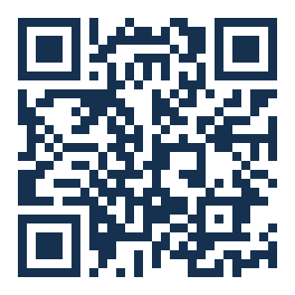

Before you go
Three reminders
Earn your certificate
2
Tell us how it went
1
Attend all 5 sessions and complete every assignment in the LMS. Both are required for the certificate.
Scan to open the evaluation survey. 90 seconds — while it's fresh.
3
Save the dates
August 6 · Townhall
August 22 · In-person meeting
www.amalandcompany.com
Module 3 · The Impact Pathway
Page 23
Notes:
End strong. Read all three reminders. Point at the QR — 'take 90 seconds NOW while your reactions are fresh; we send a follow-up email but response rate drops 40% after the same day.' Say the dates twice: 'Townhall August 6, in-person August 22.' QR resolves to https://discovery.amalandco.com/r/0QyM4Q — confirm this is still live in the discovery portal before the session. TIME: 3 min

Slide 25
Coming next · Module 4
Building the Logframe
We convert your pathway into a formal 4×4 Logical Framework Matrix — narrative, indicators, baselines, targets, and verification.
FACILITATED BY
Notes:
Land the transition. Bring your completed pathway to Module 4. TIME: 1 min

