Slide 1

EXPERT MINER

Slide 2
EXPERT MINER
Identifying earth resources in Sri Lanka
using HIS technique

Slide 3
EXPERT MINER
APPROACH
1. N dimensional space projection / Band pass filter
` 2. Noise removal projections
3. Derivative approach

Slide 4
Expert miner
ISSUES
1. Speed
2. Resolution
3. Availability

Slide 5
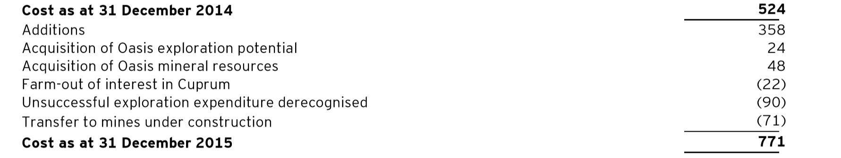
FINANCIAL review

Slide 6
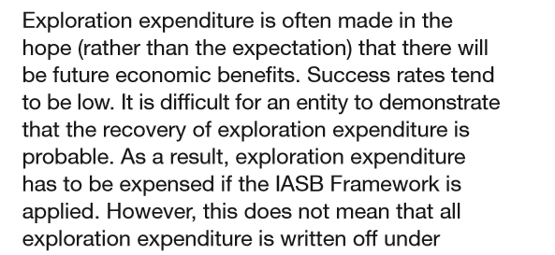
IFRS Standards
- Success rates tend to be low

Slide 7
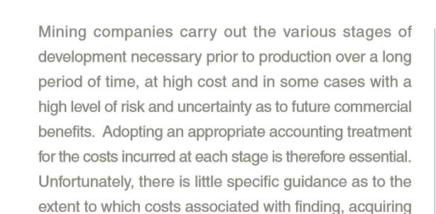
Financial models
- High risk and uncertainity as to future benefits

Slide 8
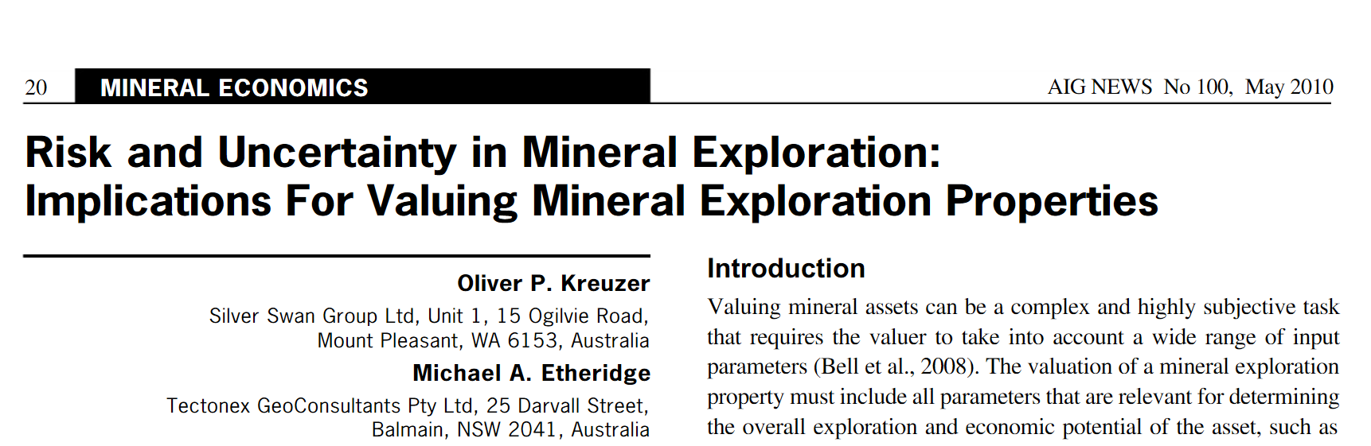
Industrial experts

Slide 9
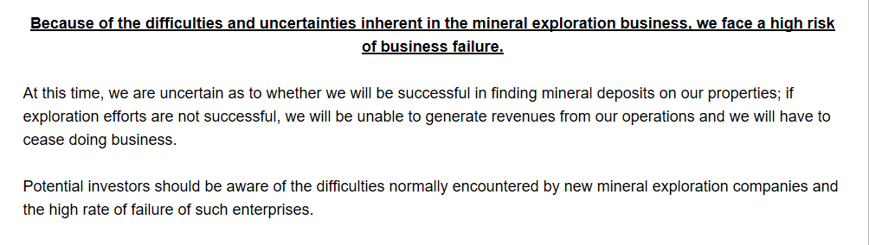
- Potential investors should be aware of difficulties and RISK of new mineral exploration companies and the HIGH RATE OF FAILURE

Slide 10
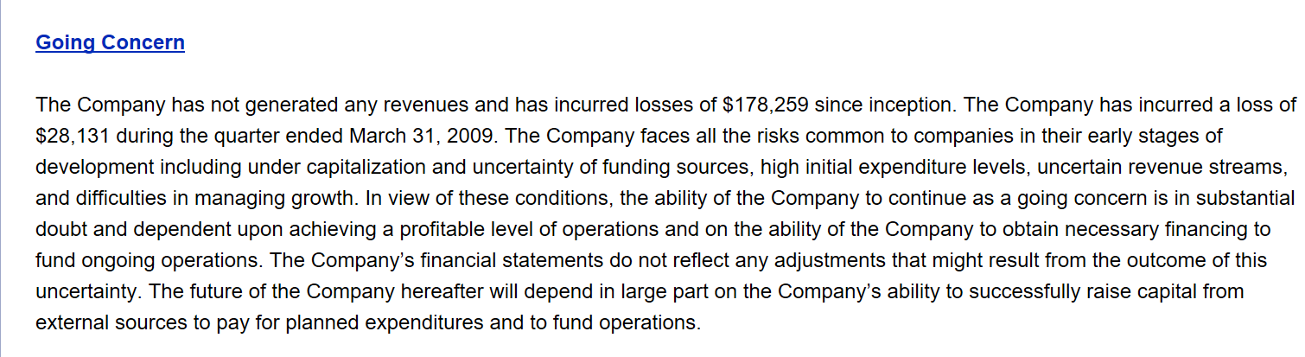
- The ability of company to continue as a GOING CONCERN is in SUBSTANTIAL DOUBT and depend upon future profits

Slide 11
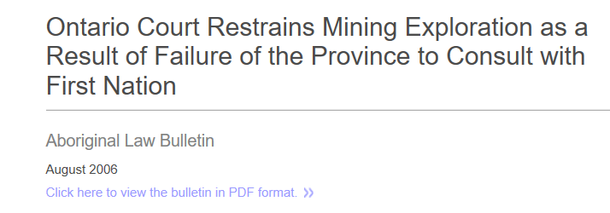
LEGAL AND ECOLOGICAL

