Slide 1

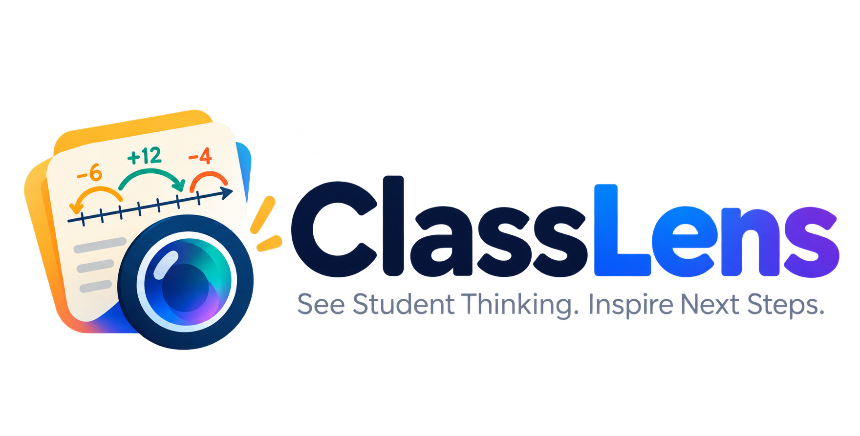

Team Details
  Team name: Token Titans
  Team leader name: Gihan Ubayawardana
  Problem Statement: Teachers can see what students got wrong, but not easily why.Manually reviewing handwritten mathematics work is time-consuming, and identifying common misconceptions across a class requires additional effort. Without timely, actionable insights, teachers struggle to deliver targeted support to students.

Slide 2
ClassLens is an AI-powered teaching assistant that transforms handwritten mathematics worksheets into meaningful learning insights.
Using Google Gemini's multimodal AI, ClassLens analyses students' handwritten solutions, identifies mathematical errors, understands the reasoning behind mistakes, and detects underlying misconceptions.
Rather than simply marking answers as right or wrong, ClassLens identifies common learning gaps across the entire class and recommends targeted teaching interventions.
By combining AI-powered reasoning with mathematical verification and teacher oversight, ClassLens helps educators reduce manual marking effort, understand how students think, and make data-driven teaching decisions.
Our vision: Move beyond marking answers to understanding how every student learns.

Slide 3
How is ClassLens different from existing solutions?
Most digital marking tools focus on grading and identifying incorrect answers. ClassLens goes beyond traditional marking by analysing handwritten mathematical reasoning, identifying underlying misconceptions, and transforming individual mistakes into class-wide learning insights.
How does ClassLens solve the problem?
- Analyses handwritten mathematics worksheets using Gemini multimodal AI.
- Identifies mathematical errors and misconceptions in students' reasoning.
- Uses mathematical verification to improve diagnostic reliability.
- Detects recurring learning gaps across the entire class.
- Recommends targeted teaching interventions to help teachers address common misconceptions.
Unique Selling Proposition (USP)
“Beyond marking answers — understanding how students think.”
ClassLens combines handwriting understanding, misconception diagnosis, and class-level teaching intelligence in a single platform.
Instead of reviewing 30 worksheets individually, teachers receive a consolidated view of student learning gaps and actionable recommendations on what to teach next.

Slide 4
Features Offered by ClassLens
1. Handwritten Worksheet Analysis – Uses Gemini multimodal AI to interpret handwritten mathematics solutions and student reasoning.
2. AI-Powered Misconception Detection – Identifies mathematical errors, incorrect reasoning steps, and underlying learning gaps.
3. Mathematical Verification – Integrates SymPy to verify mathematical calculations and improve the reliability of AI-generated diagnoses.
4. Class-Level Learning Insights – Aggregates individual student results to identify recurring misconceptions and common learning difficulties.
5. Personalised Student Feedback – Provides student-specific diagnostic feedback explaining errors and areas for improvement.
6. AI-Recommended Teaching Interventions – Suggests targeted teaching strategies and follow-up activities based on identified learning gaps.
7. Teacher Review and Oversight – Allows teachers to review AI-generated findings and retain control over final decisions.
8. Assessment Management Dashboard – Enables teachers to create assessments, upload student worksheets, monitor analysis progress, and review results.

Slide 5
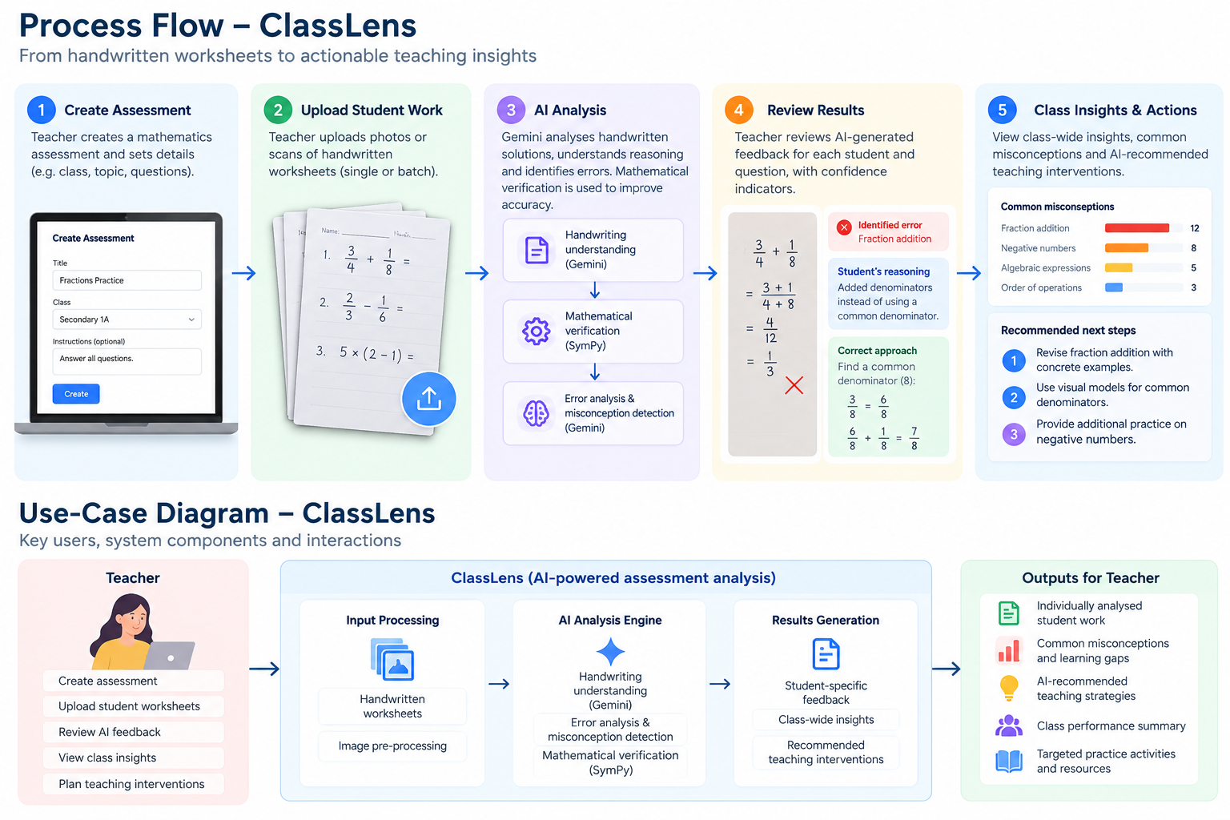

Slide 6
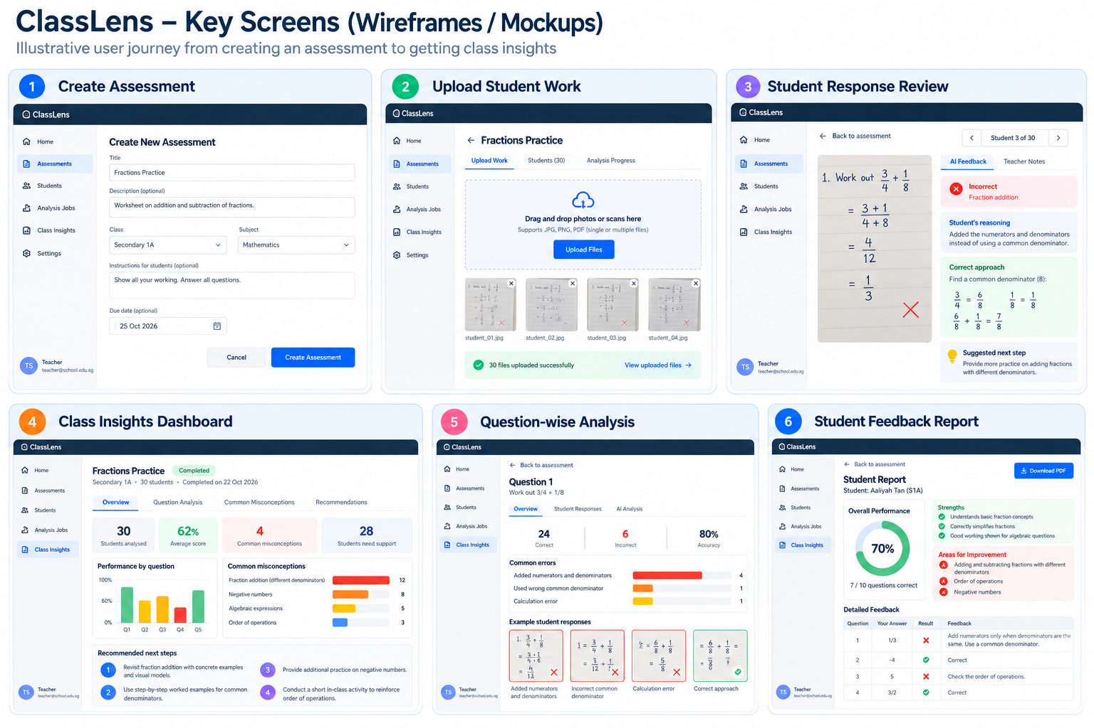

Slide 7
Architecture diagram of the proposed solution

Slide 8
Technologies to be used in the solution

Slide 9
Estimated implementation cost (optional)

Slide 10
Snapshots of the prototype

Slide 11
Prototype Performance report/Benchmarking

Slide 12
Additional Details/Future Development (if any)

Slide 13
Provide links to your:
GitHub Public Repository
Demo Video Link (3 Minutes)
Final Product Link

Slide 15


