Slide 1
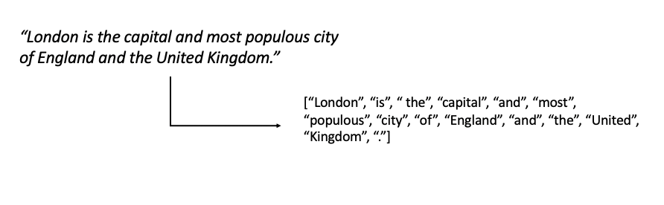
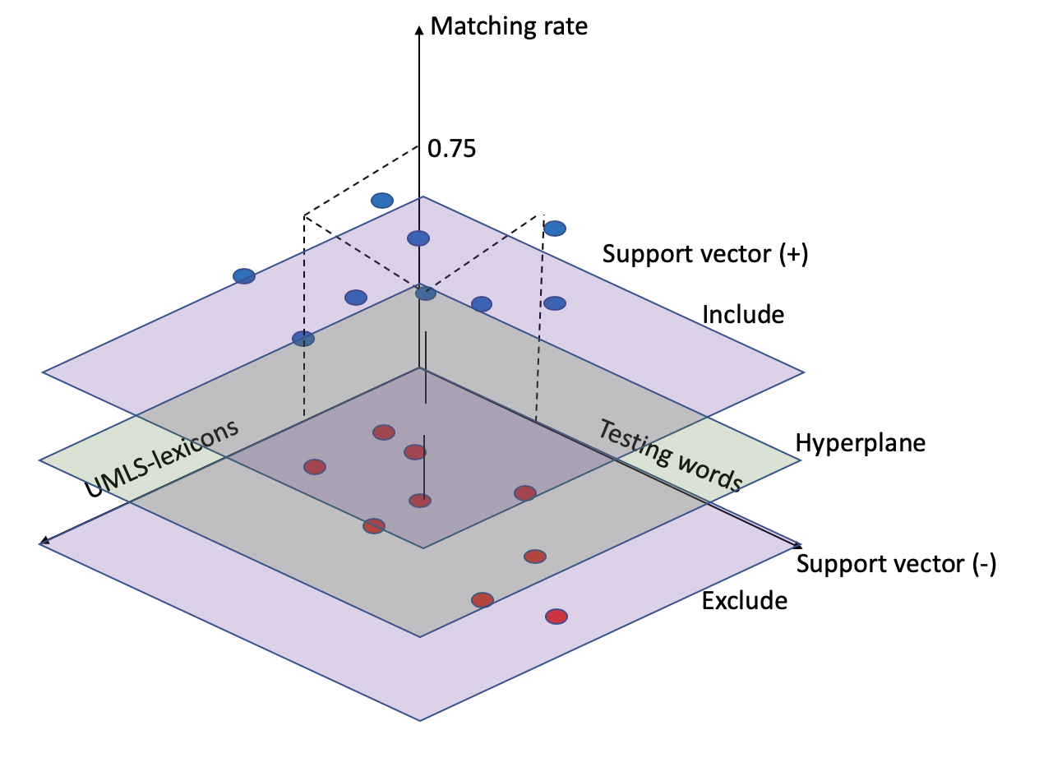
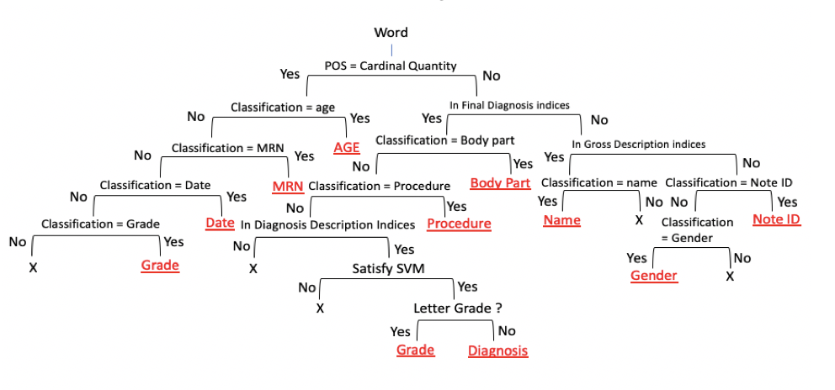
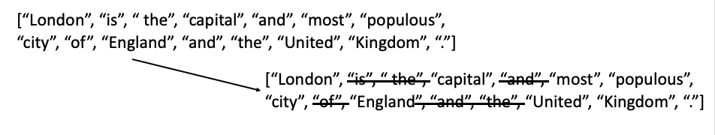
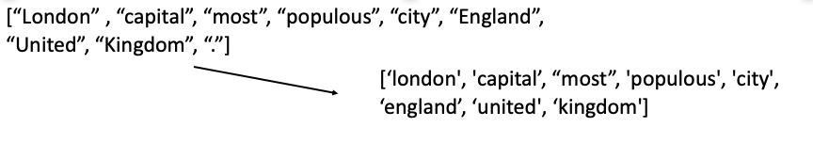
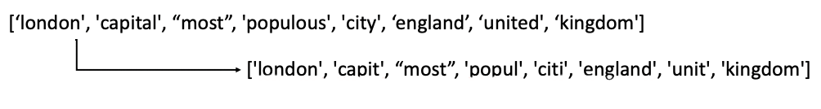
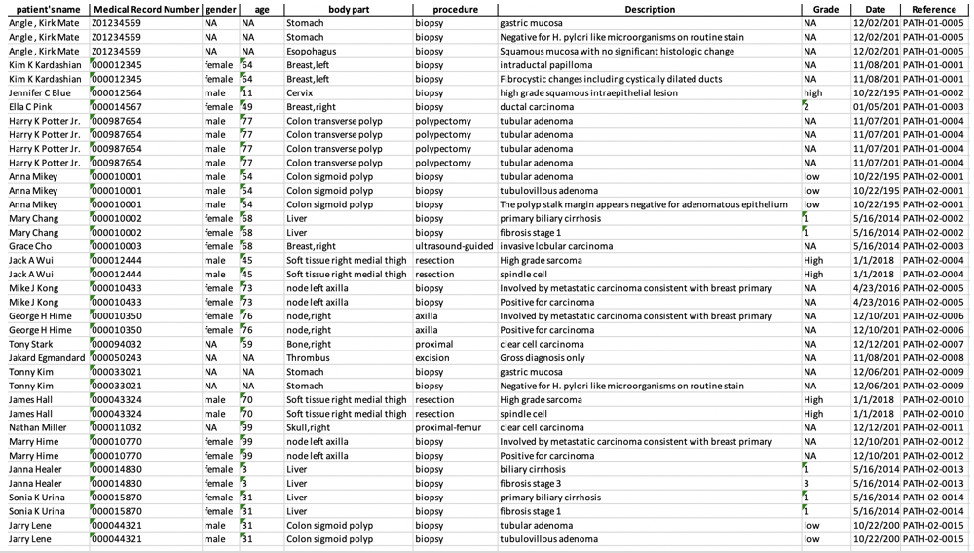
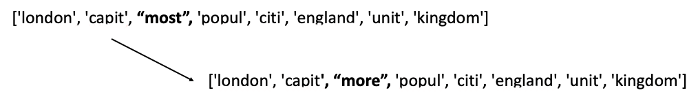
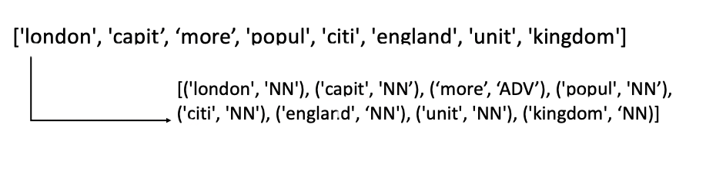
Natural Language Processing of Clinical Data
Giheon Koh, University of Central Arkansas Conway, Arkansas
ABSTRACT
IMPORTANT CONCEPTS
APPROACHES
Problem: For the rapid adoption of unstructured Electronic Medical Records (EMRs), it is necessary to extract accurate information from the EMRs to support automated systems at the point of care and to enable secondary use of EMRs for clinical and translational research.
Objectives: For this research, I designed the Natural Language Processing protocol model with applying machine learning approaches and challenged to figure out as a minimum test error rate as possible while testing EMR samples in the protocol.
Methods: For the experiment, I used 20 de-identified pathology report samples. For the workflow, I searched and extracted cardinal quantity values from the samples, then extracted the strings for the final diagnosis. When extracting the diagnosis description information, I used Support Vector Machine (SVM) algorithm. While working in the SVM model, I calculated the test error to verify how significant the extracted information is. For the entire protocol, I designed it based on the decision tree algorithm to extract necessary information from the unstructured EMRs.
Results: For the result, I extracted the patient’s name, medical record number, gender, age, body part, procedure, diagnosis description, grade, date and note ID information from each sample, and stored them in database.
Tokenization
Stop words
Normalization
Stemming
Lemmatization
Part-Of-Speech (POS) tagging
Support Vector Machine Algorithm
Decision Tree Algorithm
RESULTS
Workflow
CONCLUSIONS
1. Setting Stemming/Normalization standards and a list of stop words
2. Importing UMLS to train samples 3. Tokenized by words, filtered against stop words, and lemmatized
4. Part-of-Speech Tagging
5. Searching for cardinal quantity values ( from Part of Speech tagging)
- Because the numbers in text typically mean something. 6. Searching for gender information
7. Extracting :
strings for Final diagnosis - body part, clinical procedure information
- diagnosis grade information
patient’s diagnoses information and extract only important terms.
8. Extracting Note ID, Medical Record Number and age information from the table on Half-way result.
9. Merging and Exporting the generated information in Excel
For the rapid adoption of the unstructured Electronic Medical Record, Natural Language Processing has been developed to extract important and dependable information from such free texts.
For this project, I applied Support Vector Machine and Decision Tree algorithms to automate the processing of large-scale data
For the result, I extracted patient’s name, MRN, gender, age, body part, procedure, diagnosis description, grade, date, and note ID.
INTRODUCTION
For the last centuries, the healthcare system has been rapidly grown. For its growth, the relative healthcare data were desirably and necessarily stored to adapt throughout the evolution of healthcare technology. As a tool being adapted to the technology, Electronic Medical Record (EMR) has been providing clinicians a lot of benefits to understand patients by tracking over the histories from many healthcare providers. Through the EMRs, clinicians were efficiently able to identify general information such as treatments and medical histories of patients. However, with the rapid adoptions of unstructured or free text formatted EMRs which contain more detailed information about patients, there were some concerns raised. First, for the numbers of medical records, clinicians had to spend lots of time to read, classify and summarize information for each patient. Second, it was inevitable to extract valid and accurate information and knowledge from EMRs to support clinicians’ decisions at the point of care. Third, it was desirable to enable secondary use of EMRs for clinical and translational research. To solve these concerns, Natural Language Processing tool has been developing to facilitate information extraction from such unstructured free texts.
ACKNOWLEGEMENTS
“This project described was supported by NIH grant Number P20 GM 103429 from IDeA Networks of Biomedical Research Excellence (INBRE) Program of the National Institute of General Medical Sciences (NIHMS).” I also would like to acknowledge Dr. Ahmad Baghal, Dr. Shaymaa Al-shukri, and Annu Kumari in the Department of Biomedical Informatics at UAMS.

