Slide 1
Winter 2017 Midterm Presentation
Group 65: Jiongcheng Luo, Drew Hamm, Krisna Irawan

Slide 2
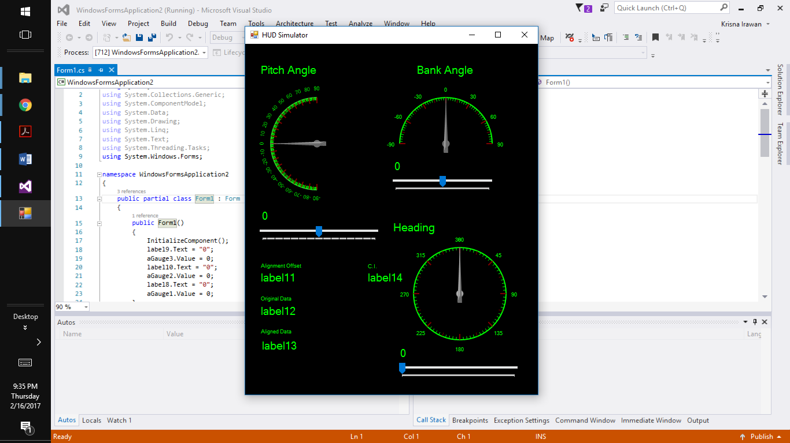
Krisna’s Current Stage
I am at the stage of connecting the graphical user interface that I created in Visual Studio to the offset algorithm part of the software created in Arduino by my teammates.
The graphical user interface run smoothly and ready to be connected.
Will need to do the first user study with the clients.

Slide 3
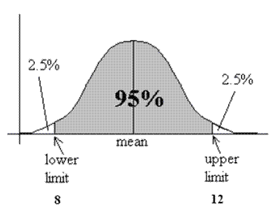
Krisna’s Leftover
Connect the GUI to the Arduino part of the software.
Need to run first user study with the clients.
Statistical Analaysis implementation of the software.
Source: https://i1.wp.com/cpmc.coriell.org/images/c_interval.gif

Slide 4
Hardware Logistic: Problem and Solution
Not be able to get the necessary hardware on timely manner.
Pro-actively contact the instructor and the TA to get the hardware.
Set up a meeting with the clients to let them know about the logistical problem that we were having.
Work in parallel to save time

Slide 5
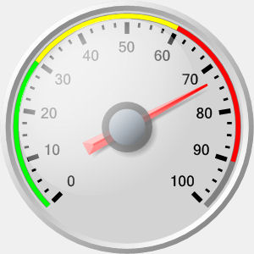
Generic HUD Symbology: Problem and Solution
Rockwell Collins uses a different methodology of generating the HUD display.
No imports file available to help generate the HUD symbology.
Use a gauge icon to represent the HUD symbology.
Source: https://www.targetdashboard.com/nlimages/badgauge.jpg

Slide 6
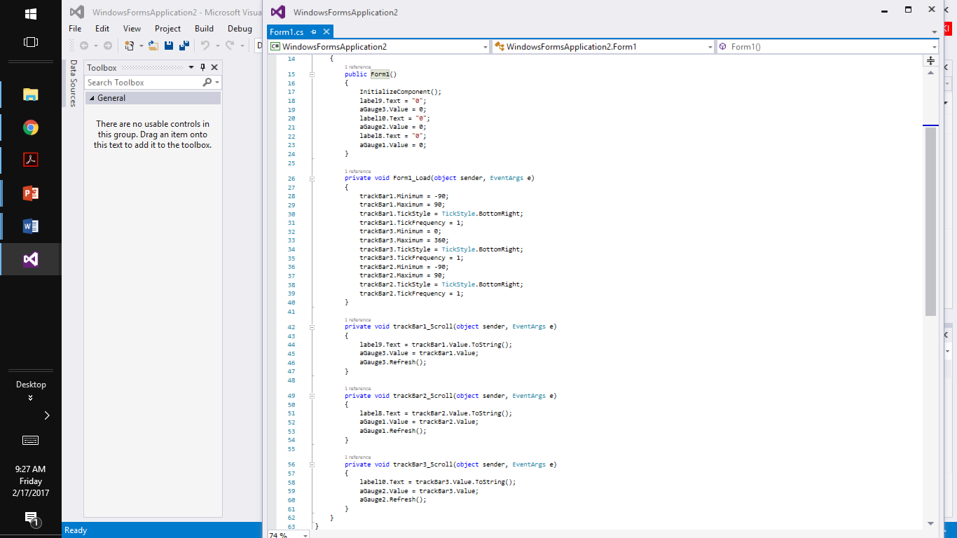
Sample Code

Slide 7
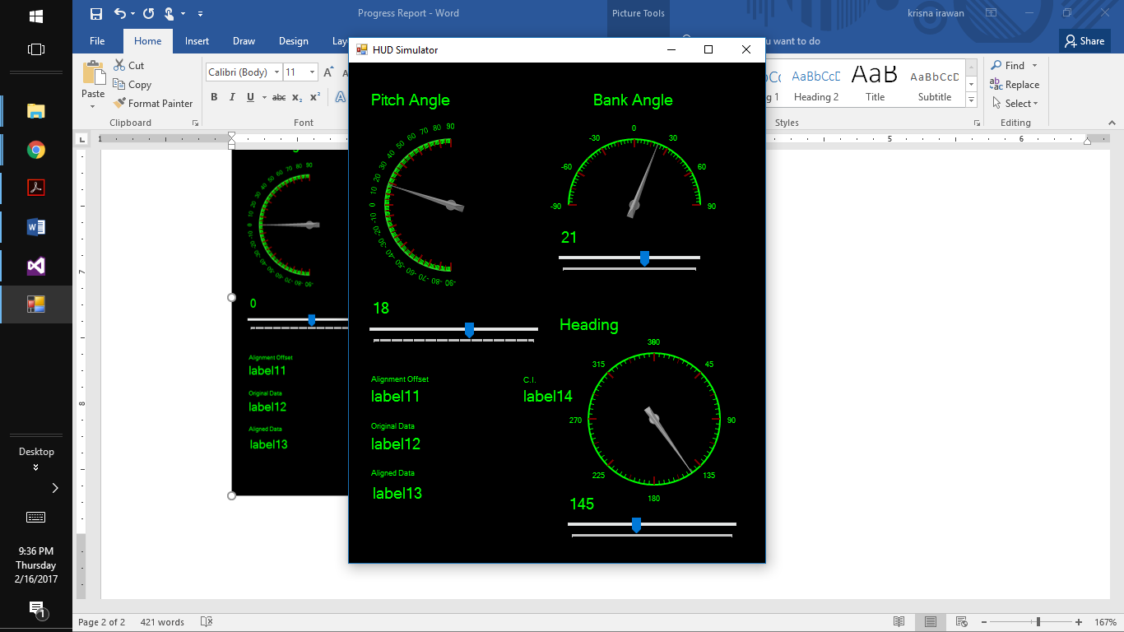
First User Study
Conduct the user study with my friends.
Need explanation to help the user understand the graphical user interface.
Need to conduct the user study with the clients.

Slide 8
Demonstration of Graphical User Interface

