Slide 1

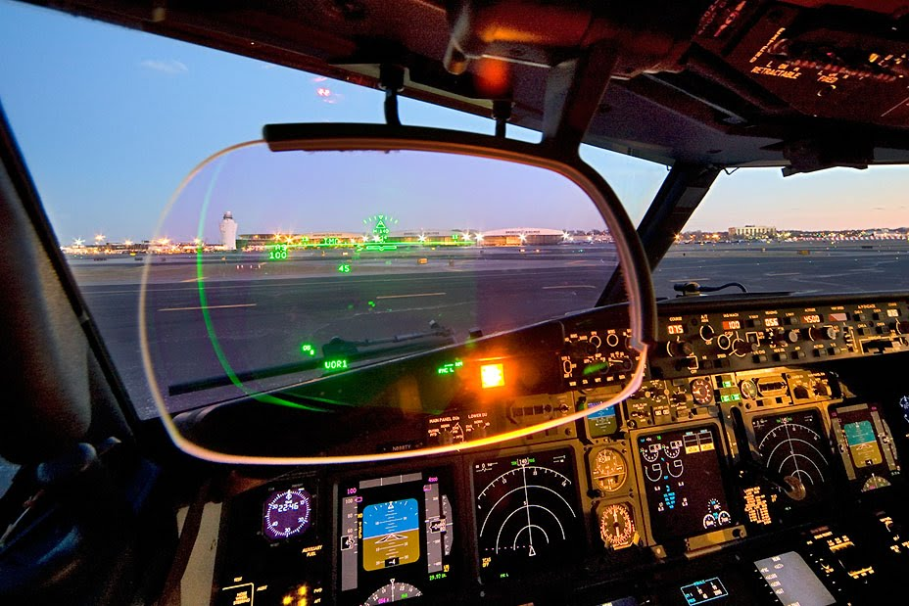
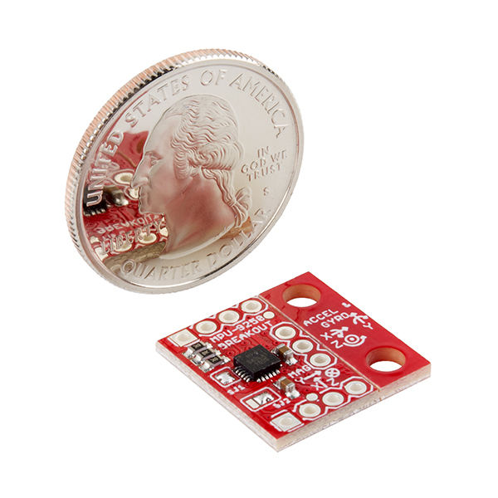
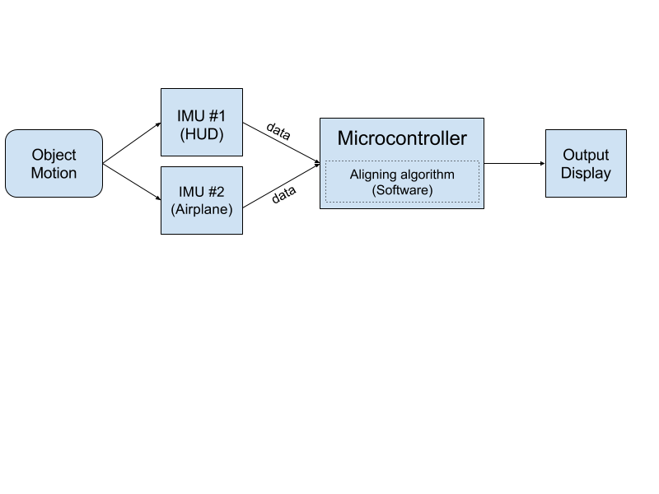
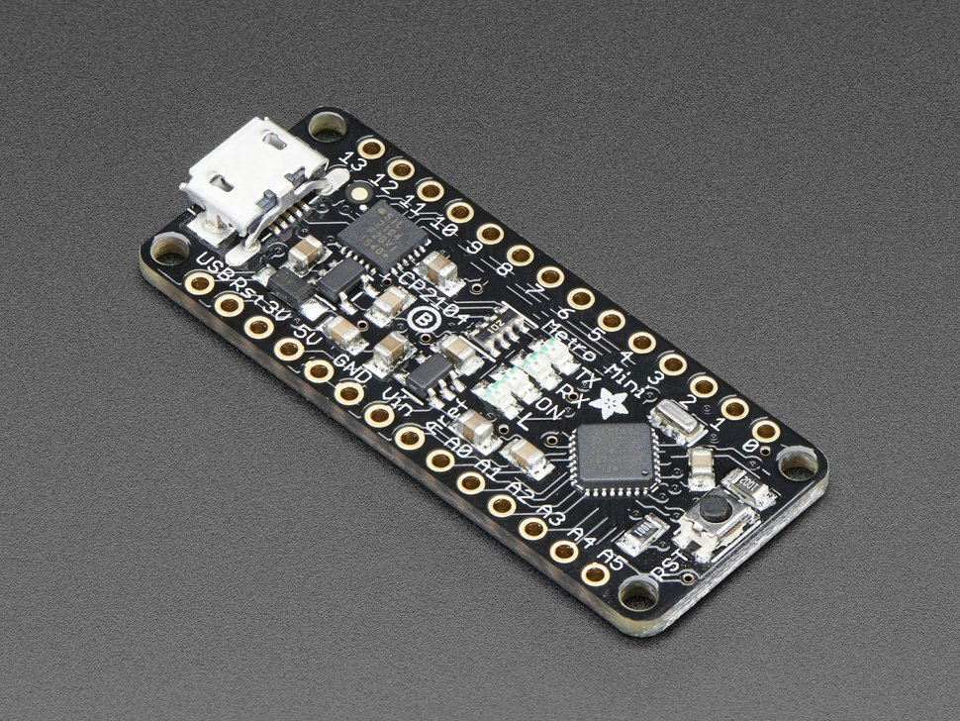

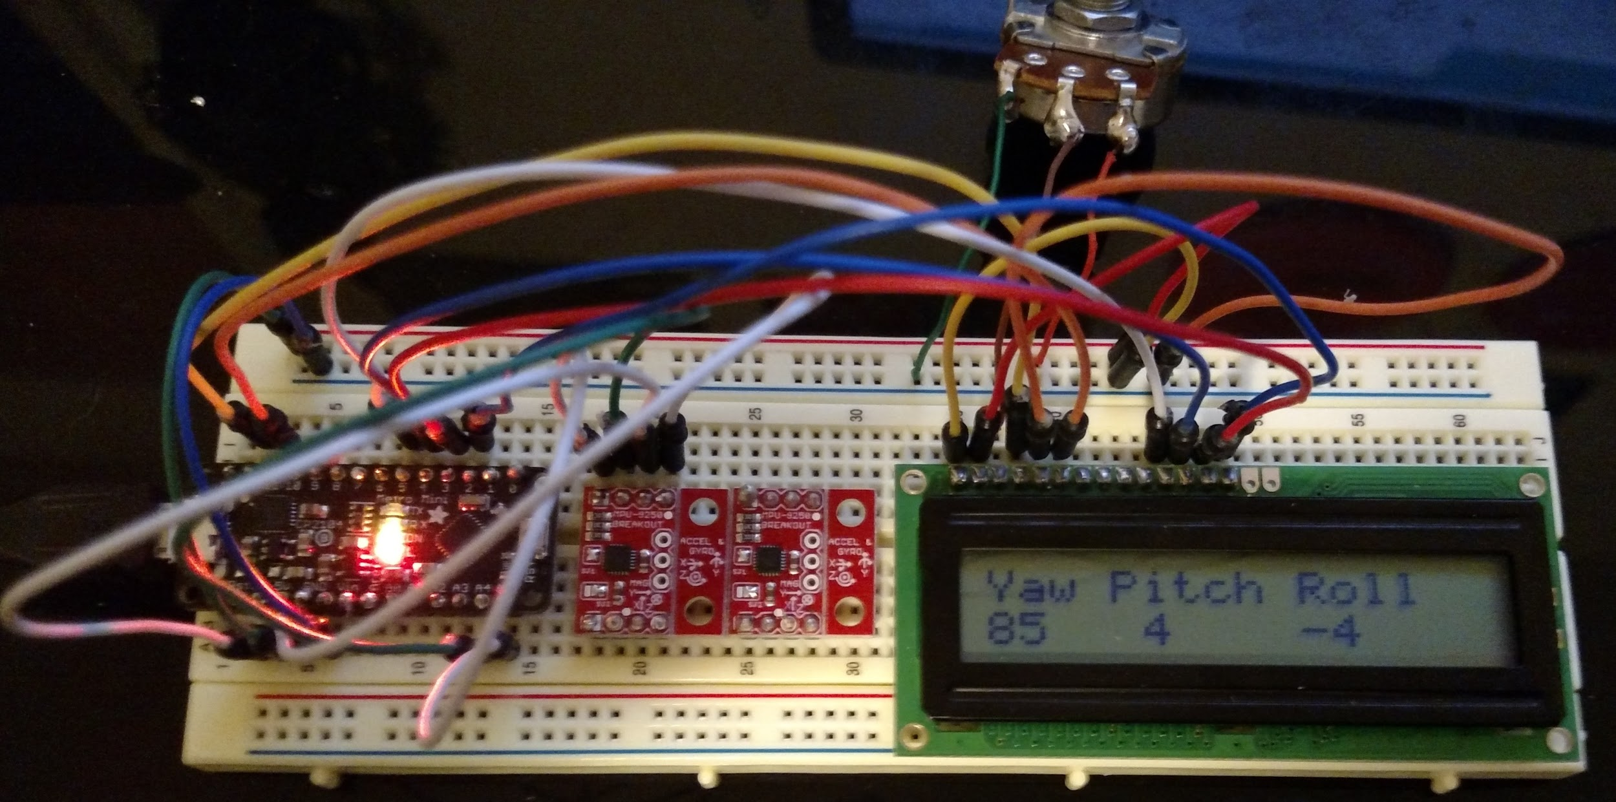
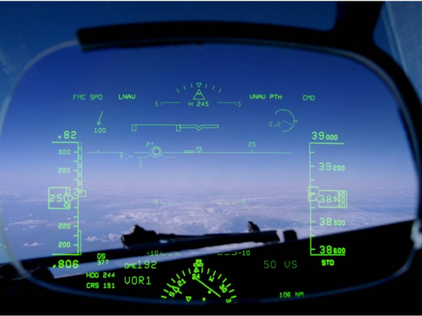
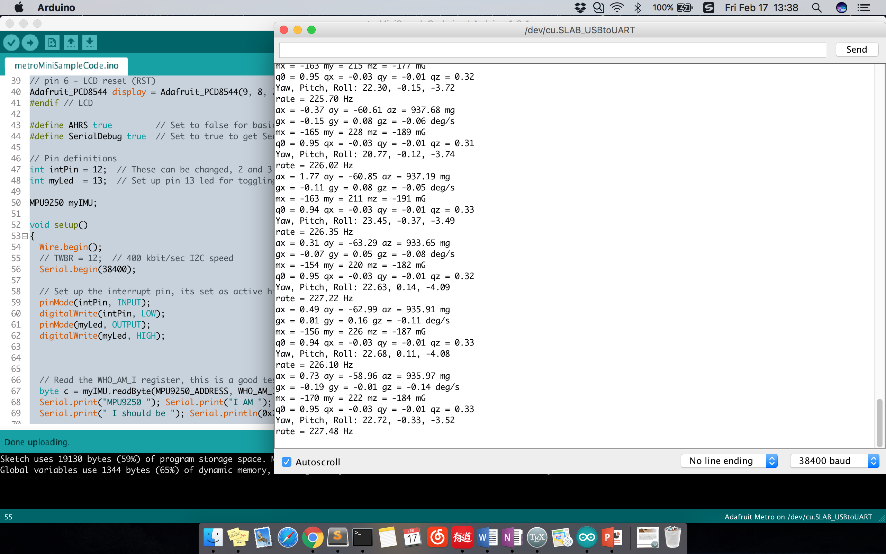
Head-UP Display auto-alignment system
What is in a cockpit?
Meet the Engineers
HEAD-UP DISPLAY
An airplane Head-Up Display (HUD) is a transparent display placed in front of a pilot’s head position in the cockpit of the aircraft. A HUD presents critical flight information to the pilots during the flight environment by using graphical, numerical and symbolical data. It provides all necessary data that pilots need in their flight environment.
The cost of an airplane maybe reduced in the future !
WHAT IS AN IMU?
Before getting more detail about this project, you should know about what an IMU is. Basically, an Inertial Measurement Unit (IMU) is made of sensors, that are usually seen as accelerometers, gyroscopes and magnetometers (compass). In this project, we used a kind of IMU is as tiny as a quarter, yet it consists of all three types of sensor, which can provide more accurate data and stable degrees of freedom. However, in order for retrieving these sensor data, a microcontroller is necessary to connect with the IMU.
HOW DID WE SOLVE THE PROBLEM?
In order to determine the HUD’s alignment error, several problems must be solved. First, individual sensor data must be generated from both HUD IMU and aircraft IMU. Our demonstration system made use of two separate IMUs to represent the individual points of origin for the HUD and aircraft. With these IMUs we were able to generate individual sensor data from each source. Next, a mechanism must be created to retrieve the generated sensor data. To solve this problem we included a microcontroller that was wired to both IMUs.
Group Members (Group #65)
Krisna Irawan - irawank@oregonstate.edu
Jiongcheng Luo – luojio@oregonstate.edu
Drew Hamm – hammd@oregonstate.edu
Sponsors – Rockwell Collins, Inc.
Brandon Wilson
Weston Lahr
Airplane Head-Up Display (HUD)
Data flow between hardware components
AUTO-ALIGNMENT SYSTEM
Currently, a HUD obtains data from an aircraft’s mounted device called an Inertial Reference Unit (IRU), which an IRU would output precise and aligned data to the HUD through an mechanical alignment system. However, the current alignment process requires specialized equipment and epoxy which is time consuming, costly, and interrupts production line progress for the original equipment manufacturer. In this project, our primary goal is to improve Rockwell Collins’s current HUD systems by reducing the installation cost and time required to precisely align flight information to the HUD. To meet our objective we will look into using a new alignment methodology in conjunction with the current HUD system as a proof of concept.
IMU - Sparkfun MPU-9250
Microcontroller - Metro Mini 328
By using the I2C protocol we were able to access each IMU and retrieve its data. Lastly, data from each sensor must be compared and analyzed in order to find the difference between the two. Our solution took us through a process that started with converting the retrieved data into a workable form and finished after performing sufficient calculations.
WHAT IS THIS PROJECT DOING?
This project was developed as a demonstration system that uses inexpensive IMUs and an alignment algorithm that utilizes these additional sensors to determine accurate HUD alignment. Initially, we would put all the needed hardware components onto a breadboard, then we connect the microcontroller with a computer via USB. While the breadboard (IMU) is in a moving motion, we could read the data from the Arduino IDE via serial port monitor.
HYPOTHETICAL OUTCOME
Although we were not able to test the system using a real HUD on the airplane, this demonstration system proves that inexpensive MEMS-IMU is correct and quick enough to calibrate for the object’s motion based on the airplane IMU (a fixed state on the object). Error may occur due to the hardware performance and the amount of IMU we could use. In overall, this system demonstrates that there is a opportunity to substantially cut the installation cost of an HUD in the future by using inexpensive IMUs mounted on a HUD.
Using LCD to test reading sensor data
WHY THIS SOLUTION WORKS?
Our solution works in the same general way that is already used in practice. The current practice uses a set of tools that measure the offset between the HUD and the aircraft. The primary difference in our solution is that we use a different set of tools to measure the offset. In our case, the tools we are using happen to be a microcontroller connected to two IMUs.
Flowchart
Arduino IDE reading sensor data from IMU
Airplane Head-Up Display (HUD)
Notes:
If tri-fold mounting at SMS – make sure no text or image is in-between the two vertical guide lines; this space will be cut away. To view the vertical guide lines: Select “View” from the main menu, select “Guides” from the pull down menu, and lastly select “Static Guides”.

