Slide 1
Winter 2017 Midterm Presentation
Group 65: Jiongcheng Luo, Drew Hamm, Krisna Irawan

Slide 2
Purpose

Slide 3
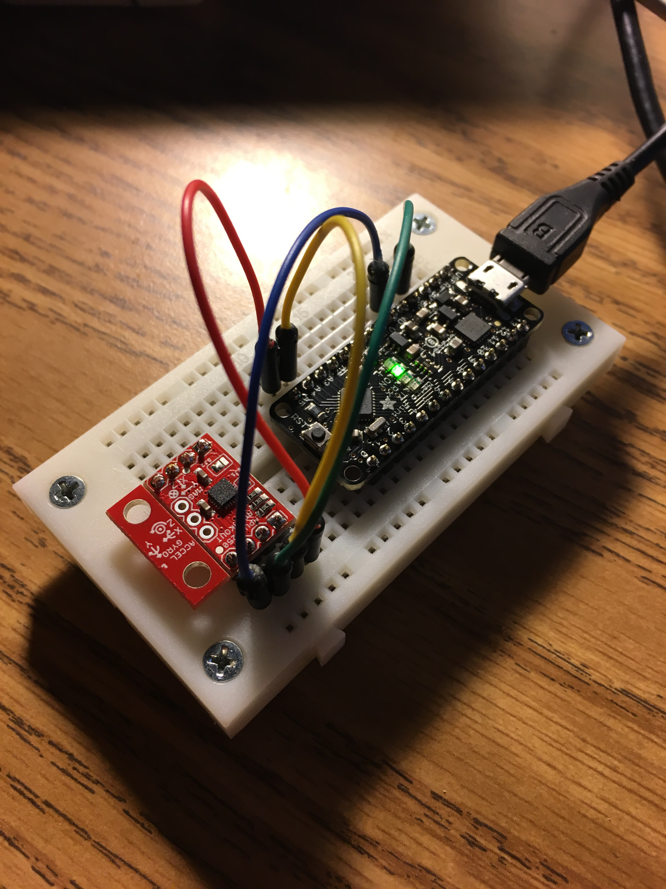
Roger’s Current Stage
Metro Mini 328
(Microcontroller)
MPU-9250
(IMU)
I2C Protocol Pins
Notes:
Currently, we have completed the hardware setup that using a Metro Mini microcontroller and MPU-9250 IMU, the microcontroller and IMU are hooked up by using I2C protocol, and we can now use Arduino IDE for programming. From the perspective of software, we are able to recognize the address of connected IMU and read the output data from all three sensors of the MPU-9250 including acceleration (accelerator value), gyroscope values and magnetometer value. In addition, we discovered two different filtering algorithms for getting quaternion output based on the raw data of the sensor, which we can generate quaternion value by using sample code and existing libraries.

Slide 4
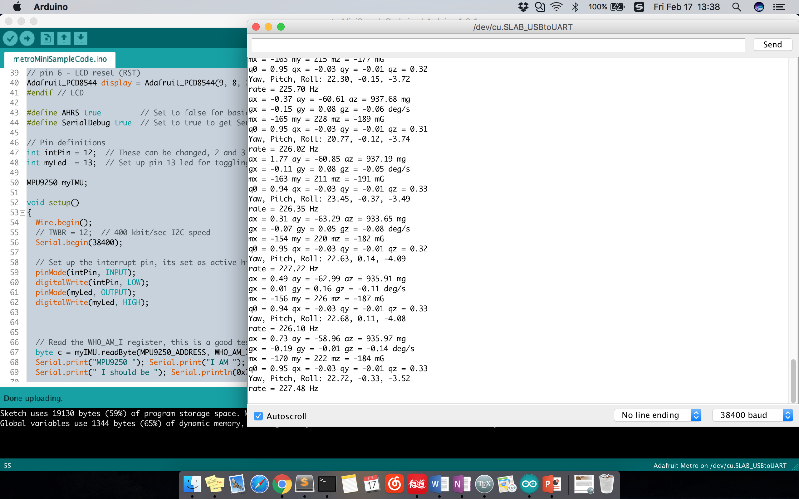
Notes:
We also successfully ran a sample code on Arduino IDE based on a quaternion filtering library, that is able to use AHRS algorithm to generate quaternion data as well as yaw-pitch-roll values

Slide 5
Roger’s Leftover
Add multiple IMUs onto single microcontroller
Get precise error of all IMUs/ sensors
Develop an alignment algorithm for aligning a group of quaternion data.
Develop demonstration interface.
Notes:
We still need to figure out how to connect slave IMUs and select the correct address of expected IMU by using I2C protocol.
Correctly calibrate the sensor error before using the sensor data to the algorithm
~
Krisna is working on this part

Slide 6
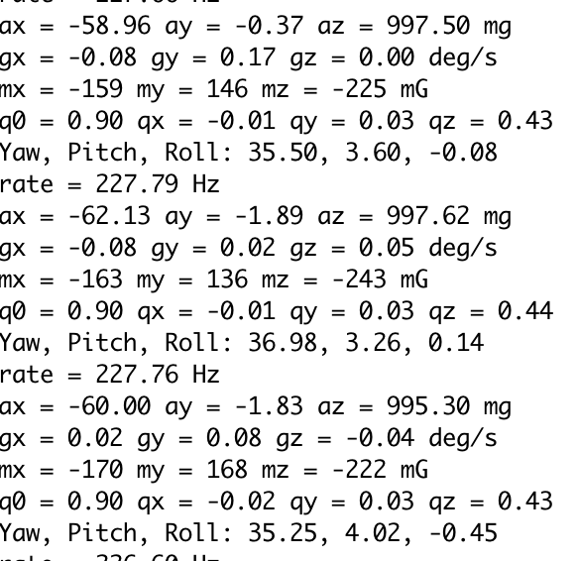
Roger’s Problems 1
Knowing the actual error of the IMU/sensors.
Notes:
It is difficult to measure actual precise error of the sensor data by just looking at it output data since the error could be very minor and unstable. Here is a screenshot comes from three groups of random data, the IMU is in a static motion and lying flat on a horizontal groud,
Error is obvious

Slide 7
Solution
Knowing the actual error of the IMU/sensors.
A solution to measure the error is by comparing the actual alter angle with the sensor output data. An actual alter angle can be calculated by using a laser pointer and a mechanical angle adjuster ~\ref{fig:widget} for assistant tool, as well as applying trigonometric algorithm. Look at experimental design description for more detail.
Notes:
A solution to measure the error is by comparing the actual alter angle with the sensor output data. An actual alter angle can be calculated by using a laser pointer and a mechanical angle adjuster for assistant tool, as well as applying trigonometric algorithm. Look at experimental design description for more detail.

Slide 8
Sensor Error Measurement Experimental Design

Slide 9
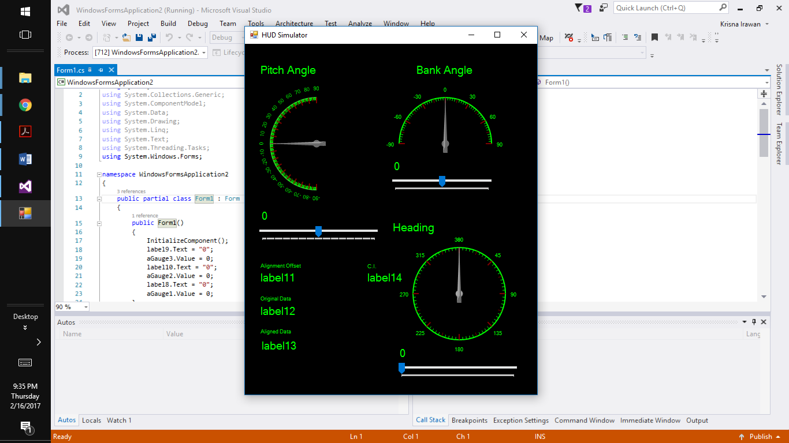
Krisna’s Current Stage
I am at the stage of connecting the graphical user interface that I created in Visual Studio to the offset algorithm part of the software created in Arduino by my teammates.
The graphical user interface run smoothly and ready to be connected.
Will need to do the first user study with the clients.

Slide 10
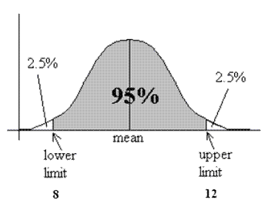
Krisna’s Leftover
Connect the GUI to the Arduino part of the software.
Need to run first user study with the clients.
Statistical Analaysis implementation of the software.
Source: https://i1.wp.com/cpmc.coriell.org/images/c_interval.gif

Slide 11
Hardware Logistic: Problem and Solution
Not be able to get the necessary hardware on timely manner.
Pro-actively contact the instructor and the TA to get the hardware.
Set up a meeting with the clients to let them know about the logistical problem that we were having.
Work in parallel to save time

Slide 12
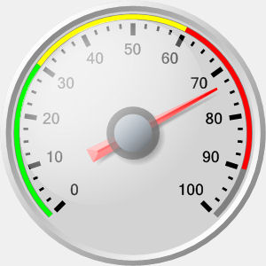
Generic HUD Symbology: Problem and Solution
Rockwell Collins uses a different methodology of generating the HUD display.
No imports file available to help generate the HUD symbology.
Use a gauge icon to represent the HUD symbology.
Source: https://www.targetdashboard.com/nlimages/badgauge.jpg

Slide 13
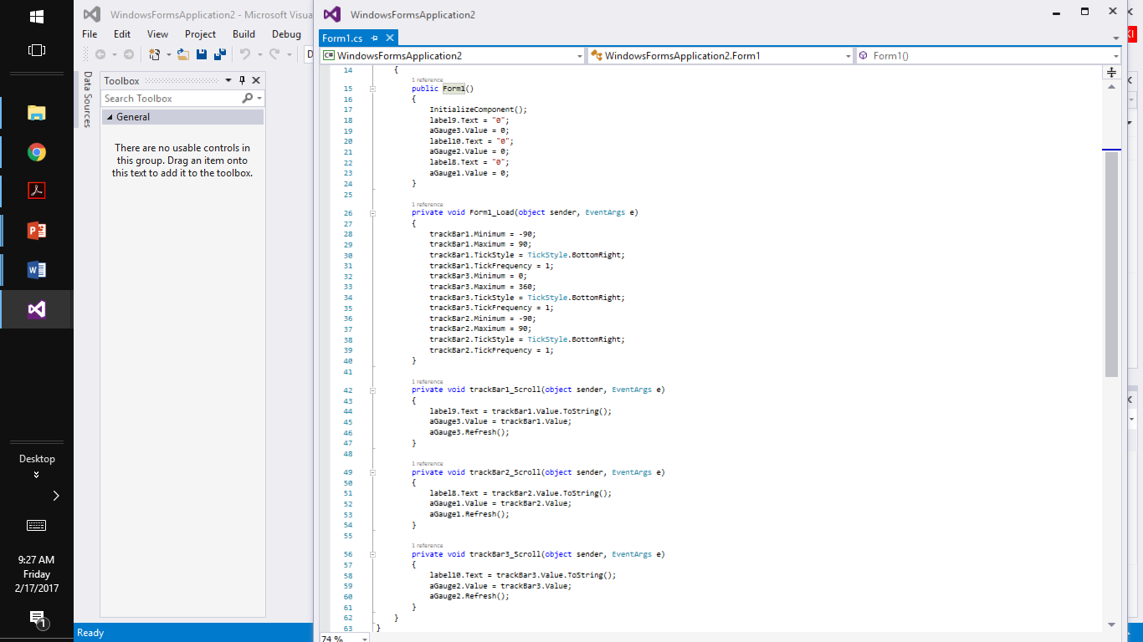
Sample Code

Slide 14
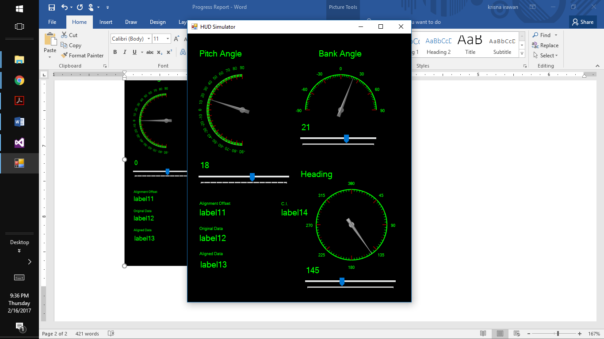
First User Study
Conduct the user study with my friends.
Need explanation to help the user understand the graphical user interface.
Need to conduct the user study with the clients.

Slide 15
Demonstration of Graphical User Interface

