Slide 1
Lecture 02
Probabilistic Modeling in Hydrology-Part I
(Moments & Probabilistic Models)

Slide 2
Review on Lecture 01
Introduction to the Course: Statistical Hydrology
Hydrology & Statistics
수문학에서의 불확실성 분류 방법 (Handbook of Hydrology, 17.1.1)
Inherent randomness of the driving variables (predominantly precipitation) and the randomness of the hydrologic system (including topographic, aquifer, and soil characteristics)
Sampling error – the measurements that hydrologists have to work with are only a small sample from a large or potentially infinite population
Uncertainty resulting from incorrect understanding of the processes involved (System error- errors in estimating or predicting system outputs from system inputs)
Introduction to Common Representative Values
Central Tendency, Dispersion, Asymmetry, Correlation

Slide 3
Today’s Topic
이전 강의에서 봤듯이, 대표값들(평균, 표준편차, 왜곡도 등)로만 어느 불확실한 변수를 설명하기에는 어려움이 있음.
따라서, 대부분의 확률변수들이 주로 따르는 이미 알려진 확률분포들에 대해서 학습하고, 이를 사용해서 확률변수를 설명하고자 함.
Probabilistic Modeling in Hydrology (Parts I & II)
Introduction to probability & probability distributions
What are Discrete/Continuous probability distributions?
What are the factors that determine the specific shape of the probability distributions? Parameters (매개변수)!
How do we decide on the “adequate” values of parameters? – P2

Slide 4
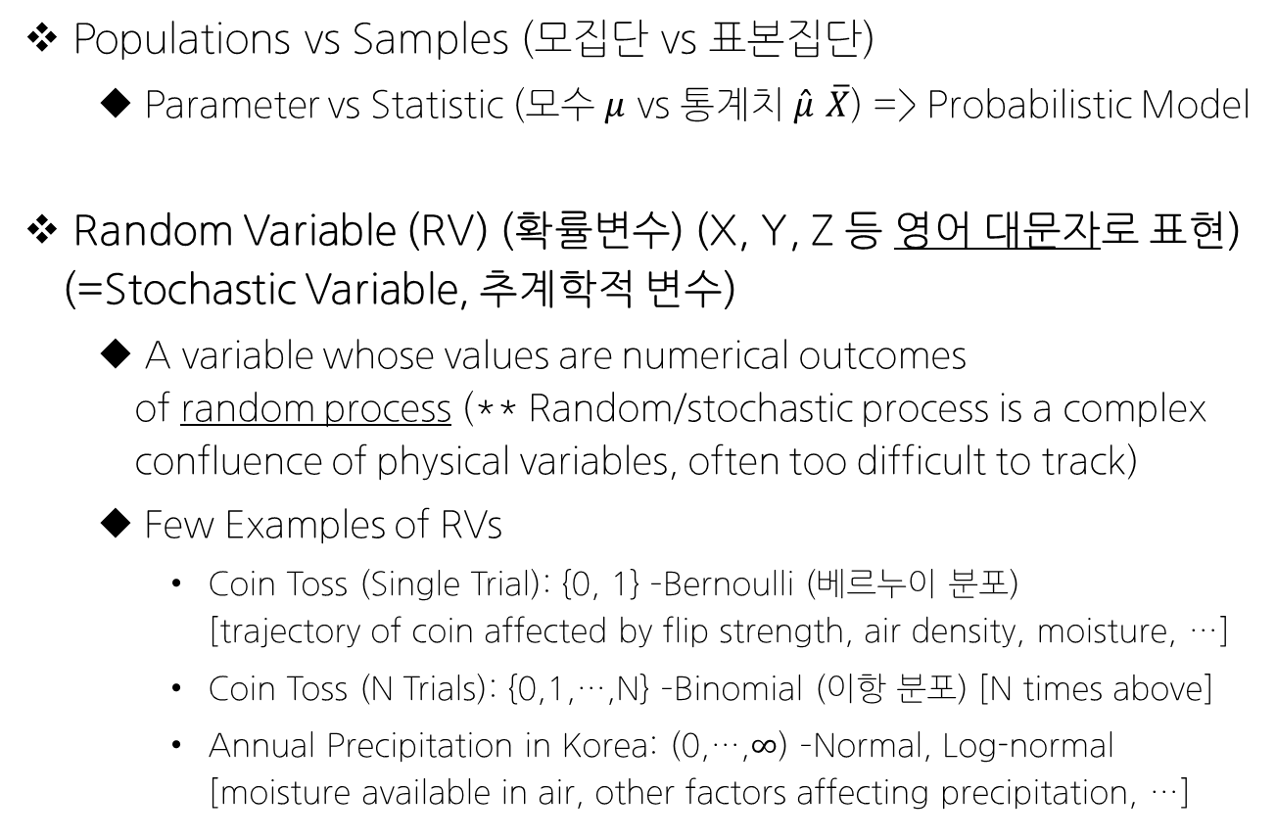
Review on Basic Probability Concepts
Populations vs Samples (모집단 vs 표본집단)
Parameter vs Statistic (모수 $μ$ vs 통계치 $\hat{μ}$ $\overline{X}$) => Probabilistic Model
Random Variable (RV) (확률변수) (X, Y, Z 등 영어 대문자로 표현) (=Stochastic Variable, 추계학적 변수)
A variable whose values are numerical outcomes of random process (** Random/stochastic process is a complex confluence of physical variables, often too difficult to track)
Few Examples of RVs
Coin Toss (Single Trial): {0, 1} –Bernoulli (베르누이 분포) [trajectory of coin affected by flip strength, air density, moisture, …]
Coin Toss (N Trials): {0,1,…,N} –Binomial (이항 분포) [N times above]
Annual Precipitation in Korea: (0,…,$∞$) –Normal, Log-normal [moisture available in air, other factors affecting precipitation, …]

Slide 5
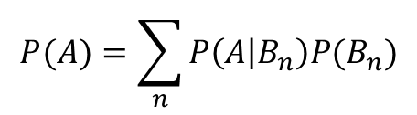
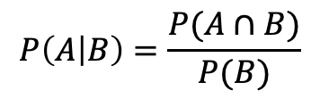
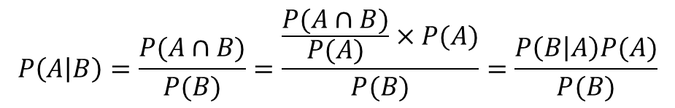



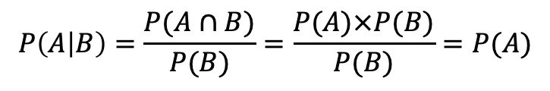
Review on Basic Probability Concepts
Mutually Exclusive (배반)
Independence (독립)
Conditional Probability (조건부확률)
Probability of occurrence of event A given that event B has already occurred is defined as:
In case of Independence,
Bayes Theorem (베이즈 정리)
Total Probability Theorem (전체 확률의 법칙)
대신, $B_{n}은$ 서로 Mutually Exclusive
$$P\left(A∩B\right)=0$$
$$P\left(A∩B\right)=P(A)×P(B)$$
$$P\left(A | B\right)=\frac{P(A∩B)}{P(B)}$$
$$P\left(A | B\right)=\frac{P(A∩B)}{P(B)}=\frac{P(A)×P(B)}{P(B)}=P(A)$$
$$P\left(A | B\right)=\frac{P(A∩B)}{P(B)}=\frac{\frac{P(A∩B)}{P(A)}×P(A)}{P(B)}=\frac{P\left(B | A\right)P(A)}{P(B)}$$
$$P(A)=\sum_{n}{P\left(A | B_{n}\right)P(B_{n})}$$

Slide 6
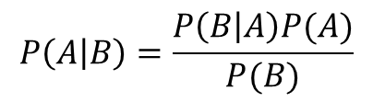
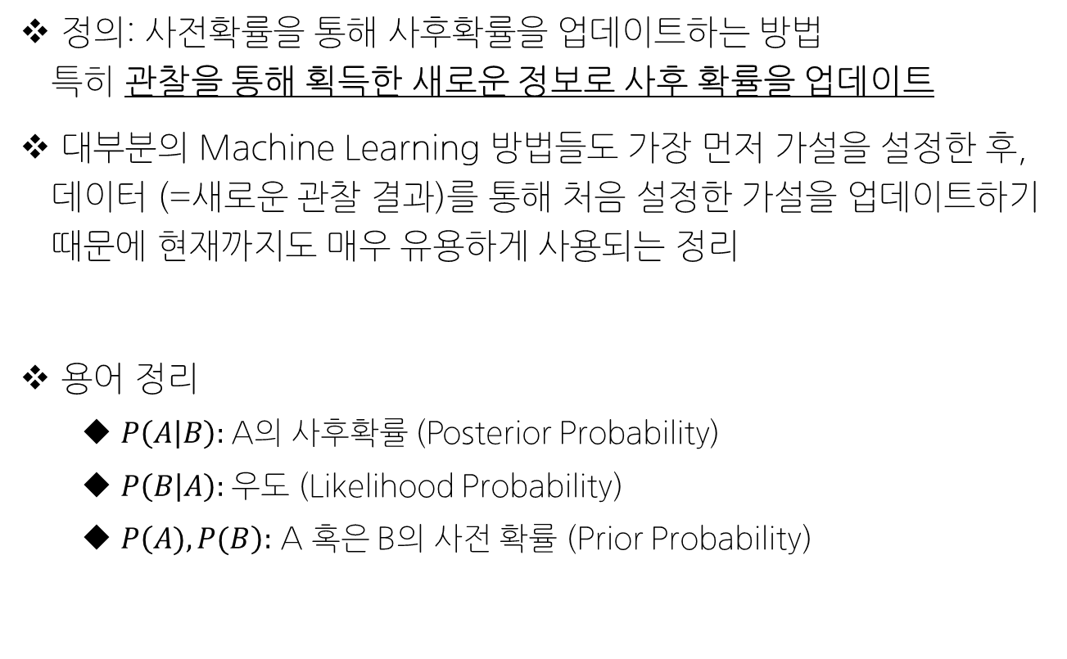
Bayes’ Theorem
$$P\left(A | B\right)=\frac{P\left(B | A\right)P(A)}{P(B)}$$
정의: 사전확률을 통해 사후확률을 업데이트하는 방법 특히 관찰을 통해 획득한 새로운 정보로 사후 확률을 업데이트
대부분의 Machine Learning 방법들도 가장 먼저 가설을 설정한 후, 데이터 (=새로운 관찰 결과)를 통해 처음 설정한 가설을 업데이트하기 때문에 현재까지도 매우 유용하게 사용되는 정리
용어 정리
$P\left(A | B\right):$A의 사후확률 (Posterior Probability)
$P\left(B | A\right):$우도 (Likelihood Probability)
$P\left(A), P(B\right):$ A 혹은 B의 사전 확률 (Prior Probability)

Slide 7
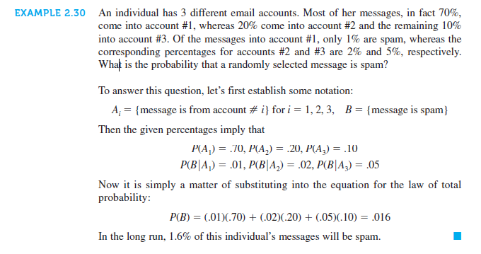
Total Probability Theorem Example

Slide 8
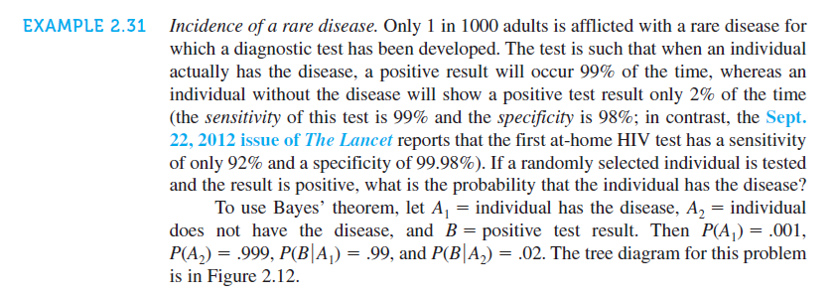
Bayes’ Theorem Example

Slide 9
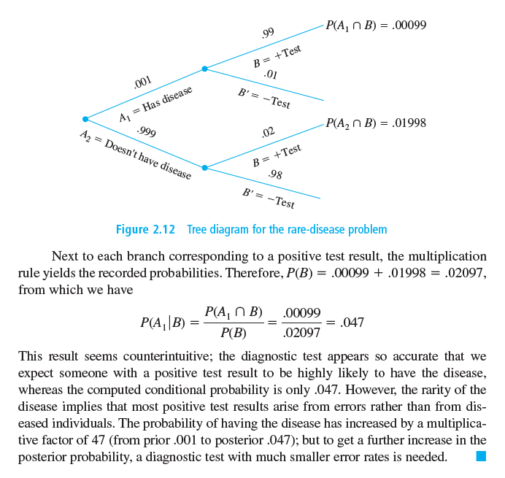
Bayes’ Theorem Example

Slide 10





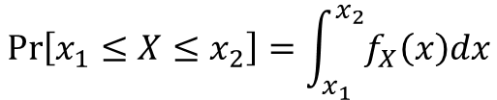

Types of Random Variables
Discrete Random Variable (이산확률변수)
Probability Mass Function (PMF)
Cumulative Distribution Function (CDF)
Example Distributions: Bernoulli, Poisson, Geometric, Negative, …
Continuous Random Variable (연속확률변수)
Probability Density Function (PDF)
Cumulative Distribution Function (CDF)
Example Distributions: Uniform, Normal, Log-normal, Generalized Extreme Value (GEV)
$$\sum{p_{X}\left(x\right)}=1$$
$$p_{X}\left(x\right)=Pr⁡[X=x]$$
$$F_{X}\left(x\right)=Pr⁡[X≤x]$$
$$\operatorname{Pr}\left[x_{1}≤X≤x_{2}\right]=\int_{x_{1}}^{x_{2}}{f_{X}\left(x\right)dx}$$
$$\int_{−∞}^{+∞}{f_{X}\left(x\right)dx=1}$$
$$F_{X}\left(x\right)=\int_{−∞}^{x}{f_{X}\left(z\right)dz}$$
$$f_{X}\left(x\right)=\frac{F_{X}\left(x\right)}{dx}$$

Slide 11
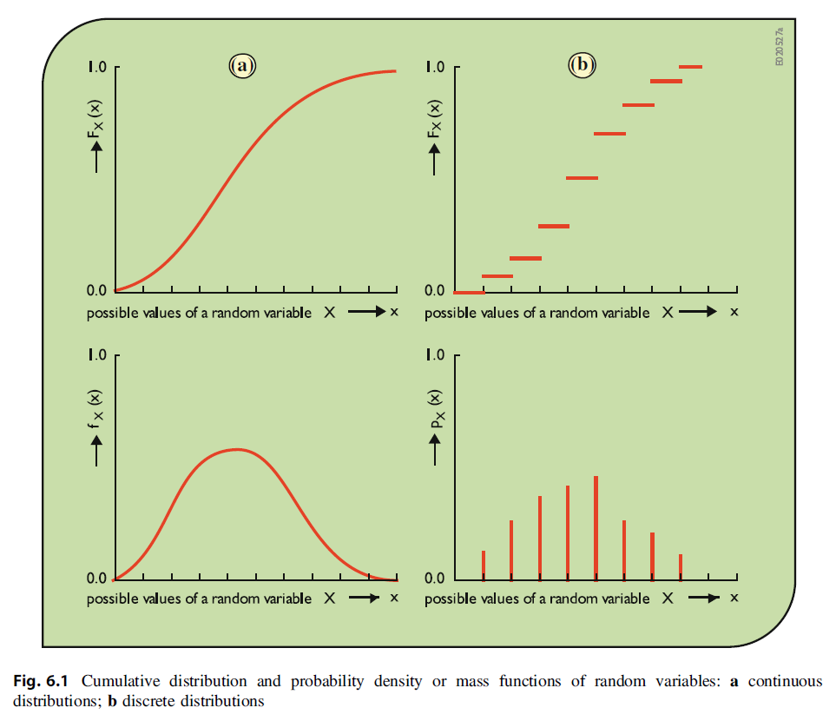
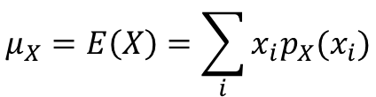
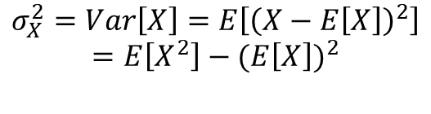
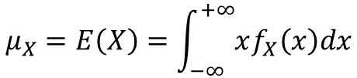
Types of Random Variables
*Discrete RV
$$μ_{X}=E\left(X\right)=\sum_{i}{x_{i}p_{X}(x_{i})}$$
$$σ_{X}^{2}=Var\left[X\right]=E\left[{\left(X−E\left[X\right]\right)}^{2}\right]$$
$$=E\left[X^{2}\right]−{(E\left[X\right])}^{2}$$
*Continuous RV
$$μ_{X}=E\left(X\right)=\int_{−∞}^{+∞}{xf_{X}\left(x\right)dx}$$

Slide 12
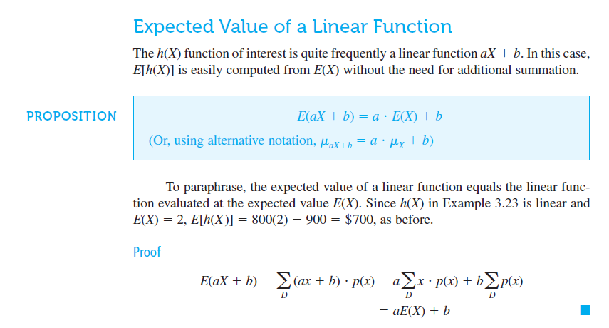
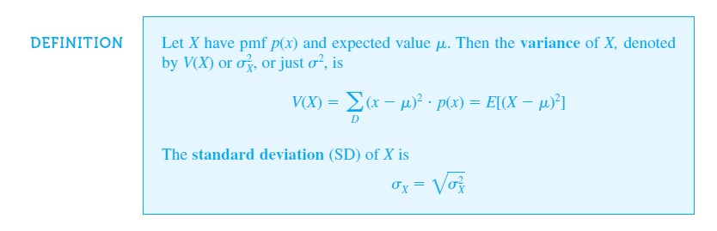
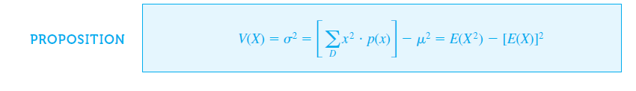

Slide 13






Bernoulli Processes & Binomial Distribution
Only two possible outcomes are possible: success or failure
The probability of occurrence of a success (or a failure) is constant
The trials are independent (i.e., the outcome of a trial does not depend on the outcome of another trial)
Extension to the Binomial Distribution (이항분포)
n times of Bernoulli trials
$$p_{X}\left(x\right)=\operatorname{Pr}\left[X=x;p\right]=p^{x}{(1−p)}^{1−x}$$
$$E\left[X\right]=p$$
$$Var\left[X\right]=p$$
$$p_{X}\left(x\right)=\operatorname{Pr}\left[X=x;n,p\right]=\left(\begin{matrix}n \\ x\end{matrix}\right)p^{x}{(1−p)}^{n−x}$$
$$E\left[X\right]=np$$
$$Var\left[X\right]=np\left(1−p\right)=npq$$

Slide 14
Example 4.4 On the average, how many times will a 10-year flood occur in a 40-year flood? What is the probability that exactly this number of 10-year floods will occur in a 40-year period?

Slide 15
Example 4.7 In order to be 90% sure that a design storm is not exceeded in a 10-year period, what should be the return period of the design storm?

Slide 16




Poisson Process
Poisson Distribution
베르누이 과정에서 $p→0$, $n→∞$이 성립할 경우, $λ=np$
Assignment! (Due Before the Class of 9/20) 이항분포의 확률 밀도 함수 (PMF)로부터 포아송 분포의 확률분포함수 (PMF)를 유도하라.
$$p_{X}\left(x\right)=\operatorname{Pr}\left[X=x;λ\right]=\frac{λ^{x}e^{−λ}}{x!}$$
$$E[X]$$
$$Var[X]$$

Slide 17







Geometric & Negative Binomial Distributions
Geometric Distribution (기하 분포)
베르누이 분포에서
처음 성공까지 시도한 횟수 X의 분포
처음 성공까지 실패한 횟수 Y=X-1의 분포
Negative Binomial Distribution (음이항분포)
기하분포의 일반식으로, r번째 성공까지 시도한 횟수 X의 분포 (probability of the rth success occurring at the xth trial)
$$p_{X}\left(x\right)=p{(1−p)}^{x−1}$$
$$p_{Y}\left(y\right)=p{(1−p)}^{y}$$
$$E\left[X\right]=1/p$$
$$Var\left[X\right]=(1−p)/p^2$$
$$p_{X}\left(x\right)=\operatorname{Pr}\left[X=x;r,p\right]=\left(\begin{matrix}x−1 \\ r−1\end{matrix}\right)p^{r}{(1−p)}^{x−r}$$
$$x=r, r+1, …$$
$$E\left[X\right]=r∗1/p$$
$$Var\left[X\right]=r∗(1−p)/p^2$$

Slide 18
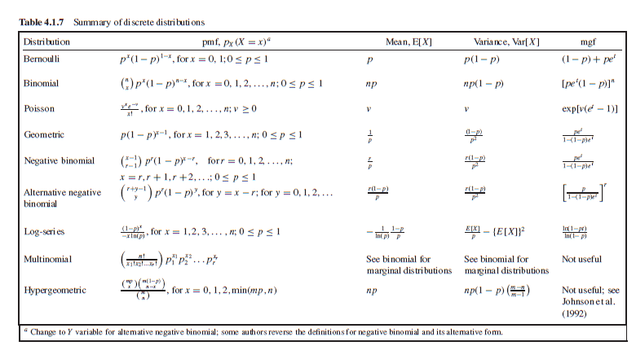
Summary of Discrete Distributions

Slide 19
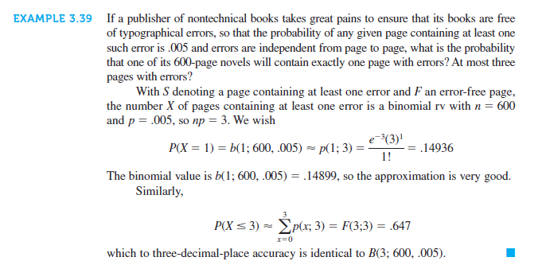
Example Problem: Poisson

Slide 20
Part II: Continuous Distributions

Slide 21
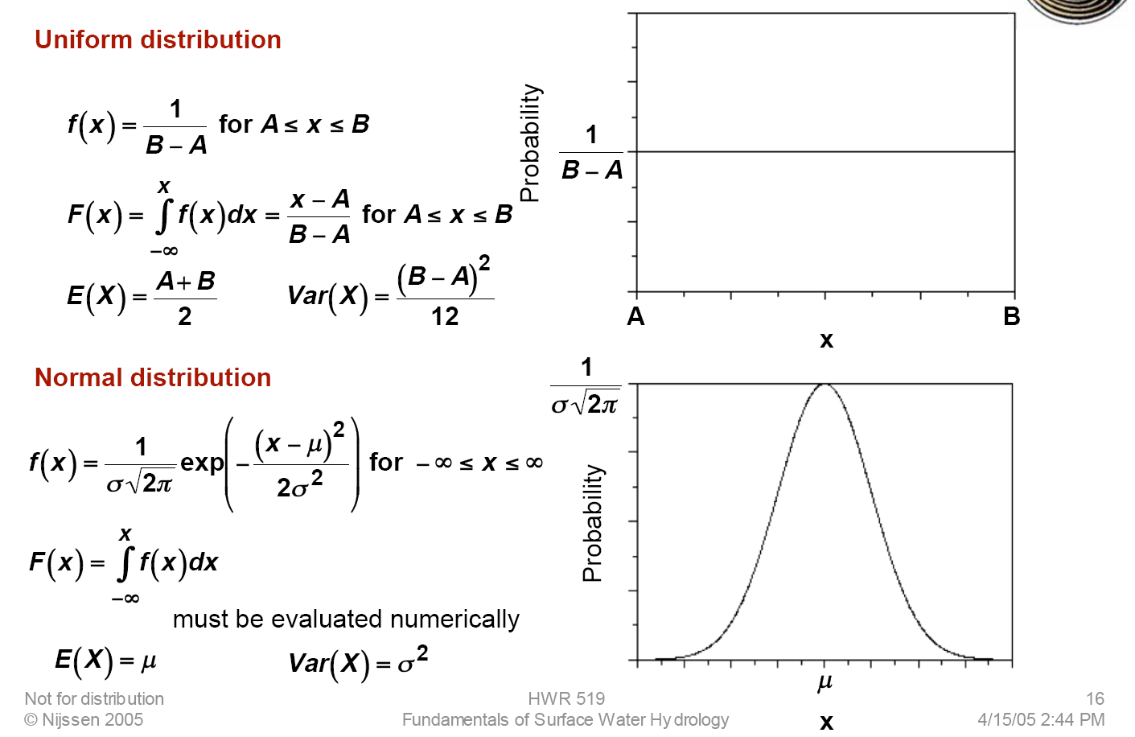
Uniform & Normal Distributions

Slide 22
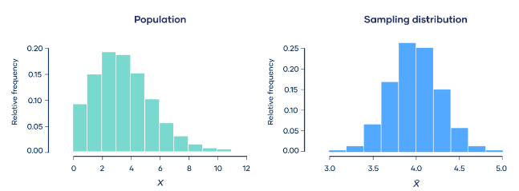
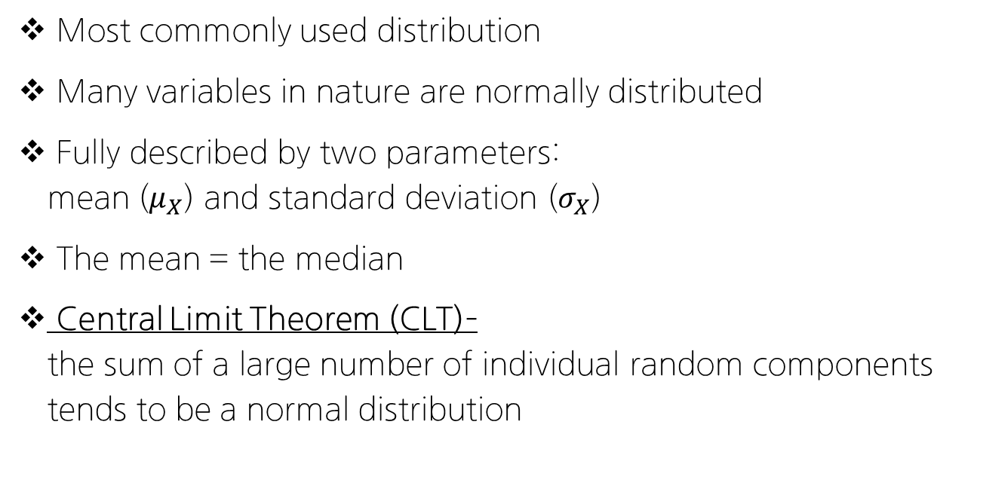
Most commonly used distribution
Many variables in nature are normally distributed
Fully described by two parameters: mean ($μ_{X}$) and standard deviation ($σ_{X}$)
The mean = the median
Central Limit Theorem (CLT)– the sum of a large number of individual random components tends to be a normal distribution

Slide 23
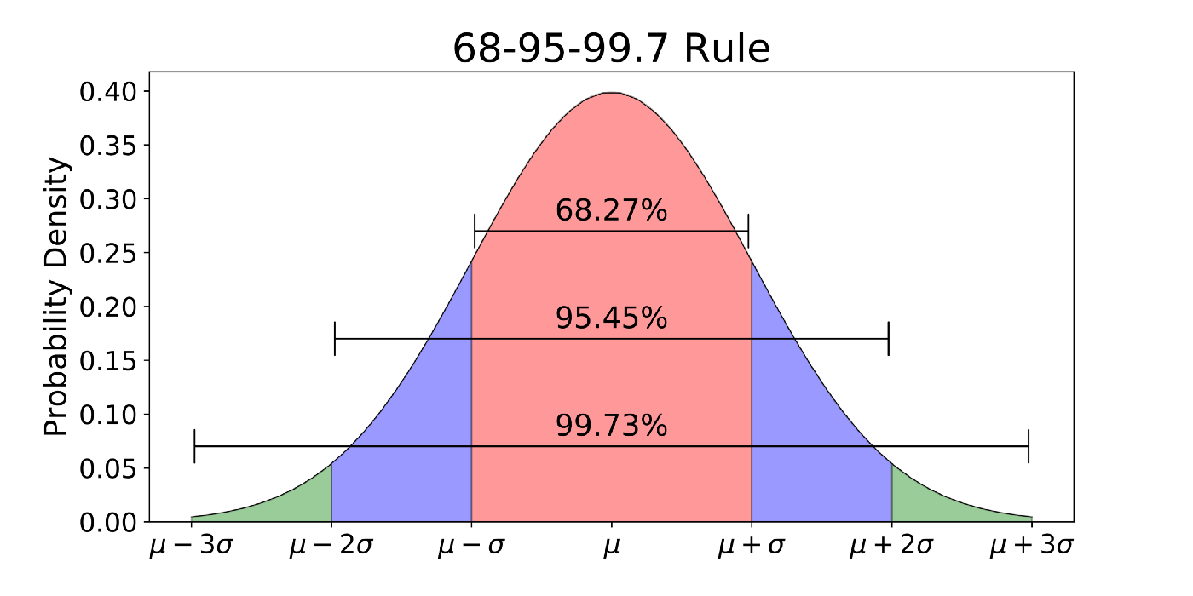

Slide 24





Special Type of Normal Distribution
Standardized Normal Distribution (표준정규분포)
정규분포 중 평균이 0, 표준편차가 1인 분포
확률변수의 표준화를 거침
Lognormal Distribution (대수정규분포)
만약 확률변수 X와 Y에 대해서 Y=ln(X) 가 성립하고,
Y가 정규분포를 따른다면
X는 대수정규분포를 따른다고 할 수 있다.
$$Z\sim N(0,1^{2})$$
$$X\sim N(μ_{X},σ_{X}^{2})$$
$$Z=(X−μ_{X})/σ_{X}$$
$$Y\sim N(μ_{Y},σ_{Y}^{2})$$
$$X\sim LN(μ_{ln⁡(X)},σ_{ln⁡(X)}^{2})$$

Slide 25
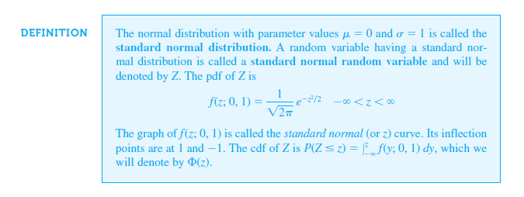
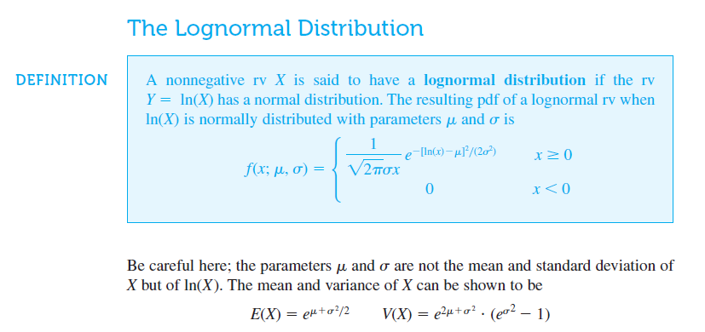
The Standardized Normal Distribution

Slide 26
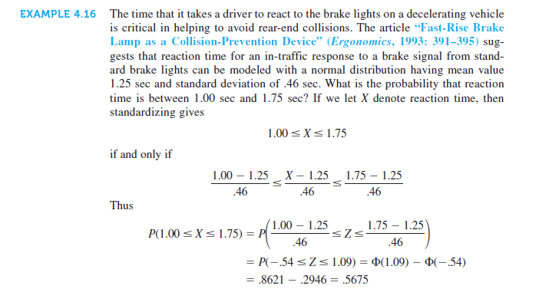
Examples: Standardized Normal Distribution

Slide 27
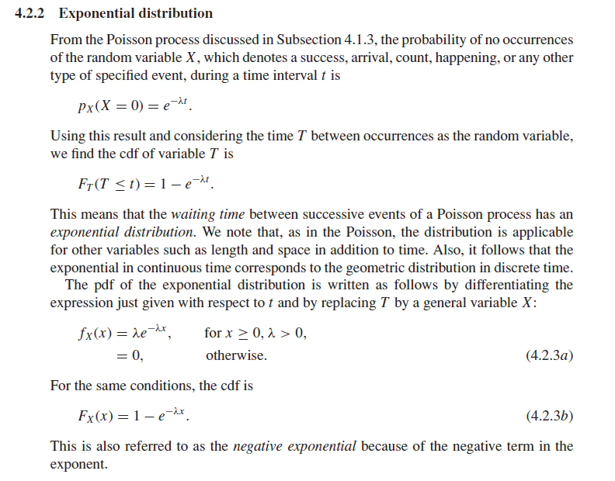


Exponential Distribution
$$x≥0, λ>0$$
Exponential Distribution (지수 분포)
사건이 서로 독립적이고,
일정 시간동안 발생하는 사건의 횟수가 포아송 분포를 따를 때
다음 사건이 일어날 때까지의 대기 시간
(=기하 분포, 그러나 연속적인 확률변수에 대해 적용이 가능)
$$f_{X}\left(x\right)=λe^{−λx}$$

Slide 28
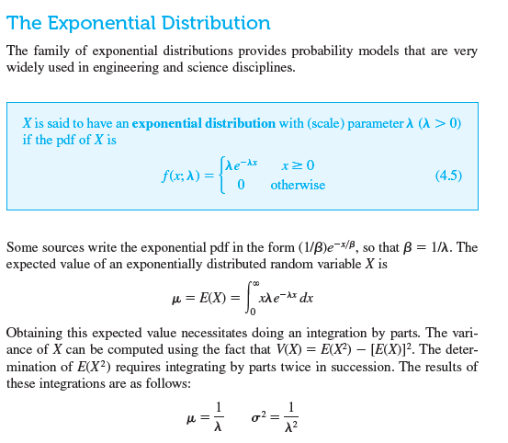
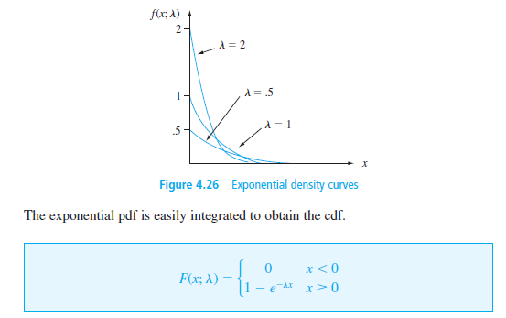

Slide 29
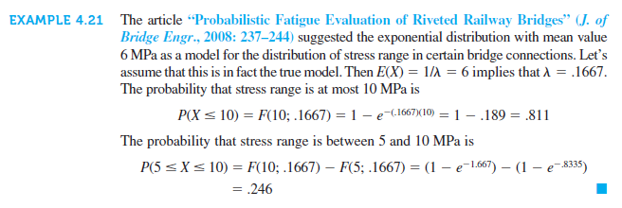
Exponential Distribution Example

Slide 30
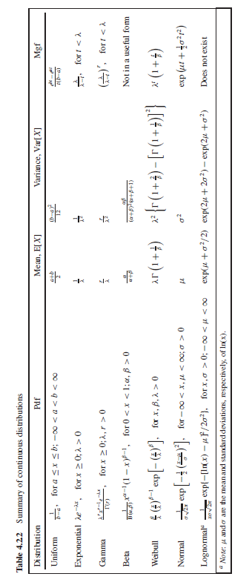
Summary of Continuous Distributions

Slide 31
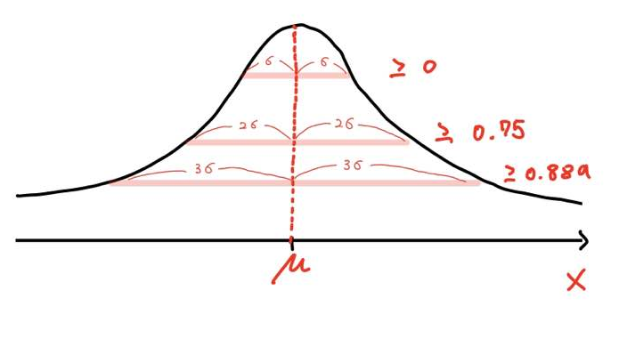
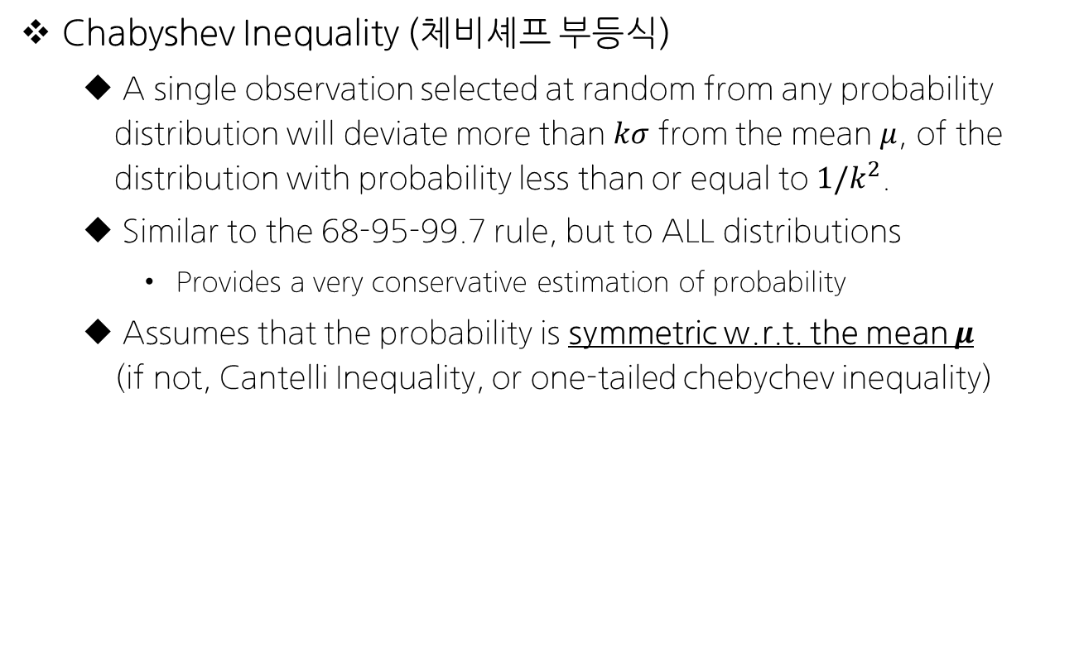
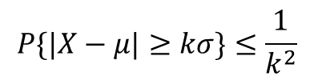
Chebyshev Inequality
$$P\{|X−μ|≥kσ\}≤\frac{1}{k^{2}}$$
Chabyshev Inequality (체비셰프 부등식)
A single observation selected at random from any probability distribution will deviate more than $kσ$ from the mean $μ$, of the distribution with probability less than or equal to $1/k^{2}$.
Similar to the 68-95-99.7 rule, but to ALL distributions
Provides a very conservative estimation of probability
Assumes that the probability is symmetric w.r.t. the mean $μ$ (if not, Cantelli Inequality, or one-tailed chebychev inequality)

Slide 32
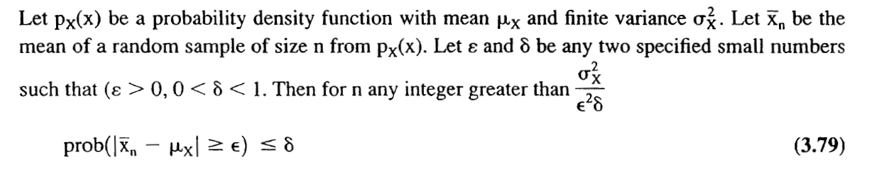
Law of Large Numbers
The (weak) Law of Large Numbers (큰 수의 약한 법칙)
큰 모집단에서 무작위로 뽑은 표본의 평균이 전체 모집단의 평균과 가까울 가능성이 높다는 개념
Related Concepts
Beginner’s Luck (장기적으로는? 수렴하게 됨)
야구에서의 “DTD”

Slide 33
Conclusion of Lecture 2
Few statistical characteristics common to many types of hydrologic data (수문 분야에서의 불확실한 변수들의 통계적 특성) (Handbook of Hydrology, 17.1.1)
Non-normal, skewed distribution functions, often having a lower bound of zero
Outliers - a few values that are much larger or much smaller than the bulk of the data
Serial correlation, or lack of independence among observations
Distributions dependent on other variables
Censoring – data concentration values reported as less than a detection limit, or discharge values less than the discharge at which flood damage occurs
Seasonal patterns; statistical characteristics tend to vary with the seasons

Slide 34
Future Schedule Preview
다음 주 강의 (2022-09-20 화요일 18:30-21:20)
Lec 03: Probabilistic Modeling in Hydrology- Part II (Maximum Likelihood Estimator & Goodness of fit tests)
Maximum Likelihood Estimation of Parameters & Examples
Goodness of fit Approaches such as: AIC, PP or QQ plots, Chi-squared test
Datacamp Assignment due 9/15 (Introduction to R)
Assignment on Page 16 (Deriving the Poisson Distribution)
Bring LAPTOPS with R & Rstudio on Sep-27! (2주 후)

