Slide 1
Lecture 03
Probabilistic Modeling in Hydrology-Part II
(MLE & Goodness of fit tests)

Slide 2
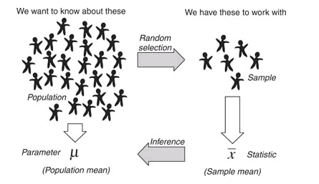
Review on Lecture 2
Basic Probability Concepts
Random Variables (RV)
Mutually Exclusive, Independence, Conditional Probability, Bayes Theorem, Total Probability Theorem, …
Types of Random Variables
Discrete RV & Continuous RV
Discrete Distributions: Binomial, Poisson, Geometric, Negative Binomial, …
Continuous Distributions: Uniform, Normal, Exponential, …
Chebyshev Inequality & Law of Large Numbers

Slide 3
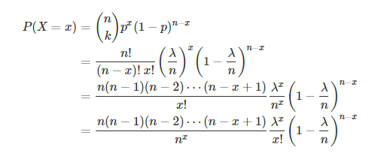
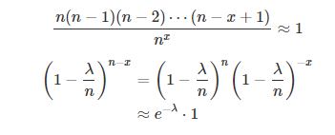

Assignment: Poisson from Binomial
Should be x

Slide 4
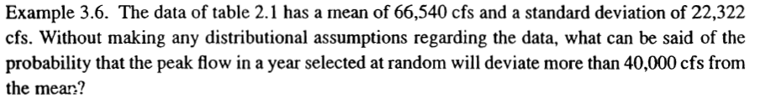
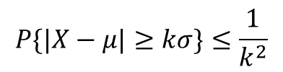
Chebyshev Inequality Example
$$P\{|X−μ|≥kσ\}≤\frac{1}{k^{2}}$$

Slide 5
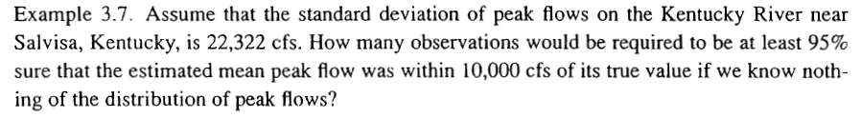
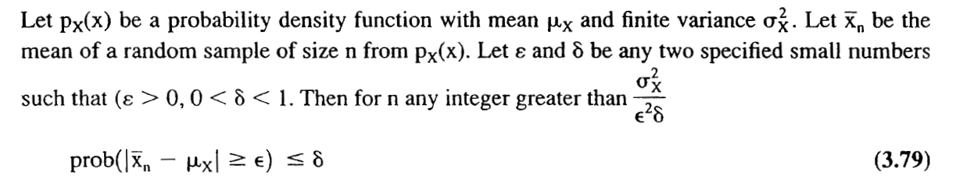
Law of Large Numbers Example

Slide 6
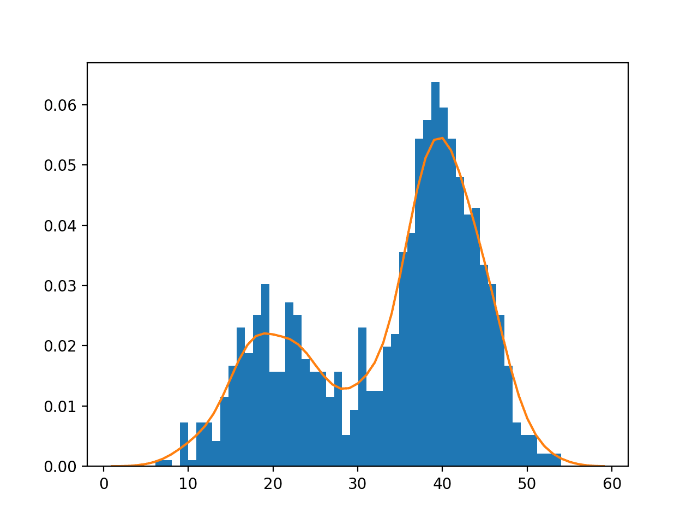
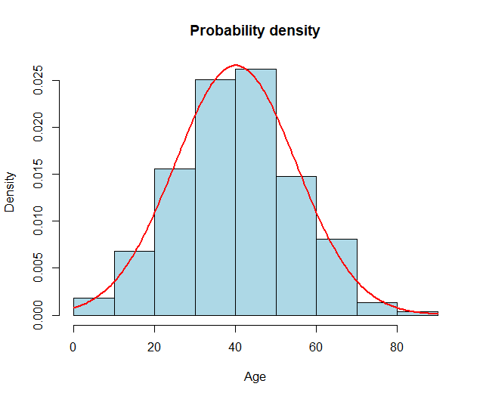
Today’s Topic: Lecture 03 (Part 1)
Steps for Probabilistic Modeling
Step 1: Adopt family of probability models: Normal, Exponential, Gamma, Binomial, Poisson
Step 2: Fit the model to data (Estimate Parameters)
Corresponding Questions to be Answered:
Step 1: How to choose the appropriate model?
Step 2: How do we estimate parameters?

Slide 7
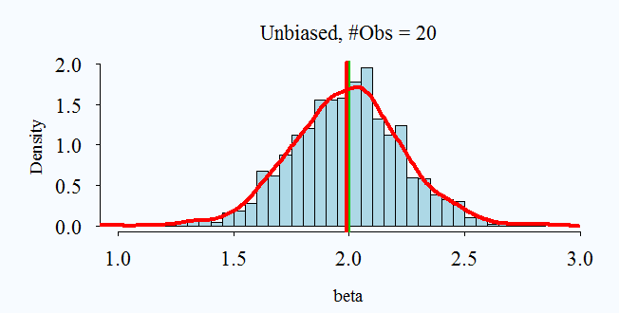
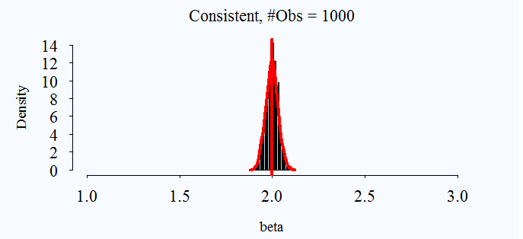

How to estimate parameters?
Concept of Unbiasedness & Consistency
Bias: $E\left(\hat{θ}\right)=θ$
Consistency $ε →0$ as $n →∞$ where $prob\left(|\hat{θ}−θ|\right)=ε$
Refer to: Haan p.70-76, Handbook of Hydrology 18.1, Devore p.264-272

Slide 8
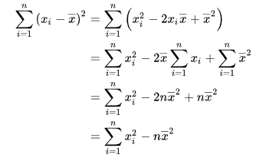

Unbiasedness Example
Prove that the unbiased estimator or sample variance, $s^{2}$, is $\sum{{\left(x_{i}−\overline{x}\right)}^{2}/(n−1)}$using the definition of bias.

Slide 9

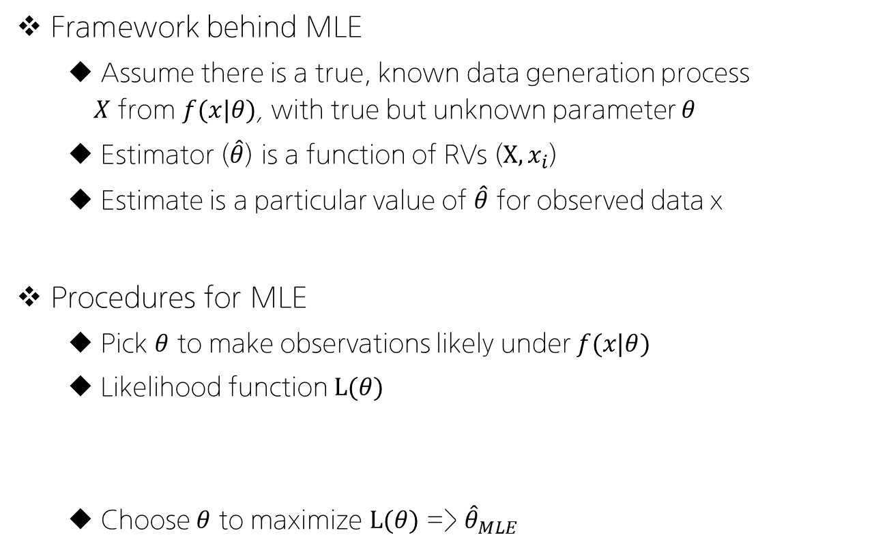
Maximum Likelihood Estimation (MLE)
Framework behind MLE
Assume there is a true, known data generation process $X$ from $f(x|θ)$, with true but unknown parameter $θ$
Estimator ($\hat{θ}$) is a function of RVs ($X, x_{i}$)
Estimate is a particular value of $\hat{θ}$ for observed data x
Procedures for MLE
Pick $θ$ to make observations likely under $f(x|θ)$
Likelihood function $L(θ)$
Choose $θ$ to maximize $L(θ)$ => ${\hat{θ}}_{MLE}$
$$L\left(θ\right)=\prod_{i=1}^{n}{f(x_{i}|θ)}$$

Slide 10
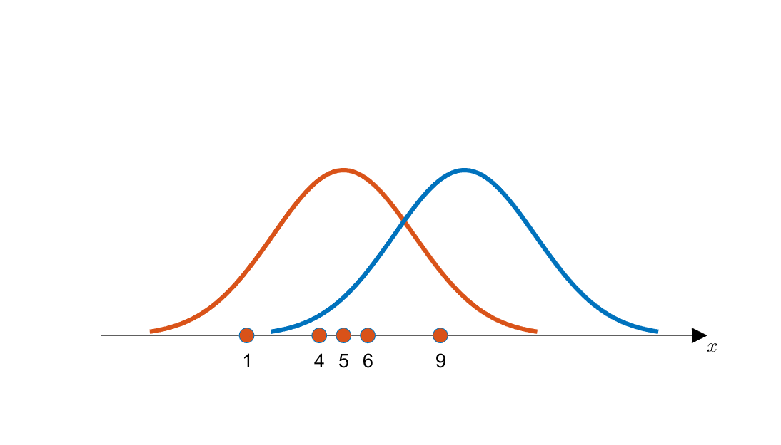
Concept of MLE

Slide 11
MLE Calculation Example (1): Normal

Slide 13
MLE Calculation Example (2): Exponential

Slide 15
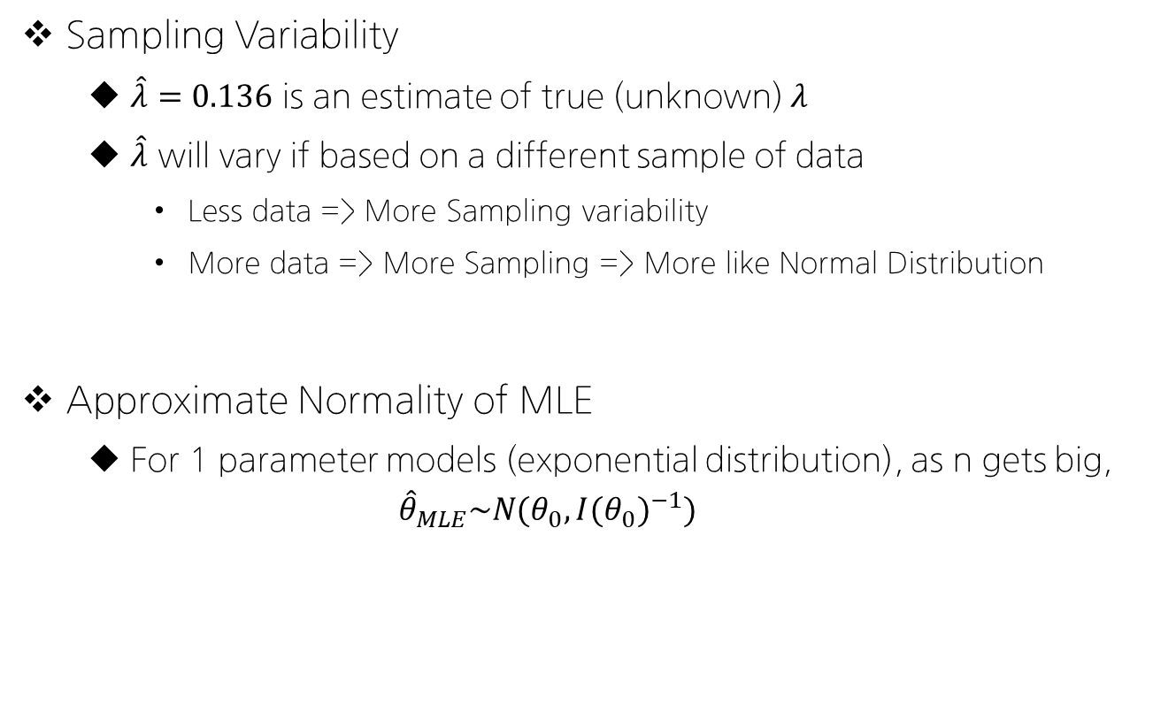
Sampling Variability in MLE
Sampling Variability
$\hat{λ}=0.136$ is an estimate of true (unknown) $λ$
$\hat{λ}$ will vary if based on a different sample of data
Less data => More Sampling variability
More data => More Sampling => More like Normal Distribution
Approximate Normality of MLE
For 1 parameter models (exponential distribution), as n gets big,
$${\hat{θ}}_{MLE}\sim N(θ_{0}, I{(θ_{0})}^{−1})$$

Slide 17
Today’s Topic: Lecture 03 (Part 2)
Steps for Probabilistic Modeling
Step 1: Adopt family of probability models: Normal, Exponential, Gamma, Binomial, Poisson
Step 2: Fit the model to data (Estimate Parameters)
Corresponding Questions to be Answered:
Step 1: How to choose the appropriate model?
Step 2: How do we estimate parameters?

Slide 18
How to pick a model? (1)
어떤 데이터를 가지고 있을 때, 알맞는 분포는 어떻게 결정하는가?
[1] Physical Basis (물리적인 특성을 바탕으로 선택)
예를 들어, 아래 성질을 가진 데이터는 __________ 분포를 따른다.
Events are Independent
Rate of occurrence is constant
Number of extreme events per year (in hydrology)

Slide 19

How to pick a model? (2)
어떤 데이터를 가지고 있을 때, 알맞는 분포는 어떻게 결정하는가?
[2] Limit Laws (극한 정리)
Theory suggest a distribution as $n→∞$
For instance, let X = daily precipitation and $X\sim exp⁡(λ)$
How about $\overline{X}=\frac{1}{365}\sum{X_{i}}$? (Annual average precipitation?)

Slide 20
How to pick a model? (3)
어떤 데이터를 가지고 있을 때, 알맞는 분포는 어떻게 결정하는가?
[3] Empirical Basis: Which model fits data best?
Goodness-of-fit Approaches such as:
Picking based on Scores (AIC)
Visual Assessments (P-P or Q-Q Plots)
Hypothesis testing (Chi-squared test)

Slide 21

How to pick a model? (3)
AIC (Akaikes Information Criterion, 아카이케 정보 기준)
$$AIC=−2×l\left({\hat{θ}}_{MLE}\right)+2×(\# of par.)$$
Goal: pick the model with smallest AIC score (Large maximum likelihood, penalty for model parameters)
Rule of thumb

Slide 22
How to pick a model? (3)
AIC Example

Slide 23
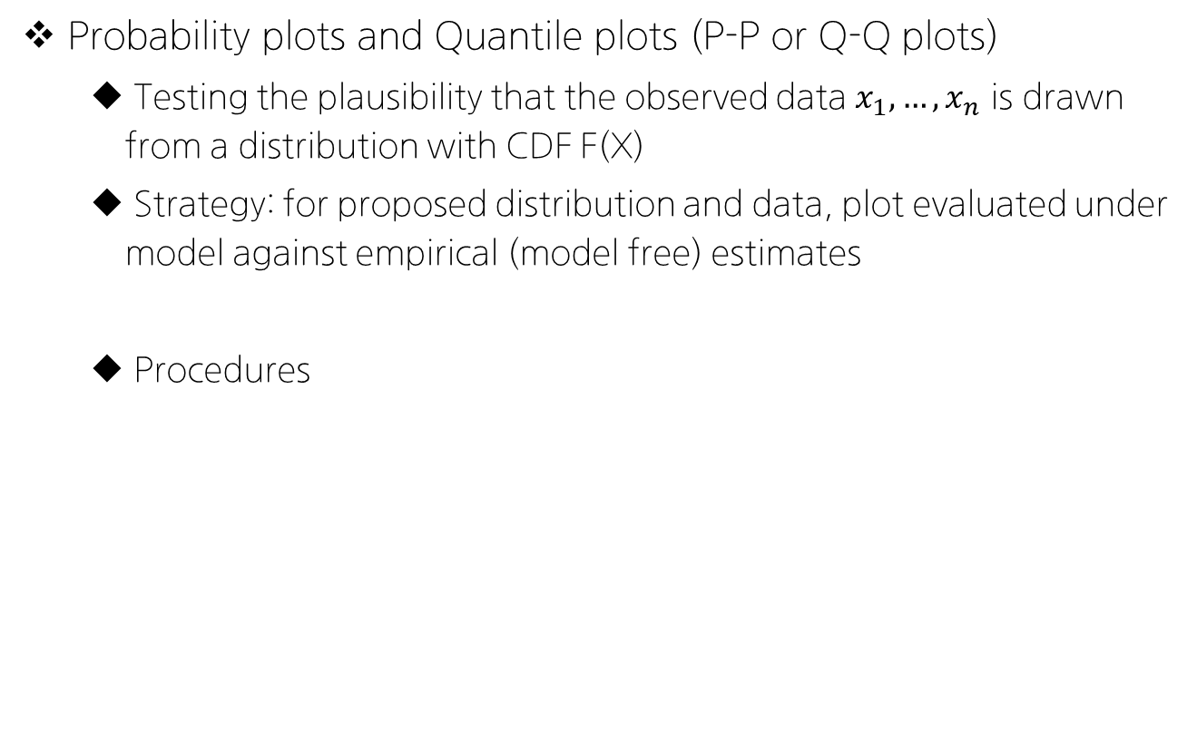
How to pick a model? (3)
Probability plots and Quantile plots (P-P or Q-Q plots)
Testing the plausibility that the observed data $x_{1},…,x_{n}$ is drawn from a distribution with CDF F(X)
Strategy: for proposed distribution and data, plot evaluated under model against empirical (model free) estimates
Procedures

Slide 24
P-P & Q-Q Plot Examples

Slide 25

How to pick a model? (3)
Goodness of Fit Tests (Chi-squared)
Define null hypothesis $H_{0}$
Define alternative hypothesis $H_{A}$
Identify a test statistics
Determine the null distribution: sampling distribution of test statistic under $H_{0}$
Compare test statistics to null distribution

Slide 26
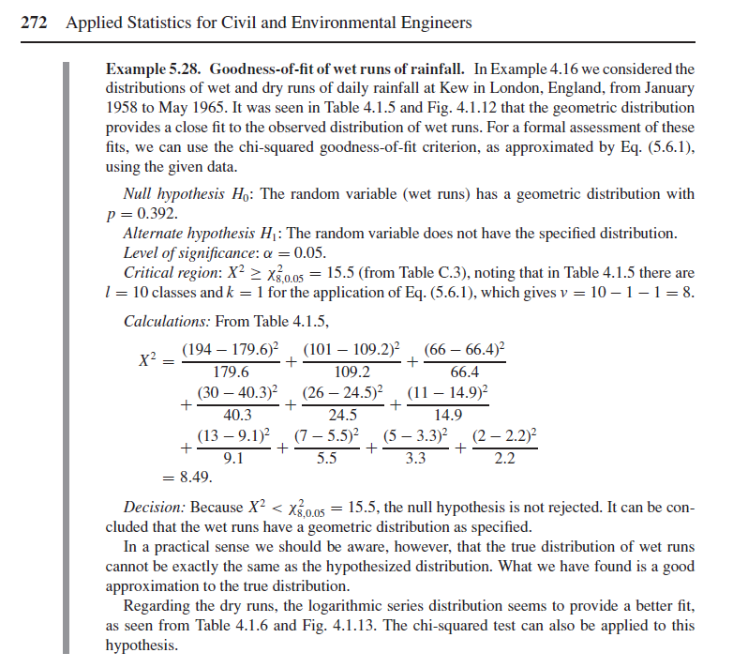
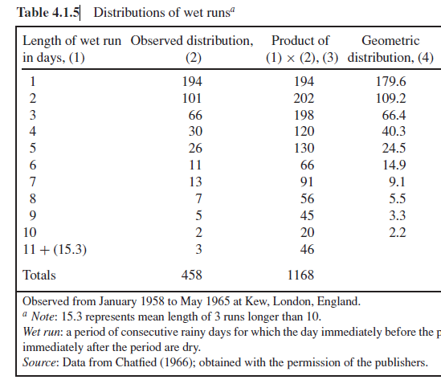
How to pick a model? (3): Example

Slide 27
복습과제 (Quiz 1, Lec 01-Lec 03)
책
문제

Slide 28
Future Schedule Preview
다음 주 강의 (2022-09-27 화요일 18:30-21:20)
Training with Probabilistic Modeling
Bring LAPTOPS with R & R studio on Sep-27!
Quiz 1 before the Training Session * Bring Calculators Multiple Questions, Short Answers, Problem Solving (~ 5-6 Q.)
Other Assignments (Plans for September)
Datacamp Assignments due 9/15 (Introduction to R)
Introduction to R due 9/15
Foundations of Probability in R due 9/23
Training Assignment (on 9/27) due 10/04

