Slide 1
Lecture 05
Extreme Event Analysis-Part II
(Flood Frequency Analysis & POT Approach)

Slide 2
Review on Lecture 4
Extreme Event Analysis: Focusing on Floods!
Questions to be answered in today’s lecture:
What distribution to use?
What design event to use?
Distributions for Extreme Values
Three Types of Extreme Distributions
Gumbel, Fréchet, Weibull (Type 1, Type II, Type III)
Generalized Extreme Value (GEV) Distribution

Slide 3
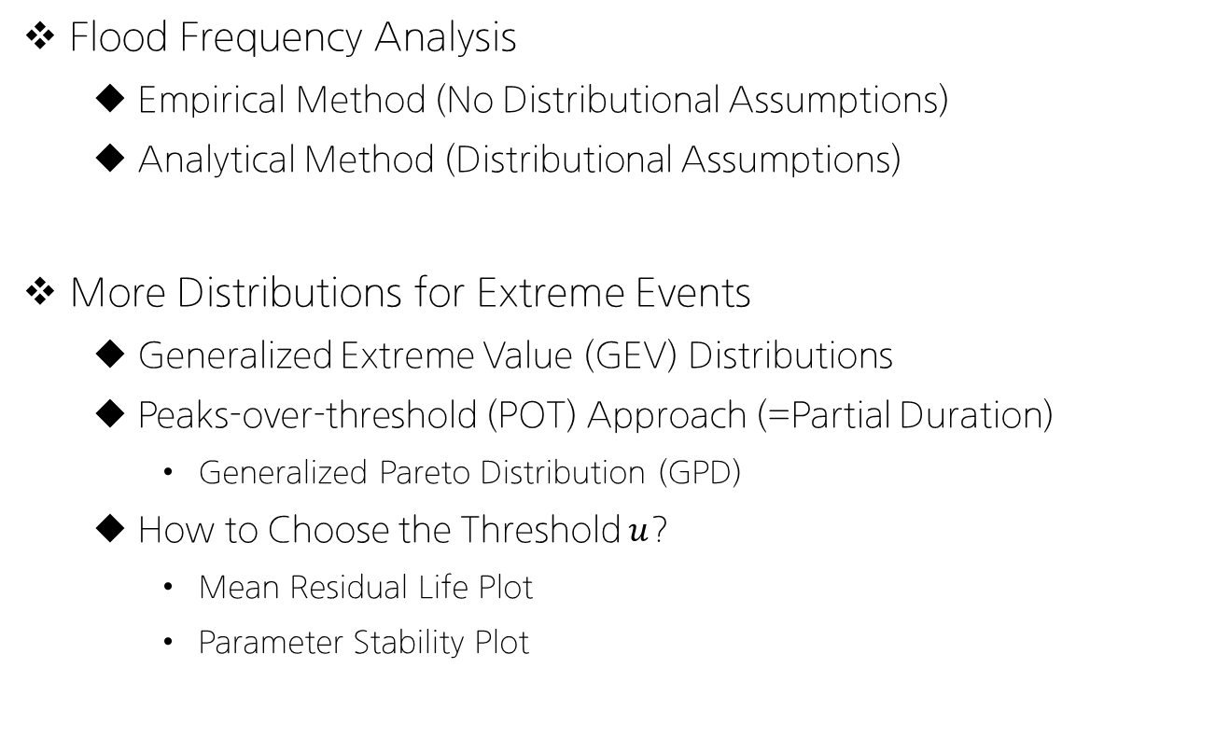
Today’s Topic: Lecture 05
Flood Frequency Analysis
Empirical Method (No Distributional Assumptions)
Analytical Method (Distributional Assumptions)
More Distributions for Extreme Events
Generalized Extreme Value (GEV) Distributions
Peaks-over-threshold (POT) Approach (=Partial Duration)
Generalized Pareto Distribution (GPD)
How to Choose the Threshold $u$?
Mean Residual Life Plot
Parameter Stability Plot

Slide 4
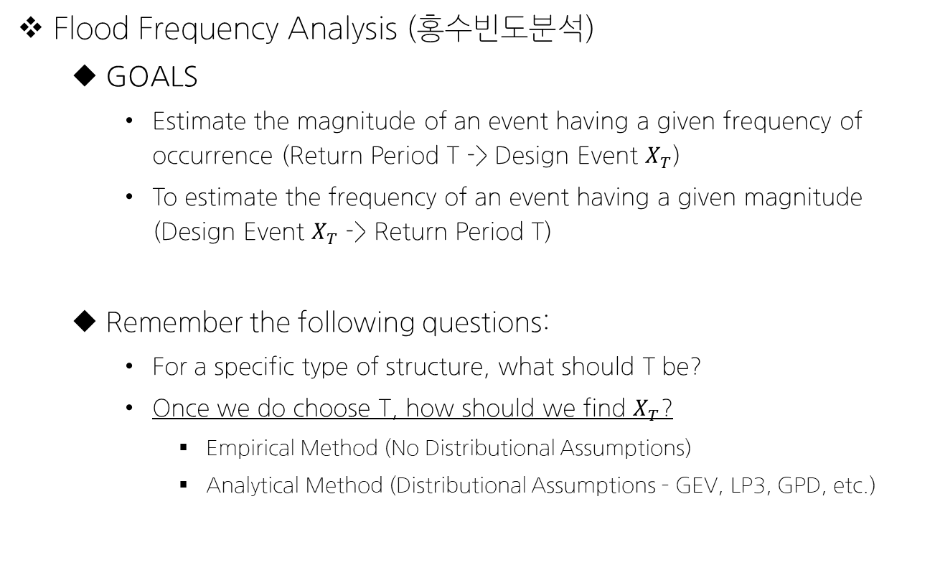
Flood Frequency Analysis (Haan Ch.7)
Flood Frequency Analysis (홍수빈도분석)
GOALS
Estimate the magnitude of an event having a given frequency of occurrence (Return Period T -> Design Event $X_{T}$)
To estimate the frequency of an event having a given magnitude (Design Event $X_{T}$ -> Return Period T)
Remember the following questions:
For a specific type of structure, what should T be?
Once we do choose T, how should we find $X_{T}$?
Empirical Method (No Distributional Assumptions)
Analytical Method (Distributional Assumptions – GEV, LP3, GPD, etc.)

Slide 5
Flood Frequency Analysis (Haan Ch.7)
Two Methods
Empirical Method (No Distributional Assumptions)
Analytical Method (Distributional Assumptions)
Empirical Method includes
Probability Plotting
Probability papers for different distributions: Normal, Lognormal, Exponential, Gamma, GEV, Weibull, etc.

Slide 6
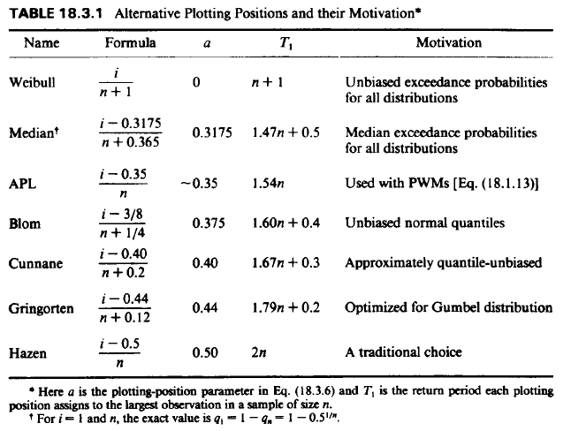
Flood Frequency Analysis: (1) Empirical
Procedures
Rank the data from the smallest (or largest) to the largest (or smallest) value.
Calculate the plotting positions of each values.
Select the type of probability paper to be used.
Plot the observations on the probability paper.

Slide 7
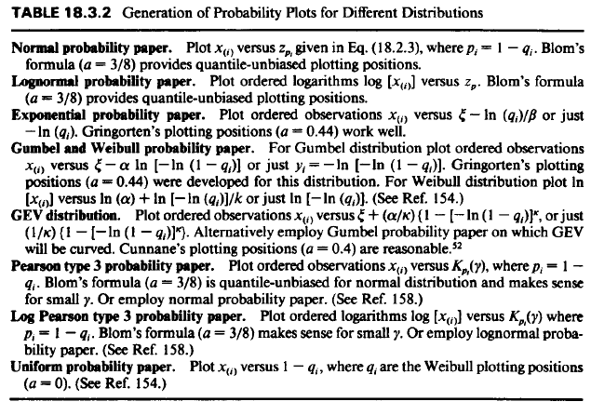
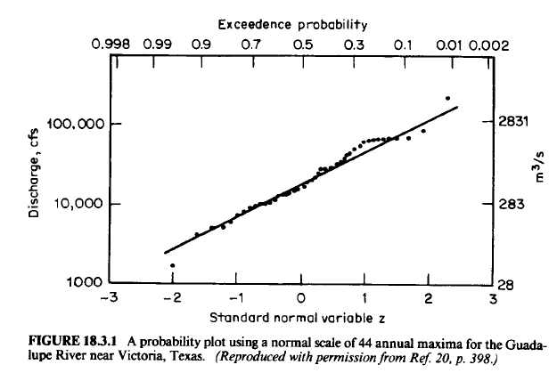

Slide 8
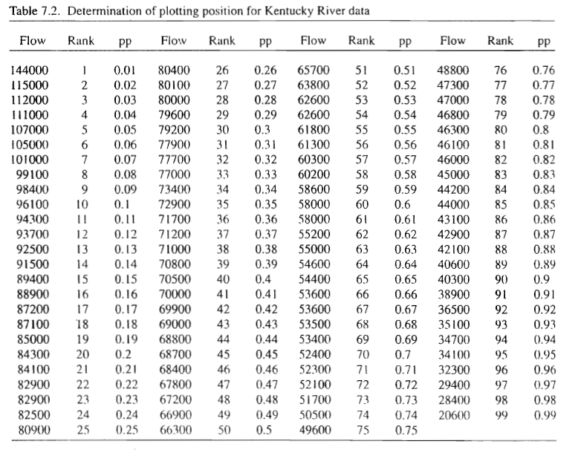
Flood Frequency Analysis: (1) Empirical
Example

Slide 9
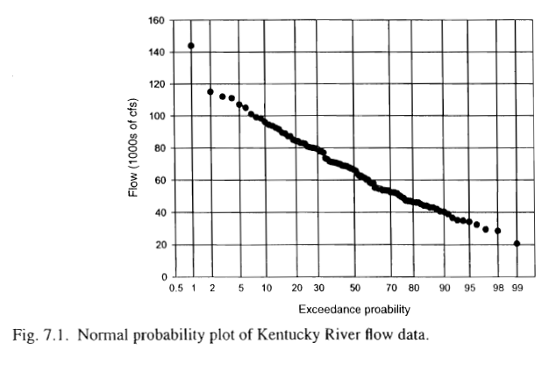
Flood Frequency Analysis: (1) Empirical
Example

Slide 10

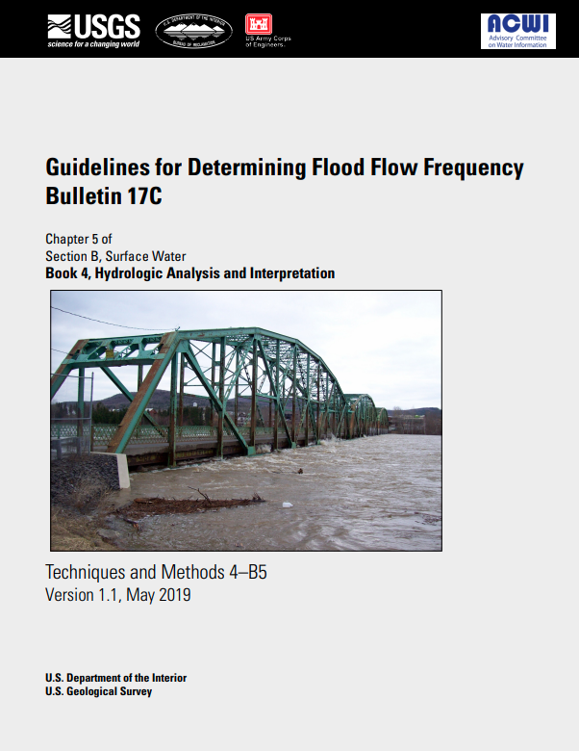
Flood Frequency Analysis: (2) Analytical
국내/미국의 설계홍수량 산정방법 (참고자료)
한국: 홍수량 산정 표준지침 (환경부)
미국: Bulletin 17B/17C (USGS: US Geological Survey)

Slide 11
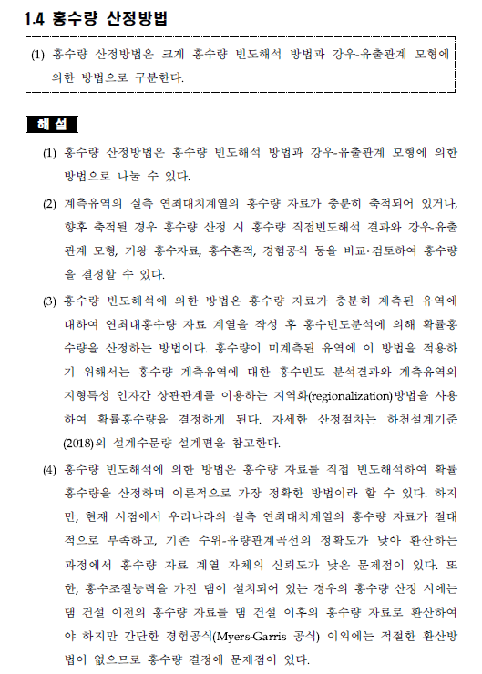
국내 설계홍수량 산정방법

Slide 12
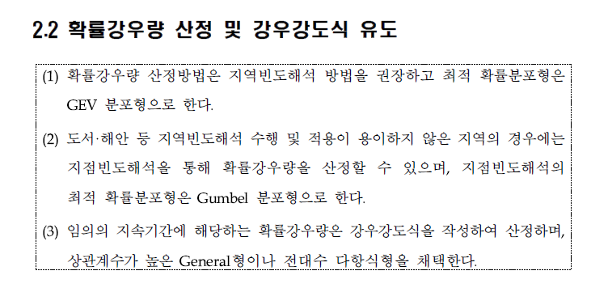
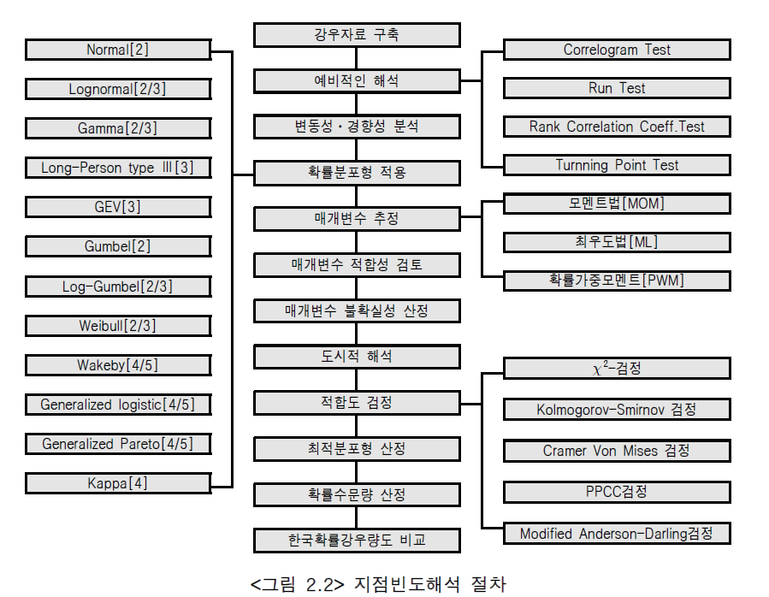

Slide 13
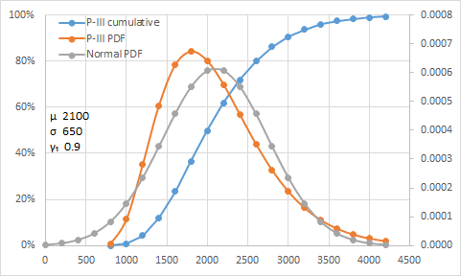
미국 설계홍수량 산정방법
In US, log-Pearson III distribution is recommended for annual maximum floods
Recommended in 1967
“there are no rigorous statistical criteria on which to base a choice of method”
“the range of uncertainty in flood analysis, regardless of the method used, is still large”
Codified in 1976 (Bulletin 17)
Updates: Bulletin 17B (1982) & Bulletin 17C (2018)
Pearson Distributions
A family of distributions (P1-P6) to flexibly model mean, variance, skew, kurtosis

Slide 14
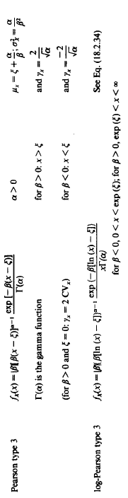
미국 설계홍수량 산정방법
Pearson Distributions
<Def>

Slide 15
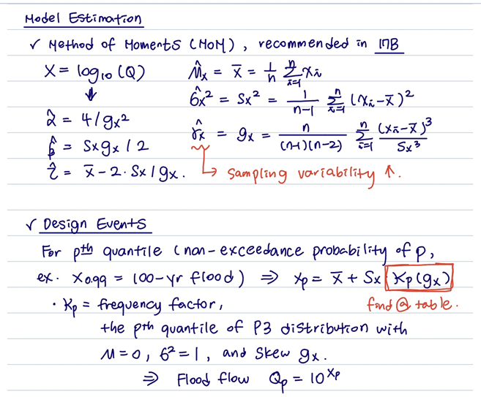

Slide 16
Flood Frequency Analysis: (2) Analytical
Example #1: Normal Distribution

Slide 17
Flood Frequency Analysis: (2) Analytical
Example #2: Lognormal Distribution

Slide 18
Flood Frequency Analysis: (2) Analytical
Example #3: Log Pearson Type III Distribution
Procedures

Slide 19
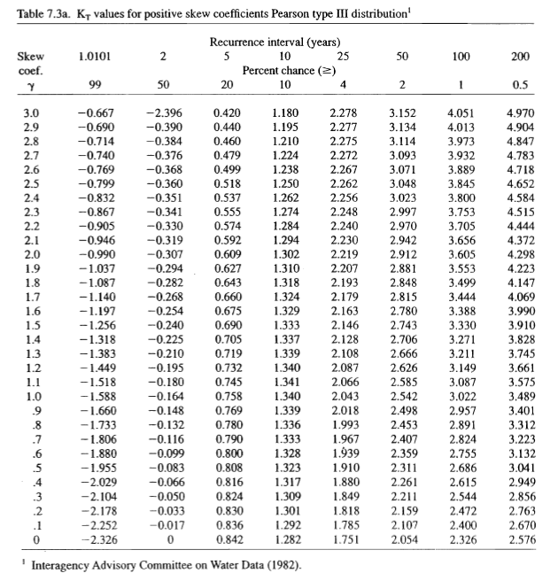

Slide 20
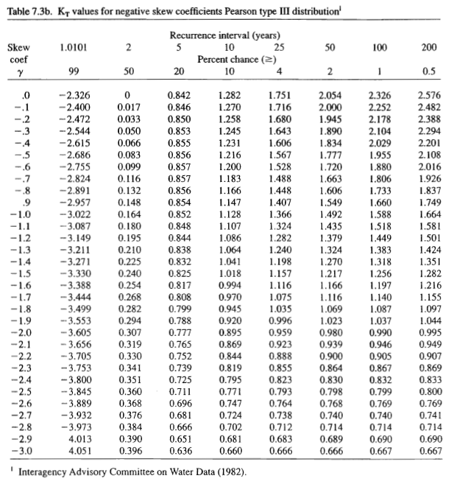

Slide 21
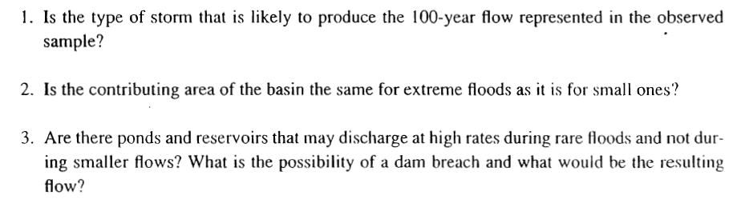
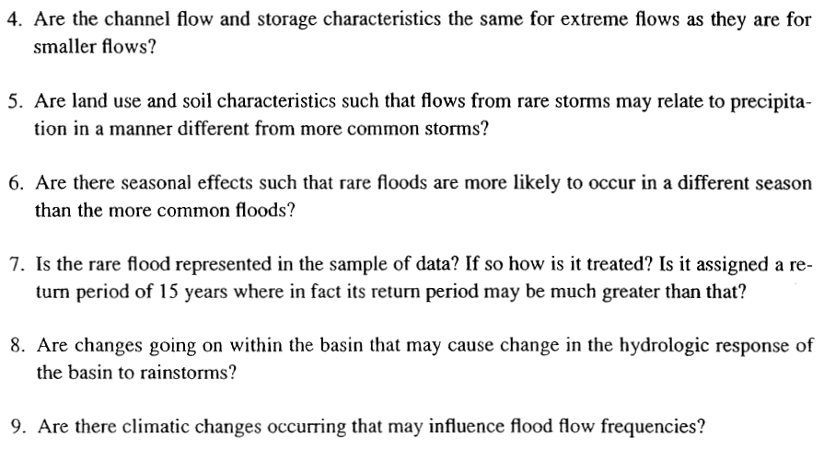
General Discussions (Haan p.178-179)

Slide 22
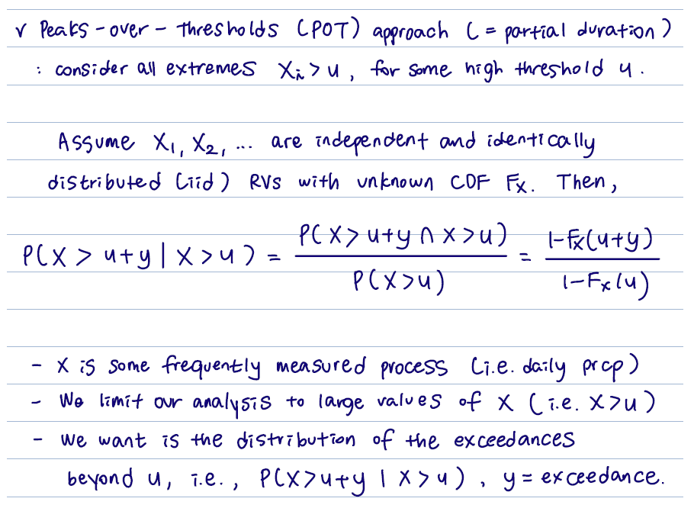
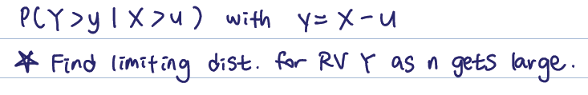

Peaks-Over-Threshold (POT) Models
Peaks-over-Thresholds (POT) approach (=partial duration)
Consider ALL extremes such that $x_{i}>u$, for some high threshold $u$

Slide 23
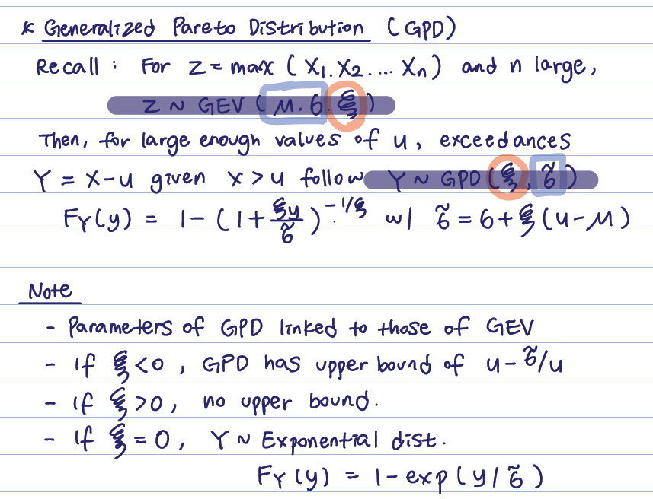

Slide 24
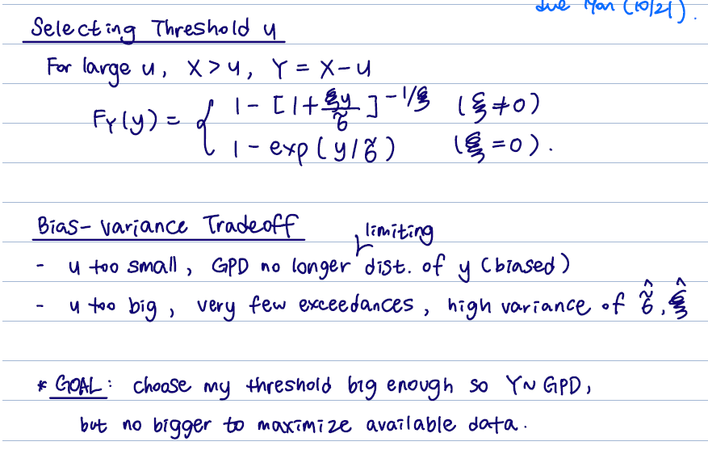
Selecting Threshold u

Slide 25
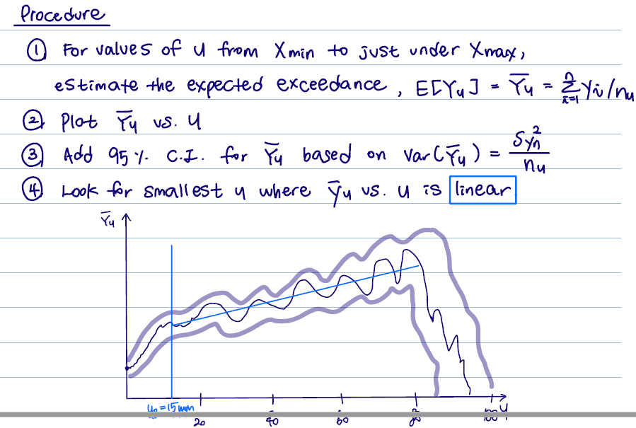
Selecting Threshold u

Slide 26
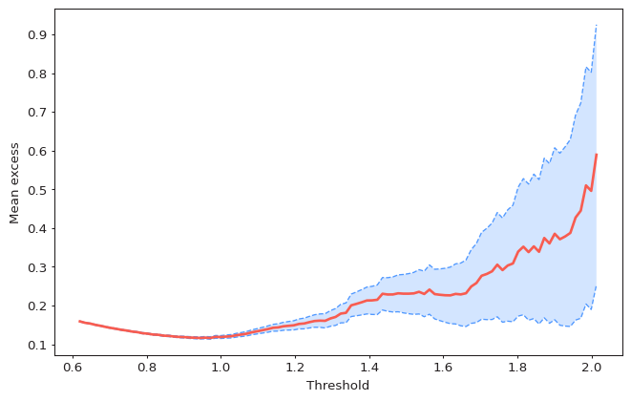
Selecting Threshold u
Example of Mean Residual Life Plot

Slide 27

Parameter Estimation & Declustering
Given $u$, estimate via MLE
Analytical maximization of Log-Likelihood is hard, thus use numerical optimization
Declustering
GPD assumes independent exceedances
However, not usually true in hydrology
3-day intense rainfall
Long lasting floods

Slide 28
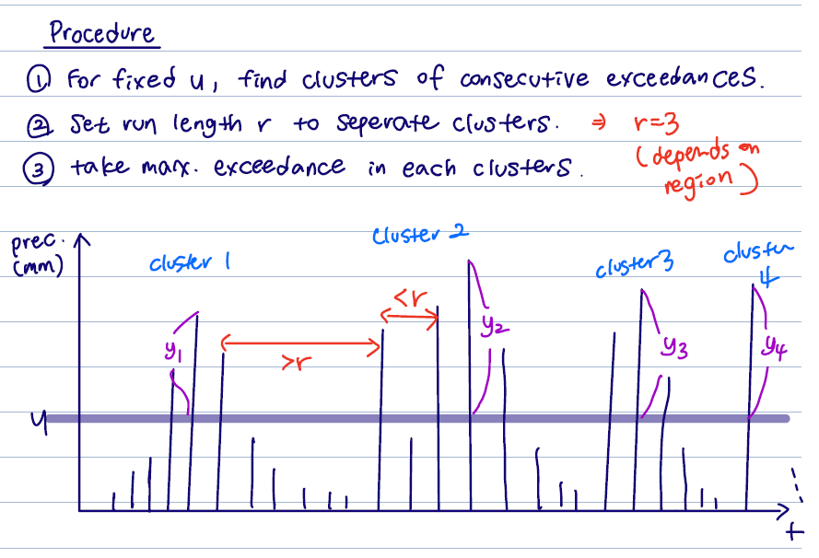
Parameter Estimation & Declustering
Procedures for Declustering
For fixed u, find clusters of consecutive exceedances
Set run length r to separate clusters
Take maximum exceedance in each clusters
Example:

Slide 29
Future Schedule Preview
다음 주 강의 (2022-11-01 화요일 18:30-21:20)
Training with Extreme Event Analysis
Flood Frequency Analysis using Extreme Distributions
Using Peaks-Over-Threshold (POT) Models
Other Assignments
Datacamp Assignments (Assigned through Web)
Introduction to Tidyverse due 10/28
Cleaning Data in R due 11/04
Mid-Term Project Report & Presentation: 11/08 Tue (Dinner?)
TEST Schedule? 11/29 Tue (예정)

Slide 30
Tentative Schedule (~End of Semester)
WEEK | DATE | TOPIC
8 | Oct-25 (Today) | Lec 05: Extreme Event Analysis Part II
9 | Nov-01 | Training with Extreme Event Analysis (Laptop)
10 | Nov-08 | Mid Term Project Presentations (& Dinner)
11 | Nov-15 | Quiz 2 / Lec 06: Introduction to Regression
12 | Nov-22 | Test Preparation (Example Problem Solutions)
13 | Nov-29 | TEST (Closed Book)
14 | Dec-06 | Lec 07: Hydrologic Statistics Frontiers
15 | Dec-13 | Final Project Presentation (Teams of 4, TBA)

