Slide 1
Lecture 06
Regression Analysis &
Introduction to Machine Learning Techniques

Slide 2
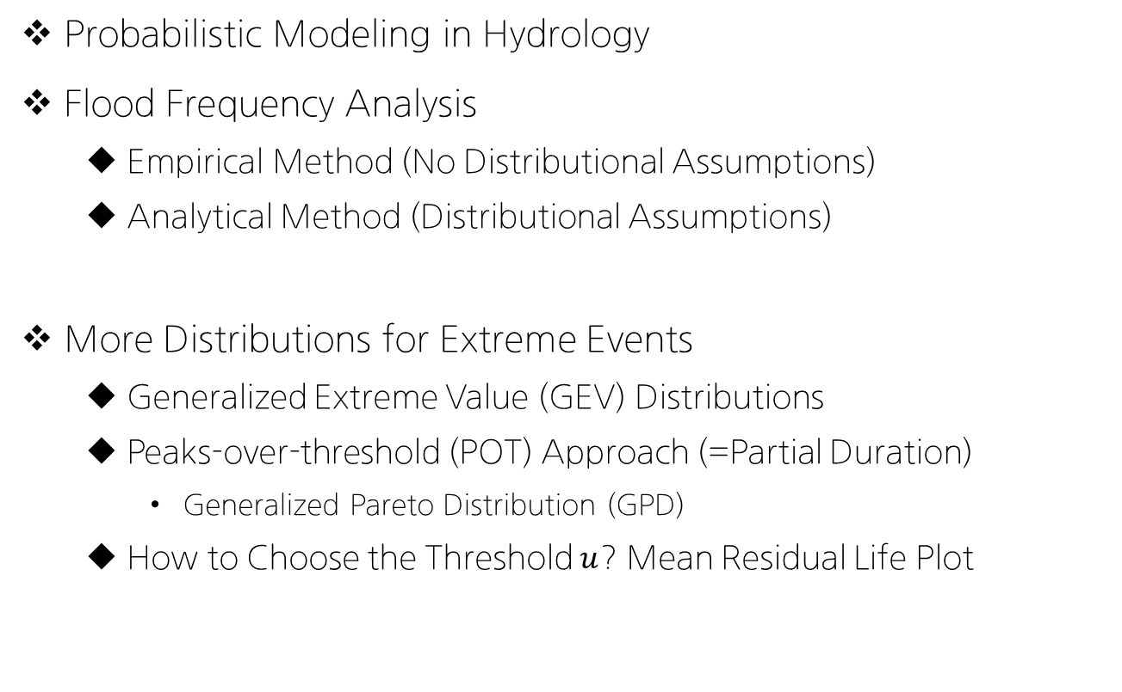
Review on Lecture 5
Probabilistic Modeling in Hydrology
Flood Frequency Analysis
Empirical Method (No Distributional Assumptions)
Analytical Method (Distributional Assumptions)
More Distributions for Extreme Events
Generalized Extreme Value (GEV) Distributions
Peaks-over-threshold (POT) Approach (=Partial Duration)
Generalized Pareto Distribution (GPD)
How to Choose the Threshold $u$? Mean Residual Life Plot

Slide 3
Today’s Topic: Lecture 06
Regression! (회귀분석)
Part I
Simple Linear Regression
Multiple Linear Regression
How to estimate the parameters? OLS/GD
Part II
Logistic Regression: Sigmoid Function (Relationship to ANNs?)
Introduction to Few Machine Learning Techniques

Slide 4
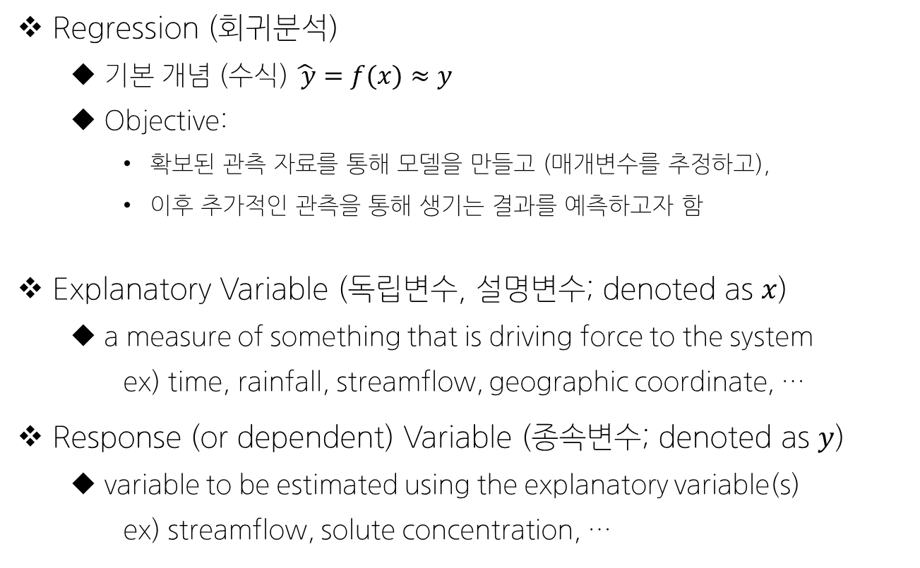
Basic Definitions for Lecture 06
Regression (회귀분석)
기본 개념 (수식) $\hat{ y}=f(x)≈y$
Objective:
확보된 관측 자료를 통해 모델을 만들고 (매개변수를 추정하고),
이후 추가적인 관측을 통해 생기는 결과를 예측하고자 함
Explanatory Variable (독립변수, 설명변수; denoted as $x$)
a measure of something that is driving force to the system
ex) time, rainfall, streamflow, geographic coordinate, …
Response (or dependent) Variable (종속변수; denoted as $y$)
variable to be estimated using the explanatory variable(s)
ex) streamflow, solute concentration, …

Slide 5
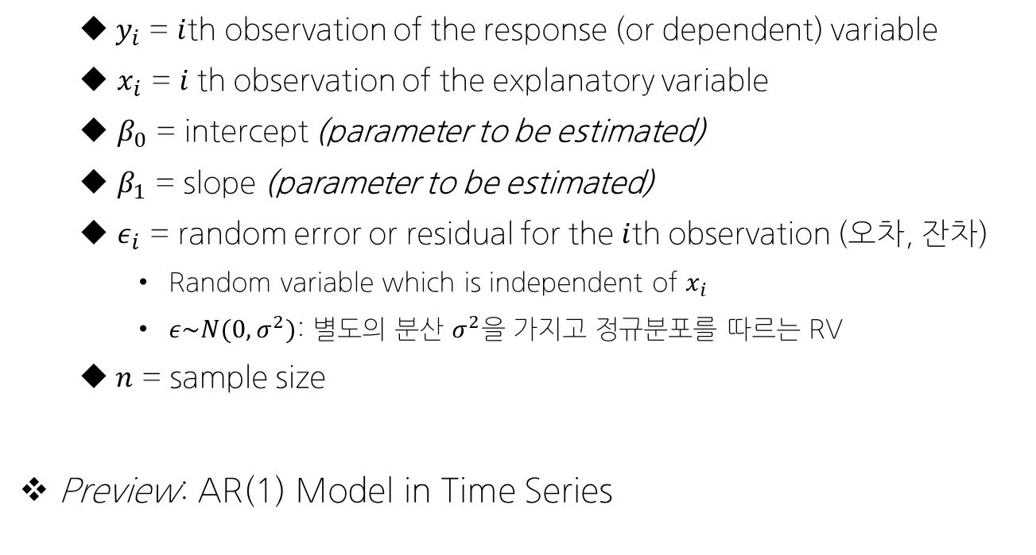

Simple Linear Regression Model
$$y_{i}=β_{0}+β_{1}x_{i}+ε_{i} i=1, 2, …,n$$
$y_{i}$ = $i$th observation of the response (or dependent) variable
$x_{i}$ = $i$th observation of the explanatory variable
$β_{0}$ = intercept (parameter to be estimated)
$β_{1}$ = slope (parameter to be estimated)
$ε_{i}$ = random error or residual for the $i$th observation (오차, 잔차)
Random variable which is independent of $x_{i}$
$ε\sim N(0,σ^{2})$: 별도의 분산 $σ^{2}$을 가지고 정규분포를 따르는 RV
$n$ = sample size
Preview: AR(1) Model in Time Series
$$y_{t}=μ+φ_{1}(y_{t−1}−μ)+ε_{t}$$

Slide 6
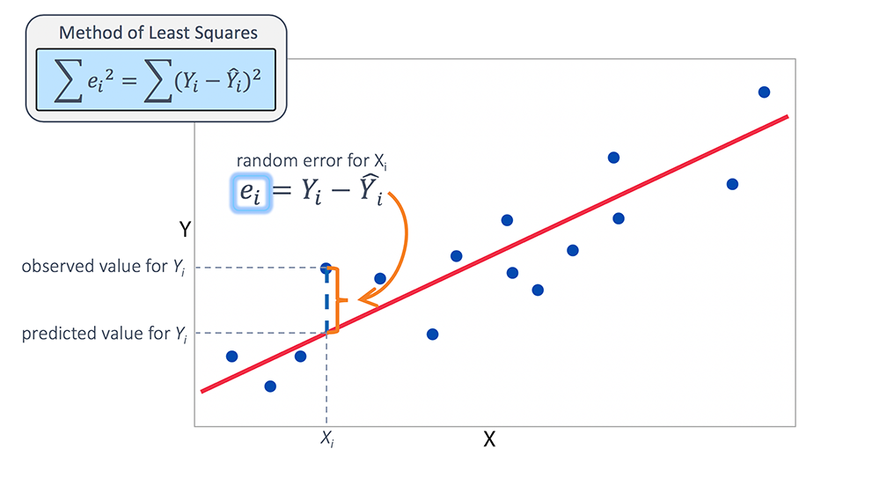
Simple Linear Regression Model

Slide 7
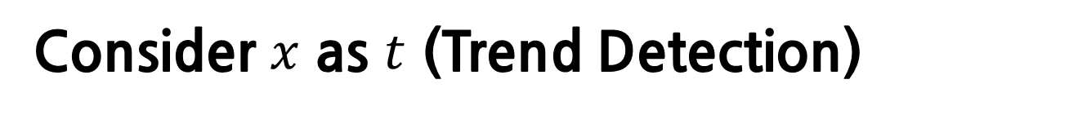
Consider $x$ as $t$ (Trend Detection)
Are conditions changing?
Here, conditions refer to mean, variance, …
Possible types of change: linear, monotonic, stepwise, expon
Is there a linear trend in the mean over time?
$$y_{t}=β_{0}+β_{1}t+ε_{t} ε_{t}\sim N(0, σ^{2})$$

Slide 8

Consider $x$ as $t$ (Trend Detection)
$$y_{t}=β_{0}+β_{1}t+ε_{t} ε_{t}\sim N(0, σ^{2})$$
Assumptions
t (time) is deterministic
parameters $β_{0}$ and $β_{1}$ are fixed & unknown
$ε_{t}$ is stochastic (RV)
$y_{t}$ is stochastic

Slide 9







Consider $x$ as $t$ (Trend Detection)
Estimation of Parameters (via MLE)
$$L\left(β_{0},β_{1},σ^{2}\right)=\prod_{i=1}^{n}{f(y_{t}|β_{0},β_{1},σ^{2},t)}$$
By setting
We get
$$\frac{∂l}{∂β_{0}}=0$$
$$\frac{∂l}{∂β_{1}}=0$$
$$\frac{∂l}{∂σ^{2}}=0$$
$$\hat{β_{0}}$$
$$\hat{β_{1}}$$
$$\hat{σ^{2}}$$

Slide 10

Consider $x$ as $t$ (Trend Detection)
By substituting $y_{t}=β_{0}+β_{1}t+ε_{t}$ into $\hat{β_{1}}$ expression, We get

Slide 11
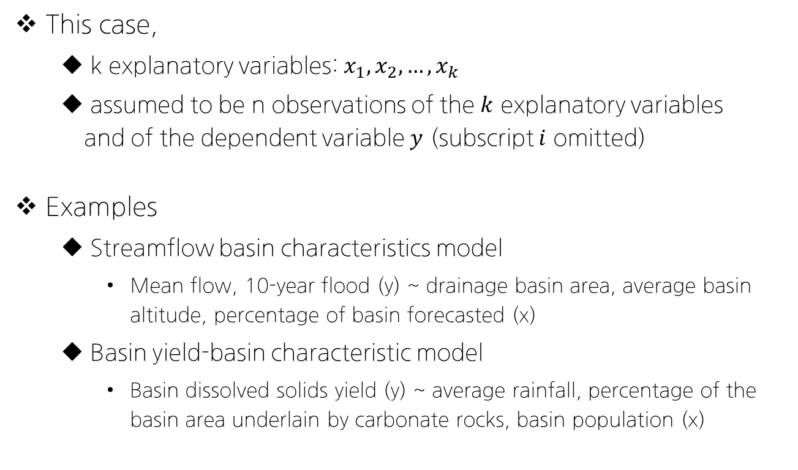
Multiple Linear Regression Model
$$y=β_{0}+β_{1}x_{1}+β_{2}x_{2}+…+β_{k}x_{k}+ε i=1, 2, …,n$$
This case,
k explanatory variables: $x_{1}, x_{2},…, x_{k}$
assumed to be n observations of the $k$ explanatory variables and of the dependent variable $y$ (subscript $i$ omitted)
Examples
Streamflow basin characteristics model
Mean flow, 10-year flood (y) ~ drainage basin area, average basin altitude, percentage of basin forecasted (x)
Basin yield-basin characteristic model
Basin dissolved solids yield (y) ~ average rainfall, percentage of the basin area underlain by carbonate rocks, basin population (x)

Slide 12

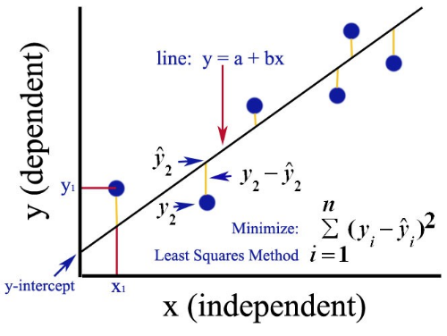
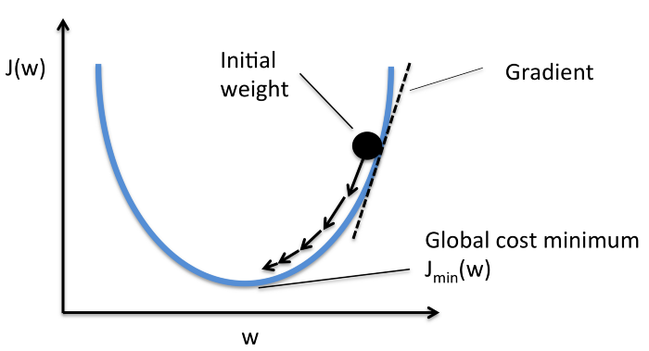

Determining the Model Parameters
Estimation of parameters of regression models $(β)$
Ordinary Least Square (OLS): Minimize
Non-iterative
Gradient Descent (Optimizer, GD)
Iterative, Learning rate $α$ should be determined

Slide 13
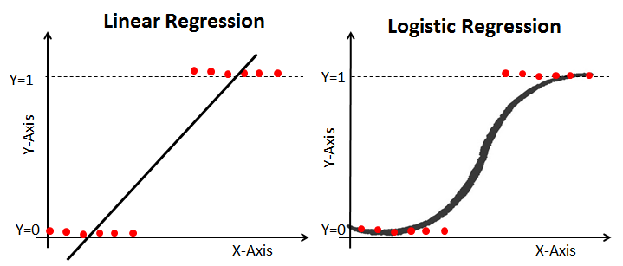
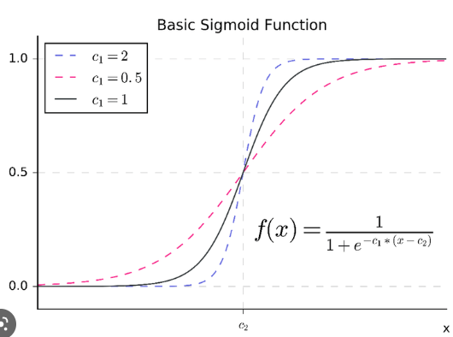

Part II: Logistic Regression
Definition: Statistical analysis method to predict a binary outcome, based on prior observations of a data set
Logistic Function (Sigmoid Function)
$$F\left(X\right)=\frac{1}{1+e^{−x}}=\frac{e^{x}}{e^{x}+1}$$

Slide 14
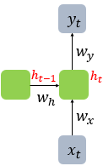
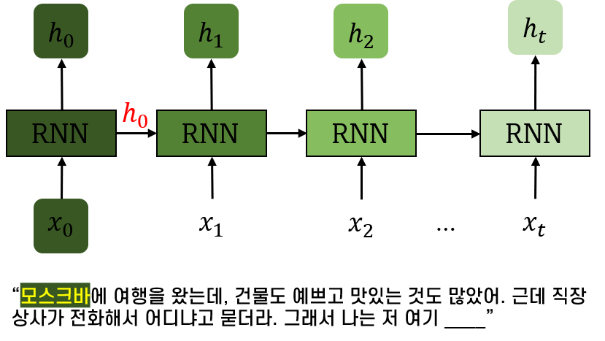
Few Machine Learning Techniques
Introducing today:
Artificial Neural Network (ANN)
known to mimic highly non-linear & complex systems well
any information about the sequential order of the inputs are lost
Deep Neural Network (DNN)
Additional number of hidden layers between input & output layers
Recurrent Neural Network (RNN)
Long-term dependency (Only 10 or less time steps)
+
-
+
-

Slide 15
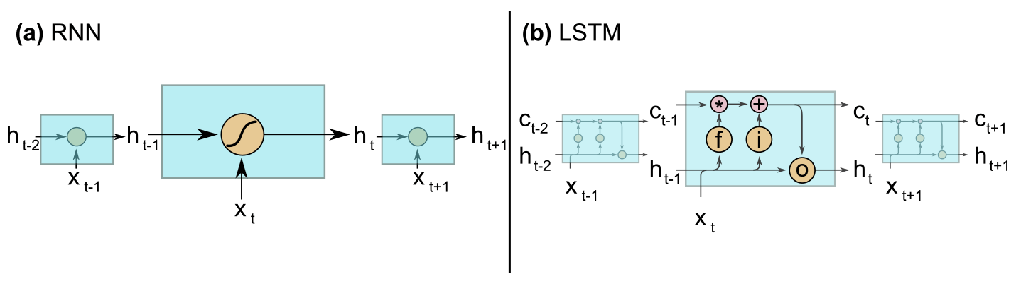
Few Machine Learning Techniques
Long-Short Term Memory (LSTM)
overcomes the problem of the traditional RNN of learning long-term dependencies representing hydrological catchments
LSTM compared to RNNs
Additional cell state (or cell memory) where information are stored
Forget/Input/Output gates (ⓕ ⓘ ⓞ) that control the information flow within the LSTM cell
+

Slide 16
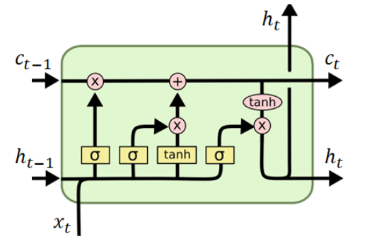
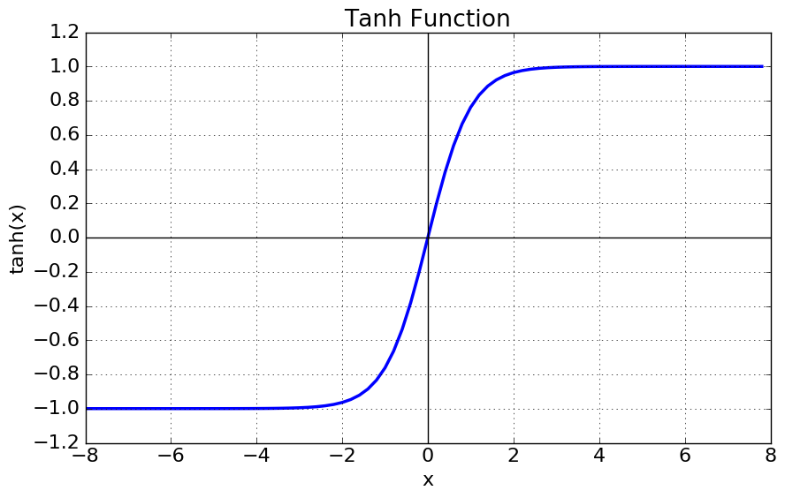
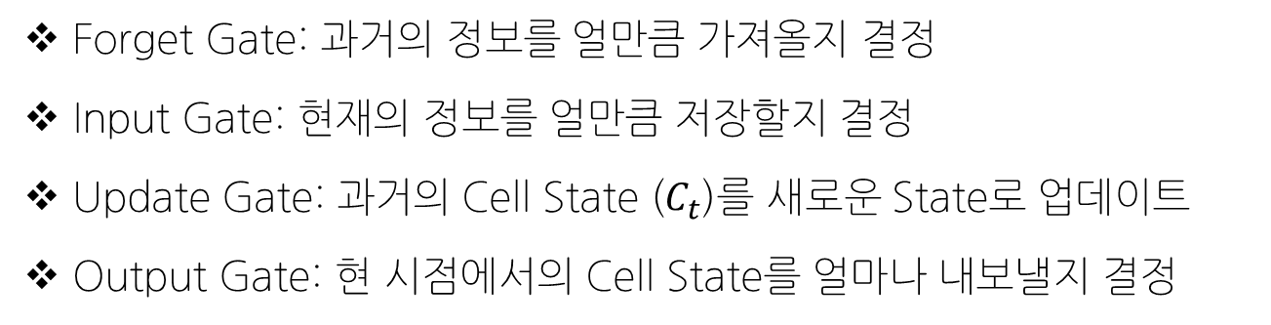
Few Machine Learning Techniques
Forget Gate: 과거의 정보를 얼만큼 가져올지 결정
Input Gate: 현재의 정보를 얼만큼 저장할지 결정
Update Gate: 과거의 Cell State ($C_{t}$)를 새로운 State로 업데이트
Output Gate: 현 시점에서의 Cell State를 얼마나 내보낼지 결정

Slide 17
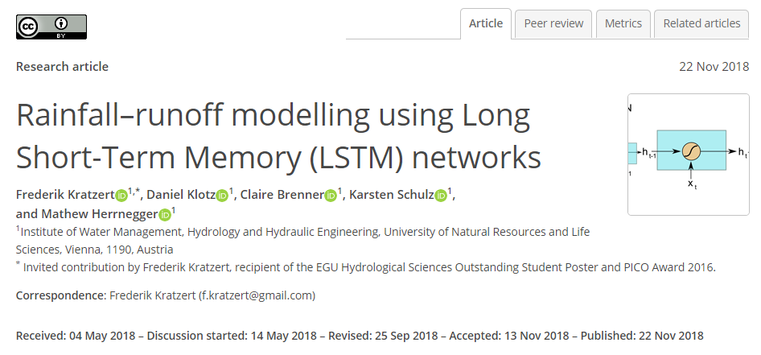
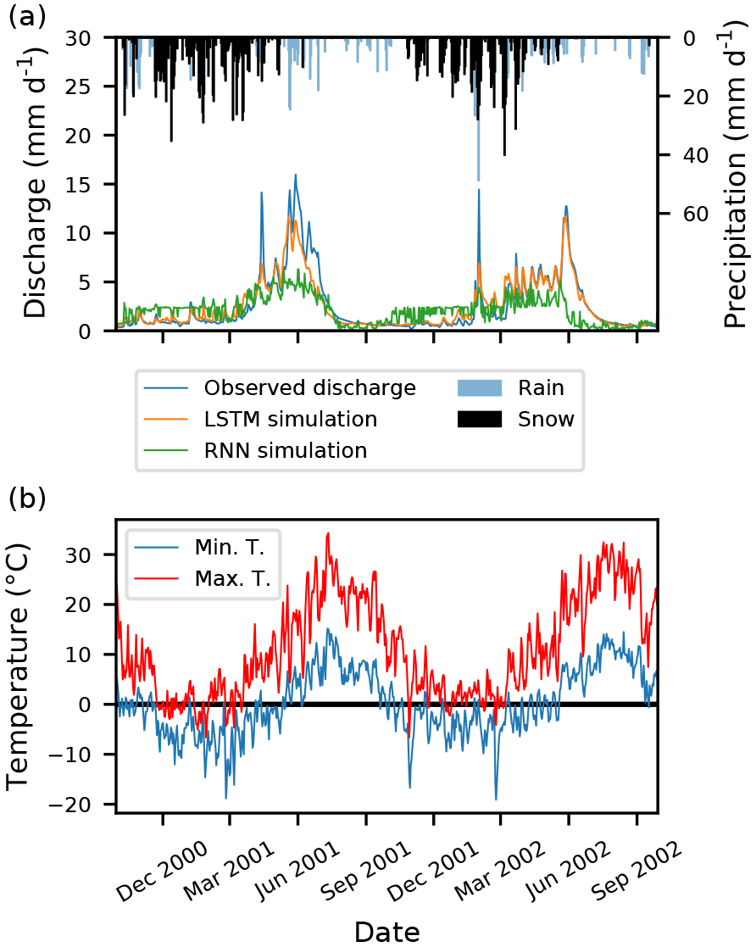
Examples of LSTM in Hydrology

Slide 18
Future Schedule Preview
다음 주 강의 (2022-11-22 화요일 18:30-21:20)
Final Exam Preparation (Optional)
Multiple Choice, Short Answers, Long Answers/Problem Solving
Keywords for the Test
Conditional probability, Bayesian theorem, Extreme value analysis, MLE, Linear regression, …
Future Schedule (~End of Semester)
11/29: TEST
12/06 (Last Lecture) Lecture 07: Hydrologic Statistical Frontiers- Introduction & Examples
12/13: Final Project Presentation (Details TBA by 12/01)

Slide 19
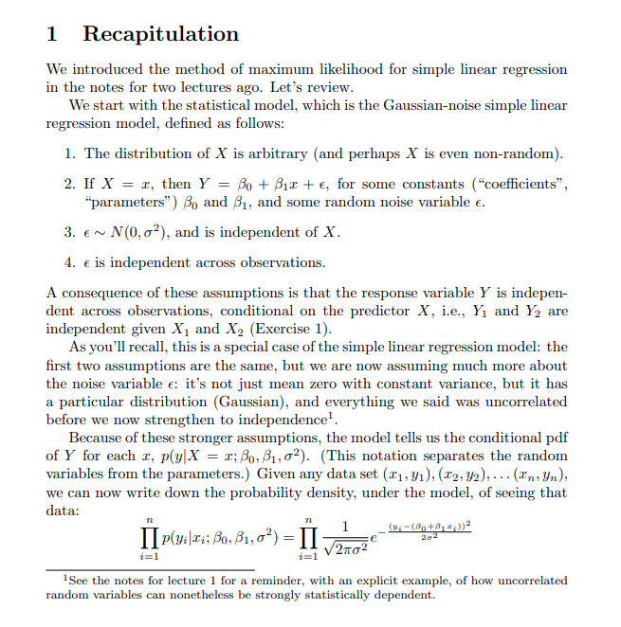
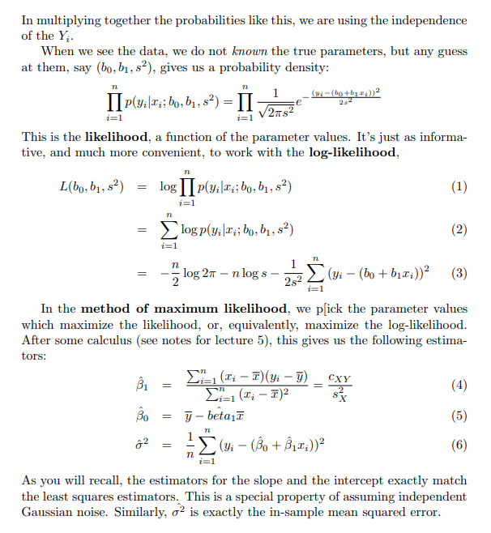
Slide 9 Proof

Slide 20
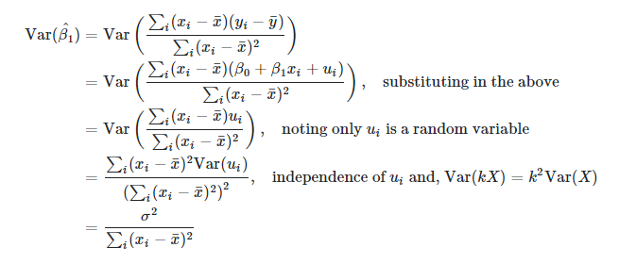
Slide 10 Proof

