Slide 1
Lecture 07
Hydrologic Forecasting

Slide 2
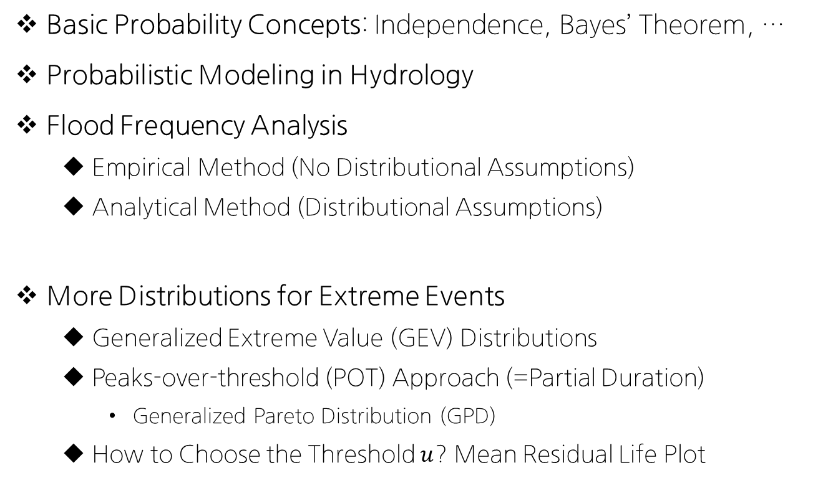
Review on Previous Lectures
Basic Probability Concepts: Independence, Bayes’ Theorem, …
Probabilistic Modeling in Hydrology
Flood Frequency Analysis
Empirical Method (No Distributional Assumptions)
Analytical Method (Distributional Assumptions)
More Distributions for Extreme Events
Generalized Extreme Value (GEV) Distributions
Peaks-over-threshold (POT) Approach (=Partial Duration)
Generalized Pareto Distribution (GPD)
How to Choose the Threshold $u$? Mean Residual Life Plot

Slide 3
Today’s Topic: Hydrological Forecasting
Time Series Analysis
Structure of Time Series Models -> Time Series Modeling
Autoregressive Moving Average (ARMA) models
Introduction to the “Hurst Phenomenon” (Long-term dependency)
Why Important?
시간에 흐름에 따라 발생하는 순차적인 데이터를 예측하는 대표적인 모수적 (parametric) 예측 방법이기 때문
수문분야 외에도, 경제학, 주식, AI 등에서도 자주 사용되는 기법
Ensemble Streamflow Prediction (ESP)
Application in Research: SNU-CCAWR

Slide 4
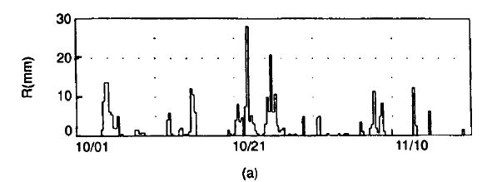
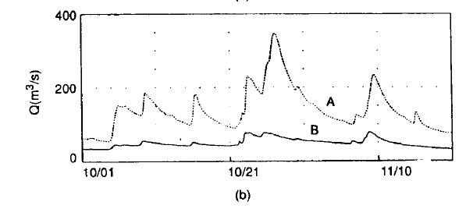
Time Series Analysis: (1) Structure
Single vs Multiple (Univariate vs. Multivariate)
One or Multiple hydrologic variable at a given site (or at multiple sites)
Uncorrelated vs. Correlated
Independent vs. Dependent (Serially/Auto-correlated)
Autocorrelation vs. Cross-correlation: Next Slide!
Intermittent (a) vs. Non-intermittent (b)

Slide 5
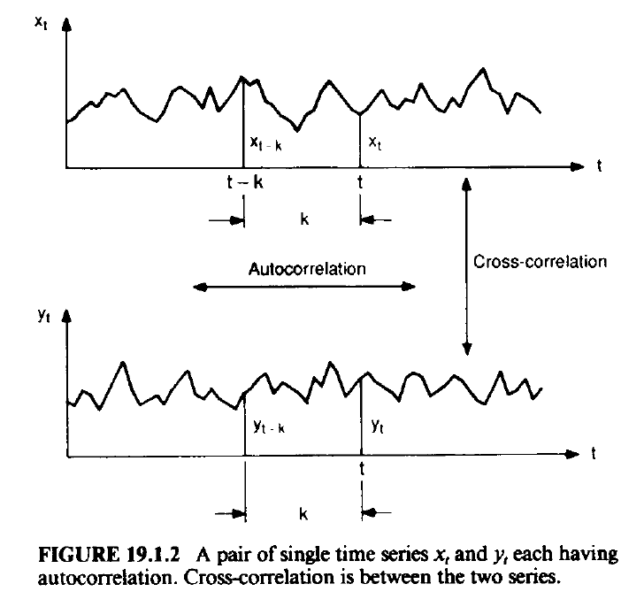
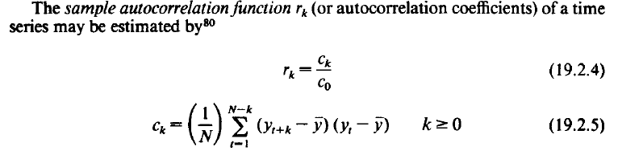

Time Series Analysis: (1) Structure
Autocorrelation vs. Cross-correlation
*Autocorrelation Coefficient (lag k)
*Cross-correlation between X & Y
(Correlation Coefficient)
$$ρ_{xy}=\frac{Cov(x,y)}{σ_{x}σ_{y}}$$

Slide 6
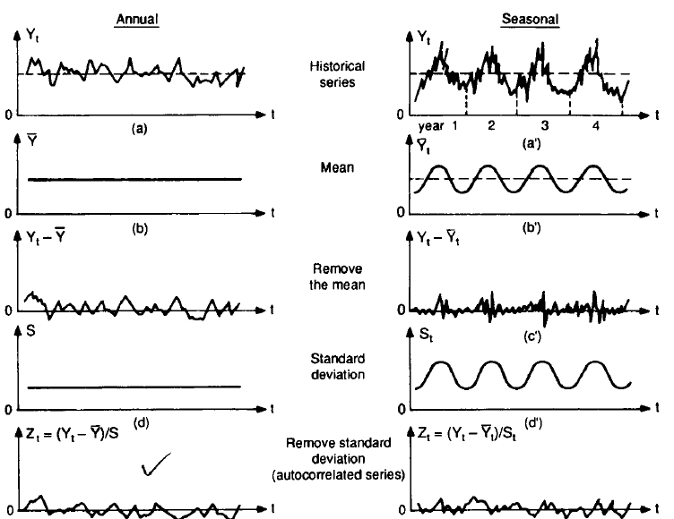

Time Series Analysis: (2) Partitioning
Decomposition of Time Series
$$Zt=r1Zt−1+et$$

Slide 7
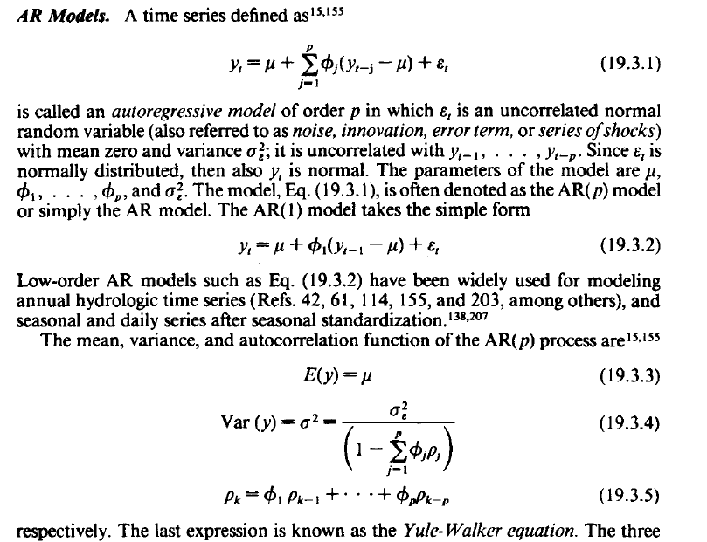
Time Series Analysis: (3) Modeling
Autoregressive (AR) Models

Slide 8
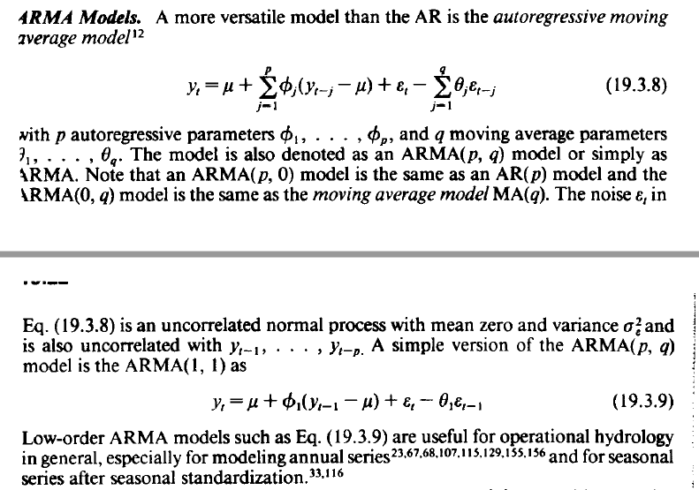
Time Series Analysis: (3) Modeling
Autoregressive Moving Average (ARMA) Models

Slide 9
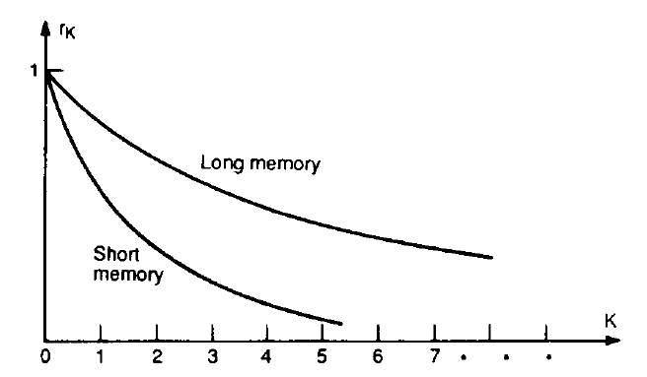
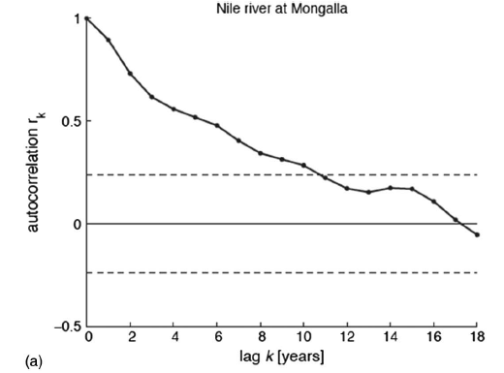
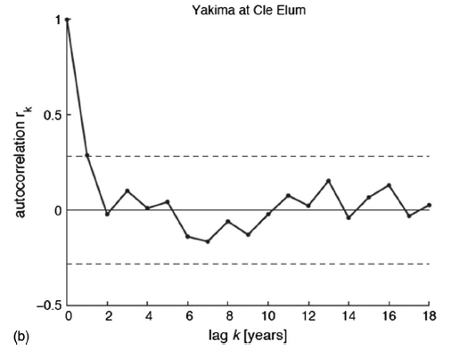
Hurst Phenomenon
*Autocorrelation Coefficient (lag k)
Long vs. Short Memory
Models for Long-term Variabilities
Fractional Gaussian Noise (FGN)
Long Memory Models: FARMA Model Fractionally differenced Autoregressive Integrated Moving Average Models

Slide 10
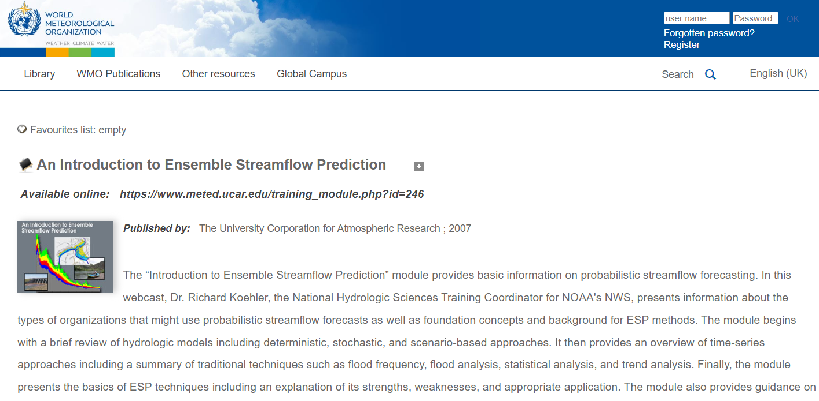
Ensemble Streamflow Prediction (ESP)
Source: https://library.wmo.int/index.php?lvl=notice_display&id=21098#.Y4gCenbP2Ul

Slide 11
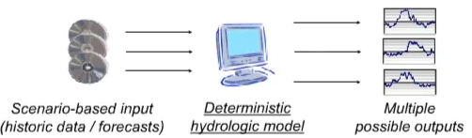
ESP: Introduction
Hydrologic Models: Simulate & forecast Streamflow
Types of Hydrologic Models
Accounting-based: Budget approach
Physics, Empirical, Statistical-based Models
Always results in Model Error & Forecast Uncertainty
Classified as either deterministic or stochastic (probabilistic)
Deterministic: Always same result for a given input
Stochastic: Multiple possible outcomes (ex. Markov Chain models)
Scenario-based deterministic model

Slide 12
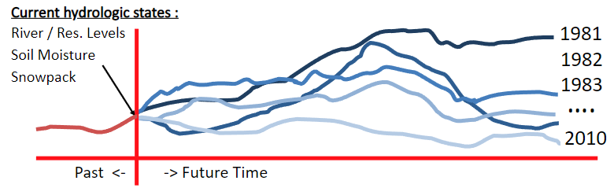
Ensemble Streamflow Prediction
ESP: a “scenario-based” approach
Captures current model state conditions (hydrologic states)
Input: Historic or forecast climate data (ex. Daily precipitation, Minimum/maximum daily air temperature, wind speed, etc.)
Output: future streamflow & related probabilities (ex. Storage, discharge, runoff, exceedance probability, likelihoods, etc.)
NOT a stochastic model
Only model forcing uncertainty is captured in the probabilities

Slide 13
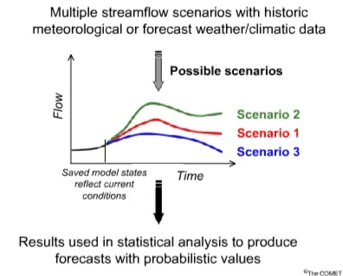
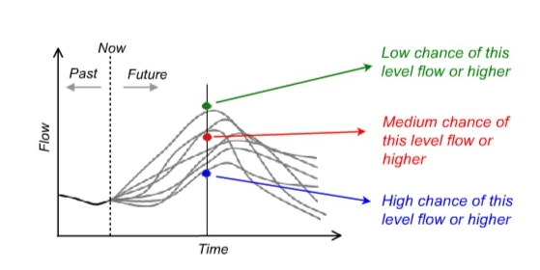
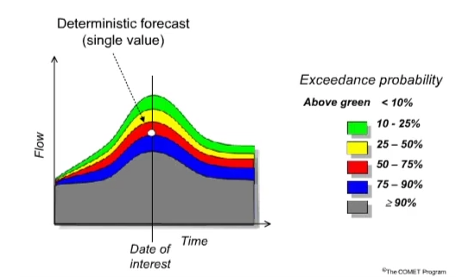
ESP Techniques

Slide 14
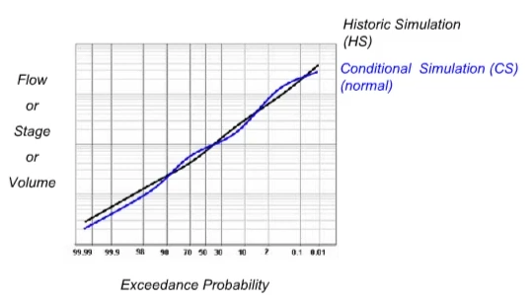
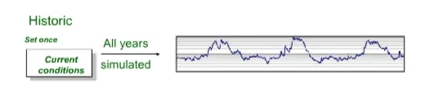
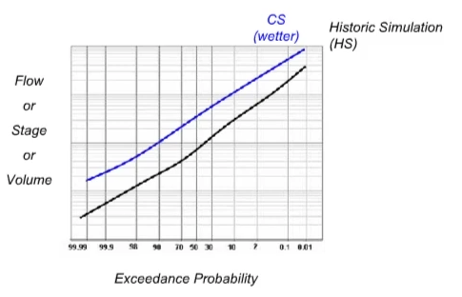
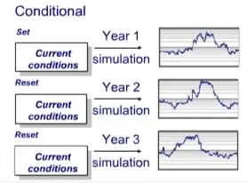
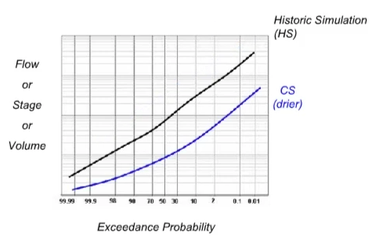
ESP Simulation
Historical simulation
Conditional simulation

Slide 15
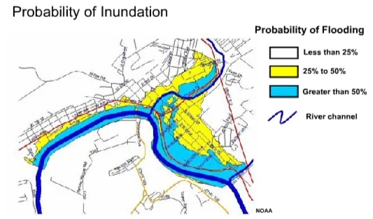
ESP Results (Probabilistic Analysis)
ESP Products for probabilistic analysis include…
Trace plots, Expected value plot, Probability plot, Exceedance plot
Probabilistic Flood Mapping (with GIS tools)

Slide 16

Applications in Research
Seoul National University-CCAWR Research Group (Climate Change Adaptation in Water Resources) http://ccawr.snu.ac.kr/

Slide 17
Future Schedule Preview
다음 주 강의 (2022-12-13 화요일 18:30-21:20)
Final Project Presentation!
Future Schedule (~End of Semester)
12/13: Final Project Presentation (Presentation Due)
12/20: Final Project Report Due (By Email)

