Slide 1
Lecture 05
Data-fitting, Evolutionary Optimization Models
Notes:
https://snu-ac-kr.zoom.us/j/84027051484?pwd=aU5OZitOKzUyRW9DQ0s0TkpIMSs4UT09

Slide 2
Review on Lecture 03 & 04
Engineering Economics: Time Streams of Economic Benefits & Costs
Solving Nonlinear Optimization Models with Calculus
Solution Using Calculus
Solution Using Hill Climbing
Solution Using the Lagrange Multiplier
Concepts of Dynamic Programming Models (DP)
Examples of Problem Solving with DP Models
Concepts of Linear Programming Models (LP)
Real-world Applications of Traditional Optimization Models

Slide 3
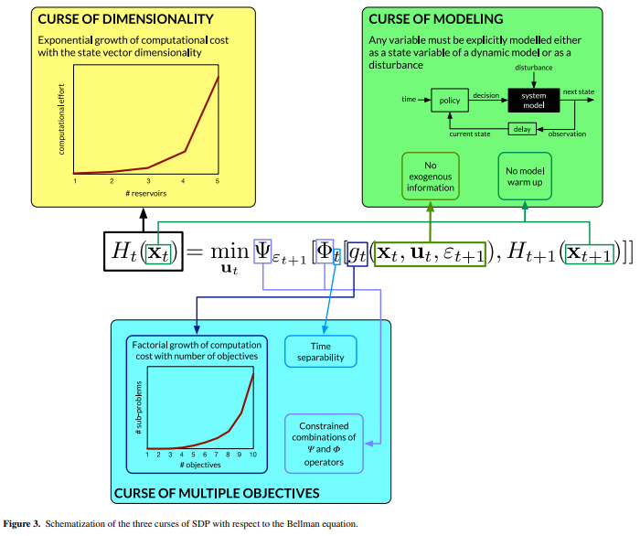
Curses of Stochastic Dynamic Programming

Slide 4
Before Lecture 05
Acronyms (약어)/Keywords in Lecture 05
EA: Evolutionary Algorithms (진화 알고리즘)
GA: Genetic Algorithms (유전 알고리즘)
GP/EP: Genetic Programming/Evolutionary Programming (유전 프로그래밍/진화 프로그래밍)
ANN: Artificial Neural Networks (인공 신경망)
DE: Differential Evolutions (차분 진화 알고리즘)
향후 주요 일정
Datacamp #2 due Apr-19
Assignment #2 due Apr-26 (23:59까지 메일로 제출)
보령댐 견학 일정: 4/25 월 (확정, 공문 공유 완료) (No class on Apr-26 Tue)
Term Project A due May-03 (PPT Presentation, prepare one color copy for the instructor)
Quiz #2 on May-03

Slide 5
Today’s Topic: Data-fitting, Evolutionary Optimization Models
EA: Evolutionary Algorithms (진화 알고리즘)
GA: Genetic Algorithms (유전 알고리즘)
GP/EP: Genetic Programming/Evolutionary Programming (유전 프로그래밍/진화 프로그래밍)
ANN: Artificial Neural Networks (인공 신경망)
DE: Differential Evolutions (차분 진화 알고리즘)
EMODPS: Multi-objective Direct Policy Search (진화적 다목적 직접 정책 검색법)

Slide 6
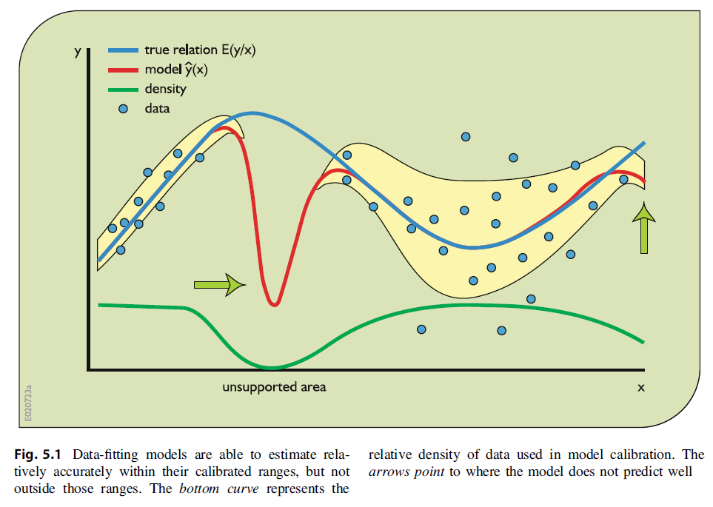

Examples of Data-driven Models: Regression
Data-fitting or Statistical Models (ex. Regression)
Converts observed inputs (rainfall, inflow, etc.) to observed outputs (runoff, release, etc.) using mathematical equations
Depend on observed inputs and observed outputs for the estimation of the values of their parameters (a, b, c, etc.)
$$y=a+b_{1}\left(x_{1}\right)+{b_{2}\left(x_{2}\right)}^{C}$$
관측값 (x,y)으로부터
그에 맞는 매개변수값 (a,b)를
찾는 방법

Slide 7
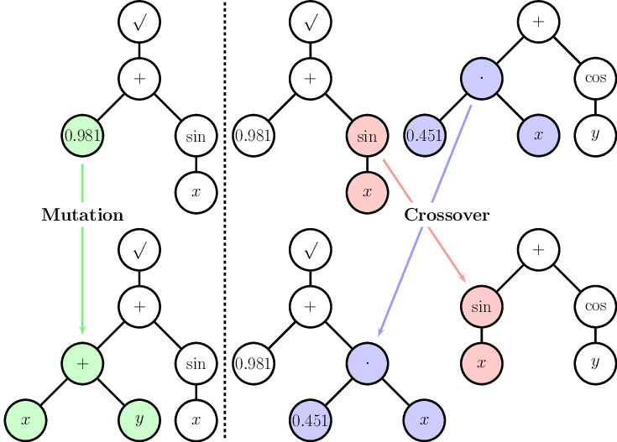
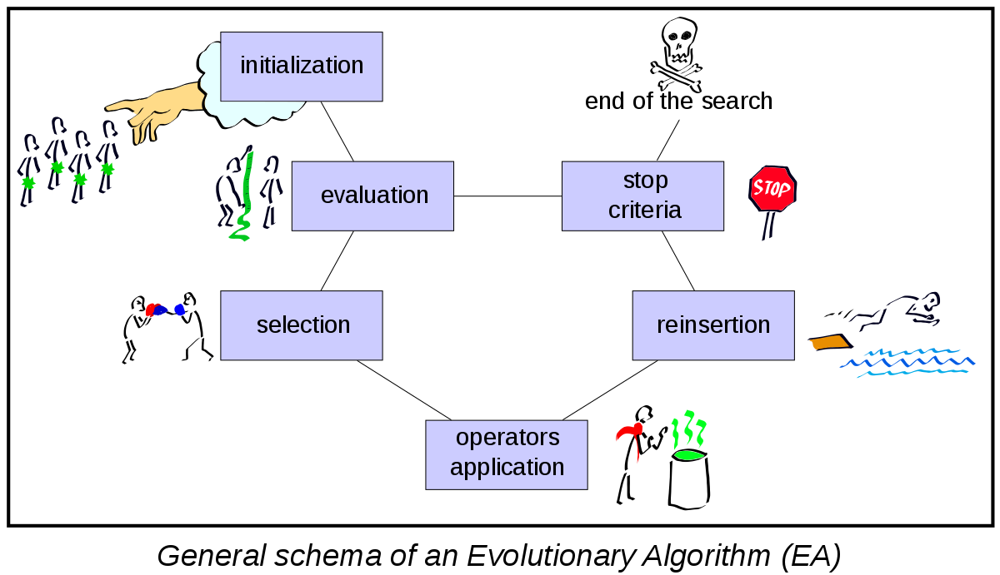
Examples of Data-driven Models
Many of them based on biological principles & concepts
Some examples…
Evolutionary Algorithms (EA)
Genetic/evolutionary Programming (GP/EP)
Evolutionary Strategy (ES), ANN, etc.

Slide 8
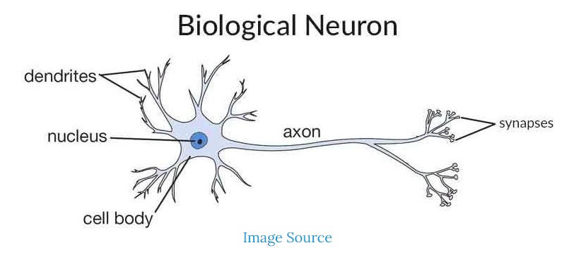
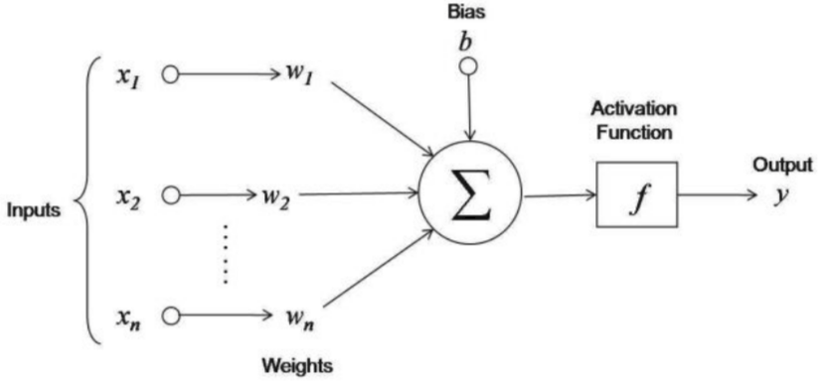
Artificial Neural Network (ANN) Models
Concepts behind the ANN Models
Information processing model inspired by the biological neuron system
Distributed, adaptive, generally nonlinear networks built from many different processing elements
Just a more complex type of regression or statistical (black-box) model

Slide 9
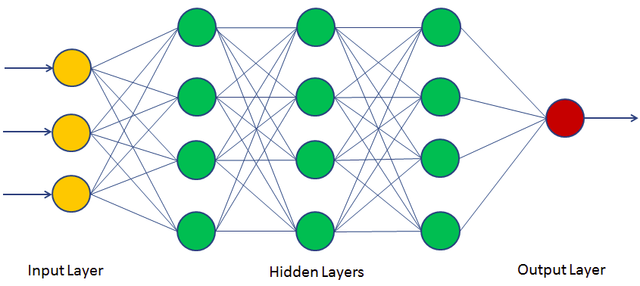
Artificial Neural Network (ANN) Models
Components of ANN models
Input layer: nodes that receive an input from the external environment (send their weighted values to hidden layer nodes)
Hidden layer: nodes that typically receive the transferred weighted inputs from the input/previous hidden layer
Output layer: nodes that receive the hidden layer output and send it to the user

Slide 10
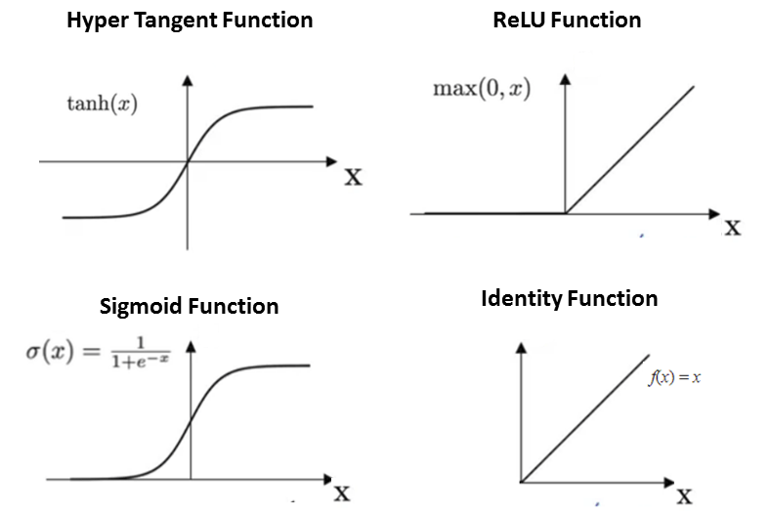
Artificial Neural Network (ANN) Models
Types of ANN Models
Feedforward ANN- NOT recursive, signals travel in ONLY ONE direction towards the output layer
Feedback ANN (=Recurrent Neural Networks, RNN)- recursive, past inputs can be fed back into with current inputs
Activation Functions
Identity function
Binary Step Function
Sigmoid Function
Ramp Function
ReLU (Rectified Linear unit)
*

Slide 11
Artificial Neural Network (ANN) Models
Procedures for preparing/training an ANN (Smith 1993)
Design a network.
Divide the dataset into training, validation, and testing subsets.
Train the network on the training data set.
Periodically stop the training and measure the error on the validation data set.
Save the weights of the network.
Repeat Steps 2, 3, 4 until the error on the validation data sets starts increasing. This is the moment where the overfitting has started.
Go back to the weights that produced the lowest error on the validation data set, and use these weights for the trained ANN.
Test the trained ANN using the testing data set. If it shows good performance, use it. If not, redesign the network and repeat the entire procedure from Step 3.

Slide 12
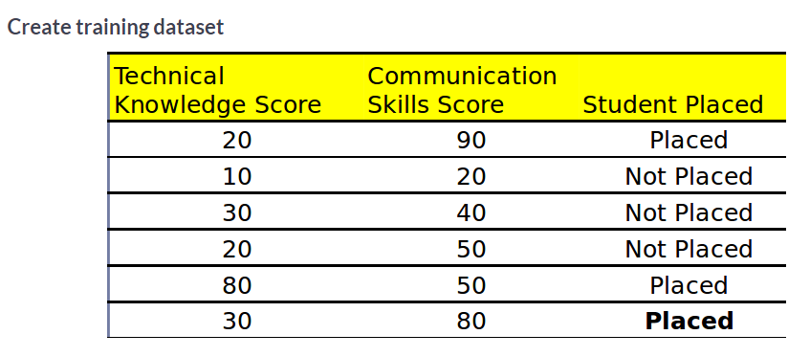
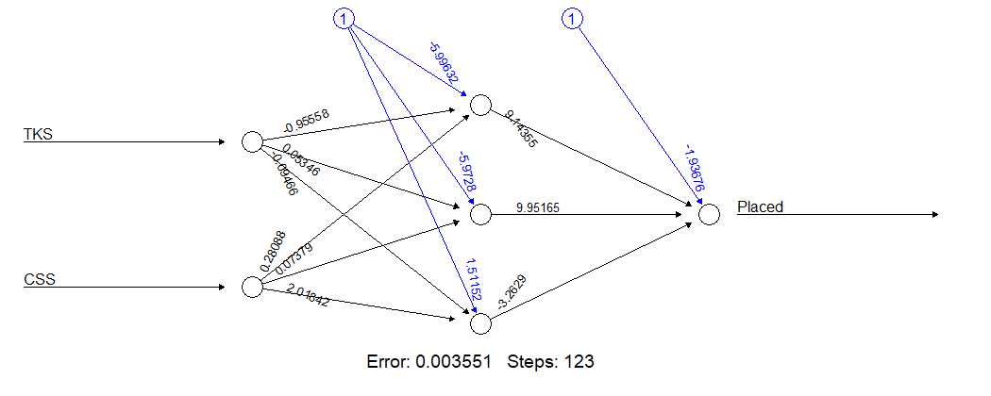
ANN Example (Binary)
Training Dataset
Train the model with given data (3 hidden layers with logistic activation function)
Result

Slide 13
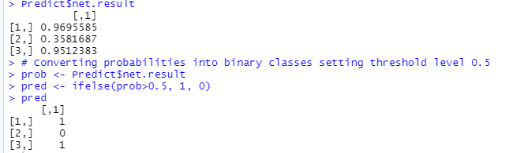
ANN Example (Binary)
Test the model with Test dataset
Technical Knowledge Score | Communication Skills Score | Student Placed
30 | 85 | ?
40 | 50 | ?
85 | 40 | ?

Slide 14
ANN Example (Binary)
#https://www.datacamp.com/community/tutorials/neural-network-models-r
#install.packages("neuralnet")
library(neuralnet)
set.seed(42)
# creating training data set
TKS=c(20,10,30,20,80,30)
CSS=c(90,20,40,50,50,80)
Placed=c(1,0,0,0,1,1)
# Here, you will combine multiple columns or features into a single set of data
df=data.frame(TKS,CSS,Placed)
nn=neuralnet(Placed~TKS+CSS,data=df, hidden=3,act.fct = "logistic",
linear.output = FALSE)
# plot neural network
plot(nn)
# creating test set
TKS=c(30,40,85)
CSS=c(85,50,40)
test=data.frame(TKS,CSS)
## Prediction using neural network
Predict=compute(nn,test)
Predict$net.result
# Converting probabilities into binary classes setting threshold level 0.5
prob <- Predict$net.result
pred <- ifelse(prob>0.5, 1, 0)
pred
ANN Models can be used in:
Pattern Recognition, such as facial/fingerprint recognition, and object detection
Anomaly detection
Time Series Prediction, such as stock price and weather forecasting
Natural Language Processing

Slide 15
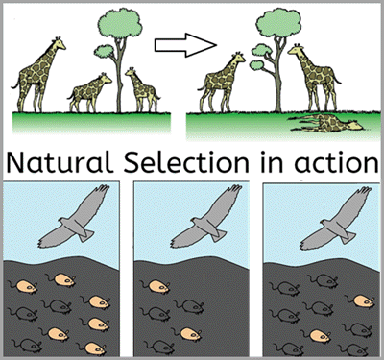
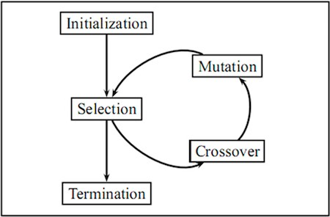
Evolutionary Algorithms (EA)
Evolutionary Algorithms
Randomized general-purpose search techniques used for finding the best values of the parameters or decision variables
Based on the mechanisms of natural selection (Goldberg 1989)

Slide 16
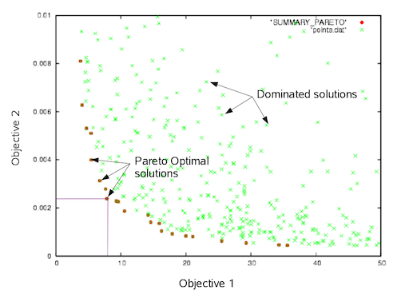
Evolutionary Algorithms (EA)
Evolutionary Algorithms
Broad spectrum of heuristic approaches for simulating biological evolution in the search for improved “fitness”
Fitness = the best values of decision variables and parameters based on an objective or fitness function
Based on mutation, recombination, & selection
Some examples
GA, ES, EP, GP
ACO, PSO, BFO, etc.

Slide 17
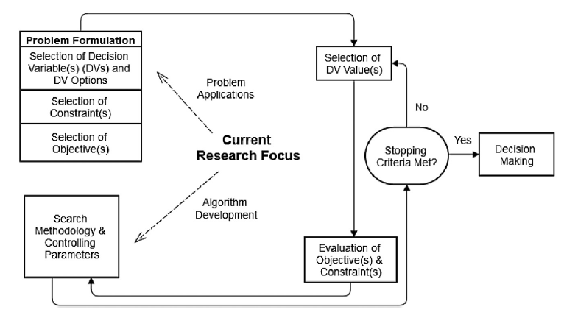
Evolutionary Algorithms (EA)
Steps in the optimization process using EAs (Maier et al. 2014)
Problem formulation (i.e. selection and definition of decision variables, objectives, and constraints).
Selection of decision variable values.
Evaluation of objectives and constraints for the selected decision variable values, which is generally done using one or more simulation models.
Selection of an updated set of decision variable values based on feedback received from the evaluation process using some search methodology.
Repetition of points 3 and 4 until the selected stopping criterion has been satisfied.
Passing the optimal solutions into an appropriate decision-making process.

Slide 18
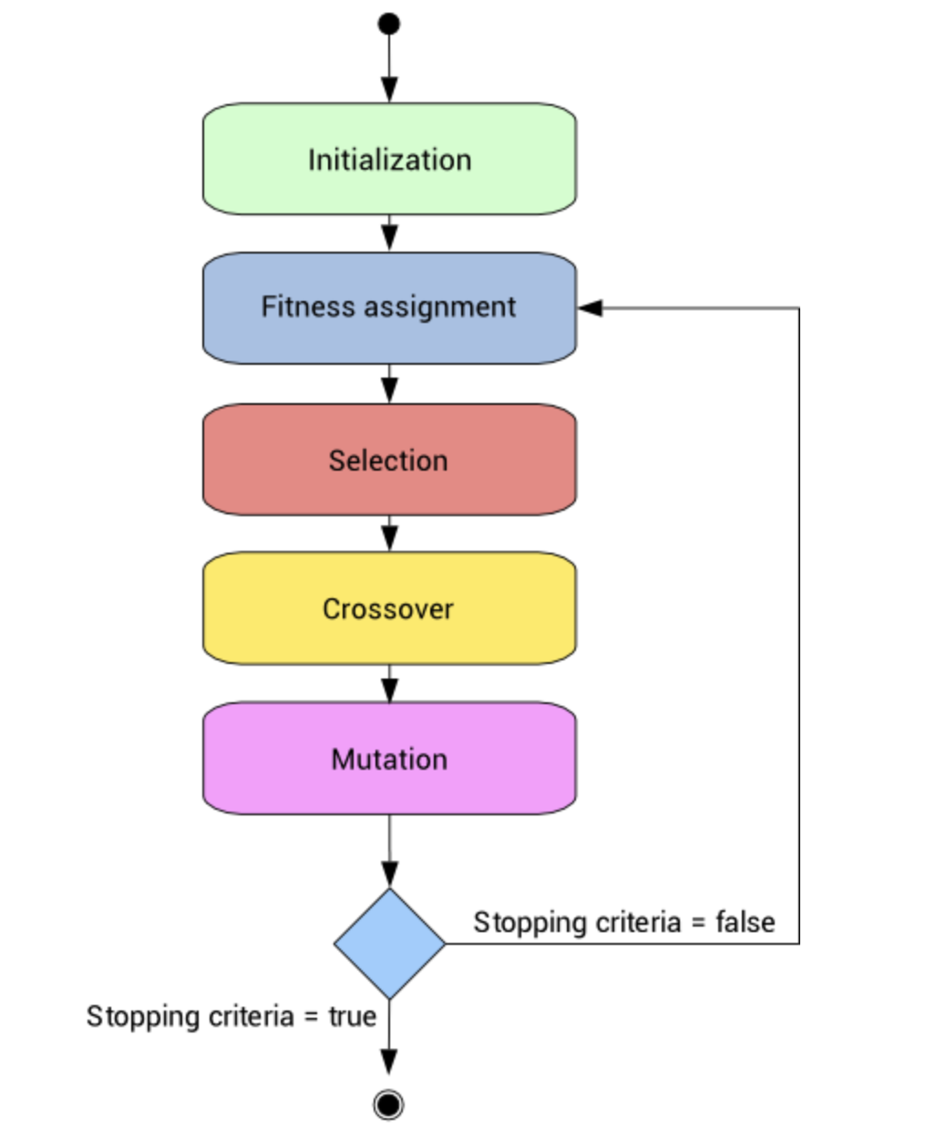
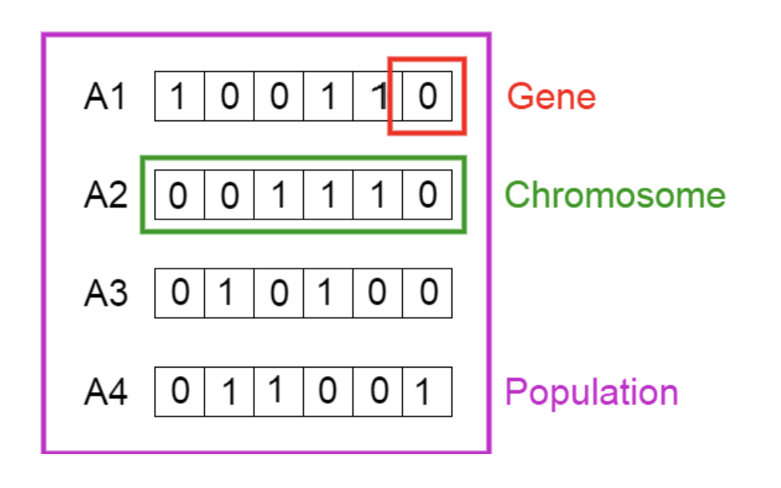
Evolutionary Algorithms (EA)
Elements of GA
Population
Chromosomes
Genes

Slide 19
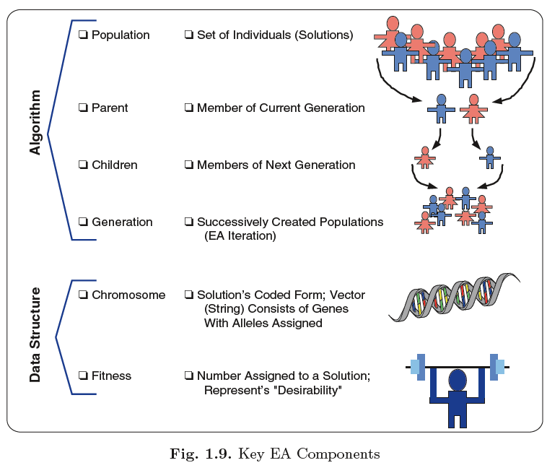
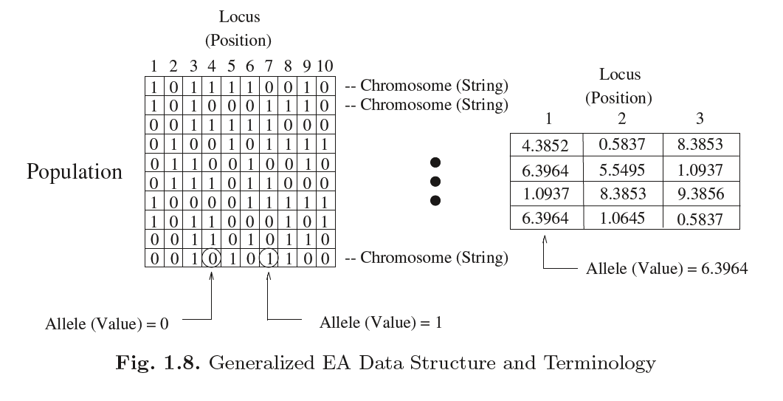
Evolutionary Algorithms (EA)

Slide 20
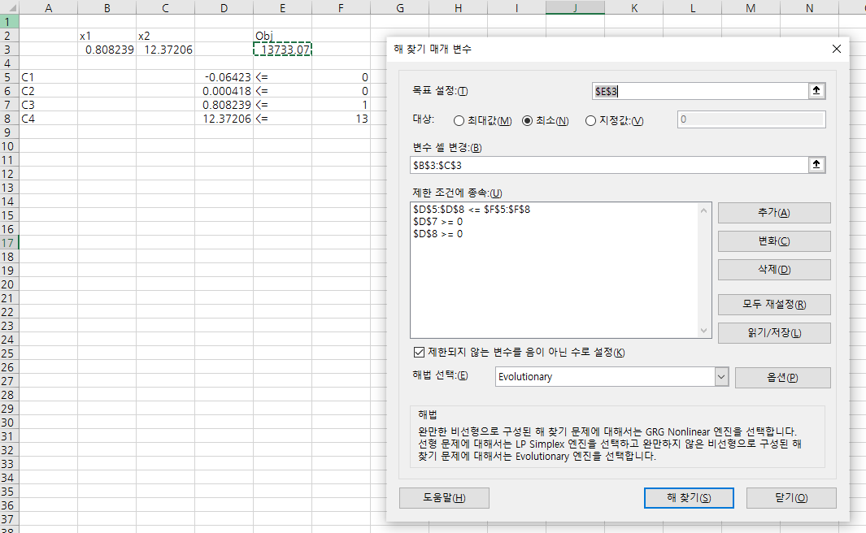
EA Examples

Slide 21
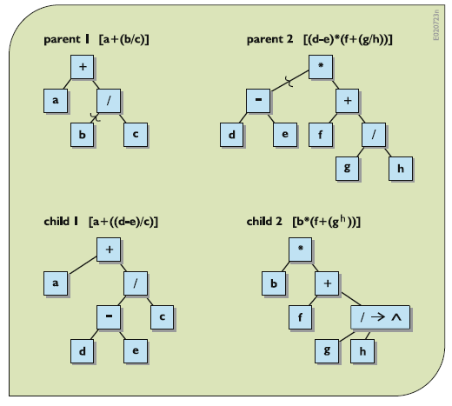
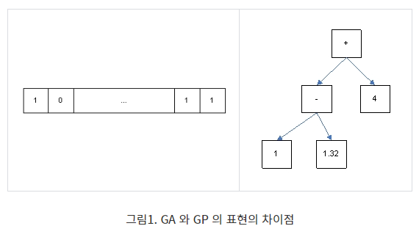
Genetic Programming (GP)
Genetic Programming (GP)
Induces a population of computer programs or models that improve automatically as they experience the data on which they are trained
GP vs GA? 가장 큰 차이점은?

Slide 22
Curses of Stochastic Dynamic Programming

Slide 23
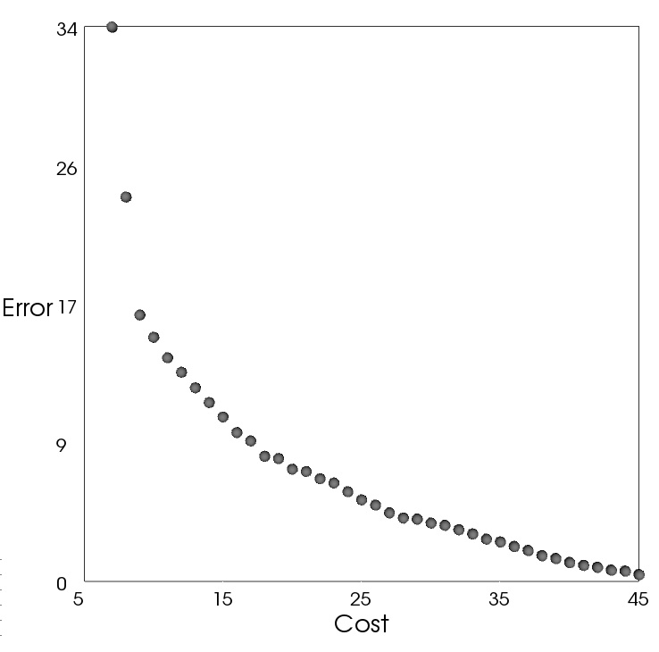

The Benefits of Many Objectives
Single Objective Design Problem…
Two Objective Design Problem…
Many-Objective Design Problem…
More compromise solutions
Considers many subproblems
Two and three objective subsets
Difficult to specify manually
The original low cost solution is now inferior when considering the error objective.
Notes:
Here are some examples of visualizing the goals and tradeoffs in planning.
The first example shows a hypothetical planning problem optimizing cost only. Each of the spheres shows a different solution to the problem, and the relative positions of the spheres shows the objective function value. Minimizing a single objective problem moves the optimal solution left on the number line to the minimal cost solution. When we add a second objective – Error - to our planning problem, our original optimal solution maps to an inferior region with respect to the error objective. This illustrates a clear a conflict between minimizing cost and minimizing error for this problem as well as the pitfalls of a single objective problem formulation.
Additionally, we can note points of diminishing return on the tradeoff between Cost and Error whereby small increases in cost result in large decreases in error followed by large increases in cost resulting in only nominal decreases in error.

Slide 24
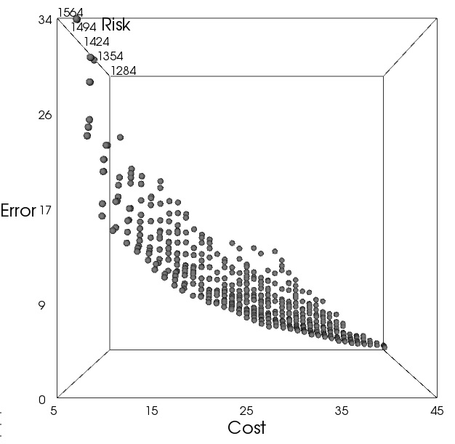
The Benefits of Many Objectives
Single Objective Design Problem…
Two Objective Design Problem…
Many-Objective Design Problem…
More compromise solutions
Considers many subproblems
Two and three objective subsets
Difficult to specify manually
The original low cost solution is now inferior when considering the error objective.
Notes:
If we add a third objective – Minimizing Risk – to our planning problem, we again see that the minimum cost solution results in maximum error and risk.

Slide 25
The Benefits of Many Objectives
Single Objective Design Problem…
Two Objective Design Problem…
Many-Objective Design Problem…
More compromise solutions
Considers many subproblems
Two and three objective subsets
Difficult to specify manually

Slide 26
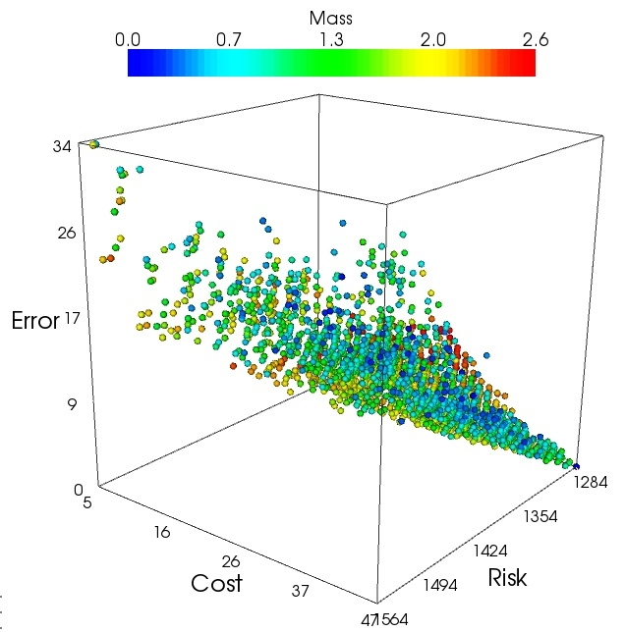
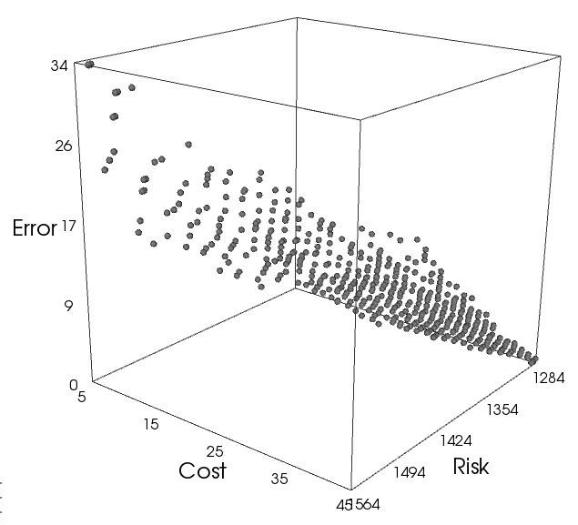
The Benefits of Many Objectives
Single Objective Design Problem…
Two Objective Design Problem…
Many-Objective Design Problem…
More compromise solutions
Considers many subproblems
Two and three objective subsets
Difficult to specify manually
Notes:
Here are some examples of visualizing the goals and tradeoffs in planning. The first example shows a single objective problem. Each of the triangles shows a different solution to the planning problem, and the relative position of the triangle shows its objective function value. Minimizing a single objective problem moves the optimal solution left on the number line. When we add a second objective (considering error explicitly), our original optimal solution maps to an inferior region with respect to the error objective. This indicates a conflict between minimizing cost and minimizing error.

Slide 27
The Benefits of Many Objectives
Single Objective Design Problem…
Two Objective Design Problem…
Many-Objective Design Problem…
More compromise solutions
Considers many subproblems
Two and three objective subsets
Difficult to specify manually
Notes:
Here are some examples of visualizing the goals and tradeoffs in planning. The first example shows a single objective problem. Each of the triangles shows a different solution to the planning problem, and the relative position of the triangle shows its objective function value. Minimizing a single objective problem moves the optimal solution left on the number line. When we add a second objective (considering error explicitly), our original optimal solution maps to an inferior region with respect to the error objective. This indicates a conflict between minimizing cost and minimizing error.

Slide 28
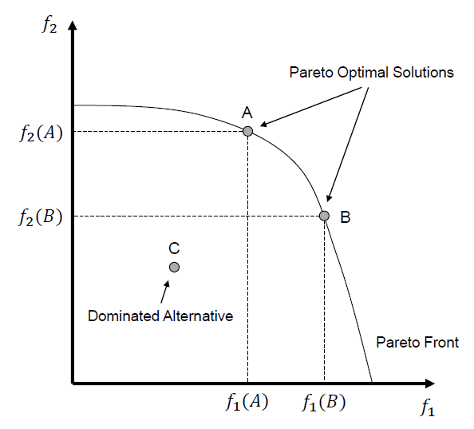
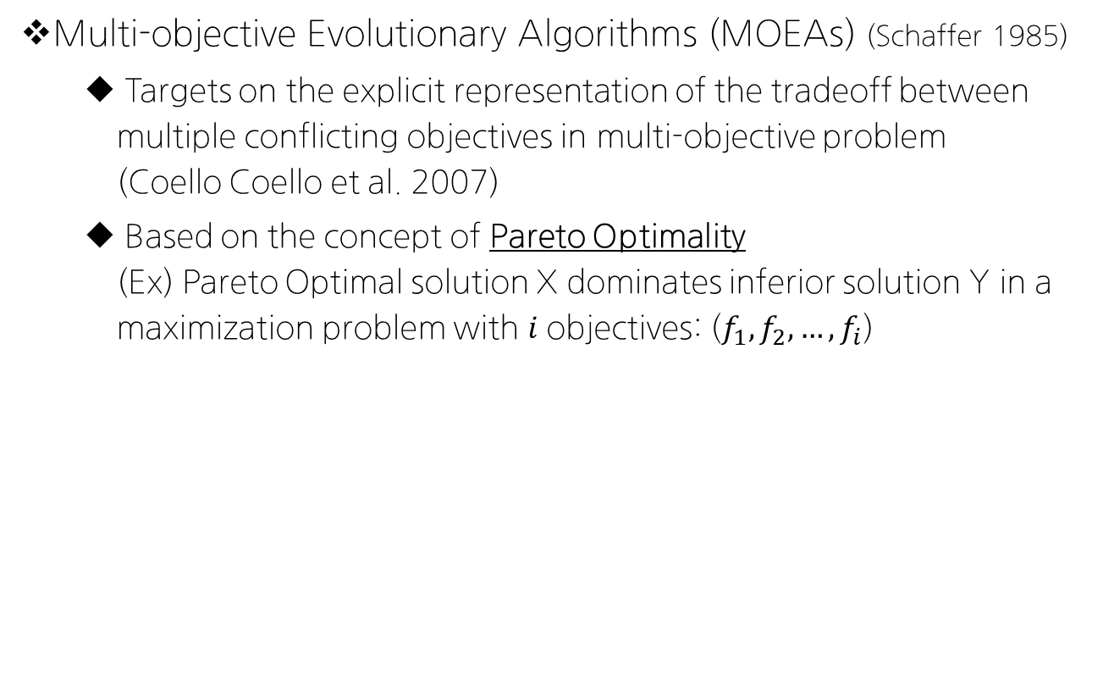


Examples of models based on EAs
Multi-objective Evolutionary Algorithms (MOEAs) (Schaffer 1985)
Targets on the explicit representation of the tradeoff between multiple conflicting objectives in multi-objective problem (Coello Coello et al. 2007)
Based on the concept of Pareto Optimality (Ex) Pareto Optimal solution X dominates inferior solution Y in a maximization problem with 𝑖 objectives: ($f_{1},f_{2},…,f_{i}$)
$$1) For all j, F_{j}(X)≥F_{j}(Y)$$
$$2) For at least one j among \\ i objectives, F_{j}\left(X\right)>F_{j}(Y)$$

Slide 29
Example: EMODPS
Evolutionary Multi-Objective Direct Policy Search (EMODPS)
Direct Policy Search (DPS) (Rosenstein and Barto, 2001)
A type of parameterization-simulation-optimization (PSO) approach in which the decision variable directly operates in the policy space
Nonlinear approximating networks: Radial Basis Function (RBFs)
Approximating function that determines the value of the release decisions
MOEAs during the solution searching process
Iterative search algorithm that evolve a Pareto-approximate set of solutions in a multi-objective problem

Slide 30
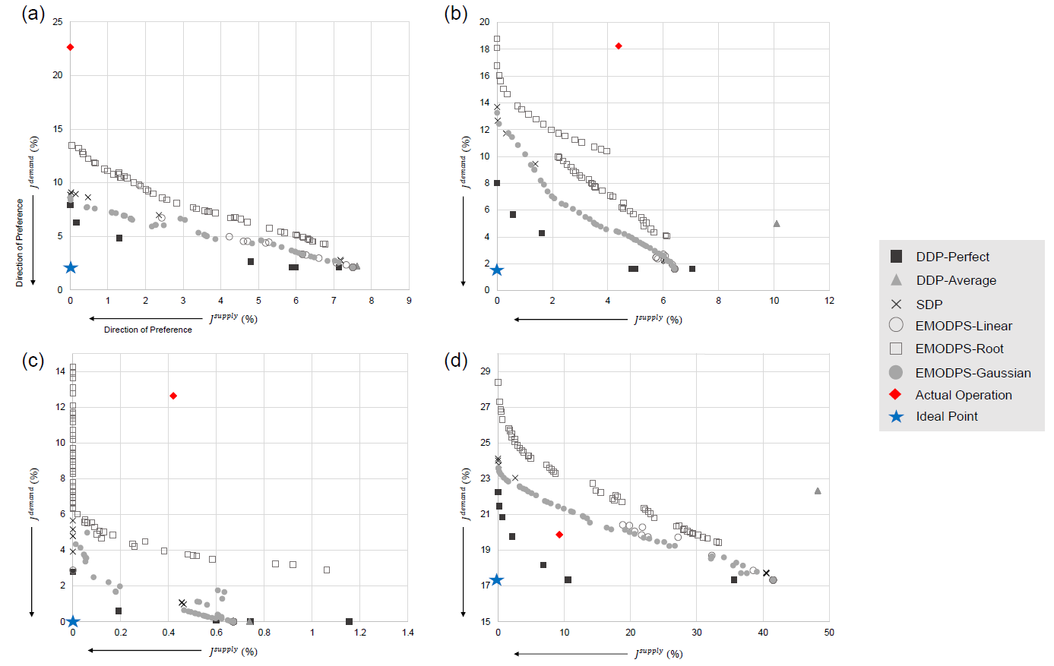
Example: EMODPS

Slide 31
Conclusion of Lecture 05
Key takeaways / Thoughts?
How does the evolutionary optimizations models differ with the conventional optimization models (LP, DP)? What are the key assumptions made in each type of model?
Possible limitations of data-driven optimization models?
“Black Box”, Outliers, anything else?
Possible Future Topics?
Uncertainty!
Chapter 6: An Introduction to Probability, Statistics, and Uncertainty

Slide 32
Future Schedule
다음 주 강의 (2022-04-19 화요일 17:00-19:50)
Training with Evolutionary Optimization Models (Laptops)
INSTALL R & RSTUDIO in your laptops
Future Schedule Reminder
Datacamp #2 due Apr-19
Assignment #2 due Apr-26 (23:59까지 메일로 제출)
보령댐 견학 일정: 4/25 월 (확정, 공문 공유 완료) (No class on Apr-26 Tue)
Term Project A due May-03 (PPT Presentation, prepare one color copy for the instructor)
Quiz #2 on May-03

