Slide 1
Lecture 06
Probability, Statistics, Uncertainty, and Stochastic Simulations
Part I
Notes:
https://snu-ac-kr.zoom.us/j/84027051484?pwd=aU5OZitOKzUyRW9DQ0s0TkpIMSs4UT09

Slide 2
Review on Previous Lectures
Lec 03-04: Introduction to Conventional Optimization Models
Nonlinear Optimization Models, LP, DP
Lec 05: Data-fitting, Evolutionary Optimization Models
EA: Evolutionary Algorithms (진화 알고리즘)
GA: Genetic Algorithms (유전 알고리즘)
GP/EP: Genetic Programming/Evolutionary Programming (유전 프로그래밍/진화 프로그래밍)
ANN: Artificial Neural Networks (인공 신경망)
DE: Differential Evolutions (차분 진화 알고리즘)
EMODPS: Multi-objective Direct Policy Search (진화적 다목적 직접 정책 검색법)

Slide 3
Today’s Topic: Probability, Statistics, Uncertainty and Stochastic Simulations
Why does Uncertainty (불확실성) occur in WRSA?
Difference in the timing of Design, Building & Operation
Time variability & change (Blöschl et al. 2019)
Stochastic (randomness over time) nature of meteorological and hydrological processes such as rainfall and evaporation
How to deal with Uncertainty?
Simplest approach = Replacing with representative values (대표값)
Mean (expected values), median, worst-case values, etc. …
However, can create a poor representation of both the average performance & the possible performance range
Probability & Statistics

Slide 4
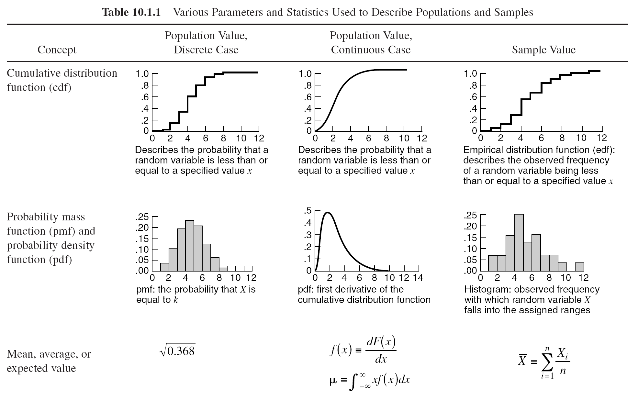
Review on Common Representative Values
Basic Probability Concepts
1) Measures of Central Tendency
Arithmetic Mean (expected values)
Median (중앙값)
=> useful for describing central tendency regardless of skewness (less sensitive to outsiders)
Mode (최빈값)
1,3, 3, 6, 7, 8, 9
Median = 6
1, 2, 3, 4, 5, 6, 8, 9
Median = (4+5) / 2 = 4.5
(Where n is the number of data points)

Slide 5
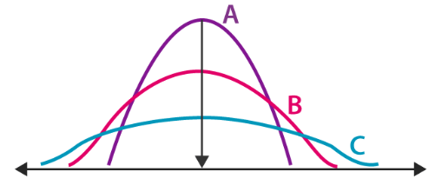
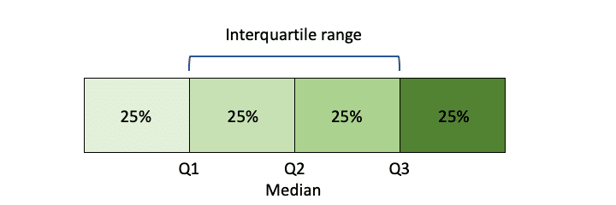
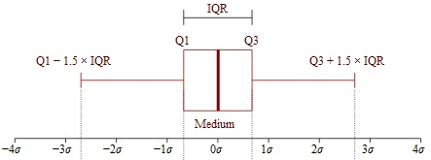

Review on Common Representative Values
Basic Probability Concepts
2) Measures of Dispersion: Describes the spread of data
Examples include:
Range: $X_{max}$ & $X_{min}$ (관측값중 가장 큰 값 & 가장 작은 값)
Quartiles & Interquartile Range
Variance (Standard Deviation)

Slide 6
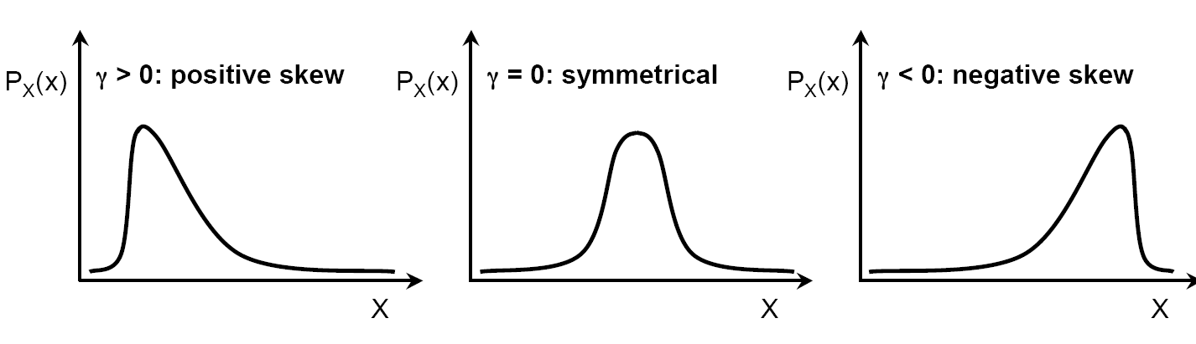
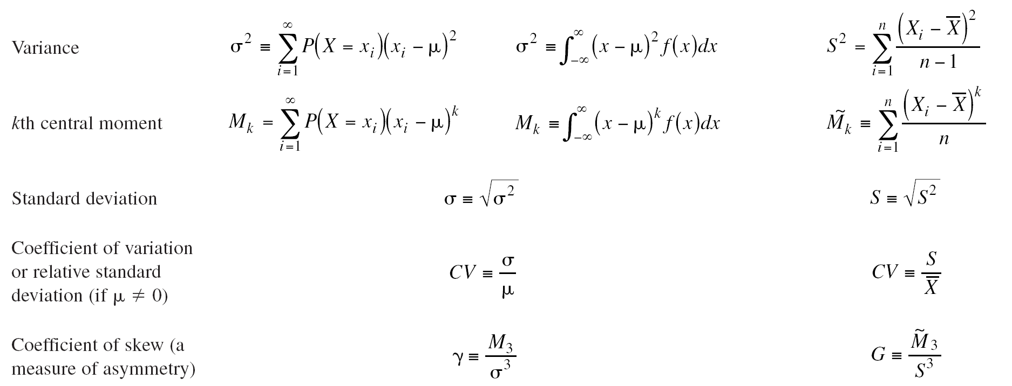
Review on Common Representative Values
Basic Probability Concepts
3) Measure of Asymmetry
Coefficient of Skew
Using the 3rd moment and the standard deviation,
and

Slide 7
Review on Common Representative Values
Basic Probability Concepts (Data observed in Pairs)
4) Measure of Correlation (Relation between two random variables)
Linear Correlation Coefficient
Correl(Rainfall,Runoff) = 0.91

Slide 8
Summary (1)
How to deal with Uncertainty?
Simplest approach = Replacing with representative values (대표값)
Mean (expected values), median, worst-case values, etc. …
However, can create a poor representation of both the average performance & the possible performance range
Common Representative Values for:
Measures of Central Tendency: mean, median, mode
Measures of Dispersion: range, IQR
Measure of Asymmetry: coefficient of skew
Measure of Correlation: linear correlation coefficient

Slide 9
Explain the data with Rep. Values?
No! Proof?
Justin Matejka, George Fitzmaurice (2017). Same Stats, Different Graphs: Generating Datasets with Varied Appearance and Identical Statistics through Simulated Annealing CHI 2017 Conference proceedings: ACM SIGCHI Conference on Human Factors in Computing Systems

Slide 10
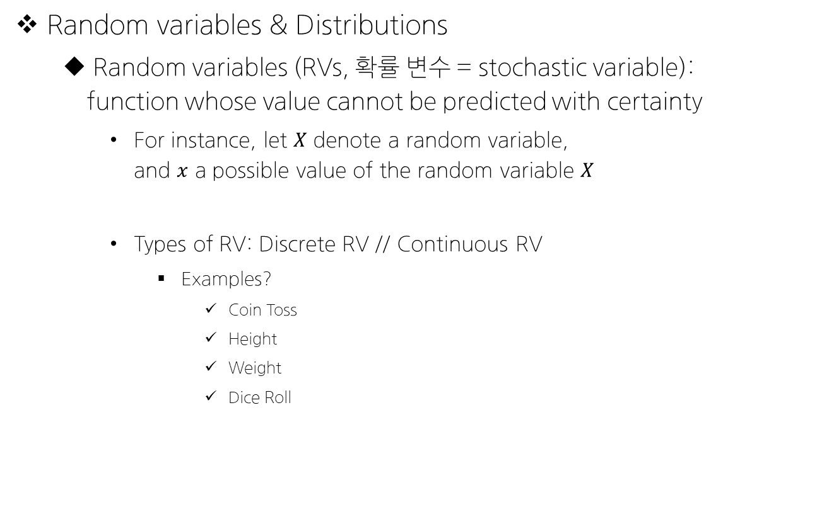
Concept of Probability
Random variables & Distributions
Random variables (RVs, 확률 변수 = stochastic variable): function whose value cannot be predicted with certainty
For instance, let $X$ denote a random variable, and $x$ a possible value of the random variable $X$
Types of RV: Discrete RV // Continuous RV
Examples?
Coin Toss
Height
Weight
Dice Roll

Slide 11

If $X$ is a discrete random variable,

Slide 12

If $X$ is a continuous random variable,

Slide 13

In case of joint probability distribution of $X$ and $Y$,

Slide 14
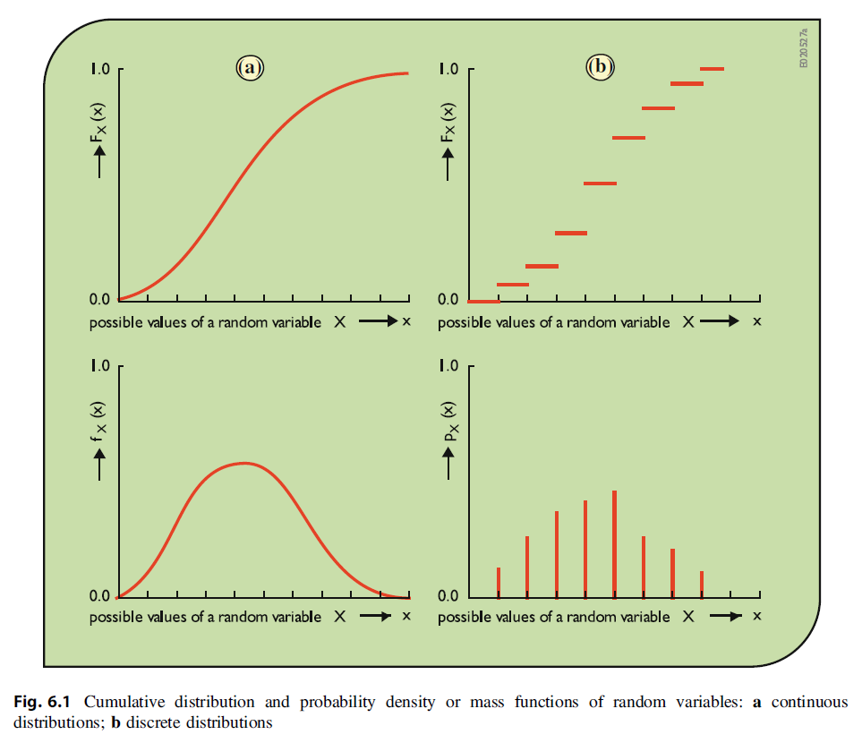
Review on the Probability Concepts
Notes:
1 2
3 4 순서대로 CDF // CDF // PDF // PMF

Slide 15
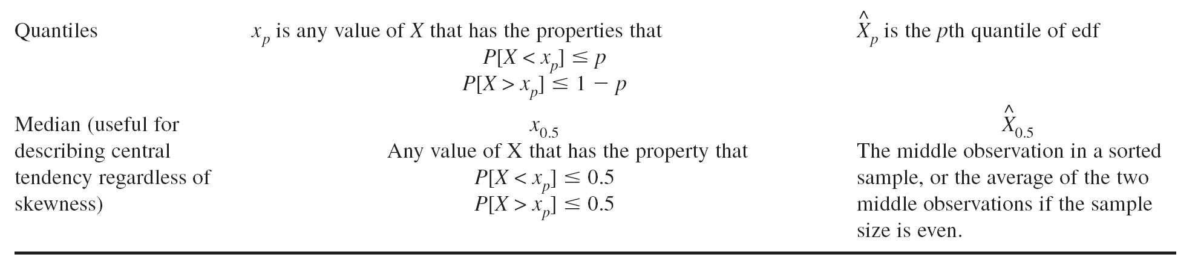
Summary (2)

Slide 16
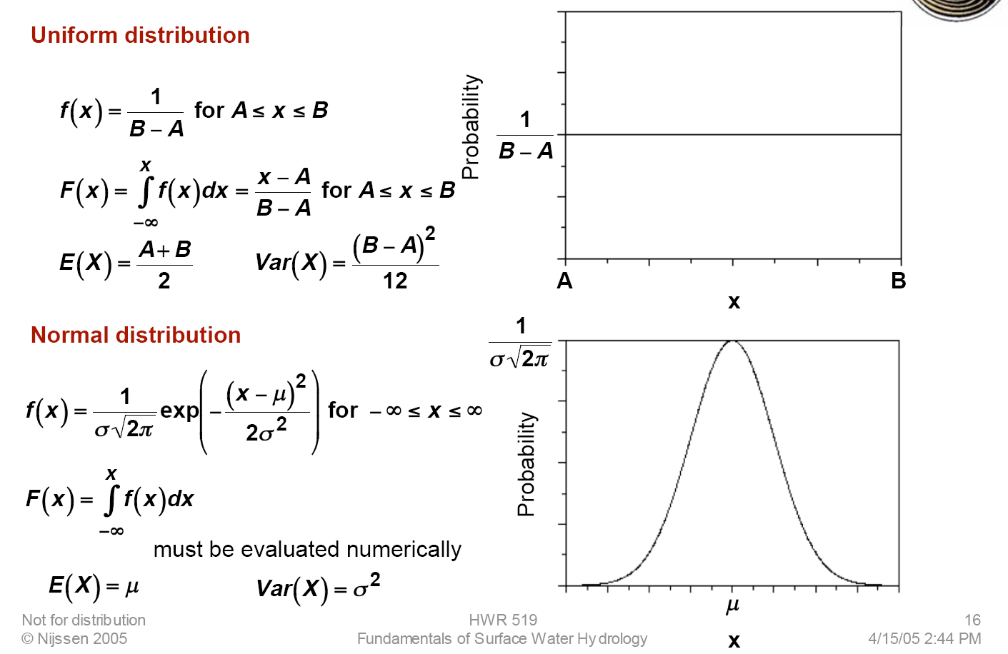
Common Distributions in WRSA

Slide 17
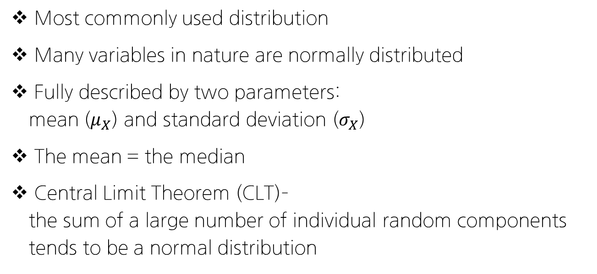

More on the Normal Distribution
$$X\sim N(μ_{X},σ_{X})$$
Most commonly used distribution
Many variables in nature are normally distributed
Fully described by two parameters: mean ($μ_{X}$) and standard deviation ($σ_{X}$)
The mean = the median
Central Limit Theorem (CLT)– the sum of a large number of individual random components tends to be a normal distribution

Slide 18

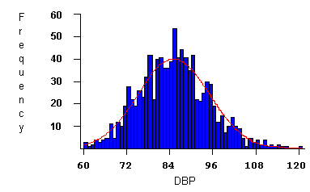
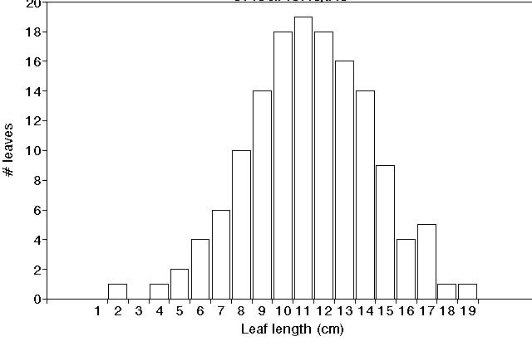
Many random variables in nature follow a normal distribution
Leaf lengths¹
Blood pressure ²
(1000 patients)
¹Oklahoma State University
²SurfStat Australia

Slide 19
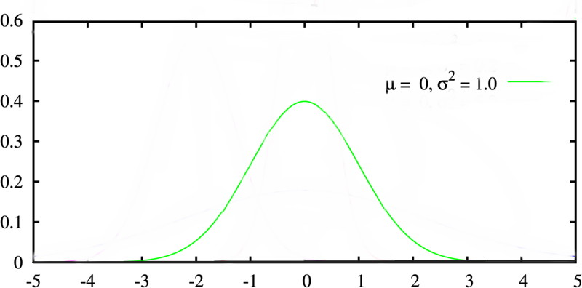
Standard Normal Distribution
A normal distribution with parameters μ = 0 and σ² = 1 is known as the standard normal distribution
Solved numerically and
results widely tabulated
Φ(z_{i}) = F_{Z}(z_{i}) = P(z < z_{i})

Slide 20
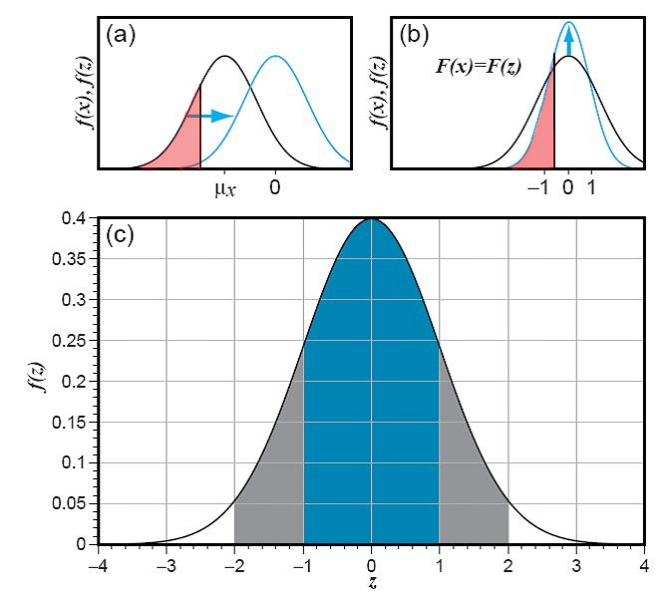
Transforming into Standard Normal Dist.
“Standard Normal Variate”
We use this equation to normalize x – in other words to find the value of z such that
F_{X}(x) = F_{Z}(z)

Slide 21
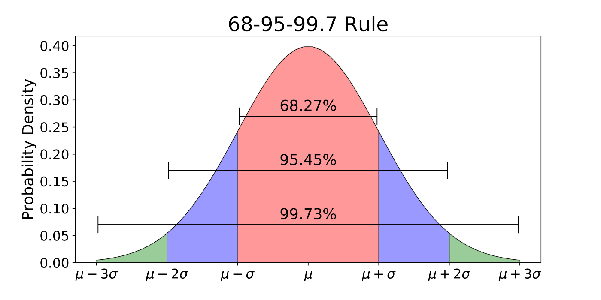
68-95-99.7 rule for a Normal Distribution

Slide 22
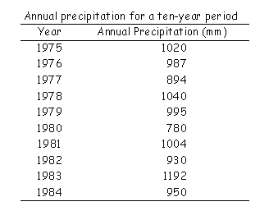
Example Problem: Annual Precipitation
1) Sketch the histogram
2) Calculate μ and σ
3) Assume a normal distribution – is this reasonable?
4) What is the probability that the annual precipitation this year will be greater than 1100 mm?

Slide 23
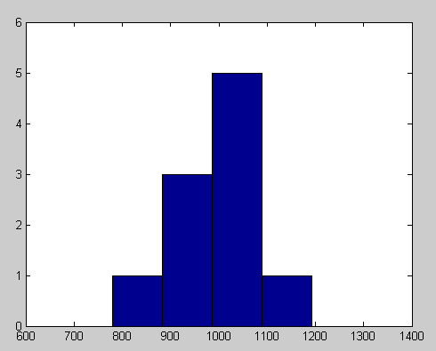
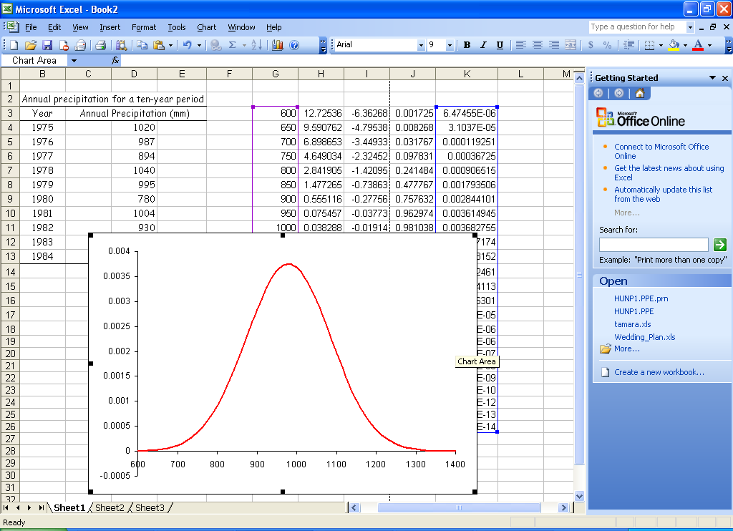
Example Problem: Annual Precipitation
1) Sketch the histogram
2) Calculate μ and σ
3) Assume a normal distribution – is this reasonable?
4) What is the probability that the annual precipitation this year will be greater than 1100 mm?
N(979.2, 106.3)
μ = 979.2 mm σ = 106.3 mm

Slide 24
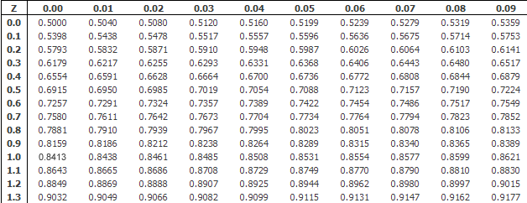




Example Problem: Annual Precipitation
4) What is the probability that the annual precipitation this year will be greater than 1100 mm?
μ = 979.2 mm, a = 1100 mm σ = 106.3 mm
$$z=\frac{a−\overline{x}}{s}=\frac{1100−979}{106} ≅1.14$$
$$F\left(z\right)=F\left(1.14\right)$$
$$F\left(1.14\right)=0.8729$$
$$Answer:1−F\left(z\right)=0.1272$$
Or less than a 12.71% chance

Slide 25
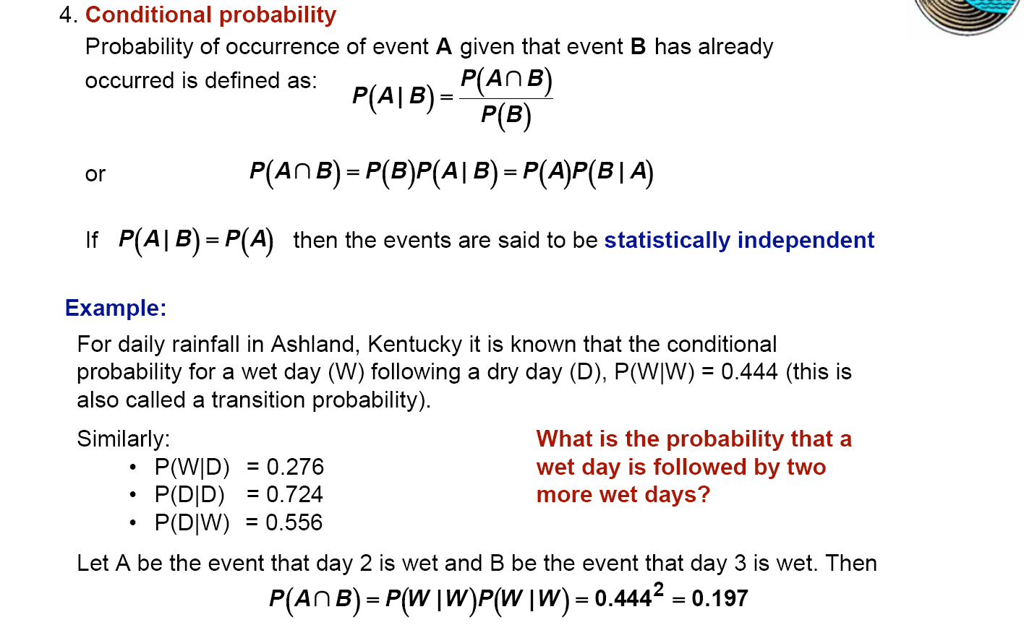
Finally, Conditional Probability P(A|B)

Slide 26
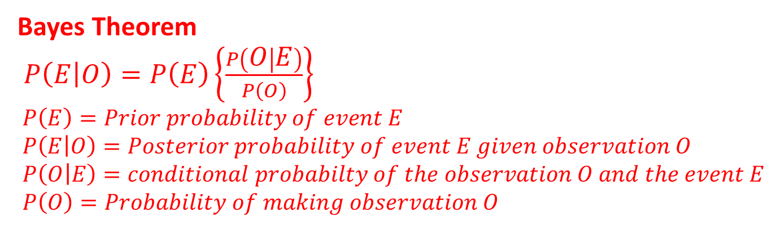
Bayes Theorem
The basics
a priori uncertainty + new information
Yields revised assessment of uncertainty
Multiple observations—use repetitions of Bayes Theorem
Bayes Theorem
$P\left(E | O\right)=P\left(E\right)\left\{\frac{P\left(O | E\right)}{P\left(O\right)}\right\}$
$P\left(E\right)=Prior probability of event E$
$P\left(E | O\right)=Posterior probability of event E given observation O$
$P\left(O | E\right)=conditional probabilty of the observation O and the event E$
$P\left(O\right)=Probability of making observation O$

Slide 27
P(E|O)
Read “probability of event E conditional on O having been observed”
New information in estimate
P(O|E)
Frequency that observation O is associated with existence of specific event E
Ex: probability of observing salt domes when there is oil
P(E|O) ≠ P(O|E) these probabilities are not symmetric!
P(O = male/E = king) = 1.0
P(E = king/ O = male) is probability of finding a king given the observation an individual is male = ~ 10⁻⁹
P(O)
Probability of making a specific observation O considering all ways it can occur
The probability of making observation O may be associated with all possible events E_{i}

Slide 28

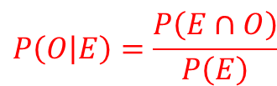




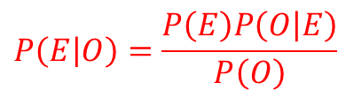


Bayes Theorem: Derivation
$$Ω$$
$$E$$
$$O$$
$$\left(E∩O\right)$$
According to conditional probability,
$$P\left(E | O\right)=\frac{P\left(E∩O\right)}{P\left(O\right)}$$
The fraction of ellipse B that
overlaps with ellipse A
and
$$P\left(O | E\right)=\frac{P\left(E∩O\right)}{P\left(E\right)}$$
The fraction of ellipse A that
overlaps with ellipse B.
Solving for $P\left(A∩B\right)$, the common factor:
$$P\left(E∩O\right)=P\left(E\right)P\left(O | E\right)=P\left(O\right)P\left(E | O\right)$$
Rearranging to give$P\left(A | B\right)$:
$$P\left(E | O\right)=\frac{P\left(E\right)P\left(O | E\right)}{P\left(O\right)}$$
Note: one can reverse E and O
and the solution is still valid

Slide 29
Example Problem: Bayes Theorem
In the United States, approximately 1 in 100 otherwise healthy people has Celiac Disease1. A new diagnostic test, has a 95% reliability, i.e., 95% of people with Celiac test positive, and 95% of people without Celiac test negative. During trials, a randomly selected person tests positive.
(a) What is the probability that the person has Celiac Disease?
(b) What is the probability that the person doesn’t?

Slide 30
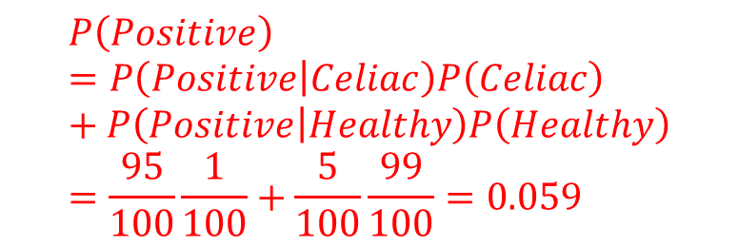

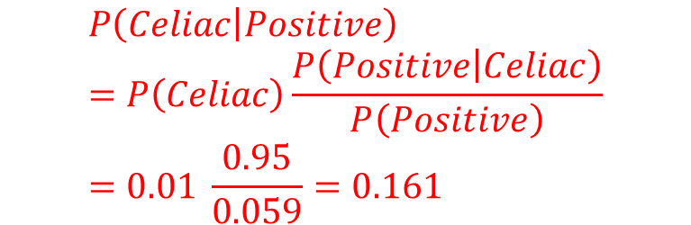
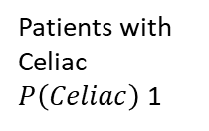
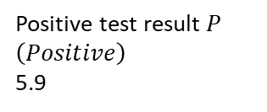
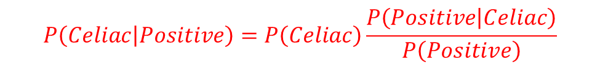
Example Problem: Bayes Theorem
(a)
$$P\left(Celiac | Positive\right)=P\left(Celiac\right)\frac{P\left(Positive | Celiac\right)}{P\left(Positive\right)}$$
Population = 100
$$P\left(Positive\right)=P\left(Positive | Celiac\right)P\left(Celiac\right)+P\left(Positive | Healthy\right)P\left(Healthy\right)=\frac{95}{100}\frac{1}{100}+\frac{5}{100}\frac{99}{100}=0.059$$
Positive test result $P\left(Positive\right)$
5.9
Patients with Celiac
$P\left(Celiac\right)$1
$$P\left(Celiac | Positive\right)=P\left(Celiac\right)\frac{P\left(Positive | Celiac\right)}{P\left(Positive\right)}=0.01 \frac{0.95}{0.059}=0.161$$
$$P\left(Celiac | Positive\right)$$

Slide 31
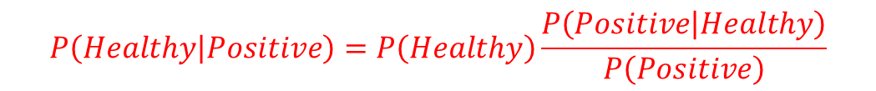

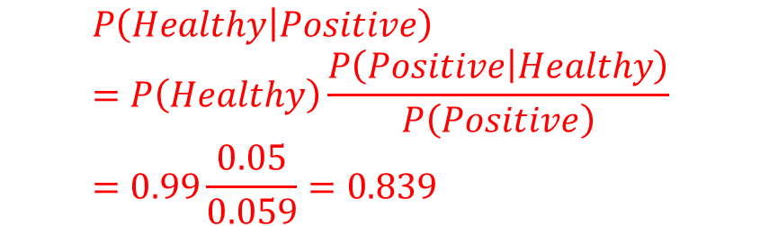
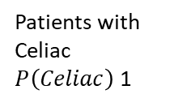
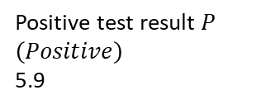
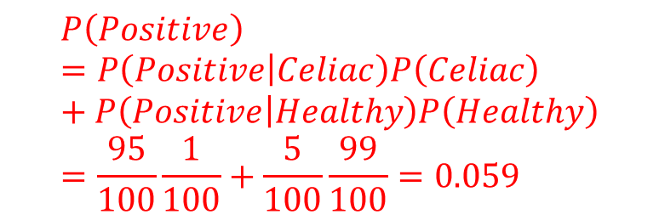
Example Problem: Bayes Theorem
(b)
$$P\left(Healthy | Positive\right)=P\left(Healthy\right)\frac{P\left(Positive | Healthy\right)}{P\left(Positive\right)}$$
Population = 100
$$P\left(Positive\right)=P\left(Positive | Celiac\right)P\left(Celiac\right)+P\left(Positive | Healthy\right)P\left(Healthy\right)=\frac{95}{100}\frac{1}{100}+\frac{5}{100}\frac{99}{100}=0.059$$
Positive test result $P\left(Positive\right)$
5.9
Patients with Celiac
$P\left(Celiac\right)$1
$$P\left(Healthy | Positive\right)=P\left(Healthy\right)\frac{P\left(Positive | Healthy\right)}{P\left(Positive\right)}=0.99\frac{0.05}{0.059}=0.839$$
$$P\left(Celiac | Positive\right)$$
Rare observations (patient with disease),
and very high or very low association with
event yield strong revisions!

Slide 32
Tips for the TEST (2022 Spring WRSE)
Closed Book, 150 mins, Calculators allows
Exact Time & Place: May 17 화요일, 17:00-19:30, 35-431
출제 범위
Primary Textbook Chapters
01, 02, 03, 04, 05, 06-(6.2.3, p.223 까지 출제범위)
Lecture Notes: 01, 02, 03, 04, 05, 06
Assignments: #1, #2
Quizzes: #1, #2
Other New Questions (1 Question, 2 Questions Max)

Slide 33
Future Schedule (~End of Course)
May-17 (1): TEST
May-24 (2):
Lec 07: Probability, Statistics, Uncertainty, and Stochastic Simulations
Lec 08: Performance Criteria
May-31 & Jun-07 (3 & 4)
Lec 09: Water Resources Systems Engineering Frontiers -Introduction and Examples Part 1
Lec 10: Water Resources Systems Engineering Frontiers -Introduction and Examples Part 2 (Invited Talk)
Jun-14: Final Project Presentation + Report Due (5)
Report는 추후에 기술기사로 출판할 예정 (6-7월 중)

