Slide 1
Lecture 07
Probability, Statistics, Uncertainty, and Stochastic Simulations
Part II
Notes:
https://snu-ac-kr.zoom.us/j/84027051484?pwd=aU5OZitOKzUyRW9DQ0s0TkpIMSs4UT09

Slide 2
Remaining Future Schedule (~End of Course)
May-17 (1): TEST
May-24 (Today’s Lecture):
Introduction to Final Project B
Lec 07: Probability, Statistics, Uncertainty, and Stochastic Simulations II (including Lec 08: Performance Criteria)
May-31 & Jun-07 (3 & 4)
Lec 09: Water Resources Systems Engineering Frontiers -Introduction and Examples Part 1
Lec 10: Water Resources Systems Engineering Frontiers -Introduction and Examples Part 2 (Invited Talk)
Jun-14: Final Project Presentation + Report Due (Jun-20)
Report는 추후에 기술기사로 출판할 예정 (7월 중): 기술기사 예시

Slide 3
Final Project B
이제, 이 수업에서 배운 내용을 활용하여 보령댐의 최적 운영방법을 도출해 봅시다. 알다시피, 보령댐은 특히 최근 다년 가뭄으로 인한 피해를 많이 입은 바 있습니다. 팀별로 아래 문제에 대한 답변을 PPT 발표에 포함하여 준비하여 주시기 바랍니다. (15분 발표, 5분 Q&A) (팀 C: 이재황 김현주 박성열 // 팀 D: 이재호 김연주 남현욱 이주형)
보령댐 및 보령댐 유역에 대한 예비 분석을 수행합니다. 직면하고 있는 문제는 무엇이며, 직면한 문제의 어떤 부분을 개선할 수 있습니까?
보령댐이 최근 겪은 가뭄은 얼마나 심각했습니까? 이벤트에 대한 확률 분석을 수행하여 봅시다.
대상 댐에 적용할 최적화 모델의 종류를 선택하고, 문제를 설정해 봅시다. 최적화를 위한 목적 함수, 결정 변수, 제약 조건은 각각 무엇인가요? 결정적/확률적 모델 중 어떤 모델을 사용해야 하나요? (R을 통한 Coding 필수)
최적화된 운영룰을 가지고 2014년 9월 1일부터 2019년 6월 30일까지의 일별 저수지 모의를 진행해 봅시다. (초기 수위는 2014년 8월 30일 저수량)
최적화 결과 및 모의 결과를 사용하여 분석을 진행해 봅시다. 실제 운영 실적과 비교하여 최적 운영룰이 어떤 측면에서 얼마나 개선된 결과를 보였나요?

Slide 4
Final Project B 최종 리포트 목차
이전에 설명드린 바와 같이, 조별로 제출한 최종 리포트는 학기가 끝난 후 정리 및 취합 과정을 거쳐 7월 중 학술기사(한국수자원학회지-물과미래)에 투고할 예정입니다. 예시로 제시한 학술기사를 참고해 주시고, 한글로 리포트 작성 부탁드립니다. 통일성을 위해, 되도록이면 첨부 파일 양식에 아래와 같은 목차를 사용하여 작성 부탁드립니다 (리포트 제출 기한: Jun-20 오후 6시까지 메일로 제출).
서론 (들어가며)
개요 (대략적인 최적화 모형 설명 및 선택한 최적화 모형 이유)
대상 유역 및 문제 제기
문제 설정 및 최적화 진행 과정 (최적화 모델 세부 구성 및 설명 추가 필요)
최적화 진행 결과 및 과거 유입량 바탕의 모의 진행 결과
결론 및 토론 (+시사점&한계점?)

Slide 5
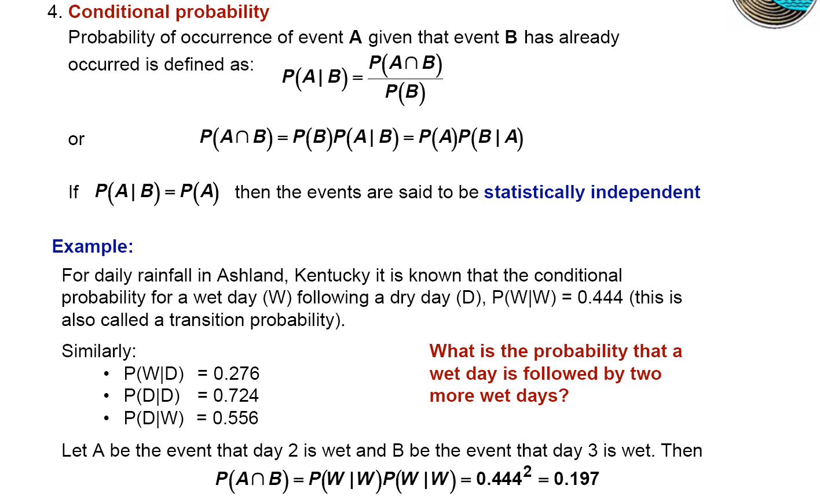
R) Finally, Conditional Probability P(A|B)

Slide 6
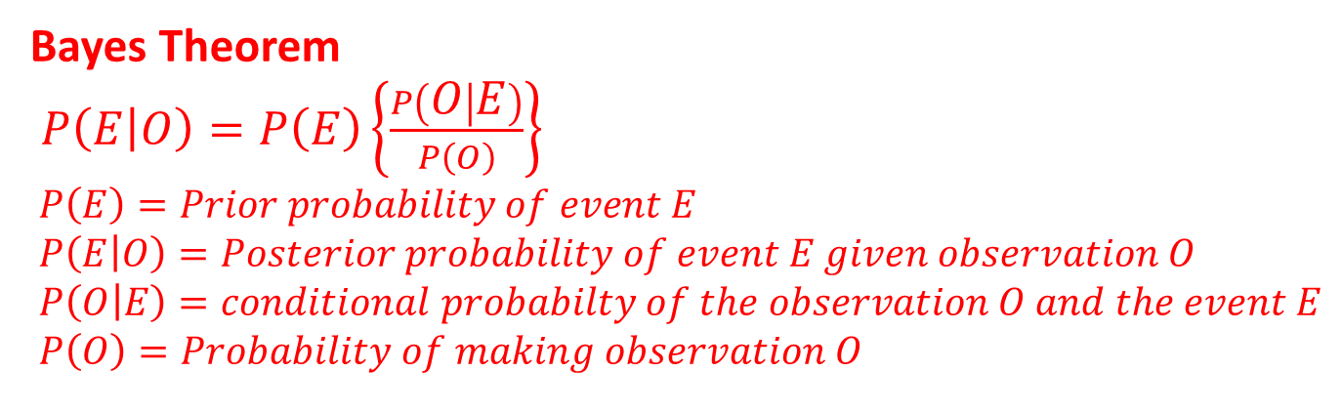
R) Bayes Theorem
The basics
a priori uncertainty + new information
Yields revised assessment of uncertainty
Multiple observations—use repetitions of Bayes Theorem
Bayes Theorem
$P\left(E | O\right)=P\left(E\right)\left\{\frac{P\left(O | E\right)}{P\left(O\right)}\right\}$
$P\left(E\right)=Prior probability of event E$
$P\left(E | O\right)=Posterior probability of event E given observation O$
$P\left(O | E\right)=conditional probabilty of the observation O and the event E$
$P\left(O\right)=Probability of making observation O$

Slide 7
P(E|O)
Read “probability of event E conditional on O having been observed”
New information in estimate
P(O|E)
Frequency that observation O is associated with existence of specific event E
Ex: probability of observing salt domes when there is oil
P(E|O) ≠ P(O|E) these probabilities are not symmetric!
P(O = male/E = king) = 1.0
P(E = king/ O = male) is probability of finding a king given the observation an individual is male = ~ 10⁻⁹
P(O)
Probability of making a specific observation O considering all ways it can occur
The probability of making observation O may be associated with all possible events E_{i}

Slide 8

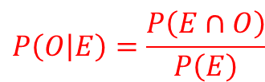




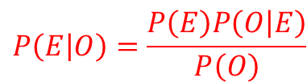


R) Bayes Theorem: Derivation
$$Ω$$
$$E$$
$$O$$
$$\left(E∩O\right)$$
According to conditional probability,
$$P\left(E | O\right)=\frac{P\left(E∩O\right)}{P\left(O\right)}$$
The fraction of ellipse B that
overlaps with ellipse A
and
$$P\left(O | E\right)=\frac{P\left(E∩O\right)}{P\left(E\right)}$$
The fraction of ellipse A that
overlaps with ellipse B.
Solving for $P\left(A∩B\right)$, the common factor:
$$P\left(E∩O\right)=P\left(E\right)P\left(O | E\right)=P\left(O\right)P\left(E | O\right)$$
Rearranging to give$P\left(A | B\right)$:
$$P\left(E | O\right)=\frac{P\left(E\right)P\left(O | E\right)}{P\left(O\right)}$$
Note: one can reverse E and O
and the solution is still valid

Slide 9
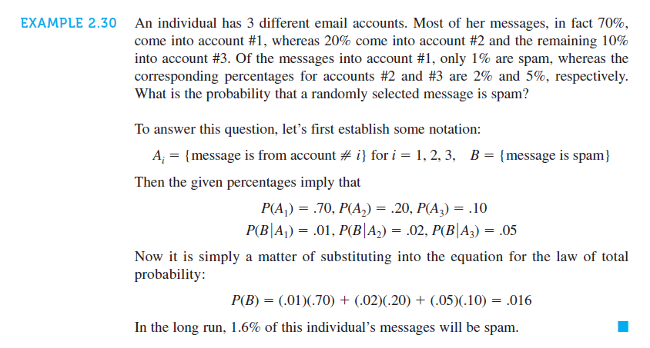
Example Problem 1: Bayes Theorem

Slide 10
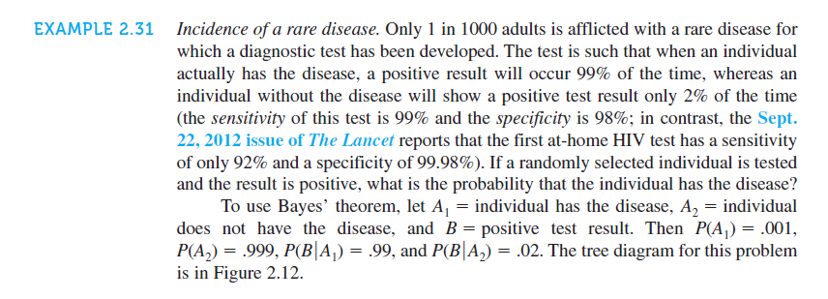
Example Problem 2: Bayes Theorem

Slide 11
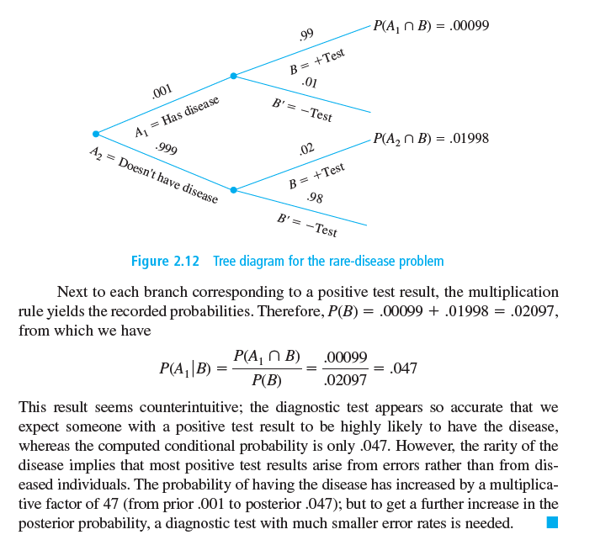
Example Problem 2: Bayes Theorem

Slide 12
Today’s Topic: Probability, Statistics, Uncertainty and Stochastic Simulations
Part I: Last Class (May-10)
Review on Common Representative Values
Concept of Probability & Review on the Probability Concepts
Common Distributions in WRSA: 68-95-99.7 rule for Norm. Dist.
Conditional Probability & Bayes Theorem
Part II: This Class (May-24)
Details & Procedures for Probabilistic Modeling
Methods for Synthetic Streamflow Generations
Performance Criteria

Slide 13
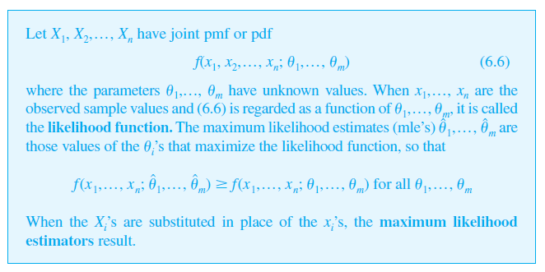
Probabilistic Modeling
Steps for Probabilistic Modeling
Pick a Model: Uniform, Normal (or Lognormal), Exponential, etc.
Fit the model to Data: MLE
Maximum Likelihood Estimator (MLE)
How to pick a model?
Physical basis: model designed for properties of physical process
Limit Laws
Empirical Basis: which model fits data best?

Slide 14
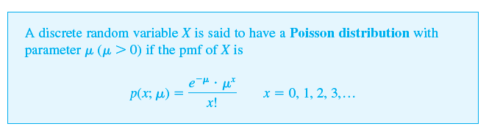
Details on Probabilistic Modeling
Then, how to pick a model?
Physical basis: model designed for properties of physical process
Ex) Poisson distribution: Number of time event occurs in an interval of time
* events are independent
* rate of occurrences is constant
* number of extreme events per year (especially in hydrology)

Slide 15
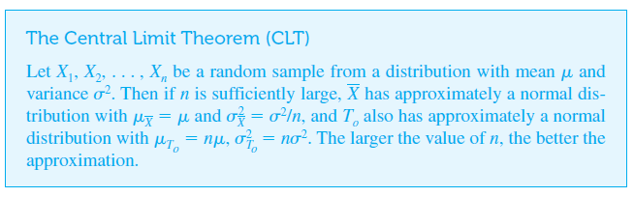
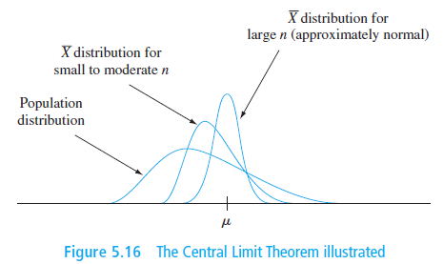
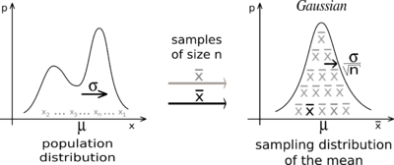

Details on Probabilistic Modeling
Then, how to pick a model?
Limit Laws
Theory suggest a distribution as n → $∞$
Ex) Central Limit Theorem (CLT)

Slide 16
Details on Probabilistic Modeling
Then, how to pick a model?
Empirical Basis: which model fits data best?
* Goodness-of-fit Approaches such as:
1) Picking model based on scores (AIC)
2) Visual Assessments (P-P or Q-Q plots)
3) Hypothesis testing (Chi-squared test)
* AIC, Akaike Information Criterion (아카이케 정보 기준)
AIC =
in which the goal is to pick the model with the smallest AIC (=large maximum likelihood, penalty for model parameter)

Slide 17
Details on Probabilistic Modeling
Then, how to pick a model?
Empirical Basis: which model fits data best?
* AIC, Akaike Information Criterion (아카이케 정보 기준)
AIC =
in which the goal is to pick the model with the smallest AIC (=large maximum likelihood, penalty for model parameter)
Ex) Exp:
Gamma:
* Rule of Thumb *

Slide 18
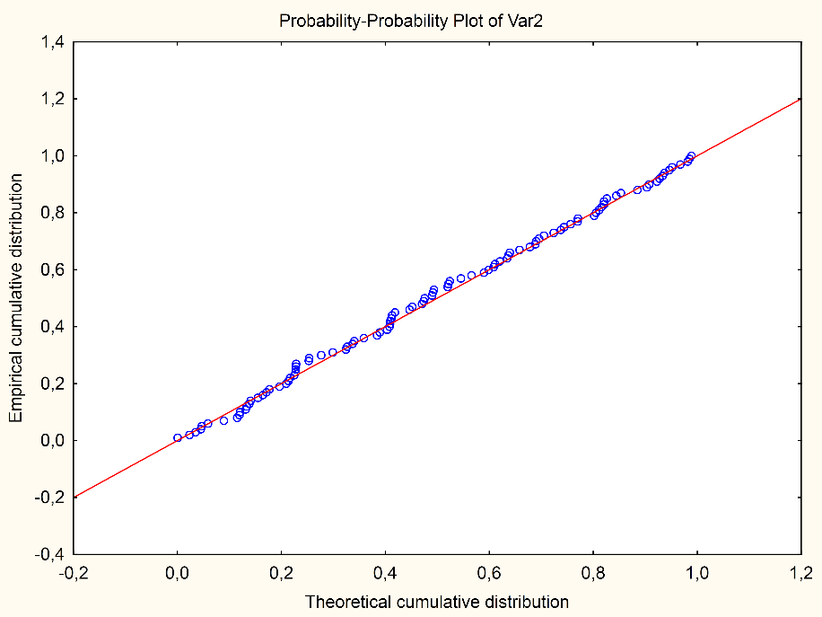
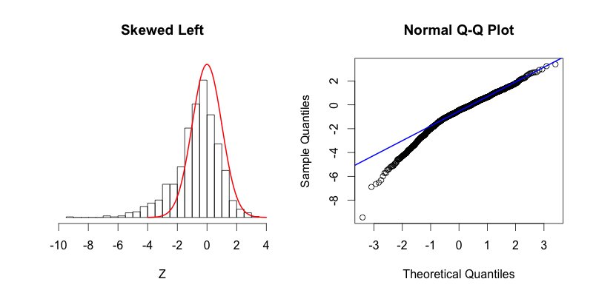
Details on Probabilistic Modeling
Then, how to pick a model?
Empirical Basis: which model fits data best?
2) Visual Assessments (P-P or Q-Q plots)

Slide 19
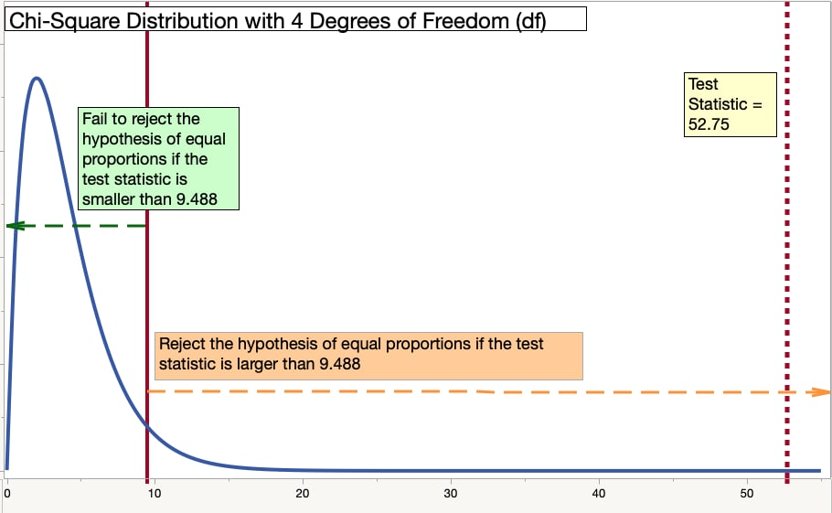
Details on Probabilistic Modeling
Then, how to pick a model?
Empirical Basis: which model fits data best?
3) Hypothesis testing (Chi-squared test)

Slide 20
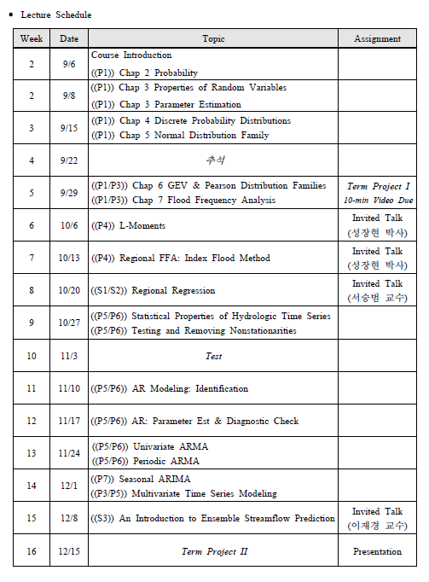
For Further Details
Refer to 2022 Fall Semester Statistical Hydrology (457.568A)
2021 Fall Semester
Statistical Hydrology
Syllabus

Slide 21
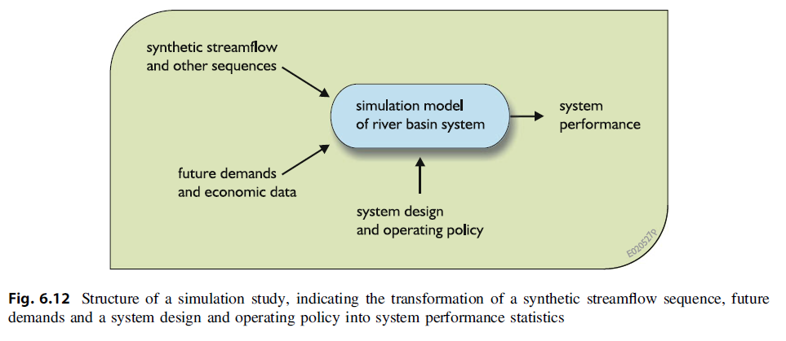
6.8 Synthetic Streamflow Generation (p.257)
Why do we Generate Synthetic Streamflow?
Little or no data for your system
Evaluate the effect of hydrologic non-stationarity on your system
Types of Synthetic streamflow generators
Indirect approach: generate precipitation and temperature series and input them to a hydrologic model of a basin (GCM)
Direct approach: uses statistical techniques to generate streamflow time series directly

Slide 22
6.8 Synthetic Streamflow Generation (p.257)
Types of Synthetic streamflow generators
Direct approach: uses statistical techniques to generate streamflow time series directly
Types of direct approaches
Parametric methods
Relies on hypothesized statistical model of streamflow whose parameters are selected to achieve a desired result
Time series model! (Autoregressive Moving Average- ARMA)
Non-parametric methods
Re-sample flows from a record & rely heavily on the data
Examples include Block bootstrapping, k-nearest neighbor, etc.

Slide 23
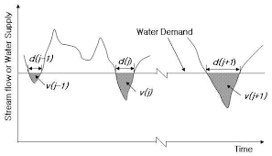
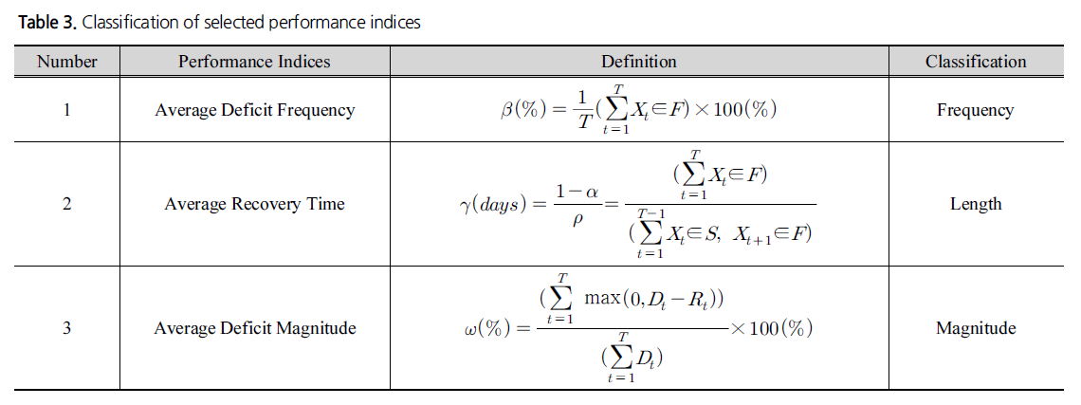
Performance Criteria
Reliability, Resilience & Vulnerability

Slide 24
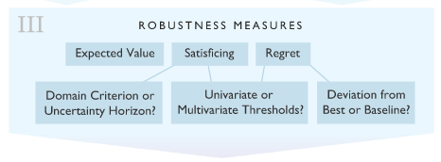
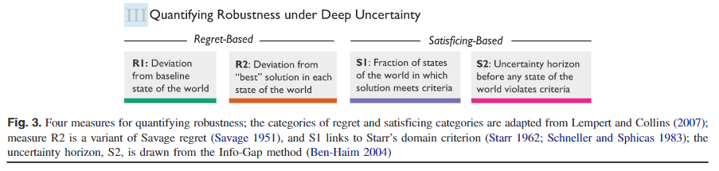
Performance Criteria: Robustness
Among multiple types of robustness measures,
Regret-based: cost of choosing incorrectly (focuses on the incorrect choice of decision alternative) (Savage 1951)
Satisficing-based: tendency of decision makers to seek outcomes that meet one or more requirements but not achieve optimal performance (Simon 1959)

Slide 25
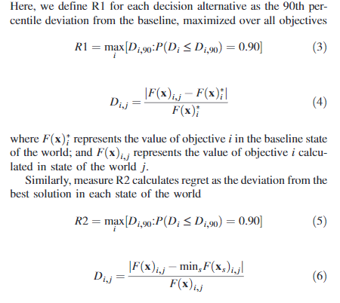

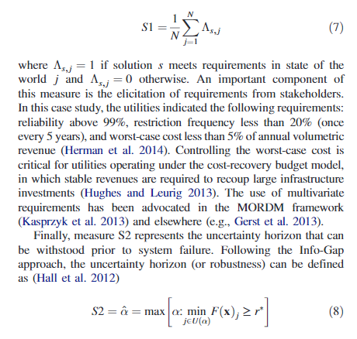
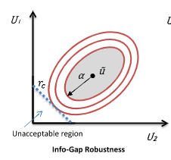
Performance Criteria: Robustness

Slide 26
End of Lecture
May-24 (Today’s Lecture):
Introduction to Final Project B
Lec 07: Probability, Statistics, Uncertainty, and Stochastic Simulations II (including Lec 08: Performance Criteria)
May-31 & Jun-07 (3 & 4)
Lec 09: Water Resources Systems Engineering Frontiers -Introduction and Examples Part 1
Lec 10: Water Resources Systems Engineering Frontiers -Introduction and Examples Part 2 (Invited Talk)

