Slide 1



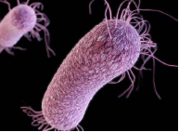
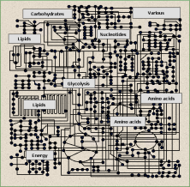
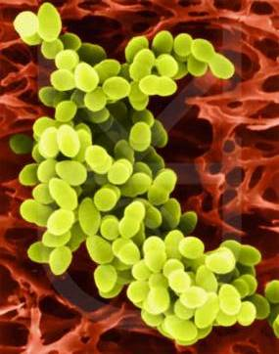
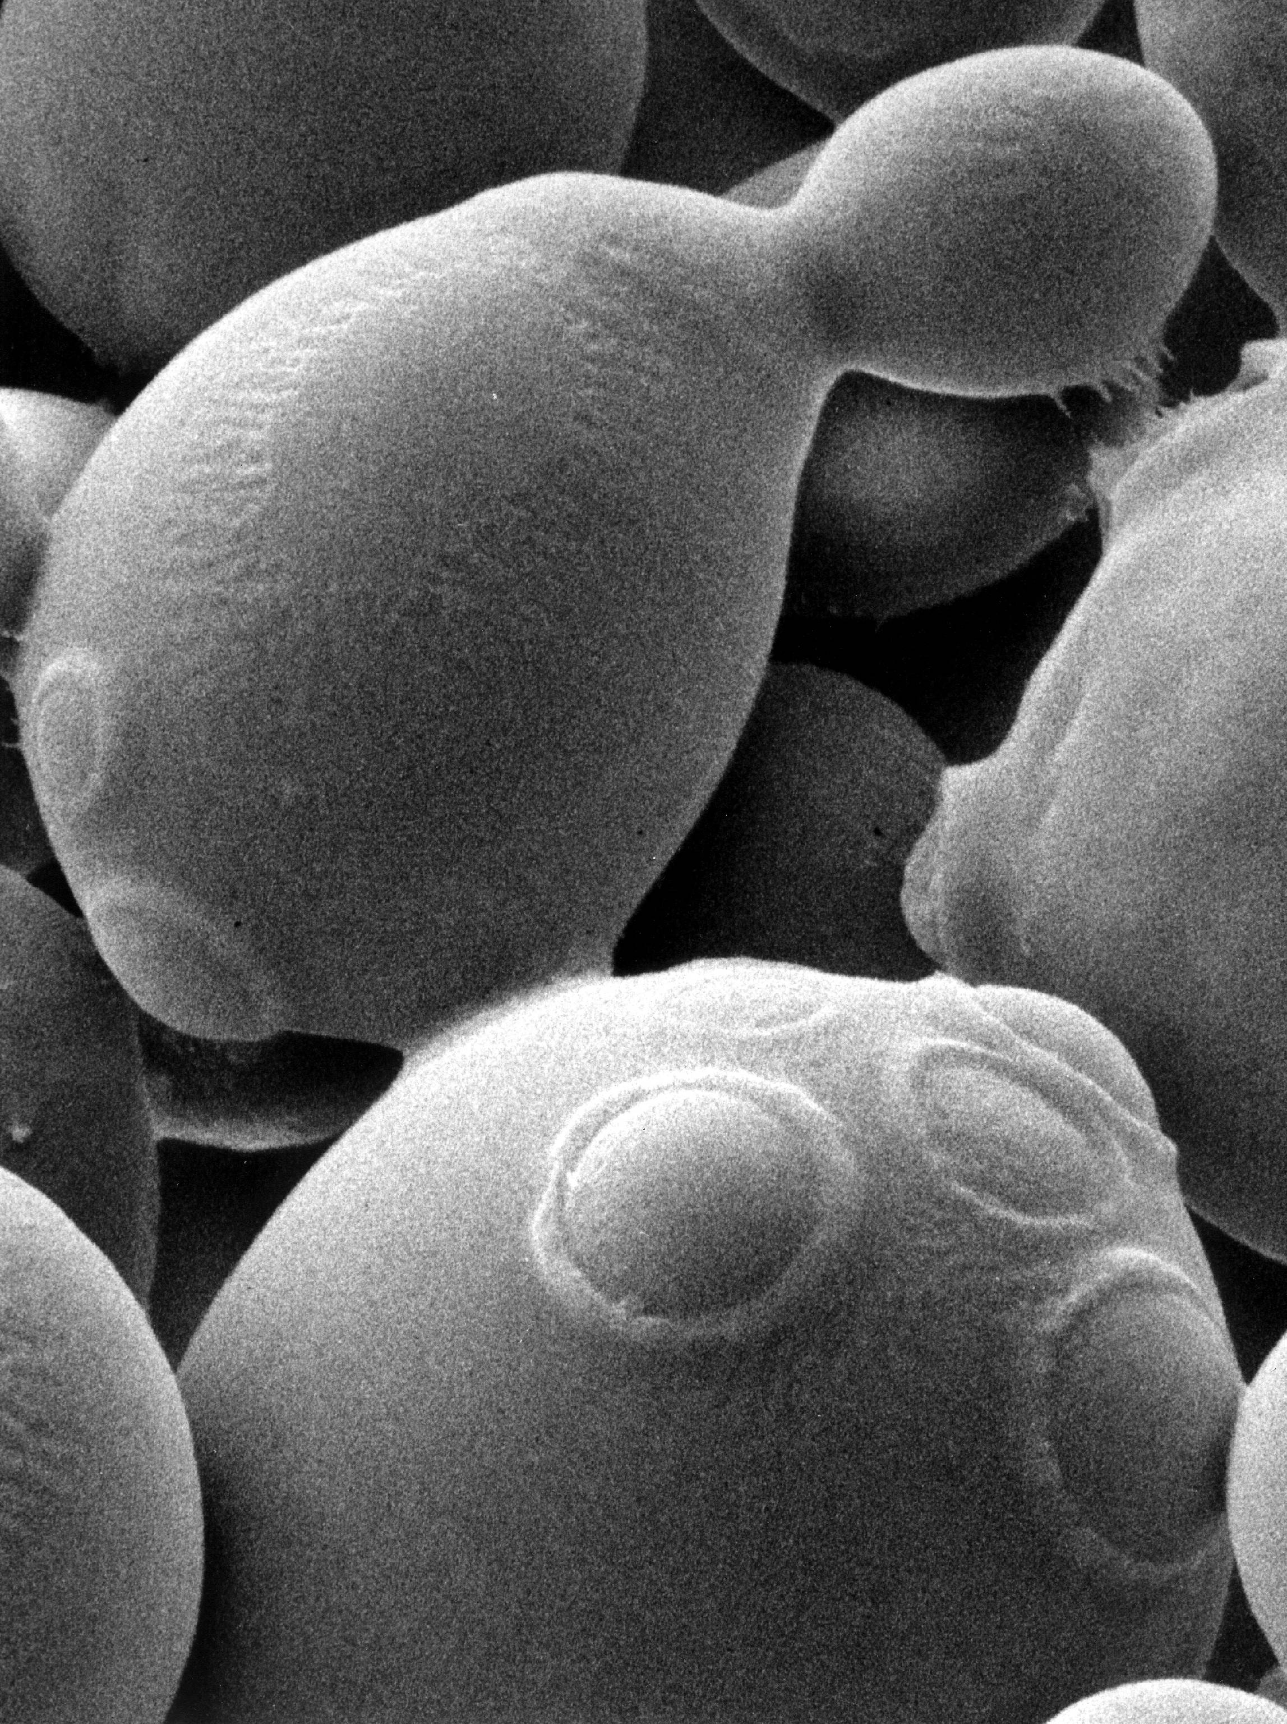
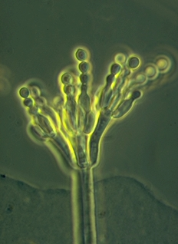
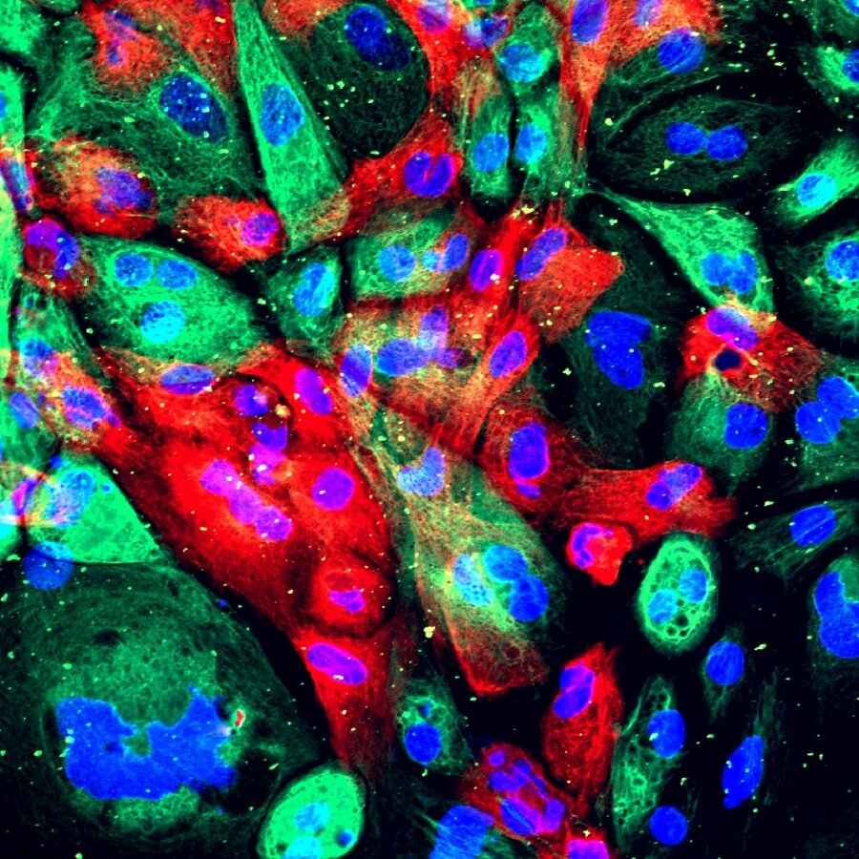
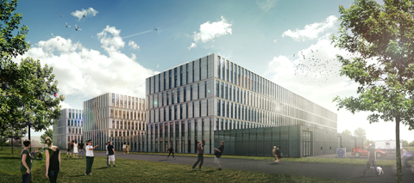

Genomic Architecture
Introduction to the MSc Course
Han de Winde

Slide 2


Genomic Architecture
Three research institutes involved:
- Institute of Biology Leiden (IBL)
- Institute of Environmental Sciences (CML)
- Naturalis Biodiversity Center
Close interactions with:
- Faculty of Science
- Leiden University Medical Centre (LUMC)
- Research institutes and companies, NL and abroad

Slide 3
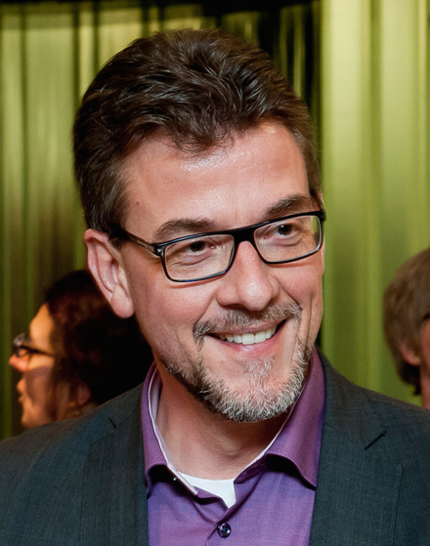
Genomic Architecture
Han de Winde
    Professor of Molecular and Industrial Biotechnology
    Previous: Vice Dean & Director of Education
    (Bio)chemistry, Molecular Biology, Bioinformatics, Systems Biology
    Pseudomonas, Saccharomyces, Aspergillus

Slide 4
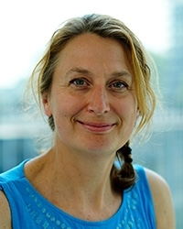
Genomic Architecture
Jo-Anne
Verschoor
Bastienne
Vriesendorp

Slide 5
Genomic Architecture
Jo-Anne Verschoor MSc IBL
Bastienne Vriesendorp MSc IBL
Adam Sidi Mabrouk MSc IBL
Prof. Akos Kovács IBL
Prof. dr. Arthur Ram IBL
Prof. dr. Vera van Noort IBL / KU Leuven (B)
Dr. Nataliia Machushynets IBL
Dr. Paco Barona IBL
Dr. Astri Kusumawardhani Univ. de Lausanne*
Dr. Sjoerd Seekles Univ. de Genève*/Nijmegen
Prof. Dr. Nicole de Voogd Naturalis / IBL
Dr. Ben Wielstra IBL / Naturalis
Dr. Yavuz Ariyurek LGTC / LUMC
Dr. Eveline Altena LUMC / CML
Dr. Gerben Voshol Genomescan bv

Slide 6
Course Objectives
Explain and apply knowledge (theory of genetics, gene
transfer, inheritance) and insight (examples of gene
function, speciation) in the field of genomics
Explain and apply basics of genetic regulatory mechanisms
workshop/assignments/group assignment
Explain, value and discuss state of the art methodology
(next generation sequencing, metagenomics analysis)
used in genomics – active participation/workshop/assignments
Apply basic bioinformatics to analyze, compare and organize genomic information for groups of organisms
bioinformatics assignments
Analyze and evaluate genomic information for answering scientific questions about evolution, development and health of different species – bioinformatics & group assignments

Slide 7
Course Overview
Brightspace pages
Live; ALL recorded (as good as it gets …)
Genome Structure
DNA and RNA structure, aligning basics;
(prokaryotic and eukaryotic genome characteristics)
Genome Structure to Function
genome expression, comparative genomics,
tools for genome analysis
Genome Variation & Development
genome evolution, genome diversity,
communities, microbiomes, wonders of the human genome
Week 4 – Project & study week
Group assignment, PPT presentation, mini-symposium
More details to be given later

Slide 8
Course Schedule
Detailed schedule available on Brightspace
- any changes will be announced

Slide 9
Course Overview
Final Exam, 18 November, USC 75%
digital exam through ANS – register !
Assessments will be digital
Questions based on lectures, literature (concepts !)
Q&A, assignments and modules
Books and papers are supportive
Final Exam obligatory, on-campus @USC
Students with travel restrictions,
or other problems, questions, unclarities;
always contact me (and please do so indeed !!)
Discussion fora on Brightspace – use those !!

Slide 10
Course Overview
Practical assignment – Bioinformatics Pass
Course will finalize with Symposium: 25%
inspection and discussion of posters made
during Week 4, group project week
All (most) lectures will be recorded and made available
All PPTs/pdf’s will be made available
All recommended and support literature via Brightspace
Rehearsal examination questions will be available

Slide 11
Genomic Architecture
Questions ?

