Slide 1
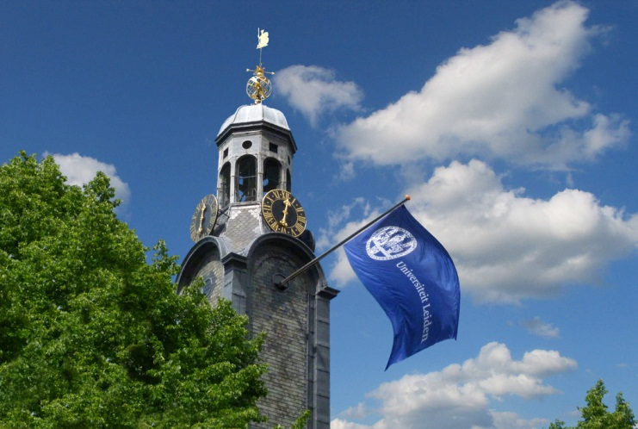

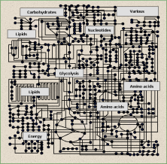
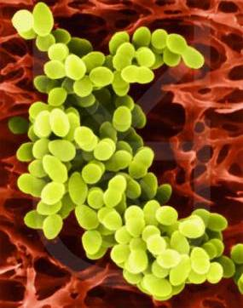
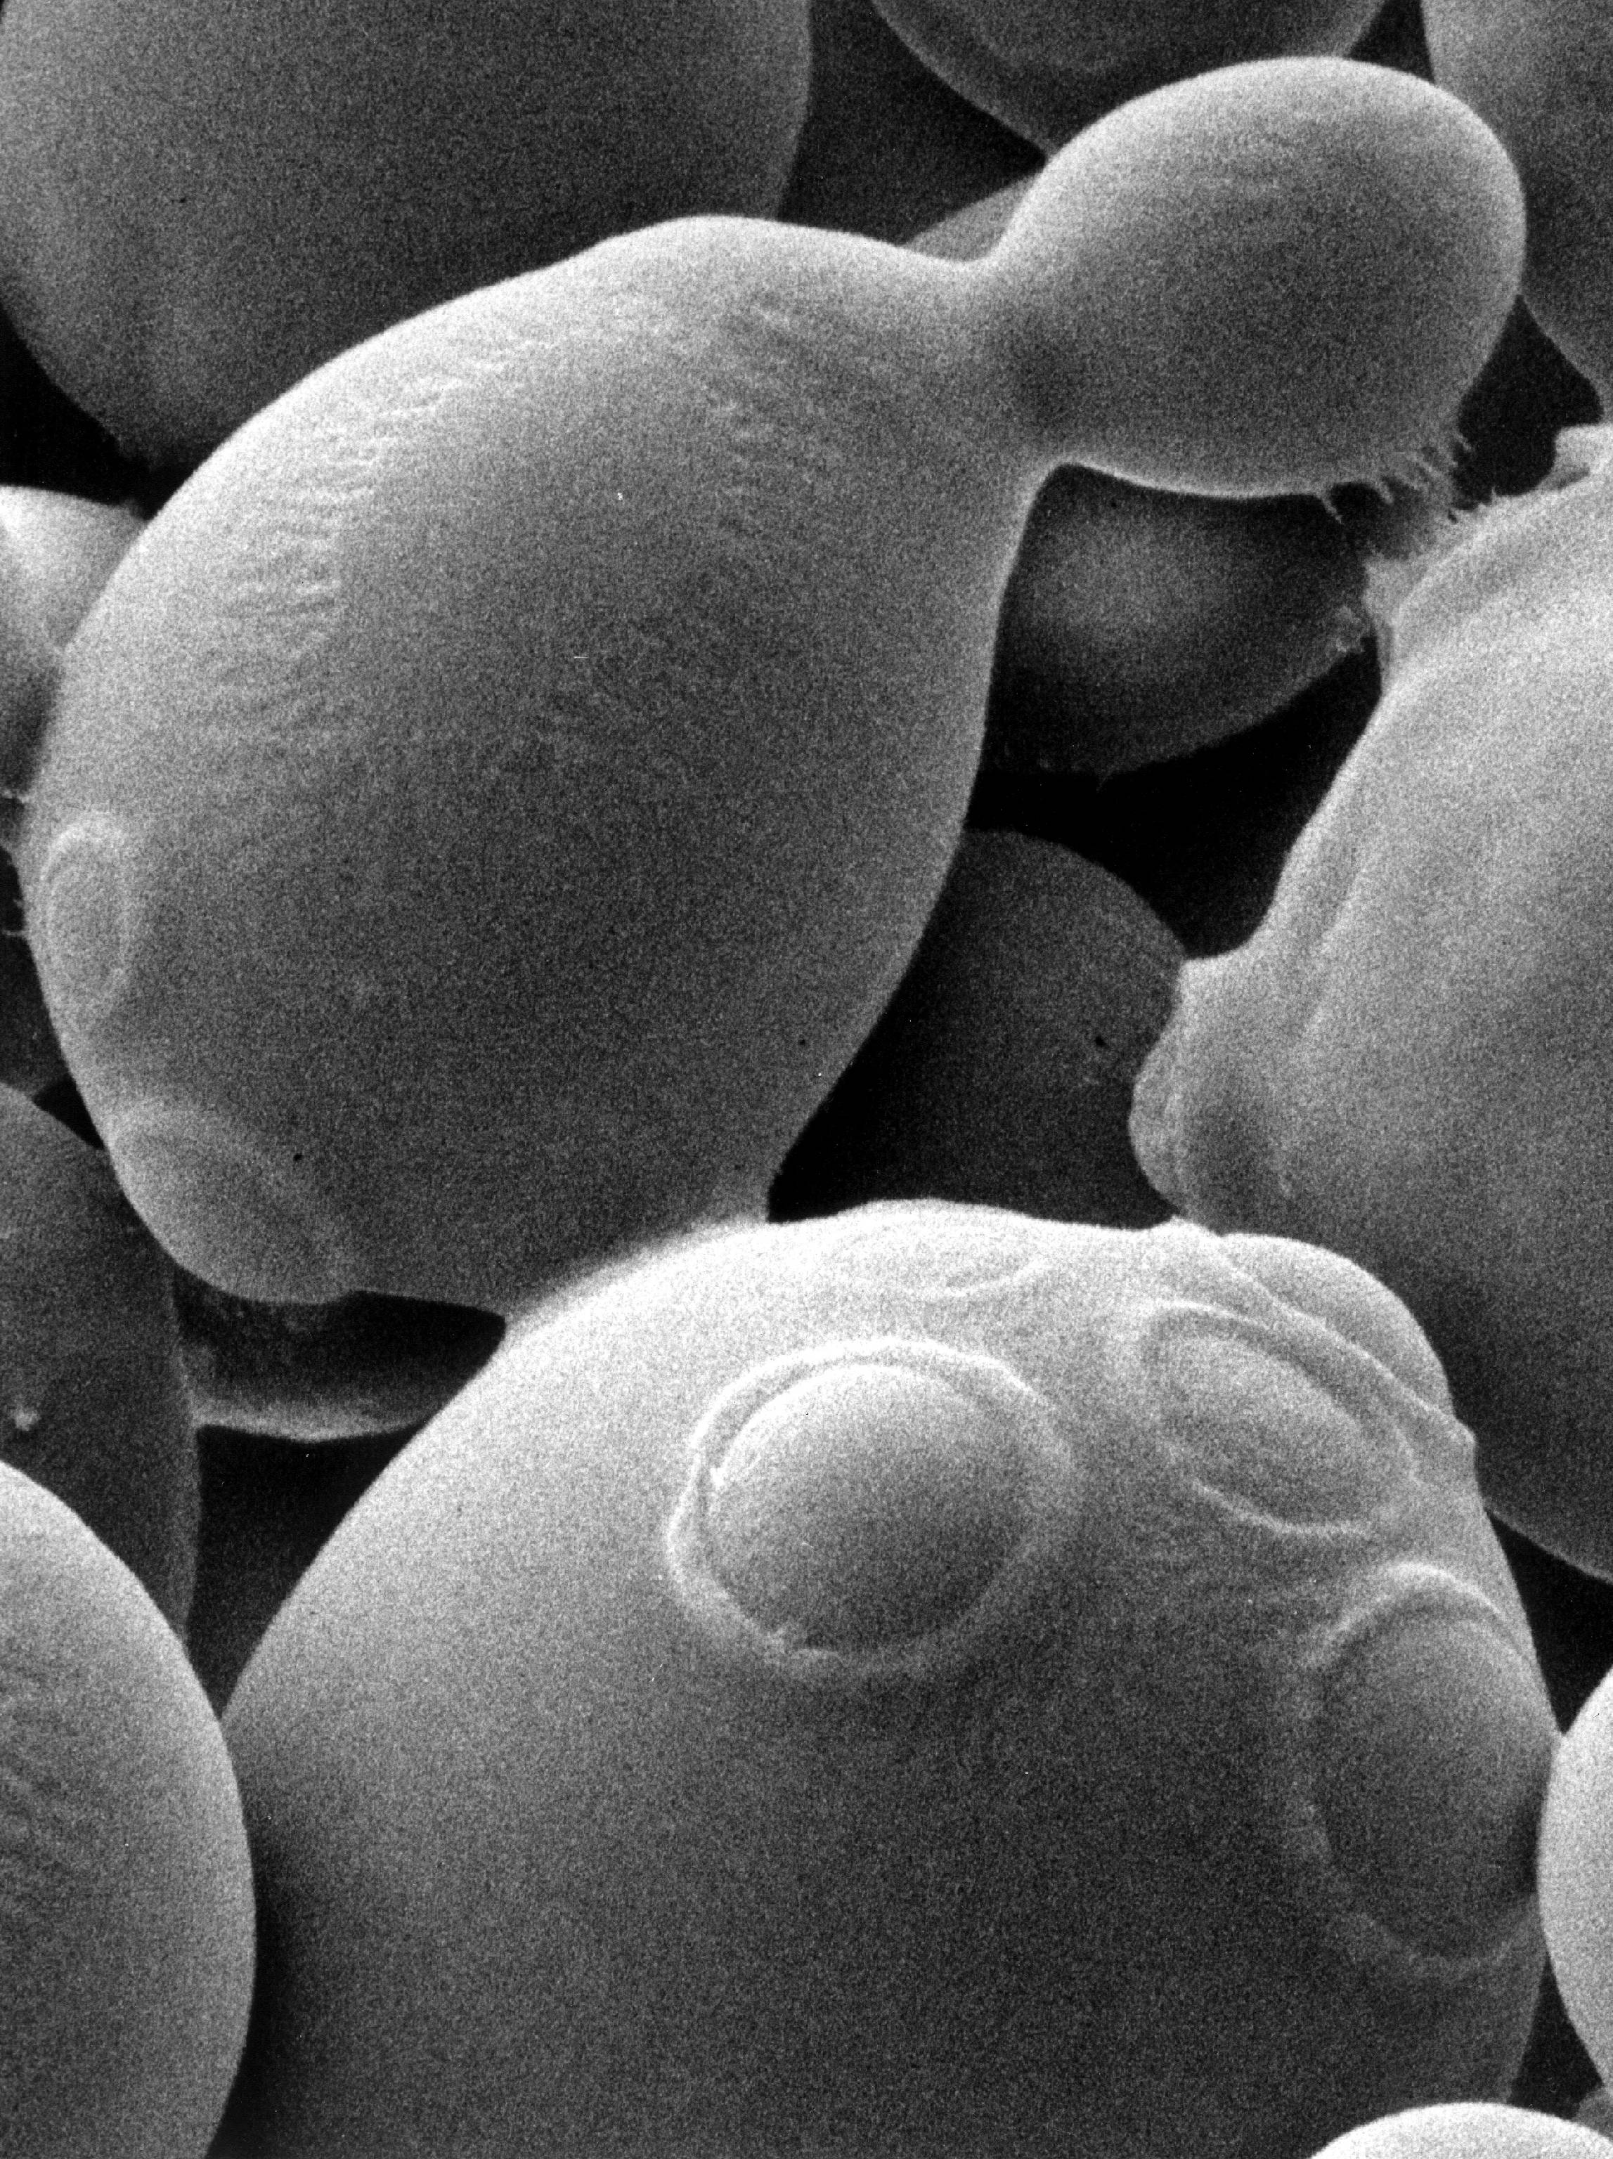
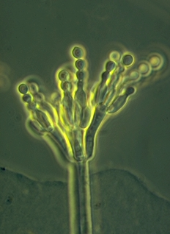
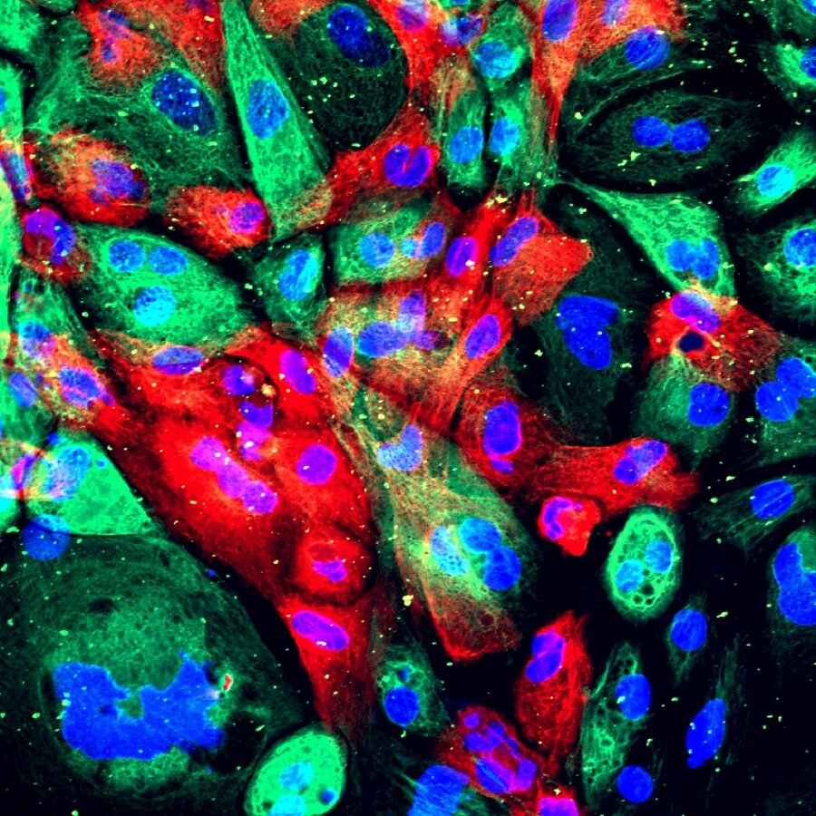
Genomic Architecture
The basics of genomics
Jo-Anne Verschoor
2-10-2024

Slide 2
Program of this lecture
Basis of Life - DNA
A short history lesson
DNA as fundament of research
The central dogma of biology
  Transcription prokaryotes
  Transcription eukaryotes
    Splicing
  Translation
Basics of regulation
Packing DNA in cells

Slide 3
Learning goals
You can describe DNA and explain it’s chemical structure
Understand and explain DNA replication
You can explain the central dogma (DNA-RNA-Protein)
Understand the difference between prokaryotes and eukaryotes through the central dogma
Name the different regulation mechanisms

Slide 4
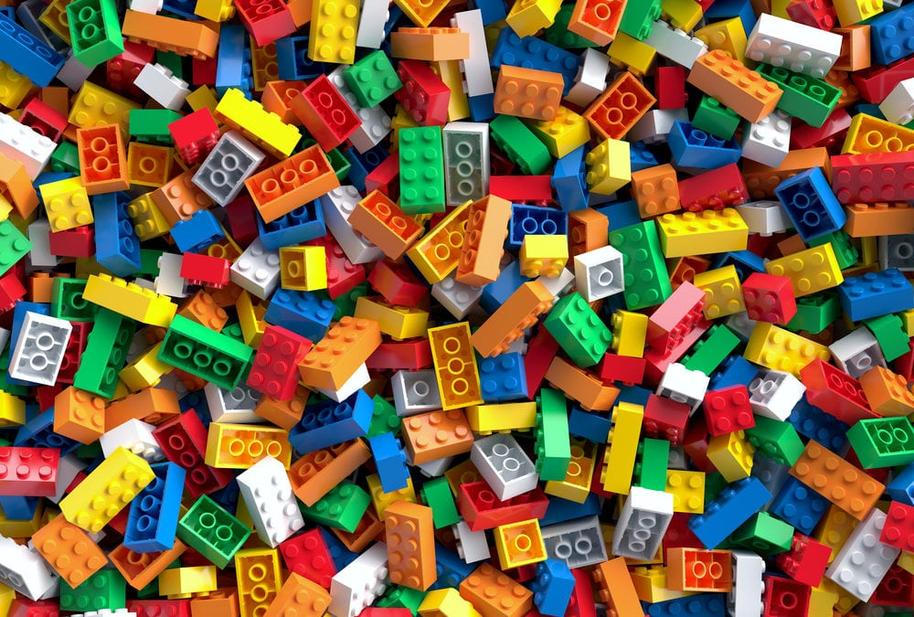
The Basis of life

Slide 5


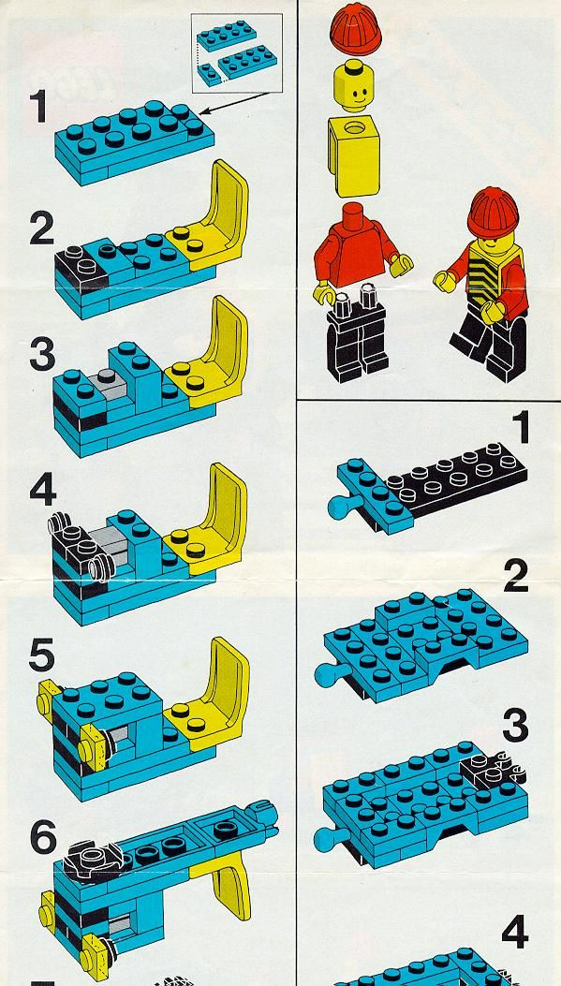
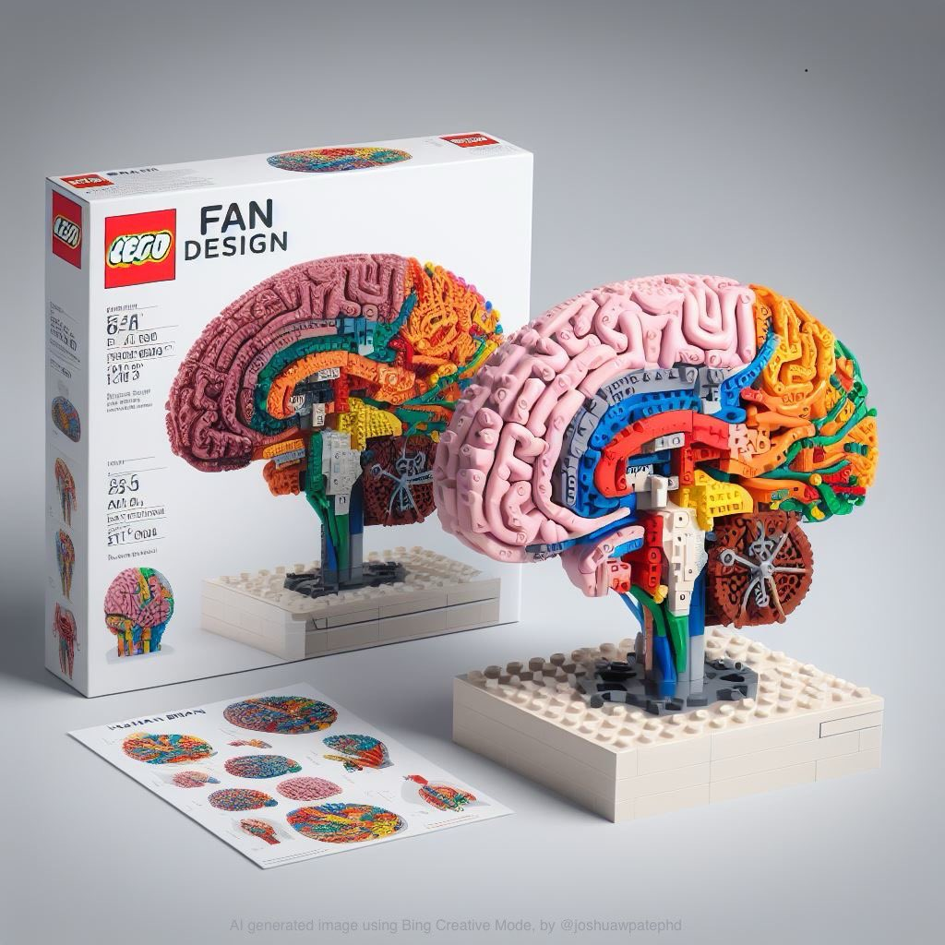
The Basis of life

Slide 6
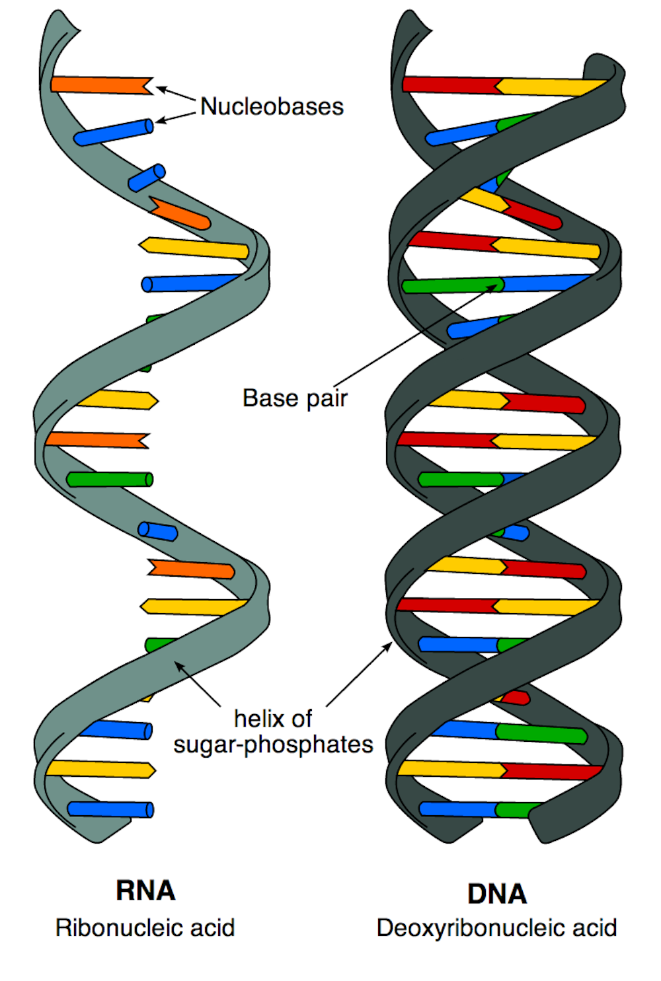
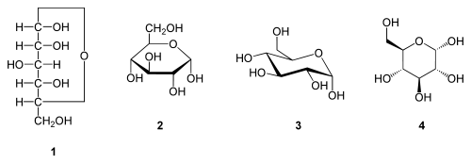
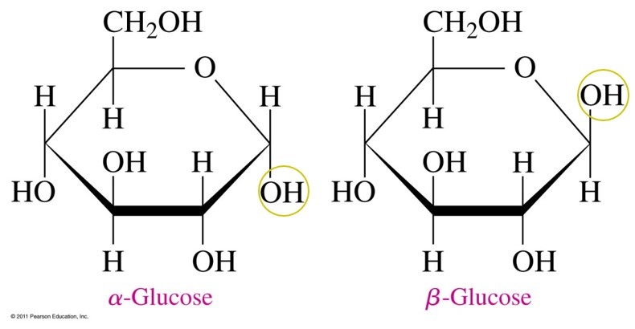
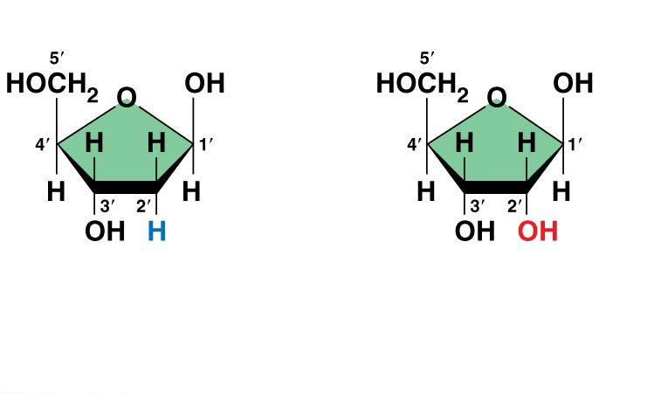
The basic components of DNA
Sugars - Riboses
Deoxyribose
Ribose

Slide 7
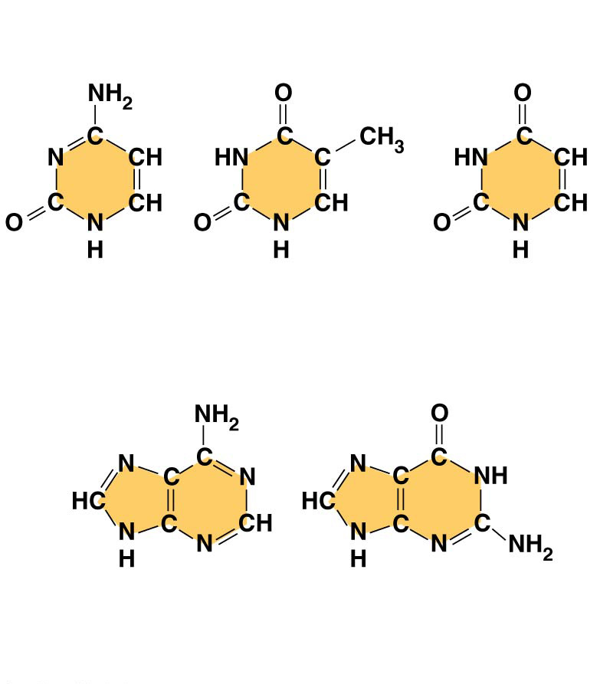
Figure 5.24b
The basic components of DNA
Nitrogenous Bases
Pyrimidines
CUT
Cytosine
(C)
Thymine
(T, in DNA)
Uracil
(U, in RNA)
Purines
Adenine (A)
Guanine (G)
(c) Nucleoside components
Notes:
Figure 5.24b Components of nucleic acids (part 2: nucleoside components, bases)

Slide 8
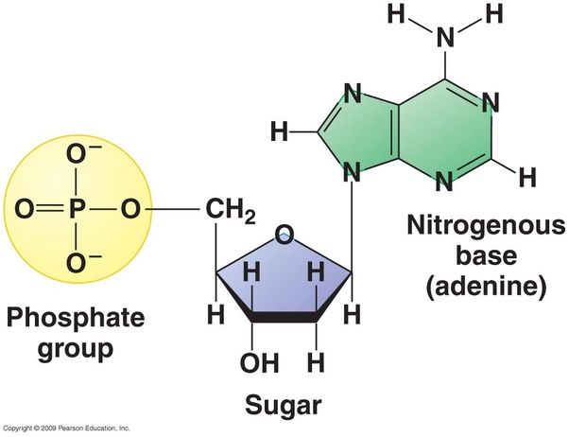
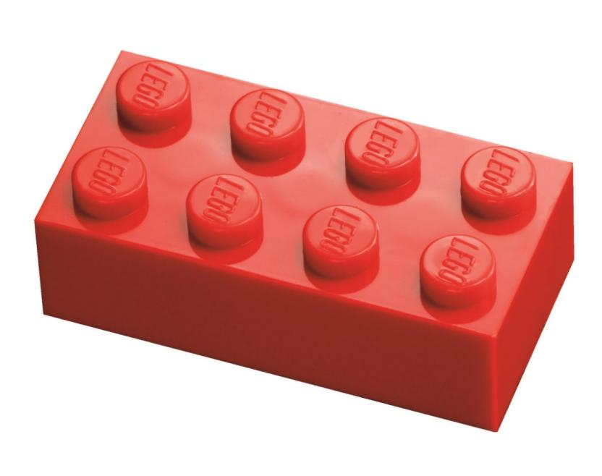
If you combine this with a phosphate group
you get….
A nucleotide
Notes:
Figure 5.24b Components of nucleic acids (part 2: nucleoside components, bases)

Slide 9
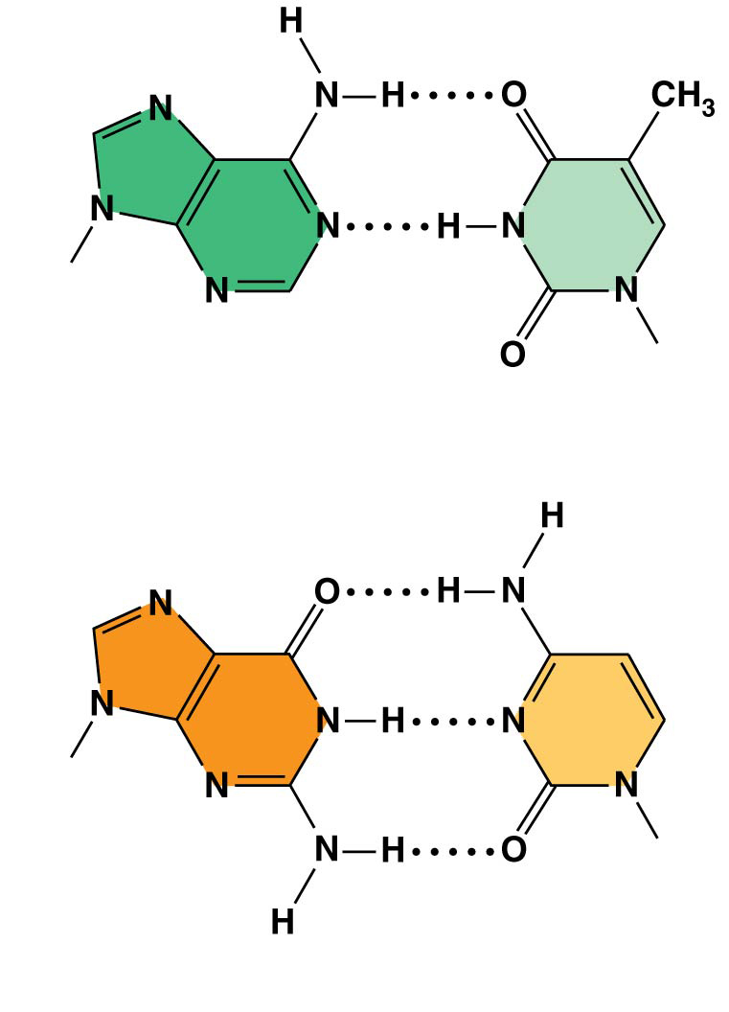
Figure 16.8
Nucleotides like to be in specific pairs
Sugar
Sugar
Adenine (A)
Thymine (T)
Sugar
Sugar
Guanine (G)
Cytosine (C)
Notes:
Figure 16.8 Base pairing in DNA

Slide 10
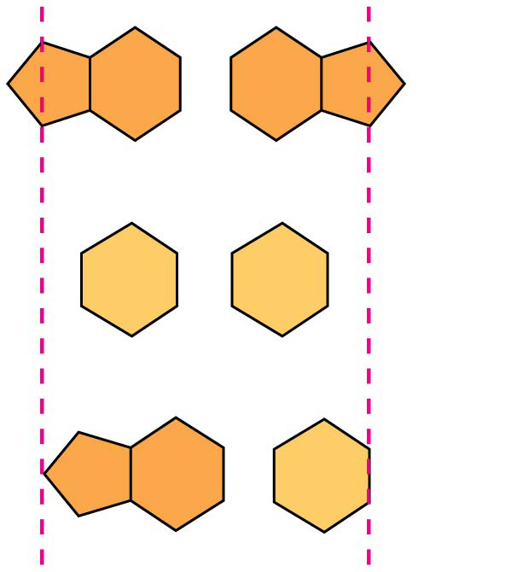
Figure 16.UN02
So close but yet so far…
Purine + purine: too wide
Pyrimidine + pyrimidine: too narrow
Purine + pyrimidine: width
consistent with X-ray data
Notes:
Figure 16.UN02 In-text figure, purines and pyrimidines, p. 318

Slide 11
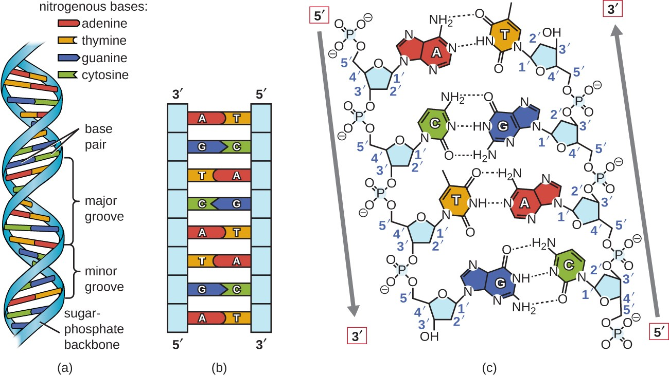
So close but yet so far…
https://courses.lumenlearning.com/microbiology/chapter/structure-and-function-of-dna/
Notes:
Figure 16.UN02 In-text figure, purines and pyrimidines, p. 318

Slide 12
Milestones in ‘DNA’ research
Not known that DNA was linked to genetic units
Arms race between DNA and protein as genetic materials (double helix)
Notes:
For a long time it was an arms race between the people believed in DNA and

Slide 13
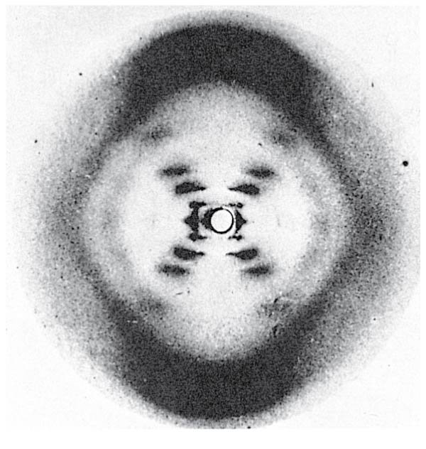
Milestones in ‘DNA’ research

Slide 14
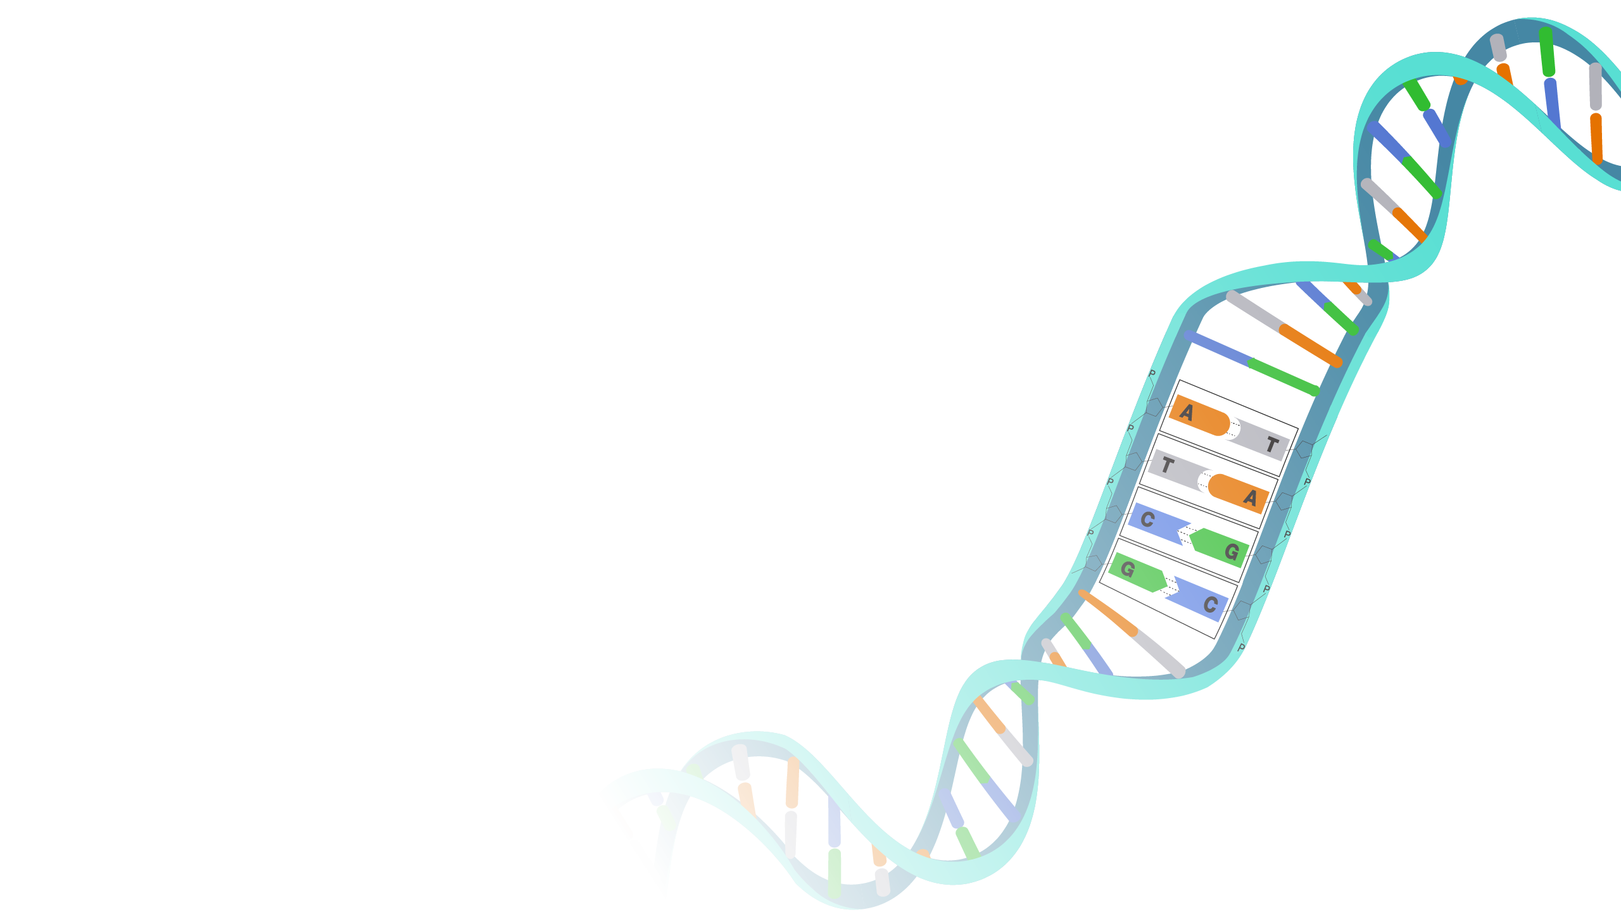
DNA as the foundation of modern research
DNA is a biological macromolecule consisting of two long polymer strands that contains the genetic instructions for development, function, growth, reproduction.
The genome is the complete genetic make-up of an organism or cell
Genomics: the biology concerned with the structure, function, evolution and mapping of genomes
(What may happen)
Notes:
Figure 16.10 Three alternative models of DNA replication

Slide 15
Other facts about genomes
Only small parts of the genome code for proteins
  Regulation
  Targets
  Pseudogenes
  Repetitions
  Expression machinery
Within species small signal nucleotide differences (SNPs) are needed to identify idividuals
  These can have extensive effects for the individual

Slide 16
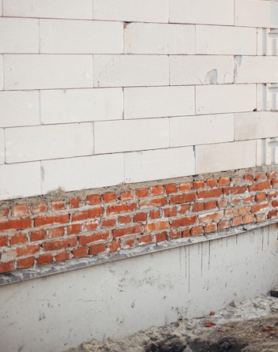
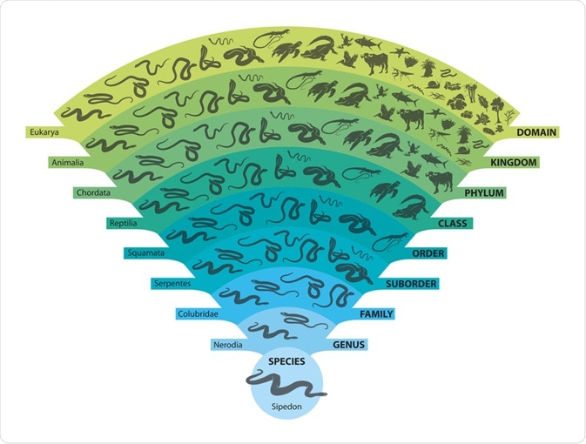
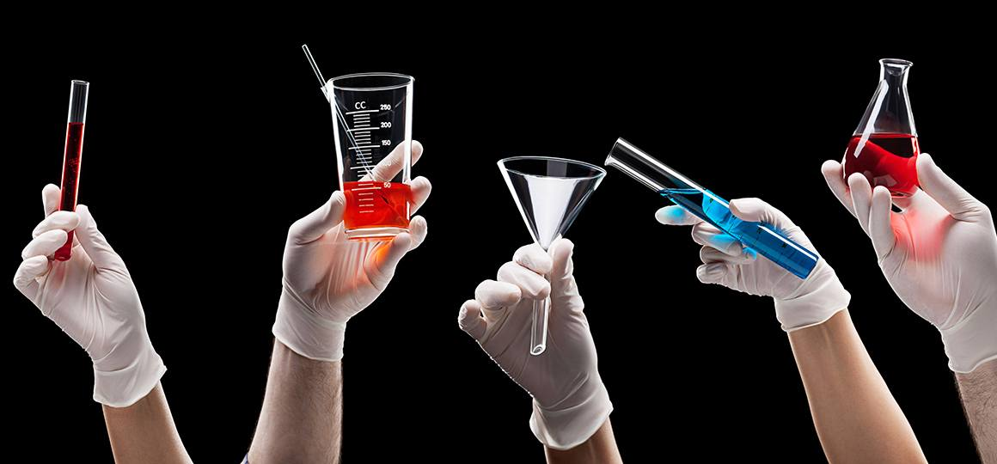
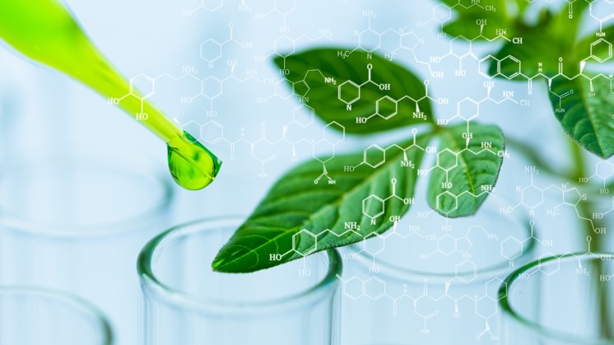
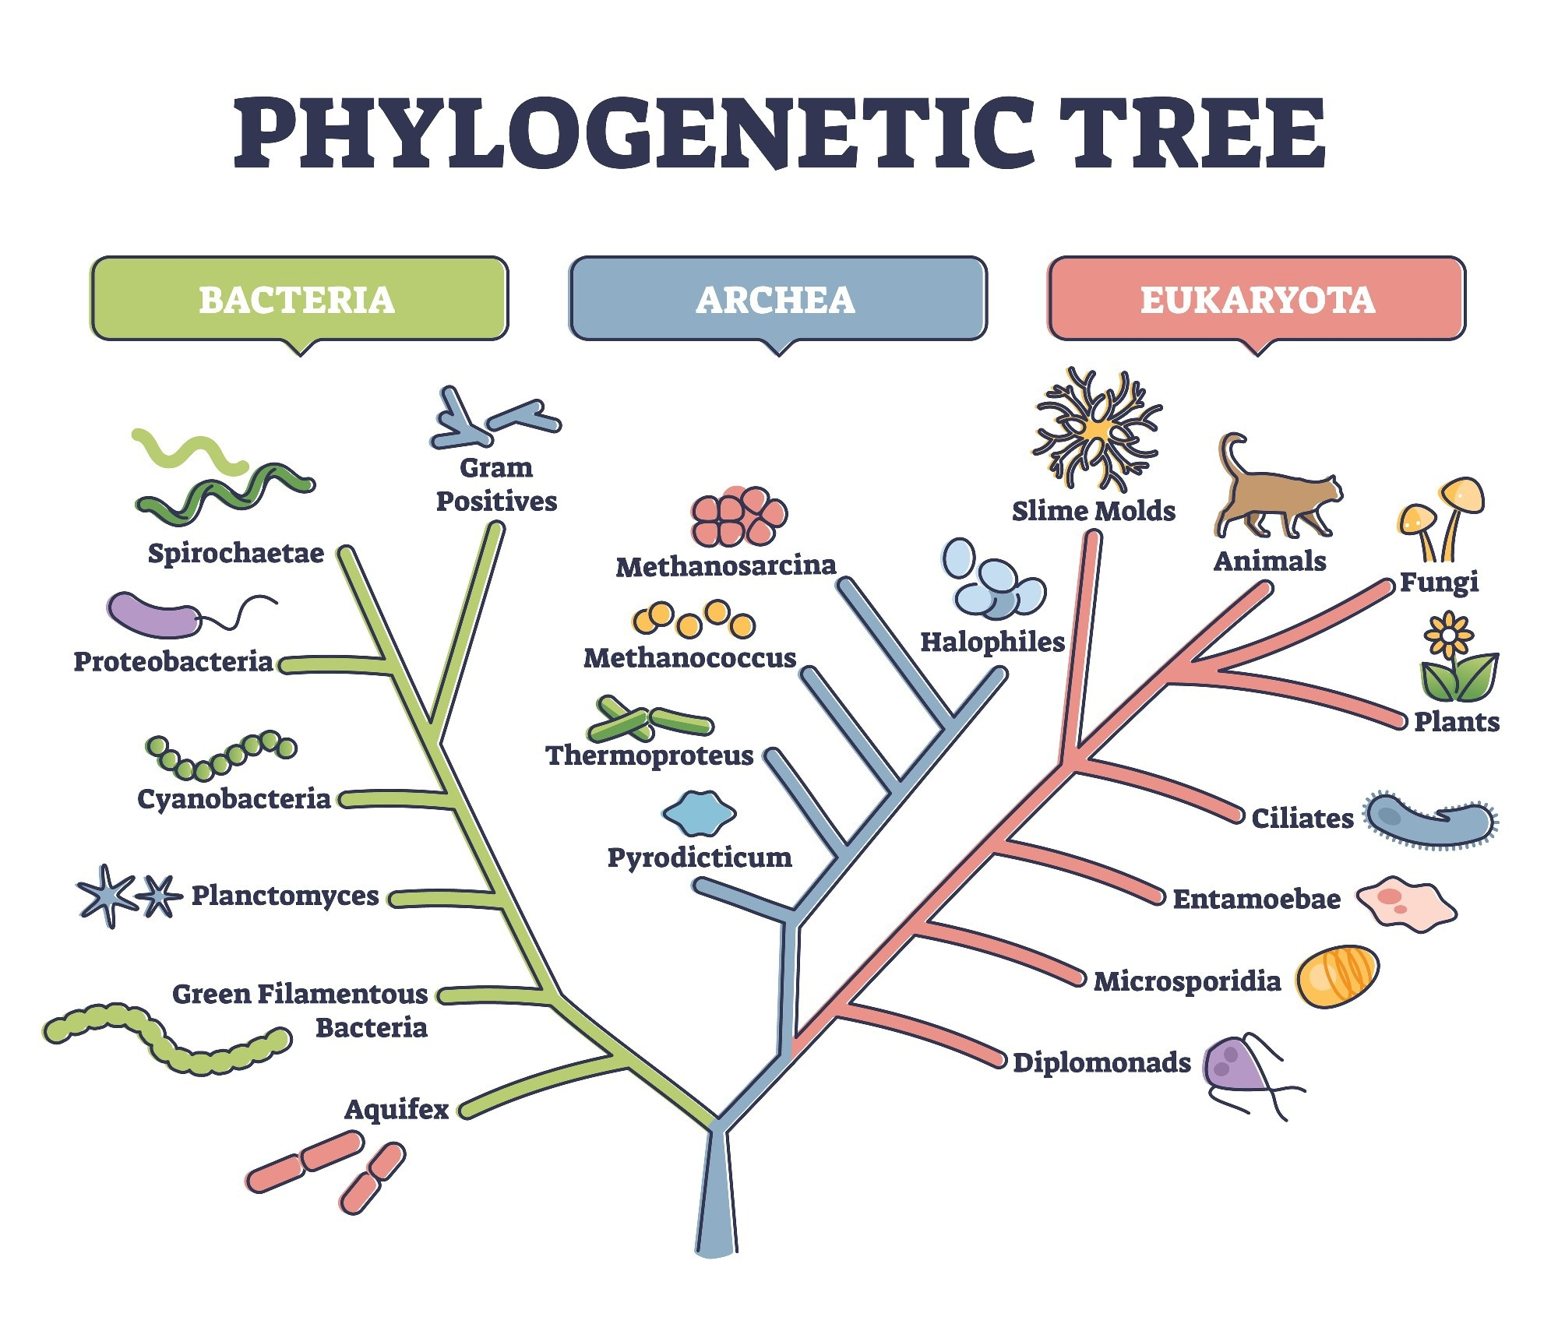

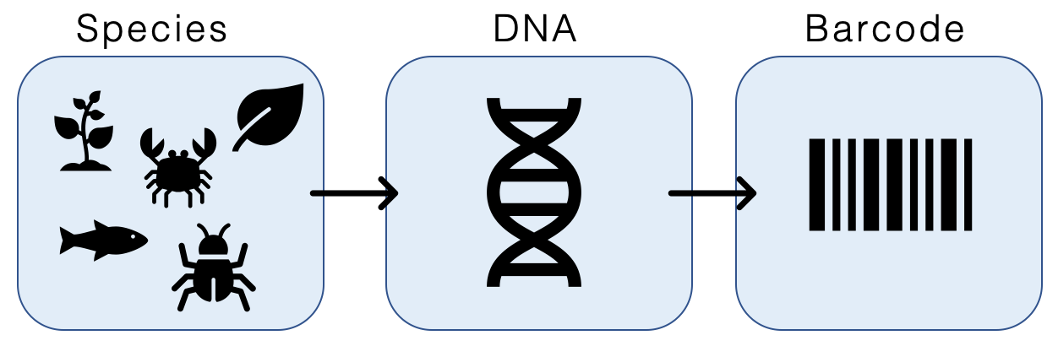
DNA as the foundation of modern research
Understanding the basis is key to understanding your experiments
Notes:
Figure 16.10 Three alternative models of DNA replication

Slide 17
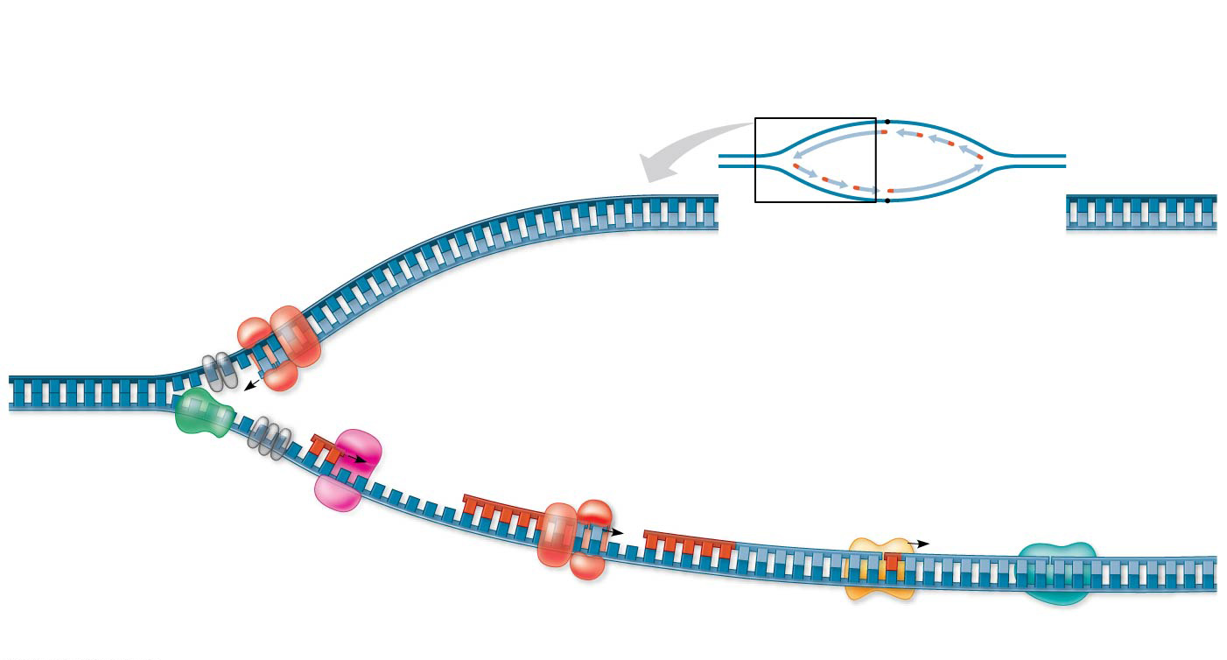
DNA replication
Overview
Leading
strand
Origin of
replication
Lagging
strand
Leading strand
template
3′
Lagging
strand
Leading
strand
Single-strand
binding proteins
5′
Leading strand
Overall directions
of replication
Helicase
5′
DNA pol III
3′
Primer
3′
5′
3′
Primase
Parental
DNA
5
DNA pol III
Lagging
strand
5′
3′
DNA pol I
DNA ligase
4
5′
3
2
1
3′
Topoisopolymerase – relaxes supercoiled DNA
Helicase – unwinds the DNA
Primase - makes short primer
DNA polymerase III – replicates
DNA polymerase I– fills gaps
Ligase – pasts together
5′
Lagging strand
template
DNA always from ‘’5->’3

Slide 18
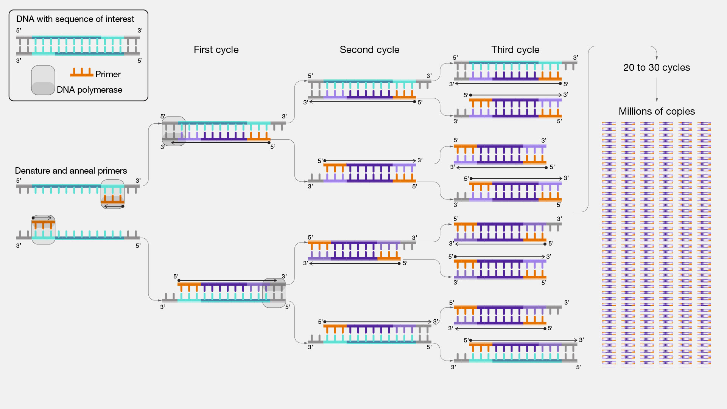
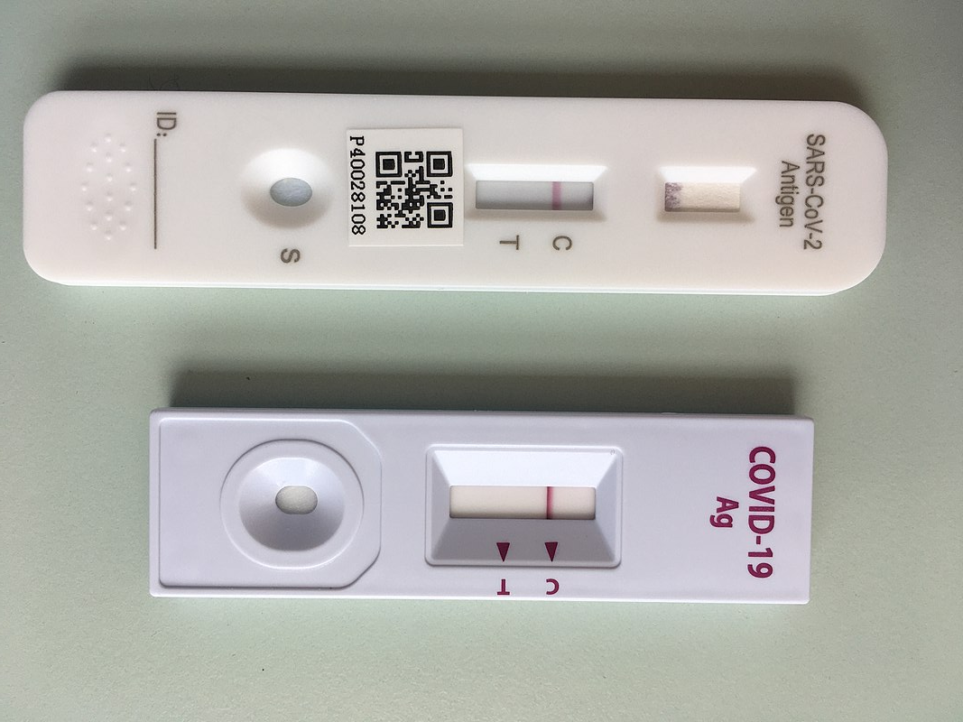
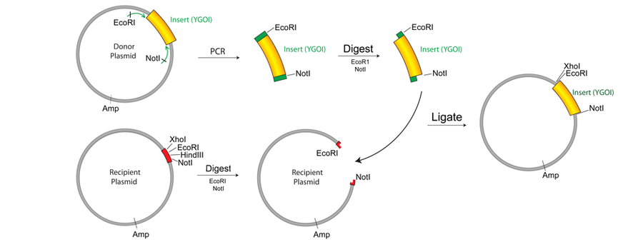
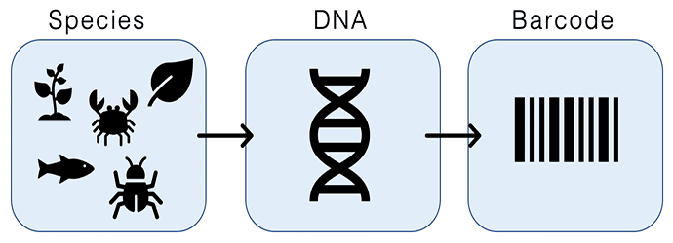
DNA replication base for PCR
DNA amplification

Slide 19
DNA is not the end…. Its just the beginning
Central Dogma

Slide 20
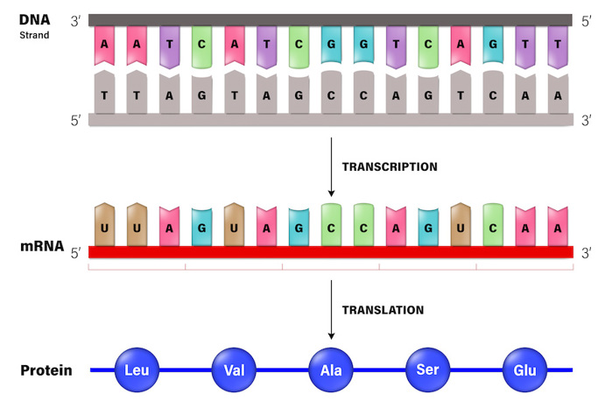
Central dogma – Francis Crick, 1958

Slide 21
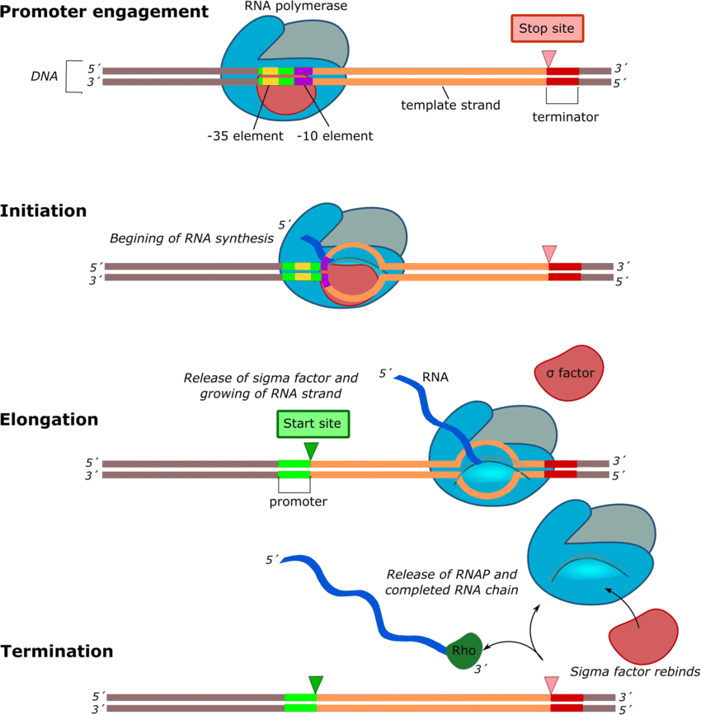
Prokaryotes - Transcription
Promotor
Ribosome binding site
RNA polymerase
Sigma factor
Start codon
Stop codon
terminator

Slide 22
Bacterial genes
Operons, poly-cistronic mRNA’s
Small promoters (regulation)
Genes often clustered in operons
Regulatory element upstream of operons
Notes:
Figure 17.26 Types of small-scale mutations that affect mRNA sequence

Slide 23
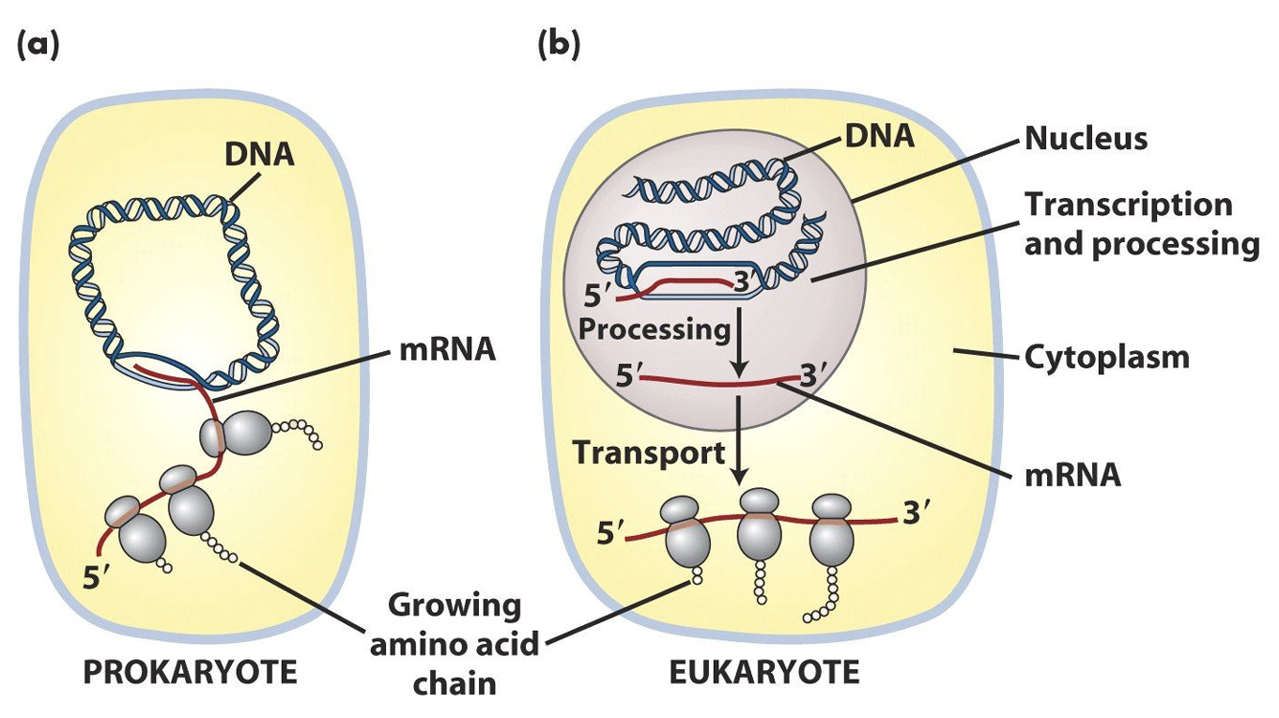
Transcription-Prokaryotes vs Eukaryotes
Molecular biology of the cell

Slide 24
Prokaryotes vs Eukaryotes
Notes:
Figure 17.26 Types of small-scale mutations that affect mRNA sequence

Slide 25
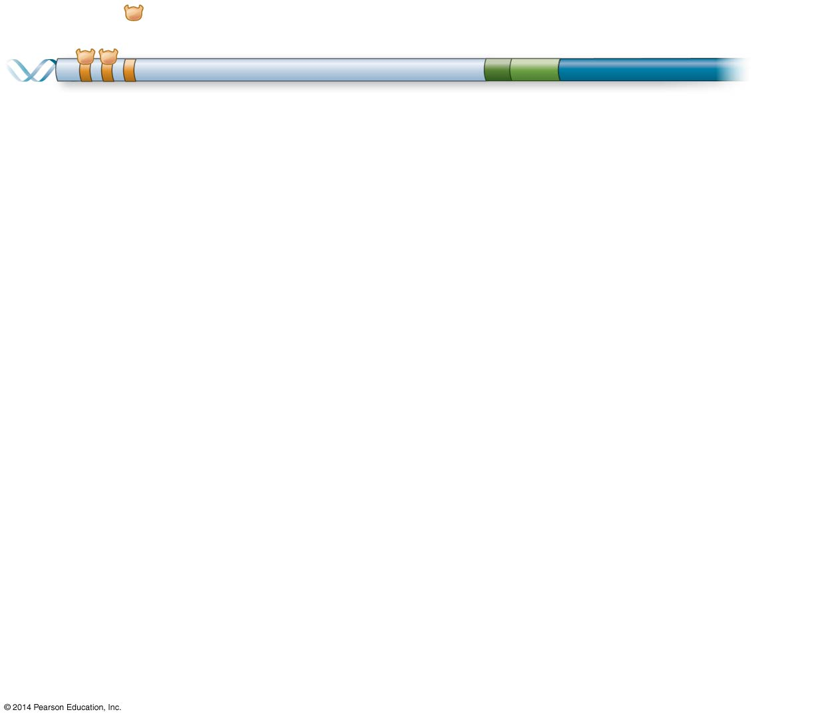
DNA
Activators
Promoter
Gene
Enhancer
Distal control
element
TATA
box
Notes:
Figure 18.10-1 A model for the action of enhancers and transcription activators (step 1)

Slide 26
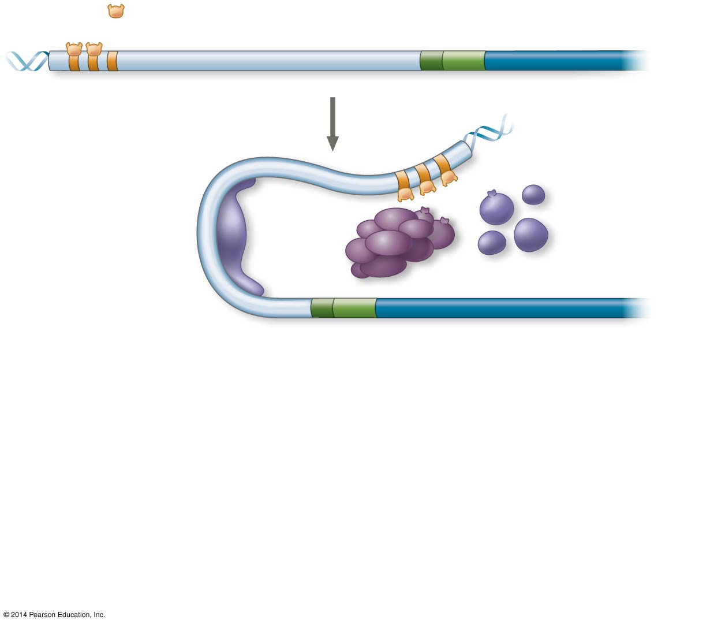
DNA
Activators
Promoter
Gene
Enhancer
Distal control
element
TATA
box
General
transcription
factors
DNA-
bending
protein
Group of mediator proteins
Notes:
Figure 18.10-2 A model for the action of enhancers and transcription activators (step 2)

Slide 27
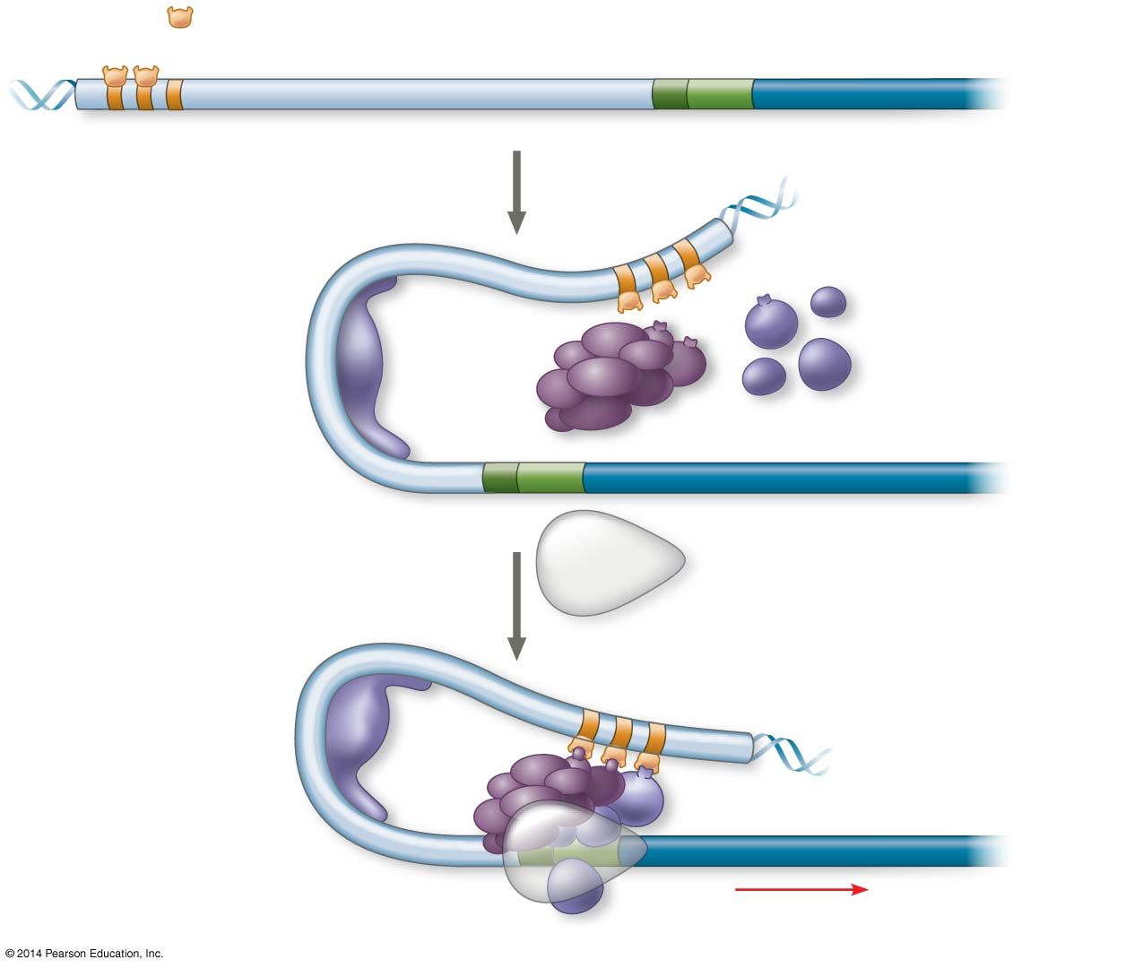
DNA
Activators
Promoter
Gene
Enhancer
Distal control
element
TATA
box
General
transcription
factors
DNA-
bending
protein
Group of mediator proteins
RNA
polymerase II
RNA polymerase II
Transcription
initiation complex
RNA synthesis
Notes:
Figure 18.10-3 A model for the action of enhancers and transcription activators (step 3)

Slide 28
Eukaryotic genes
Transcription initiation complex !
Notes:
Figure 17.26 Types of small-scale mutations that affect mRNA sequence

Slide 29
Eukaryotic genes
Splicing
Notes:
Figure 18.10-3 A model for the action of enhancers and transcription activators (step 3)

Slide 30
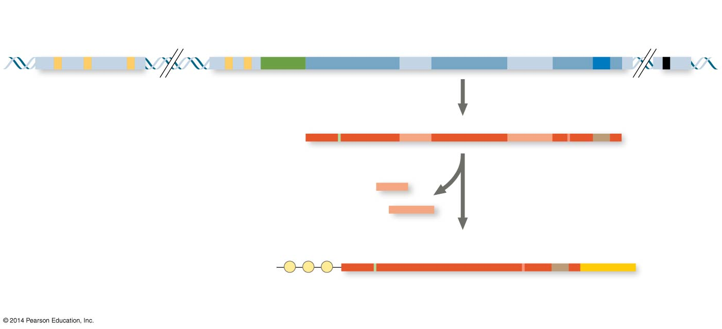
Eukaryotic genes
Splicing and poly-Adenylation
Enhancer (group of
distal control elements)
Proximal
control elements
Transcription
start site
Poly-A signal
sequence
Transcription
termination
region
DNA
Exon
Intron
Exon
Intron
Exon
Upstream
Promoter
Downstream
Transcription
Poly-A
signal
Primary RNA
transcript
(pre-mRNA)
Exon
Intron
Exon
Intron
Exon
Cleaved 3′ end
of primary
transcript
5′
Intron RNA
RNA processing
Coding segment
mRNA
G P P P
AAA⋯AAA
3′
5′ Cap
5′ UTR
Start
codon
Stop
codon
3′ UTR
Poly-A
tail
Exon -> expression
Intron -> removed
Notes:
Figure 18.10-3 A model for the action of enhancers and transcription activators (step 3)

Slide 31
Eukaryotic genes
Alternative splicing and poly-Adenylation
Notes:
Figure 18.10-3 A model for the action of enhancers and transcription activators (step 3)

Slide 32
Eukaryotic genes
Alternative splicing
Notes:
Figure 18.10-3 A model for the action of enhancers and transcription activators (step 3)

Slide 33
Eukaryotic genes
Alternative splicing caused by DNA mutations !
Notes:
Figure 18.10-3 A model for the action of enhancers and transcription activators (step 3)

Slide 34
Eukaryotic genes
Single genes, monocistronic mRNA, intron splicing
- Large promoters (-> 1000s of bp)
Regulatory elements upstream, downstream,
and in introns/exons
Introns and exons in
Notes:
Figure 17.26 Types of small-scale mutations that affect mRNA sequence

Slide 35
Transcription the recipe for proteins
RNA: ribonucleic acid, a nucleic acid present in all living cells. Its principal role is to act as a messenger carrying instructions from DNA for controlling the synthesis of proteins, although in some viruses RNA rather than DNA carries the genetic information.
The transcriptome a collection of all RNA transcripts (coding and non-coding) in an individual or collection of cells (full-organism)
(What can happen)
Notes:
Figure 16.10 Three alternative models of DNA replication

Slide 36
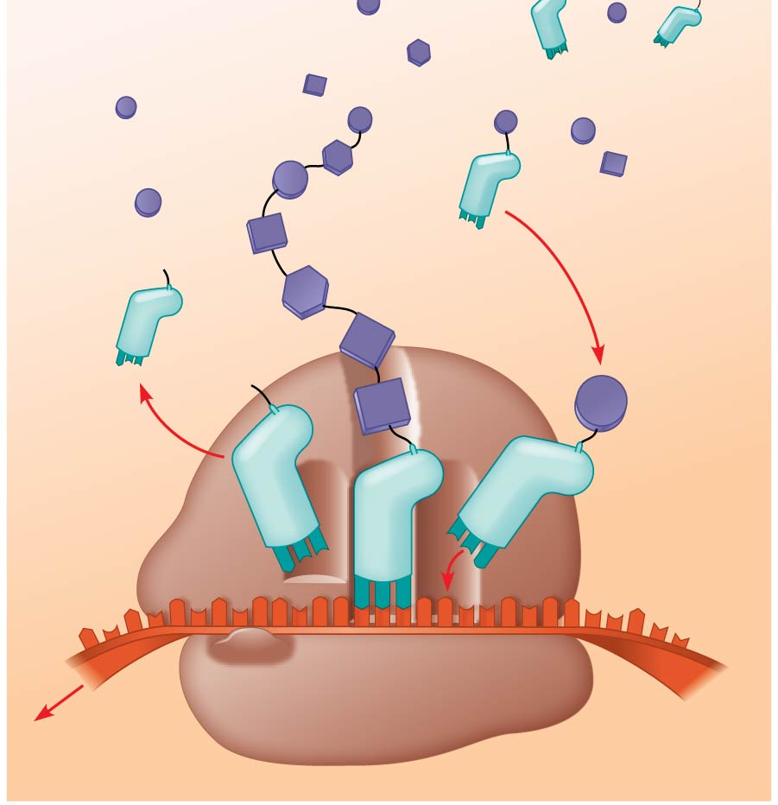
Translation
Amino
acids
Polypeptide
tRNA with
amino acid
attached
Ribosome
Trp
Phe
Gly
tRNA
C
C
C
Anticodon
A
C
G
A
A
A
U
G
G
U
U
U
G
G
C
5′
Codons
3′
mRNA
https://youtu.be/5bLEDd-PSTQ
Notes:
Figure 17.14 Translation: the basic concept

Slide 37
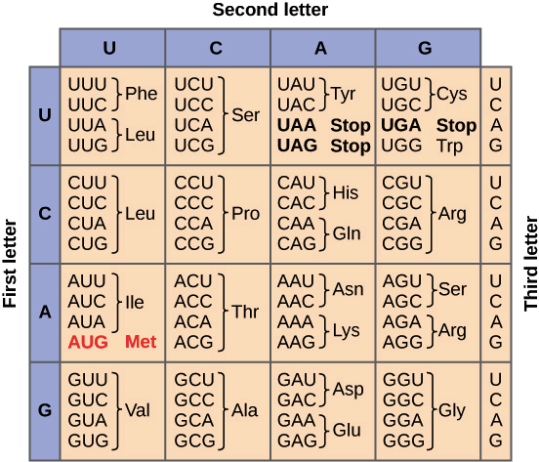
Notes:
Figure 17.5 The codon table for mRNA

Slide 38
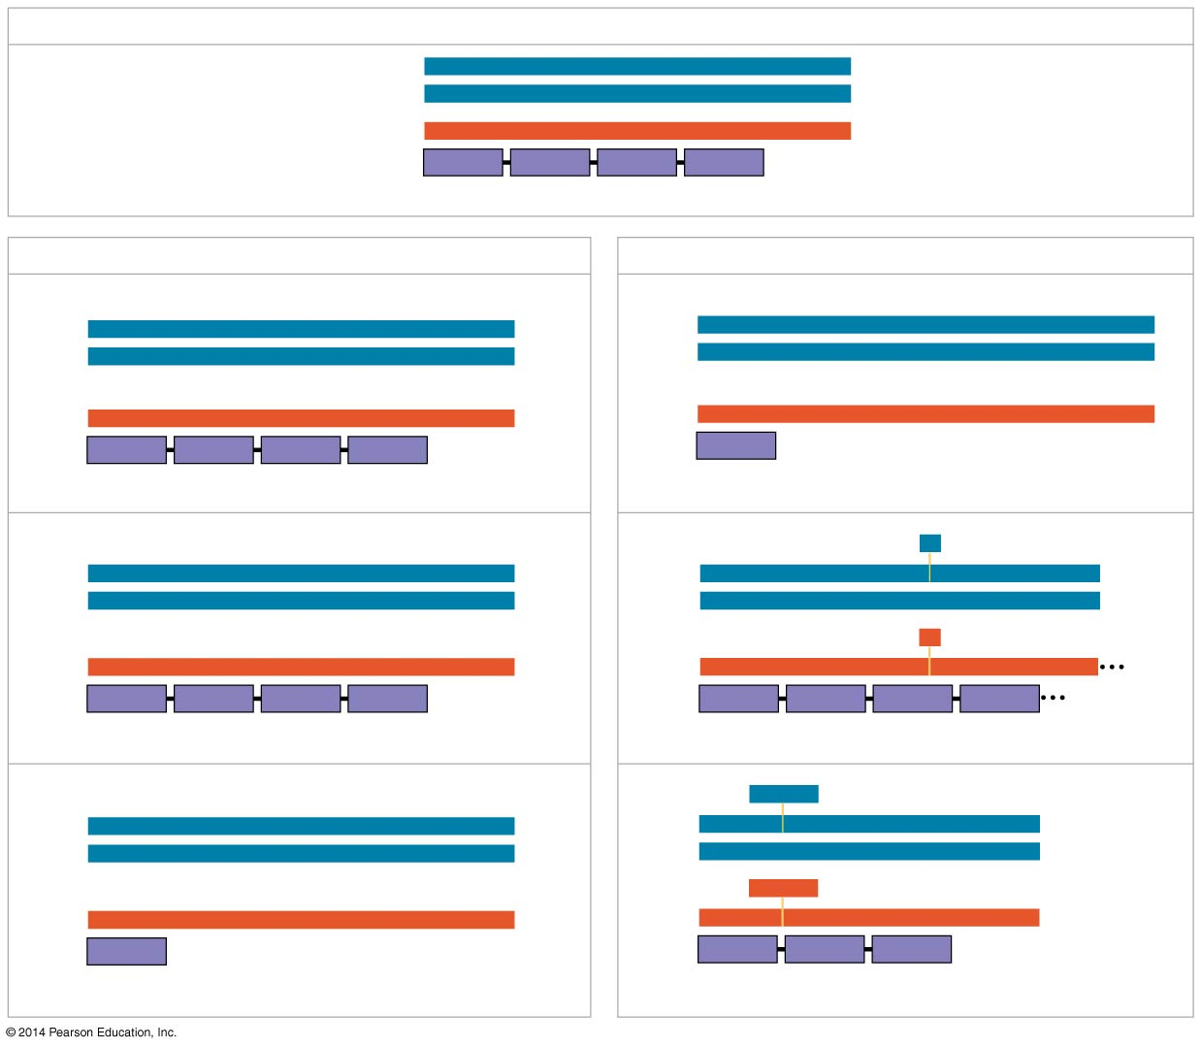
Wild type
DNA template strand
3′
T
A
C
T
T
C
A
A
A
C
C
G
A
T
T
5′
5′
A
T
G
A
A
G
T
T
T
G
G
C
T
A
A
3′
mRNA
Protein
5′
A
U
G
A
A
G
U
U
U
G
G
C
U
A
A
3′
Met
Lys
Phe
Gly
Stop
Amino end
Carboxyl end
(a) Nucleotide-pair substitution
(b) Nucleotide-pair insertion or deletion
A instead of G
Extra A
3′
T
A
C
T
T
C
A
A
A
C
C
A
A
T
T
5′
3′
T
A
C
A
T
T
C
A
A
A
C
C
G
A
T
T
5′
5′
A
T
G
A
A
G
T
T
T
G
G
T
T
A
A
3′
5′
A
T
G
T
A
A
G
T
T
T
G
G
C
T
A
A
3′
U instead of C
Extra U
5′
A
U
G
A
A
G
U
U
U
G
G
U
U
A
A
3′
5′
A
U
G
U
A
A
G
U
U
U
G
G
C
U
A
A
3′
Met
Lys
Phe
Gly
Stop
Met
Stop
Stop
Silent
Frameshift (1 nucleotide-pair insertion)
T instead of C
A
missing
3′
T
A
C
T
T
C
A
A
A
T
C
G
A
T
T
5′
3′
T
A
C
T
T
C
A
A
C
C
G
A
T
T
5′
5′
A
T
G
A
A
G
T
T
T
A
G
C
T
A
A
3′
5′
A
T
G
A
A
G
T
T
G
G
C
T
A
A
3′
A instead of G
U
missing
5′
A
U
G
A
A
G
U
U
U
A
G
C
U
A
A
3′
5′
A
U
G
A
A
G
U
U
G
G
C
U
A
A
3′
Met
Lys
Phe
Ser
Stop
Met
Lys
Leu
Ala
Missense
Frameshift (1 nucleotide-pair deletion)
A instead of T
T
T
C
missing
3′
T
A
C
A
T
C
A
A
A
C
C
G
A
T
T
5′
3′
T
A
C
A
A
A
C
C
G
A
T
T
5′
5′
A
T
G
T
A
G
T
T
T
G
G
C
T
A
A
3′
5′
A
T
G
T
T
T
G
G
C
T
A
A
3′
U instead of A
A
A
G
missing
5′
A
U
G
U
A
G
U
U
U
G
G
U
U
A
A
3′
5′
A
U
G
U
U
U
G
G
C
U
A
A
3′
Met
Stop
Met
Phe
Gly
Stop
Nonsense
3 nucleotide-pair deletion
Notes:
Figure 17.26 Types of small-scale mutations that affect mRNA sequence

Slide 39
Translation – Where?

Slide 40
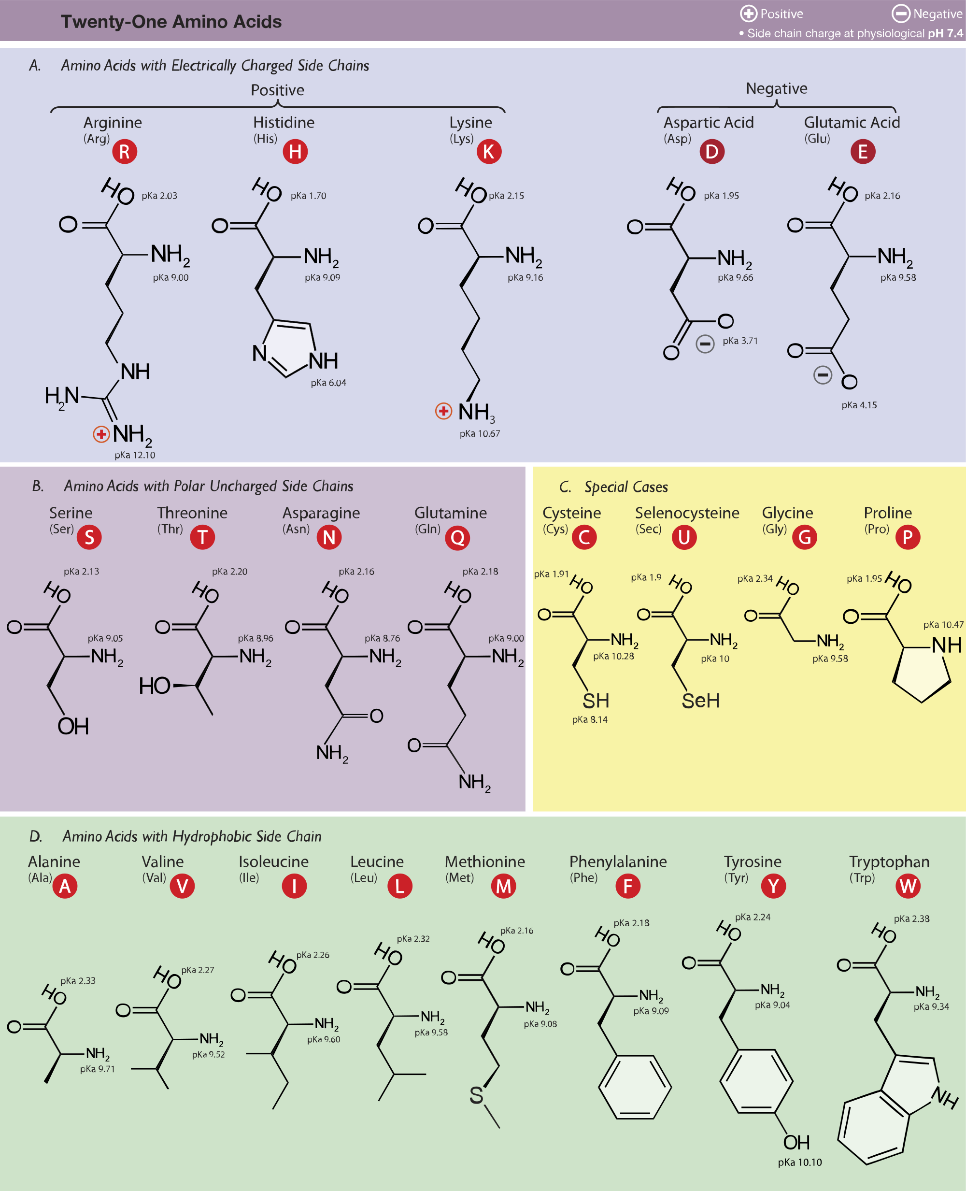
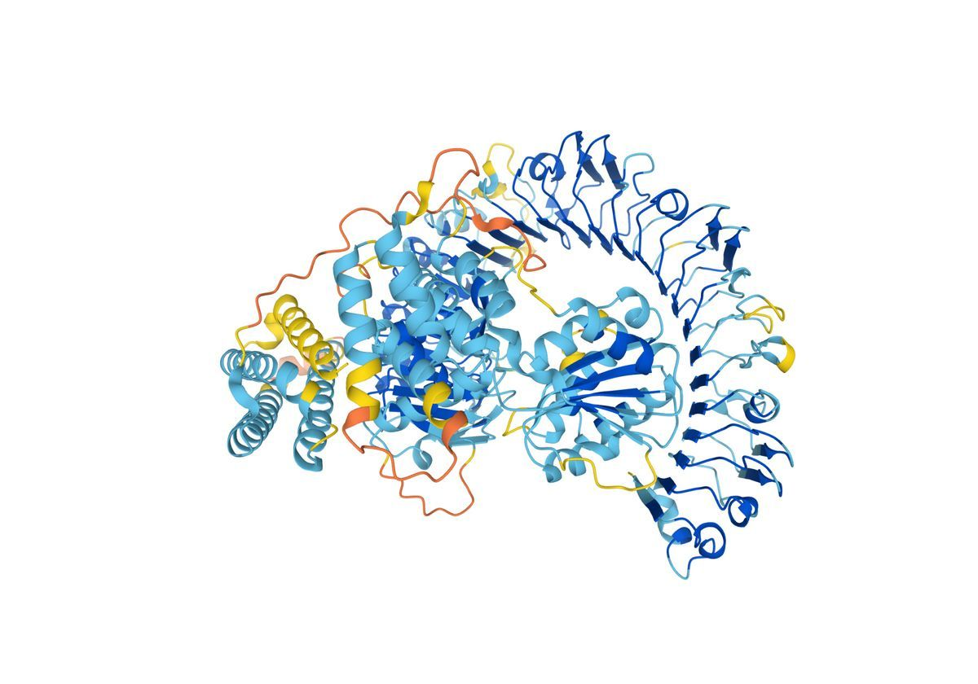
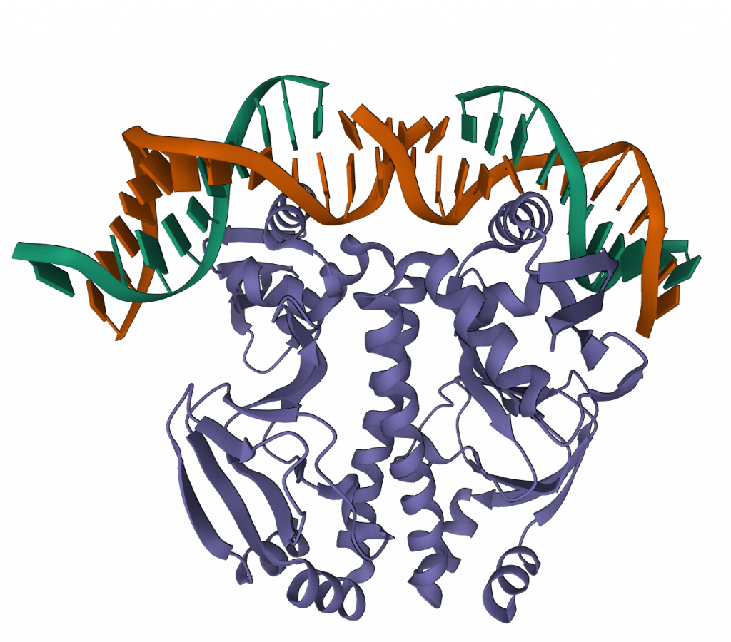
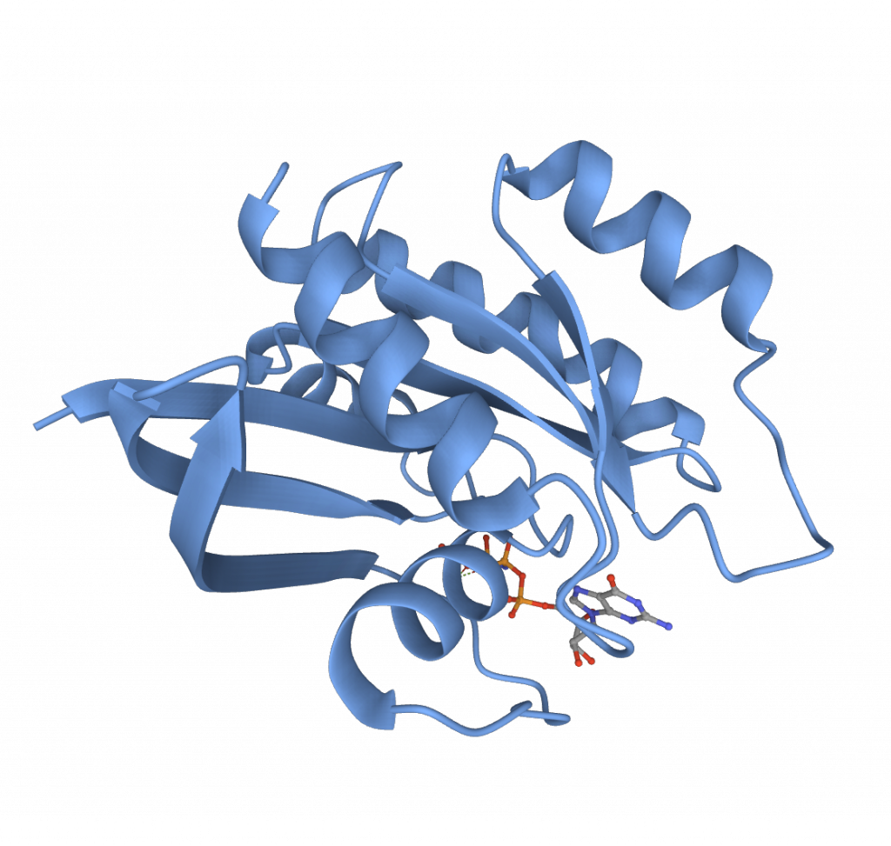
Proteins are work horses
Notes:
Figure 5.14 The 20 amino acids of proteins

Slide 41
Proteins the work horses of the cells
Proteins: large molecules composed of one or more long chains of amino acids and are an essential part of all living organisms, especially as structural components of body tissues such as muscle, hair, etc., and as enzymes and antibodies.
The proteome the entire complement of proteins that is or can be expressed by a cell, tissue, or organism.
(What should happen)
Notes:
Figure 16.10 Three alternative models of DNA replication

Slide 42
Regulation of expression
However, there are many ways to regulate protein activity

Slide 43
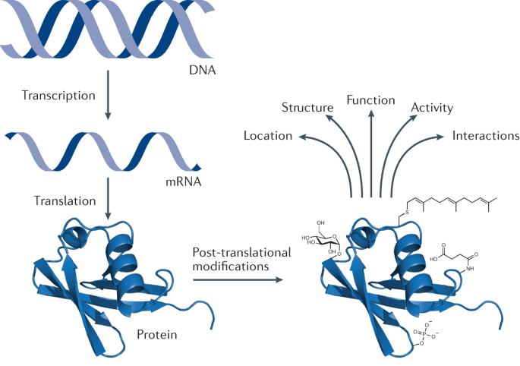
Regulation across all stages of the central dogma
Gene copy number
Promotor activity
Repression/induction (transcription factors)
DNA methylation
mRNA lifetime
Codon usage
tRNA levels
Ribosome binding
Alternative splicing
RNA interferance
Protein turnover (activity)
Chemical modification (phosphorylation)
Inhibition (blocking/degradation)
Allosteric change (change of configuration)
Conibear (2020)
Notes:
Figure 17.26 Types of small-scale mutations that affect mRNA sequence

Slide 44
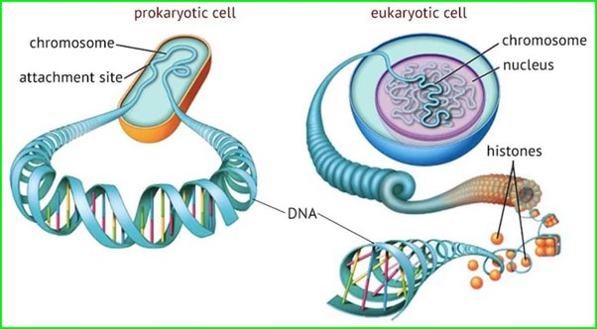
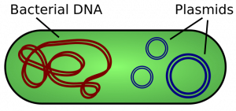
DNA and Chromosomes
Histones and nucleosomes
Lesk introduction and background p4.
Notes:
2 M of DNA per cell

Slide 45
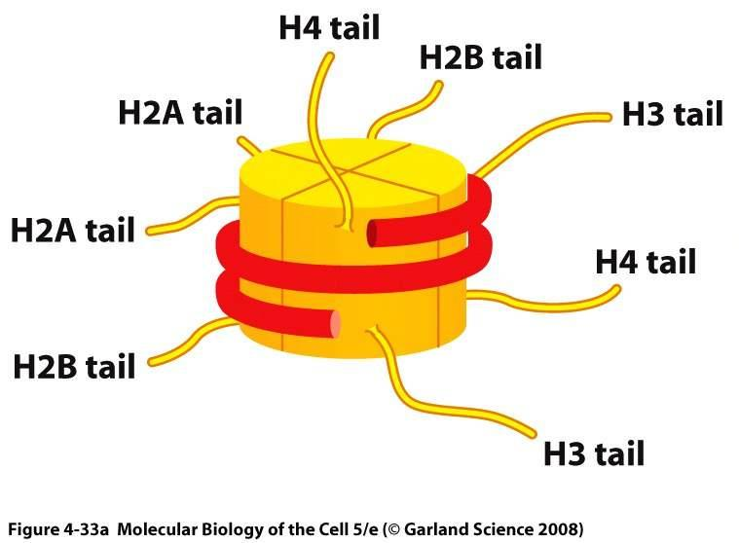
DNA and Chromosomes
Histones and nucleosomes - epigenetics
Lesk introduction and background p5.
Notes:
Figure 18.10-3 A model for the action of enhancers and transcription activators (step 3)
2M DNA in 1 cell

Slide 46

Not everything is about the code
Epigenetics: Non-hereditary changes to the genome that regulare its activity.
Do not change the sequence of the DNA but attach molecules, compression of the DNA

Slide 47
Take home messages
You can describe DNA and explain it’s make up
Understand and explain DNA replication
You can explain the central dogma (DNA-RNA-Protein)
Understand the difference between prokaryotes and eukaryotes through the central dogma
Name the different regulation mechanisms

