Slide 1



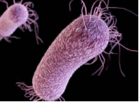
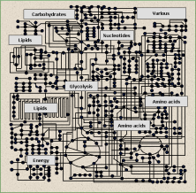
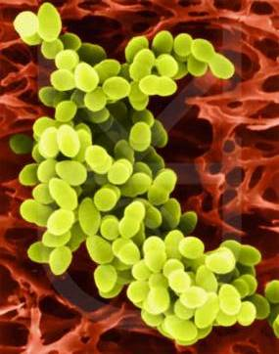
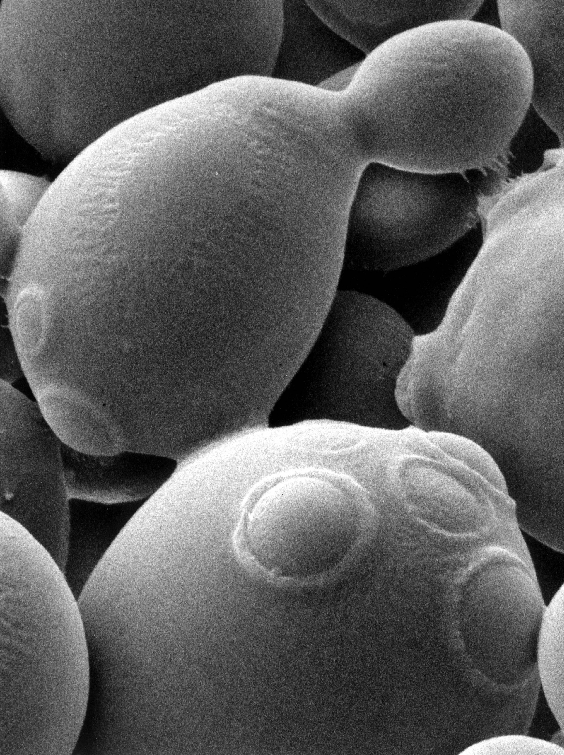
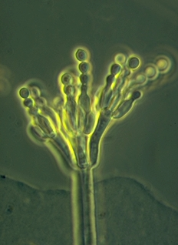
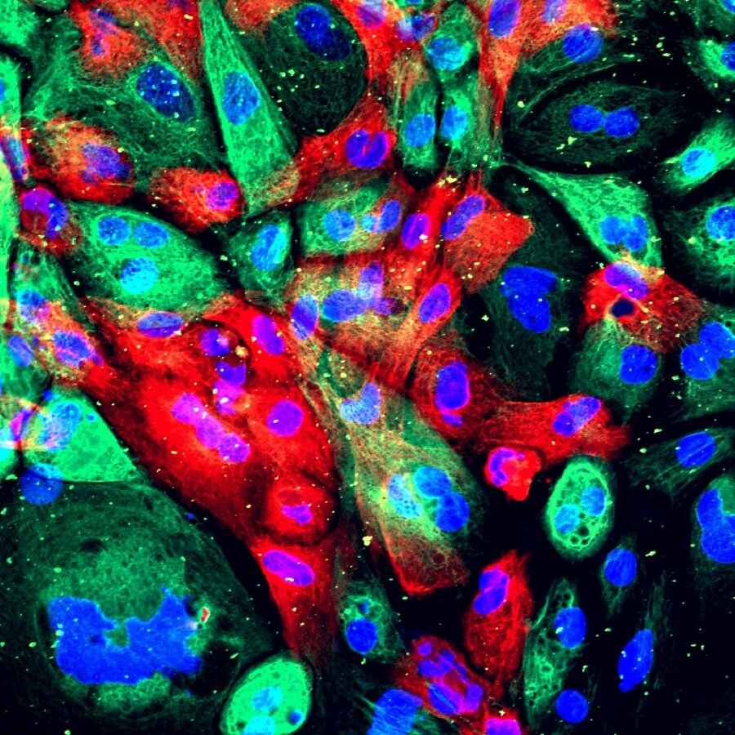
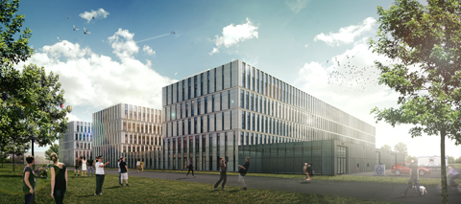
Genomic Architecture
Genome Diversity, an introduction
Han de Winde

Slide 2
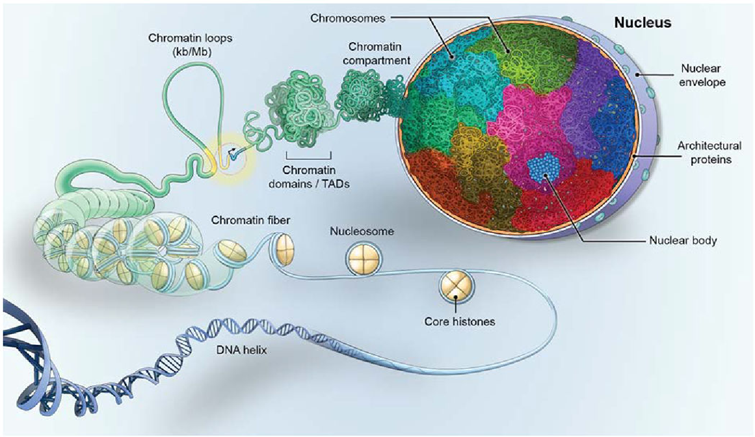
Genomic Architecture
Definition
… Genomic architecture can be defined
as the totality of non-random arrangements
of functional elements
(genes, regulatory regions etc.)
in the genome …
E.V. Koonin, Int J Biochem Cell Biol. 2009 Feb; 41(2): 298–306.

Slide 3
Genomic Architecture
Definition
Genomic architecture can be defined:
- as the spatial arrangement of chromosomes within the nuclear volume
- the relative linear organization of DNA sequences of different types (e.g. unique, repetitive, etc.)
A.O. Zalenski, Adv. Genome Biology 1998 Feb; 5: 179.

Slide 4
Basics of Genetics
DNA, RNA, PROTEINS
THE CENTRAL DOGMA
of Molecular Biology and Genetics

Slide 5
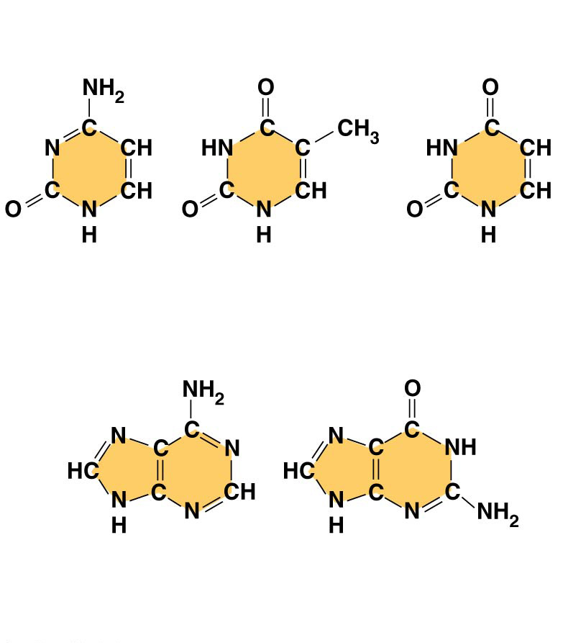
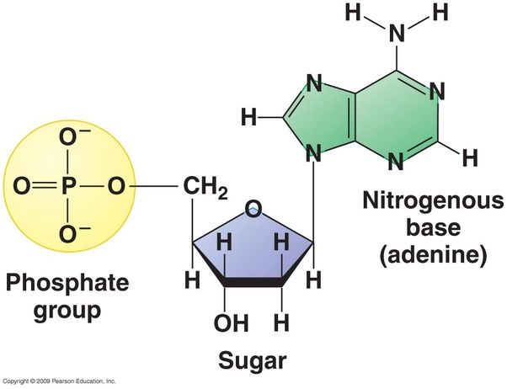
Basics of Genetics
Figure 5.24b
NITROGENOUS BASES
Pyrimidines
Cytosine
(C)
Thymine
(T, in DNA)
Uracil
(U, in RNA)
Purines
Adenine (A)
Guanine (G)

Slide 6
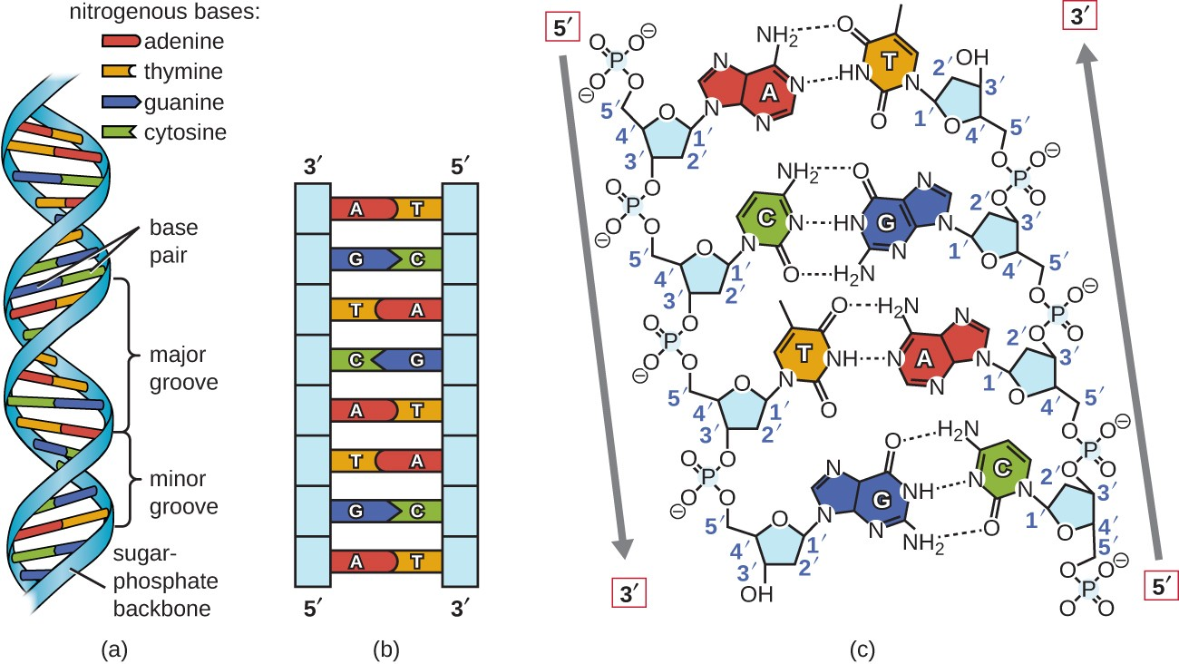
Basics of Genetics

Slide 7
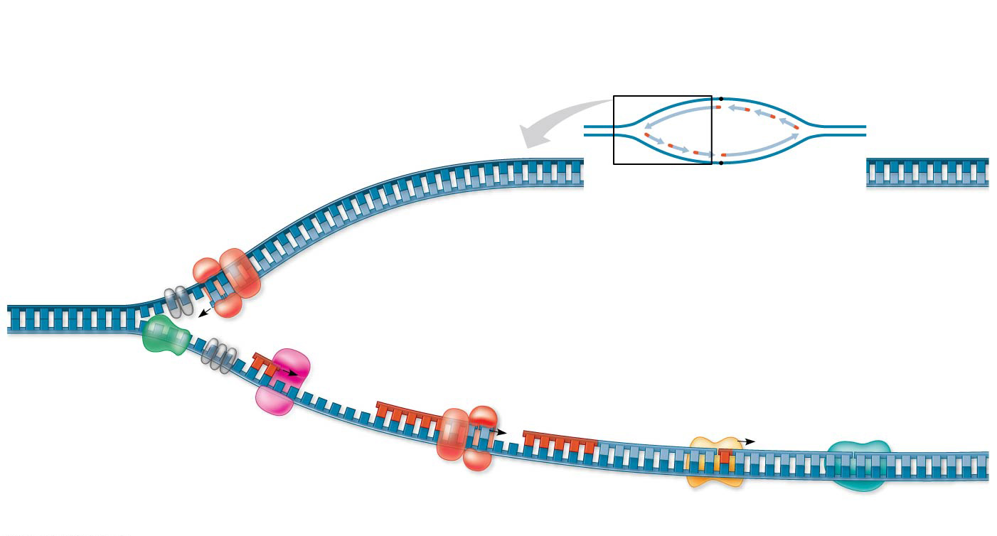
Basics of Genetics
Overview
Leading
strand
Origin of
replication
Lagging
strand
Leading strand
template
3′
Lagging
strand
Leading
strand
Single-strand
binding proteins
5′
Leading strand
Overall directions
of replication
Helicase
5′
DNA pol III
3′
Primer
3′
5′
3′
Primase
Parental
DNA
5
DNA pol III
Lagging
strand
5′
3′
DNA pol I
DNA ligase
4
5′
3
2
1
3′
Lagging strand
template
5′

Slide 8
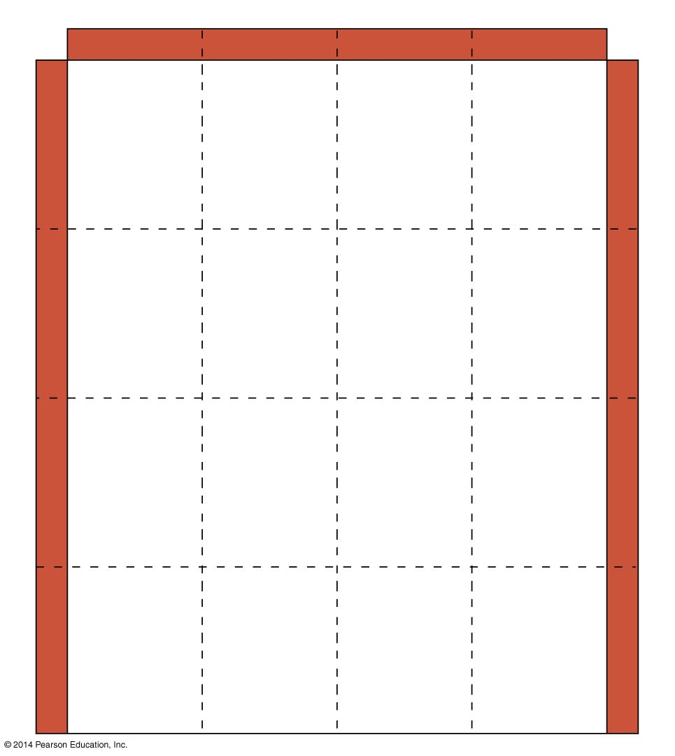
Second mRNA base
U
C
A
G
UUU
UCU
UAU
UGU
U
Phe
Tyr
Cys
U
UUC
UCC
UAC
UGC
C
Ser
UUA
UCA
UAA
Stop
UGA
Stop
A
Leu
UUG
UCG
UAG
Stop
UGG
Trp
G
CUU
CCU
CAU
CGU
U
His
C
CUC
CCC
CAC
CGC
C
Leu
Pro
Arg
CUA
CCA
CAA
CGA
A
Gln
CUG
CCG
CAG
CGG
G
First mRNA base (5′ end of codon)
Third mRNA base (3′ end of codon)
AUU
ACU
AAU
AGU
U
Asn
Ser
AUC
Ile
ACC
AAC
AGC
C
A
Thr
AUA
ACA
AAA
AGA
A
Lys
Arg
AUG
Met or
start
ACG
AAG
AGG
G
GUU
GCU
GAU
GGU
U
Asp
G
GUC
GCC
GAC
GGC
C
Val
Ala
Gly
GUA
GCA
GAA
GGA
A
Glu
GUG
GCG
GAG
GGG
G

Slide 9
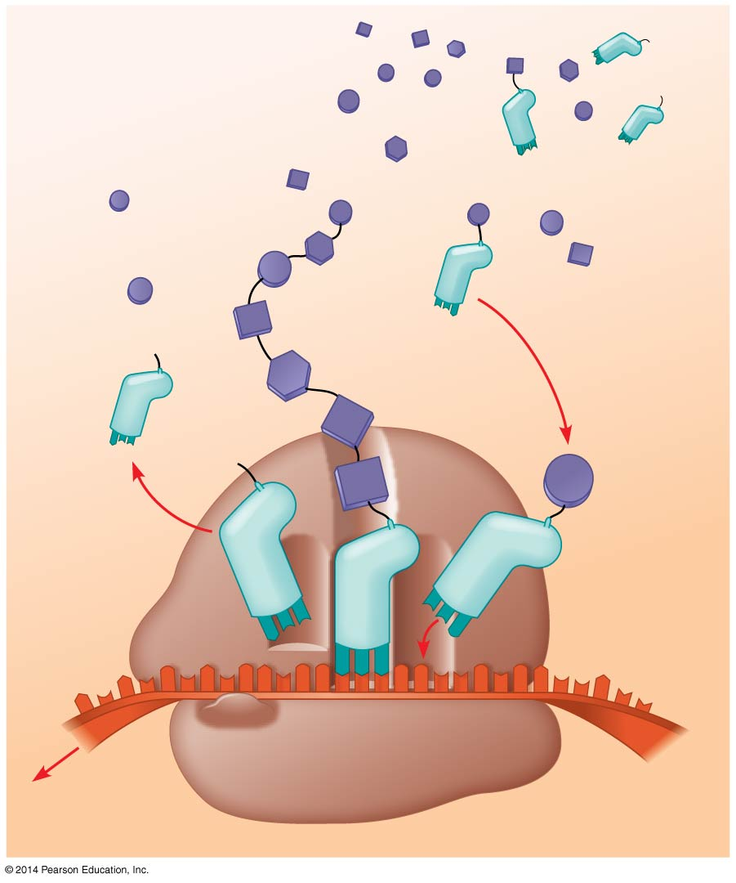
Amino
acids
Polypeptide
tRNA with
amino acid
attached
Ribosome
Trp
Phe
Gly
tRNA
C
C
C
Anticodon
A
C
G
A
A
A
U
G
G
U
U
U
G
G
C
5′
Codons
3′
mRNA

Slide 10
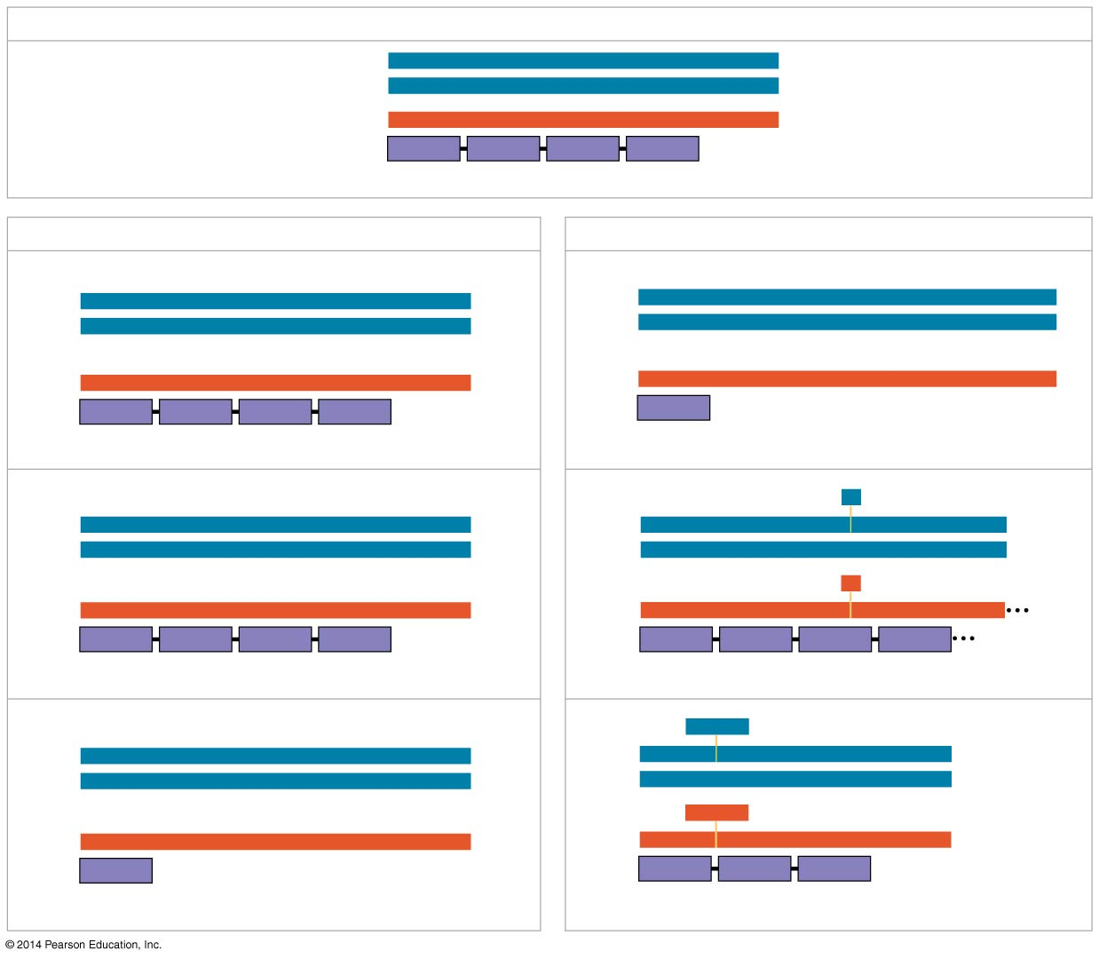
Wild type
Basics of Genetics
DNA template strand
3′
T
A
C
T
T
C
A
A
A
C
C
G
A
T
T
5′
5′
A
T
G
A
A
G
T
T
T
G
G
C
T
A
A
3′
mRNA
Protein
5′
A
U
G
A
A
G
U
U
U
G
G
C
U
A
A
3′
Met
Lys
Phe
Gly
Stop
Amino end
Carboxyl end
(a) Nucleotide-pair substitution
(b) Nucleotide-pair insertion or deletion
A instead of G
Extra A
3′
T
A
C
T
T
C
A
A
A
C
C
A
A
T
T
5′
3′
T
A
C
A
T
T
C
A
A
A
C
C
G
A
T
T
5′
5′
A
T
G
A
A
G
T
T
T
G
G
T
T
A
A
3′
5′
A
T
G
T
A
A
G
T
T
T
G
G
C
T
A
A
3′
U instead of C
Extra U
5′
A
U
G
A
A
G
U
U
U
G
G
U
U
A
A
3′
5′
A
U
G
U
A
A
G
U
U
U
G
G
C
U
A
A
3′
Met
Lys
Phe
Gly
Stop
Met
Stop
Stop
Silent
Frameshift (1 nucleotide-pair insertion)
T instead of C
A
missing
3′
T
A
C
T
T
C
A
A
A
T
C
G
A
T
T
5′
3′
T
A
C
T
T
C
A
A
C
C
G
A
T
T
5′
5′
A
T
G
A
A
G
T
T
T
A
G
C
T
A
A
3′
5′
A
T
G
A
A
G
T
T
G
G
C
T
A
A
3′
A instead of G
U
missing
5′
A
U
G
A
A
G
U
U
U
A
G
C
U
A
A
3′
5′
A
U
G
A
A
G
U
U
G
G
C
U
A
A
3′
Met
Lys
Phe
Ser
Stop
Met
Lys
Leu
Ala
Missense
Frameshift (1 nucleotide-pair deletion)
A instead of T
T
T
C
missing
3′
T
A
C
A
T
C
A
A
A
C
C
G
A
T
T
5′
3′
T
A
C
A
A
A
C
C
G
A
T
T
5′
5′
A
T
G
T
A
G
T
T
T
G
G
C
T
A
A
3′
5′
A
T
G
T
T
T
G
G
C
T
A
A
3′
U instead of A
A
A
G
missing
5′
A
U
G
U
A
G
U
U
U
G
G
U
U
A
A
3′
5′
A
U
G
U
U
U
G
G
C
U
A
A
3′
Met
Stop
Met
Phe
Gly
Stop
Nonsense
3 nucleotide-pair deletion

Slide 11
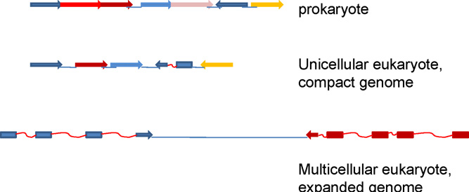
Basics of Genetics

Slide 12
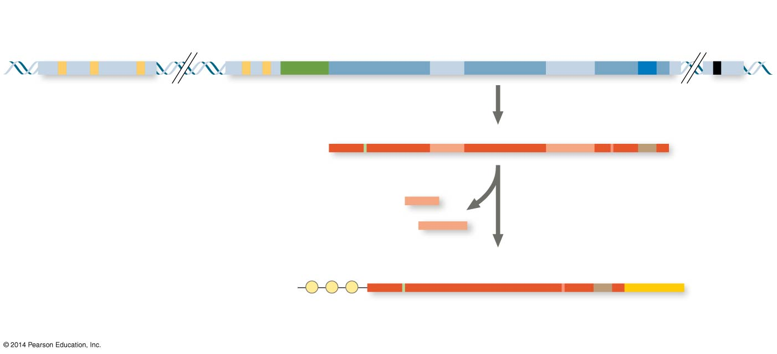
Basics of Genetics
Enhancer (group of
distal control elements)
Proximal
control elements
Transcription
start site
Poly-A signal
sequence
Transcription
termination
region
DNA
Exon
Intron
Exon
Intron
Exon
Upstream
Promoter
Downstream
Transcription
Poly-A
signal
Primary RNA
transcript
(pre-mRNA)
Exon
Intron
Exon
Intron
Exon
Cleaved 3′ end
of primary
transcript
5′
Intron RNA
RNA processing
Coding segment
mRNA
G P P P
AAA⋯AAA
3′
5′ Cap
5′ UTR
Start
codon
Stop
codon
3′ UTR
Poly-A
tail

Slide 13
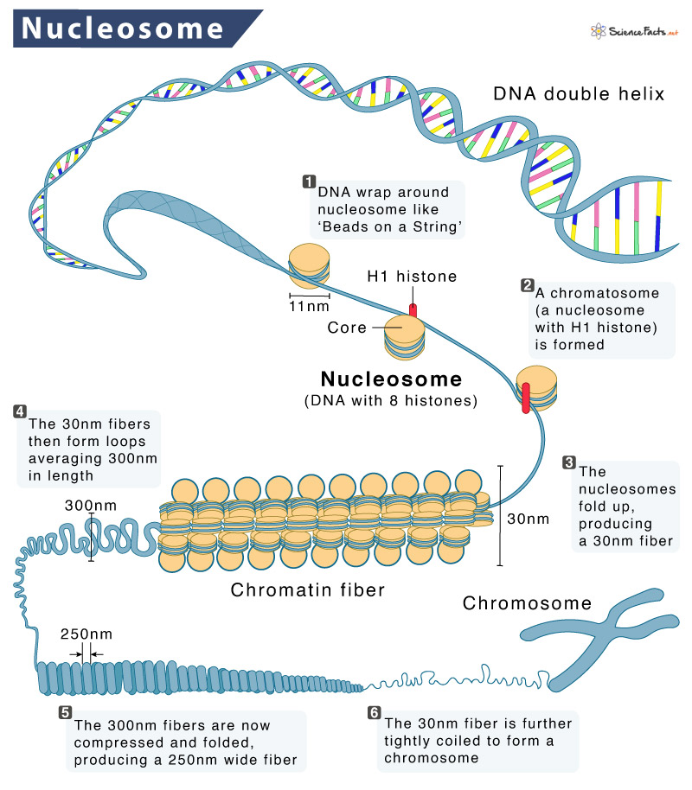
Basics of Genetics
https://www.sciencefacts.net/nucleosome.html

Slide 14
Genome Diversity

Slide 15
Genome Diversity
How many species on Earth ?

Slide 16
Genome Diversity

Slide 17
Genome Diversity
https://journals.plos.org/plosbiology/article/file?type=printable&id=10.1371/journal.pbio.1001127

Slide 18
Genome Diversity
~8.7 million eukaryotic species
~2.2 million marine species
~1.7 million described unique species
~86% of land species and 91% of ocean species remain undescribed
~including prokaryotes: hundreds of millions to trillions ….
https://journals.plos.org/plosbiology/article/file?type=printable&id=10.1371/journal.pbio.1001127

Slide 19
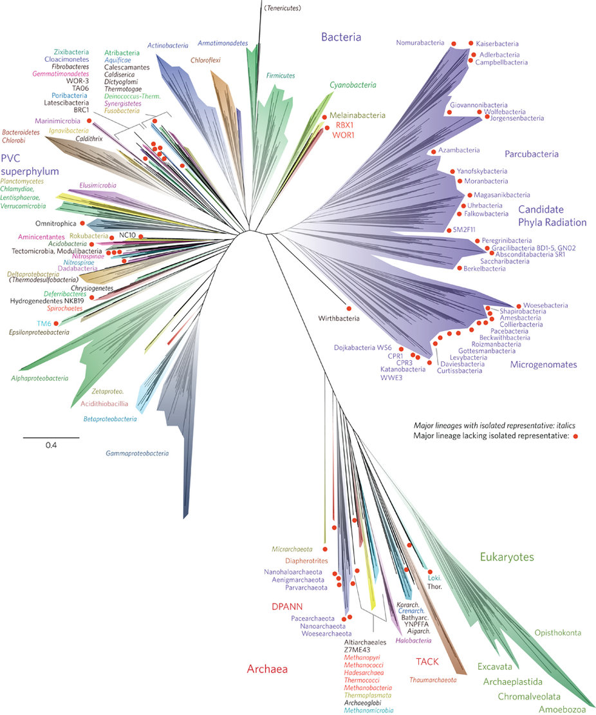
Tree of Life

Slide 20
Prokarya and Archea
How many genes in bacteria ?

Slide 21
Prokarya and Archea
500 – 6000 genes

Slide 22
Prokarya and Archea
500 – 6000 genes …
The largest known bacterial genome belongs to the myxobacterium Sorangium cellulosum;
circular chromosome of 13,033,799 bp
9367 predicted protein‑coding sequences (genes)
https://www.nature.com/articles/nbt1354

Slide 23
Eukaryotes do for more …

Slide 24
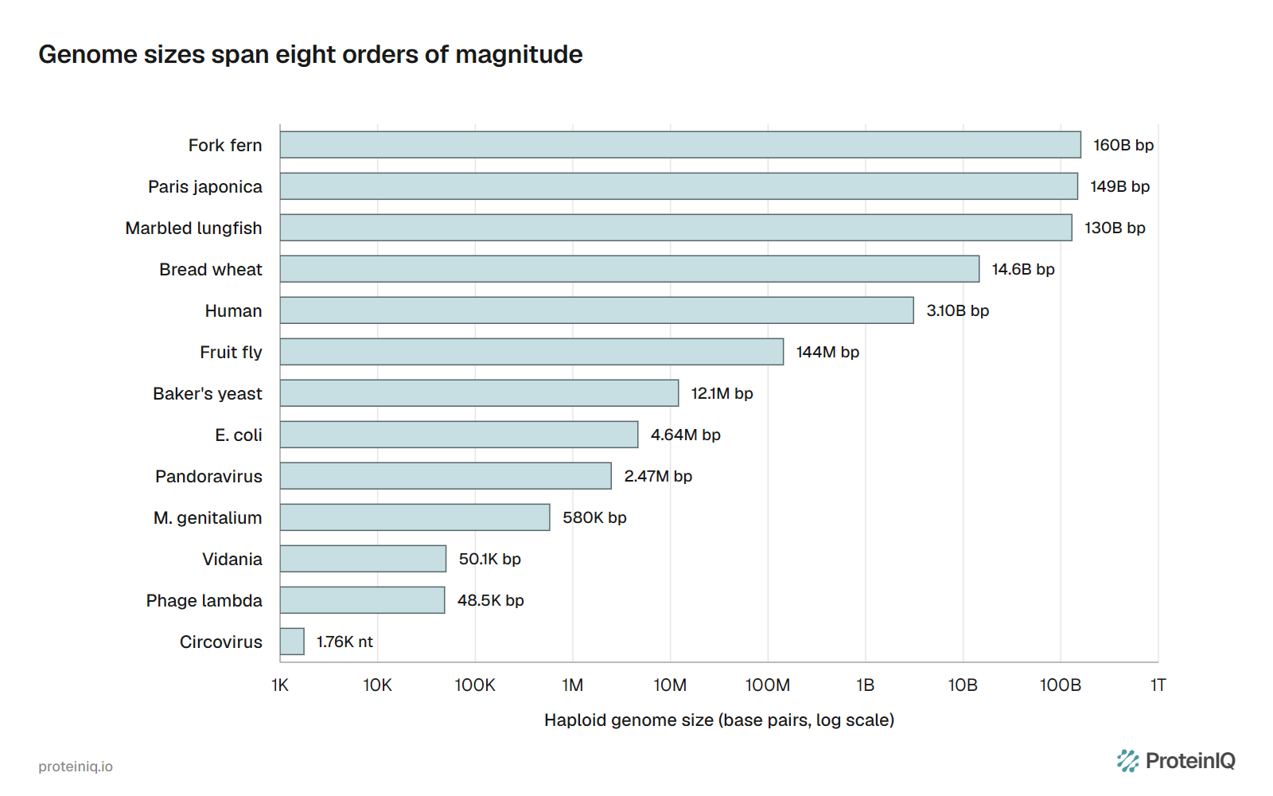
Genome sizes span orders of magnitude
https://proteiniq.io/guides/largest-and-smallest-genomes

Slide 25
Genome Diversity
Many fully sequenced genomes to date

Slide 26
Genome Diversity
>200 gene families common to all branches

Slide 27
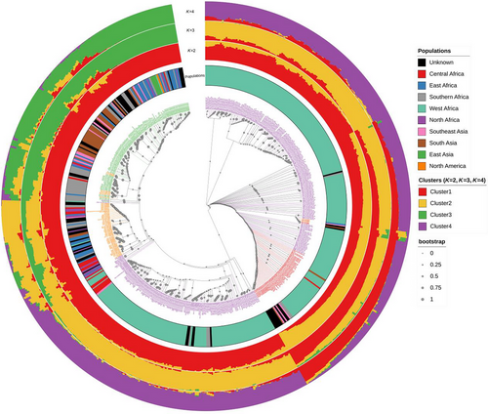
Genome Diversity
>200 gene families common to all branches
Speciation:
Core genes; essential cellular functions
Accessory genes; adaptive, beneficial traits within a species,
shaping diversity and evolutionary potential
Together constitute the Pangenome
Specialization, Speciation …

Slide 28
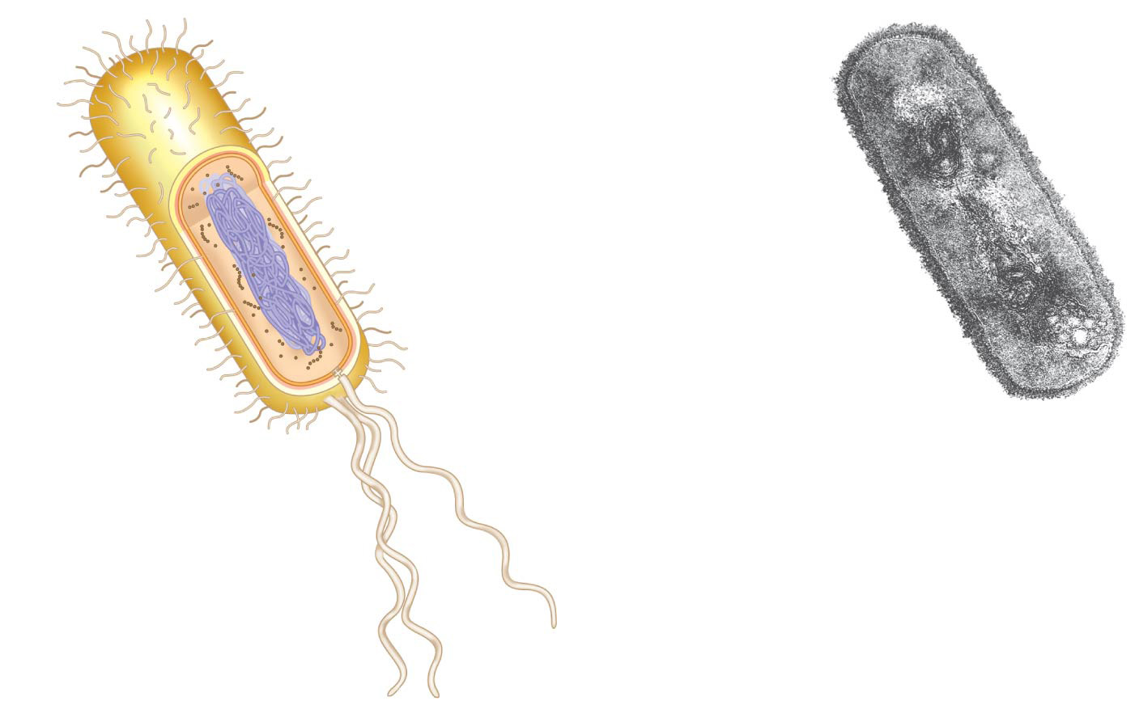
Bacterial structure
Fimbriae
Nucleoid
Ribosomes
Plasma membrane
Cell wall
Bacterial
chromosome
Capsule
0.5 µm
Flagella
(a)
A typical
rod-shaped
bacterium
(b)
A thin section through
the bacterium Bacillus
coagulans (TEM)

Slide 29
Bacterial structure
Largest biochemical and structural diversity

Slide 30
Prokaryotic model organism
E. coli

Slide 31
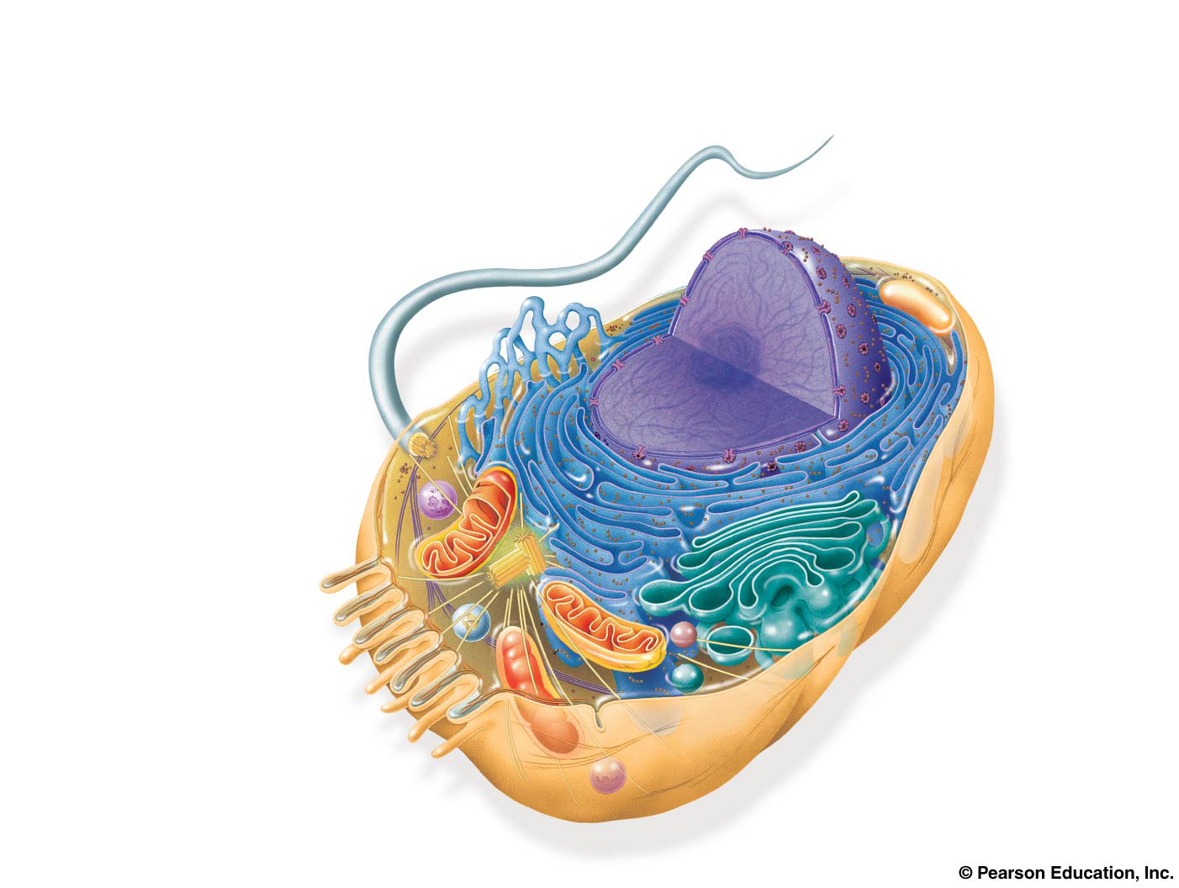
Eukaryotic cells
ENDOPLASMIC
RETICULUM (ER)
Nuclear
envelope
Rough ER
Smooth ER
Nucleolus
NUCLEUS
Flagellum
Chromatin
Centrosome
Plasma
membrane
CYTOSKELETON:
Microfilaments
Intermediate filaments
Microtubules
Ribosomes
Microvilli
Golgi apparatus
Peroxisome
Lysosome
Mitochondrion

Slide 32
Eukaryotic cells evolved from symbiosis

Slide 33
Eukaryotic cells evolved from symbiosis

Slide 34
Eukaryotic cells evolved from symbiosis
The Chloroplast

Slide 35
Eukaryotic cells evolved from symbiosis

Slide 36
Genome Diversity
Eukaryotes have hybrid genomes

Slide 37
Eukaryotes have hybrid genomes
Origin of genetic information of eukaryotic cells: ancestral anaerobic eukaryote and bacteria
Mitochondrial and chloroplast DNA have bacterial origin; degenerate, reduced, retracted versions
Human mitochondrial DNA: 16,569 bp coding for 13 proteins, 2 rRNAs and 22 tRNAs
Yeast mitochondrial DNA: approx. 78,000 bp
Genes moved from mitochondrial genome to the nuclear genome

Slide 38
Genome sizes span orders of magnitude
https://proteiniq.io/guides/largest-and-smallest-genomes

Slide 39
Genome Size Diversity

Slide 40
Genome (Size) Diversity
The human genome contains:
• 1000x as many bp as the genome of a typical bacterium
• 20x as many genes
• ~10,000x as much noncoding DNA
• ~98 % of the human genome noncoding, 11% for E. coli

Slide 41
Eukaryotic ‘model’ organisms
Saccharomyces cerevisiae – baker’s yeast

Slide 42
Eukaryotic ‘model’ organisms
Arabidopsis thaliana – thale cress (zandraket)

Slide 43
Eukaryotic ‘model’ organisms
Caenorhabditis elegans– a nematode

Slide 44
Eukaryotic ‘model’ organisms
Drosophila melanogaster– fruitfly

Slide 45
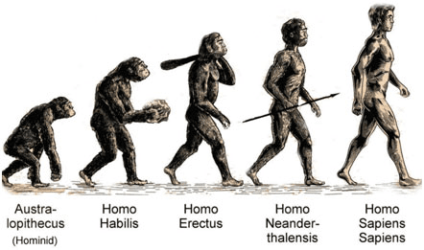
Eukaryotic ‘model’ organisms
Homo sapiens– us !

Slide 47
How do genomes evolve ?
Speciation ?

Slide 48
Mutations are key
Genome alterations are caused by failures in copying and maintaining DNA
DNA replication and repair are extremely accurate, but not perfect

Slide 49
Mutations are key
→ e.g. bacteria
“Magic by numbers”

Slide 50
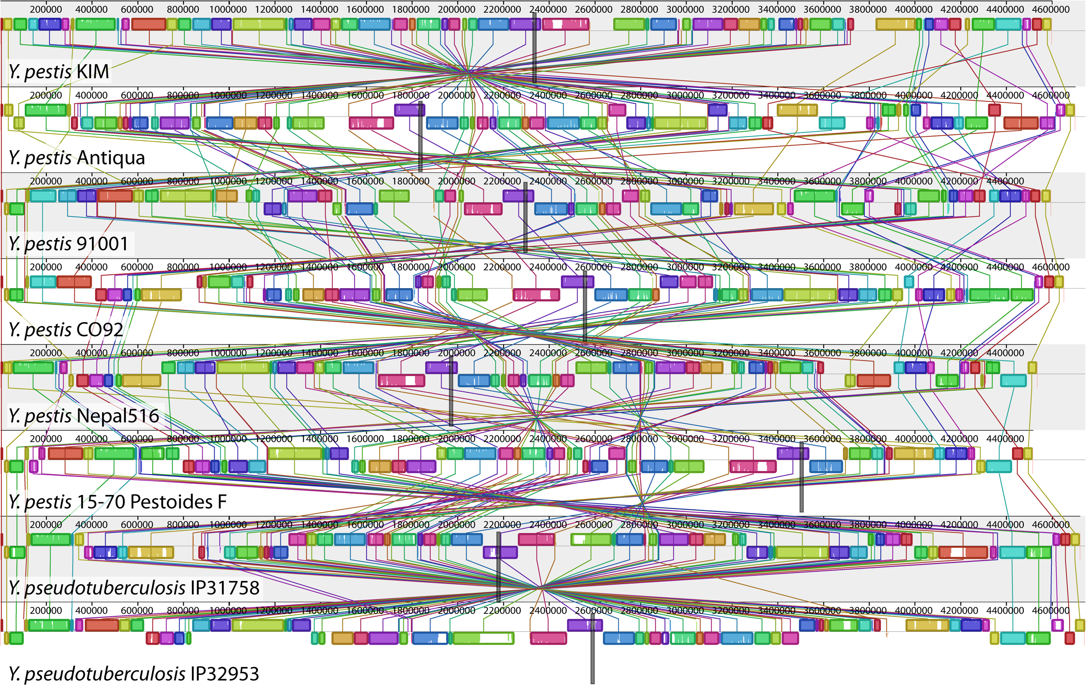
Mutations are key
→ genome rearrangements
https://commons.wikimedia.org/wiki/File:A_genome_alignment_of_eight_Yersinia_isolates.png

Slide 51
Mutations are key
→ genome rearrangements
https://commons.wikimedia.org/wiki/File:A_genome_alignment_of_eight_Yersinia_isolates.png
https://rosalind.info/glossary/genome-rearrangement/

Slide 52
Mutations are key
→ Transposons

Slide 53
Mutations are key
→ Horizontal Gene Transfer (HGT)

Slide 54
Gene duplication
Important source of genetic novelty during evolution

Slide 55
Gene duplication
Gives rise to families of related genes
Orthologs: genes in two separate species that are derived from the same ancestral gene in the last common ancestor of those two species
Paralogs: related genes that have resulted from a gene duplication event within a single genome
Homologs: genes that related by descent in either way (a general term to cover both types of relationship)

Slide 56
Gene duplication
Gives rise to families of related genes

Slide 57
Gene duplication
Example – complex family of homologous genes

Slide 58
Gene evolution - summarized

Slide 59
Gene evolution - summarized
Sequence comparison, conserved sequences

Slide 60
Gene evolution - summarized
Sequence comparison, tracing relationship

Slide 61
Genome Diversity

Slide 62
Genomic Architecture
Definition
Genomic architecture can be defined:
- as the spatial arrangement of chromosomes within the nuclear volume
- the relative linear organization of DNA sequences of different types (e.g. unique, repetitive, etc.)
A.O. Zalenski, Adv. Genome Biology 1998 Feb; 5: 179.

Slide 63
Genomic Architecture
Definition
Genomic architecture can be defined
as the totality of non-random arrangements
of functional elements
(genes, regulatory regions etc.)
in the genome.
E.V. Koonin, Int J Biochem Cell Biol. 2009 Feb; 41(2): 298–306.

Slide 64
Genomic Architecture
This was the starting point ☺
To do: Self-Test with questions and answers in Brightspace
Quizz: Basic Knowledge Test
answers under ‘hints’
No grading, however, important to complete
Self test, to check your position at the starting level
If you lack some basic knowledge → Background literature !

