Slide 1
WSN Interface
Matt Buland, Marc Rubin, Tracy Camp
Colorado School of Mines
Electrical Engineering and Computer Science

Slide 2
Overview
Introduction
Hardware
Libraries
Application design
Demo
Conclusion

Slide 3
Introduction
Collect data and Monitor health
Remote deployment
Minimize gear
Dynamic Interface

Slide 4
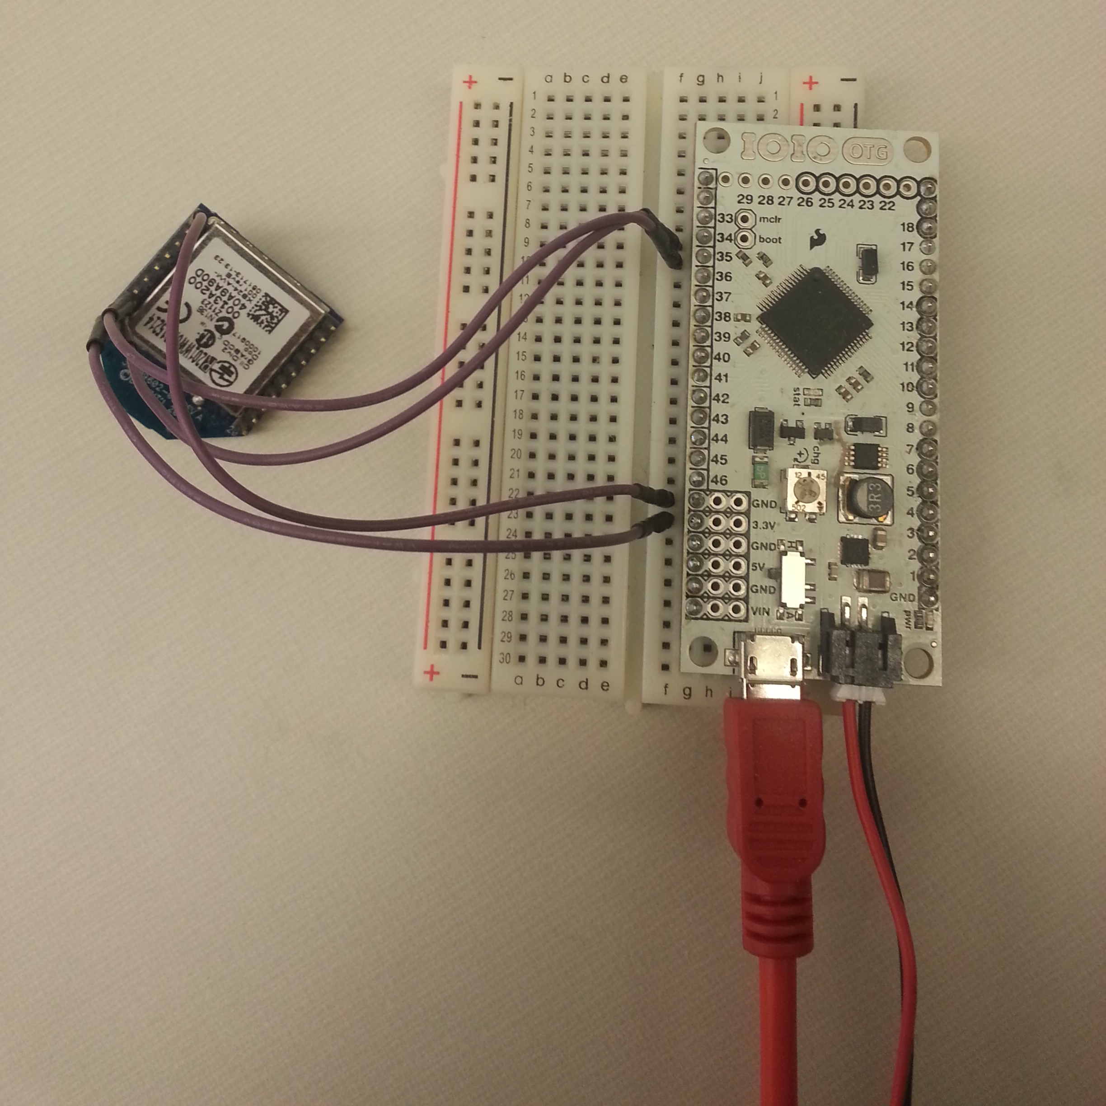
Hardware
Android Phone or Tablet
IOIO-OTG
  Requires 5-15v
XBee Series 1

Slide 5
Libraries
IOIO Framework
  Basic control over the IOIO, much like the basic Arduino libraries
xbee-api
  API mode manipulation
AndroidPlot
  Graphing widget and library

Slide 6
Libraries -> IOIO Framework
IOIOActivity
IOIOLooper
  setup
  loop
UART
  SoftwareSerial
  InputStream.read() == Serial.read()
  OutputStream.write() == Serial.write()

Slide 7
Libraries -> xbee-api
XBee
  send(A)synchronous
AtCommand
RemoteAtCommand
TxRequest
XBeeAddress

Slide 8
Libraries -> AndroidPlot
Graphing widget
  XY, bar, pie, etc
Alternative options:
  AChartEngine
    Poor documentation
  ChartDroid
    Intent-based external application

Slide 9
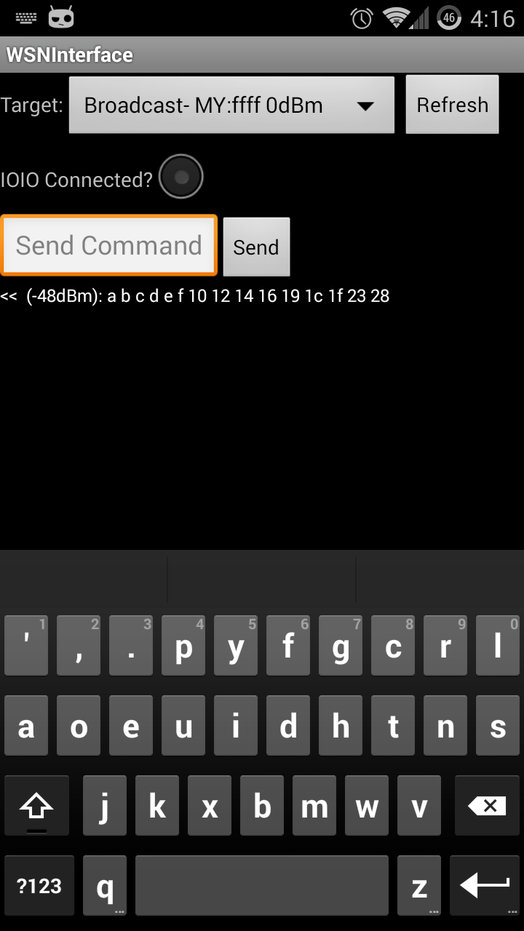
Implementation
Developed on GS-III
Broken into:
  IOIO Connection
  XBee API Mode
  Graphing

Slide 10
Implementation -> IOIO Connection
Versioning
  New IOIO: v3
  Firmware flashing
  No backwards compatibility to v3
UART
  InputStream.read() == Serial.read()
  OutputStream.write() == Serial.write()

Slide 11
Implementation -> XBee API Mode
ATAP=2
Custom “Protocol” : Passthrough with streams
Remainder:
  Sending
  Receiving
  Node Discovery

Slide 12
Implementation -> XBee API Mode :: Tx
Enter in messages
  AT → ATCommand
  RAT → Remote AT Command
  TxRequest
Place into queue
Decoded and sent to XBee asynchronously

Slide 13
Implementation -> XBee API Mode :: Rx
PacketListener
  Required for Asynchronous
API Packet Structure:
Add packet to display list

Slide 14
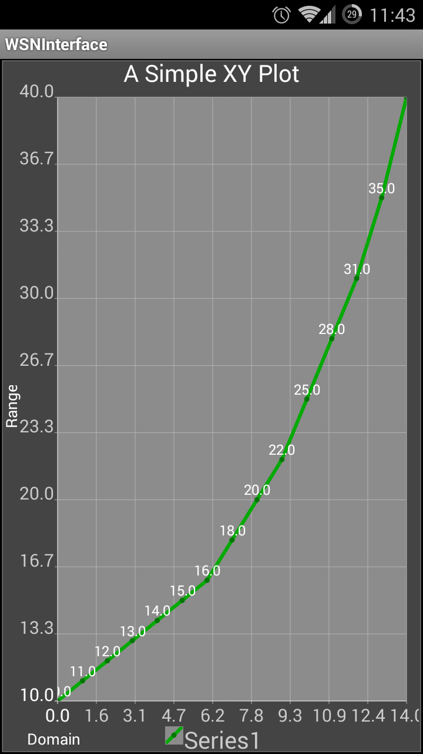
Implementation -> Graphing
Long Press packet
  Save
  Graph
Encoding options:
  Y_VALS_ONLY
    [Y1, Y2, Y3 … ]
  XY_VALS_INTERLEAVED
    [X1, Y1, X2, Y2 … ]
  X/Y byte length

Slide 15
Demo
Random Data Mote
Send “T”, get 48 bytes

Slide 16
Conclusion
Application works
Battery requirement is a drag
API mode is fun
Room to grow:
  RSSI Graphing
  Graph Zooming
  Configuration

