Slide 1



FINAL PROJECT DATA ANALYTICS PT
HANDWRITING DIGITALIZATION
THE tool that reads your DOODLE
GIACOMO ROSSINI

Slide 2




SUMMARY
1
3
2
4
MODEL
EXAMPLES
IMPROVEMENT
CONCLUSION
LIBRARIES in PYTHON
TESTS & METRICS
IDEAS & NEXT STEPS
OPEN TO Q&A

Slide 3
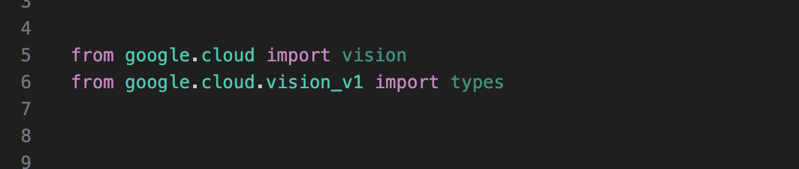
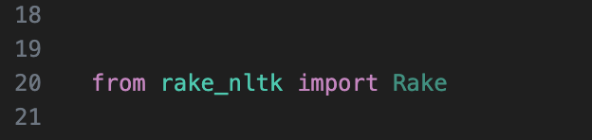
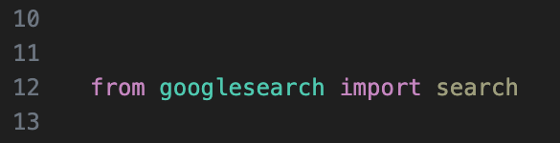
1. LIBRARIES: GOOGLE VISION, GOOGLESEARCH & RAKE_NTLK
GOOGLE VISION
RAKE_NTLK
GOOGLESEARCH

Slide 4
1. LIBRARIES: GOOGLE VISION, GOOGLESEARCH & RAKE_NTLK
GOOGLE VISION
RAKE_NTLK
GOOGLESEARCH
The Vision API allows developers to easily integrate vision detection features within applications, including image labeling, face and landmark detection, optical character recognition (OCR), and tagging of explicit content

Slide 5
1. LIBRARIES: GOOGLE VISION, GOOGLESEARCH & RAKE_NTLK
GOOGLE VISION
RAKE_NTLK
GOOGLESEARCH
RAKE short for Rapid Automatic Keyword Extraction algorithm, is a domain independent keyword extraction algorithm which tries to determine key phrases in a body of text by analyzing the frequency of word appearance and its co-occurance with other words in the text.

Slide 6
1. LIBRARIES: GOOGLE VISION, GOOGLESEARCH & RAKE_NTLK
GOOGLE VISION
GOOGLESEARCH
RAKE_NTLK
It uses requests and BeautifulSoup4 to scrape Google.
It returns a link.
The algorithm handles words as input and return links through Google environment.

Slide 7
1. LIBRARIES: GOOGLE VISION, GOOGLESEARCH & RAKE_NTLK
GOOGLE VISION
RAKE_NTLK
GOOGLESEARCH
The Vision API allows developers to easily integrate vision detection features within applications, including image labeling, face and landmark detection, optical character recognition (OCR), and tagging of explicit content
RAKE short for Rapid Automatic Keyword Extraction algorithm, is a domain independent keyword extraction algorithm which tries to determine key phrases in a body of text by analyzing the frequency of word appearance and its co-occurance with other words in the text.
It uses requests and BeautifulSoup4 to scrape Google.
It returns a link.
The algorithm handles words as input and return links through Google environment.

Slide 8

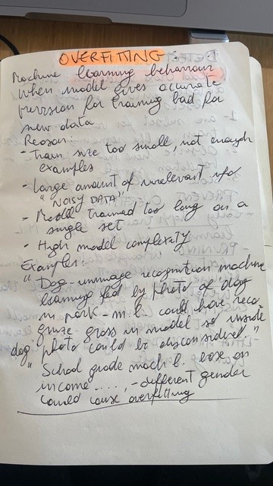
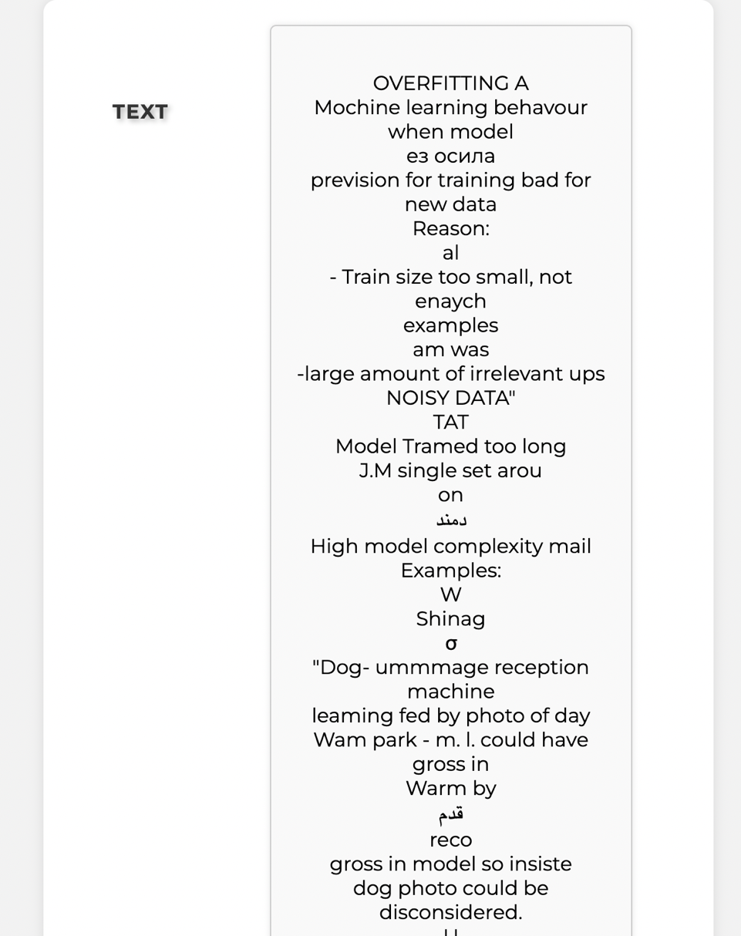
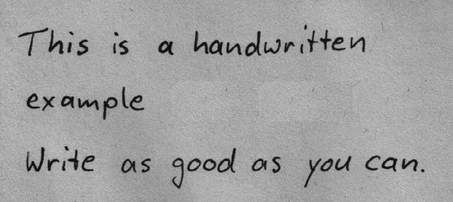
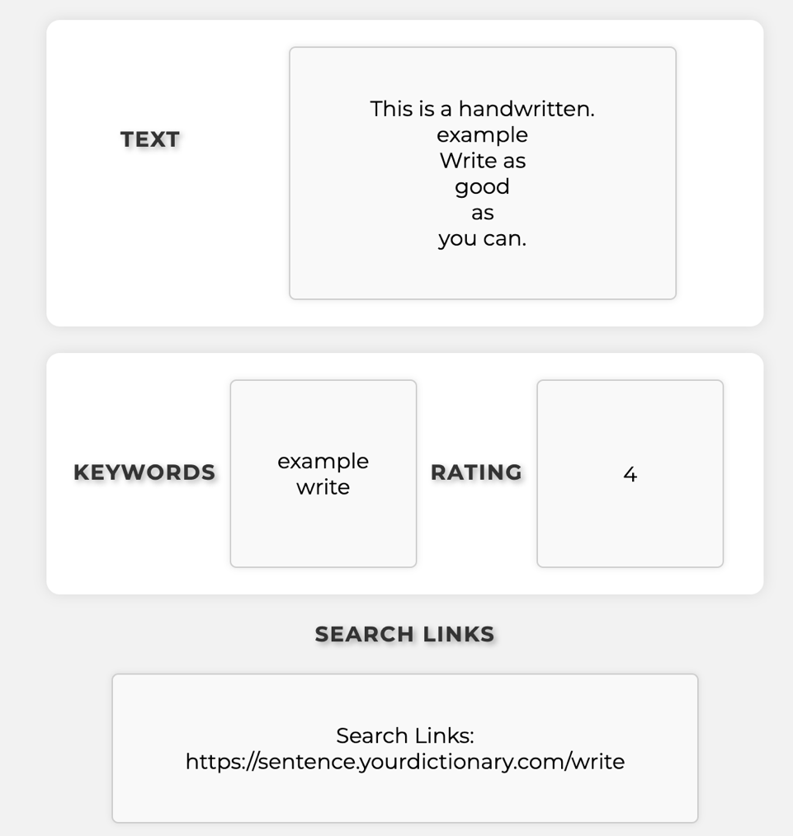
2. EXAMPLES & METRICS
Avg Block Confidence
Avg Paragraph Confidence

Slide 9
2. EXAMPLES & METRICS
96.06%
69.95%
Avg Block Confidence
96.06%
70.01%
Avg Paragraph Confidence

Slide 10
3. IMPROVEMENT
01
Combine a static model as Google Vision with a dynamic machine learning – develop a combined system that uses the power of learning to understand writing and learn from it

Slide 11
3. IMPROVEMENT
01
02
Combine a static model as Google Vision with a dynamic machine learning – develop a combined system that uses the power of learning to understand writing and learn from it
Improve the speed of the algorithm – This will allow the app to handle long queries and return multiple results.

Slide 12
3. IMPROVEMENT
01
02
03
Combine a static model as Google Vision with a dynamic machine learning – develop a combined system that uses the power of learning to understand writing and learn from it
Improve the speed of the algorithm – This will allow the app to handle long queries and return multiple results.
Apply NLP model in order to weight better the keyword thus limiting the search to words that we must enhance - This will power up the funtionality of the search and return more value added.

Slide 13
Q&A
THANK YOU
FOR YOUR ATTENTION

