Slide 1
Data Mining
20240166 Seoyeon Shim
20240203 Hajin Kim

Slide 2



Classification
Clustering
Classify and Predict
the Type of Wine

Slide 3
Classification : Preprocessing
Deal with Missing Values (ex: NaN, Null..)
2) Process outliers with Normalizing with Z-Score
3) Remove Duplicated Data
4) Replace String Data with Integer

Slide 4
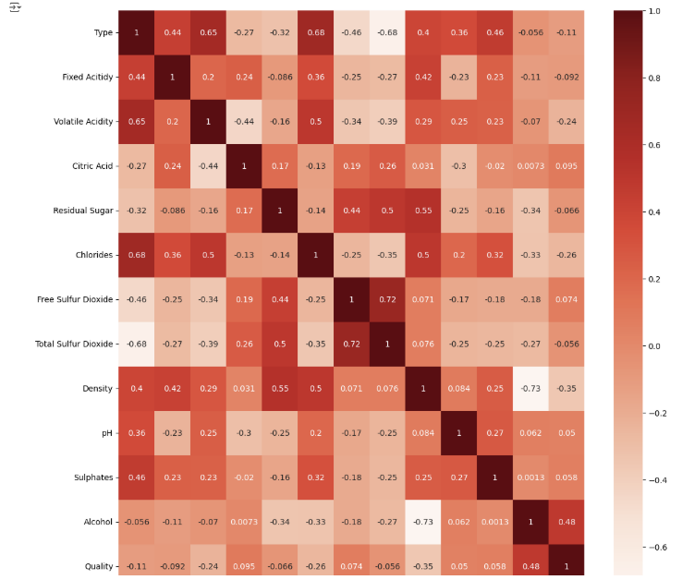
Classification : Correlation Plot
|R| >= 0.4
-Fixed Acidity
-Volatile Acidity
-Chlorides
-Density
-Sulfates

Slide 5
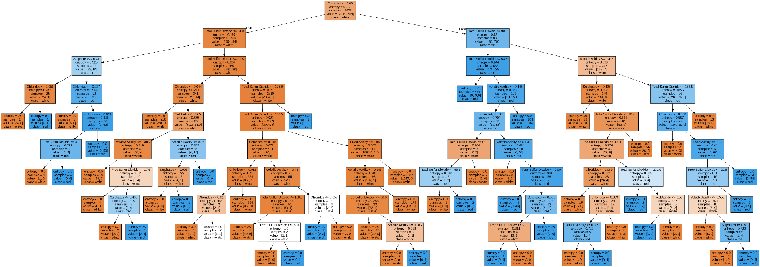
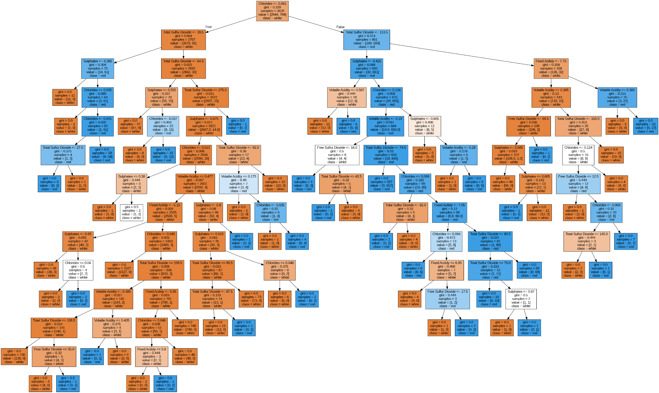
Classification : Decision Tree Classifier
Criterion: Entropy
Criterion: Gini

Slide 6


Classification : Ensemble Classifiers

Slide 7
Clustering : Preprocessing
Drop Unnecessary Columns
2) Deal with Missing Values (ex: NaN, Null..)
3) Frequency-based Filtering
4) Exploratory Data Analysis(EDA)

Slide 8
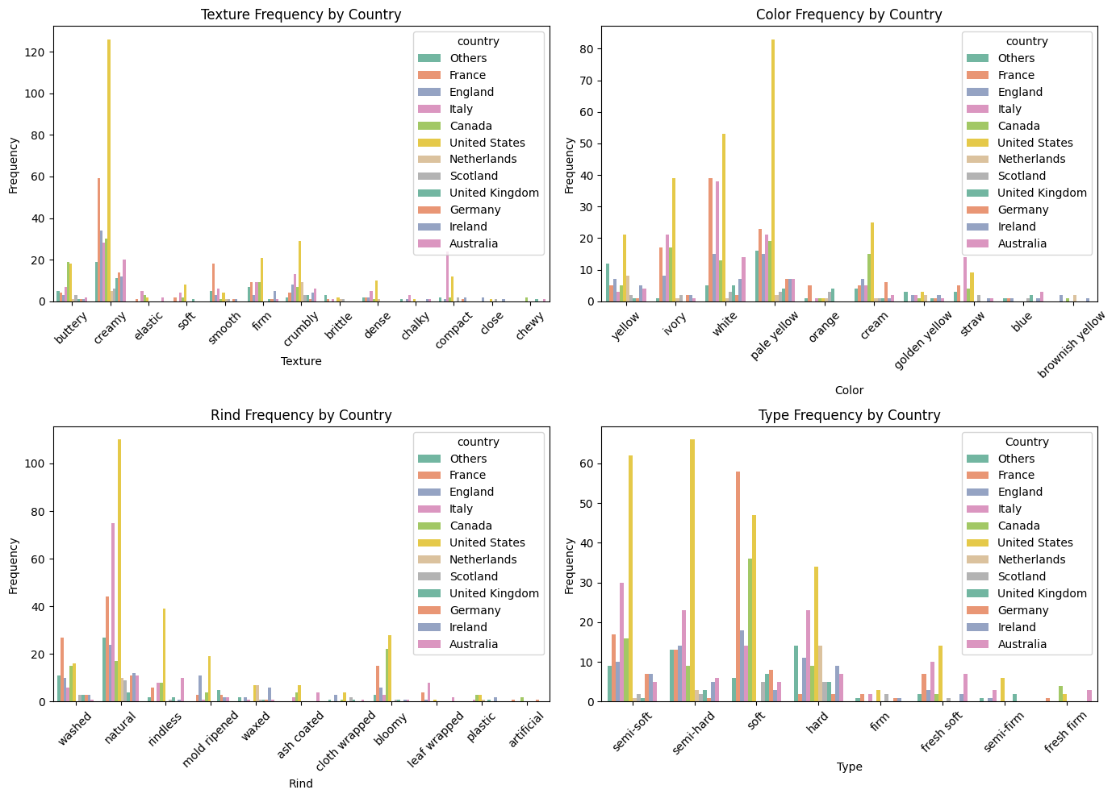
Clustering : Exploratory Data Analysis (EDA)

Slide 9
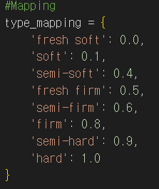
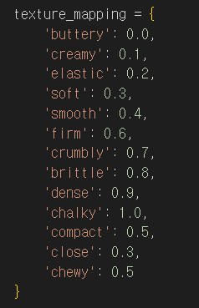
Clustering : K-means Clustering ; Mapping

Slide 10
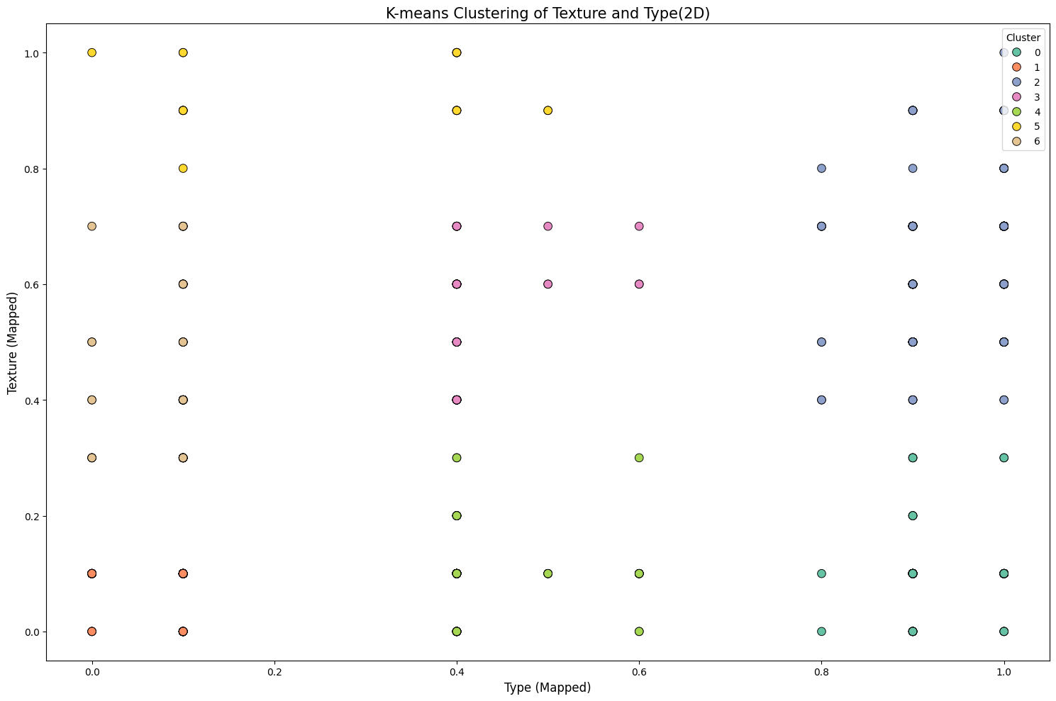
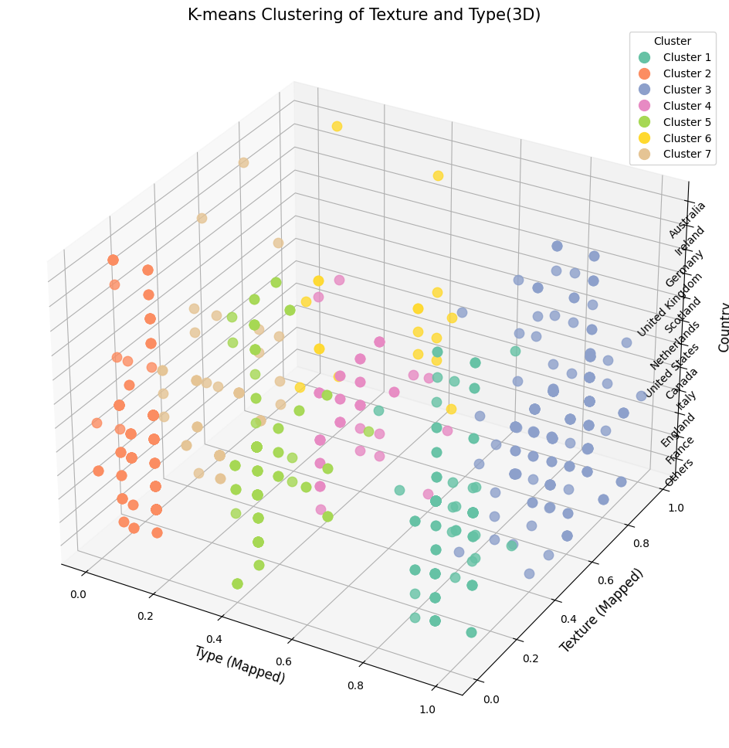
Clustering : K-means Clustering

Slide 11
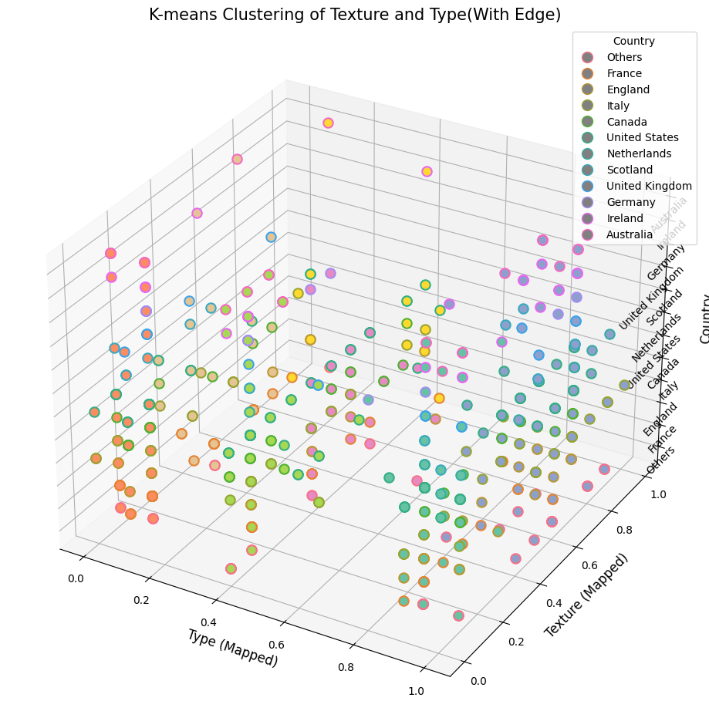
Clustering : K-means Clustering

Slide 12
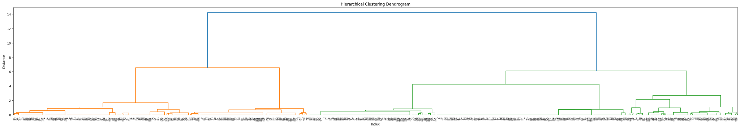
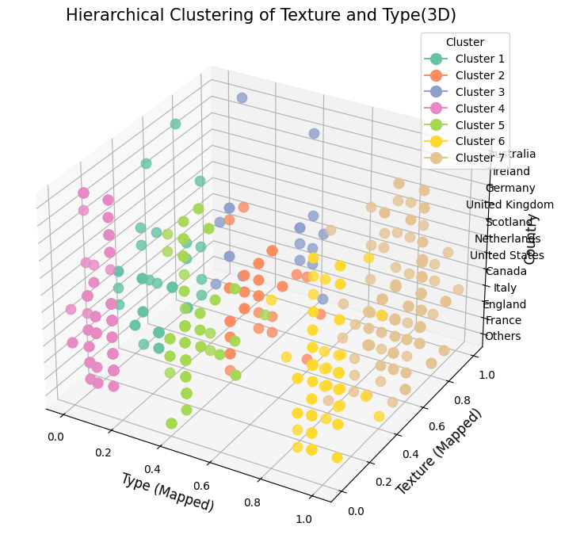
Clustering : Hierarchical Clustering

Slide 13

Conclusions
Wine Classification and Cheese clustering
Discrete and non-numerical data -> hard to cluster related to each other
Mapping values can be the solution

