Slide 1




Final Presentation Signal Processing Cup - 2023
Students: Nir Luria, Gil Kapel, Nofar Tuval, Adam Katav, Roy Shpilberg
Supervisor: Yair Moshe
Semester: Winter semester 2023
Date: 23/03/2023

Slide 2
Outline
Goal and mission
Background
Our solution
Results and conclusions
References

Slide 3
Project Goal
Winning the SP Cup 2023 competition:
Classify between Schizophrenia and Bipolar Disorder, based on resting-state functional MRI (rsfMRI)
Mission
Build an algorithm that maximizes the classification score on the test set

Slide 4
Background

Slide 5
Why Schizophrenia and Bipolar Disorder?
Both are relatively common mental illnesses
Among the top 20 leading causes of disability
Diagnoses are inaccurate in the early stages
Up to 30% misdiagnosis rate!
Biomarker-based, objective diagnosis would help psychiatrists take care of their patients with the right treatment

Slide 6
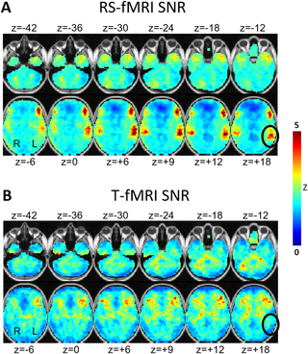
fMRI and rsfMRI
Functional MRI measures the blood flow to different regions of the brain
Resting state MRI is a unique method of fMRI scanning, in which the patient is required to stay still
Notes:
stay still, calm down and preferably think about nothing (differently from regular scans in which the patient is asked to preform certain activities)

Slide 7
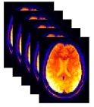
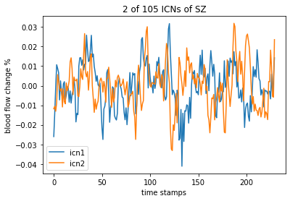
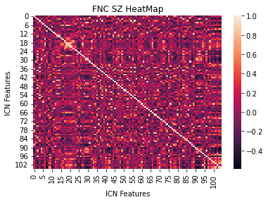
The Dataset
ICN
intrinsic connectivity network
FNC
functional network connectivity
fMRI
Preprocess
Pearson correlation
ICA - Independent Component Analysis
Outlier removal
Rigid body motion correction
Timing correction
Distortion correction
Registered into a common space
Gaussian Smooth
The dataset consisted 786 patients in total
471 were labeled (train set) and 315 were unlabeled (test set)
Notes:
ICA = which divides the signal into subcomponents as statistically independent as possible.
Quality control was applied to identify high-quality data. (2) Each subject's rsfMRI data were preprocessed using a common procedure, including rigid body motion correction, slice timing correction, and distortion correction. (3) Preprocessed subject data were registered into a common space, resampled to 3 mm3 isotropic voxels, and spatially smoothed using a Gaussian kernel with a 6 mm full width at half-maximum (FWHM).

Slide 8
The competition
Our task: Build a classifier that predicts the probability that a patient has a certain disorder.
Score = Area Under the Curve (AUC)
The Test set was divided into two:
First half: Evaluate the model during the competition
Second half: Unseen results during the competition, published after the deadline for final scores
Notes:
AUC = which measures the ability of a binary classifier to distinguish between classes and is used as a summary of the ROC curve.

Slide 9
Literature Survey
No research has been conducted about distinguishing the two diseases
Similar research about differentiating mentally ill from healthy people scans has already been conducted:
Distinguishing ill from healthy patients – (Yin, et al, 2022)
Using rsfMRI for mental health diagnosis – (Yang, Gohel, 2020), (Khosla, Meenakshi, et al, 2019)
Notes:
Shahbazi, Mahdiyar, et al. "Using distance on the Riemannian manifold to compare representations in brain and in models." NeuroImage 239 (2021): 118271.
You, Kisung, and Hae-Jeong Park. "Re-visiting Riemannian geometry of symmetric positive definite matrices for the analysis of functional connectivity." NeuroImage 225 (2021): 117464.
Radovic, Milos, et al. "Minimum redundancy maximum relevance feature selection approach for temporal gene expression data." BMC bioinformatics 18.1 (2017): 1-14.
Khosla, Meenakshi, et al. "Machine learning in resting-state fMRI analysis." Magnetic resonance imaging 64 (2019): 101-121.
Yang, Jackie, Suril Gohel, and Behroze Vachha. "Current methods and new directions in resting state fMRI." Clinical imaging 65 (2020): 47-53.
Canario, Edgar, Donna Chen, and Bharat Biswal. "A review of resting-state fMRI and its use to examine psychiatric disorders." Psychoradiology 1.1 (2021): 42-53.
Yin, Wutao, Longhai Li, and Fang-Xiang Wu. "Deep learning for brain disorder diagnosis based on fMRI images." Neurocomputing 469 (2022): 332-345.

Slide 10
Our solution

Slide 11
Proposed solutions and methods
Data
Statistical data analysis
Features
Feature selection
Classifiers
SVM
Data augmentation (noise, mixup, sliding window)
Dynamic FNCs
Riemannian projection
Clustering
MLP
CNN
GNN
Boosting (xgboost, LGBM, ADA)
Bagging

Slide 12
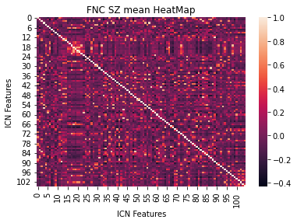
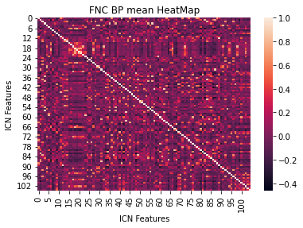
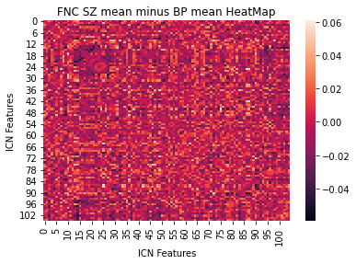
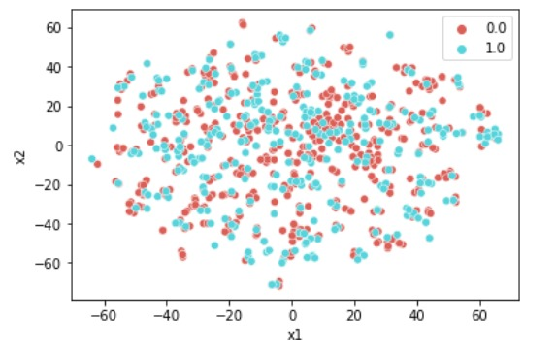
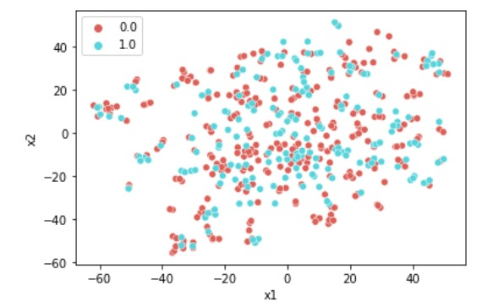
Data analysis
SZ FNC Mean vs BP FNC Mean
tSNE: Test vs Train sets BP vs SZ

Slide 13
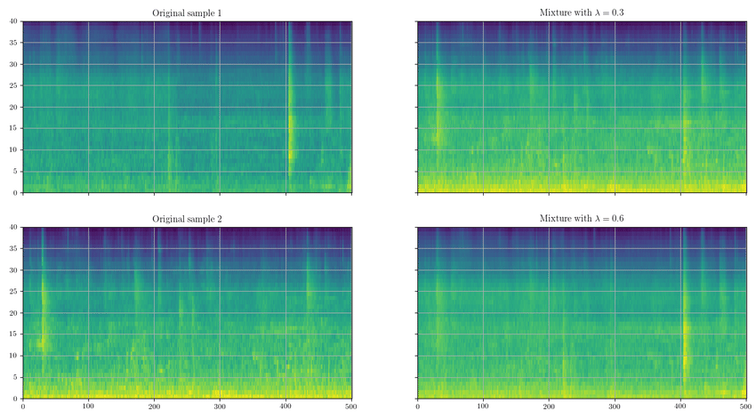
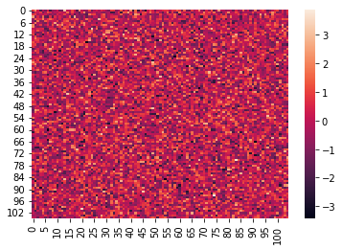
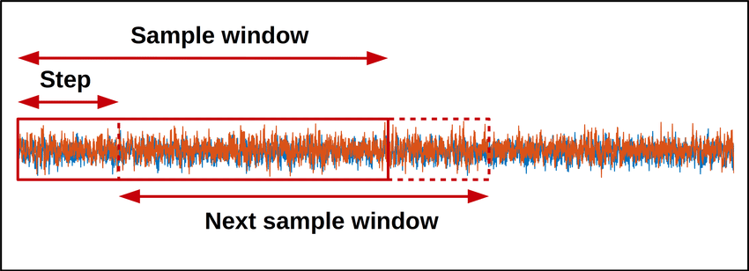
Augmentations
ICN Mix-up
FNC noise addition
ICN sliding window

Slide 14
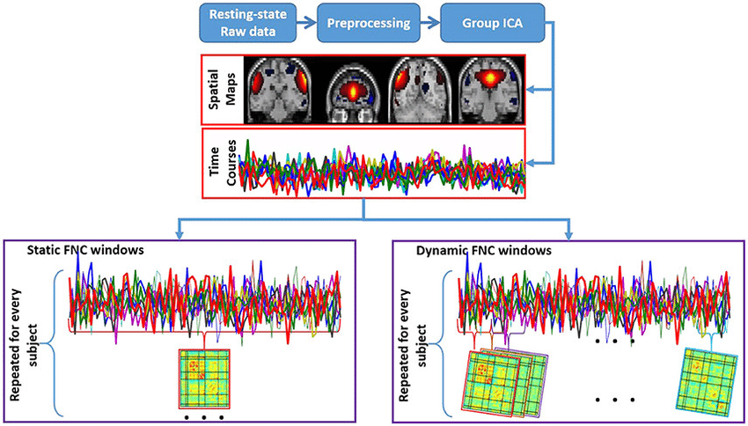
Dynamic FNC
Dynamic FNC = Sliding window on the ICN → Pearson correlation on each window
Dynamic FNC = Time series matrices for each patient
Each patient can have a different numer of dFNC – depending on it’s ICN length

Slide 15
Proposed solutions and methods
Data
Statistical data analysis
Features
Feature selection
Classifiers
SVM
Data augmentation (noise, mixup, sliding window)
Dynamic FNCs
Riemannian projection
Clustering
MLP
CNN
GNN
Boosting (xgboost, LGBM, ADA)
Bagging

Slide 16
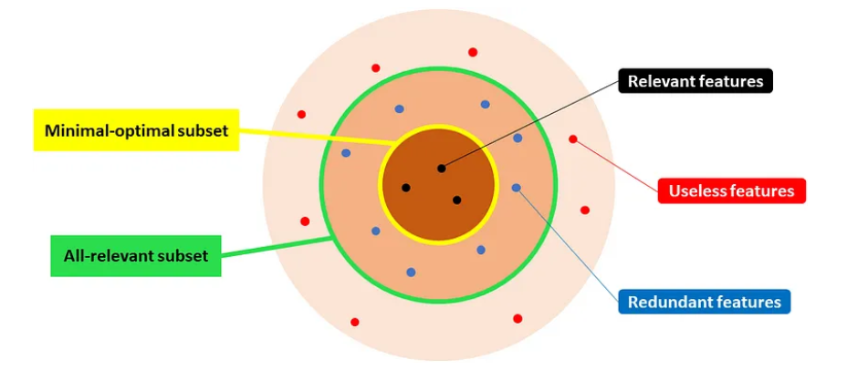

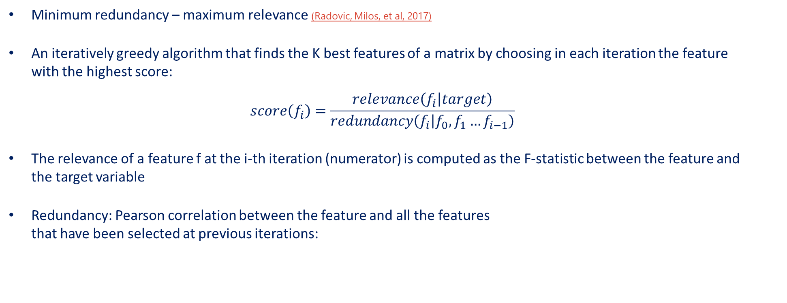
Feature selection – MRMR on FNC
Minimum redundancy – maximum relevance (Radovic, Milos, et al, 2017)
An iteratively greedy algorithm that finds the K best features of a matrix by choosing in each iteration the feature with the highest score:
$$score\left(f_{i}\right)=\frac{relevance\left(f_{i} | target\right)}{redundancy\left(f_{i} | f_{0}, f_{1}…f_{i−1}\right)}$$
The relevance of a feature f at the i-th iteration (numerator) is computed as the F-statistic between the feature and the target variable
Redundancy: Pearson correlation between the feature and all the features that have been selected at previous iterations:

Slide 17
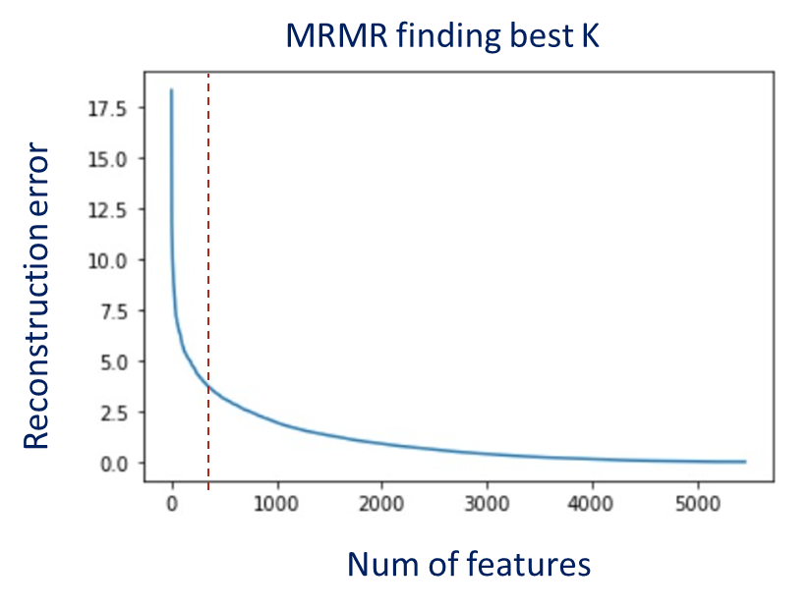
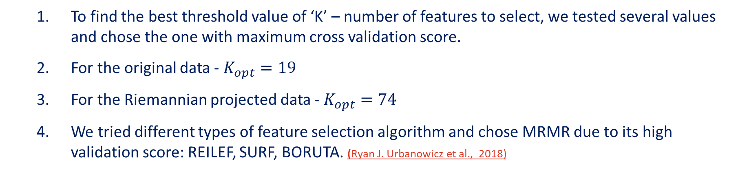
Feature selection - MRMR
To find the best threshold value of ‘K’ – number of features to select, we tested several values and chose the one with maximum cross validation score.
For the original data - $K_{opt}=19$
For the Riemannian projected data - $K_{opt}=74$
We tried different types of feature selection algorithm and chose MRMR due to its high validation score: REILEF, SURF, BORUTA. (Ryan J. Urbanowicz et al., 2018)
Notes:
Emphasize the key idea
If the audience remembers only one thing from your talk, what should it be?
Then, give a more detailed explanation of the chosen solution
You usually start with a block diagram slide followed by a few more slides describing each block in the diagram in detail
Prefer deep details (technical ‘meat’) of part of the solution over a shallow overview of many topics

Slide 18
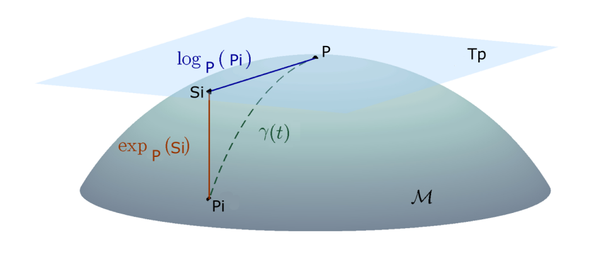
Riemannian Projection
FNC matrices are PSD (positive semi definite) and symmetric (correlation matrices)
Assume that each FNC isn’t located on the same Euclidian domain
We want to project each FNC to a relevant Riemannian manifold and use regular distance functions to fit a model and predict

Slide 19
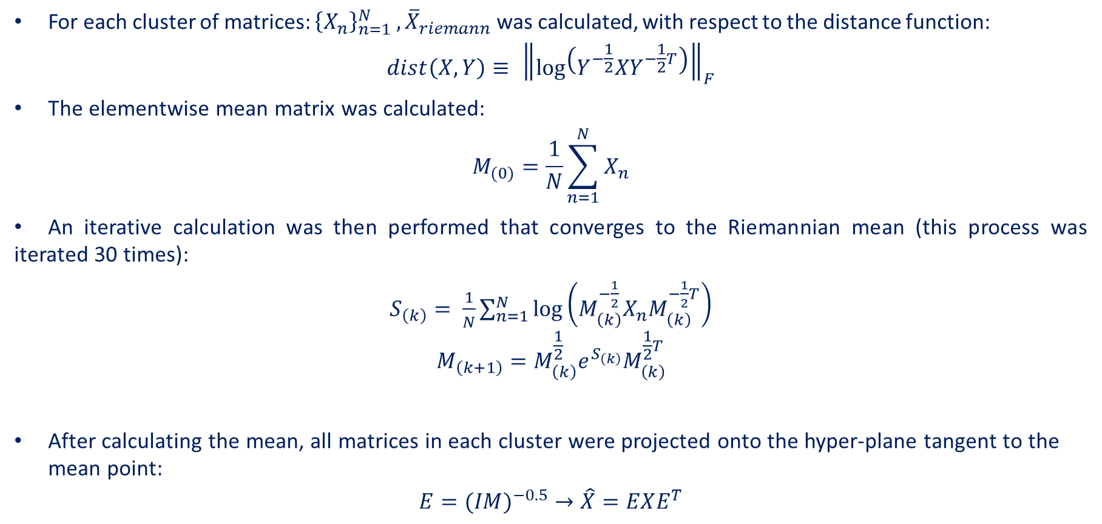
Riemannian Projection
For each cluster of matrices: ${\left\{X_{n}\right\}}_{n=1}^{N} , {\overline{X}}_{riemann}$ was calculated, with respect to the distance function:
$$dist\left(X, Y\right)≡ {\left\|\log\left(Y^{−\frac{1}{2}}XY^{−\frac{1}{2}T}\right)\right\|}_{F}$$
The elementwise mean matrix was calculated:
$$M_{(0)}=\frac{1}{N}\sum_{n=1}^{N}{X_{n}}$$
An iterative calculation was then performed that converges to the Riemannian mean (this process was iterated 30 times):
$S_{\left(k\right)}= \frac{1}{N}\sum_{n=1}^{N}{\log\left(M_{\left(k\right)}^{−\frac{1}{2}}X_{n}M_{\left(k\right)}^{−\frac{1}{2}T}\right)}$ $$M_{\left(k+1\right)}=M_{\left(k\right)}^{\frac{1}{2}}e^{S_{\left(k\right)}}M_{\left(k\right)}^{\frac{1}{2}T}$$
After calculating the mean, all matrices in each cluster were projected onto the hyper-plane tangent to the mean point:
$$E={(IM)}^{−0.5} →\hat{X}=EXE^{T}$$
Notes:
Emphasize the key idea
If the audience remembers only one thing from your talk, what should it be?
Then, give a more detailed explanation of the chosen solution
You usually start with a block diagram slide followed by a few more slides describing each block in the diagram in detail
Prefer deep details (technical ‘meat’) of part of the solution over a shallow overview of many topics

Slide 20
Cluster the dataset
We chose to cluster the data by using the lengths of the ICNs of each patient
A hidden assumption is that each data source should have the same test – therefore each test takes the same time.
For dynamic FNCs we used each patient as a single cluster and averaged (with Riemannian projection) between the time series matrices.
Notes:
Emphasize the key idea
If the audience remembers only one thing from your talk, what should it be?
Then, give a more detailed explanation of the chosen solution
You usually start with a block diagram slide followed by a few more slides describing each block in the diagram in detail
Prefer deep details (technical ‘meat’) of part of the solution over a shallow overview of many topics

Slide 21
Proposed solutions and methods
Data
Statistical data analysis
Features
Feature selection
Classifiers
SVM
Data augmentation (noise, mixup, sliding window)
Dynamic FNCs
Riemannian projection
Clustering
MLP
CNN
GNN
Boosting (xgboost, LGBM, ADA)
Bagging
Predictions
Ensemble

Slide 22
CNN
Aligned ICN’s
256 samples of 105x100
Convolution block – 1 to 3
Prediction
Adaptive pooling
FC – 1 to 2
Cross entropy loss
Sigmoid
Possible reasons for low scores:
Too many parameters ←→ small dataset
Trade off – kernel size
Noisy signals
Alignment to fix length
Convolution block
1DConv → Activation → 1DConv
Tried also pooling after each block
Notes:
Emphasize the key idea
If the audience remembers only one thing from your talk, what should it be?
Then, give a more detailed explanation of the chosen solution
You usually start with a block diagram slide followed by a few more slides describing each block in the diagram in detail
Prefer deep details (technical ‘meat’) of part of the solution over a shallow overview of many topics

Slide 23
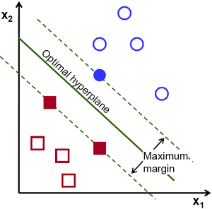
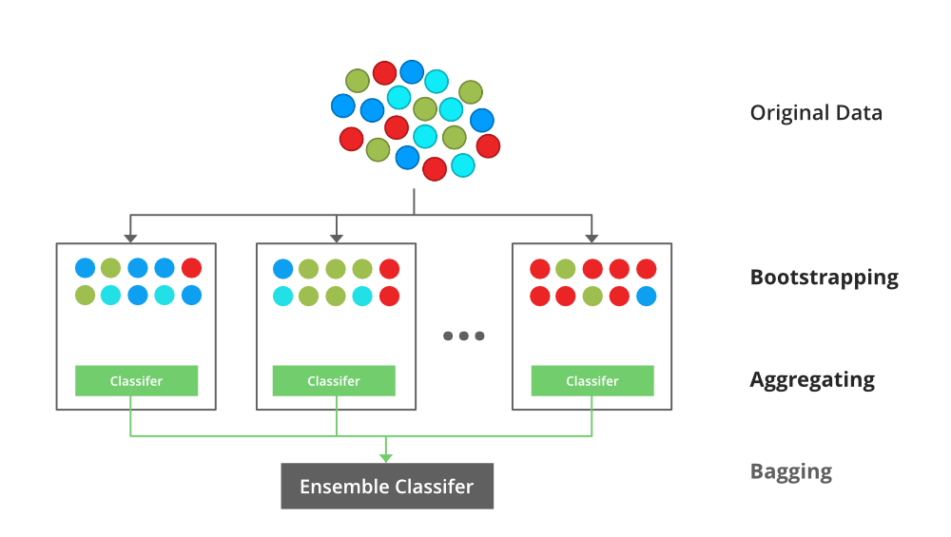
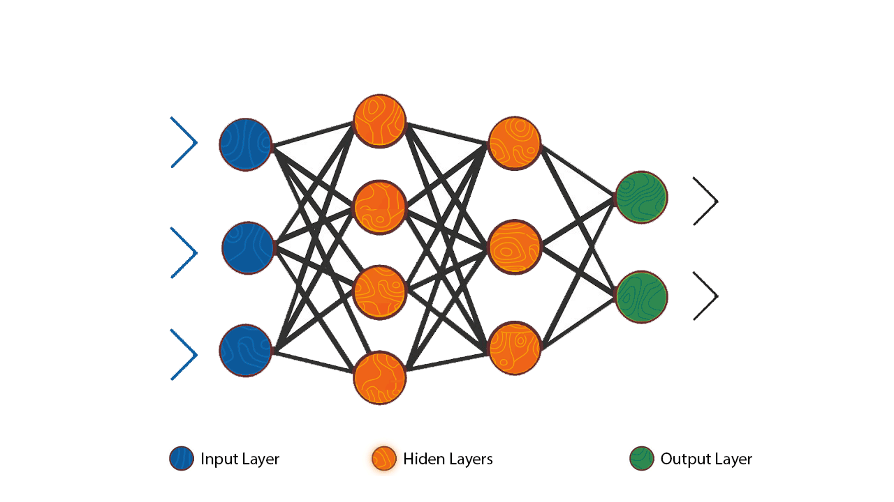
Ensemble
Kernel SVM
Validation Score
Validation Score
Validation Score
0.66
60%
0.69
Bagging and boosting
60%
40%
0.74
0.65
40%
MLP
0.63
Notes:
Emphasize the key idea
If the audience remembers only one thing from your talk, what should it be?
Then, give a more detailed explanation of the chosen solution
You usually start with a block diagram slide followed by a few more slides describing each block in the diagram in detail
Prefer deep details (technical ‘meat’) of part of the solution over a shallow overview of many topics

Slide 24
Chosen Solution
Feature selection
MRMR
Classifier
FNCs
Cluster FNCs
(by ICN length)
Riemannian manifold parallel transport
Ensemble
Predictions
FNC
groups
Reduce 90% of features
Choose best classifiers
ICNs
FNC in
Parallel dimension
Feature selection
MRMR
Classifier
Classifier
Classifier

Slide 25
Our Results
On the first half, our best result was 0.74, using the method we have described (received only 0.58 on the second half)
On the second half, our best result was 0.65, using an SVM classifier on the dynamic FNCs (received 0.57 on the first half)
Overall, there seems to be a large discrepancy between the results on the first and second halves for all teams

Slide 26
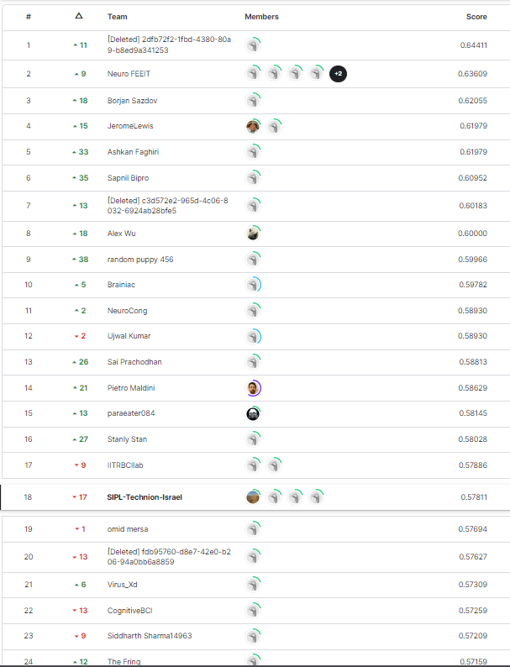
Final Results

Slide 27
Conclusions
There have been no satisfactory and consistent solution, out of the ones submitted by the different teams
Possible reasons: small size dataset, No significant difference between fMRI scans of BPD and SZ patients.
Better organization and planning are needed
Document more strictly the tests and results

Slide 28
Future Work
Find the best way to cluster the data for the Riemannian Projection
Improve the classifiers selection and the ensemble weights solution
Develop an algorithm that uses the dFNC to classify by using its time series character
Take our methods to other domains (classifications between healthy and schizophrenic patients)

Slide 29
References
Shahbazi, Mahdiyar, et al. "Using distance on the Riemannian manifold to compare representations in brain and in models." NeuroImage 239 (2021): 118271.
You, Kisung, and Hae-Jeong Park. "Re-visiting Riemannian geometry of symmetric positive definite matrices for the analysis of functional connectivity." NeuroImage 225 (2021): 117464.
Radovic, Milos, et al. "Minimum redundancy maximum relevance feature selection approach for temporal gene expression data." BMC bioinformatics 18.1 (2017): 1-14.
Khosla, Meenakshi, et al. "Machine learning in resting-state fMRI analysis." Magnetic resonance imaging 64 (2019): 101-121.
Yang, Jackie, Suril Gohel, and Behroze Vachha. "Current methods and new directions in resting state fMRI." Clinical imaging 65 (2020): 47-53.
Canario, Edgar, Donna Chen, and Bharat Biswal. "A review of resting-state fMRI and its use to examine psychiatric disorders." Psychoradiology 1.1 (2021): 42-53.
Yin, Wutao, Longhai Li, and Fang-Xiang Wu. "Deep learning for brain disorder diagnosis based on fMRI images." Neurocomputing 469 (2022): 332-345.

