Slide 1
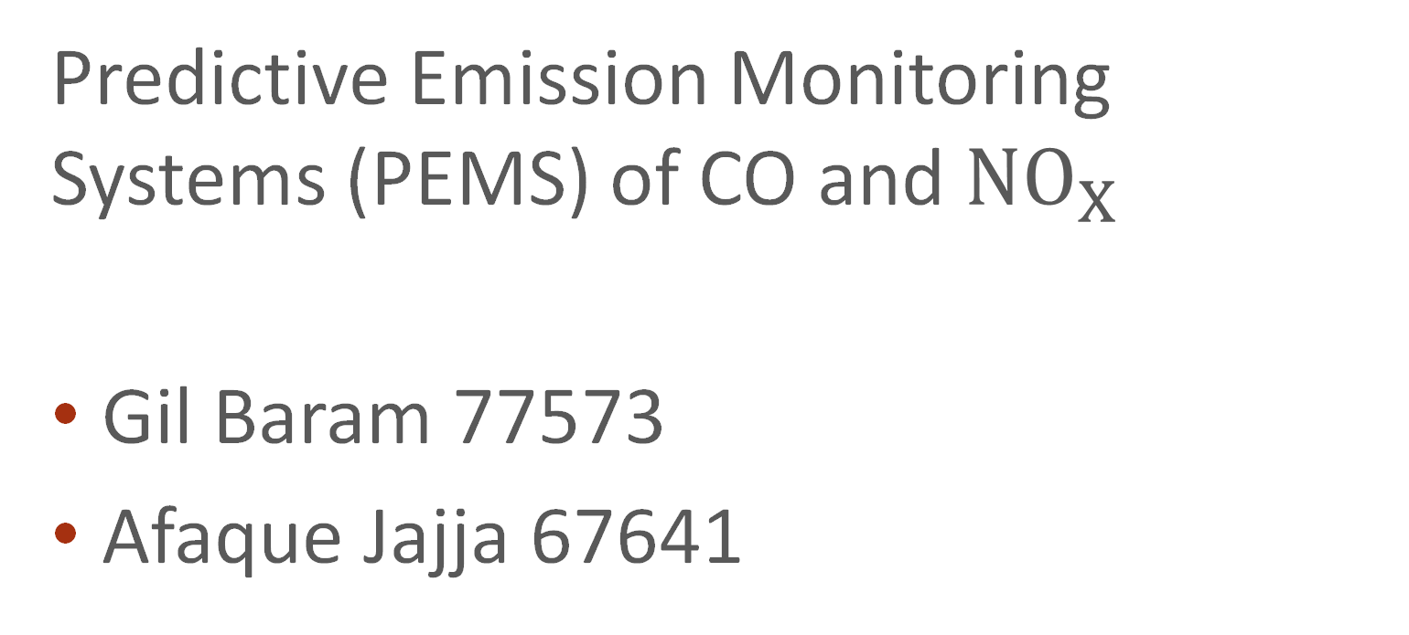
Analyse von Prozess- und Produktdaten DSCB450
Predictive Emission Monitoring Systems (PEMS) of CO and ${NO}_{X}$
Gil Baram 77573
Afaque Jajja 67641
SoSe 22
Gruppe 6: Gil Baram, Afaque Jajja
DSCB450 Analyse von Prozess- und Produktdaten

Slide 2
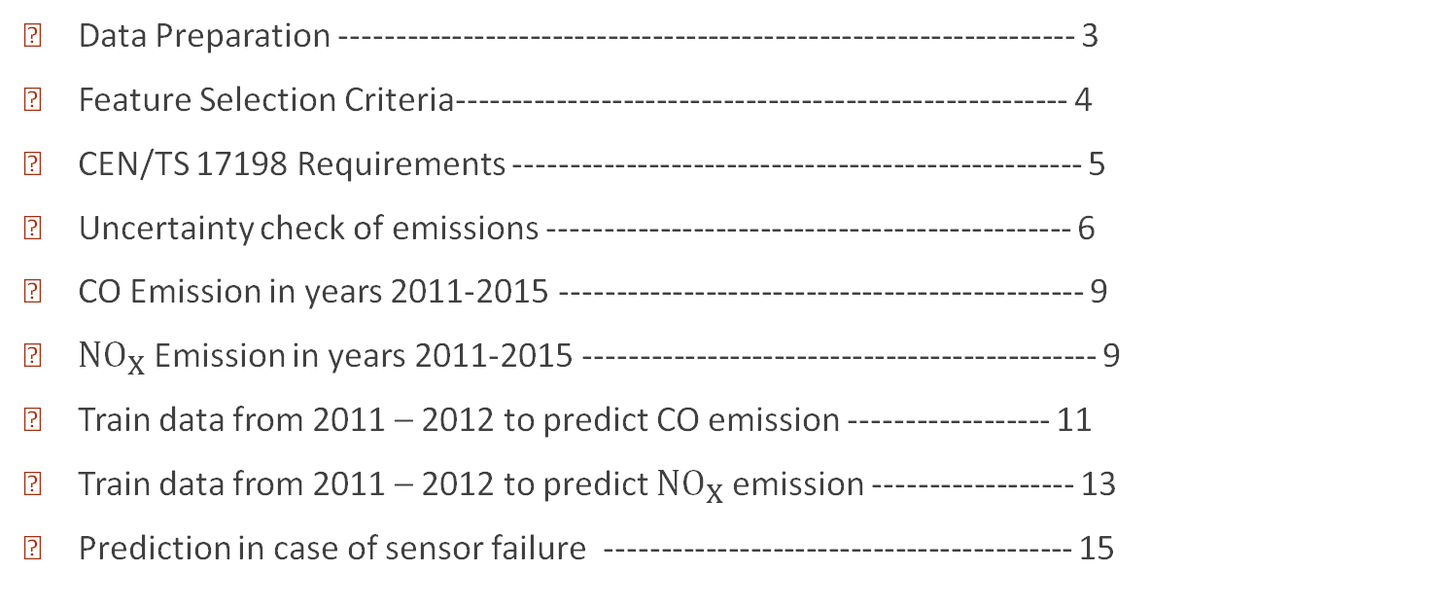
Contents
2
Data Preparation ------------------------------------------------------------------ 3
Feature Selection Criteria------------------------------------------------------- 4
CEN/TS 17198 Requirements --------------------------------------------------- 5
Uncertainty check of emissions ----------------------------------------------- 6
CO Emission in years 2011-2015 ----------------------------------------------- 9
${NO}_{X}$ Emission in years 2011-2015 ---------------------------------------------- 9
Train data from 2011 – 2012 to predict CO emission ------------------ 11
Train data from 2011 – 2012 to predict ${NO}_{X}$ emission ------------------ 13
Prediction in case of sensor failure ------------------------------------------ 15
SoSe 22
Gruppe 6: Gil Baram, Afaque Jajja
DSCB450 Analyse von Prozess- und Produktdaten

Slide 3
Data Preparation
3
Load .csv file of each year
Add Datetime column to every year’s dataframe
Concat to make it one big pandas.Dataframe
Save it as a .parquet file
SoSe 22
Gruppe 6: Gil Baram, Afaque Jajja
DSCB450 Analyse von Prozess- und Produktdaten

Slide 4
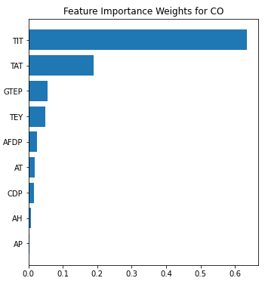
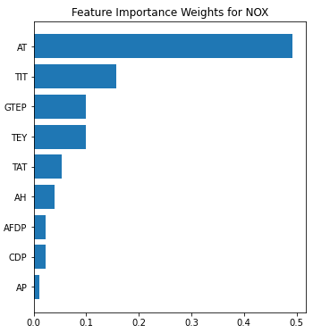
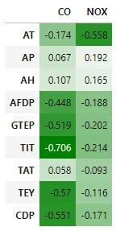
Feature Selection Criteria
4
SoSe 22
Gruppe 6: Gil Baram, Afaque Jajja
DSCB450 Analyse von Prozess- und Produktdaten

Slide 5
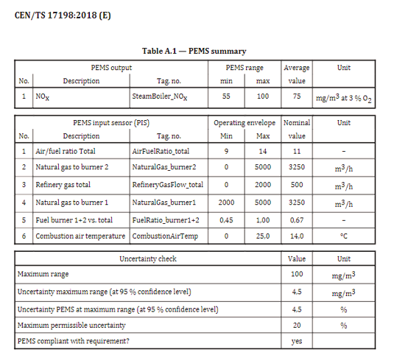
CEN/TS 17198:2018 Stationary source emissions - Predictive Emission Monitoring Systems (PEMS) - Applicability, execution and quality assurance
5
SoSe 22
Gruppe 6: Gil Baram, Afaque Jajja
DSCB450 Analyse von Prozess- und Produktdaten

Slide 6
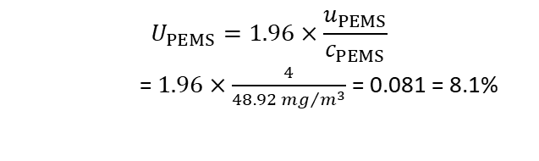
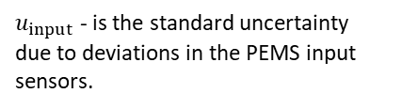





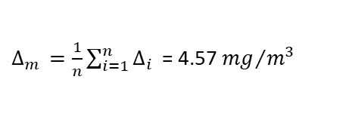


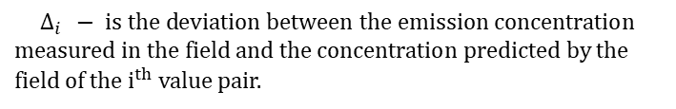

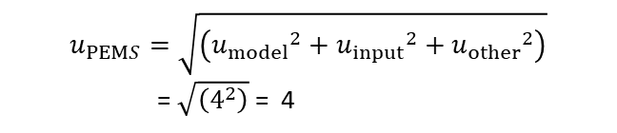

Uncertainty Check of NOX Emission
6
$C_{m}\left(i\right)$ - is the concentration measured in the field of the $i^{th}$value pair.
$u_{input}$ - is the standard uncertainty due to deviations in the PEMS input sensors.
$C_{p}\left(i\right)$ - is the concentration measured in the field of the $i^{th}$value pair.
*$u_{other}$ - is the standard uncertainty due to parameters not included in the PEMS.
$$∆_{i } − is the deviation between the emission concentration$$
$measured in the field and the concentration$ predicted by the field of the $i^{th}$value pair.
$u_{PEMS}$ - is the standard uncertainty of the PEMS.
$∆_{i } =C_{m}\left(i\right)$ - $C_{p}\left(i\right)$
$$u_{PEMS}=\sqrt{\left({u_{model}}^{2}+{u_{input}}^{2}+{u_{other}}^{2}\right)}$$
= $\sqrt{\left(4^{2}\right)}$ = 4
$$∆_{m } − is the mean the relative deviations$$
$∆_{m } =\frac{1}{n}\sum_{i=1}^{n}{∆_{i }}$ = 4.57 ${mg}/{m^{3}}$
$u_{model}$ - is the standard uncertainty of the emission model.
$c_{PEMS}$ - is the concentration range of the PEMS.
$u_{model}=\sqrt{\frac{\sum{{\left(∆_{i }−∆_{m }\right)}^{2}}}{n−1}}$ = 4
$U_{PEMS}$ - is the relative expanded uncertainty of the PEMS.
$$U_{PEMS}=1.96×\frac{u_{PEMS}}{c_{PEMS}}$$
= $1.96×\frac{4}{48.92 {mg}/{m^{3}}}$ = 0.081 = 8.1%
* Uncertainty of Parameters not included in PEMS have no impact
SoSe 22
Gruppe 6: Gil Baram, Afaque Jajja
DSCB450 Analyse von Prozess- und Produktdaten

Slide 7
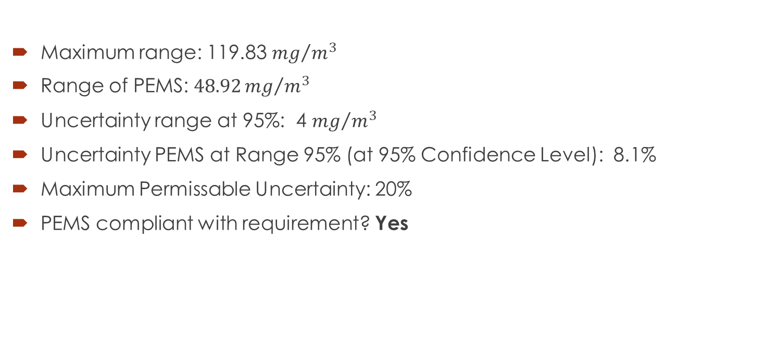
Uncertainty Check of NOX Emission
7
Maximum range: 119.83 ${mg}/{m^{3}}$
Range of PEMS: $48.92{mg}/{m^{3}}$
Uncertainty range at 95%: 4 ${mg}/{m^{3}}$
Uncertainty PEMS at Range 95% (at 95% Confidence Level): 8.1%
Maximum Permissable Uncertainty: 20%
PEMS compliant with requirement? Yes
SoSe 22
Gruppe 6: Gil Baram, Afaque Jajja
DSCB450 Analyse von Prozess- und Produktdaten

Slide 8
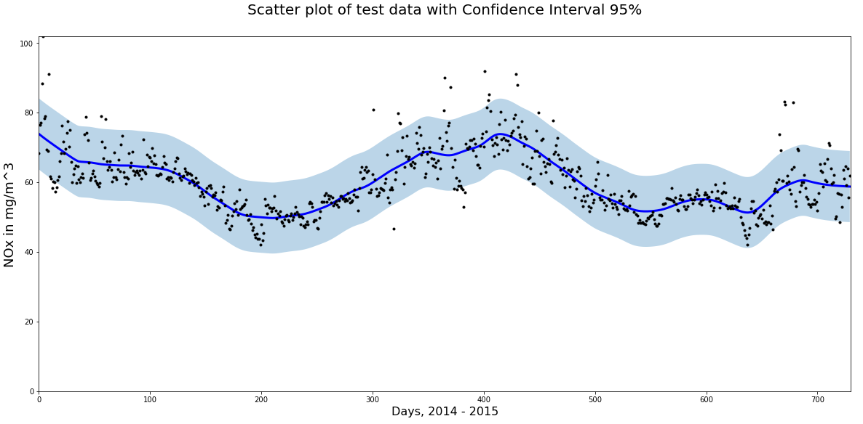
8

Slide 9
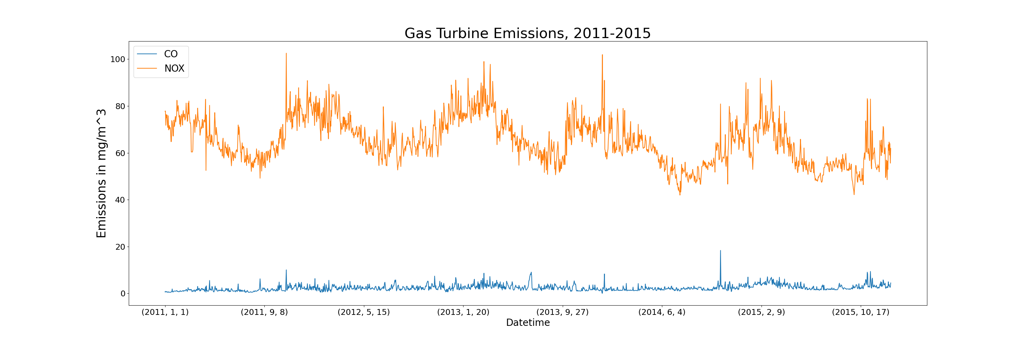
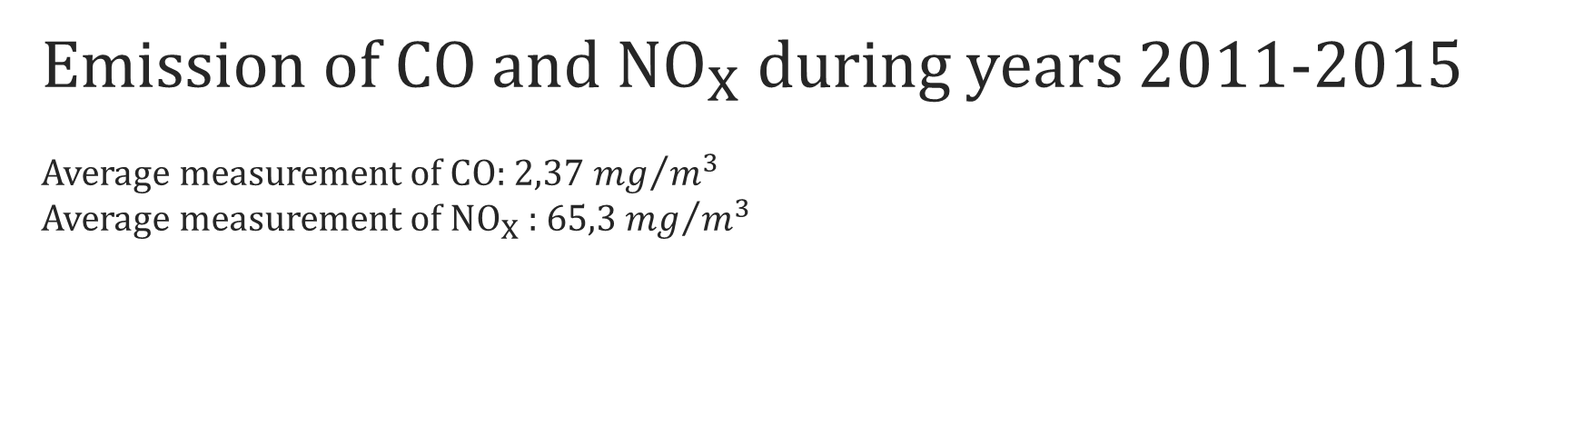
Emission of CO and ${NO}_{X}$during years 2011-2015 Average measurement of CO: 2,37 ${mg}/{m^{3}}$ Average measurement of ${NO}_{X}$ : 65,3 ${mg}/{m^{3}}$
9
SoSe 22
Gruppe 6: Gil Baram, Afaque Jajja
DSCB450 Analyse von Prozess- und Produktdaten

Slide 10
Prediction
10
Data from years 2011-2013 to train our model
Data from years 2014 and 2015 to test our model
SoSe 22
Gruppe 6: Gil Baram, Afaque Jajja
DSCB450 Analyse von Prozess- und Produktdaten

Slide 11
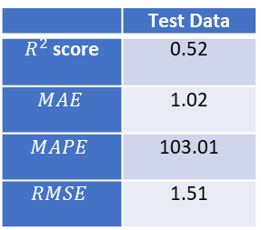
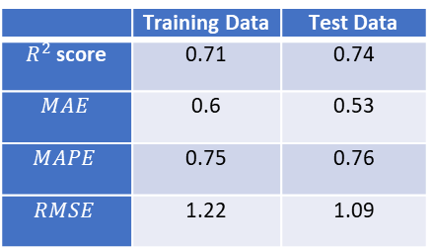
Model trained on data from 2011-2013 to predict CO emissions
11
Model: MLPRegressor
Model: GradientBoostingRegressor with Cross validation
 | Test Data
$R^{2}$score | 0.52
$$MAE$$ | 1.02
$$MAPE$$ | 103.01
$$RMSE$$ | 1.51
 | Training Data | Test Data
$R^{2}$score | 0.71 | 0.74
$$MAE$$ | 0.6 | 0.53
$$MAPE$$ | 0.75 | 0.76
$$RMSE$$ | 1.22 | 1.09
SoSe 22
Gruppe 6: Gil Baram, Afaque Jajja
DSCB450 Analyse von Prozess- und Produktdaten

Slide 12
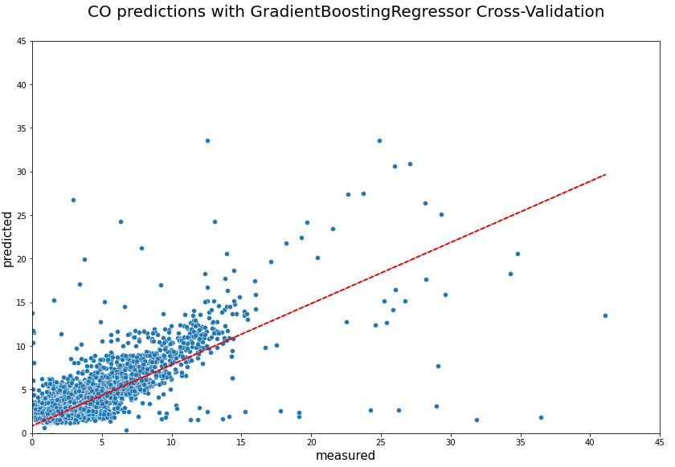
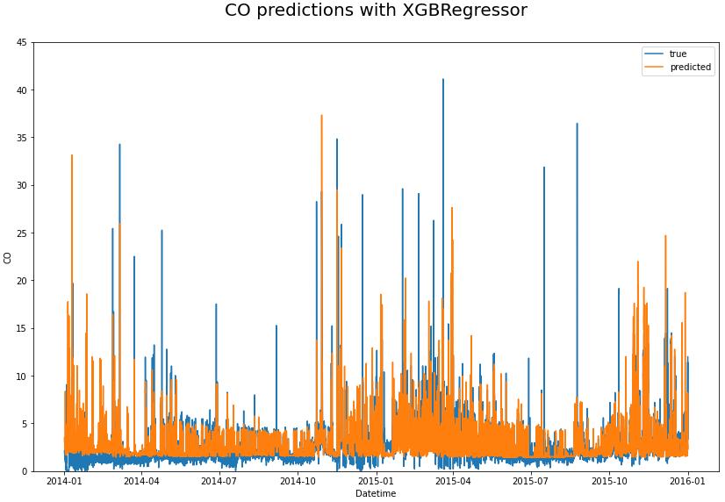
Plotting true values against predicted values
12
SoSe 22
Gruppe 6: Gil Baram, Afaque Jajja
DSCB450 Analyse von Prozess- und Produktdaten

Slide 13
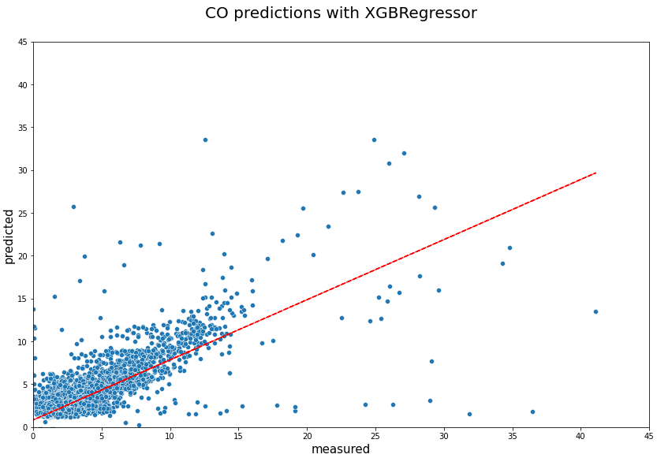
Plotting true values against predicted values
13
SoSe 22
Gruppe 6: Gil Baram, Afaque Jajja
DSCB450 Analyse von Prozess- und Produktdaten

Slide 14
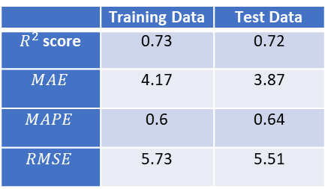
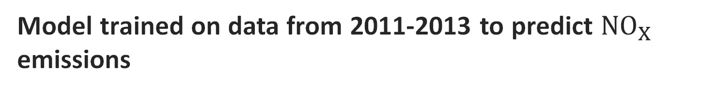
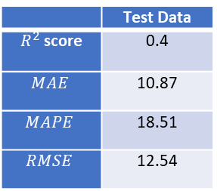
Model trained on data from 2011-2013 to predict ${NO}_{X}$ emissions
13
Model: MLPRegressor
Model: GradientBoostingRegressor with Cross validation
 | Test Data
$R^{2}$score | 0.4
$$MAE$$ | 10.87
$$MAPE$$ | 18.51
$$RMSE$$ | 12.54
 | Training Data | Test Data
$R^{2}$score | 0.73 | 0.72
$$MAE$$ | 4.17 | 3.87
$$MAPE$$ | 0.6 | 0.64
$$RMSE$$ | 5.73 | 5.51
SoSe 22
Gruppe 6: Gil Baram, Afaque Jajja
DSCB450 Analyse von Prozess- und Produktdaten

Slide 15
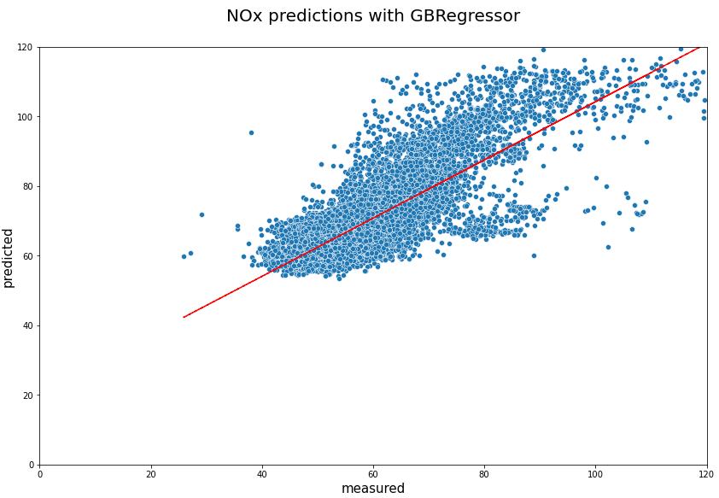
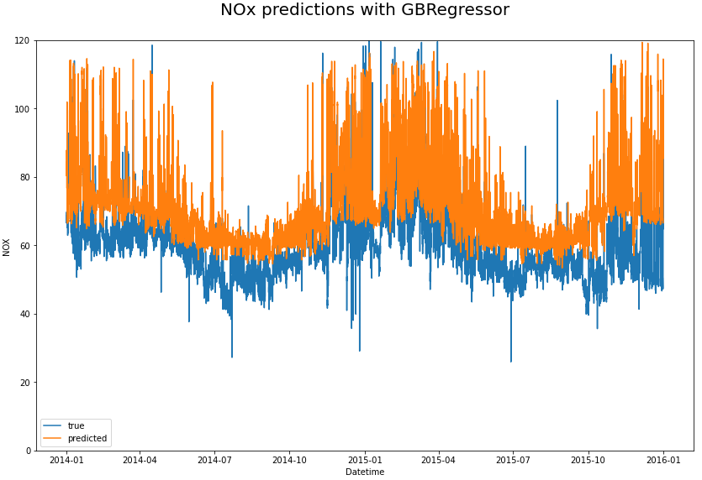
Plotting true values against predicted values
15
SoSe 22
Gruppe 6: Gil Baram, Afaque Jajja
DSCB450 Analyse von Prozess- und Produktdaten

Slide 16
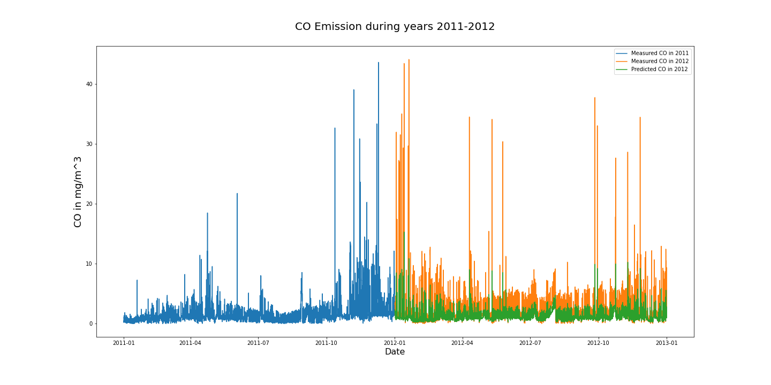
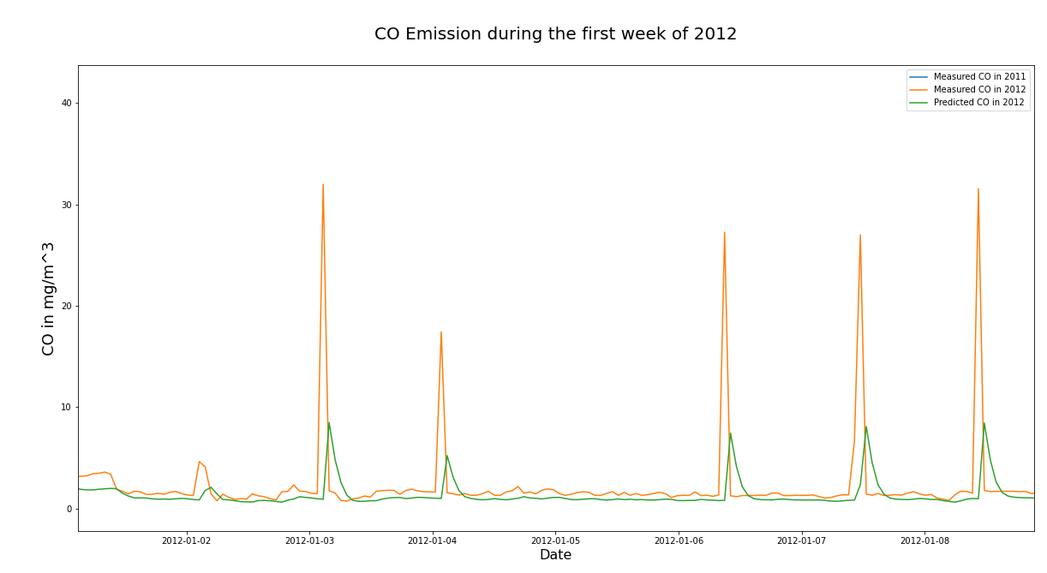
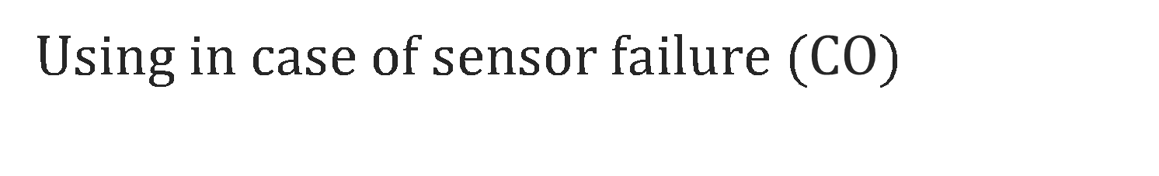
Using in case of sensor failure ($CO$)
16
SoSe 22
Gruppe 6: Gil Baram, Afaque Jajja
DSCB450 Analyse von Prozess- und Produktdaten

Slide 17
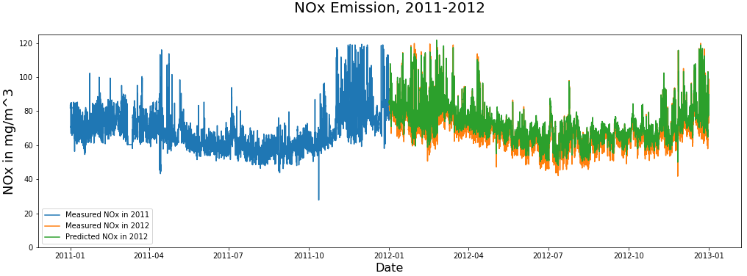
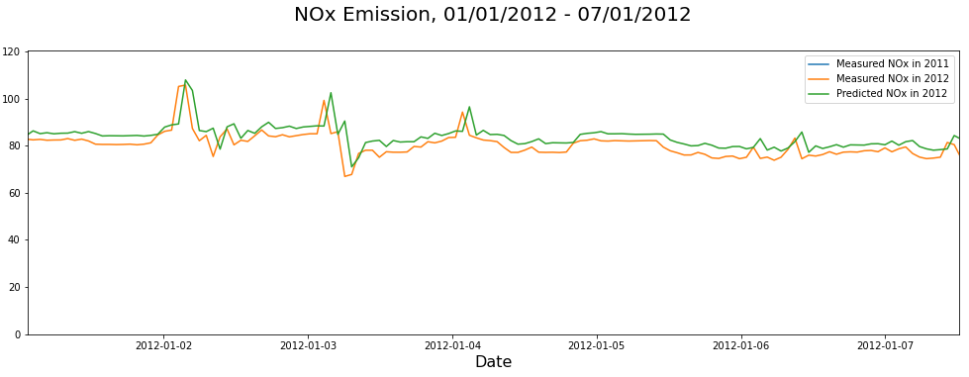
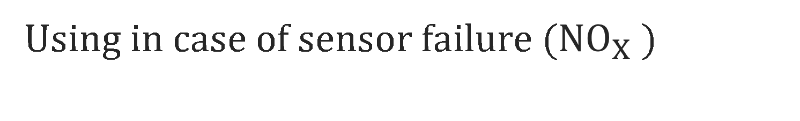
Using in case of sensor failure (${NO}_{X}$)
16
SoSe 22
Gruppe 6: Gil Baram, Afaque Jajja
DSCB450 Analyse von Prozess- und Produktdaten

Slide 18
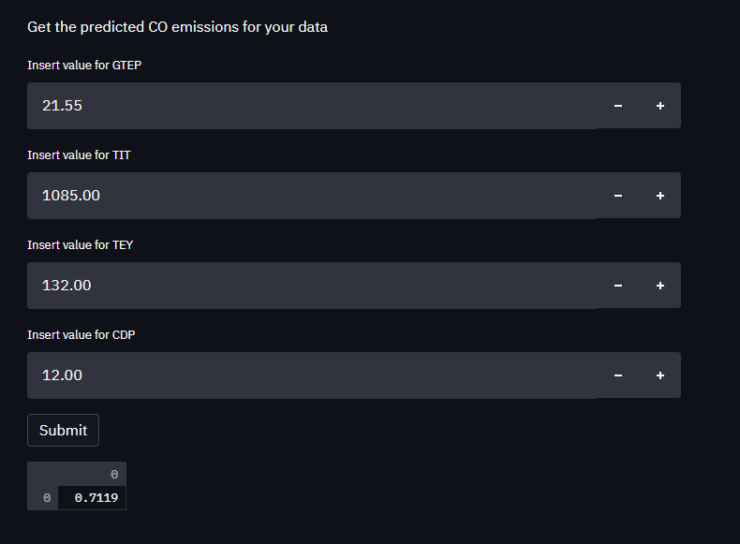
Streamlit
18

Slide 19
19
Vielen Dank für Ihre Aufmerksamkeit
SoSe 22
Gruppe 6: Gil Baram, Afaque Jajja
DSCB450 Analyse von Prozess- und Produktdaten

