Slide 1
“Animemebers” data & prediction
Data collection (CRAWLER), EDA visualization and predictive models (machine learning)
Gil Shevach 313193617
Daniel Shepelev 207056037

Slide 2
Research question
What predicts the given animation it’s “source” material
What are the variables that predict “members”, does “member” prediction differ between “source”

Slide 3
Data collection and source
We have used the “Beautiful Soup” library to build a crawler to get our data
All data was saved to “concat_data_mal.csv” (shape of the data frame is 12150 instances and 12 properties)
Source – https://www.myanimelist.net

Slide 4
Data handling – duplicates and missing data
We dropped all duplicates rows as each needs to be unique
High miss columns were completely dropped
All missing values of numeric columns approximating a normal distribution were replaces with means
All missing values of the categorical columns were replaced with modes
Columns “episodes” missing values were replaced with means by “type” classification

Slide 5
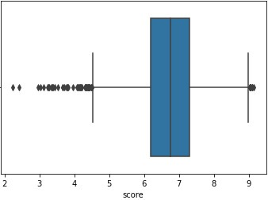
Data handling – dealing with list column and outliers
We handled outliers with 1.5 IQR method for each numerical column
In order to be able to work with genre column we had to create Boolean features for each unique genre in all the column list and assigned values accordingly
We removed all the unnecessary columns

Slide 6
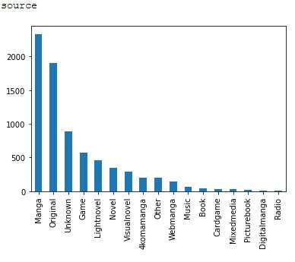
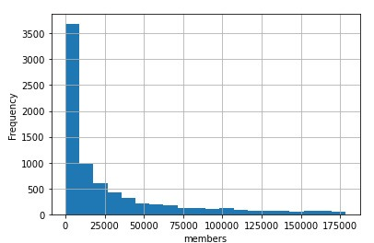
EDA – 1D visualization
We have checked all the columns and examined the way that the data is distributed

Slide 7
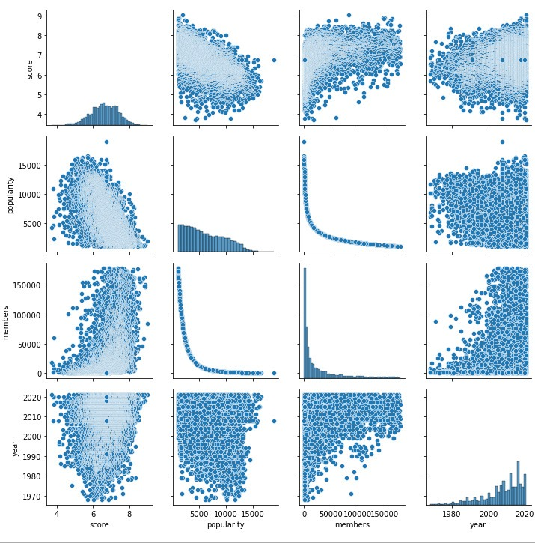
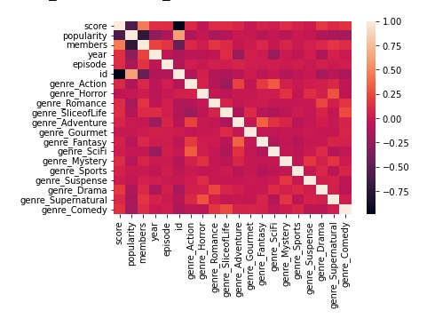
EDA – 2D visualization
We than checked all pairs of correlation and P value according to type

Slide 8
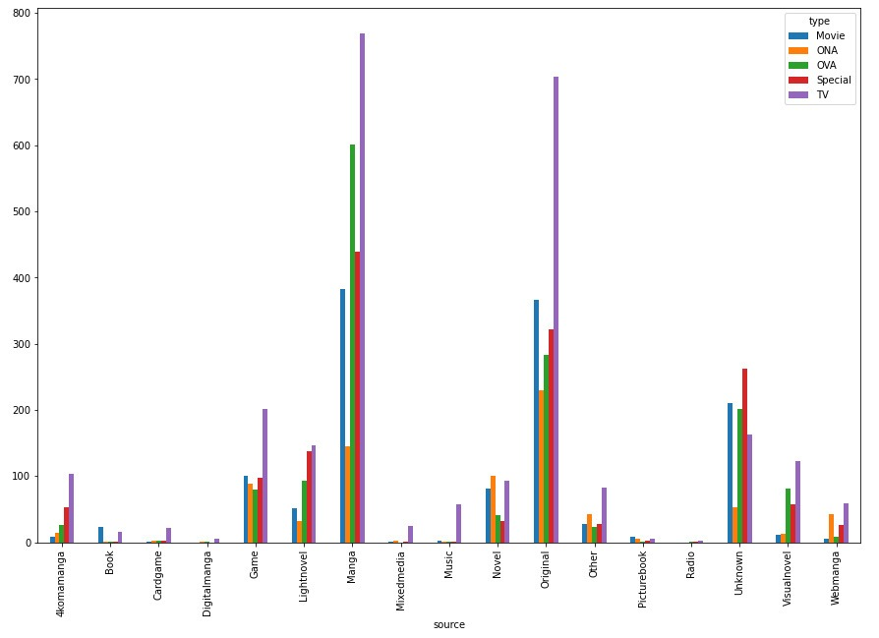
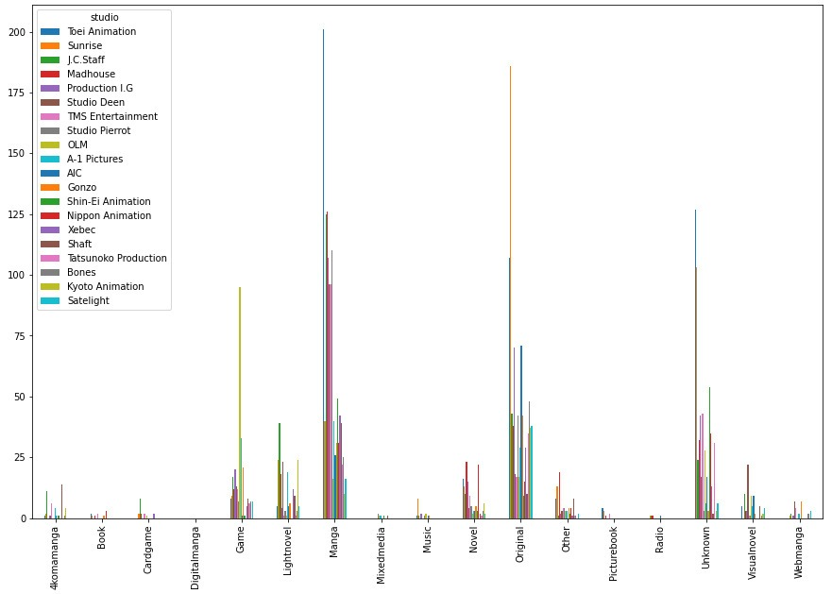
EDA – 2D visualization
We have checked the “source” against “type” and “studio” to determine dependency and prevalence by those categories

Slide 9
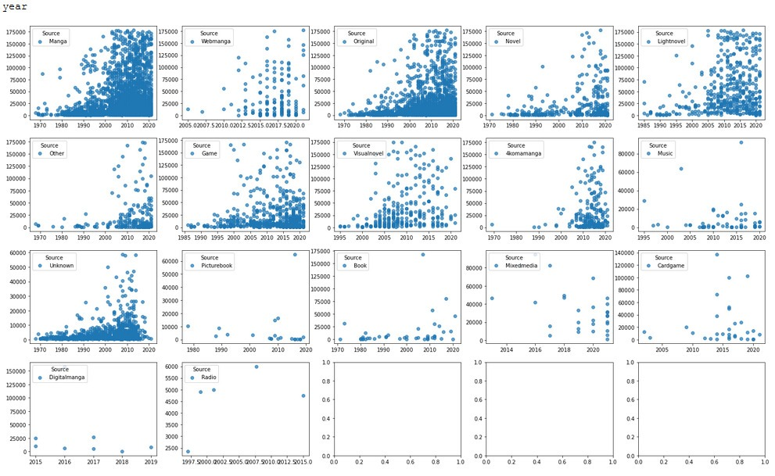
EDA – multidimensional visualization
We have divided our data by “source” and compared “members” against each variable

Slide 10
Predictive models
We have used three types of machine learning models :
KNN
Decision Tree
Linear Regression
For each model we splitted the data to 80% train for model fitting and 20% test for predictions.

Slide 11


KNN
We have used the KNN method to create classification model for feature “source” using grid search to identify best K parameter.
And through feature manipulation improved our accuracy by 0.02 and F1 by 0.03

Slide 12


Decision Tree
We have tried to use decision tree method to improve the scores.
We used grid search to determine depth and samples split parameters with scores:
For validation we used random forest with grid search to determined number of estimators.

Slide 13
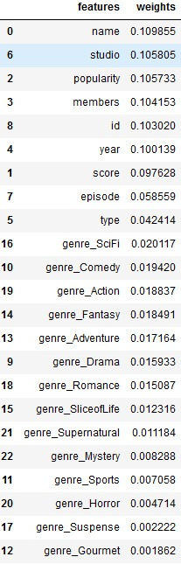
Decision tree
Through random forest we have extracted the features with the most weights:

Slide 14
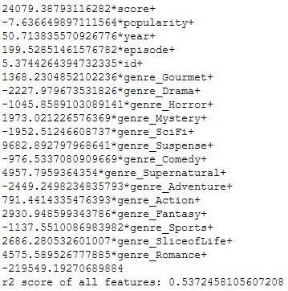
Linear Regression
We have used the “members” against all the other features
Given all features, the regression
explains 54% of the member’s variance.
Creating linear regression between all
Features against “members” those with the
greatest r2 were score and popularity.

Slide 15

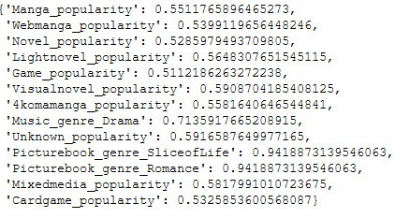
Linear Regression
Than we divided our data by “source” and made linear regression against all features by each “source”.
Those were the highest r2 for members divided by “source”.
And the highest r2 for members
pairs for each “source”.

Slide 16
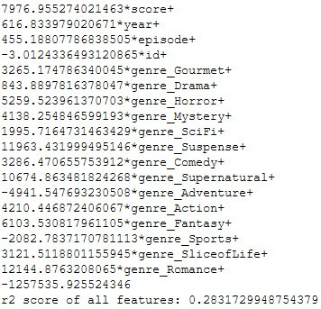

Linear Regression
After we have seen “popularity” prominence we made a new model excluding “popularity” with greater decrease of r2.
The highest r2 for members divided by
“source”.
And the highest r2 for members pairs for
each “source”.

Slide 17
Conclusion
By both classification models (KNN & decision tree) accuracy score was roughly 42% which means we can not reliably predict classification of the “source” by all the given features
Generally all the given features explain about 54% of “members” variance. After dividing by “source” we mostly got r2 in range of the general case r2 apart from a couple of sources with r2 > 0.85 . The features that mostly explained the result were “popularity” and “score”. The features that explained the results the least were all the genres (even after excluding “popularity”) apart from 3 cases aforementioned.

