Slide 1

QSM Training
Angular
May 13, 2019

Slide 2
Things To Cover
Template syntax
Built-in directive
Form
Resources

Slide 3
Template syntax
Description | Template syntax
Binds the CSS class to the expression | <div [class.extra-sparkle]="isDelightful">
Binds style property to expression in pixels | <div [style.width.px]="mySize">
Calls method when a click event is triggered | <button (click)="readRainbow($event)">
Binds text content to an interpolated string. | <p>Hello {{ponyName}}</p>
The safe navigation operator (?) | <p>Employer: {{employer?.companyName}}</p>
https://angular.io/guide/cheatsheet

Slide 4
Built-in directives
Description | Template syntax
Removes or recreates a portion of the DOM tree based on the expression | <section *ngIf="showSection">
Turns the li element and its contents into a template, and uses that to instantiate a view for each item in list. | <li *ngFor="let item of list">
Binds the presence of CSS classes on the element to the truthiness of the associated map values | <div [ngClass]="{'active': isActive, 'disabled': isDisabled}">
Allows you to assign styles to an HTML element using CSS. | <div [ngStyle]="{'property': 'value'}"> <div [ngStyle]="dynamicStyles()">
https://angular.io/guide/cheatsheet

Slide 5
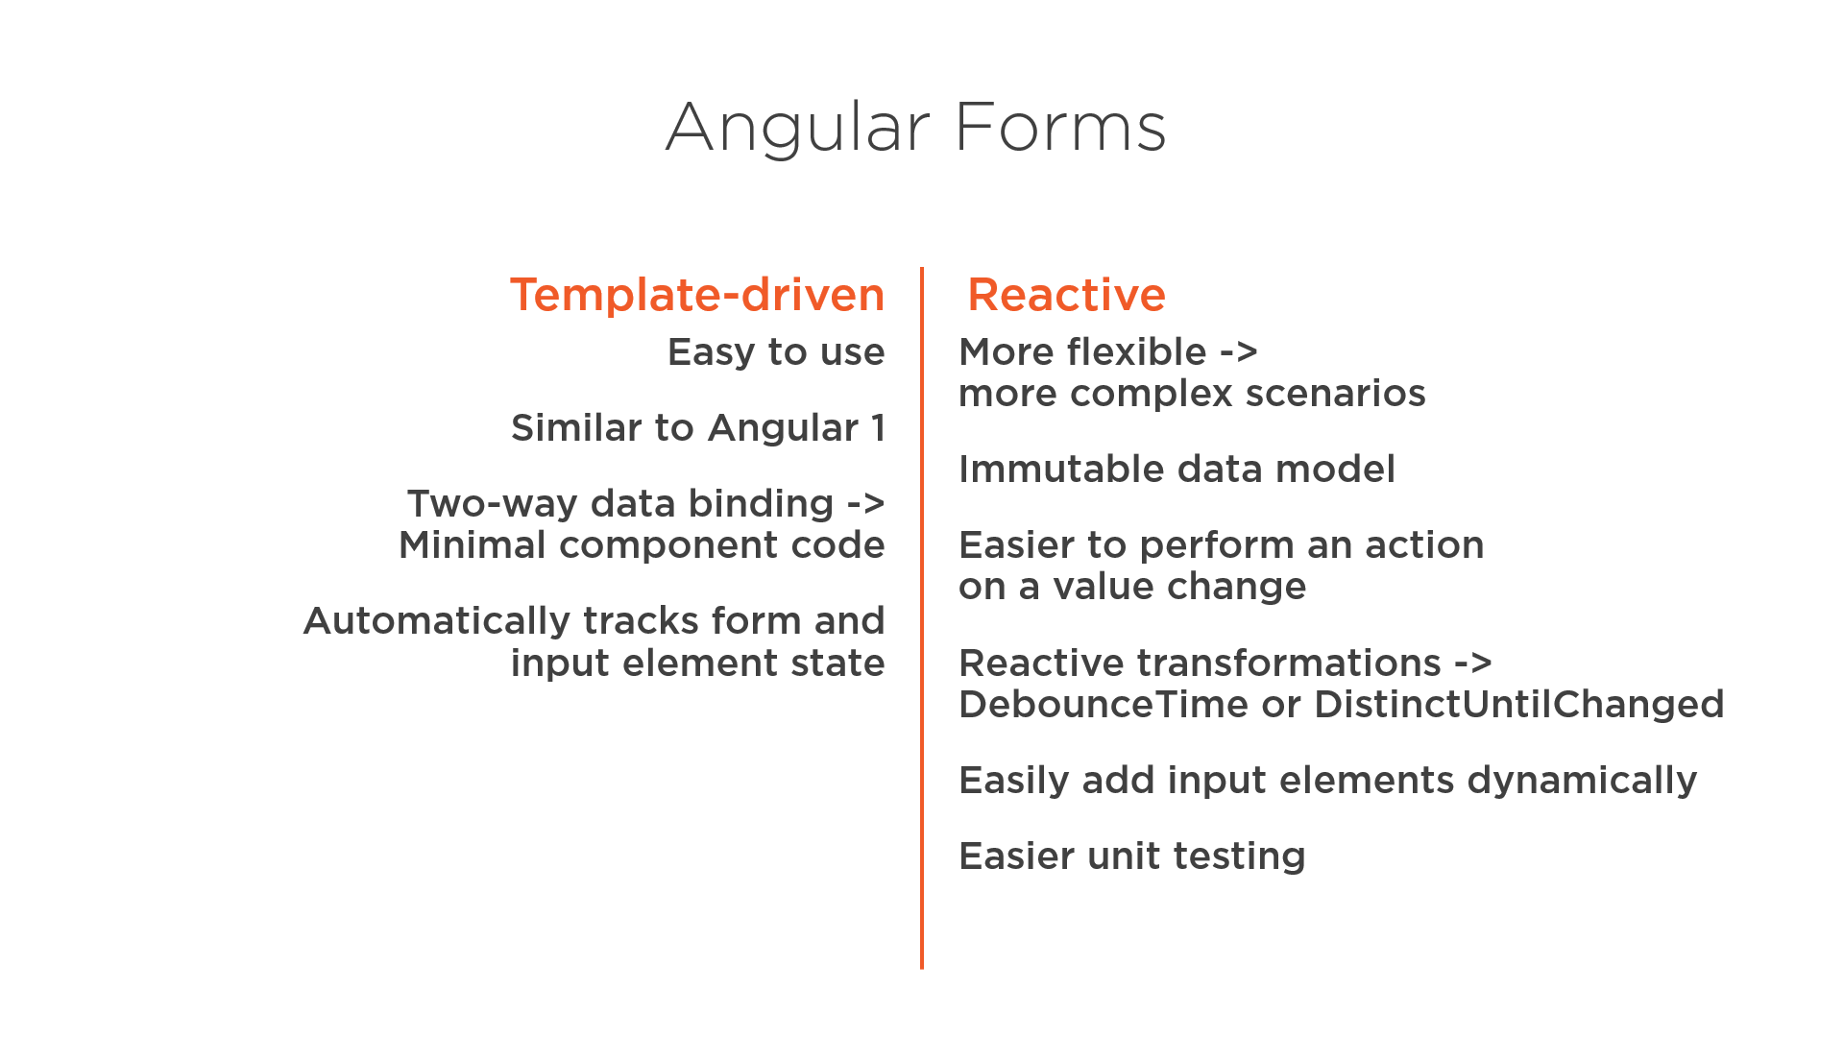
Form
https://angular.io/guide/forms-overview

Slide 6
Resources
https://angular.io/guide/cheatsheet
https://angular.io/guide/forms-overview

