Slide 1
MODERN OPERATING SYSTEMS Third Edition ANDREW S. TANENBAUM Chapter 1 Introduction
Tanenbaum, Modern Operating Systems 3 e, (c) 2008 Prentice-Hall, Inc. All rights reserved. 0-13-6006639
Notes:
1

Slide 2
What Is An Operating System (1)
A modern computer consists of:
One or more processors
Main memory
Disks
Printers
Various input/output devices
Managing all these components requires a layer of software – the operating system
Tanenbaum, Modern Operating Systems 3 e, (c) 2008 Prentice-Hall, Inc. All rights reserved. 0-13-6006639

Slide 3
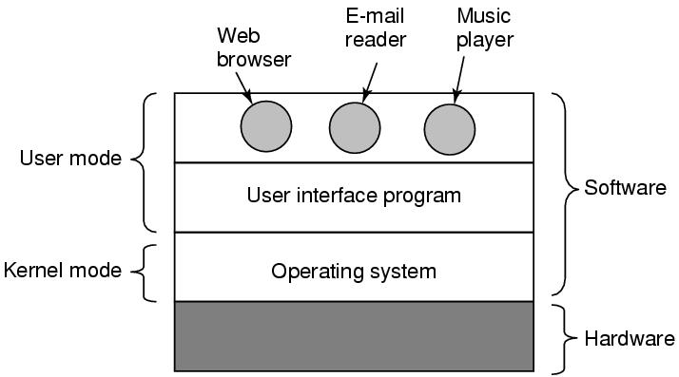
What Is An Operating System (2)
Figure 1-1. Where the operating system fits in.
Tanenbaum, Modern Operating Systems 3 e, (c) 2008 Prentice-Hall, Inc. All rights reserved. 0-13-6006639

Slide 4
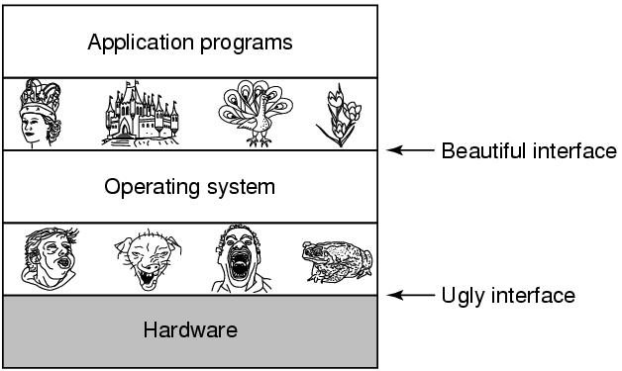
The Operating System as an Extended Machine
Figure 1-2. Operating systems turn ugly hardware into beautiful abstractions.
Tanenbaum, Modern Operating Systems 3 e, (c) 2008 Prentice-Hall, Inc. All rights reserved. 0-13-6006639

Slide 5
The Operating System as a Resource Manager
Allow multiple programs to run at the same time
Manage and protect memory, I/O devices, and other resources
Includes multiplexing (sharing) resources in two different ways:
In time
In space
Tanenbaum, Modern Operating Systems 3 e, (c) 2008 Prentice-Hall, Inc. All rights reserved. 0-13-6006639

Slide 6
History of Operating Systems
Generations:
(1945–55) Vacuum Tubes
(1955–65) Transistors and Batch Systems
(1965–1980) ICs and Multiprogramming
(1980–Present) Personal Computers
Tanenbaum, Modern Operating Systems 3 e, (c) 2008 Prentice-Hall, Inc. All rights reserved. 0-13-6006639

Slide 7
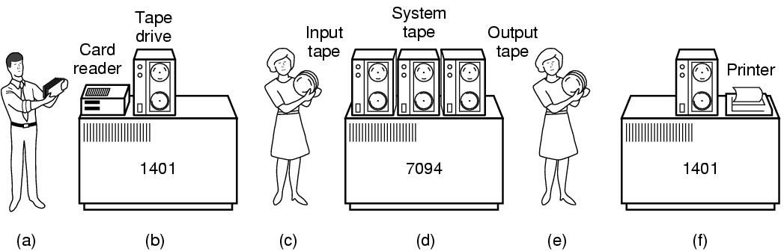
Transistors and Batch Systems (1)
Figure 1-3. An early batch system. (a) Programmers bring cards to 1401. (b)1401 reads batch of jobs onto tape.
Tanenbaum, Modern Operating Systems 3 e, (c) 2008 Prentice-Hall, Inc. All rights reserved. 0-13-6006639

Slide 8
Transistors and Batch Systems (2)
Figure 1-3. (c) Operator carries input tape to 7094. (d) 7094 does computing. (e) Operator carries output tape to 1401. (f) 1401 prints output.
Tanenbaum, Modern Operating Systems 3 e, (c) 2008 Prentice-Hall, Inc. All rights reserved. 0-13-6006639

Slide 9
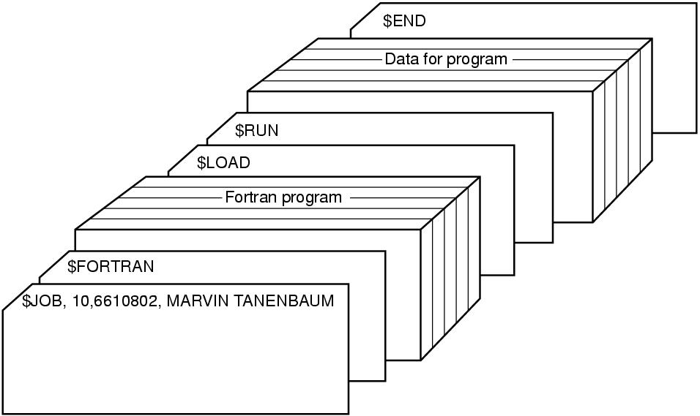
Transistors and Batch Systems (4)
Figure 1-4. Structure of a typical FMS job.
Tanenbaum, Modern Operating Systems 3 e, (c) 2008 Prentice-Hall, Inc. All rights reserved. 0-13-6006639

Slide 10
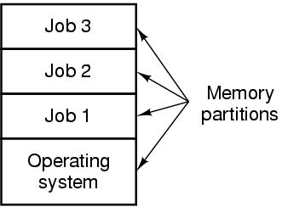
ICs and Multiprogramming
Figure 1-5. A multiprogramming system with three jobs in memory.
Tanenbaum, Modern Operating Systems 3 e, (c) 2008 Prentice-Hall, Inc. All rights reserved. 0-13-6006639

Slide 11
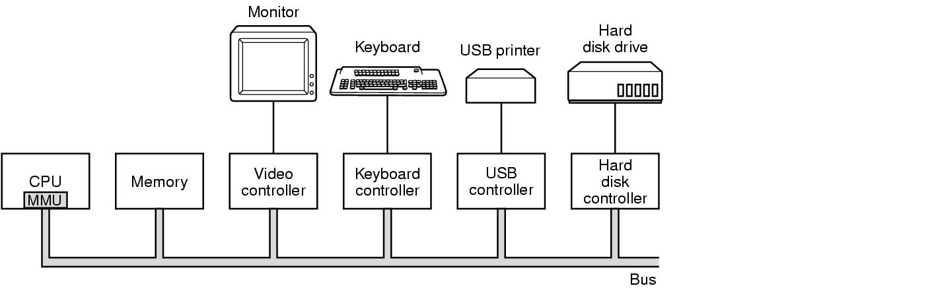
Computer Hardware Review
Figure 1-6. Some of the components of a simple personal computer.
Tanenbaum, Modern Operating Systems 3 e, (c) 2008 Prentice-Hall, Inc. All rights reserved. 0-13-6006639

Slide 12
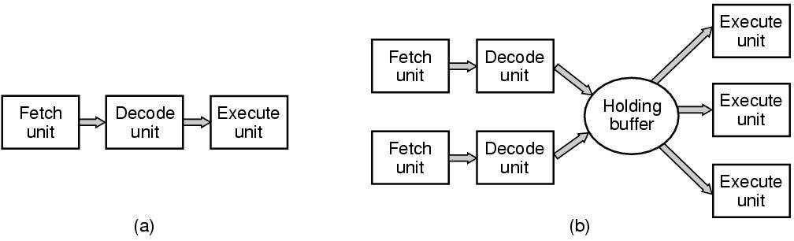
CPU Pipelining
Figure 1-7. (a) A three-stage pipeline. (b) A superscalar CPU.
Tanenbaum, Modern Operating Systems 3 e, (c) 2008 Prentice-Hall, Inc. All rights reserved. 0-13-6006639

Slide 13
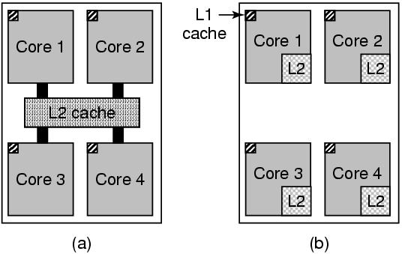
Multithreaded and Multicore Chips
Figure 1-8. (a) A quad-core chip with a shared L2 cache. (b) A quad-core chip with separate L2 caches.
Tanenbaum, Modern Operating Systems 3 e, (c) 2008 Prentice-Hall, Inc. All rights reserved. 0-13-6006639

Slide 14
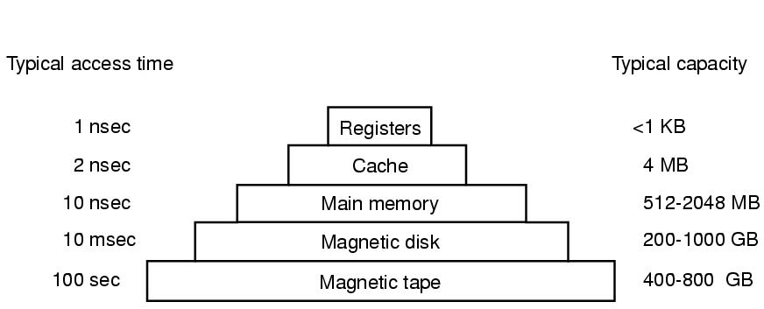
Memory (1)
Figure 1-9. A typical memory hierarchy. The numbers are very rough approximations.
Tanenbaum, Modern Operating Systems 3 e, (c) 2008 Prentice-Hall, Inc. All rights reserved. 0-13-6006639

Slide 15
Memory (2)
Questions when dealing with cache:
When to put a new item into the cache.
Which cache line to put the new item in.
Which item to remove from the cache when a slot is needed.
Where to put a newly evicted item in the larger memory.
Tanenbaum, Modern Operating Systems 3 e, (c) 2008 Prentice-Hall, Inc. All rights reserved. 0-13-6006639

Slide 16
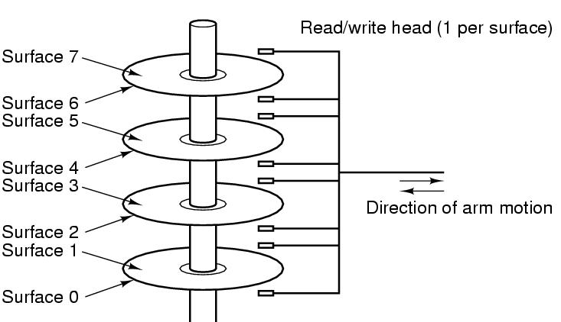
Disks
Figure 1-10. Structure of a disk drive.
Tanenbaum, Modern Operating Systems 3 e, (c) 2008 Prentice-Hall, Inc. All rights reserved. 0-13-6006639

Slide 17
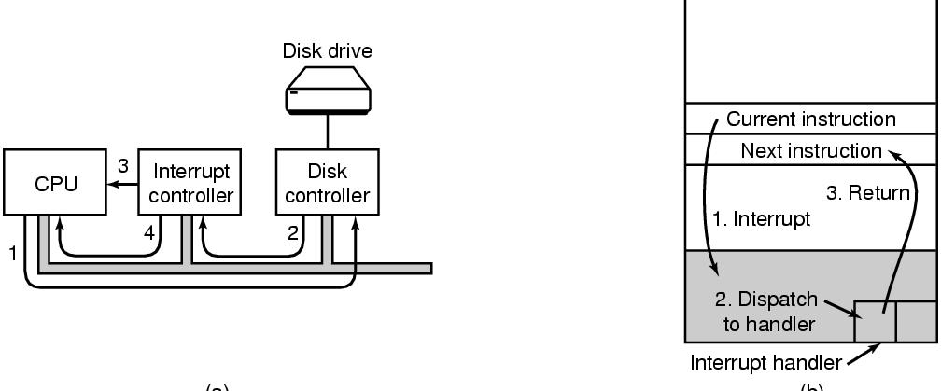
I/O Devices
Figure 1-11. (a) The steps in starting an I/O device and getting an interrupt.
Tanenbaum, Modern Operating Systems 3 e, (c) 2008 Prentice-Hall, Inc. All rights reserved. 0-13-6006639

Slide 18
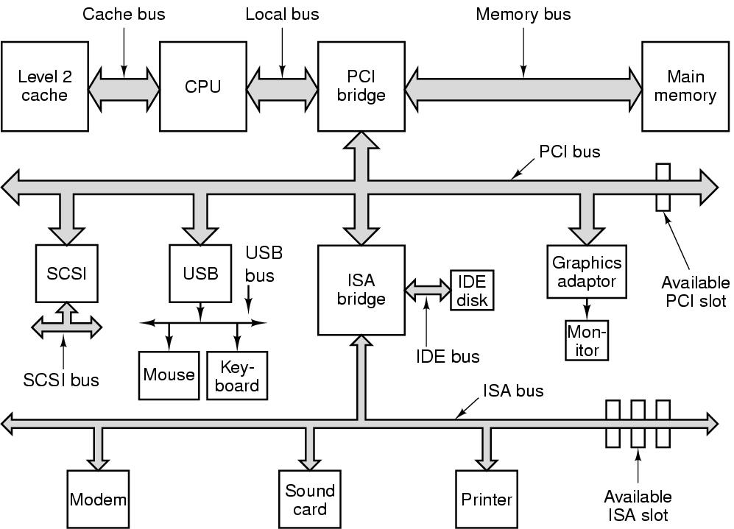
Buses
Figure 1-12. The structure of a large Pentium system
Tanenbaum, Modern Operating Systems 3 e, (c) 2008 Prentice-Hall, Inc. All rights reserved. 0-13-6006639

Slide 19
The Operating System Zoo
Mainframe operating systems
Server operating systems
Multiprocessor operating systems
Personal computer operating systems
Handheld operating systems
Embedded operating systems
Sensor node operating systems
Real-time operating systems
Smart card operating systems
Tanenbaum, Modern Operating Systems 3 e, (c) 2008 Prentice-Hall, Inc. All rights reserved. 0-13-6006639

Slide 20
Operating System Concepts
Processes
Address spaces
Files
Input/Output
Protection
The shell
Ontogeny recapitulates phylogeny
Large memories
Protection hardware
Disks
Virtual memory
Tanenbaum, Modern Operating Systems 3 e, (c) 2008 Prentice-Hall, Inc. All rights reserved. 0-13-6006639

Slide 21
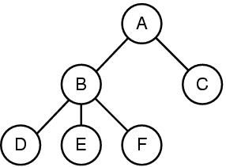
Processes
Figure 1-13. A process tree. Process A created two child processes, B and C. Process B created three child processes, D, E, and F.
Tanenbaum, Modern Operating Systems 3 e, (c) 2008 Prentice-Hall, Inc. All rights reserved. 0-13-6006639
Notes:
21

Slide 22
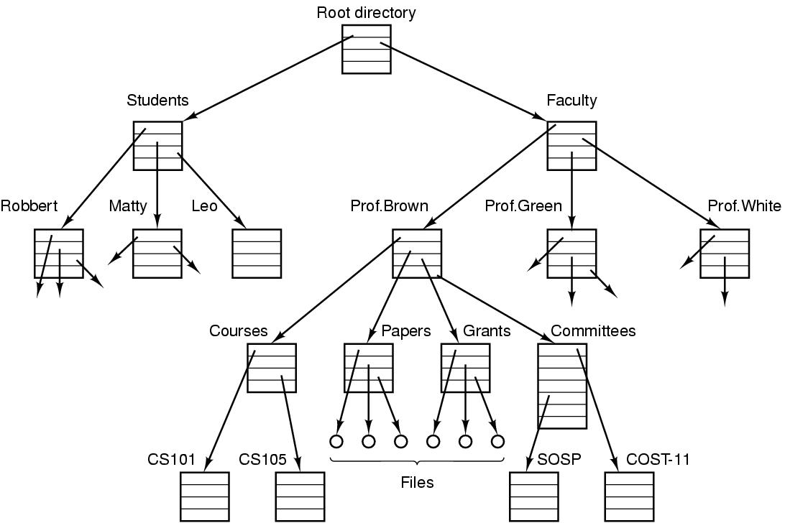
Files (1)
Figure 1-14. A file system for a university department.
Tanenbaum, Modern Operating Systems 3 e, (c) 2008 Prentice-Hall, Inc. All rights reserved. 0-13-6006639

Slide 23
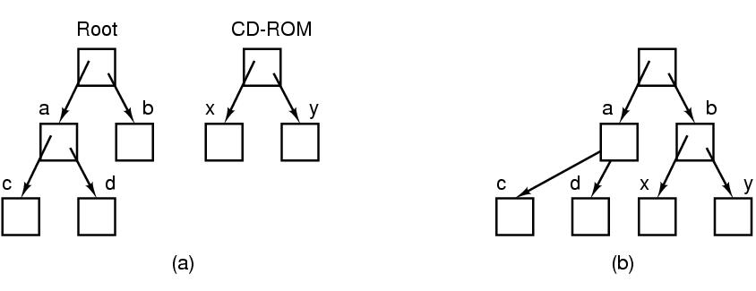
Files (2)
Figure 1-15. (a) Before mounting, the files on the CD-ROM are not accessible. (b) After mounting, they are part of the file hierarchy.
Tanenbaum, Modern Operating Systems 3 e, (c) 2008 Prentice-Hall, Inc. All rights reserved. 0-13-6006639

Slide 24
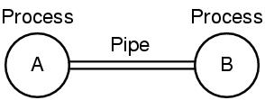
Files (3)
Figure 1-16. Two processes connected by a pipe.
Tanenbaum, Modern Operating Systems 3 e, (c) 2008 Prentice-Hall, Inc. All rights reserved. 0-13-6006639

Slide 25
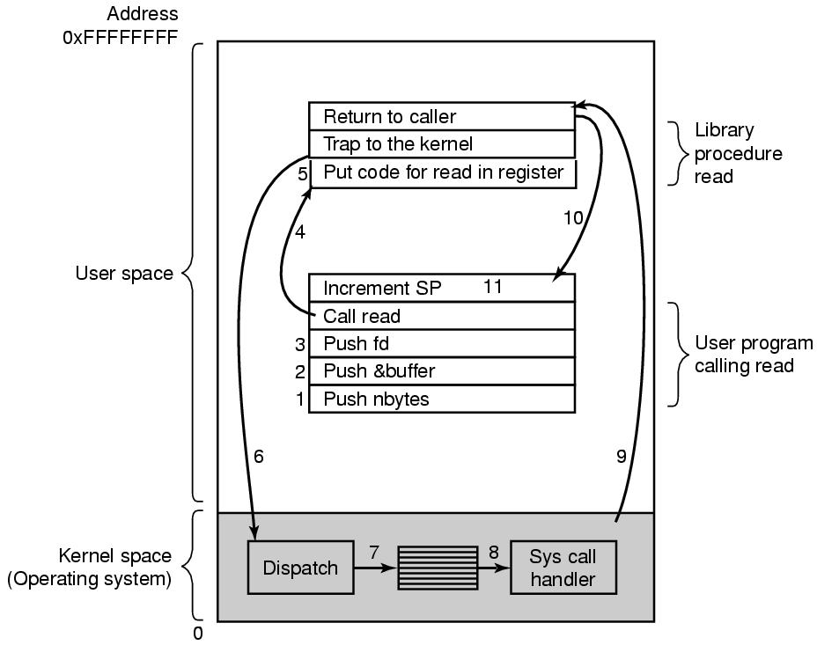
System Calls
Figure 1-17. The 11 steps in making the system call read(fd, buffer, nbytes).
Tanenbaum, Modern Operating Systems 3 e, (c) 2008 Prentice-Hall, Inc. All rights reserved. 0-13-6006639

Slide 26
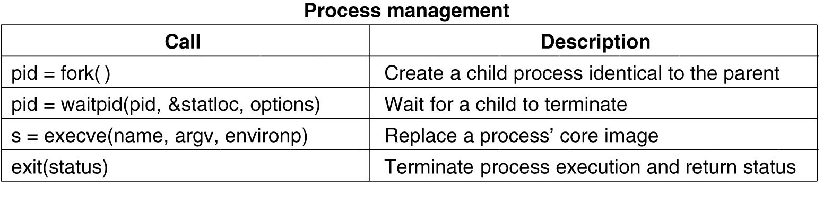
System Calls for Process Management
Figure 1-18. Some of the major POSIX system calls.
Tanenbaum, Modern Operating Systems 3 e, (c) 2008 Prentice-Hall, Inc. All rights reserved. 0-13-6006639

Slide 27
System Calls for File Management (1)
Figure 1-18. Some of the major POSIX system calls.
Tanenbaum, Modern Operating Systems 3 e, (c) 2008 Prentice-Hall, Inc. All rights reserved. 0-13-6006639

Slide 28
System Calls for File Management (2)
Figure 1-18. Some of the major POSIX system calls.
Tanenbaum, Modern Operating Systems 3 e, (c) 2008 Prentice-Hall, Inc. All rights reserved. 0-13-6006639

Slide 29
Miscellaneous System Calls
Figure 1-18. Some of the major POSIX system calls.
Tanenbaum, Modern Operating Systems 3 e, (c) 2008 Prentice-Hall, Inc. All rights reserved. 0-13-6006639

Slide 30
A Simple Shell
Figure 1-19. A stripped-down shell.
Tanenbaum, Modern Operating Systems 3 e, (c) 2008 Prentice-Hall, Inc. All rights reserved. 0-13-6006639

Slide 31
Memory Layout
Figure 1-20. Processes have three segments: text, data, and stack.
Tanenbaum, Modern Operating Systems 3 e, (c) 2008 Prentice-Hall, Inc. All rights reserved. 0-13-6006639

Slide 32
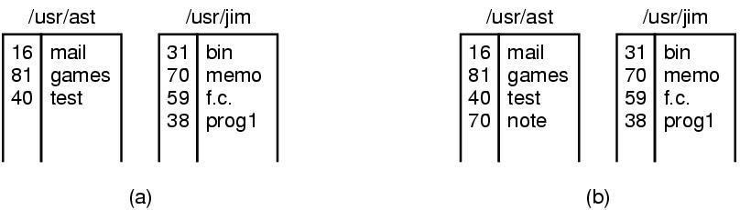
Linking
Figure 1-21. (a) Two directories before linking /usr/jim/memo to ast’s directory. (b) The same directories after linking.
Tanenbaum, Modern Operating Systems 3 e, (c) 2008 Prentice-Hall, Inc. All rights reserved. 0-13-6006639

Slide 33
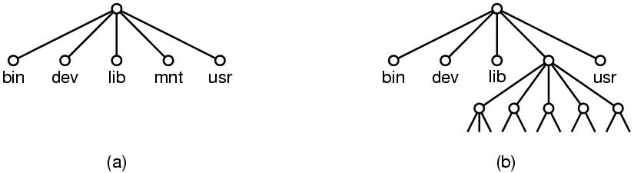
Mounting
Figure 1-22. (a) File system before the mount. (b) File system after the mount.
Tanenbaum, Modern Operating Systems 3 e, (c) 2008 Prentice-Hall, Inc. All rights reserved. 0-13-6006639

Slide 34
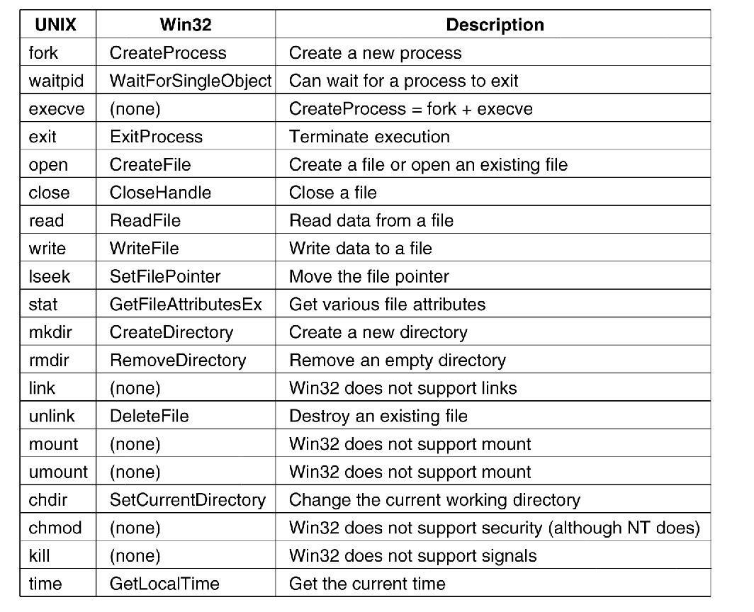
Windows Win32 API
Figure 1-23. The Win32 API calls that roughly correspond to the UNIX calls of Fig. 1-18.
Tanenbaum, Modern Operating Systems 3 e, (c) 2008 Prentice-Hall, Inc. All rights reserved. 0-13-6006639

Slide 35
Operating Systems Structure
Monolithic systems – basic structure:
A main program that invokes the requested service procedure.
A set of service procedures that carry out the system calls.
A set of utility procedures that help the service procedures.
Tanenbaum, Modern Operating Systems 3 e, (c) 2008 Prentice-Hall, Inc. All rights reserved. 0-13-6006639

Slide 36
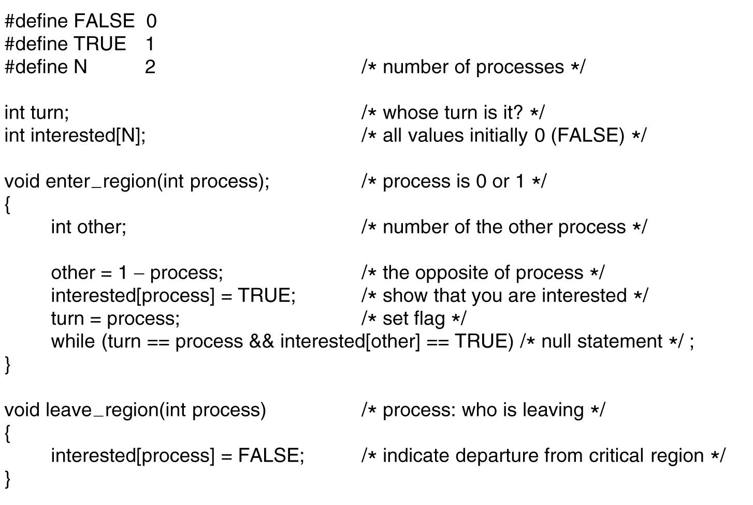
Monolithic Systems
Figure 1-24. A simple structuring model for a monolithic system.
Tanenbaum, Modern Operating Systems 3 e, (c) 2008 Prentice-Hall, Inc. All rights reserved. 0-13-6006639

Slide 37
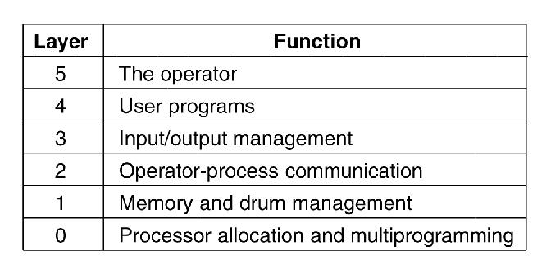
Layered Systems
Figure 1-25. Structure of the THE operating system.
Tanenbaum, Modern Operating Systems 3 e, (c) 2008 Prentice-Hall, Inc. All rights reserved. 0-13-6006639

Slide 38
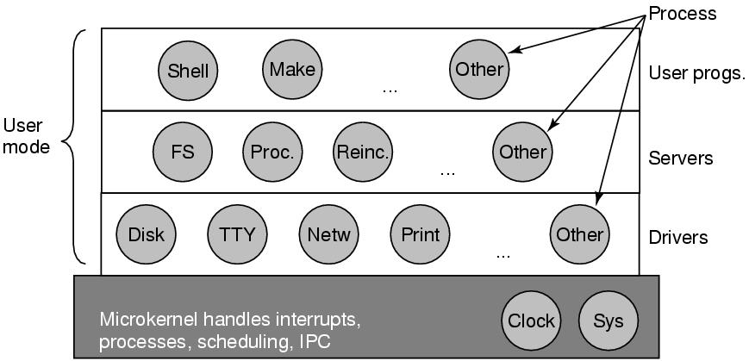
Microkernels
Figure 1-26. Structure of the MINIX 3 system.
Tanenbaum, Modern Operating Systems 3 e, (c) 2008 Prentice-Hall, Inc. All rights reserved. 0-13-6006639

Slide 39
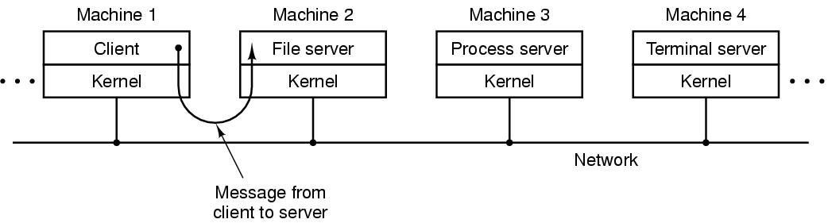
Client-Server Model
Figure 1-27. The client-server model over a network.
Tanenbaum, Modern Operating Systems 3 e, (c) 2008 Prentice-Hall, Inc. All rights reserved. 0-13-6006639

Slide 40
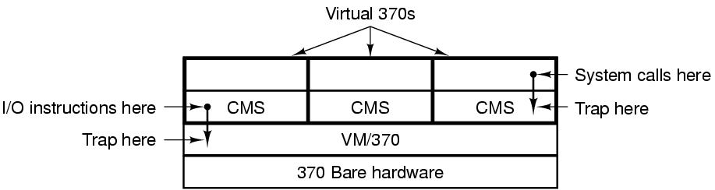
Virtual Machines (1)
Figure 1-28. The structure of VM/370 with CMS.
Tanenbaum, Modern Operating Systems 3 e, (c) 2008 Prentice-Hall, Inc. All rights reserved. 0-13-6006639

Slide 41
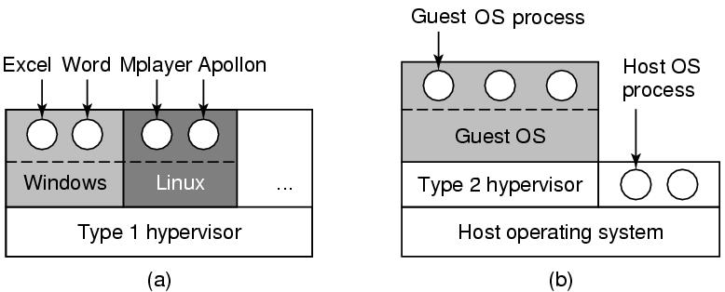
Virtual Machines (2)
Figure 1-29. (a) A type 1 hypervisor. (b) A type 2 hypervisor.
Tanenbaum, Modern Operating Systems 3 e, (c) 2008 Prentice-Hall, Inc. All rights reserved. 0-13-6006639

Slide 42
The World According to C
The C language
Header files
Large programming projects
The model of run time
Tanenbaum, Modern Operating Systems 3 e, (c) 2008 Prentice-Hall, Inc. All rights reserved. 0-13-6006639

Slide 43
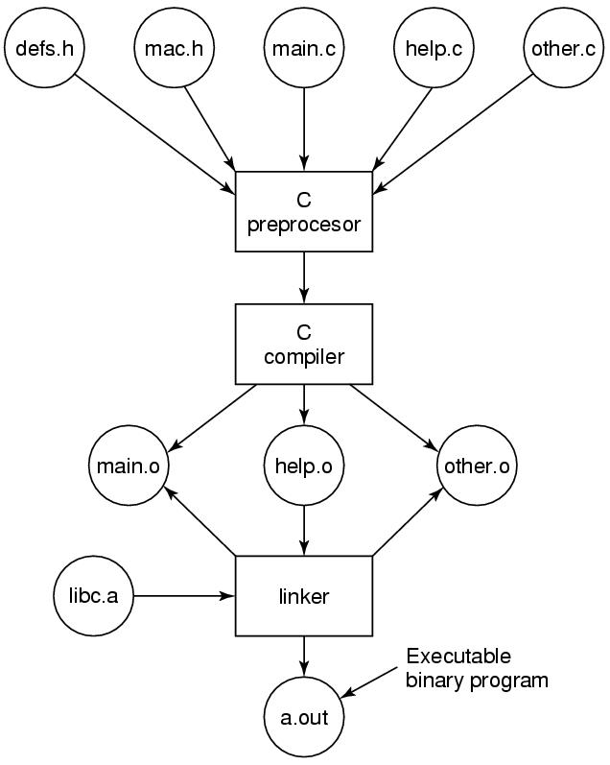
The Model of Run Time
Figure 1-30. The process of compiling C and header files to make an executable.
Tanenbaum, Modern Operating Systems 3 e, (c) 2008 Prentice-Hall, Inc. All rights reserved. 0-13-6006639

