Slide 1
MODERN OPERATING SYSTEMS Third Edition ANDREW S. TANENBAUM Chapter 3 Memory Management
Tanenbaum, Modern Operating Systems 3 e, (c) 2008 Prentice-Hall, Inc. All rights reserved. 0-13-6006639

Slide 2
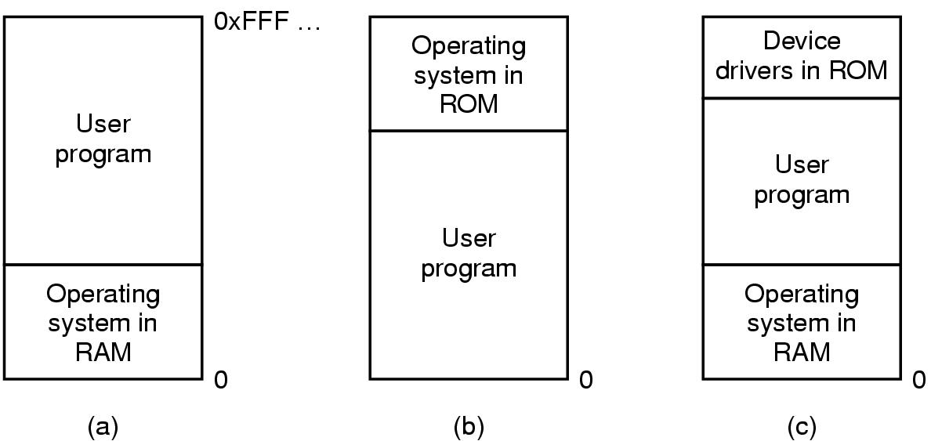
No Memory Abstraction
Figure 3-1. Three simple ways of organizing memory with an operating system and one user process.
Tanenbaum, Modern Operating Systems 3 e, (c) 2008 Prentice-Hall, Inc. All rights reserved. 0-13-6006639

Slide 3
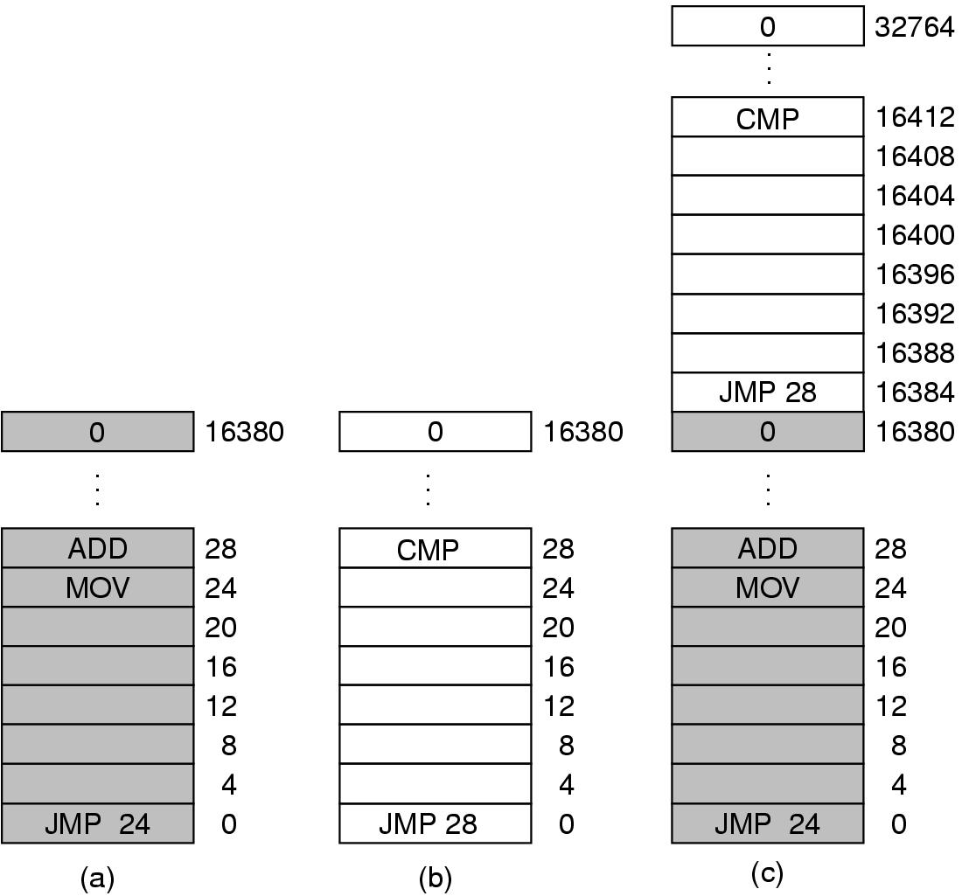
Multiple Programs Without Memory Abstraction
Figure 3-2. Illustration of the relocation problem.
Tanenbaum, Modern Operating Systems 3 e, (c) 2008 Prentice-Hall, Inc. All rights reserved. 0-13-6006639

Slide 4
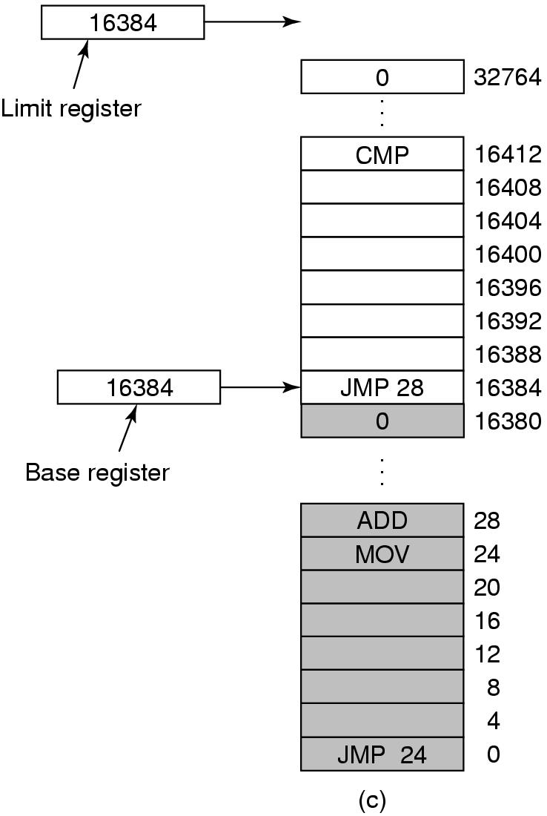
Base and Limit Registers
Figure 3-3. Base and limit registers can be used to give each process a separate address space.
Tanenbaum, Modern Operating Systems 3 e, (c) 2008 Prentice-Hall, Inc. All rights reserved. 0-13-6006639

Slide 5
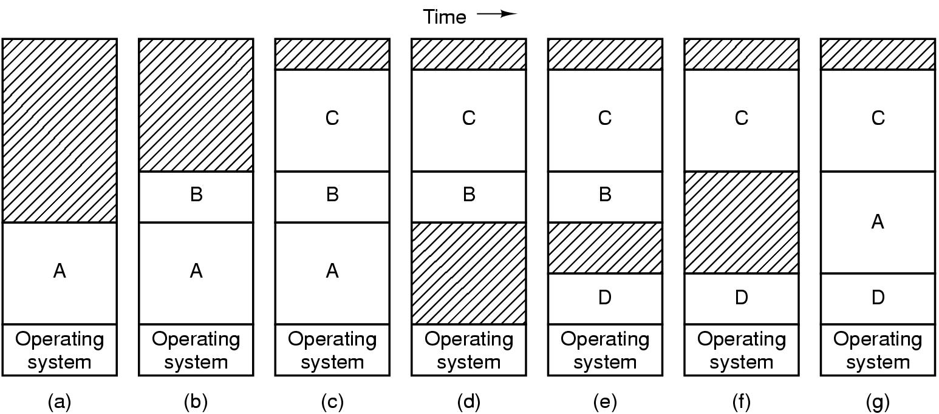
Swapping (1)
Figure 3-4. Memory allocation changes as processes come into memory and leave it. The shaded regions are unused memory.
Tanenbaum, Modern Operating Systems 3 e, (c) 2008 Prentice-Hall, Inc. All rights reserved. 0-13-6006639

Slide 6
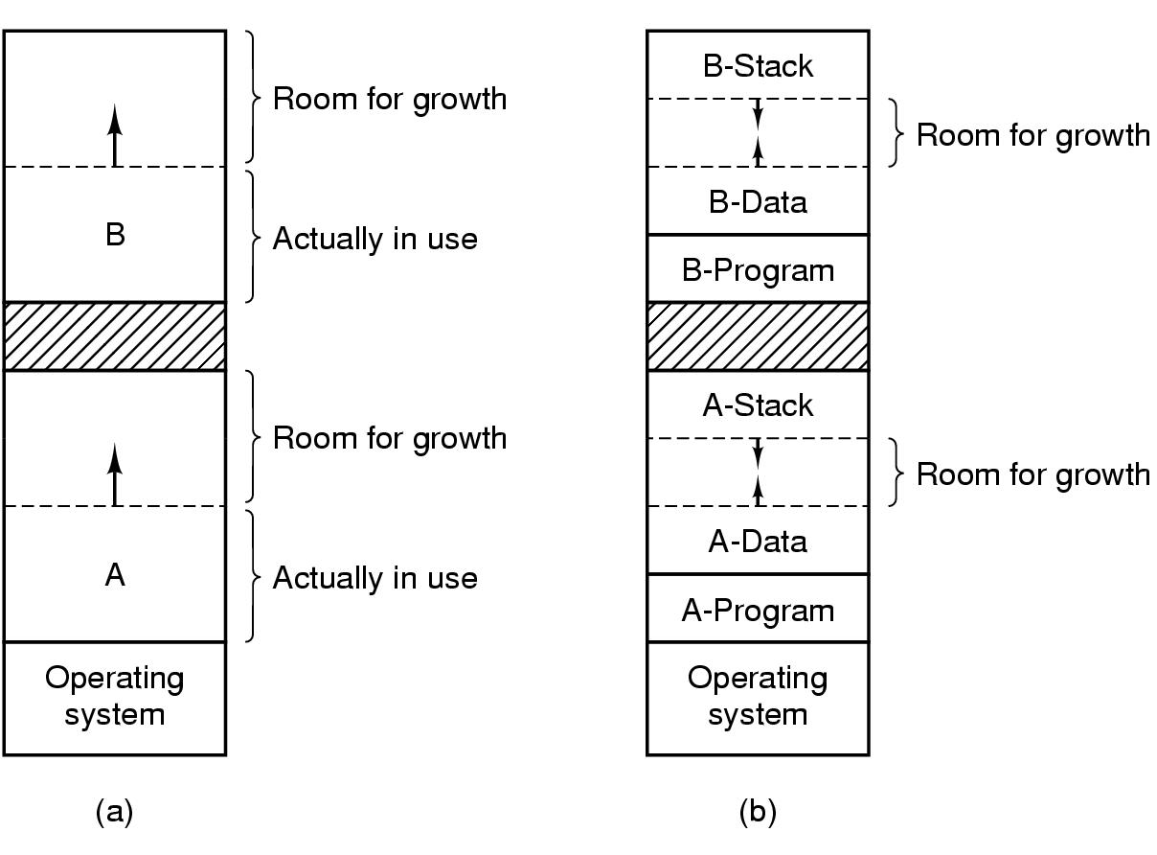
Swapping (2)
Figure 3-5. (a) Allocating space for growing data segment. (b) Allocating space for growing stack, growing data segment.
Tanenbaum, Modern Operating Systems 3 e, (c) 2008 Prentice-Hall, Inc. All rights reserved. 0-13-6006639

Slide 7
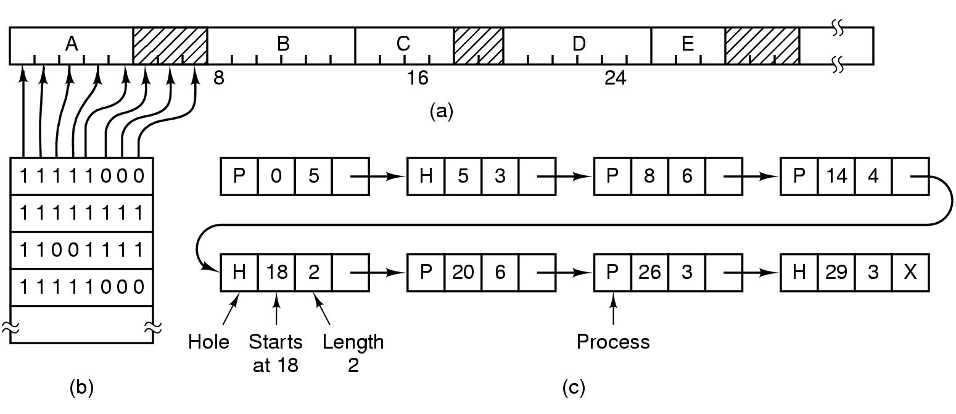
Memory Management with Bitmaps
Figure 3-6. (a) A part of memory with five processes and three holes. The tick marks show the memory allocation units. The shaded regions (0 in the bitmap) are free. (b) The corresponding bitmap. (c) The same information as a list.
Tanenbaum, Modern Operating Systems 3 e, (c) 2008 Prentice-Hall, Inc. All rights reserved. 0-13-6006639

Slide 8
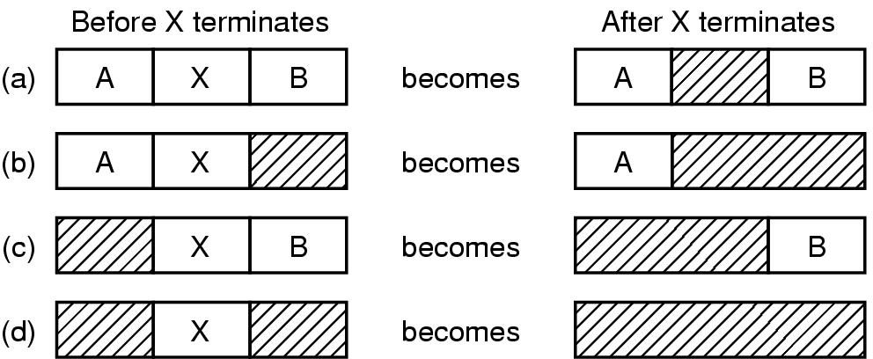
Memory Management with Linked Lists
Figure 3-7. Four neighbor combinations for the terminating process, X.
Tanenbaum, Modern Operating Systems 3 e, (c) 2008 Prentice-Hall, Inc. All rights reserved. 0-13-6006639

Slide 9
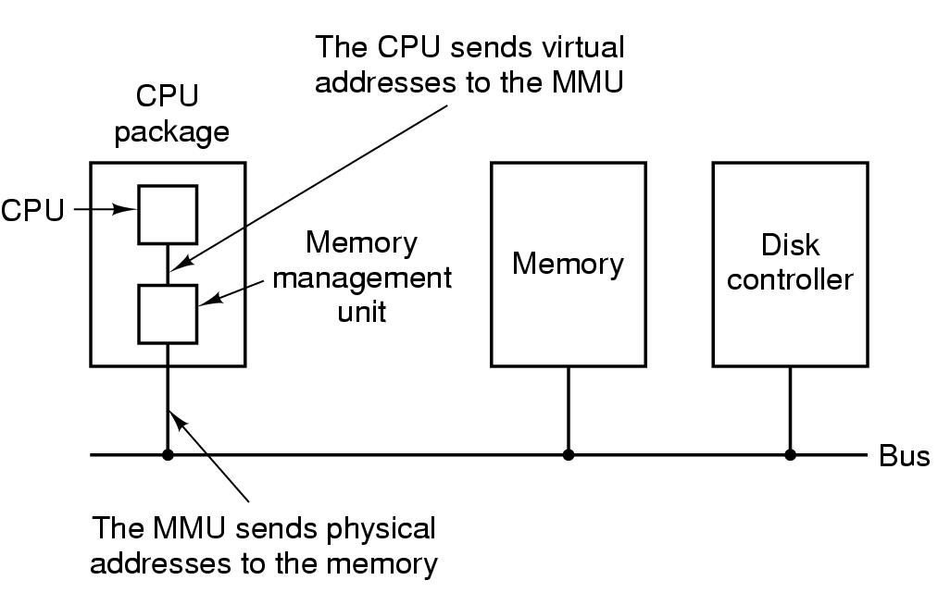
Virtual Memory – Paging (1)
Figure 3-8. The position and function of the MMU – shown as being a part of the CPU chip (it commonly is nowadays). Logically it could be a separate chip, was in years gone by.
Tanenbaum, Modern Operating Systems 3 e, (c) 2008 Prentice-Hall, Inc. All rights reserved. 0-13-6006639

Slide 10
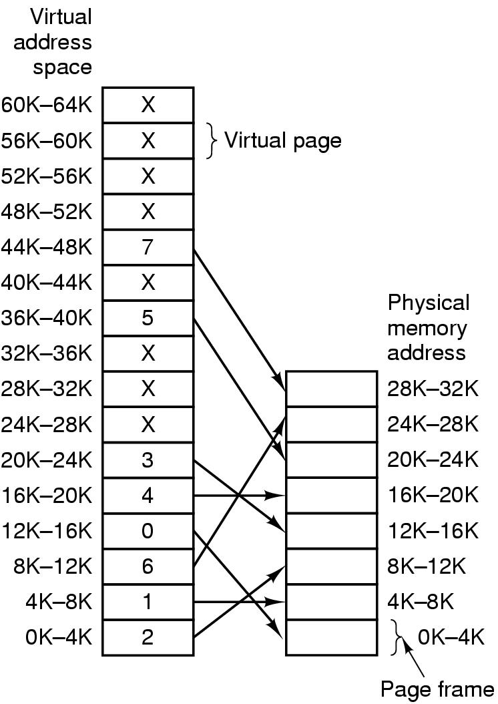
Paging (2)
Figure 3-9. Relation between virtual addresses and physical memory addresses given by page table.
Tanenbaum, Modern Operating Systems 3 e, (c) 2008 Prentice-Hall, Inc. All rights reserved. 0-13-6006639

Slide 11
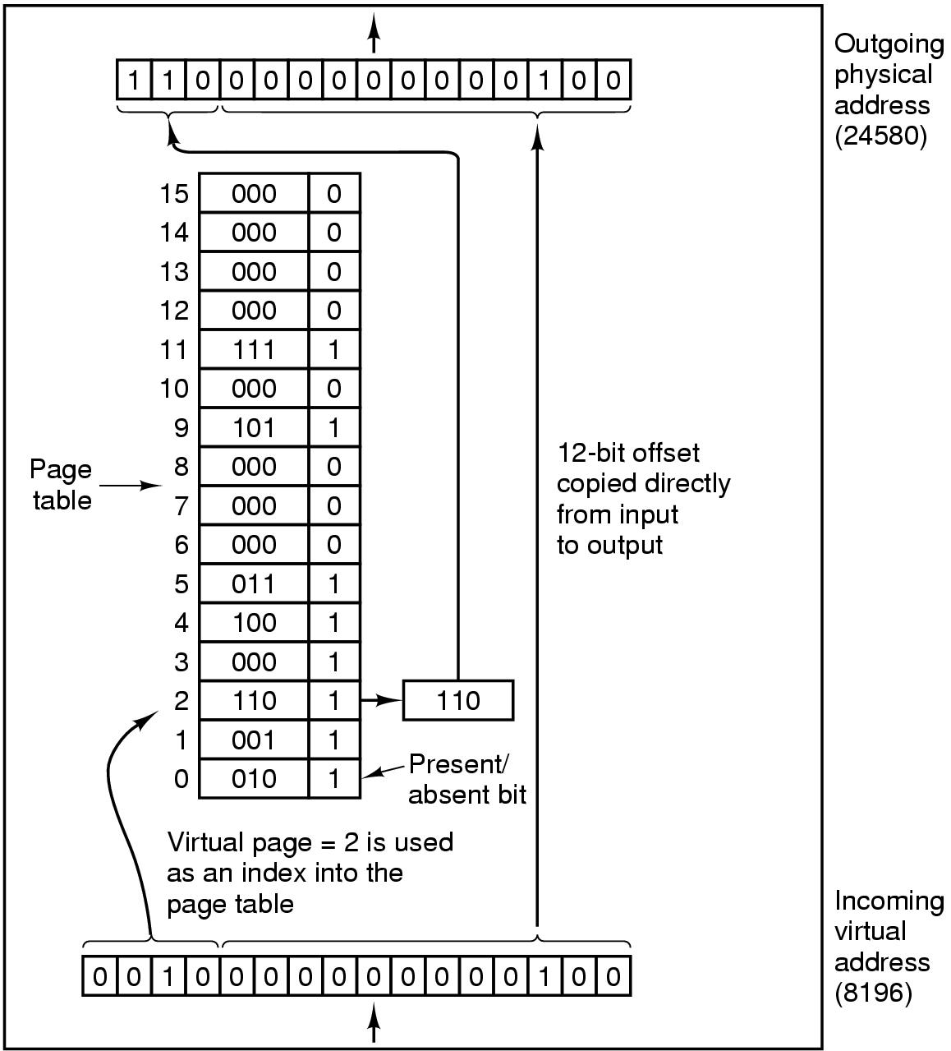
Paging (3)
Figure 3-10. The internal operation of the MMU with 16 4-KB pages.
Tanenbaum, Modern Operating Systems 3 e, (c) 2008 Prentice-Hall, Inc. All rights reserved. 0-13-6006639

Slide 12
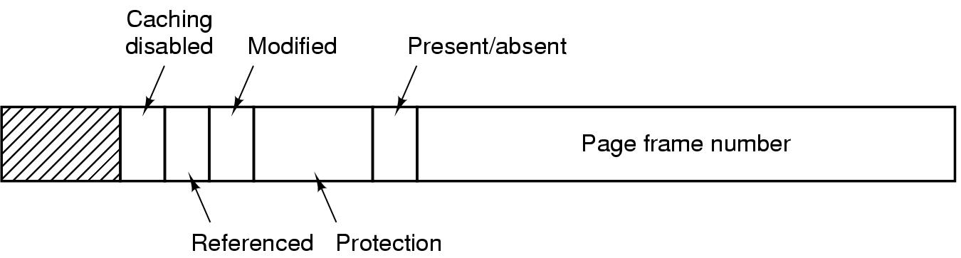
Structure of Page Table Entry
Figure 3-11. A typical page table entry.
Tanenbaum, Modern Operating Systems 3 e, (c) 2008 Prentice-Hall, Inc. All rights reserved. 0-13-6006639

Slide 13
Speeding Up Paging
Paging implementation issues:
The mapping from virtual address to physical address must be fast.
If the virtual address space is large, the page table will be large.
Tanenbaum, Modern Operating Systems 3 e, (c) 2008 Prentice-Hall, Inc. All rights reserved. 0-13-6006639

Slide 14
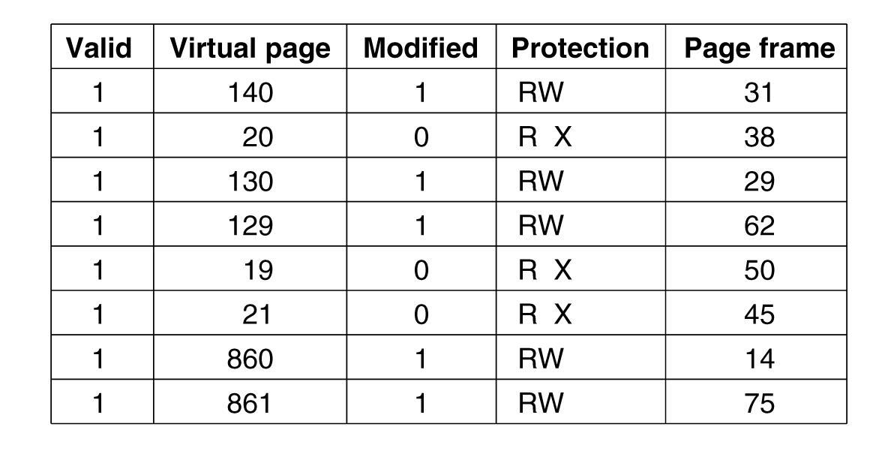
Translation Lookaside Buffers
Figure 3-12. A TLB to speed up paging.
Tanenbaum, Modern Operating Systems 3 e, (c) 2008 Prentice-Hall, Inc. All rights reserved. 0-13-6006639

Slide 15
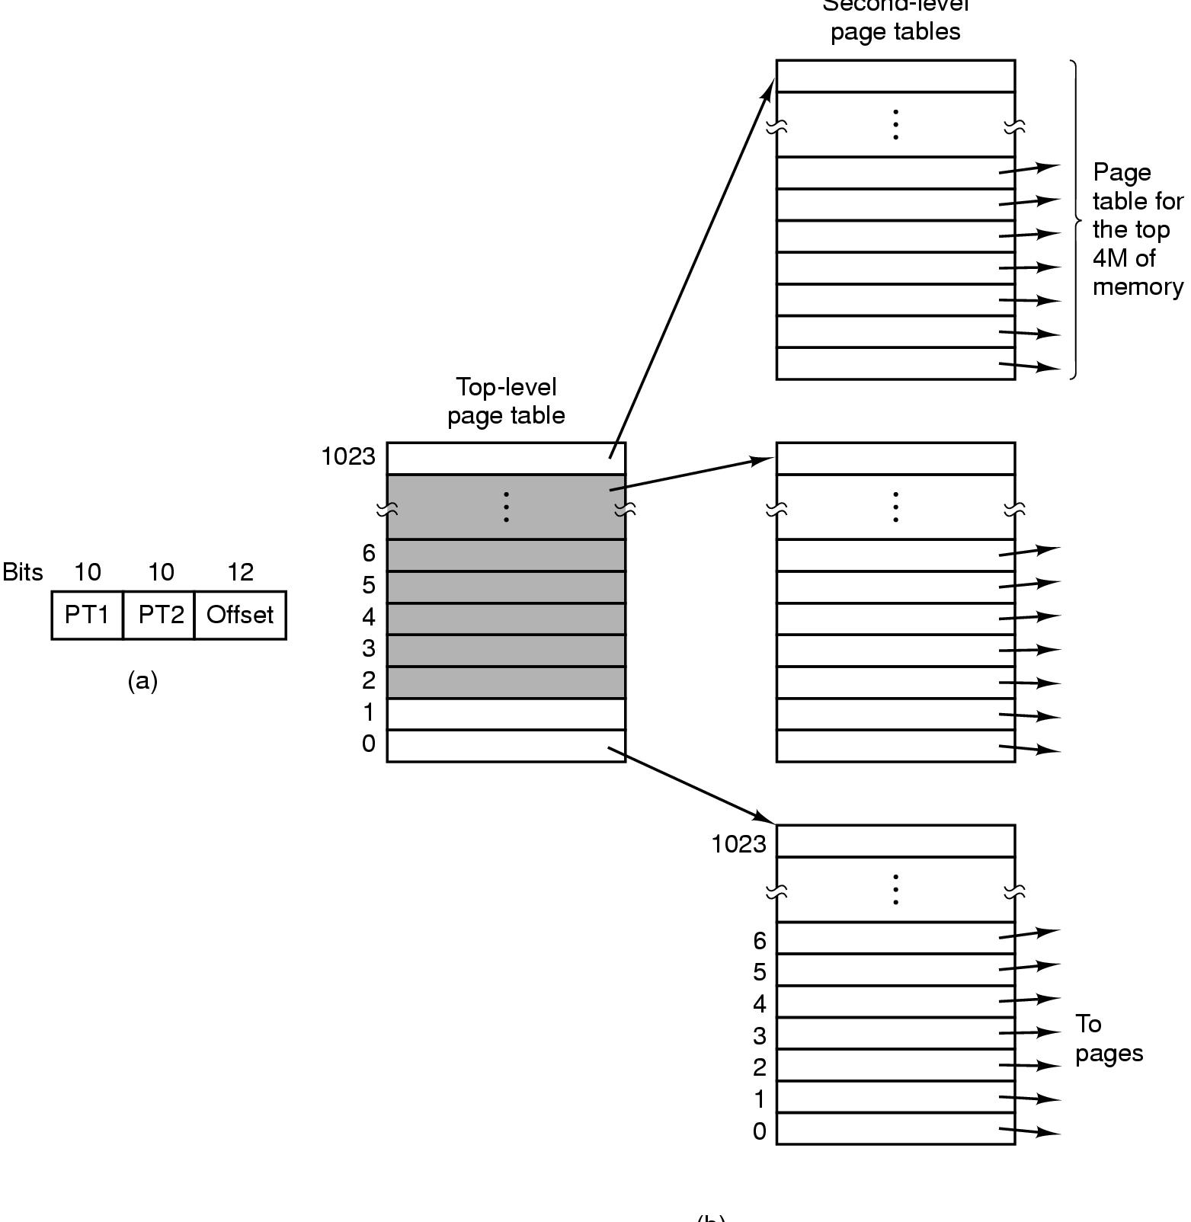
Multilevel Page Tables
Figure 3-13. (a) A 32-bit address with two page table fields. (b) Two-level page tables.
Tanenbaum, Modern Operating Systems 3 e, (c) 2008 Prentice-Hall, Inc. All rights reserved. 0-13-6006639

Slide 16
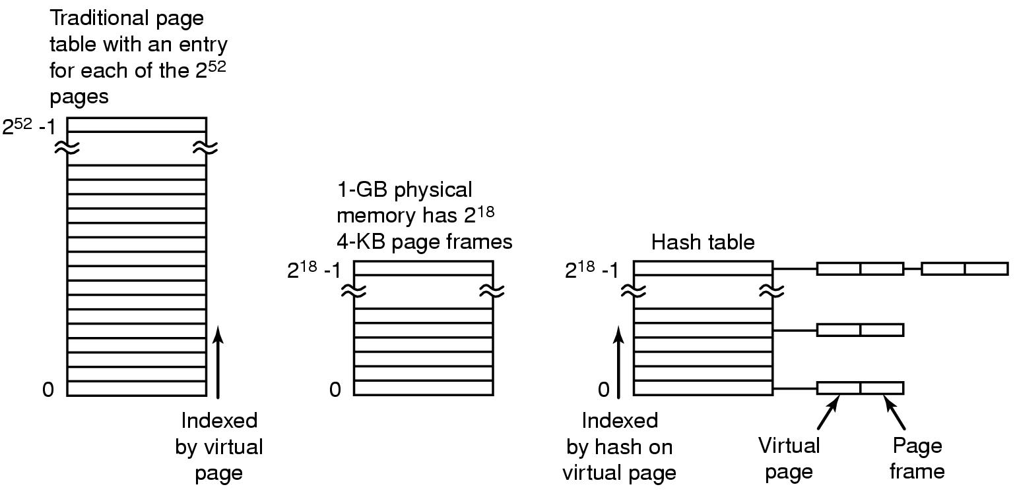
Inverted Page Tables
Figure 3-14. Comparison of a traditional page table with an inverted page table.
Tanenbaum, Modern Operating Systems 3 e, (c) 2008 Prentice-Hall, Inc. All rights reserved. 0-13-6006639

Slide 17
Page Replacement Algorithms
Optimal page replacement algorithm
Not recently used page replacement
First-In, First-Out page replacement
Second chance page replacement
Clock page replacement
Least recently used page replacement
Working set page replacement
WSClock page replacement
Tanenbaum, Modern Operating Systems 3 e, (c) 2008 Prentice-Hall, Inc. All rights reserved. 0-13-6006639

Slide 18
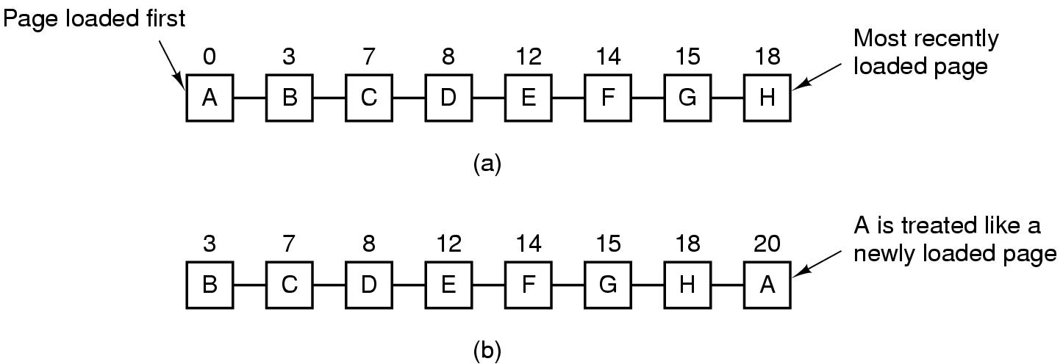
Second Chance Algorithm
Figure 3-15. Operation of second chance. (a) Pages sorted in FIFO order. (b) Page list if a page fault occurs at time 20 and A has its R bit set. The numbers above the pages are their load times.
Tanenbaum, Modern Operating Systems 3 e, (c) 2008 Prentice-Hall, Inc. All rights reserved. 0-13-6006639

Slide 19
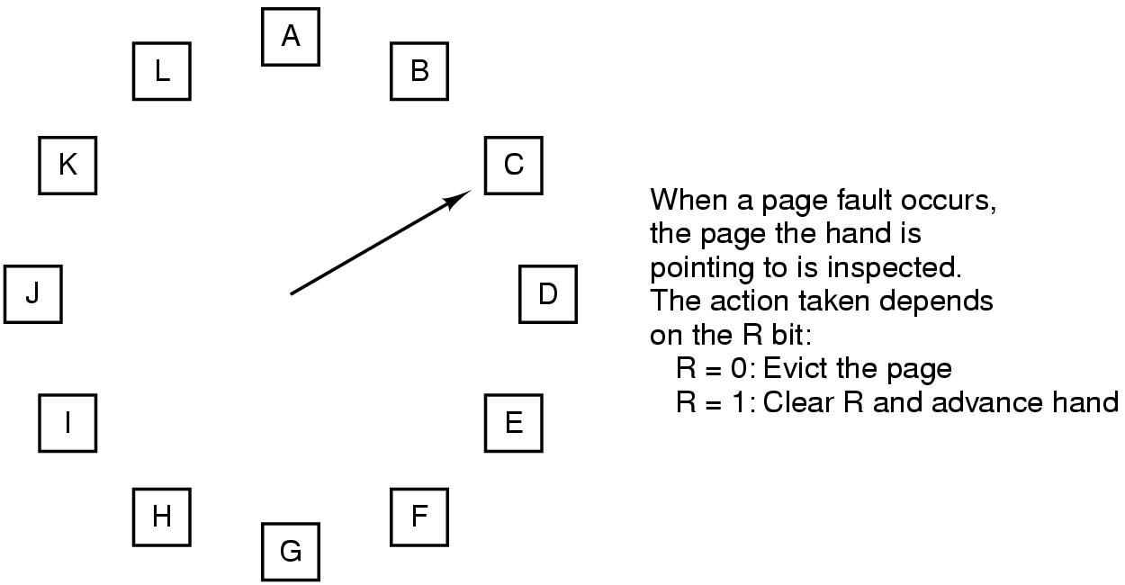
The Clock Page Replacement Algorithm
Figure 3-16. The clock page replacement algorithm.
Tanenbaum, Modern Operating Systems 3 e, (c) 2008 Prentice-Hall, Inc. All rights reserved. 0-13-6006639

Slide 20
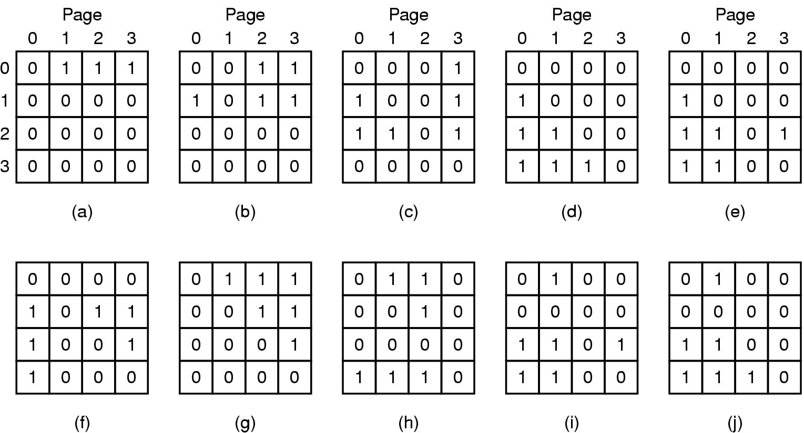
LRU Page Replacement Algorithm
Figure 3-17. LRU using a matrix when pages are referenced in the order 0, 1, 2, 3, 2, 1, 0, 3, 2, 3.
Tanenbaum, Modern Operating Systems 3 e, (c) 2008 Prentice-Hall, Inc. All rights reserved. 0-13-6006639

Slide 21
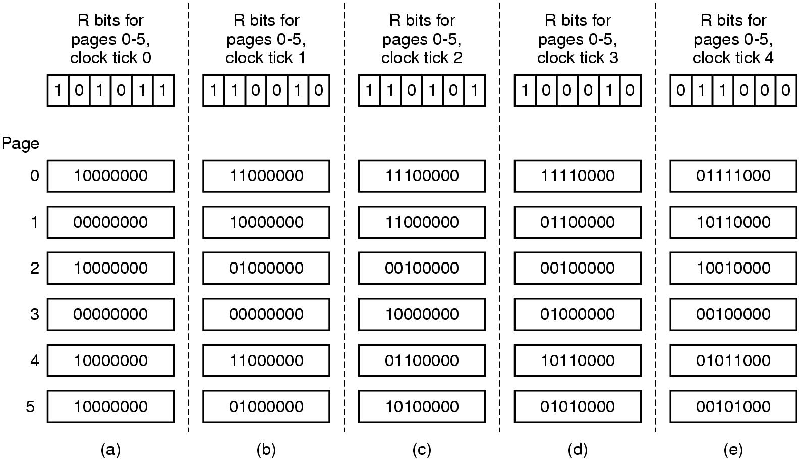
Simulating LRU in Software
Figure 3-18. The aging algorithm simulates LRU in software. Shown are six pages for five clock ticks. The five clock ticks are represented by (a) to (e).
Tanenbaum, Modern Operating Systems 3 e, (c) 2008 Prentice-Hall, Inc. All rights reserved. 0-13-6006639

Slide 22
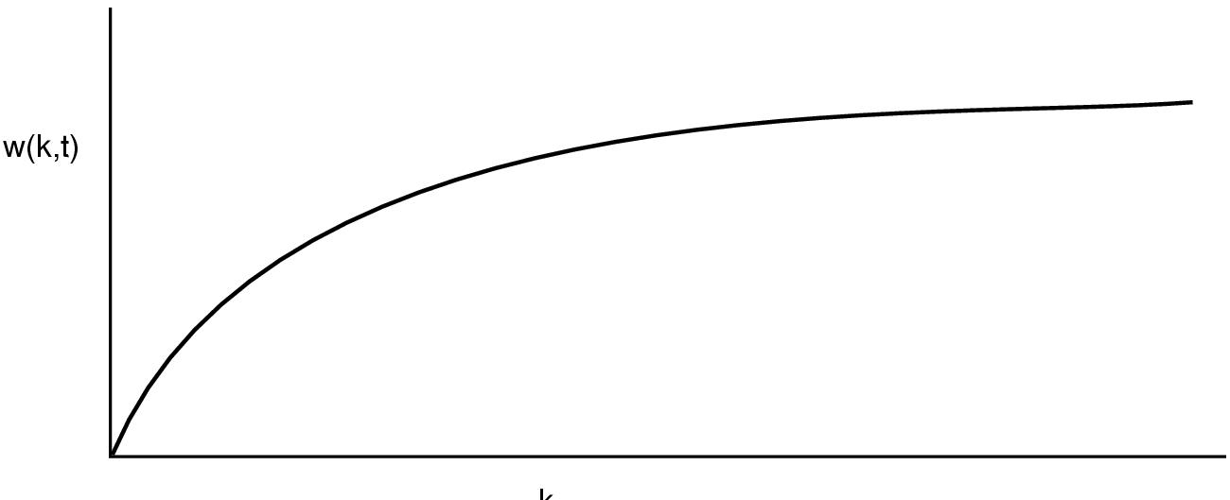
Working Set Page Replacement (1)
Figure 3-19. The working set is the set of pages used by the k most recent memory references. The function w(k, t) is the size of the working set at time t.
Tanenbaum, Modern Operating Systems 3 e, (c) 2008 Prentice-Hall, Inc. All rights reserved. 0-13-6006639

Slide 23
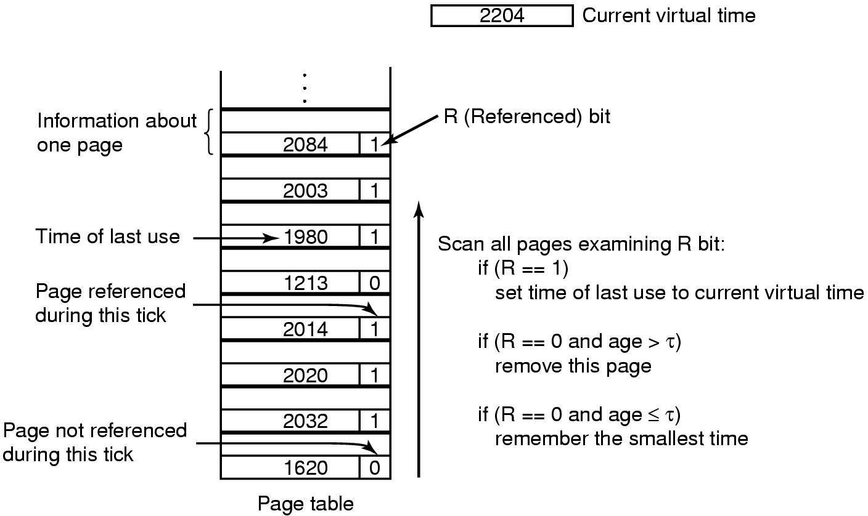
Working Set Page Replacement (2)
Figure 3-20. The working set algorithm.
Tanenbaum, Modern Operating Systems 3 e, (c) 2008 Prentice-Hall, Inc. All rights reserved. 0-13-6006639

Slide 24
The WSClock Page Replacement Algorithm (1)
When the hand comes all the way around to its
starting point there are two cases to consider:
At least one write has been scheduled.
No writes have been scheduled.
Tanenbaum, Modern Operating Systems 3 e, (c) 2008 Prentice-Hall, Inc. All rights reserved. 0-13-6006639

Slide 25
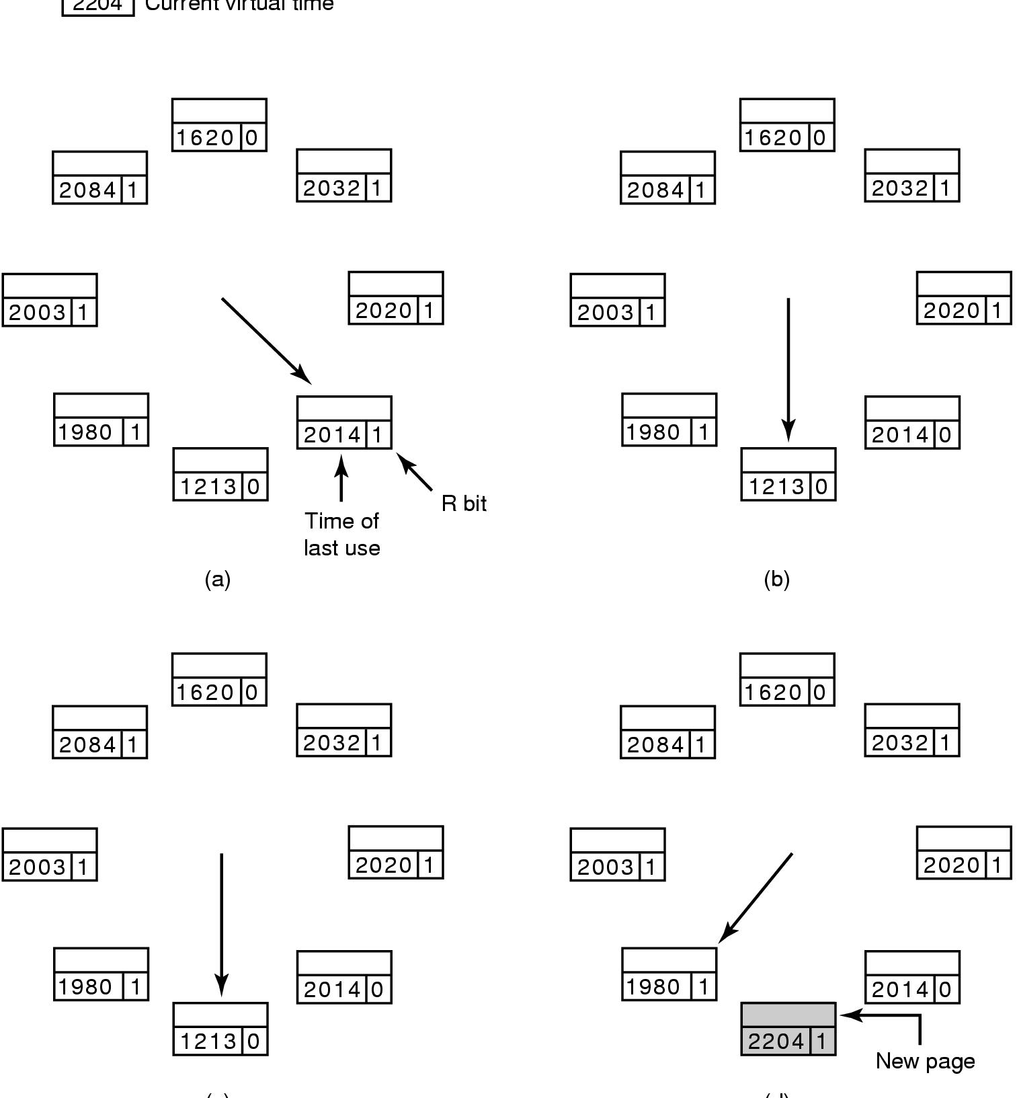
The WSClock Page Replacement Algorithm (2)
Figure 3-21. Operation of the WSClock algorithm. (a) and (b) give an example of what happens when R = 1.
Tanenbaum, Modern Operating Systems 3 e, (c) 2008 Prentice-Hall, Inc. All rights reserved. 0-13-6006639

Slide 26
The WSClock Page Replacement Algorithm (3)
Figure 3-21. Operation of the WSClock algorithm. (c) and (d) give an example of R = 0.
Tanenbaum, Modern Operating Systems 3 e, (c) 2008 Prentice-Hall, Inc. All rights reserved. 0-13-6006639

Slide 27
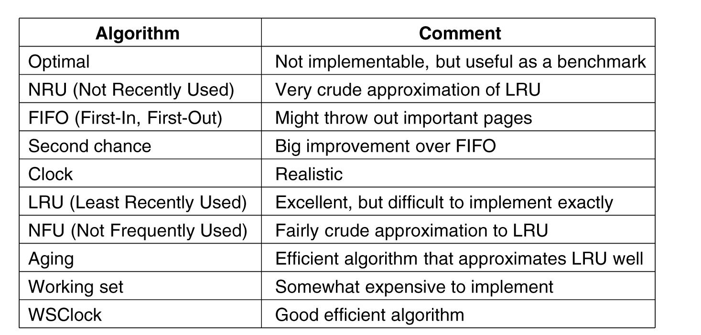
Summary of Page Replacement Algorithms
Figure 3-22. Page replacement algorithms discussed in the text.
Tanenbaum, Modern Operating Systems 3 e, (c) 2008 Prentice-Hall, Inc. All rights reserved. 0-13-6006639

Slide 28
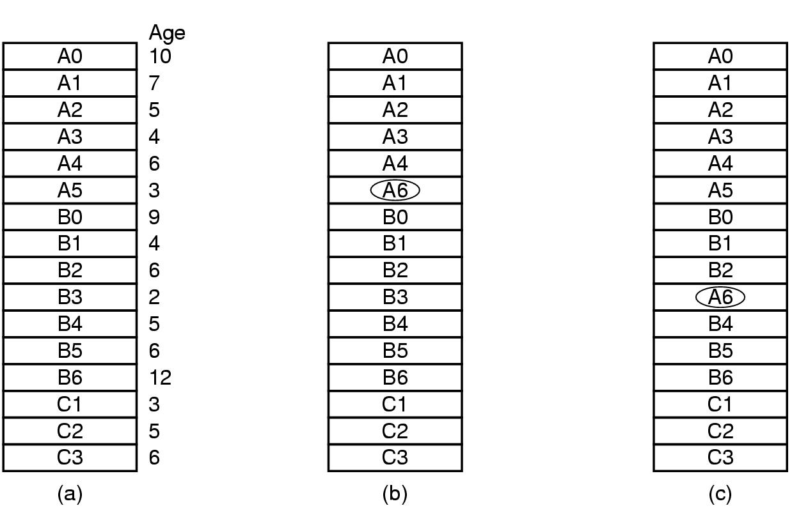
Local versus Global Allocation Policies (1)
Figure 3-23. Local versus global page replacement. (a) Original configuration. (b) Local page replacement. (c) Global page replacement.
Tanenbaum, Modern Operating Systems 3 e, (c) 2008 Prentice-Hall, Inc. All rights reserved. 0-13-6006639

Slide 29
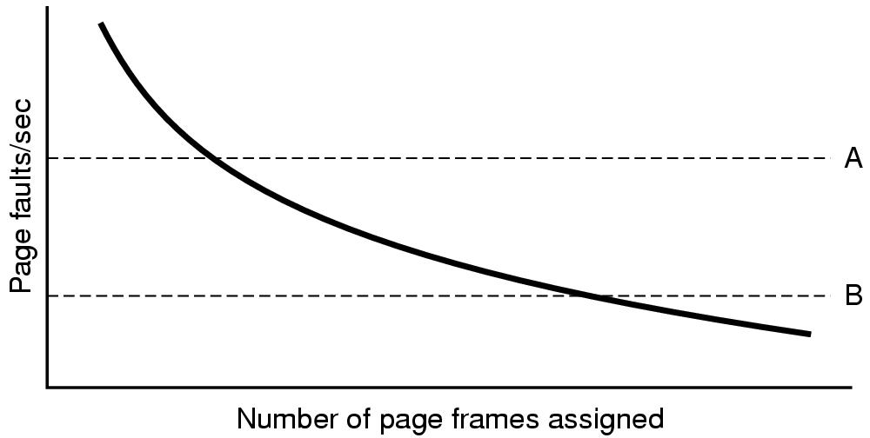
Local versus Global Allocation Policies (2)
Figure 3-24. Page fault rate as a function of the number of page frames assigned.
Tanenbaum, Modern Operating Systems 3 e, (c) 2008 Prentice-Hall, Inc. All rights reserved. 0-13-6006639

Slide 30
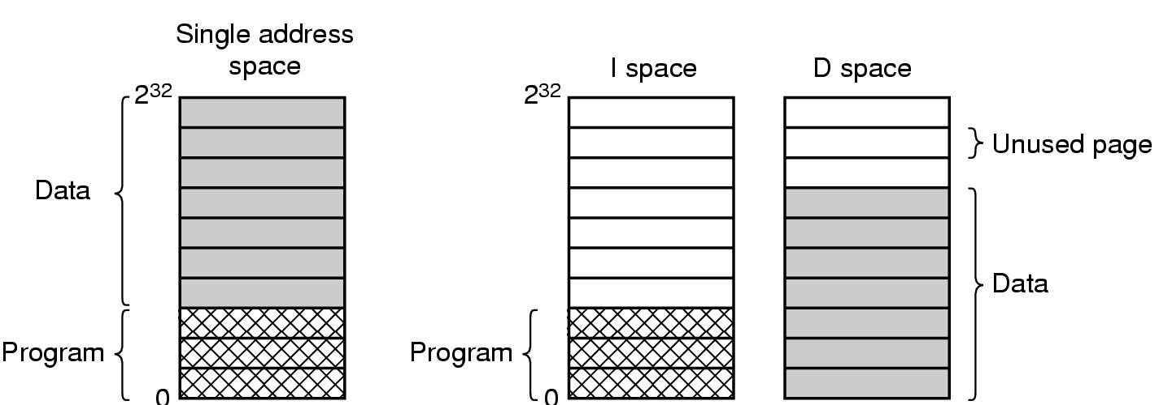
Separate Instruction and Data Spaces
Figure 3-25. (a) One address space. (b) Separate I and D spaces.
Tanenbaum, Modern Operating Systems 3 e, (c) 2008 Prentice-Hall, Inc. All rights reserved. 0-13-6006639

Slide 31
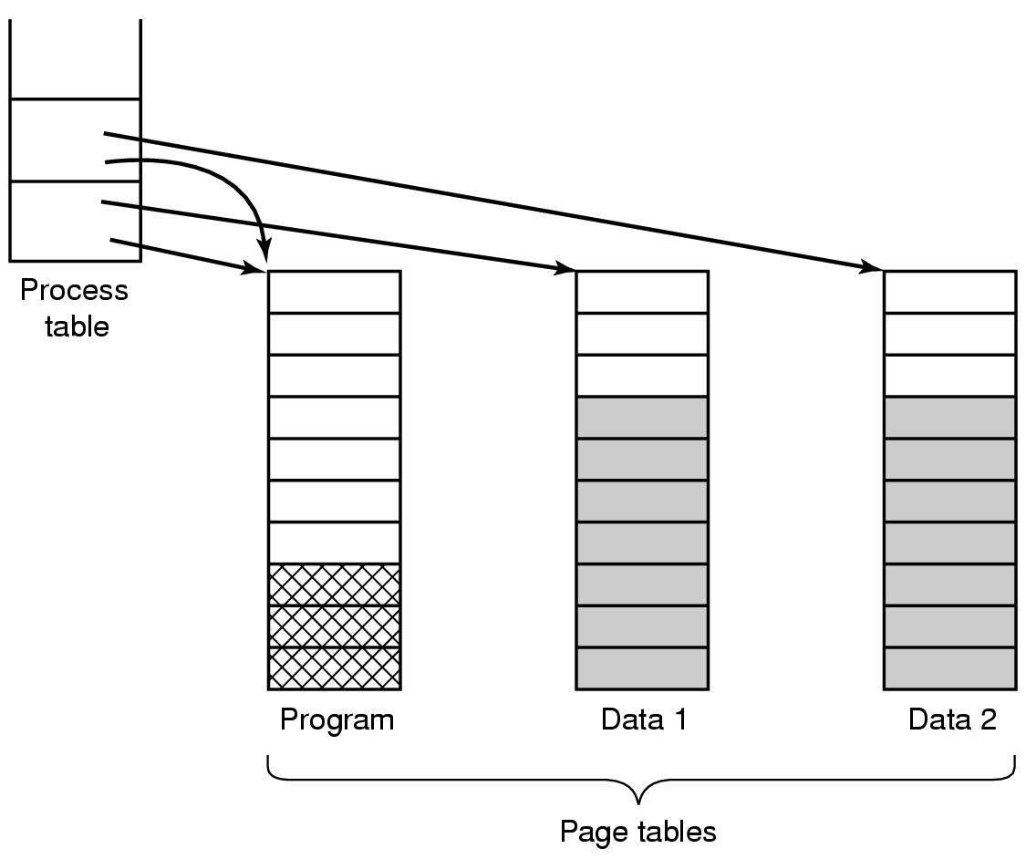
Shared Pages
Figure 3-26. Two processes sharing the same program sharing its page table.
Tanenbaum, Modern Operating Systems 3 e, (c) 2008 Prentice-Hall, Inc. All rights reserved. 0-13-6006639

Slide 32
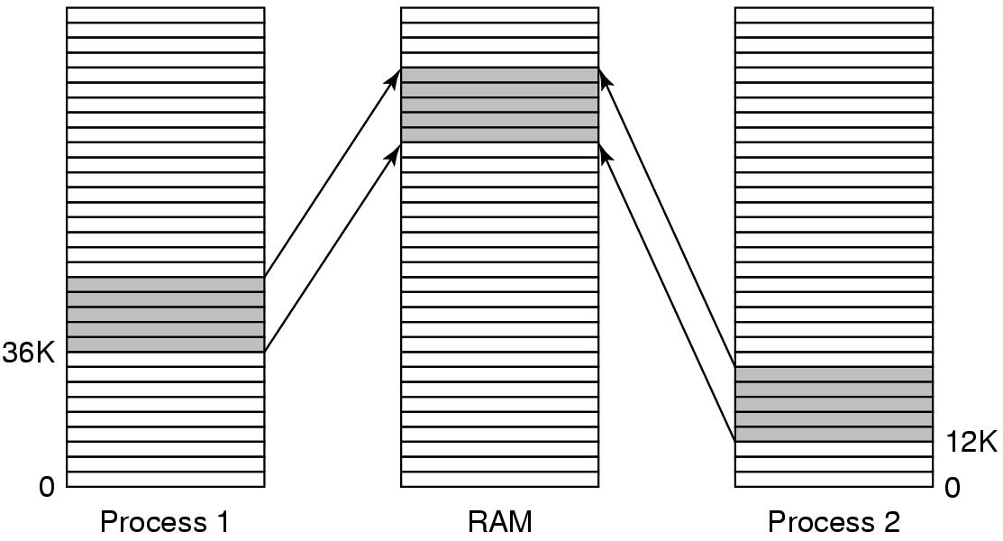
Shared Libraries
Figure 3-27. A shared library being used by two processes.
Tanenbaum, Modern Operating Systems 3 e, (c) 2008 Prentice-Hall, Inc. All rights reserved. 0-13-6006639

Slide 33
Page Fault Handling (1)
The hardware traps to the kernel, saving the program counter on the stack.
An assembly code routine is started to save the general registers and other volatile information.
The operating system discovers that a page fault has occurred, and tries to discover which virtual page is needed.
Once the virtual address that caused the fault is known, the system checks to see if this address is valid and the protection consistent with the access
Tanenbaum, Modern Operating Systems 3 e, (c) 2008 Prentice-Hall, Inc. All rights reserved. 0-13-6006639

Slide 34
Page Fault Handling (2)
If the page frame selected is dirty, the page is scheduled for transfer to the disk, and a context switch takes place.
When page frame is clean, operating system looks up the disk address where the needed page is, schedules a disk operation to bring it in.
When disk interrupt indicates page has arrived, page tables updated to reflect position, frame marked as being in normal state.
Tanenbaum, Modern Operating Systems 3 e, (c) 2008 Prentice-Hall, Inc. All rights reserved. 0-13-6006639

Slide 35
Page Fault Handling (3)
Faulting instruction backed up to state it had when it began and program counter reset to point to that instruction.
Faulting process scheduled, operating system returns to the (assembly language) routine that called it.
This routine reloads registers and other state information and returns to user space to continue execution, as if no fault had occurred.
Tanenbaum, Modern Operating Systems 3 e, (c) 2008 Prentice-Hall, Inc. All rights reserved. 0-13-6006639

Slide 36
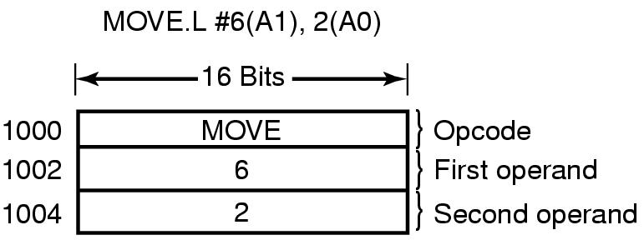
Instruction Backup
Figure 3-28. An instruction causing a page fault.
Tanenbaum, Modern Operating Systems 3 e, (c) 2008 Prentice-Hall, Inc. All rights reserved. 0-13-6006639

Slide 37
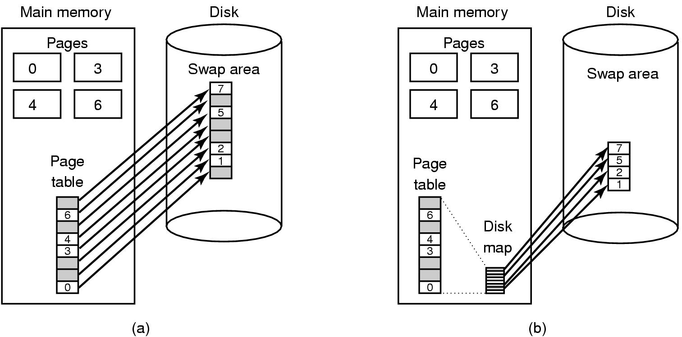
Backing Store (1)
Figure 3-29. (a) Paging to a static swap area.
Tanenbaum, Modern Operating Systems 3 e, (c) 2008 Prentice-Hall, Inc. All rights reserved. 0-13-6006639

Slide 38
Backing Store (2)
Figure 3-29. (b) Backing up pages dynamically.
Tanenbaum, Modern Operating Systems 3 e, (c) 2008 Prentice-Hall, Inc. All rights reserved. 0-13-6006639

Slide 39
Separation of Policy and Mechanism (1)
Memory management system is divided into
three parts:
A low-level MMU handler.
A page fault handler that is part of the kernel.
An external pager running in user space.
Tanenbaum, Modern Operating Systems 3 e, (c) 2008 Prentice-Hall, Inc. All rights reserved. 0-13-6006639

Slide 40
Separation of Policy and Mechanism (2)
Figure 3-30. Page fault handling with an external pager.
Tanenbaum, Modern Operating Systems 3 e, (c) 2008 Prentice-Hall, Inc. All rights reserved. 0-13-6006639

Slide 41
Segmentation (1)
A compiler has many tables that are built up as compilation proceeds, possibly including:
The source text being saved for the printed listing (on batch systems).
The symbol table – the names and attributes of variables.
The table containing integer, floating-point constants used.
The parse tree, the syntactic analysis of the program.
The stack used for procedure calls within the compiler.
Tanenbaum, Modern Operating Systems 3 e, (c) 2008 Prentice-Hall, Inc. All rights reserved. 0-13-6006639

Slide 42
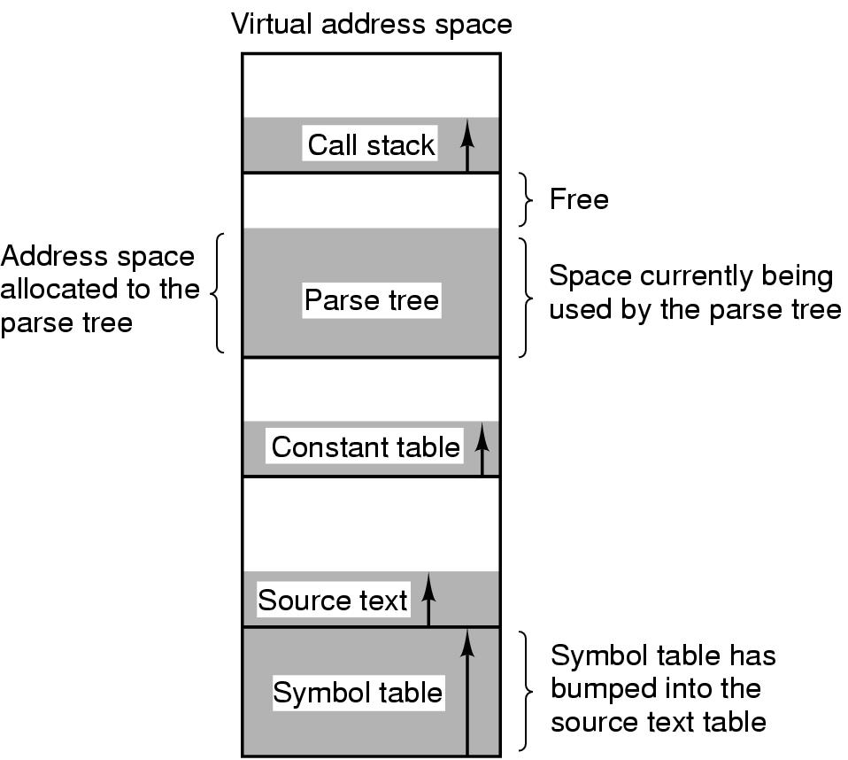
Segmentation (2)
Figure 3-31. In a one-dimensional address space with growing tables, one table may bump into another.
Tanenbaum, Modern Operating Systems 3 e, (c) 2008 Prentice-Hall, Inc. All rights reserved. 0-13-6006639

Slide 43
Segmentation (3)
Figure 3-32. A segmented memory allows each table to grow or shrink independently of the other tables.
Tanenbaum, Modern Operating Systems 3 e, (c) 2008 Prentice-Hall, Inc. All rights reserved. 0-13-6006639

Slide 44
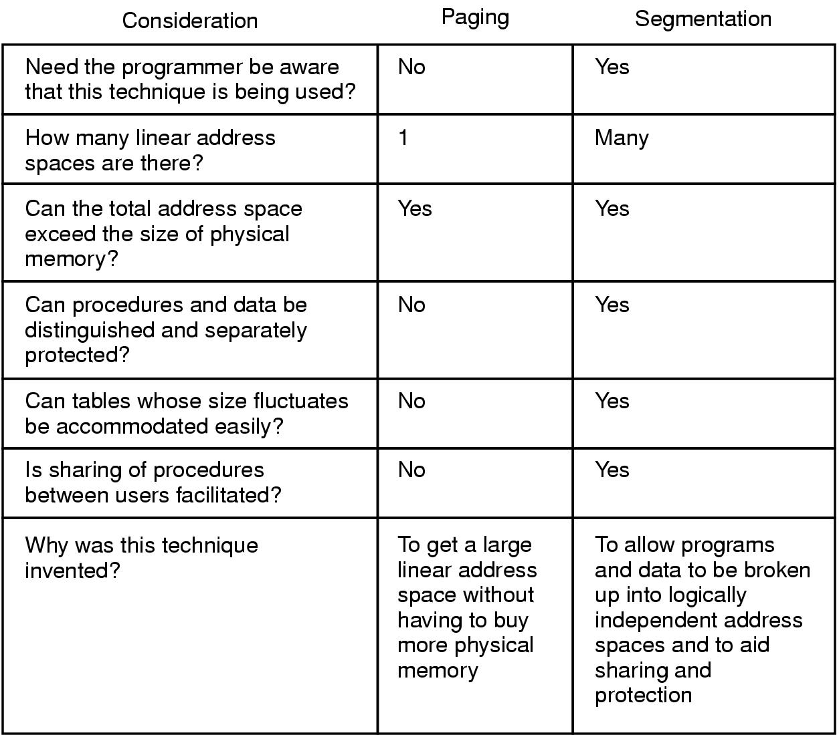
Implementation of Pure Segmentation
Figure 3-33. Comparison of paging and segmentation.
Tanenbaum, Modern Operating Systems 3 e, (c) 2008 Prentice-Hall, Inc. All rights reserved. 0-13-6006639

Slide 45
Segmentation with Paging: MULTICS (1)
Figure 3-34. (a)-(d) Development of checkerboarding. (e) Removal of the checkerboarding by compaction.
Tanenbaum, Modern Operating Systems 3 e, (c) 2008 Prentice-Hall, Inc. All rights reserved. 0-13-6006639

Slide 46
Segmentation with Paging: MULTICS (2)
Figure 3-35. The MULTICS virtual memory. (a) The descriptor segment points to the page tables.
Tanenbaum, Modern Operating Systems 3 e, (c) 2008 Prentice-Hall, Inc. All rights reserved. 0-13-6006639

Slide 47
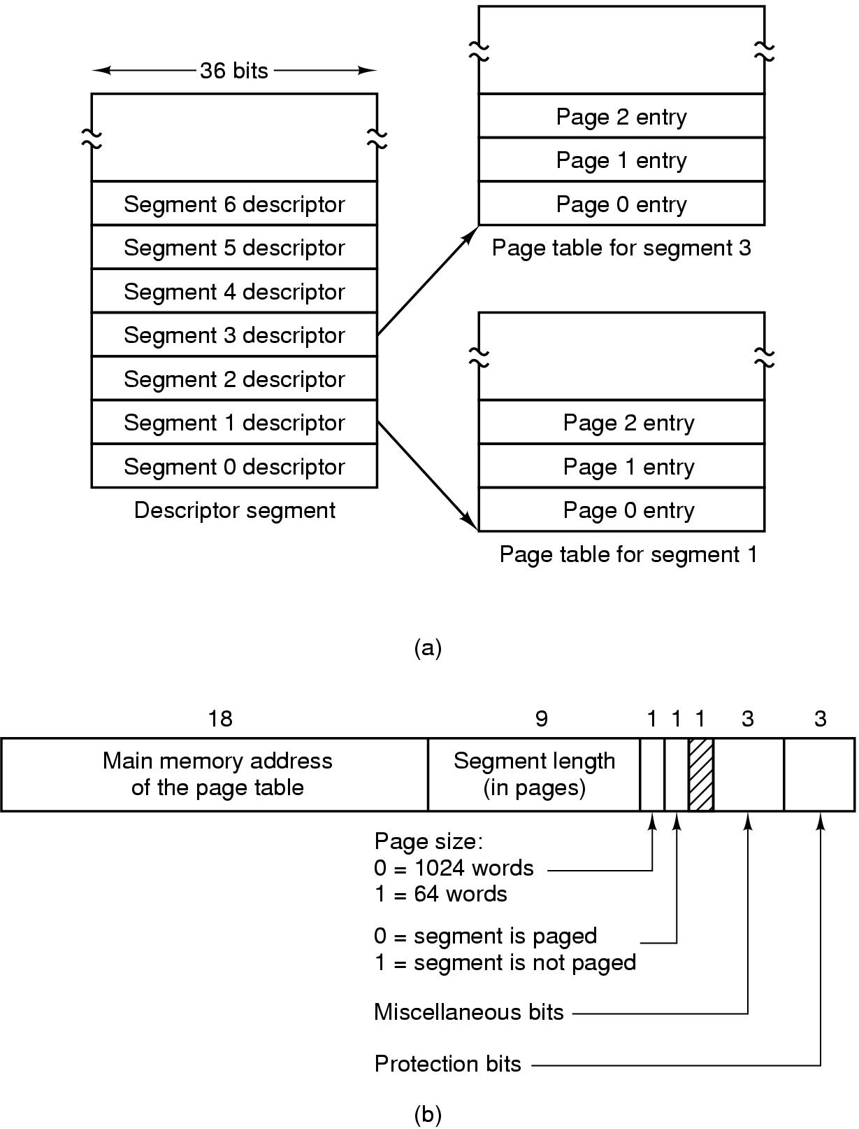
Segmentation with Paging: MULTICS (5)
Figure 3-35. The MULTICS virtual memory. (b) A segment descriptor. The numbers are the field lengths.
Tanenbaum, Modern Operating Systems 3 e, (c) 2008 Prentice-Hall, Inc. All rights reserved. 0-13-6006639

Slide 48
Segmentation with Paging: MULTICS (6)
When a memory reference occurs, the following algorithm is carried out:
The segment number used to find segment descriptor.
Check is made to see if the segment’s page table is in memory.
If not, segment fault occurs.
If there is a protection violation, a fault (trap) occurs.
Tanenbaum, Modern Operating Systems 3 e, (c) 2008 Prentice-Hall, Inc. All rights reserved. 0-13-6006639

Slide 49
Segmentation with Paging: MULTICS (7)
Page table entry for the requested virtual page examined.
If the page itself is not in memory, a page fault is triggered.
If it is in memory, the main memory address of the start of the page is extracted from the page table entry
The offset is added to the page origin to give the main memory address where the word is located.
The read or store finally takes place.
Tanenbaum, Modern Operating Systems 3 e, (c) 2008 Prentice-Hall, Inc. All rights reserved. 0-13-6006639

Slide 50
Segmentation with Paging: MULTICS (8)
Figure 3-36. A 34-bit MULTICS virtual address.
Tanenbaum, Modern Operating Systems 3 e, (c) 2008 Prentice-Hall, Inc. All rights reserved. 0-13-6006639

Slide 51
Segmentation with Paging: MULTICS (9)
Figure 3-37. Conversion of a two-part MULTICS address into a main memory address.
Tanenbaum, Modern Operating Systems 3 e, (c) 2008 Prentice-Hall, Inc. All rights reserved. 0-13-6006639

Slide 52
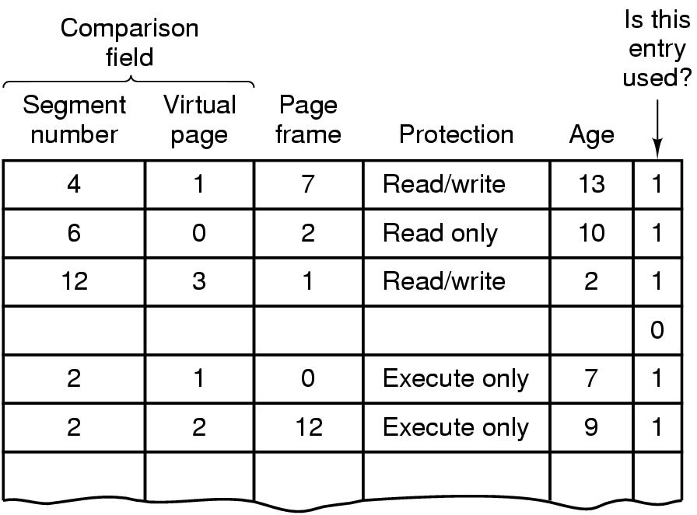
Segmentation with Paging: MULTICS (10)
Figure 3-38. A simplified version of the MULTICS TLB. The existence of two page sizes makes the actual TLB more complicated.
Tanenbaum, Modern Operating Systems 3 e, (c) 2008 Prentice-Hall, Inc. All rights reserved. 0-13-6006639

Slide 53
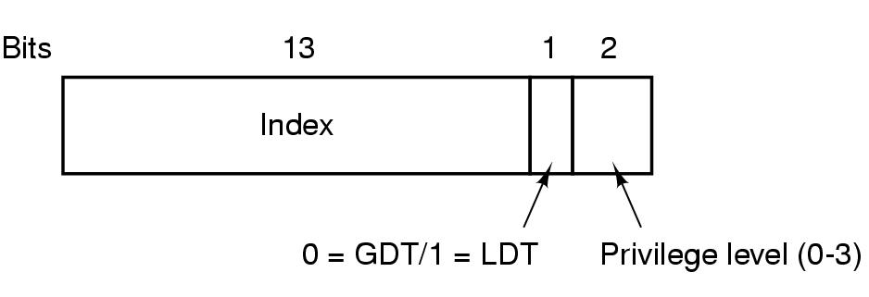
Segmentation with Paging: The Pentium (1)
Figure 3-39. A Pentium selector.
Tanenbaum, Modern Operating Systems 3 e, (c) 2008 Prentice-Hall, Inc. All rights reserved. 0-13-6006639

Slide 54
Segmentation with Paging: The Pentium (2)
Figure 3-40. Pentium code segment descriptor. Data segments differ slightly.
Tanenbaum, Modern Operating Systems 3 e, (c) 2008 Prentice-Hall, Inc. All rights reserved. 0-13-6006639

Slide 55
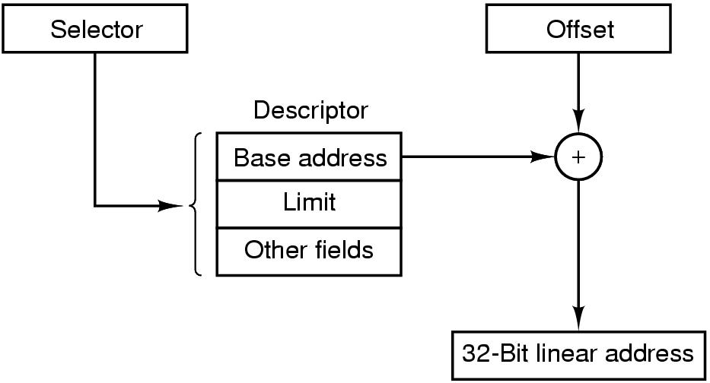
Segmentation with Paging: The Pentium (3)
Figure 3-41. Conversion of a (selector, offset) pair to a linear address.
Tanenbaum, Modern Operating Systems 3 e, (c) 2008 Prentice-Hall, Inc. All rights reserved. 0-13-6006639

Slide 56
Segmentation with Paging: The Pentium (4)
Figure 3-42. Mapping of a linear address onto a physical address.
Tanenbaum, Modern Operating Systems 3 e, (c) 2008 Prentice-Hall, Inc. All rights reserved. 0-13-6006639

Slide 57
Segmentation with Paging: The Pentium (5)
Figure 3-43. Protection on the Pentium.
Tanenbaum, Modern Operating Systems 3 e, (c) 2008 Prentice-Hall, Inc. All rights reserved. 0-13-6006639

