Slide 1
MODERN OPERATING SYSTEMS Third Edition ANDREW S. TANENBAUM Chapter 5 Input/Output

Slide 2
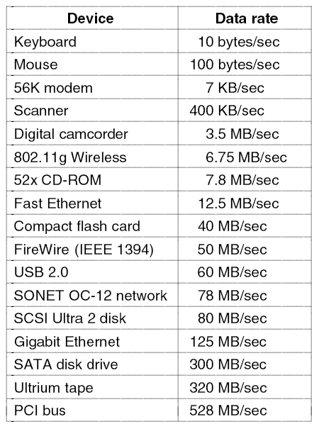
I/O Devices
Figure 5-1. Some typical device, network, and bus data rates.

Slide 3
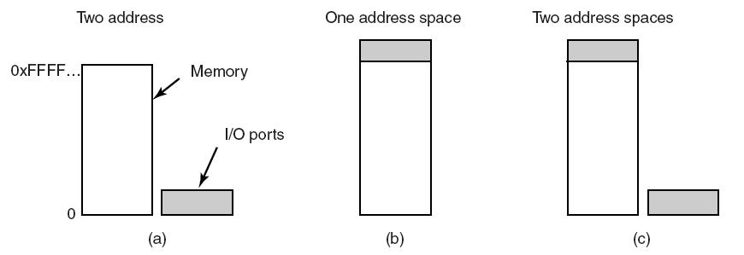
Memory-Mapped I/O (1)
Figure 5-2. (a) Separate I/O and memory space. (b) Memory-mapped I/O. (c) Hybrid.

Slide 4
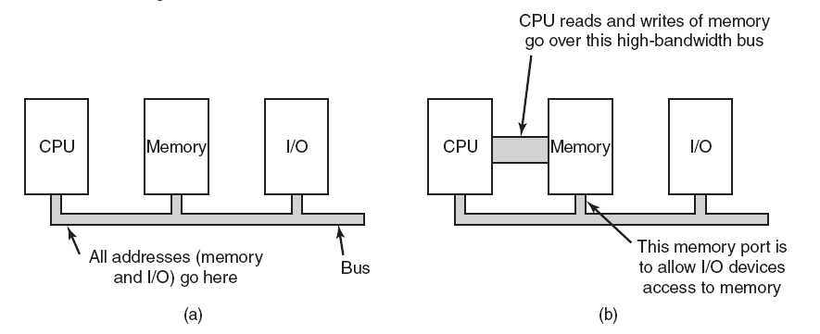
Memory-Mapped I/O (2)
Figure 5-3. (a) A single-bus architecture. (b) A dual-bus memory architecture.

Slide 5
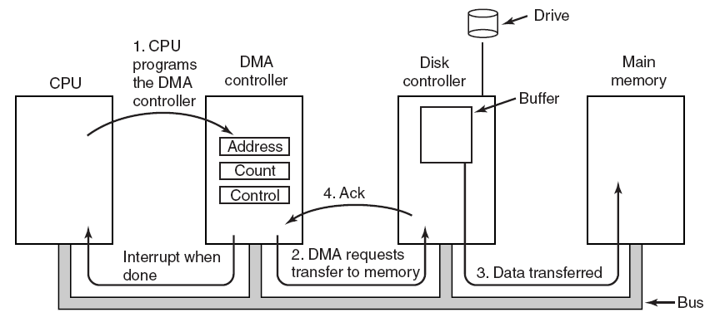
Direct Memory Access (DMA)
Figure 5-4. Operation of a DMA transfer.

Slide 6
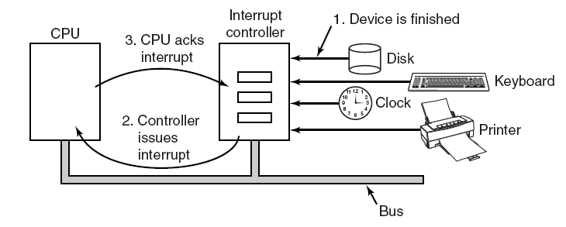
Interrupts Revisited
Figure 5-5. How an interrupt happens. The connections between the devices and the interrupt controller actually use interrupt lines on the bus rather than dedicated wires.

Slide 7
Precise and Imprecise Interrupts (1)
Properties of a precise interrupt
PC (Program Counter) is saved in a known place.
All instructions before the one pointed to by the PC have fully executed.
No instruction beyond the one pointed to by the PC has been executed.
Execution state of the instruction pointed to by the PC is known.

Slide 8
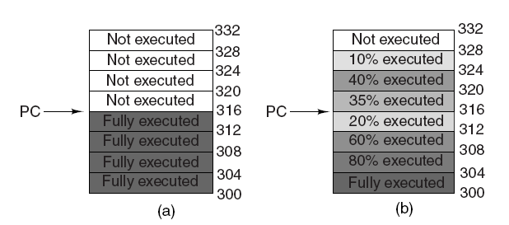
Precise and Imprecise Interrupts (2)
Figure 5-6. (a) A precise interrupt. (b) An imprecise interrupt.

Slide 9
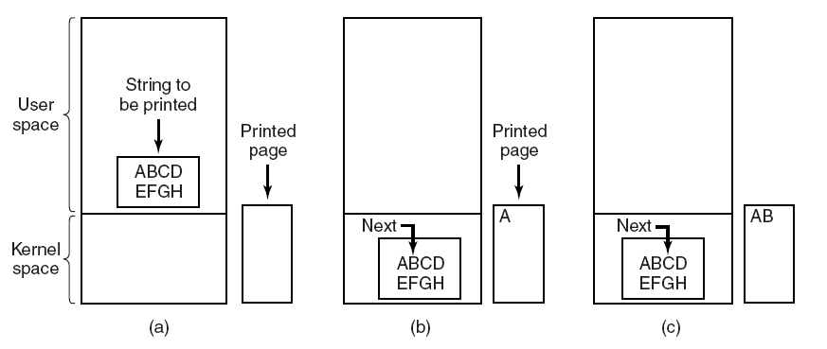
Programmed I/O (1)
Figure 5-7. Steps in printing a string.

Slide 10
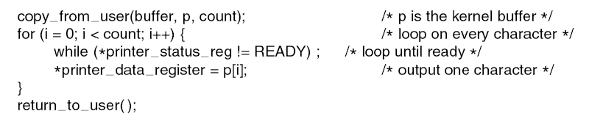
Programmed I/O (2)
Figure 5-8. Writing a string to the printer using programmed I/O.

Slide 11
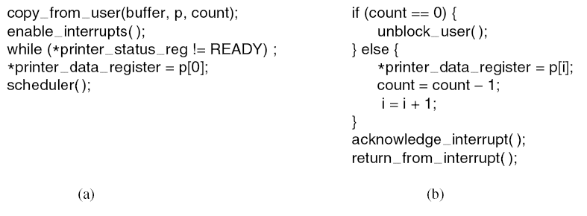
Interrupt-Driven I/O
Figure 5-9. Writing a string to the printer using interrupt-driven I/O. (a) Code executed at the time the print system call is made. (b) Interrupt service procedure for the printer.

Slide 12
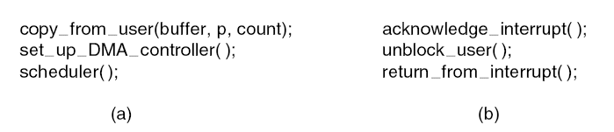
I/O Using DMA
Figure 5-10. Printing a string using DMA. (a) Code executed when the print system call is made. (b) Interrupt service procedure.

Slide 13
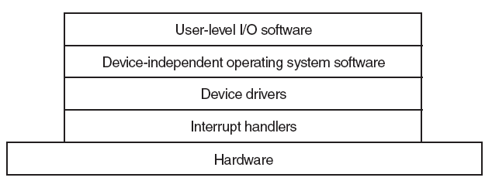
I/O Software Layers
Figure 5-11. Layers of the I/O software system.

Slide 14
Interrupt Handlers (1)
Save registers not already been saved by interrupt hardware.
Set up a context for the interrupt service procedure.
Set up a stack for the interrupt service procedure.
Acknowledge the interrupt controller. If there is no centralized interrupt controller, reenable interrupts.
Copy the registers from where they were saved to the process table.

Slide 15
Interrupt Handlers (2)
Run the interrupt service procedure.
Choose which process to run next.
Set up the MMU context for the process to run next.
Load the new process’ registers, including its PSW.
Start running the new process.

Slide 16
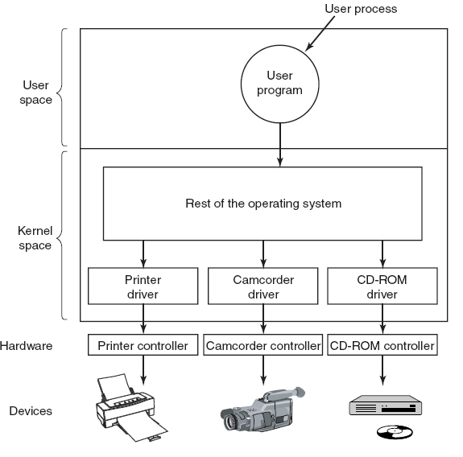
Device Drivers
Figure 5-12. Logical positioning of device drivers. In reality all communication between drivers and device controllers goes over the bus.

Slide 17
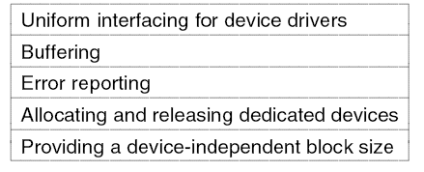
Device-Independent I/O Software
Figure 5-13. Functions of the device-independent I/O software.

Slide 18
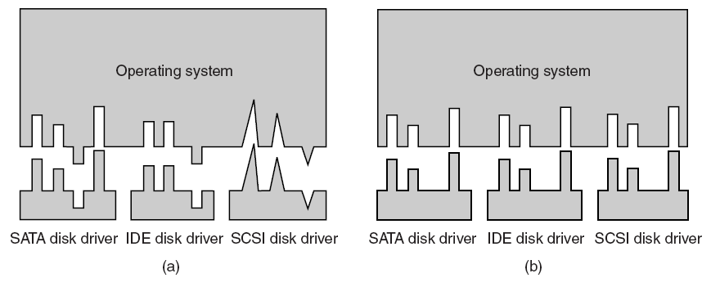
Uniform Interfacing for Device Drivers
Figure 5-14. (a) Without a standard driver interface. (b) With a standard driver interface.

Slide 19
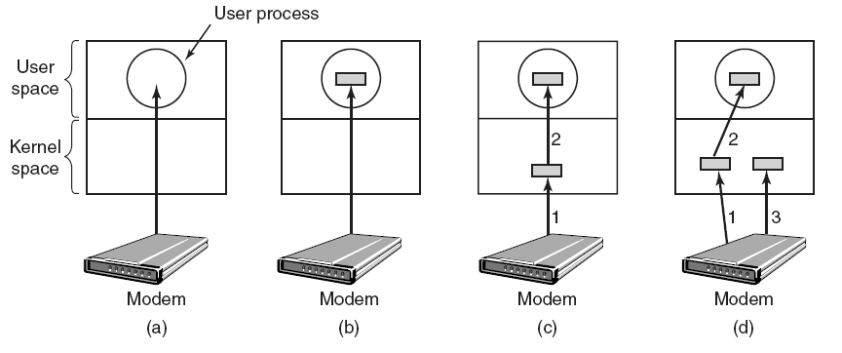
Buffering (1)
Figure 5-15. (a) Unbuffered input. (b) Buffering in user space. (c) Buffering in the kernel followed by copying to user space. (d) Double buffering in the kernel.

Slide 20
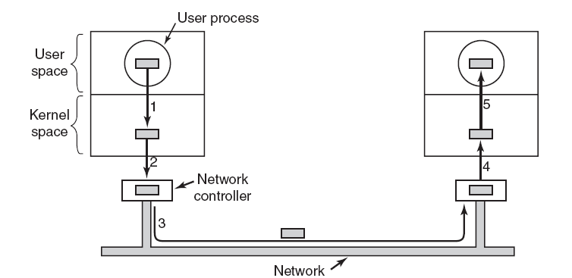
Buffering (2)
Figure 5-16. Networking may involve many copies of a packet.

Slide 21
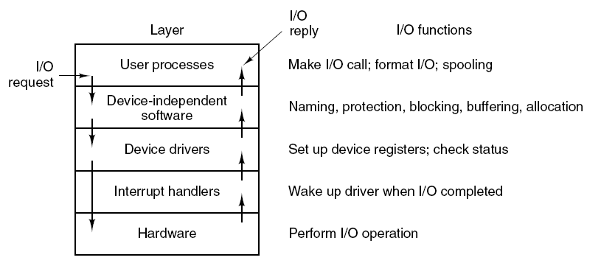
User-Space I/O Software
Figure 5-17. Layers of the I/O system and the main functions of each layer.

Slide 22
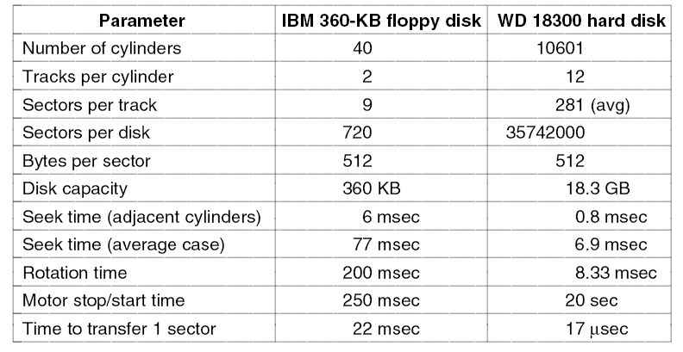
Magnetic Disks (1)
Figure 5-18. Disk parameters for the original IBM PC 360-KB floppy disk and a Western Digital WD 18300 hard disk.

Slide 23
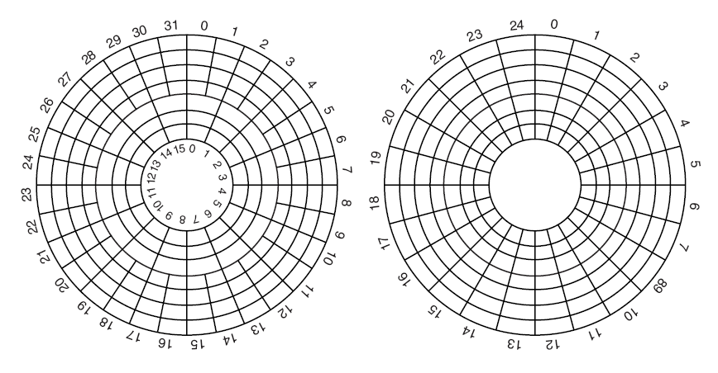
Magnetic Disks (2)
Figure 5-19. (a) Physical geometry of a disk with two zones. (b) A possible virtual geometry for this disk.

Slide 24
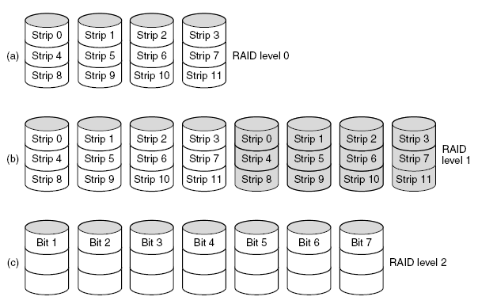
RAID (1)
Figure 5-20. RAID levels 0 through 5. Backup and parity drives are shown shaded.

Slide 25
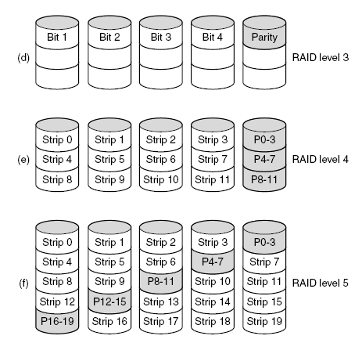
RAID (2)
Figure 5-20. RAID levels 0 through 5. Backup and parity drives are shown shaded.

Slide 26
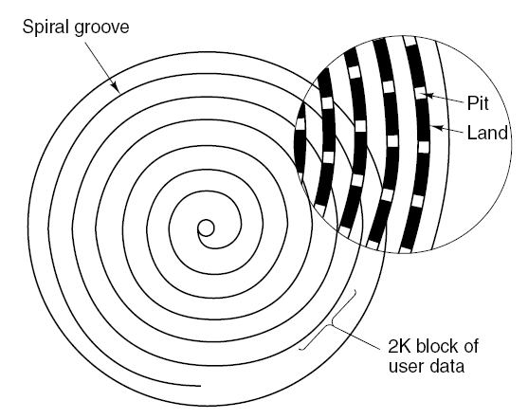
CD-ROMs (1)
Figure 5-21. Recording structure of a compact disc or CD-ROM.

Slide 27
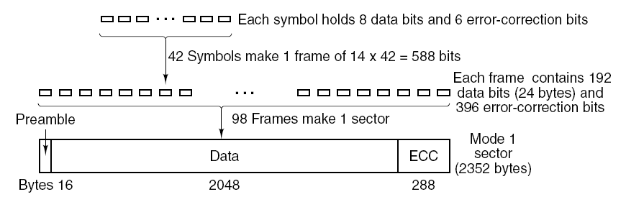
CD-ROMs (2)
Figure 5-22. Logical data layout on a CD-ROM.

Slide 28
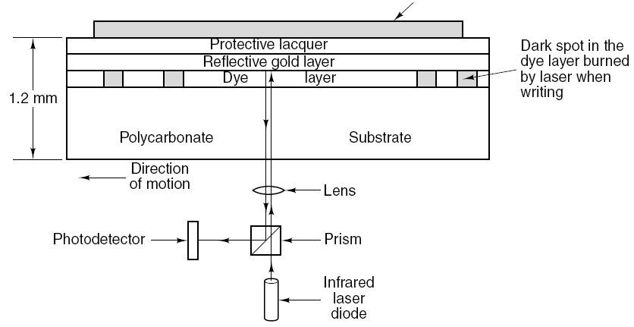
CD-Recordables (1)
Figure 5-23. Cross section of a CD-R disk and laser. A silver CD-ROM has similar structure, except without dye layer and with pitted aluminum layer instead of gold layer.

Slide 29
DVD (1)
DVD Improvements on CDs
Smaller pits (0.4 microns versus 0.8 microns for CDs).
A tighter spiral (0.74 microns between tracks versus 1.6 microns for CDs).
A red laser (at 0.65 microns versus 0.78 microns for CDs).

Slide 30
DVD (2)
DVD Formats
Single-sided, single-layer (4.7 GB).
Single-sided, dual-layer (8.5 GB).
Double-sided, single-layer (9.4 GB).
Double-sided, dual-layer (17 GB).

Slide 31
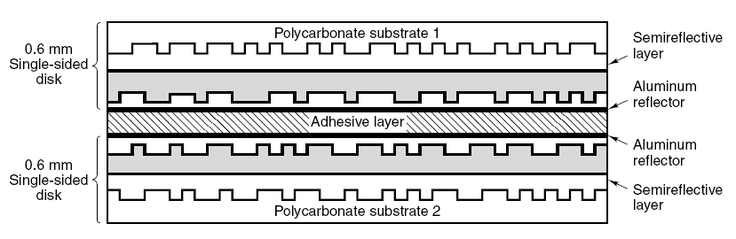
DVD (3)
Figure 5-24. A double-sided, dual-layer DVD disk.

Slide 32
Disk Formatting (1)
Figure 5-25. A disk sector.

Slide 33
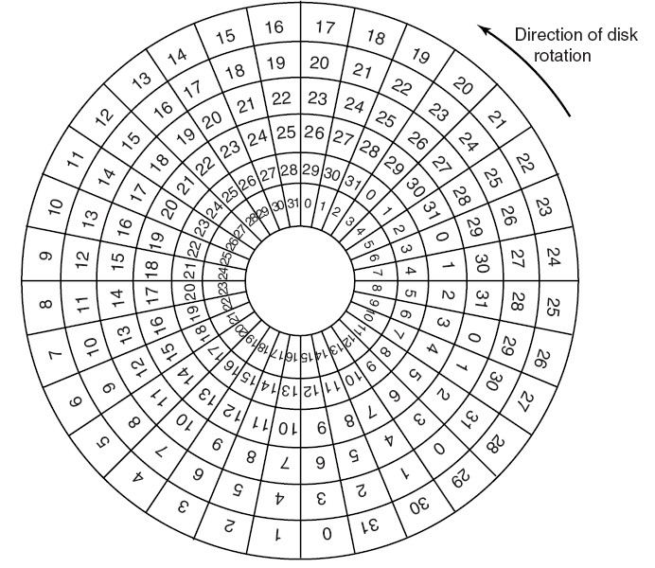
Disk Formatting (2)
Figure 5-26. An illustration of cylinder skew.

Slide 34
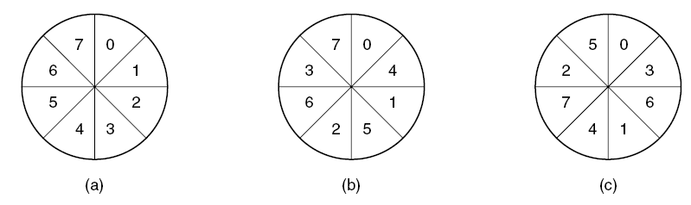
Disk Formatting (3)
Figure 5-27. (a) No interleaving. (b) Single interleaving. (c) Double interleaving.

Slide 35
Disk Arm Scheduling Algorithms (1)
Read/write time factors
Seek time (the time to move the arm to the proper cylinder).
Rotational delay (the time for the proper sector to rotate under the head).
Actual data transfer time.

Slide 36
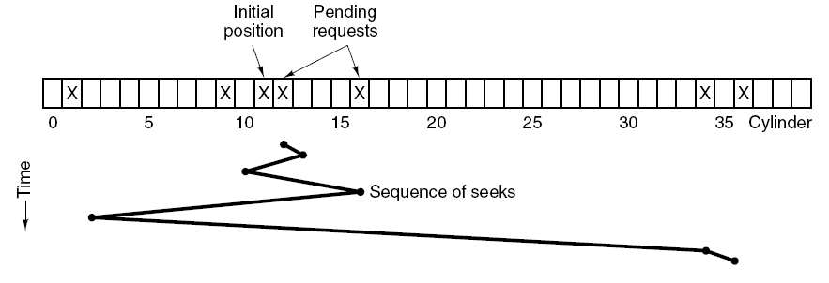
Disk Arm Scheduling Algorithms (2)
Figure 5-28. Shortest Seek First (SSF) disk scheduling algorithm.

Slide 37
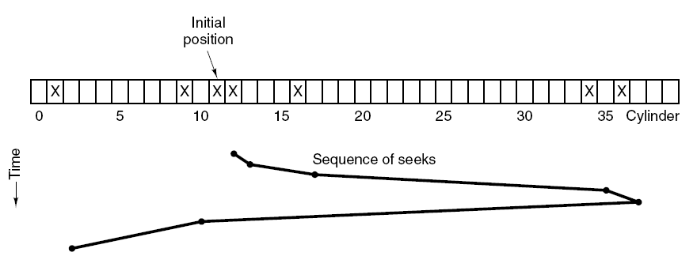
Disk Arm Scheduling Algorithms (3)
Figure 5-29. The elevator algorithm for scheduling disk requests.

Slide 38
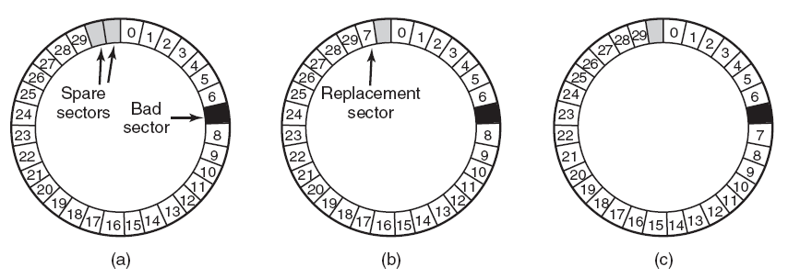
Error Handling
Figure 5-30. (a) A disk track with a bad sector. (b) Substituting a spare for the bad sector. (c) Shifting all the sectors to bypass the bad one.

Slide 39
Stable Storage (1)
Operations for stable storage using identical disks:
Stable writes
Stable reads
Crash recovery

Slide 40
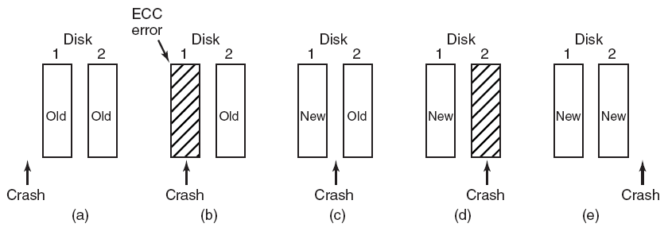
Stable Storage (2)
Figure 5-31. Analysis of the influence of crashes on stable writes.

Slide 41
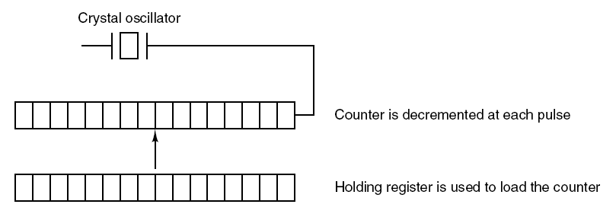
Clock Hardware
Figure 5-32. A programmable clock.

Slide 42
Clock Software (1)
Typical duties of a clock driver
Maintaining the time of day.
Preventing processes from running longer than they are allowed to.
Accounting for CPU usage.
Handling alarm system call made by user processes.
Providing watchdog timers for parts of the system itself.
Doing profiling, monitoring, statistics gathering.

Slide 43
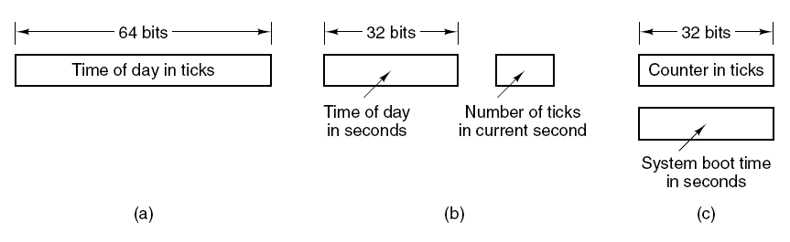
Clock Software (2)
Figure 5-33. Three ways to maintain the time of day.

Slide 44
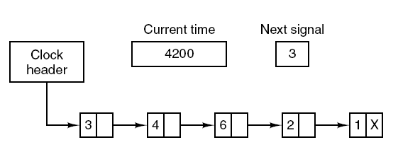
Clock Software (3)
Figure 5-34. Simulating multiple timers with a single clock.

Slide 45
Soft Timers
Soft timers succeed according to rate at which kernel entries are made because of:
System calls.
TLB misses.
Page faults.
I/O interrupts.
The CPU going idle.

Slide 46
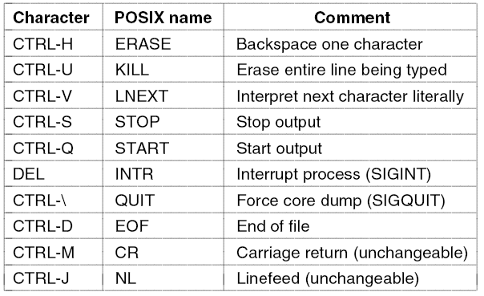
Keyboard Software
Figure 5-35. Characters that are handled specially in canonical mode.

Slide 47
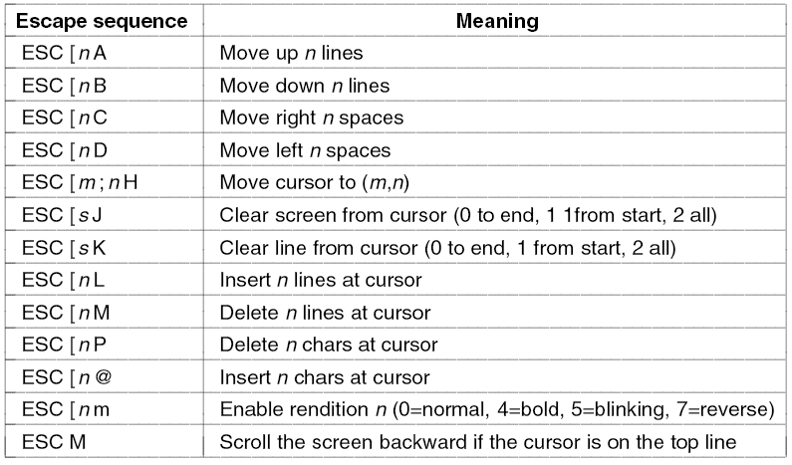
The X Window System (1)
Figure 5-36. The ANSI escape sequences accepted by the terminal driver on output. ESC denotes the ASCII escape character (0x1B), and n, m, and s are optional
numeric parameters.

Slide 48
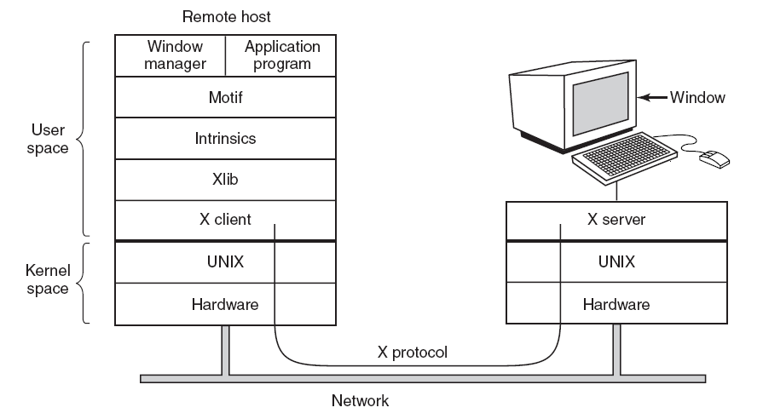
The X Window System (2)
Figure 5-37. Clients and servers in the M.I.T. X Window System.

Slide 49
The X Window System (3)
Types of messages between client and server:
Drawing commands from the program to the workstation.
Replies by the workstation to program queries.
Keyboard, mouse, and other event announcements.
Error messages.

Slide 50
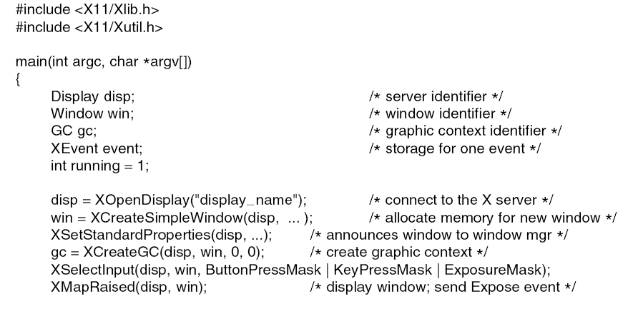
Graphical User Interfaces (1)
. . .
Figure 5-38. A skeleton of an X Window application program.

Slide 51
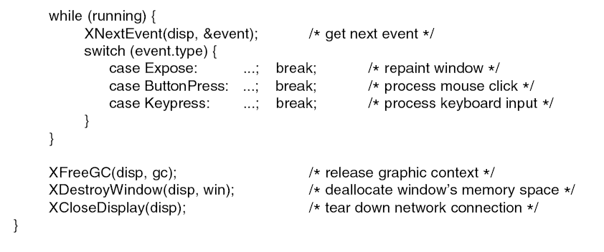
Graphical User Interfaces (2)
. . .
Figure 5-38. A skeleton of an X Window application program.

Slide 52
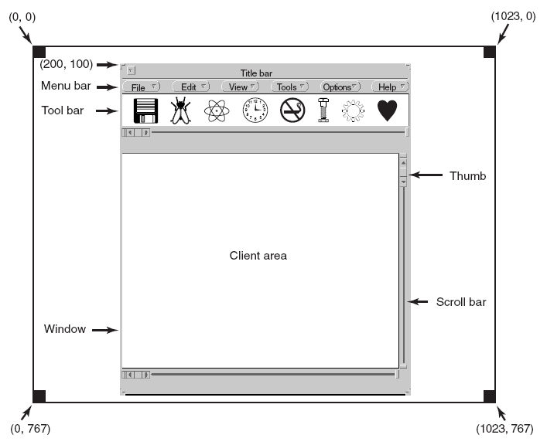
Graphical User Interfaces (3)
Figure 5-39. A sample window located at (200, 100) on an XGA display.

Slide 53
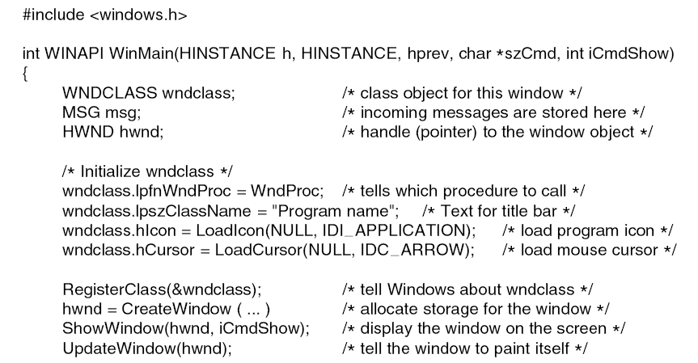
Graphical User Interfaces (4)
. . .
Figure 5-40. A skeleton of a Windows main program.

Slide 54
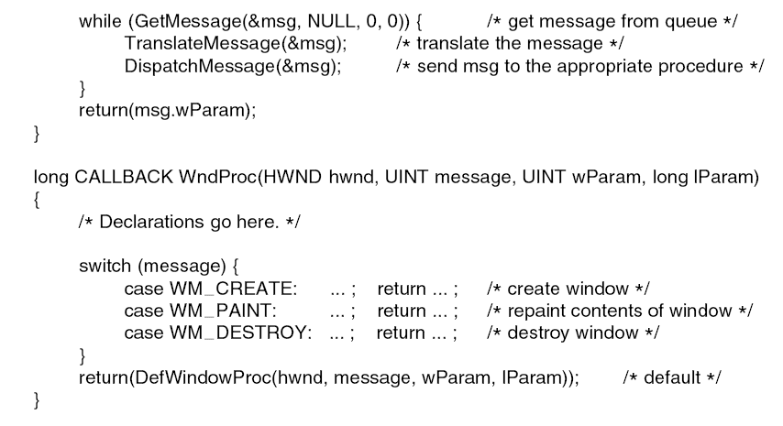
Graphical User Interfaces (5)
. . .
Figure 5-40. A skeleton of a Windows main program.

Slide 55
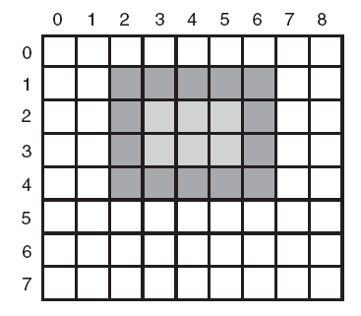
Bitmaps (1)
Figure 5-41. An example rectangle drawn using Rectangle. Each box represents one pixel.

Slide 56
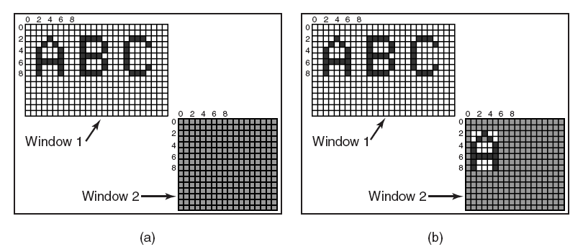
Bitmaps (2)
Figure 5-42. Copying bitmaps using BitBlt. (a) Before. (b) After.

Slide 57
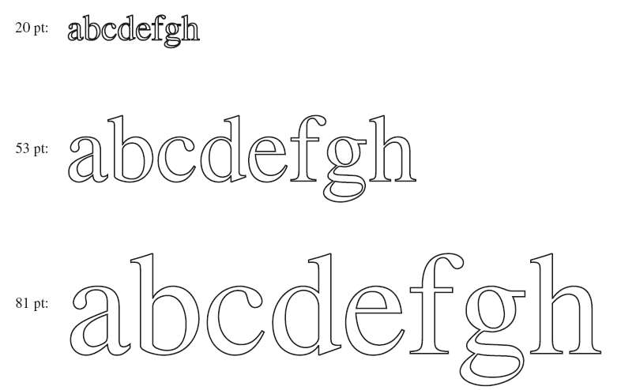
Fonts
Figure 5-43. Some examples of character outlines at different point sizes.

Slide 58
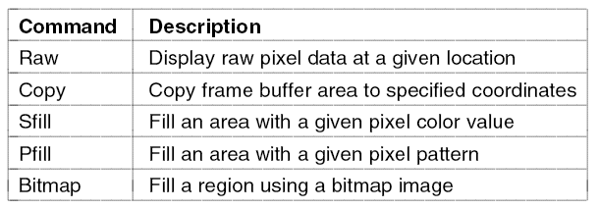
Thin Clients
Figure 5-44. The THINC protocol display commands.

Slide 59
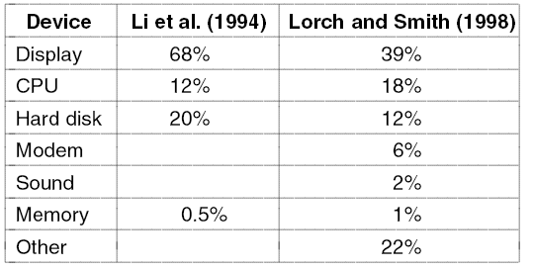
Power Management Hardware Issues
Figure 5-45. Power consumption of various parts of a notebook computer.

Slide 60
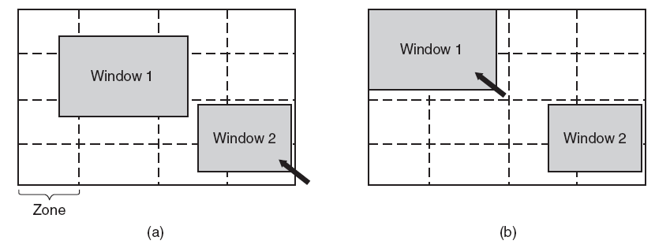
Power Management The Display
Figure 5-46. The use of zones for backlighting the display. (a) When window 2 is selected it is not moved. (b) When window 1 is selected, it moves to reduce the number of zones illuminated.

Slide 61
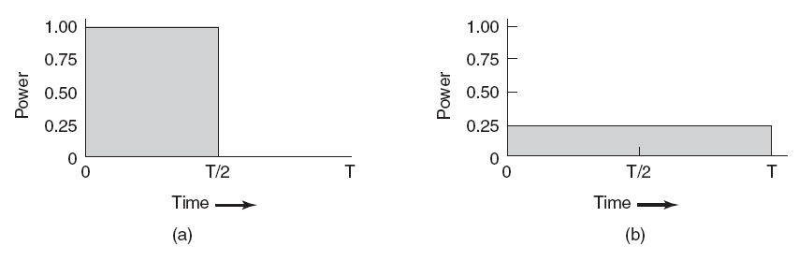
Power Management The CPU
Figure 5-47. (a) Running at full clock speed. (b) Cutting voltage by two cuts clock speed by two and power consumption by four.

