Slide 1
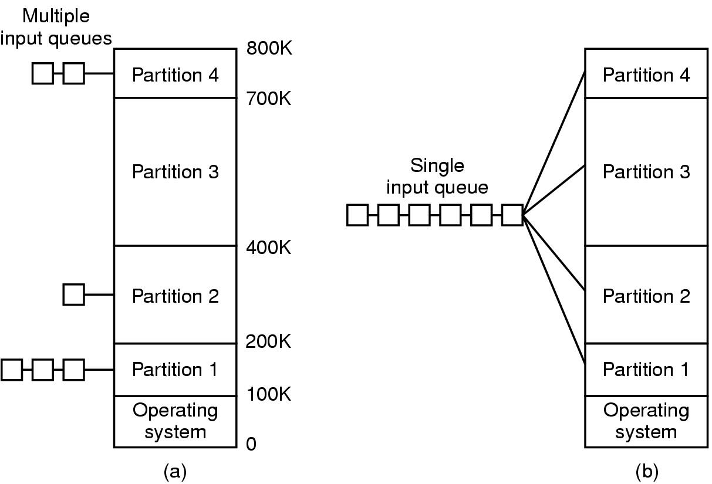
Queuing

Slide 2


Fundamentals of Queuing Theory
A code describing the arrival process
A similar code representing the service process.
(3) The Number of service channels.
(4) In what order are jobs in the line served.
(5) The maximum size of the system. The maximum number of customers allowed in the system including those in service.
(6) The size of calling source. The size of the population from which the customers come. This limits the arrival rate.

Slide 3
Fundamentals of Queuing Theory
M/M/1 queue.
Steady state
constant average arrival rate, λ, is less than the constant potential service rate, µ.
Arrivals are random
- that is, they form a Poisson Process at a constant average rate.
FCFS
The queue discipline is first-come, first served.
Exponential Service Times
Service time is random and has an exponential distribution.
There are no limits on the size of the queue or the population from which the customers come. There is 1 server.

Slide 4

Exponential distribution
Probability density function
f(x, λ) | = | probability of exactly n customers arriving per unit time
x | = | number of customers arriving over time t
λ | = | average arrival rate

Slide 5
Arrivals vs. departures
Constant average arrival rate is less than constant potential service rate
The ratio
is also called the utilization.
For steady-state, it must be less than 1 for a single-server queue

Slide 6
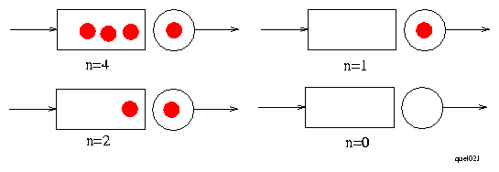
System state
At any instant the system can be in one of a number of states. For M/M/1 queue those states are described by n – the number of customers in the system.
From HCM 2000

Slide 7
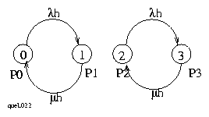
State-space diagram
Marcovian system – the probability of transition depends only on the state
In a small interval of time the probability of arrival is λh; of departure µh
Notes:
Less than 2
P(0) = e-(0.20)(15) = 0.0498
P(1) = 0.1494
P(0) + P(1) = 0.0498 + 0.1494 = 0.1992
More than 2
P(n>2) = 1 – (0.1992 + 0.224) = 0.5768

Slide 8
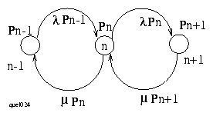
State-space diagram (cont.)
The transition rates must balance in a steady state. To get the steady state probabilities we find the balance equations for the transitions between every pair of states. Thus, between the pair Pn and Pn-1, the rates must balance

Slide 9
State-space diagram (cont.)
λPn-1 = µPn
Pn = (λ/µ) Pn-1
Pn = ρPn-1
Thus
Pn = ρ^nP0

Slide 10
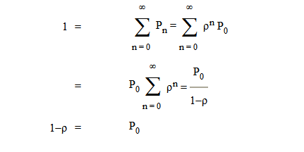


State-space diagram (cont.)

Slide 11
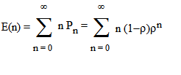

Expected number of customers
Notes:
Exponential distribution of times between vehicle arrivals = Poisson arrivals

Slide 12
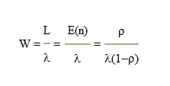
Little’s Law
If λ castomes arrive each unit of time and wait for W units until served, then λ W customers are in the system at any instance
If L is an avarage number of customers, then:

Slide 13
M/M/N
Average length of queue
Average time waiting in queue
λ/N = arrival rate μ = departure rate

Slide 14
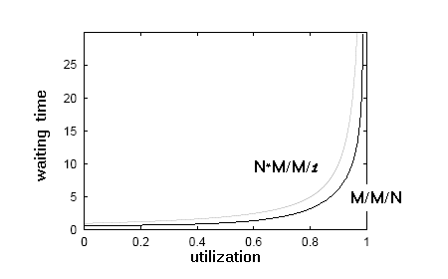
N*M/M/1 vs. M/M/N

Slide 15
References
1)
M/M/1 QUEUES
G A Vignaux
http://www.mcs.vuw.ac.nz/~vignaux/docs/mm1.html
2)
M/M/1 Solver & Simulator
Dr. Jaroslav Sklenar
http://staff.um.edu.mt/jskl1/simweb/simmm1.html

