Slide 1
Introduction
Chapter 1
1.1 What is an operating system
1.2 History of operating systems
1.3 The operating system zoo
1.4 Computer hardware review
1.5 Operating system concepts
1.6 System calls
1.7 Operating system structure

Slide 2
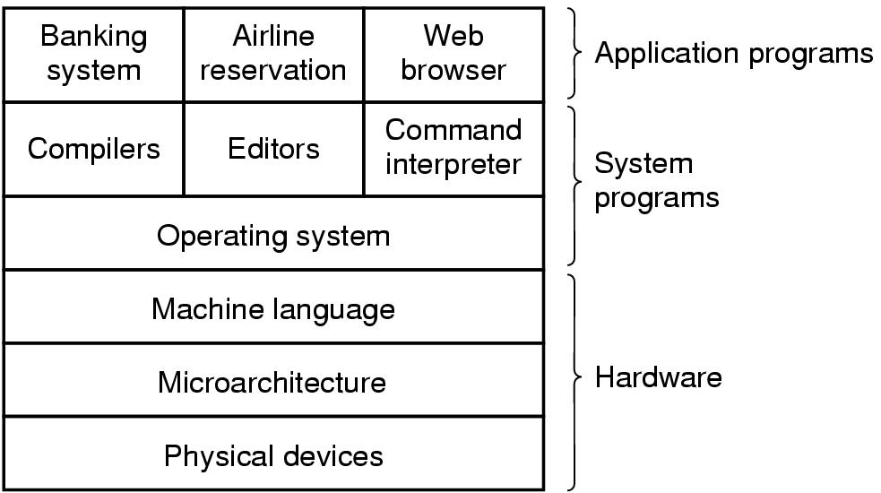
Introduction
User mode
Kernel mode
חוצצת
מסתירה
ממשק נח למשתמש
ניהול משאבים
אי תלות בחומרה, (מ"ה כן תלויה בחומרה)
הגנה על החומרה (התקנים)
A computer system consists of
hardware
system programs
application programs

Slide 3
What is an Operating System
It is an extended machine
Hides the messy details which must be performed
Presents user with a virtual machine, easier to use
It is a resource manager
Each program gets time with the resource
Each program gets space on the resource
System calls

Slide 4
The Operating System as a Resource Manager
Allow multiple programs to run at the same time
Manage and protect memory, I/O devices, and other resources
Includes multiplexing (sharing) resources in two different ways:
In time
In space
Tanenbaum, Modern Operating Systems 3 e, (c) 2008 Prentice-Hall, Inc. All rights reserved. 0-13-6006639

Slide 5
History of Operating Systems (2)
First generation 1945 - 1955
vacuum tubes, plug boards
Second generation 1955 - 1965
transistors, batch systems
Third generation 1965 – 1980
ICs and multiprogramming
Fourth generation 1980 – present
personal computers

Slide 6
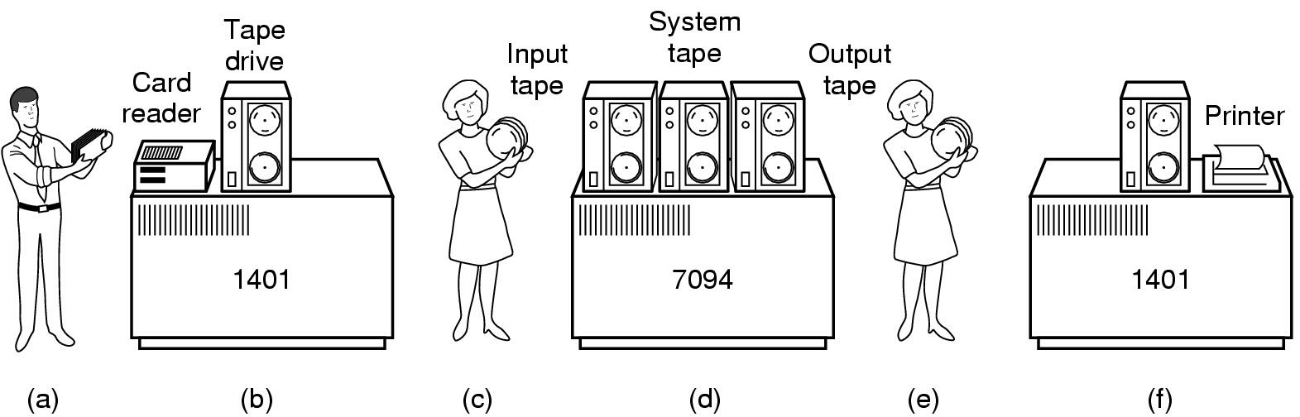
History of Operating Systems (1)
Early batch system
bring cards to 1401
read cards to tape
put tape on 7094 which does computing
put tape on 1401 which prints output
ללא מגע יד אדם

Slide 7
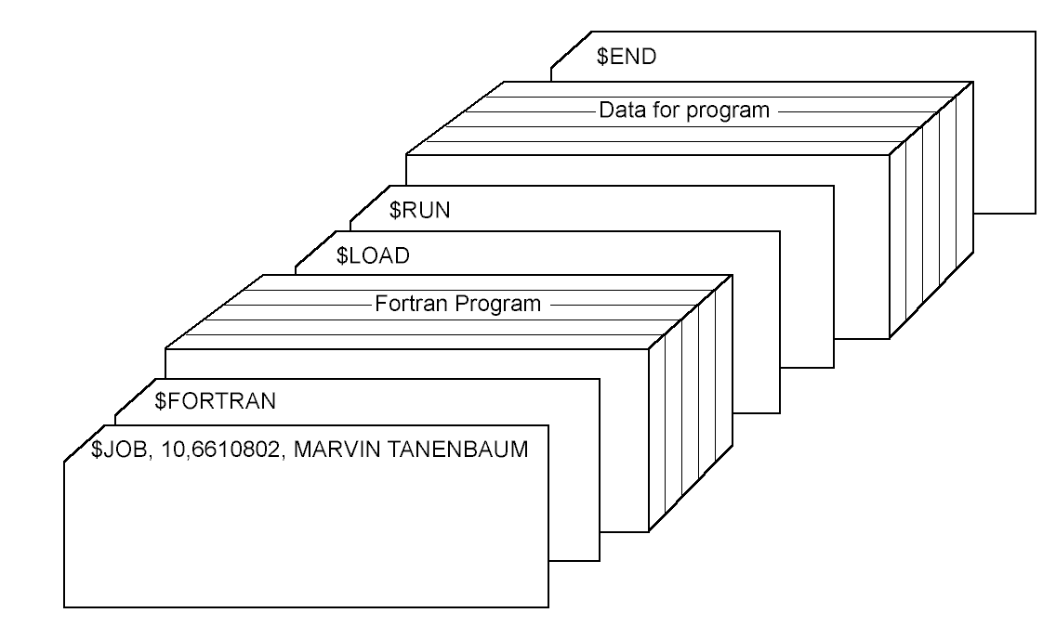
History of Operating Systems (3)
Structure of a typical FMS job – 2nd generation

Slide 8
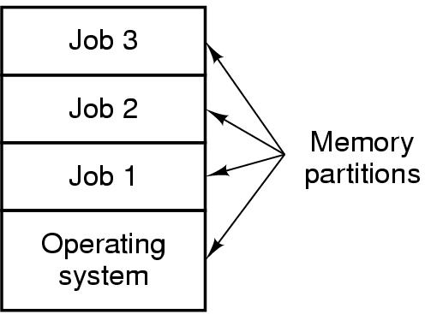
History of Operating Systems (4)
94% idle i/o
6% cpu usage
מקבליות אמיתית
מקבליות מדומה
אמיתית בזמן המתנה ל IO
מדומה, מתקבלת מהחלפה מהירה בין תהליכים.
Multiprogramming system
three jobs in memory – 3rd generation

Slide 9
The Operating System Zoo
Mainframe operating systems
Server operating systems
Multiprocessor operating systems
Personal computer operating systems
Real-time operating systems
Embedded operating systems
Smart card operating systems

Slide 10
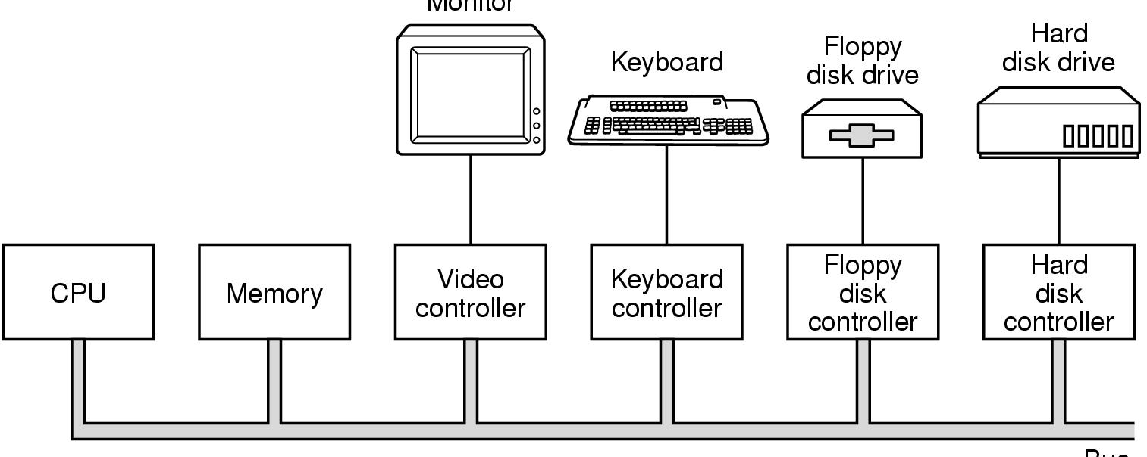
Computer Hardware Review (1)
Monitor
Bus
Components of a simple personal computer

Slide 11
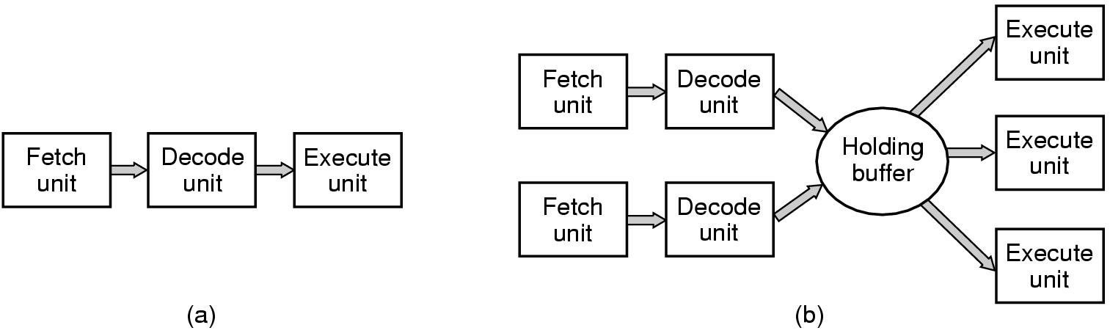
Computer Hardware Review (2)
(a) A three-stage pipeline
(b) A superscalar CPU

Slide 12
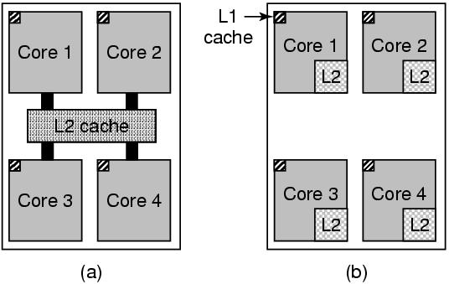
Multithreaded and Multicore Chips
Figure 1-8. (a) A quad-core chip with a shared L2 cache. (b) A quad-core chip with separate L2 caches.
Tanenbaum, Modern Operating Systems 3 e, (c) 2008 Prentice-Hall, Inc. All rights reserved. 0-13-6006639

Slide 13
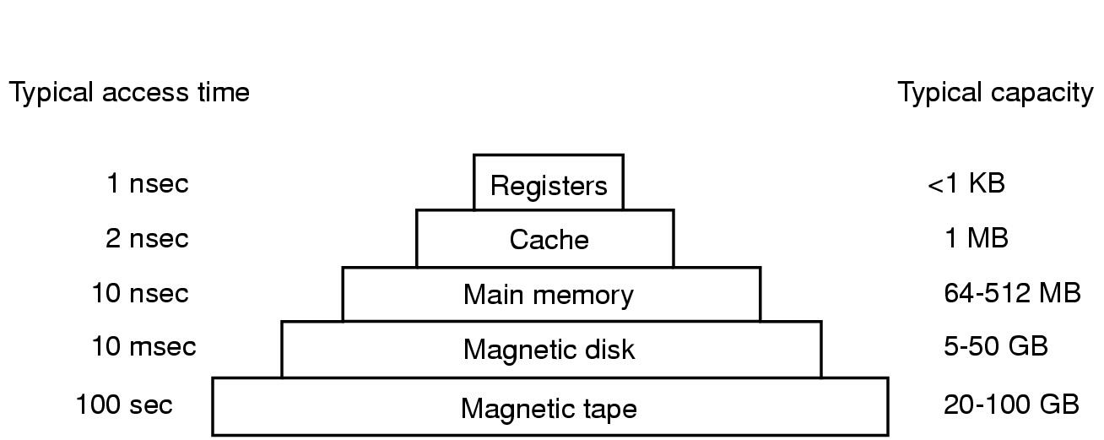
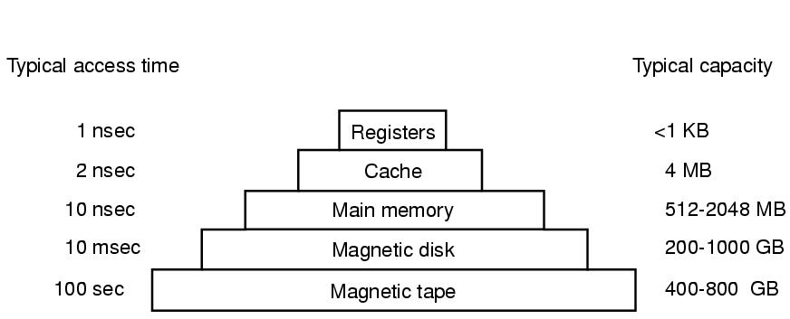
Computer Hardware Review (3)
Typical memory hierarchy
numbers shown are rough approximations

Slide 14
Memory (2)
Questions when dealing with cache:
When to put a new item into the cache.
Which cache line to put the new item in.
Which item to remove from the cache when a slot is needed.
Where to put a newly evicted item in the larger memory.
Tanenbaum, Modern Operating Systems 3 e, (c) 2008 Prentice-Hall, Inc. All rights reserved. 0-13-6006639

Slide 15
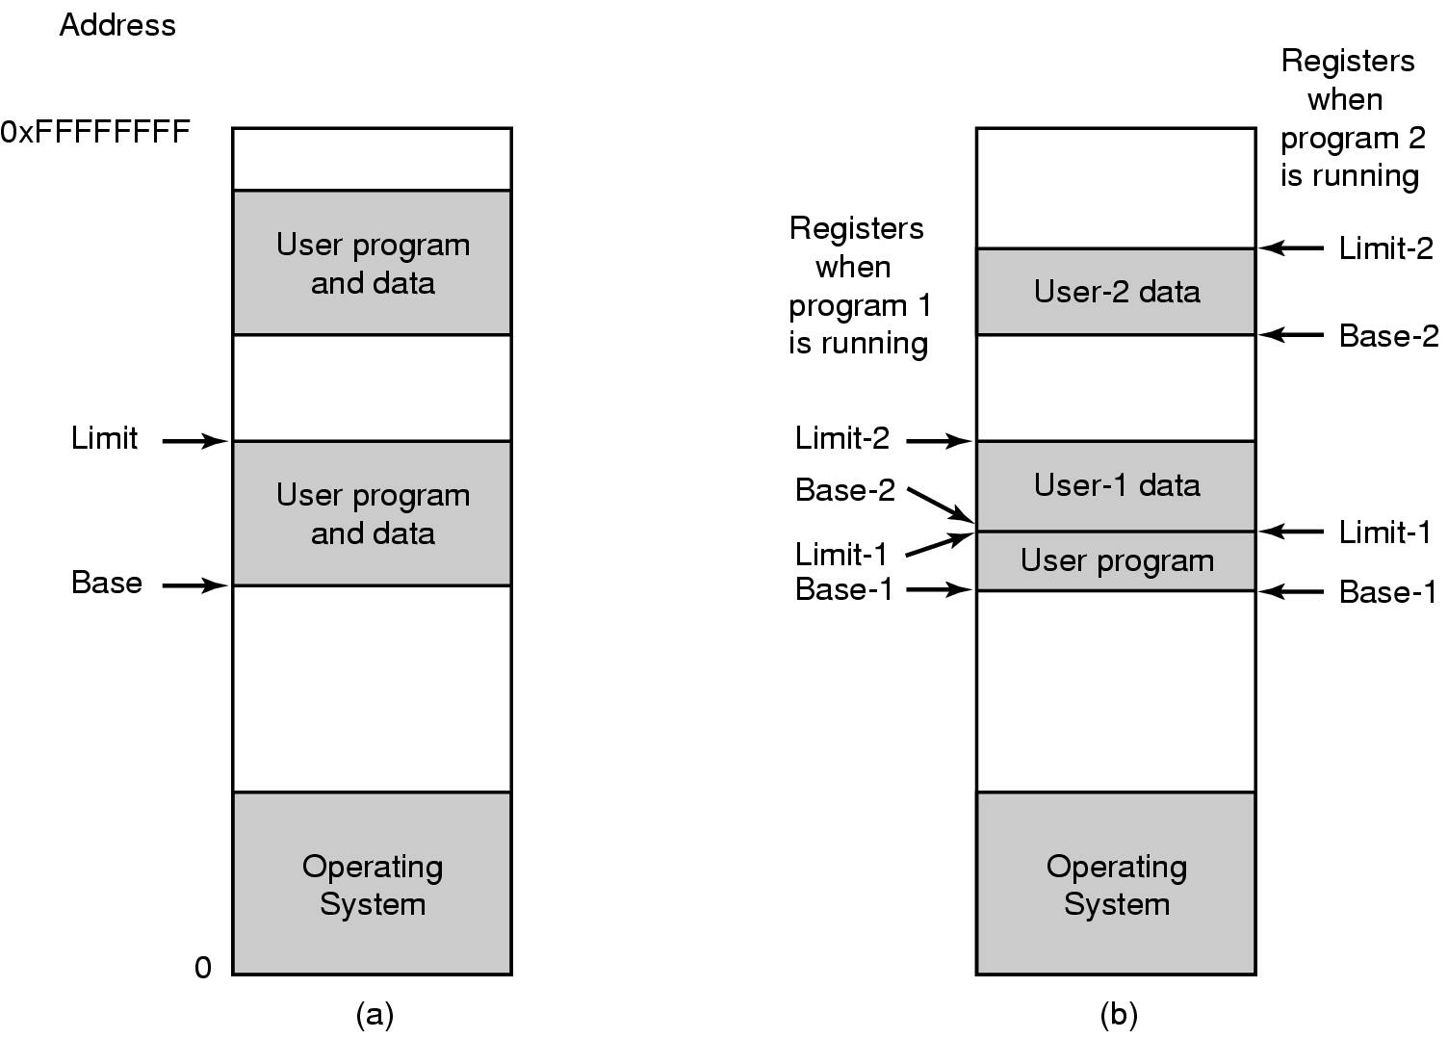
Computer Hardware Review (5)
One base-limit pair and two base-limit pairs

Slide 16
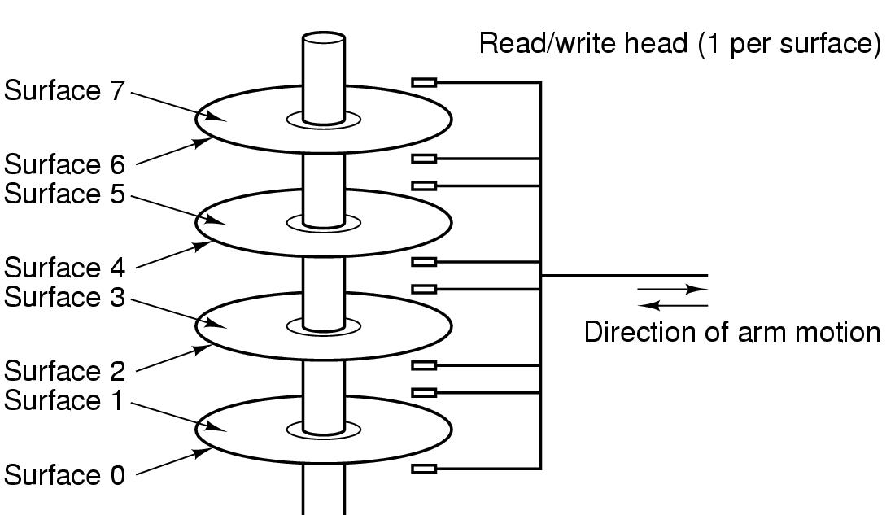
Computer Hardware Review (4)
Structure of a disk drive

Slide 17
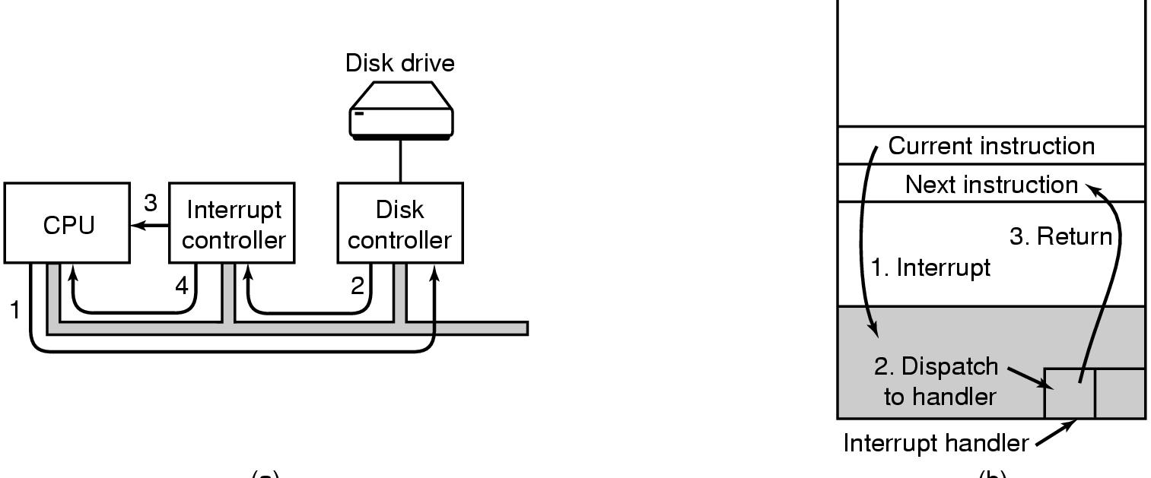
Computer Hardware Review (6)
Hardware interrupt
Vector interrupt
PC=*int_handler
(a)
(b)
(a) Steps in starting an I/O device and getting interrupt
(b) How the CPU is interrupted

Slide 18
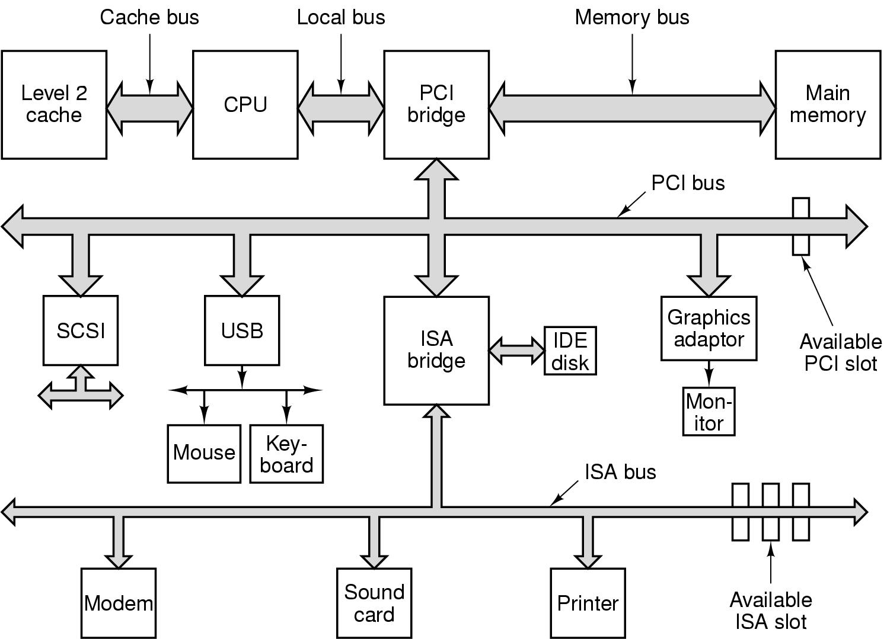
Computer Hardware Review (7)
Structure of a large Pentium system

Slide 19
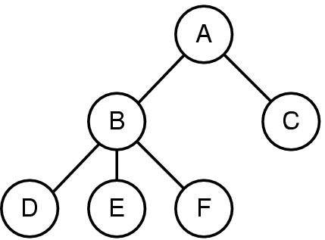
Operating System Concepts (1)
A process tree
A created two child processes, B and C
B created three child processes, D, E, and F

Slide 20
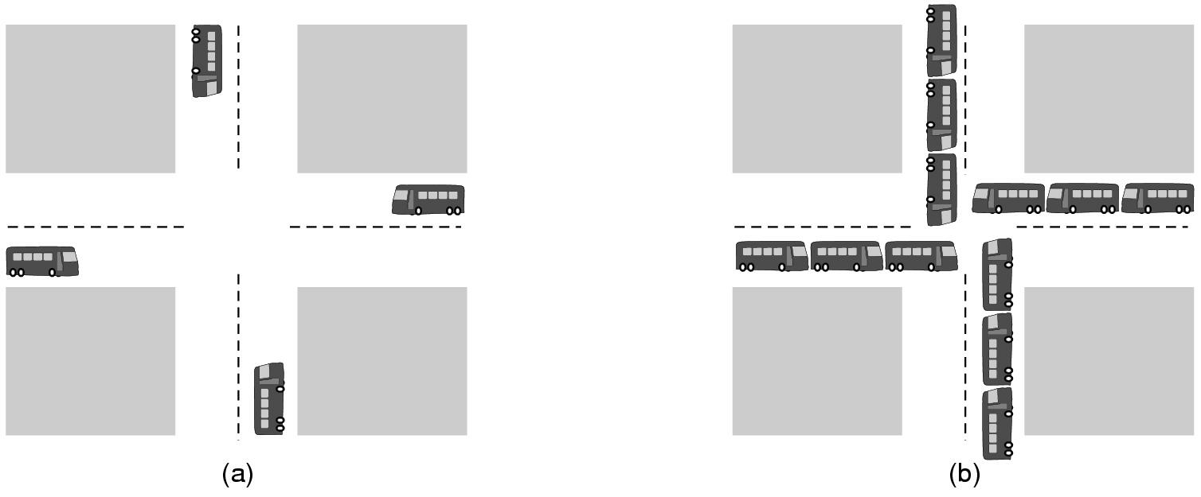
Operating System Concepts (2)
(a) A potential deadlock. (b) an actual deadlock.

Slide 21
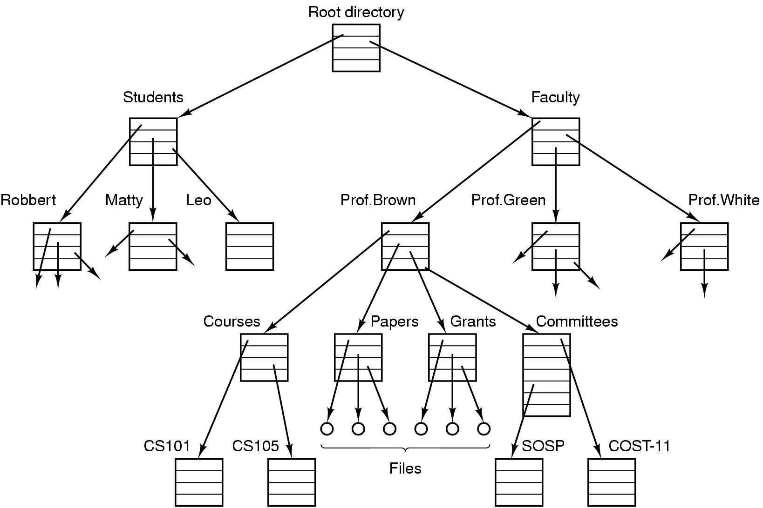
Operating System Concepts (3)
File system for a university department

Slide 22
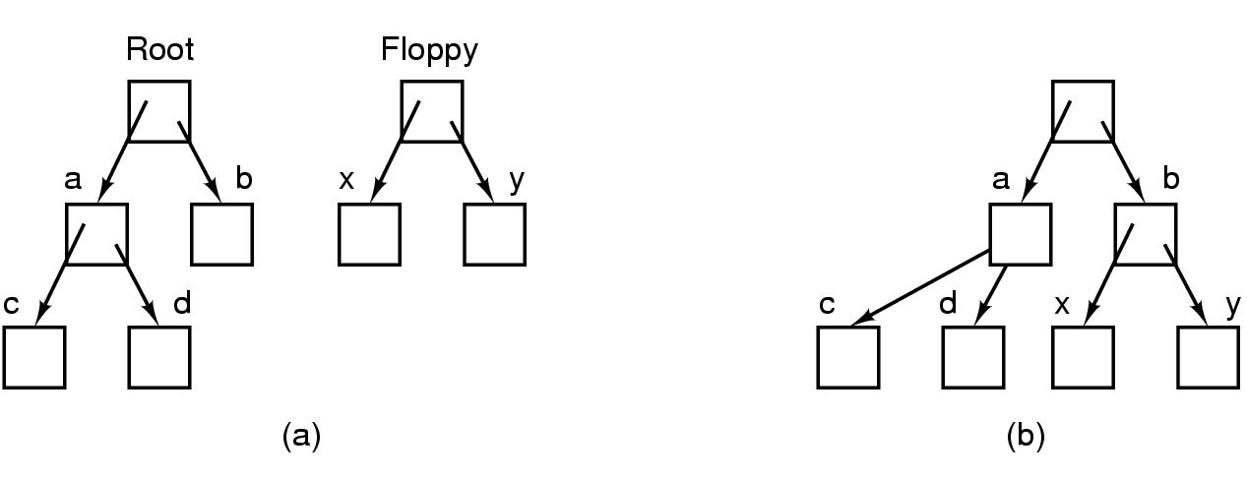
Operating System Concepts (4)
Before mounting,
files on floppy are inaccessible
After mounting floppy on b,
files on floppy are part of file hierarchy

Slide 23
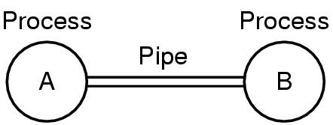
Operating System Concepts (5)
Two processes connected by a pipe

Slide 24
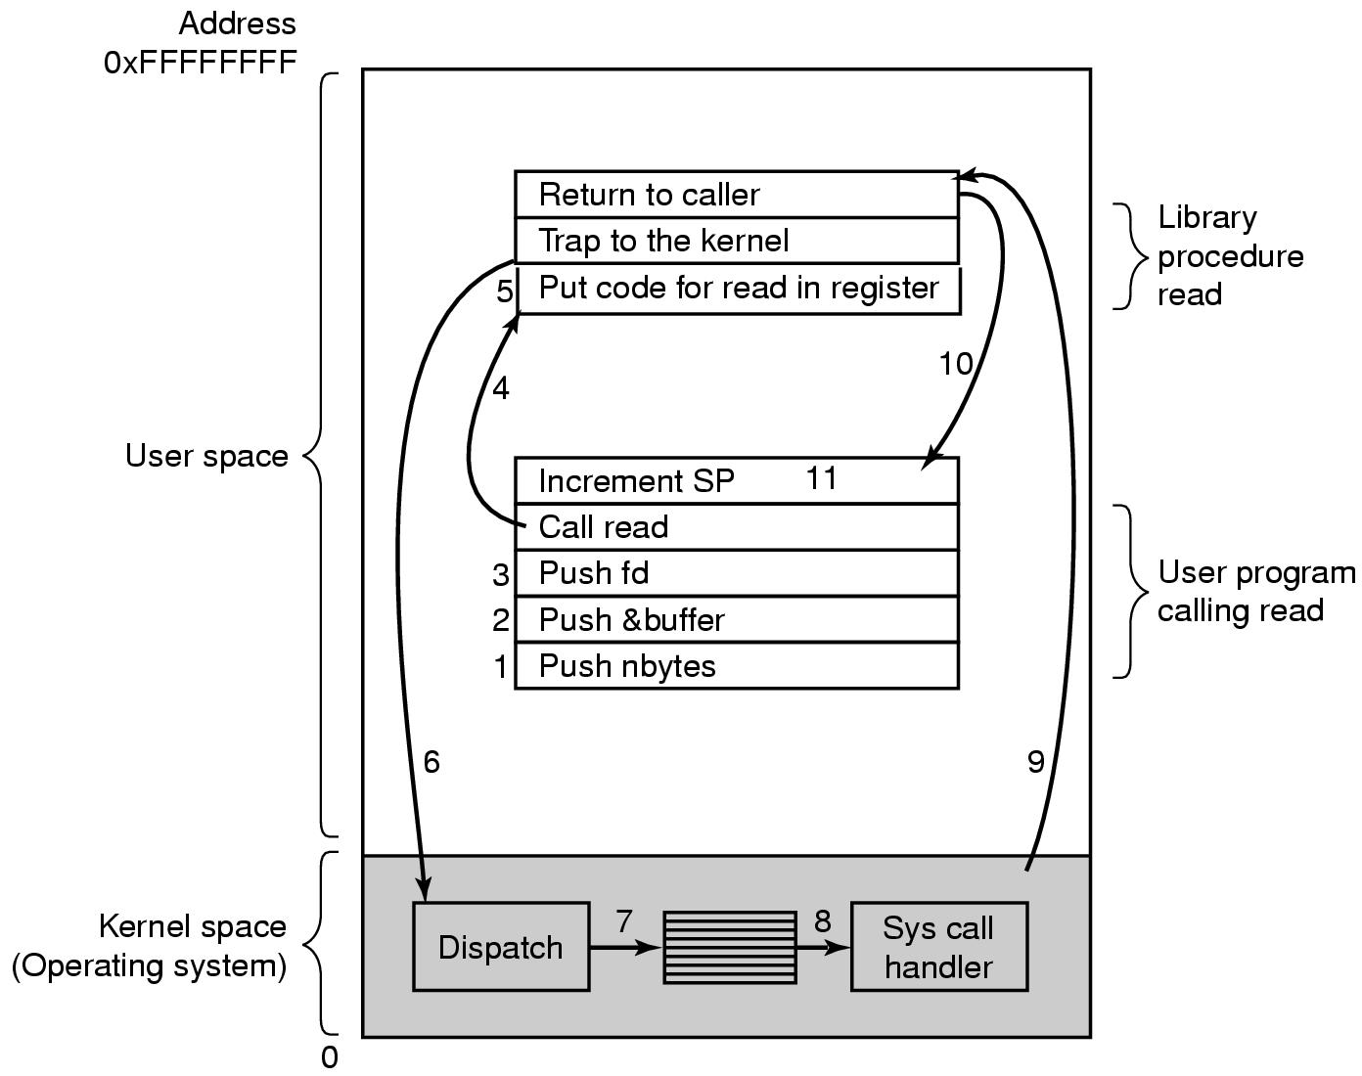
Steps in Making a System Call
System call==software interrupt
Trap to kernel ==
Kernel mode
מה ההבדל בין קריאה לפונקציה לבין קריאת מערכת?
User mode
Kernel mode
PSW
PC==IP
There are 11 steps in making the system call
read (fd, buffer, nbytes)
-> block

Slide 25
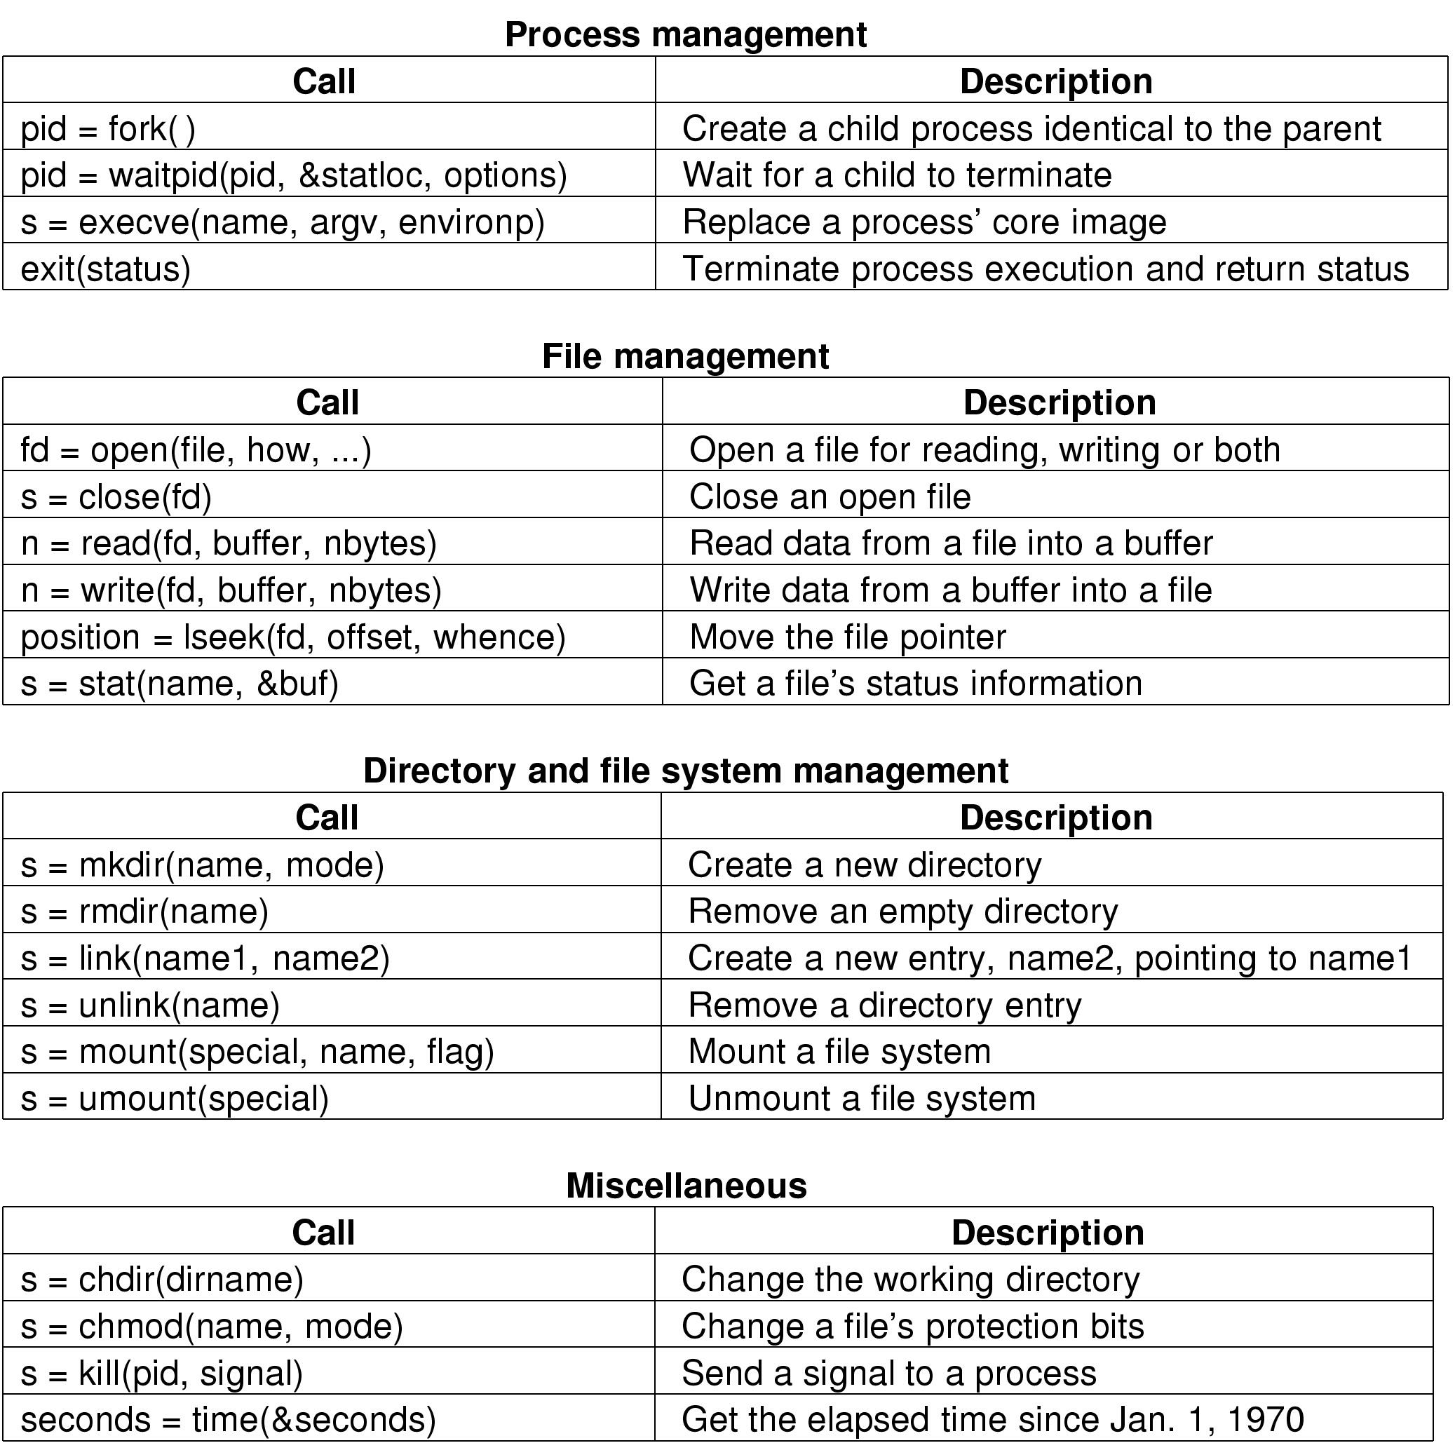
Some System Calls For Process Management

Slide 26
Some System Calls For File Management

Slide 27
Some System Calls For Directory Management

Slide 28
Some System Calls For Miscellaneous Tasks

Slide 29
System Calls (1)
A stripped down shell:
while (TRUE) { /* repeat forever */
type_prompt( ); /* display prompt */
read_command (command, parameters) /* input from terminal */
if (fork() != 0) { /* fork off child process */
/* Parent code */
waitpid( -1, &status, 0); /* wait for child to exit */
} else {
/* Child code */
execve (command, parameters, 0); /* execute command */
}
}

Slide 30
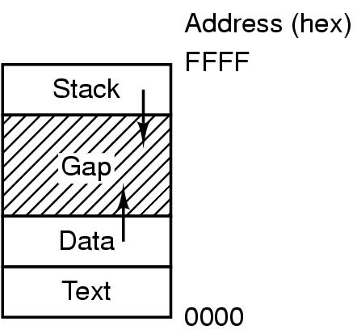
System Calls (2)
Processes have three segments: text, data, stack

Slide 31
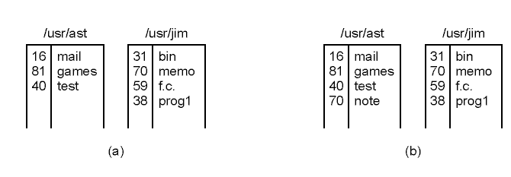
System Calls (3)
(a) Two directories before linking /usr/jim/memo to ast's directory
(b) The same directories after linking

Slide 32
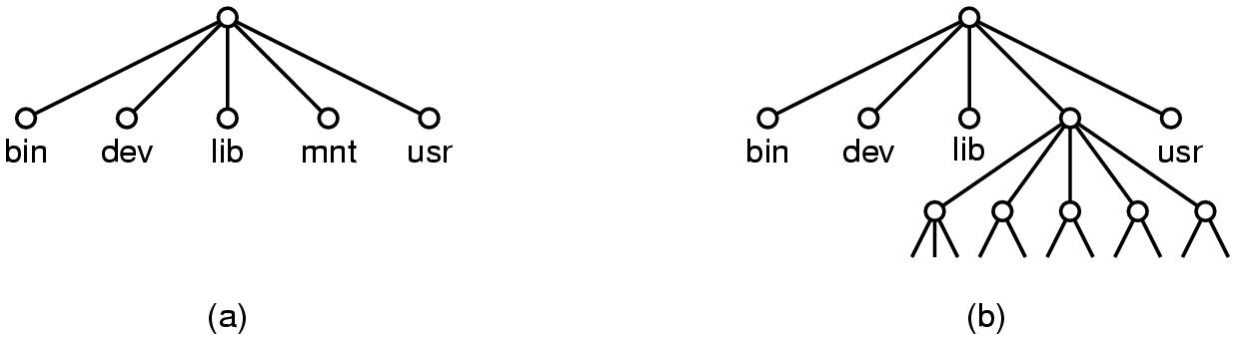
System Calls (4)
(a) File system before the mount
(b) File system after the mount

Slide 33
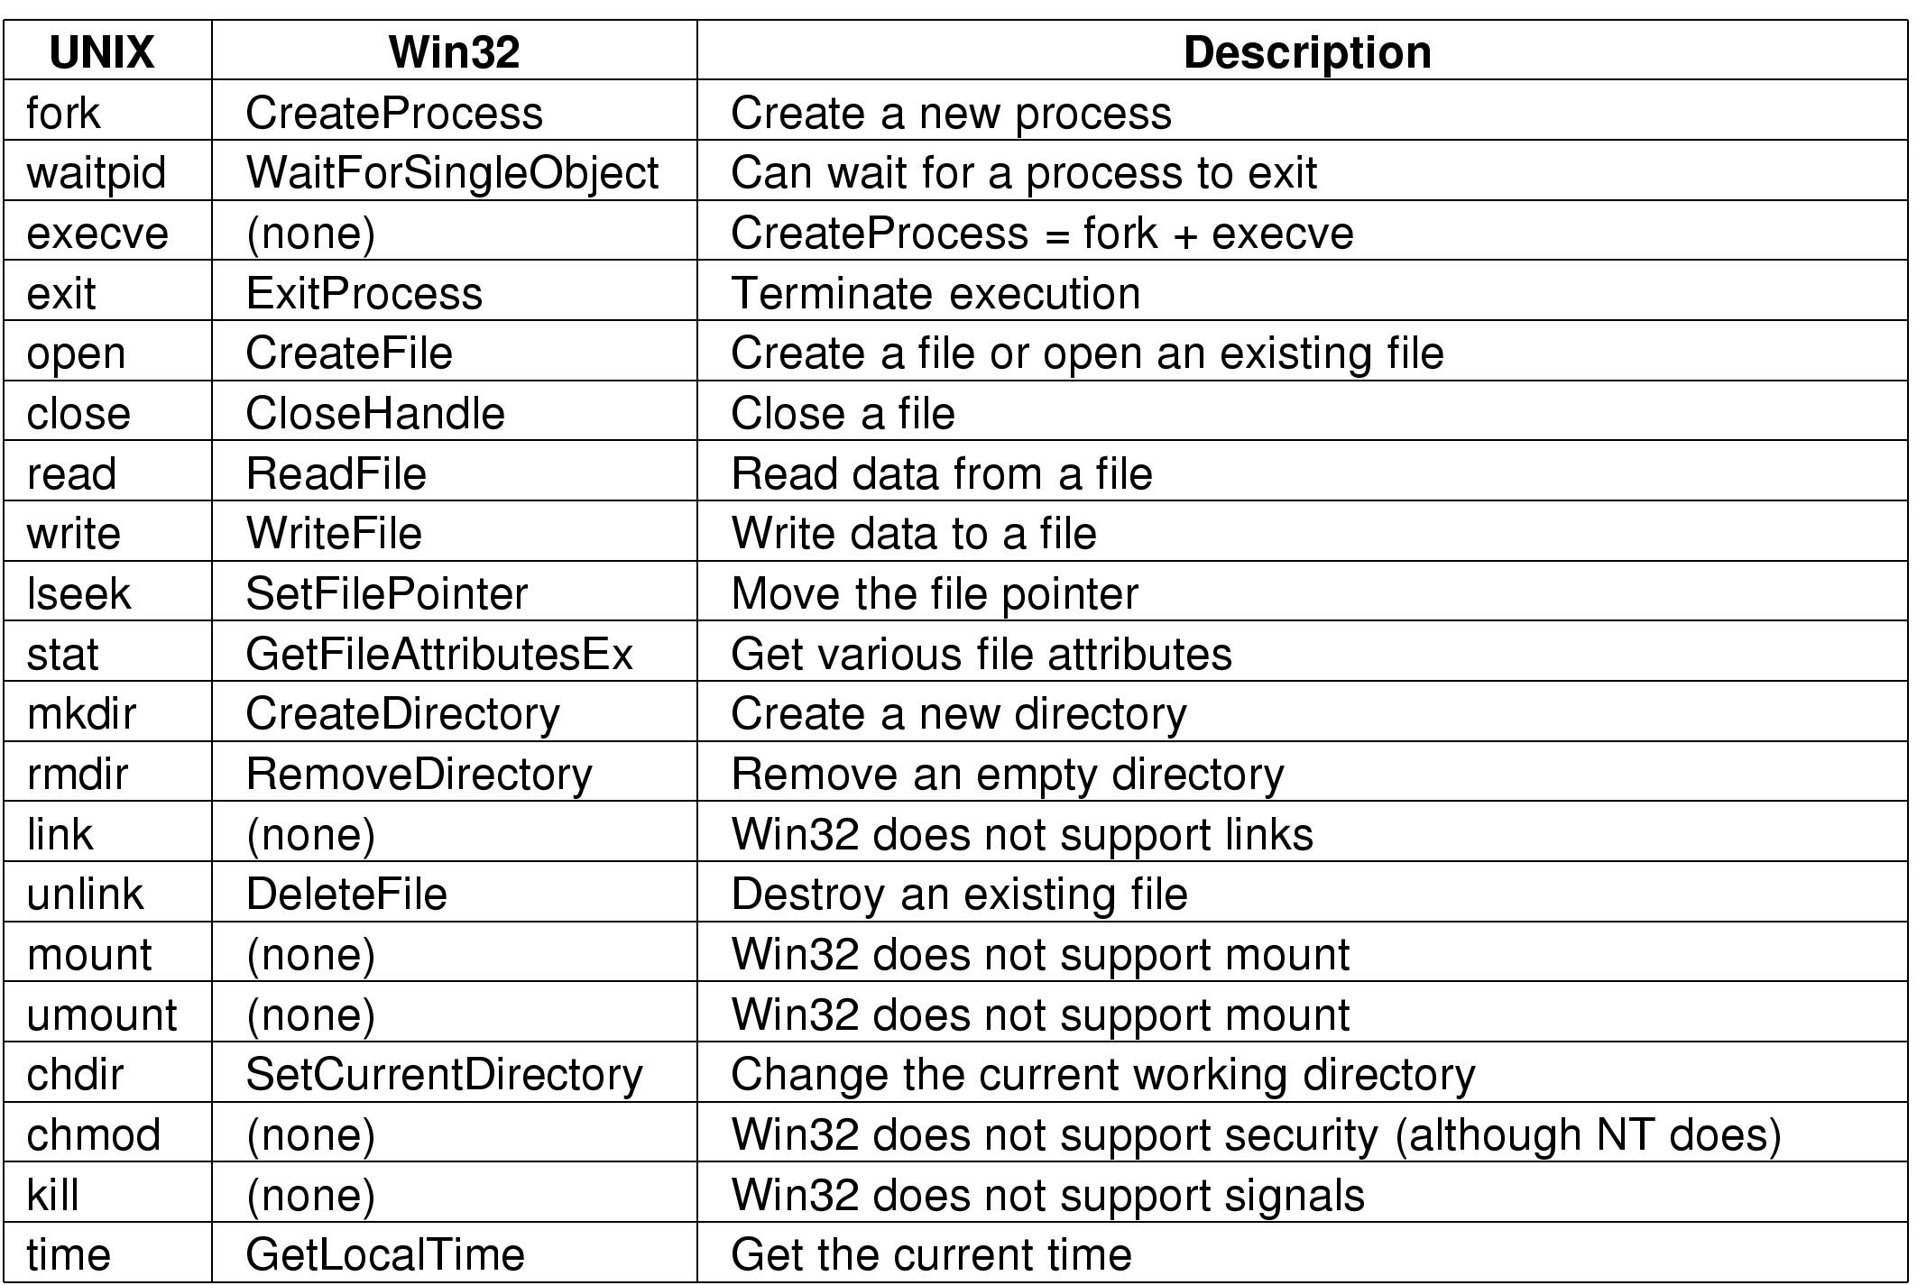
System Calls (5)
Some Win32 API calls

Slide 34
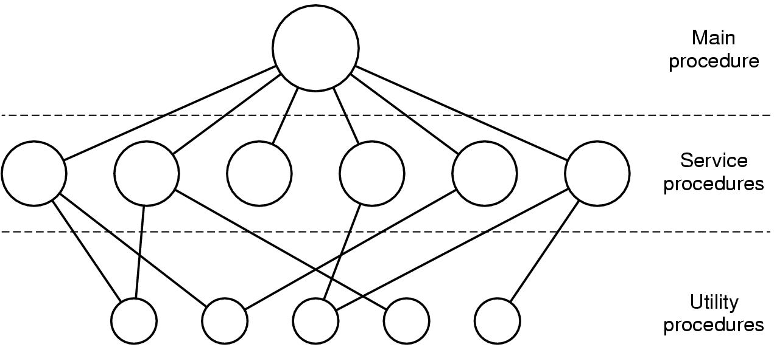
Operating System Structure (1)
אוסף של פרוצדורות שכל אחת יכולה לקרא לשנייה. אין הסתרת מידע אין מבנים. קשה לעדכן, קשה לבזר, תלויית מימוש , לא ניידת
Simple structuring model for a monolithic system

Slide 35
Operating Systems Structure
Monolithic systems – basic structure:
A main program that invokes the requested service procedure.
A set of service procedures that carry out the system calls.
A set of utility procedures that help the service procedures.
Tanenbaum, Modern Operating Systems 3 e, (c) 2008 Prentice-Hall, Inc. All rights reserved. 0-13-6006639

Slide 36
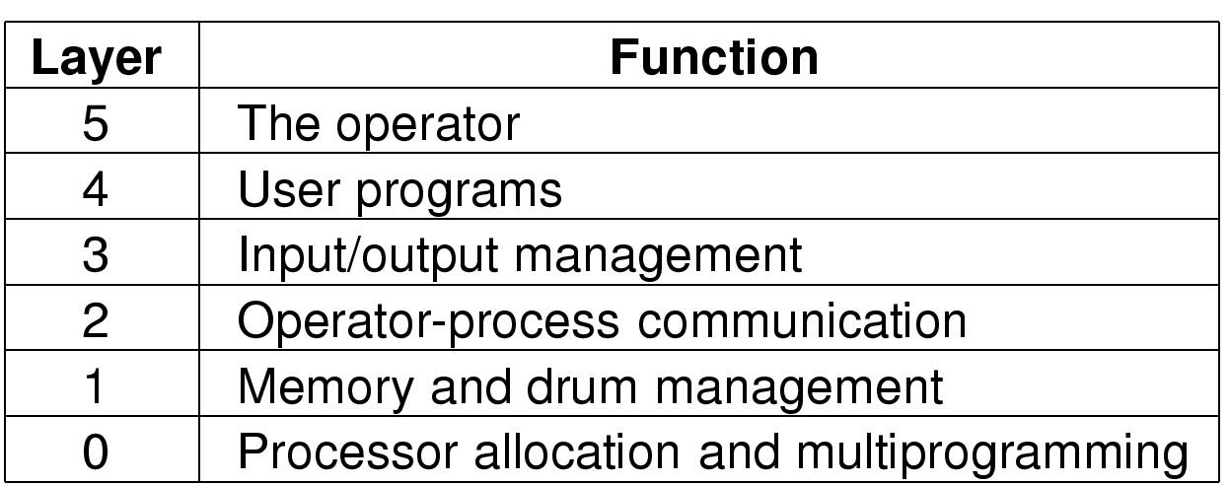
Operating System Structure (2)
שכבות/טבעות , יש מספר רמות הרשאה
Structure of the THE operating system

Slide 37
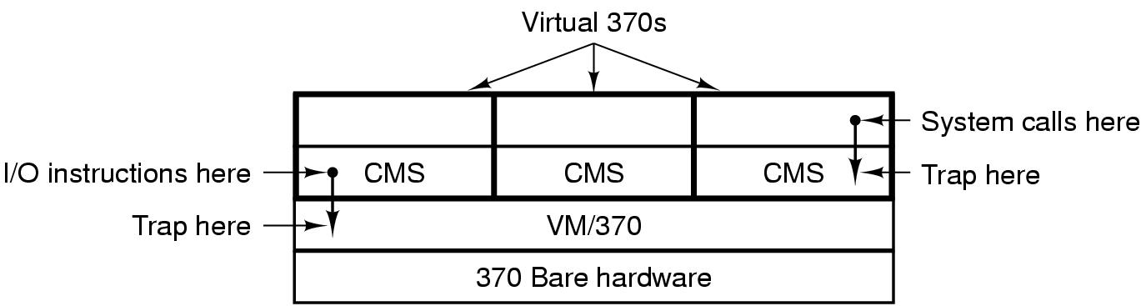
Operating System Structure (3)
כאילו משכפלת את החומרה
Structure of VM/370 with CMS

Slide 38
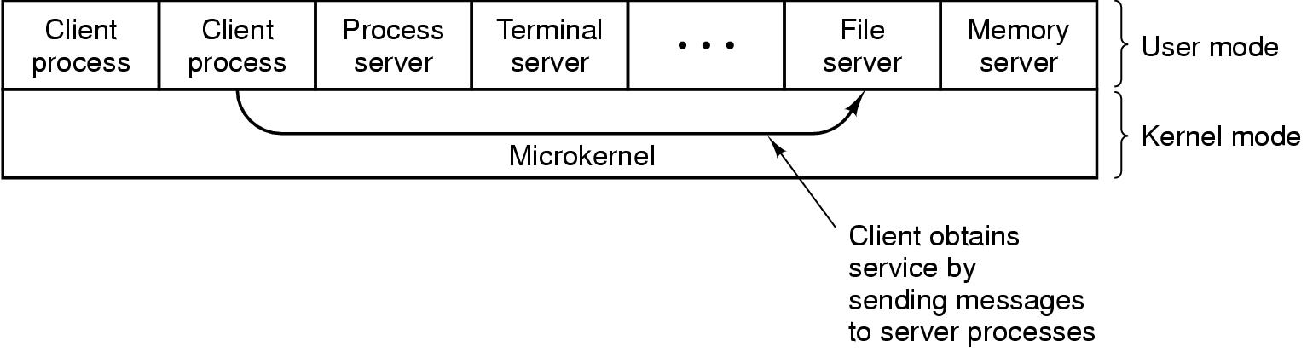
Operating System Structure (4)
גרעין מינאלי
קל לבזר, לעדכן , להרחיב.
The client-server model

Slide 39
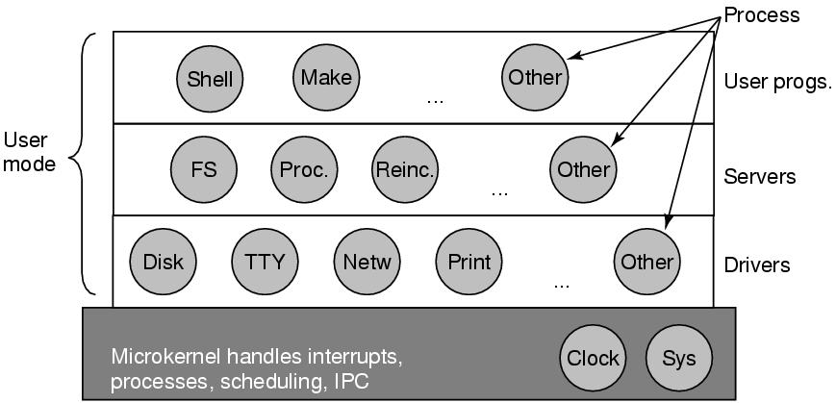
Microkernels
Figure 1-26. Structure of the MINIX 3 system.
Tanenbaum, Modern Operating Systems 3 e, (c) 2008 Prentice-Hall, Inc. All rights reserved. 0-13-6006639

Slide 40
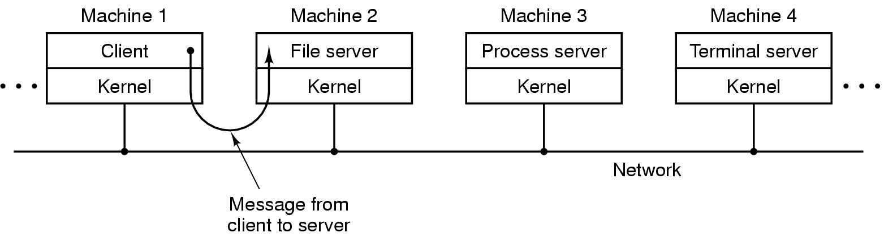
Operating System Structure (5)
ממוקם במרחק פיזי שונה. הפרדה בין השירותים השונים
The client-server model in a distributed system

Slide 41
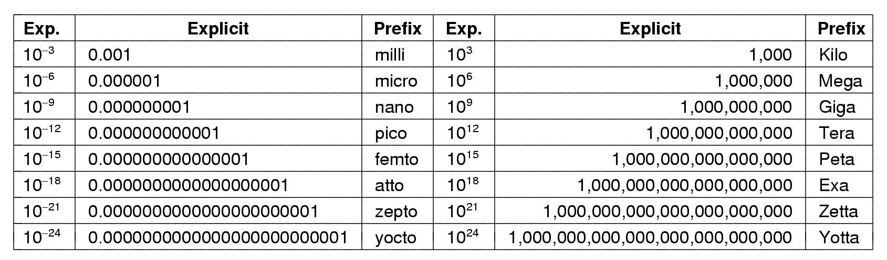
Metric Units
The metric prefixes

