Slide 1
Wixer ?
To be continued
Project Definition
Team members: Gilad Bergmann Shmuel Elkis and Tal Mashiah

Slide 2
HIGH LIGHTS
Product Name: wixer?
Product Short Description: build your dream website using the newest technologies while keeping it simple.
Users: guests, users, Admin users
Key features: build/create a website , edit/view your website
Guest mode: Guest can create a website. Need to login in order to save the website.
Admin:

Slide 3
Main Pages
Home Page:
Header – link to examples , templates, my sites ( dashboard (logged in users, sign in).
Each section has a background, short explanation
And a link (get started -→ dashboard) and
FAQ.
header
Main section :
Few sections – smaller ones
Section – stunning templates
footer

Slide 4
Dashboard / Templates
UserSites : management of all user websites, (if there are no websites present “ start your first website” (link to templates).
dashboard
Templates
UserSites
Filter
Button (to templates )
TemplateList
graphs nice to have
Template: includes a filter , and a list of website templates.
On hover display edit/view buttons.

Slide 5
Template details/edit
אולי לעשות באותו עמוד ולא שני עמודים.
Includes 2 cmps
Edit page
details page
EditSite
ViewSite
EditSite: enables user to create a website chosen by user.
ViewSite: enables a user to view a chosen template.

Slide 6
AUTH
Form of credentials
And another div of
Links (facebook .. Etc)
Sign in / sign up
div

Slide 7
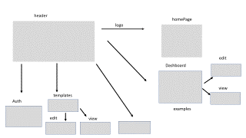
Main Flows
HomePage
Dashboard
Template edit

Slide 8
header
homePage
logo
edit
Dashboard
view
templates
Auth
examples
edit
view

