Slide 1
Momentum Across Regimes
A regime-conditioned cross-sectional momentum model
call with Gadi 29.5

Slide 2
innovation in methodology — model flexibility and accuracy
• legacy top 10% momentum, adjusting horizon weight or exposure according to market conditions
• ability to select any momentum level — maybe best to select the ones that crashed the hardest?
• simple probability indicator (market drawdown level)
• smart regime probability indicator (based on HMM)

Slide 3
innovation in methodology — model flexibility and accuracy
• legacy top 10% momentum, adjusting horizon weight or exposure according to market conditions
• ability to select any momentum level — maybe best to select the ones that crashed the hardest?
• simple probability indicator (market drawdown level)
• smart regime probability indicator (based on HMM)

Slide 4
innovation in methodology — model flexibility and accuracy
• legacy top 10% momentum, adjusting horizon weight or exposure according to market conditions
• ability to select any momentum level — maybe best to select the ones that crashed the hardest?
• simple probability indicator (market drawdown level)
• smart regime probability indicator (based on HMM)

Slide 5
innovation in methodology — model flexibility and accuracy
• legacy top 10% momentum, adjusting horizon weight or exposure according to market conditions
• ability to select any momentum level — maybe best to select the ones that crashed the hardest?
• simple probability indicator (market drawdown level)
• smart regime probability indicator (based on HMM)

Slide 6
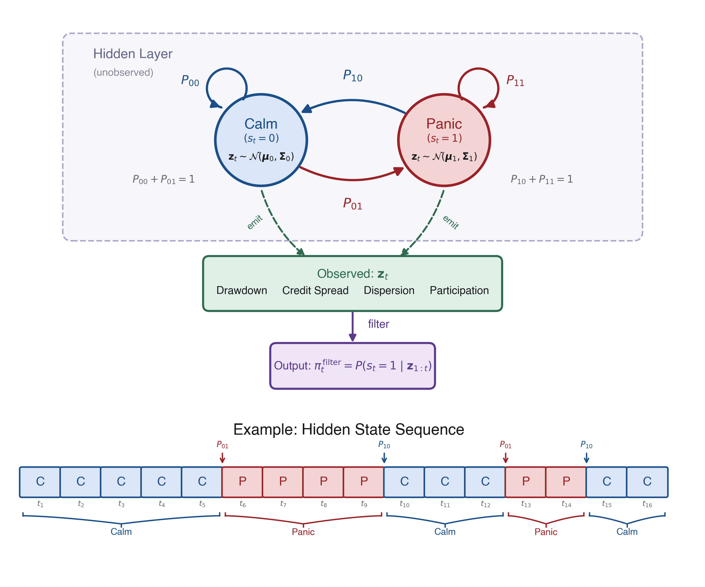
methodology
HMM regime classifier + 12-month return horizons per stock → XGBoost ensemble → long–short portfolio

Slide 7
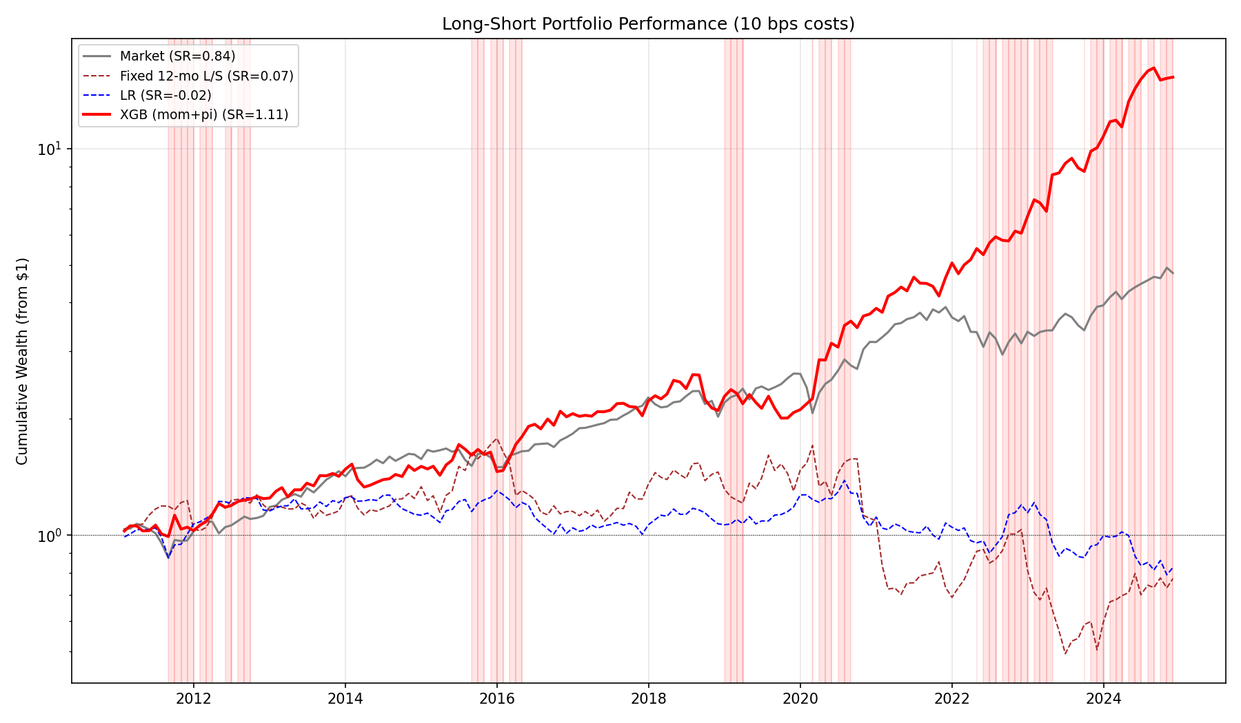
main results — performance
XGB (mom + π) Sharpe 1.11 | FF6 α 24.7% (t = 4.78) | final $15.7 from $1 (2011–2025)

Slide 8
regime conditioning is the alpha
the model earns its keep where legacy momentum dies
Sharpe | Full | Calm (n=108) | Panic (n=59)
Market | 0.84 | 0.64 | 1.13
Fixed 12-mo momentum | 0.06 | 0.08 | 0.05
LR (linear baseline) | -0.03 | -0.30 | 0.35
XGB (mom + π) | 1.11 | 0.82 | 1.56
Panic Sharpe (1.56) ≈ 2× Calm Sharpe (0.82). The conditioning is doing the work.

Slide 9
main results
• in calm, invest in the stock with good momentum in most horizons
• in panic, invest in stocks that have underperformed (buying the dip)
• the risk here is sustained crash if there is no short rebound
panic decomposes:
Sub-type | Months | Ann Ret | Sharpe
Calm | 108 | 13.8% | 0.82
Panic — Crash (mkt down) | 18 | -7.2% | -0.33
Panic — Recovery (mkt up) | 41 | +64.4% | 2.35
panic Sharpe is driven entirely by recovery months

Slide 10
open questions for Gadi
• how to hedge the sustained-crash tail — short rebound never arrives?
• which momentum level to pick in panic — the worst crashers, or something risk-adjusted?
• is the HMM regime probability stable enough to trade on at month boundaries?
• international replication (UK / JP panels) — does the regime signal port?

