Slide 1


Slide 2
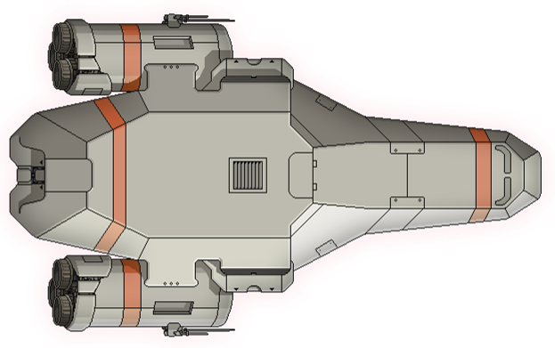
WEAPON 3
WEAPON 1
WEAPON 2
WEAPON 4

Slide 3




Slide 4
(HOVER)
CHEAT
SHEET

Slide 5


Slide 6

Piloting
Combat
Engines
Repair
Shields
Weapons

Slide 7

WEAPONS
COMBAT
SHIELDS
ENGINES
REPAIR
PILOTING

Slide 8

BERKO
ALISON
ELNUBNUB
LIAM
DECLAN
BETH

