Slide 1
Monitoring traffic TCP / UDP in an Environment Ryu, OpenFlow and Mininet
Gil Andriani
04/24/2019
Notes:
Martin’s role
Past is prologue
This talk is about the future, but we should first learn from the past
1

Slide 2
Objective?
Use and understood Ryu and apps Simple_Switch and Simple_monitoring on openflow version 1.3, build my own app;
Recognize and summarize TCP and UDP app/service traffic;
Build develop SDN environment;

Slide 3
SDN - Software Defined Network
Specifies behavior
Control Program
Abstract Network Model
Compiles to topology
Network Virtualization
Global Network View
Transmits to switches
Network OS

Slide 4
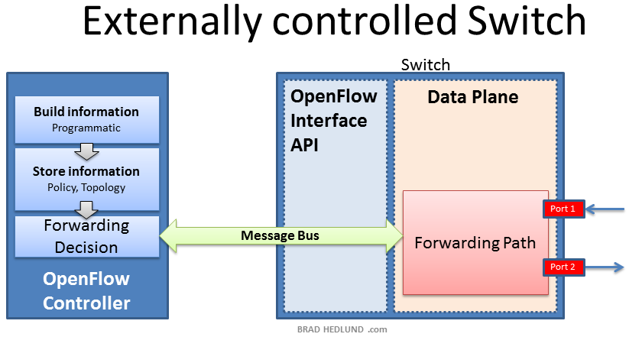
Software Defined Network

Slide 5
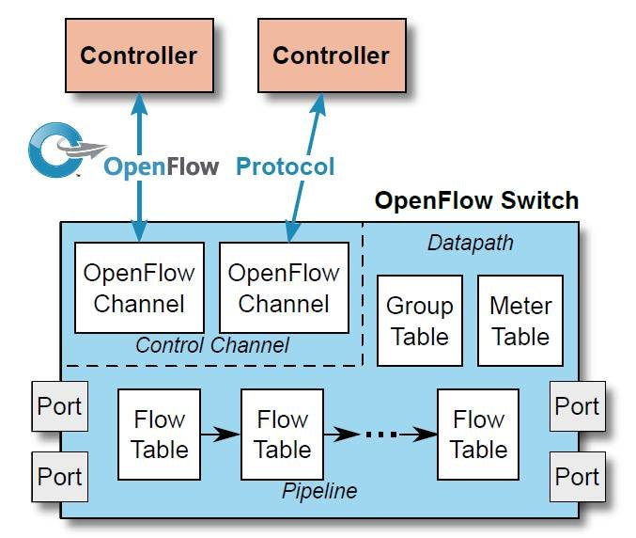
OpenFlow Switch

Slide 6
Ryu Simple_Switch
Ryu Controller
EventOFPSwitchFeatures
Add_flow
EventOFPPacketIn
Switch
Switch Table Flow

Slide 7
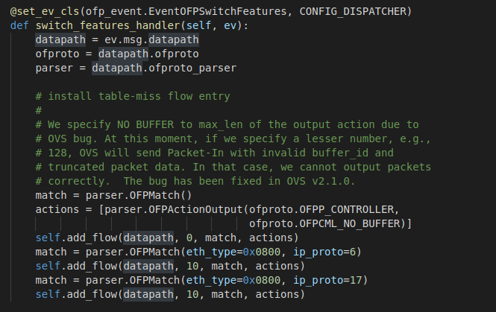
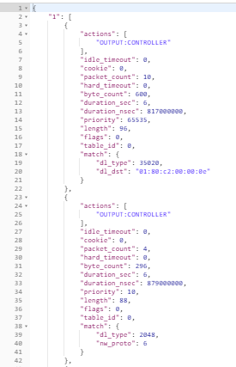
Ryu Simple_Switch
EventOFPSwitchFeatures

Slide 8
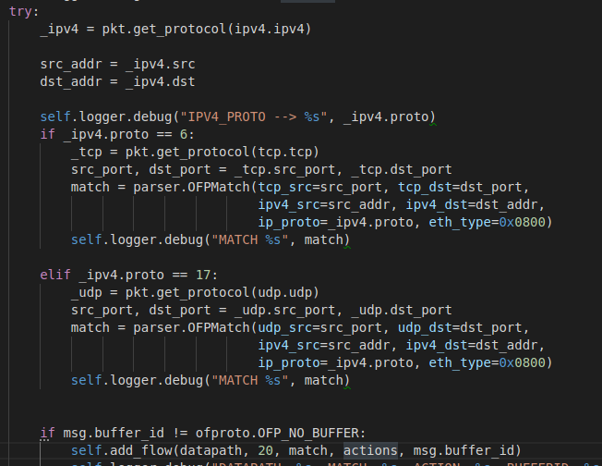
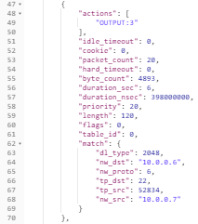
Ryu Simple_Switch
EventOFPPacketIn (TCP/UDP)

Slide 9
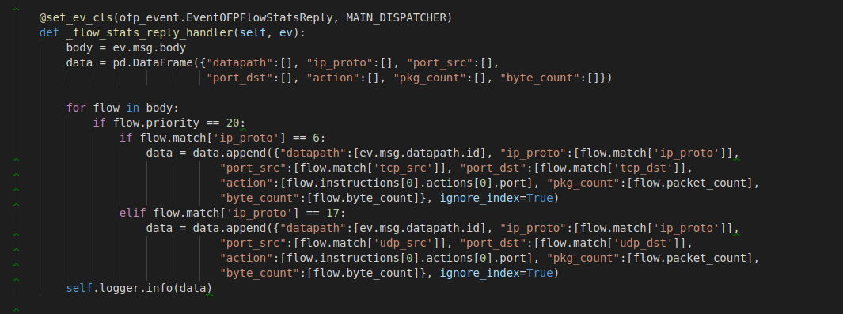
Ryu Simple_monitor
Switch
Ryu Controller
Summarize
Switch Table Flow

Slide 10
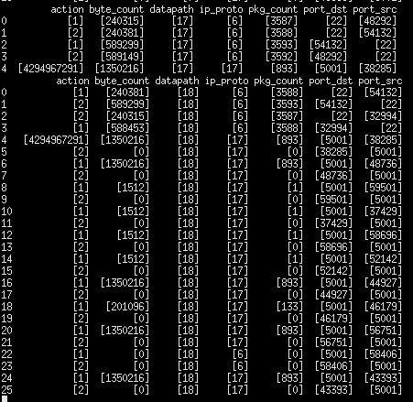
Ryu Simple_monitor

Slide 11
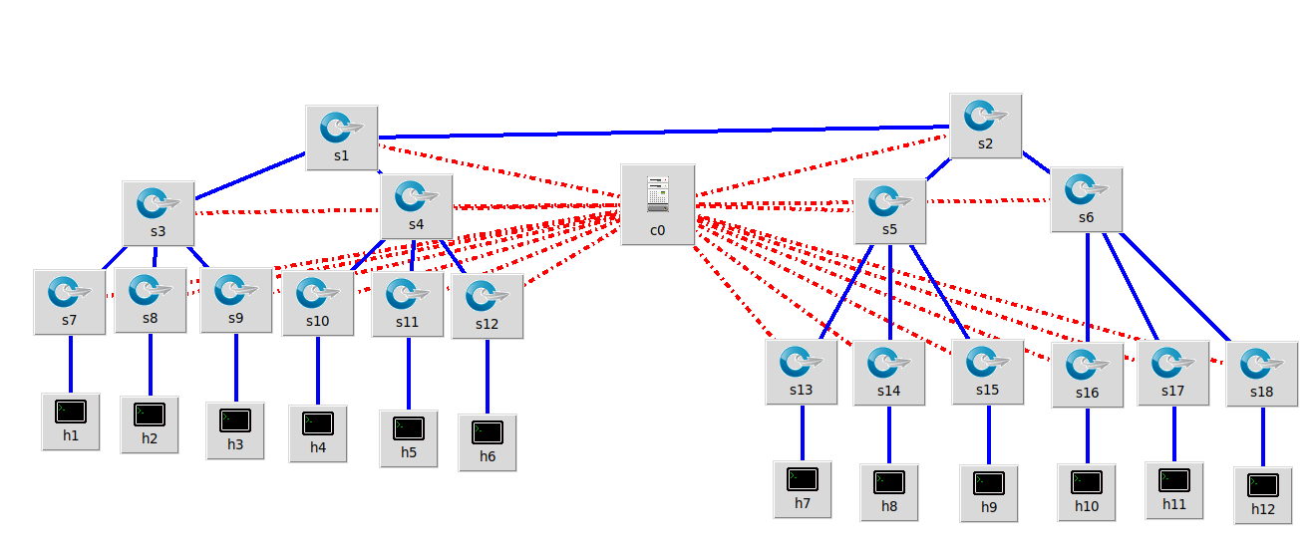
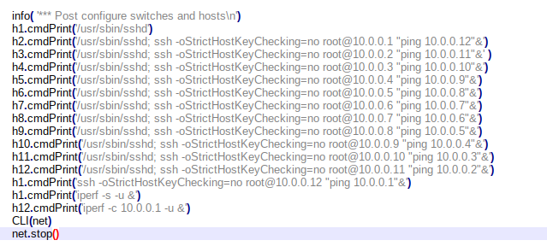
MiniNet – Topology

Slide 12
My Enviroment
Windows 10 – Build 16299
Dropbox 6.02
Linux Distribution --> Ubuntu Desktop 18.04.2 LTS, with GNOME 3.28.2:
(usuário: labnet | pass: labnet2019)
Open Virtual Switch - ovs --> v2.9.4 - 20/02/2019;
Mininet --> 2.3.0d5
Ryu --> 4.9
Postman with Inside OpenFlow
Visual Studio Code
Nodepad++
Python pandas, etc....
Avaliable: https://1drv.ms/f/s!ArP-f8cb4RnyidgtUZd03syyEqGsEA

