Slide 1
Increasing annual members through strategic partnership
Gilang Wahyu Basyari

Slide 2
Outline
Cyclistic Profile
Benefits of increasing annual memberships
Differences between annual and casual members
Ride characteristics
Weekday rides
Weekend rides
Conclusion
Marketing strategy
Potential strategic partners

Slide 3
Cyclistic Profile
Bike sharing company based on Chicago.
5800 bikes across 600 stations.
Two types of riders:
Casual (One-time and daily).
Member (Annual membership).
Offers wide selection of bikes and prices.
Trying to pivot its strategy to annual members focused.

Slide 4
Benefits of increasing annual memberships
Financial report shows annual memberships gives more profits
Better long-term business plan
Therefore, increasing annual members should be given priority to gaining new members

Slide 5
Differences between annual and casual members

Slide 6
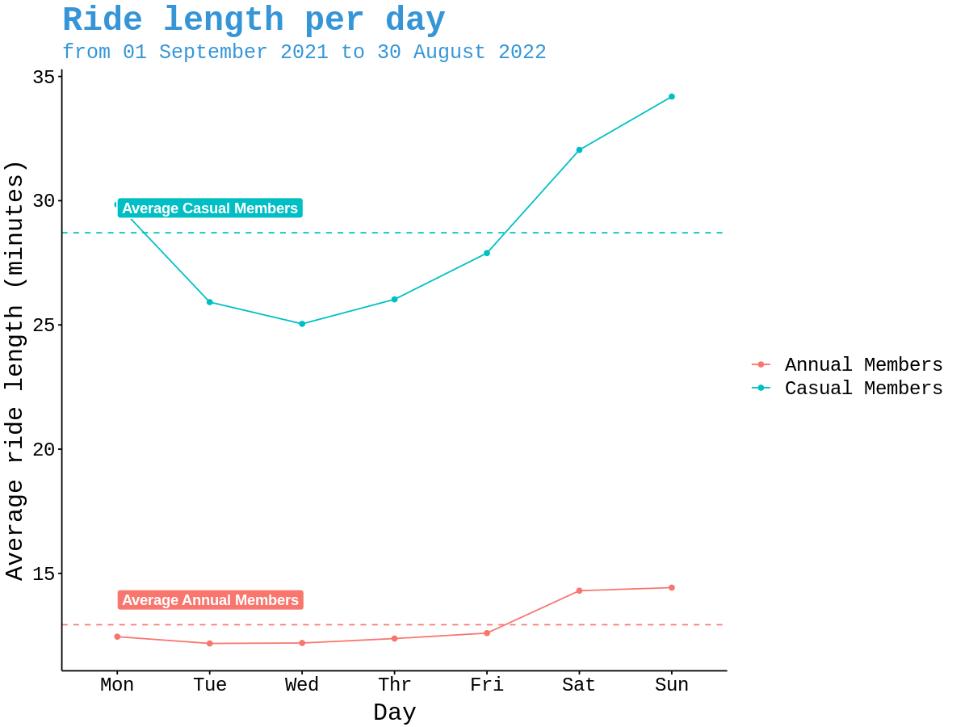
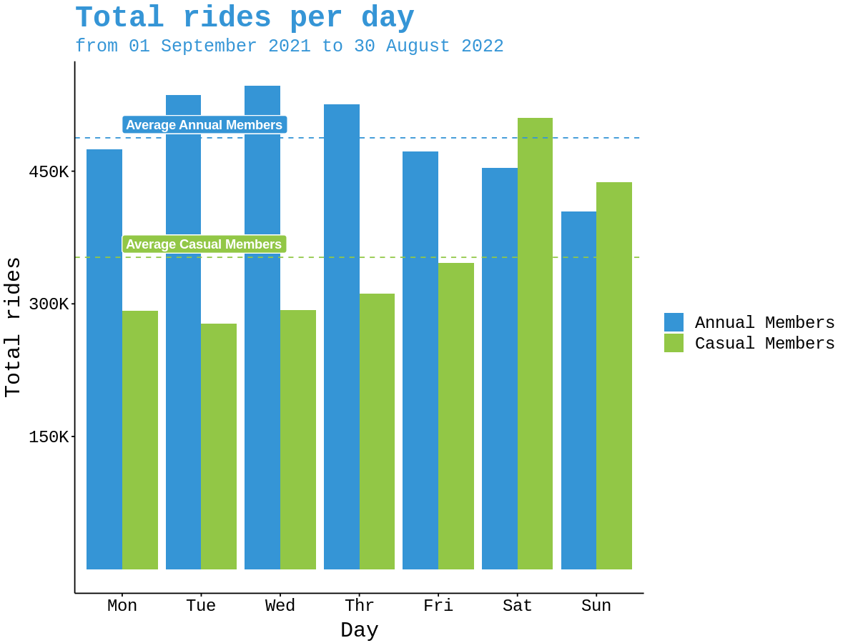
Ride characteristics

Slide 7
Ride characteristics
Annual members tends to takes shorter rides then casual members
Annual members do takes more number of rides
This suggest Annual members usage are more organized, only for particular purpose, such as commuting.
In the weekend, there are more casual rides, suggesting that casual members uses bikes for leisure.

Slide 8
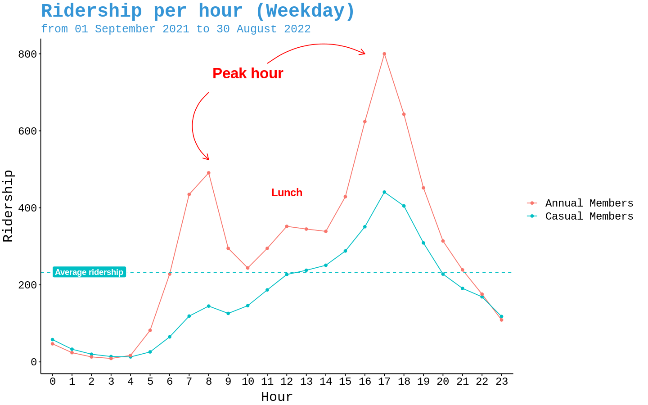
Weekday rides
There are 2 peak hours, morning and evening commute.
A small increase also happens in lunch hour.
The rides characteristics consistent across membership type.
Annual members uses Cyclistic for commute significantly more.

Slide 9
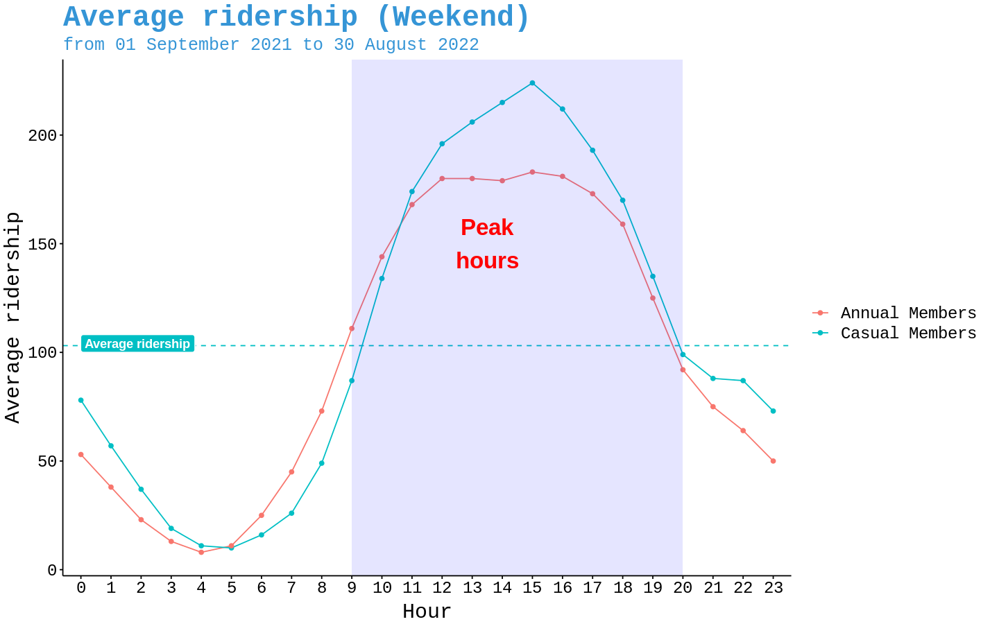
Weekend rides
Weekend peak hours (above average ridership) occurs between 09-20 hrs.
This suggest on weekend the bikes are being used for casual activities.
Crucially there aren’t many joggers and late night riders.

Slide 10
Conclusion
Riders tends to use the bikes for commuting.
Annual members have a more organized renting schedule.
In weekend bikes is used to do leisure activities.

Slide 11
Marketing strategy
Entice more commuter to be annual members by offering discount to other transport method as membership benefit.
Offers discount at popular cafes and restaurant is also promising since ridership also rises during lunch time in weekday.
Partnering with daytime weekend leisure establishment with collaboration programs or discount.

Slide 12
Potential strategic partners
Public transportation companies.
Cafes and restaurants.
Public Venues.
Daytime entertainment estabishments.

Slide 13
Thank you for your attention
☺

