Slide 1
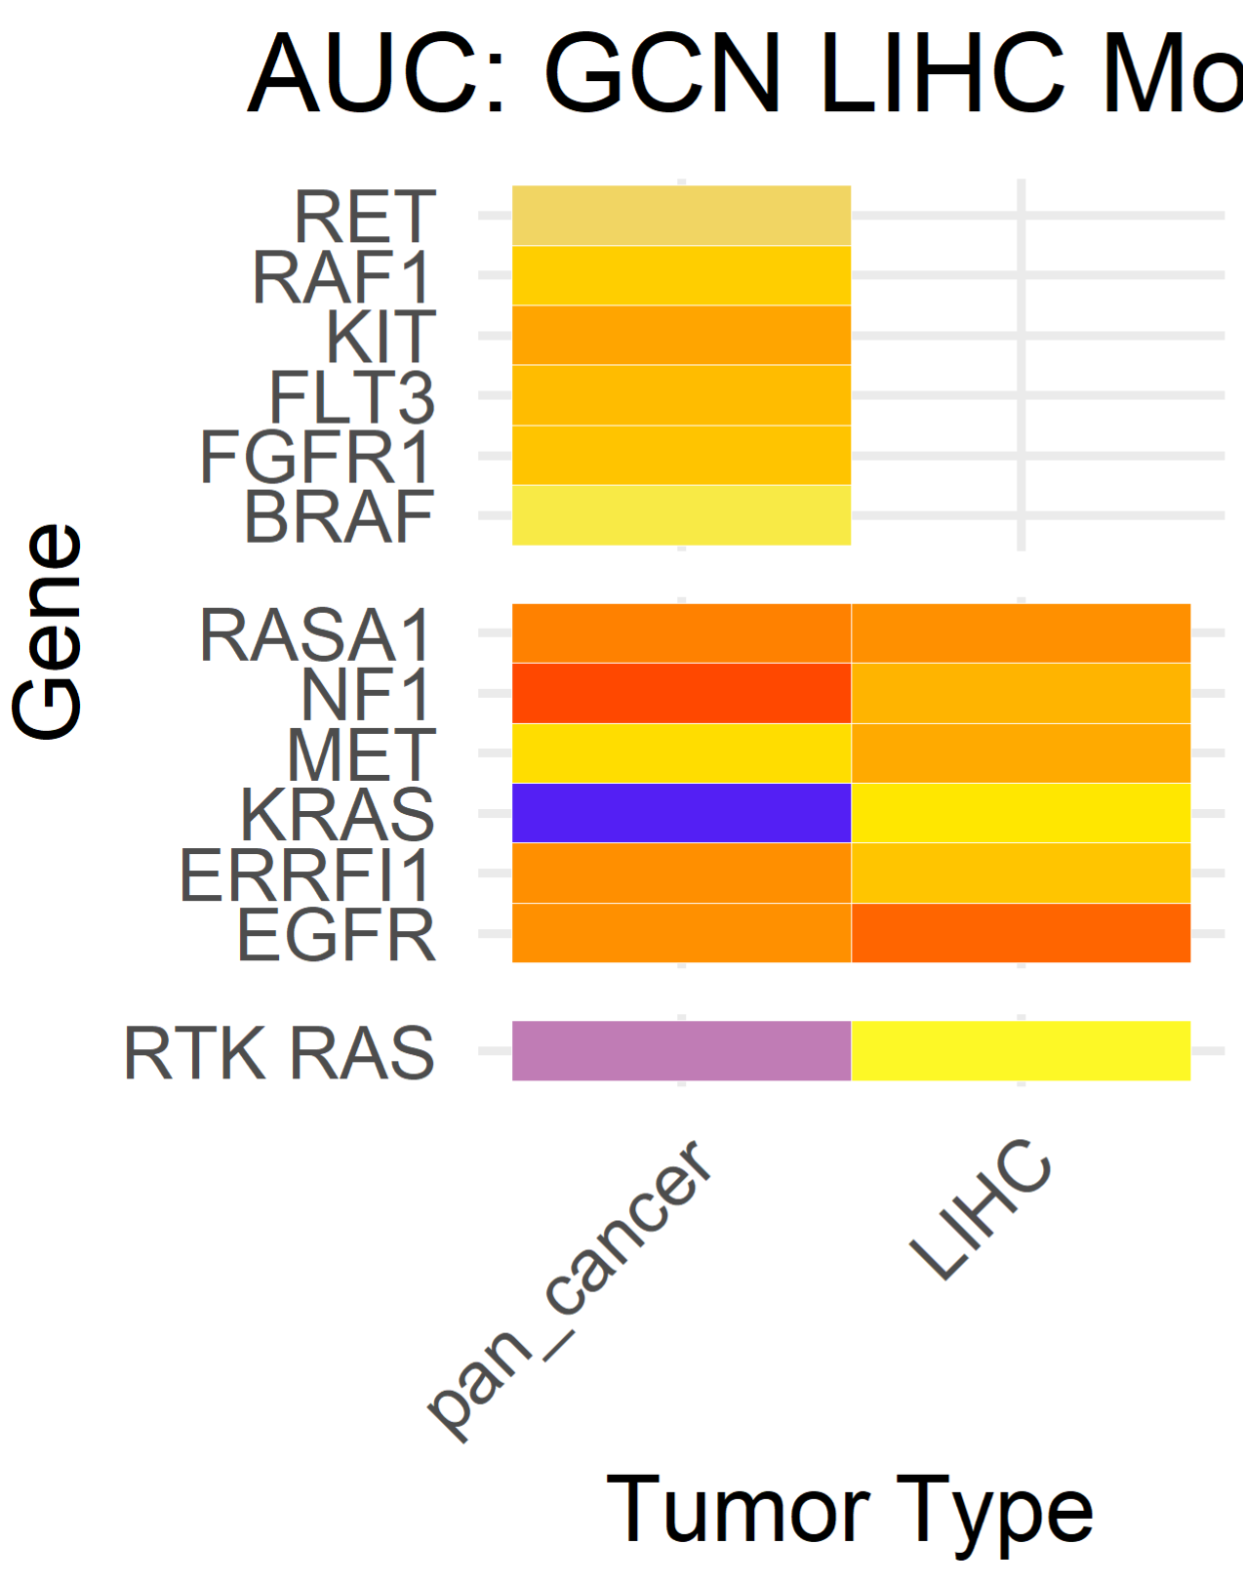
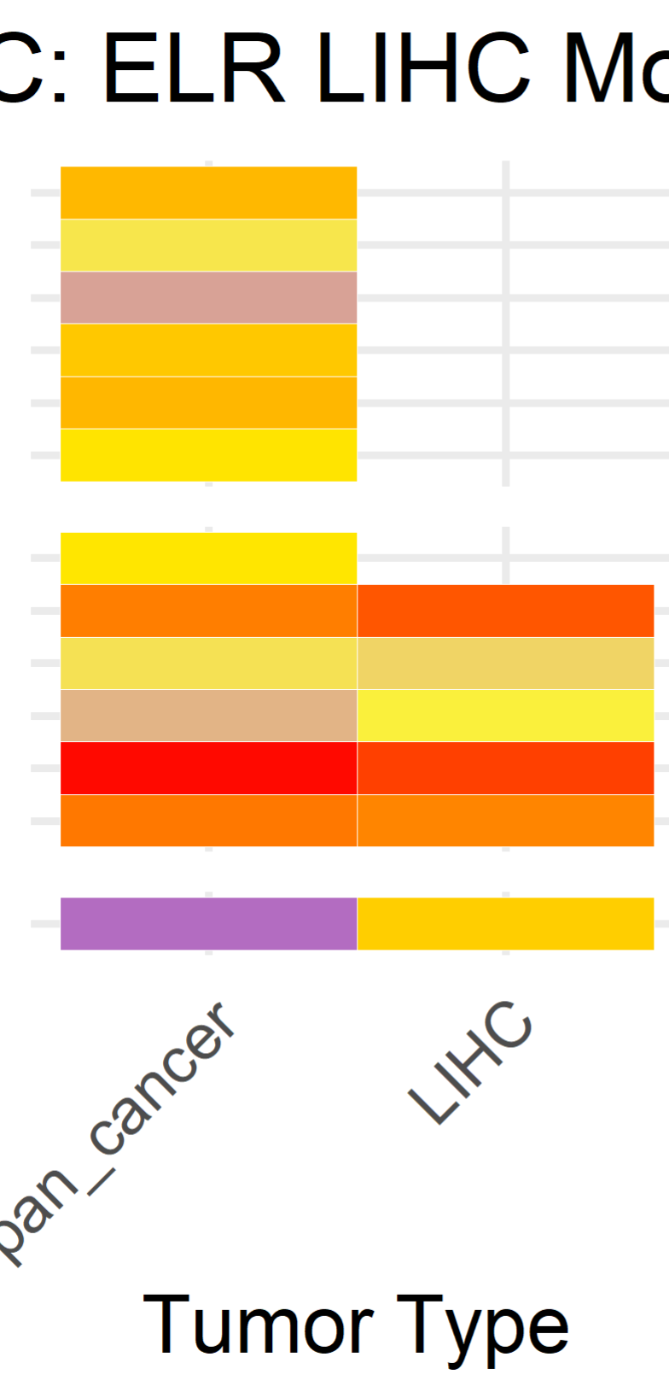
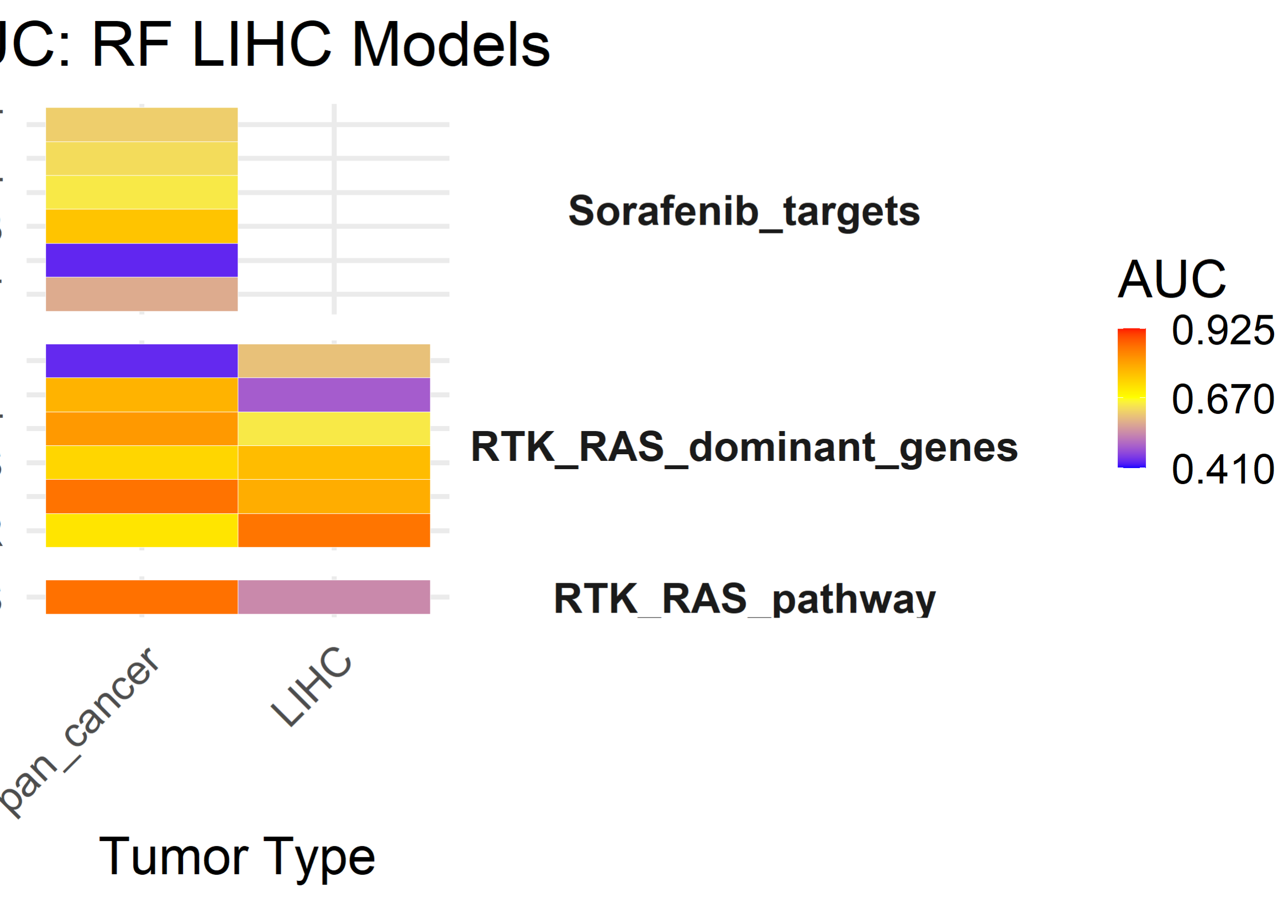
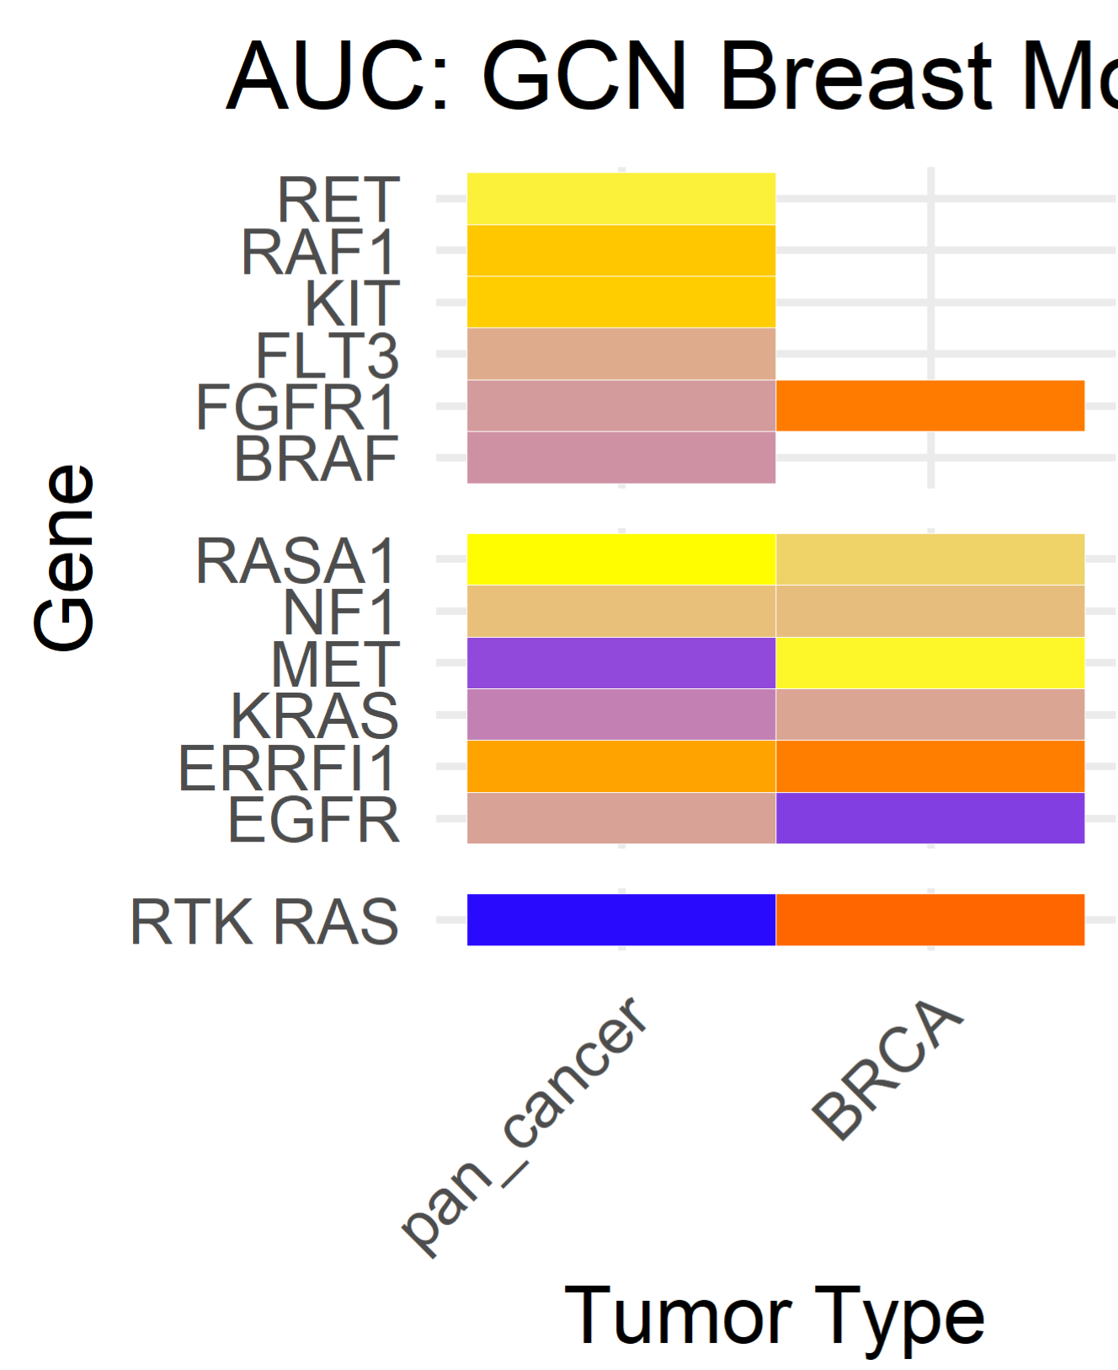
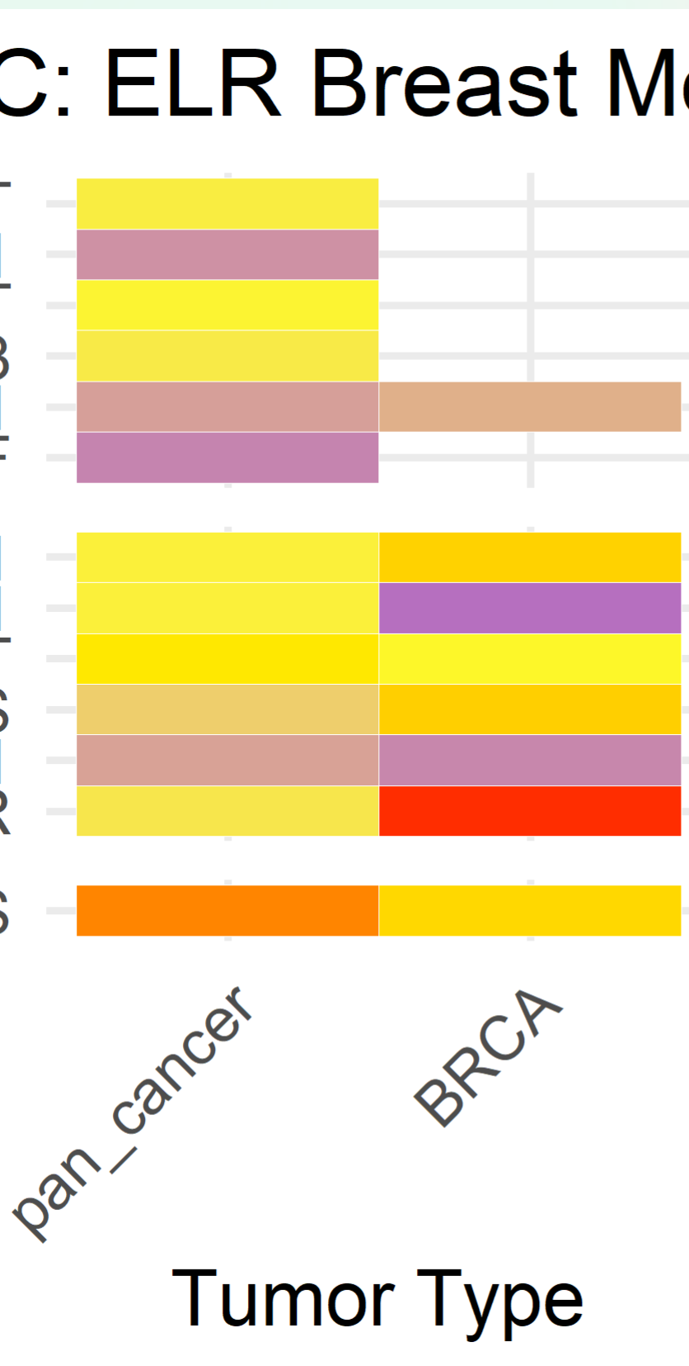
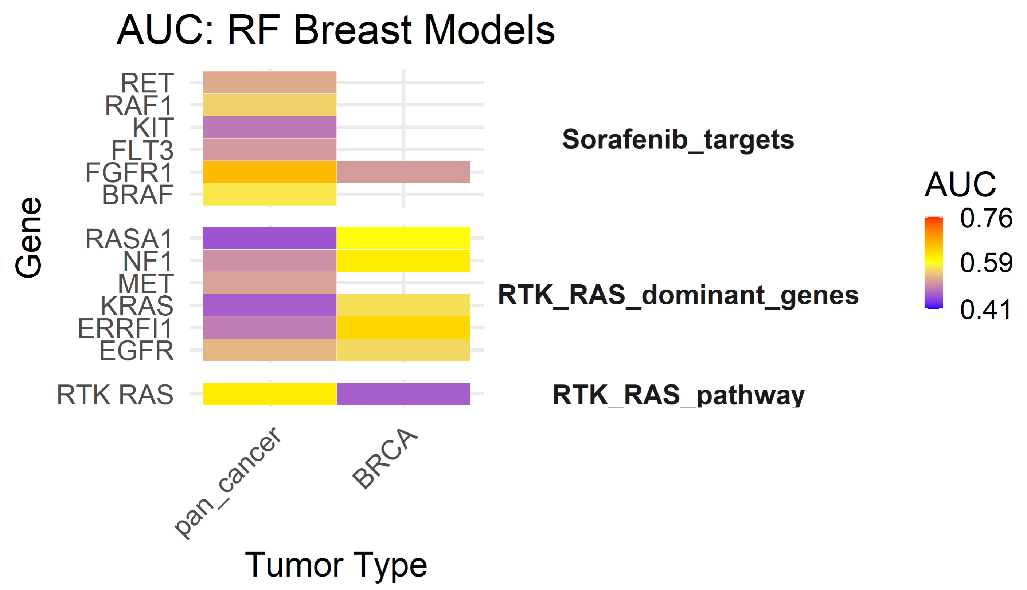

Slide 2
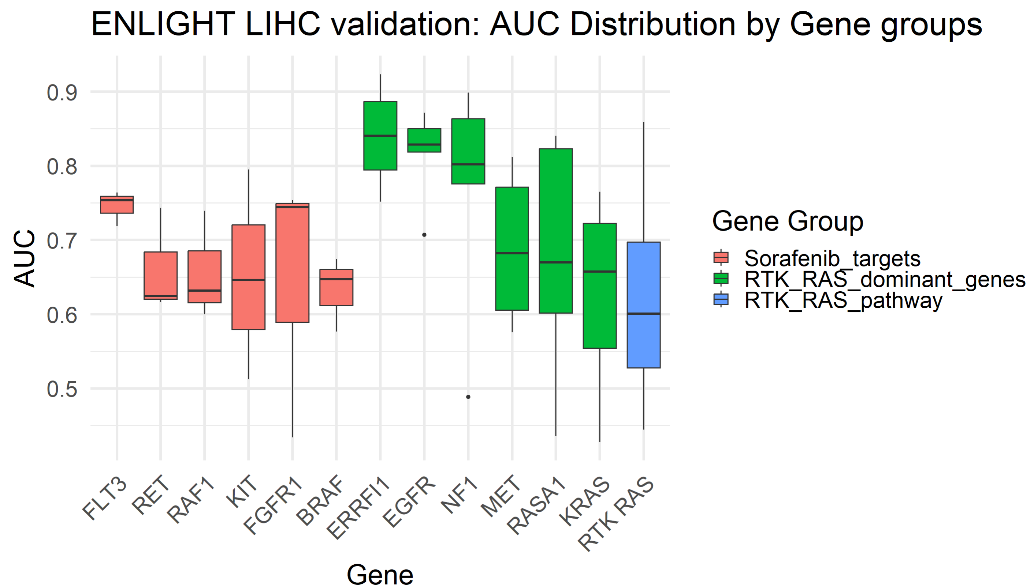
Notes:
LIHC: By different genes / gene groups
6 options per gene (3 models- GCN, ELR, RF; 2 training options- pan / LIHC)
Kruskal Wallis for LIHC:
By gene group: chi-squared = 7.3465, df = 2, p-value = 0.02539
By gene: chi-squared = 23.105, df = 12, p-value = 0.02685
Indistinctive:
Model: chi-squared = 2.1925, df = 2, p-value = 0.3341 tumor type (trained on pan / LIHC): chi-squared = 0.70679, df = 1, p-value = 0.4005

Slide 3
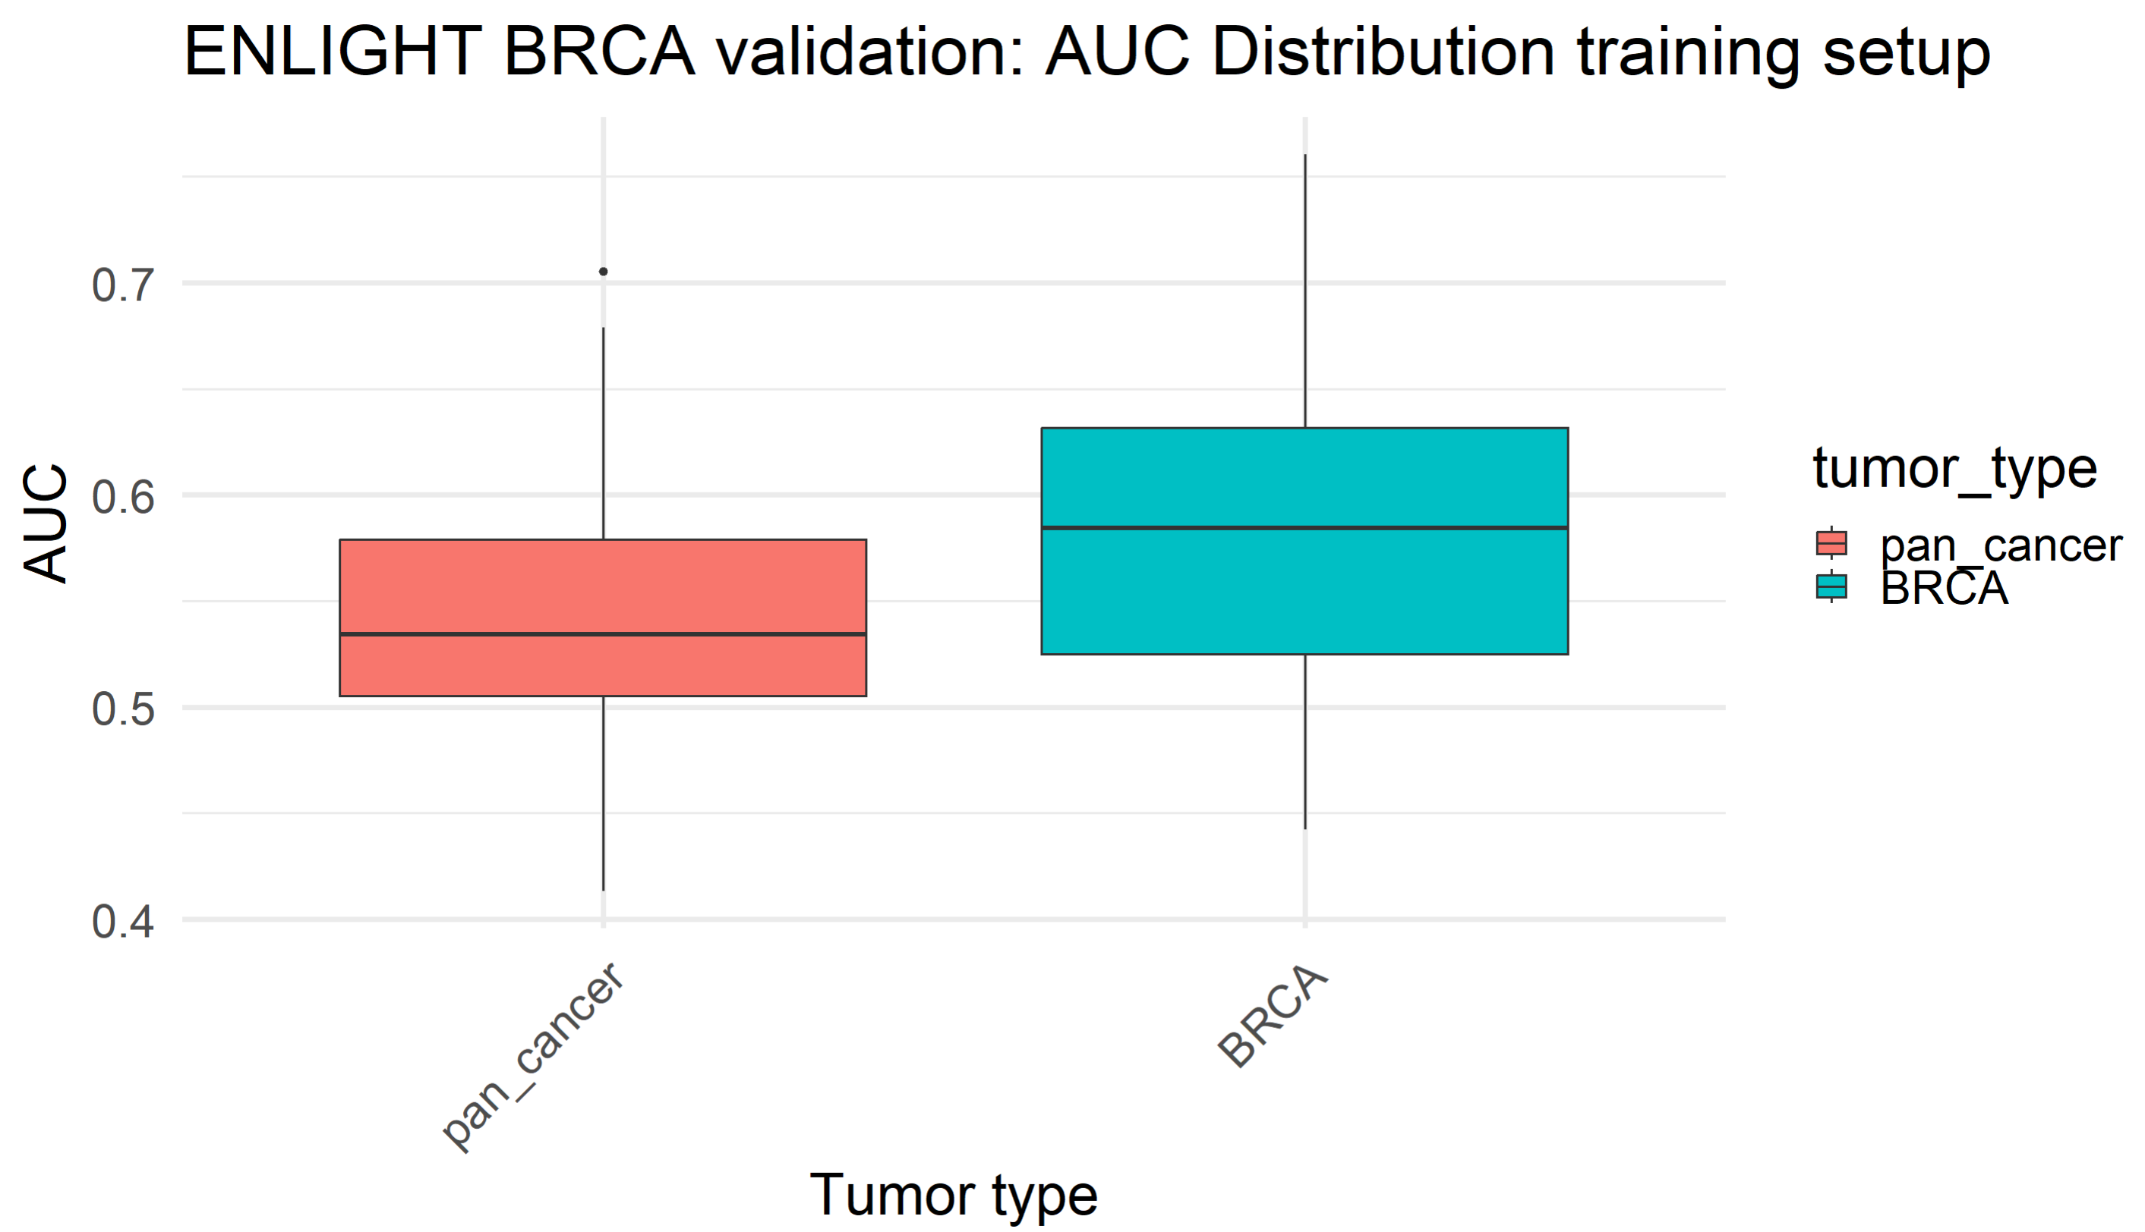
Notes:
Kruskal Wallis for BRCA (almost distinctive):
Tumor type: chi-squared = 3.2142, df = 1, p-value = 0.073
Indistinctive:
Gene inclusion: chi-squared = 0.68848, df = 2, p-value = 0.7088
Gene: chi-squared = 3.8479, df = 12, p-value = 0.986
Model: chi-squared = 2.3632, df = 2, p-value = 0.3068

