Slide 1
Statistical Process Control Approaches for Computer Network Intrusion Detection
Brian Gilbert

Slide 2
Outline
Background
Traditional SPC Methods
Modification of Traditional SPC Methods
Nonparametric Multi-Chart CUSUM

Slide 3
Background
Specifically focus on Denial of Service (DOS) attacks
Use techniques from Statistical Process Control and Change-Point Theory to detect when an attack has occurred
Host-based system vs. Network-based system
Data?

Slide 4
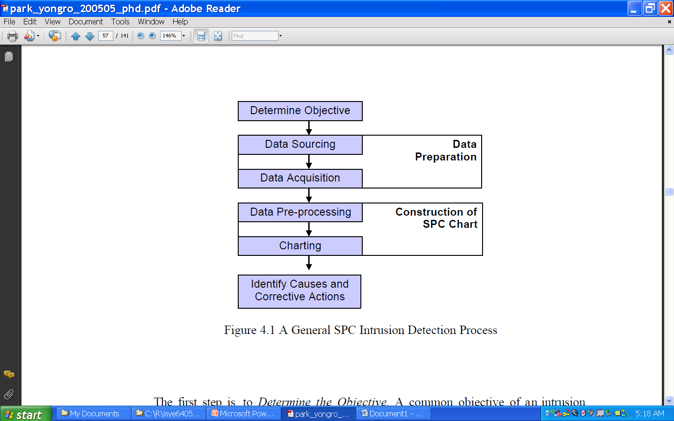
SPC Intrusion Detection Process

Slide 5
Example of a BSM File
file,Thu 01 Jun 2000 09:59:38 PM EDT, + 391003 msec,
header,111,2,execve(2),,Thu 01 Jun 2000 09:59:41 PM EDT, + 220000000 msec
path,/usr/bin/finger
attribute,100555,root,bin,26738688,74333,0
subject,root,root,other,root,other,648,281,0 0 localhost
return,success,0
header,61,2,exit(2),,Thu 01 Jun 2000 09:59:41 PM EDT, + 240000000 msec
subject,root,root,other,root,other,648,281,0 0 localhost
return,success,0
header,79,2,fork(2),,Thu 01 Jun 2000 09:59:57 PM EDT, + 860000000 msec
argument,0,0x289,child PID
subject,root,root,other,root,other,580,281,0 0 localhost
return,success,0
Event type
Event time
Event intensity: how many events occurred in a unit of time
Notes:
Event Intensity is of interest -> only use the time of event
<number>

Slide 6
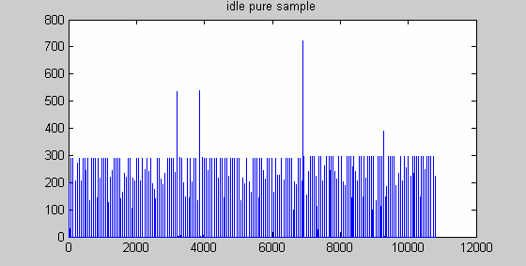
System Idle with no attack

Slide 7
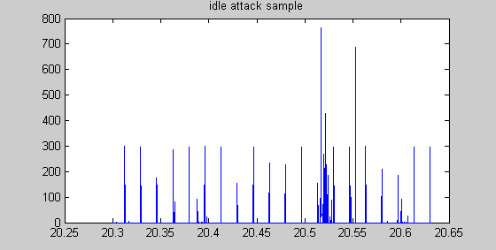
System Idle with attack

Slide 8
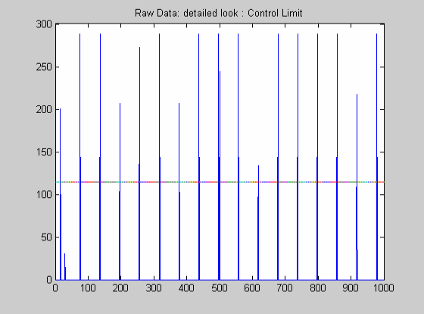
Raw Data shows 60 second cycles: Need to remove the autocorrelation to apply standard SPC methods
Notes:
<number>

Slide 9
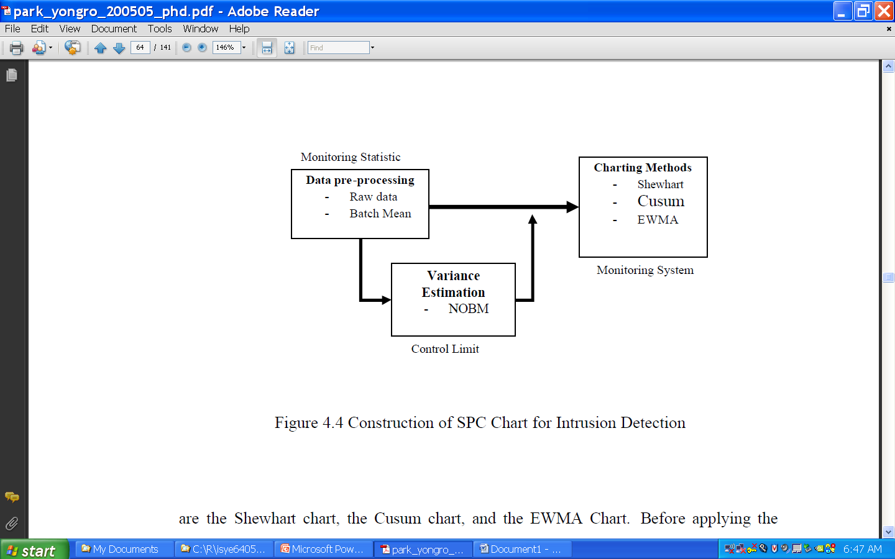
Construction of SPC Chart

Slide 10
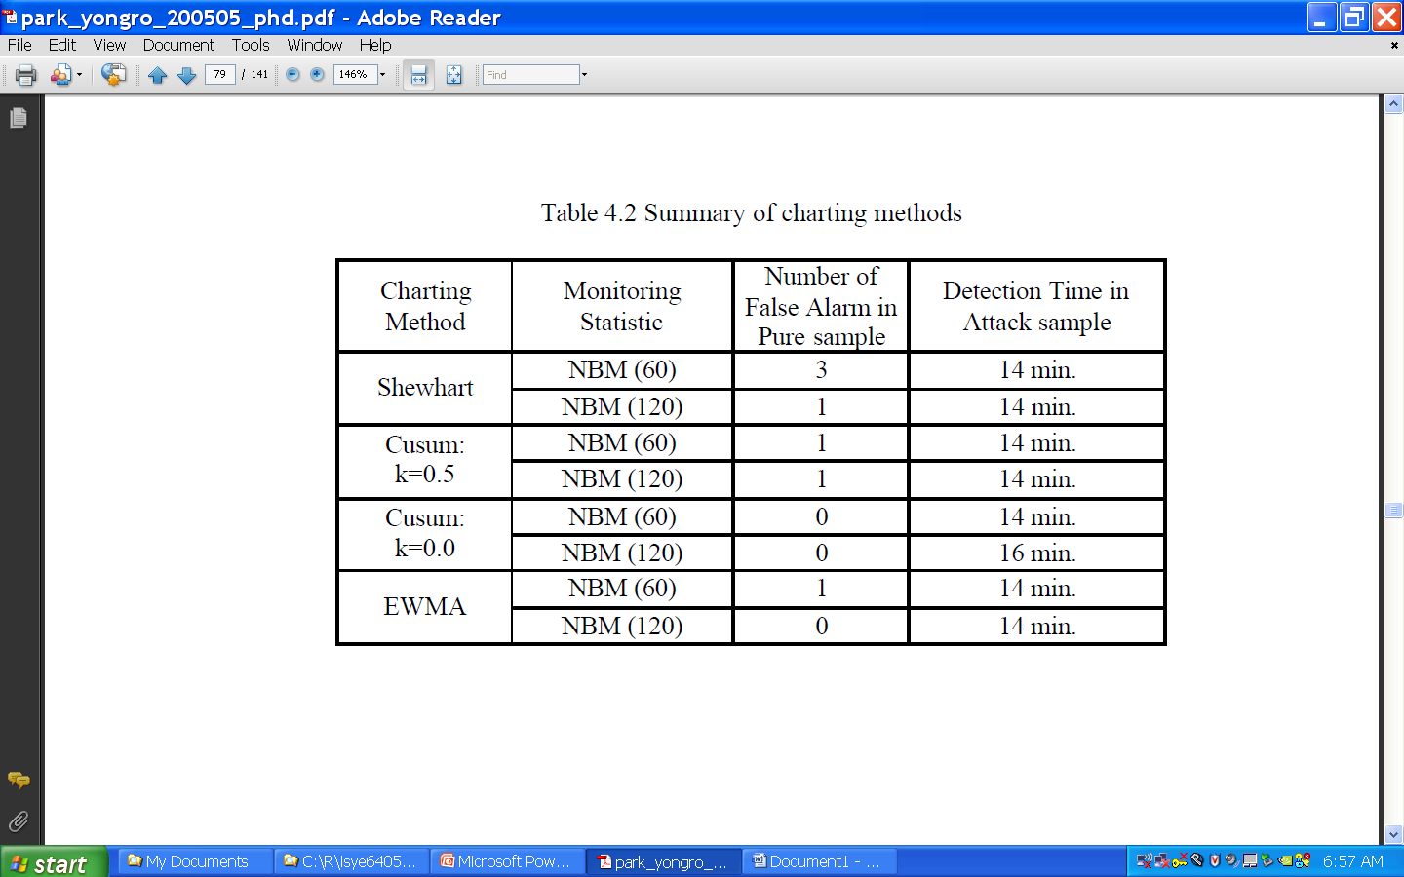
Summary of Charting Methods

Slide 11
Summary of Charting Methods
Number of false alarms decreased as batch size increased
Overall, CUSUM and EWMA had fewer false alarms
All charts detected attack at 14th minute (end of batch) except CUSUM with k=0 and batch=120 (H too large to detect)
Smaller batch size gives better detection time performance
Since 1 and 4 conflict, hard to determine batch size ➔ Modified Batch Mean Method

Slide 12
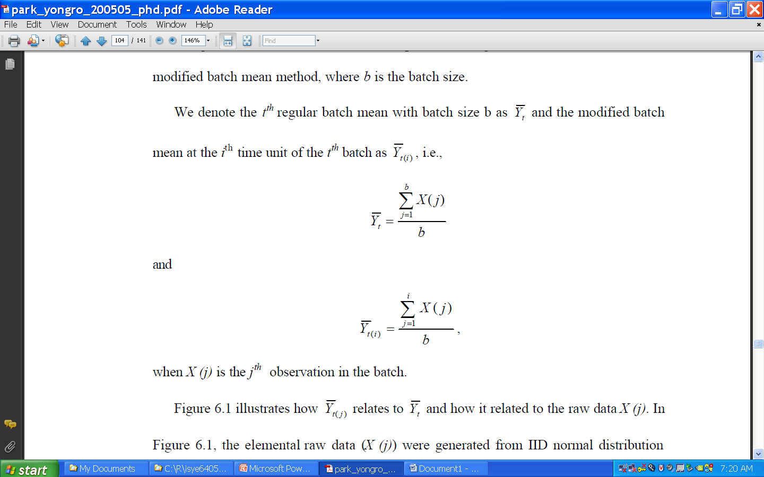
Modified Batch Mean

Slide 13
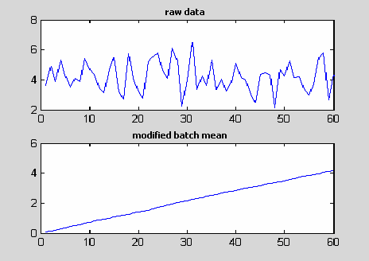
Concept of MBM: N(4,1) data with batch size 60

Slide 14
Modified Batch Mean
MBM=RBM at the end of each batch, hence MBM will detect signal earlier or at same time as RBM
Also detect false alarms earlier, but since the is large, the impact is small
MBM Shewhart, CUSUM, and EWMA outperform RBM counterparts, especially with large batches and/or large signals

Slide 15
Normality Assumption
One problem encountered during simulation studies was a higher than expected false alarm rate – violation of normality assumption
Central Limit Theorem arguments show that increasing batch size or parameter changes can lead to robust procedures
Robust MBM Shewhart, CUSUM, and EWMA
According to simulation, robust MBM EWMA has best detection time performance and control limits easily established

Slide 16
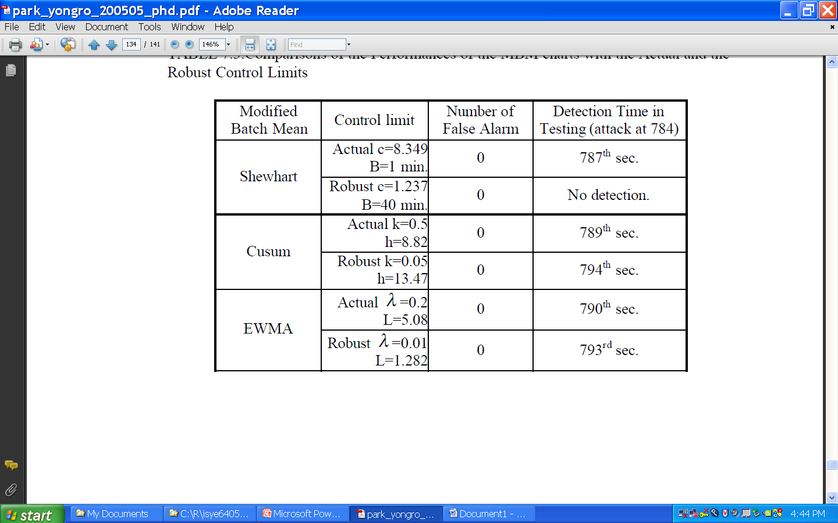
Actual vs. Robust

Slide 17
A Different Approach
Nonparametric Multichart CUSUM
Multichart (multichannel) – observe several characteristics of the data simultaneously
Example – total number of UDP packets with certains size (N=13) or total number of TCP SYN packets arrived with a destination IP address in predefined prefix intervals (N=256)
Well known minimax solution to parametric problem based on CUSUM extension and utilizing log-likelihood ratio – however requires complete prior information regarding pre-change and post-change distributions

Slide 18
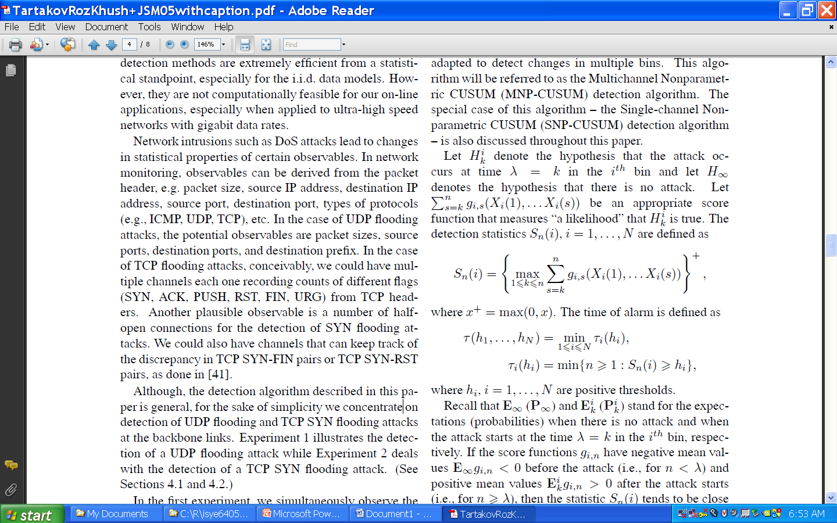
Definitions

Slide 19


Slide 20
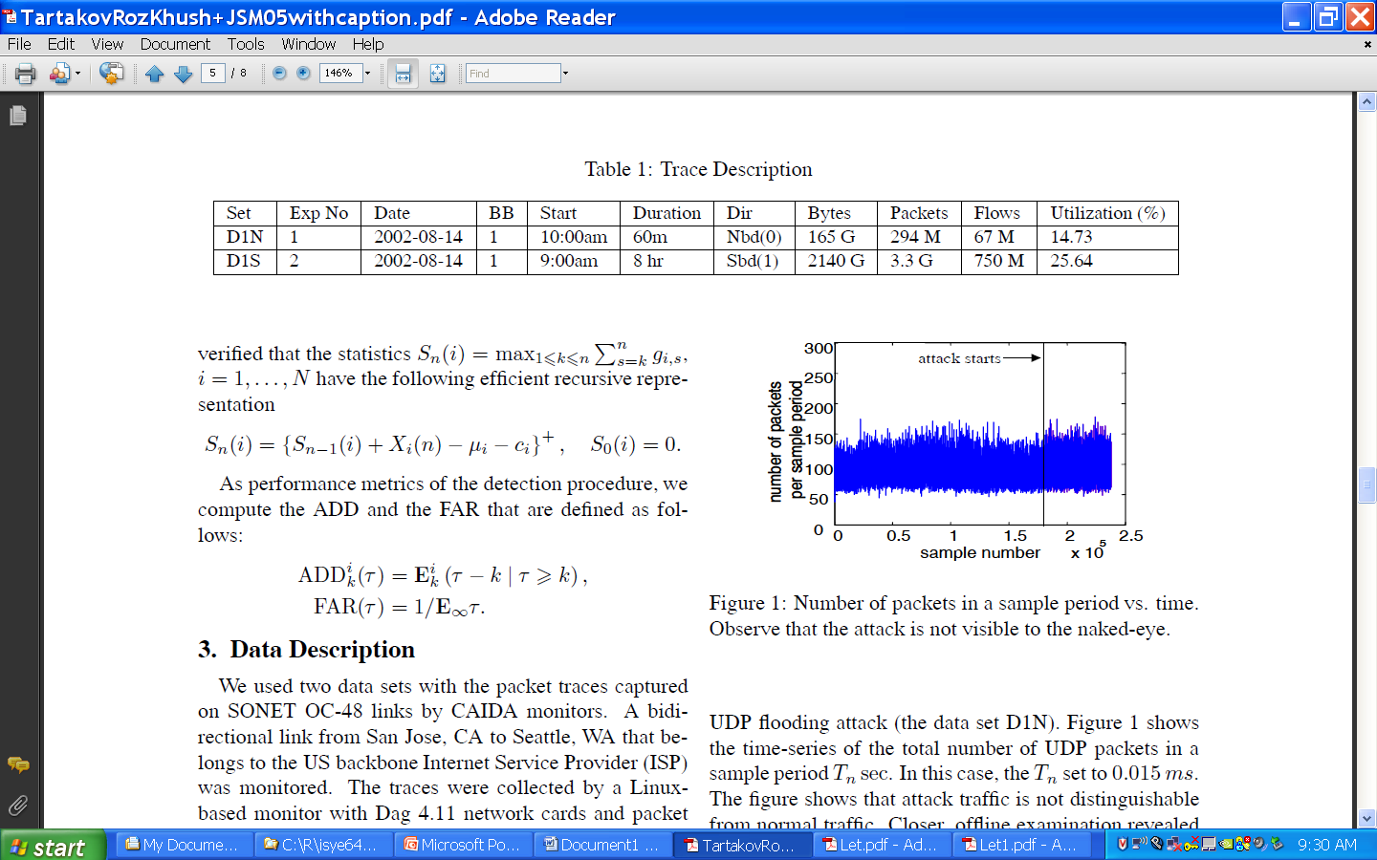
Experiment 1: UDP Flooding Attack

Slide 21
UDP Attack
Attacker sends twice as many packets of a particular size
Splitting into size bins and using multi-channel detection helps to localize the attack and therefore detect it more rapidly

Slide 22
Experiment 2: TCP Flooding Attack
Divide channels based on destination IP address (256 channels)
Again, splitting into channels allows us to localize and enhance detection capabilities
MNP-CUSUM performs significantly better than SNP-CUSUM
Future – Set up various channels to detect different kinds of attacks, test on real data

Slide 23
Conclusion
Many methods of attack, many methods of detection
Active research area combining statistics and computer science
Always something new

Slide 24
References
Park, Y. (2005). A Statistical Process Control Approach for Network Intrusion Detection, Ph.D. Dissertation
Tartakovsky, Rozovskii, and Shah, (2005). A Nonparametric Multichart CUSUM Test for Rapid Intrusion Detection, Proceedings of Joint Statistical Meetings, Minneapolis, MN. 2005
Carl, Kesidis, Brooks, and Rai, (2006). Denial-of-Service Attack Detection Techniques, IEEE Internet Computing, Jan-Feb 2006

