Slide 1



























Icons with default resolution (96 x 96 px)

Slide 2








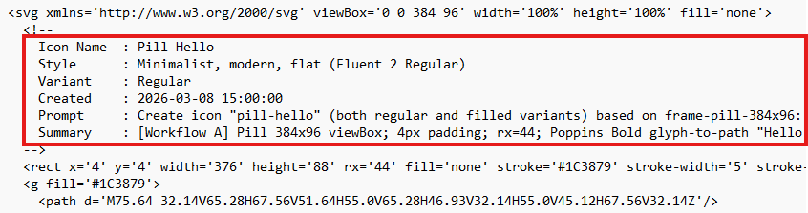
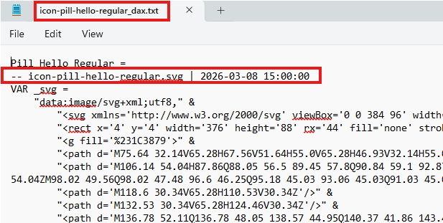
icon-frame-pill-384x96-regular.svg
icon-frame-pill-384x96-filled.svg
Icons for statuses (table visuals), created with a custom viewBox, not the default resolution (96 x 96 px)
Poppins bold and Figtree Black 900, not available in Power BI, converted to paths
Arial is available in Power BI, font not converted to path, it renders correctly in Power BI (center, middle)
The .svg file contains a header for traceability and serves as a prompt feedback loop (prompt versus agent work summary)
The DAX measure file contains only the time of the original .svg file creation
Rendered in Power BI

